Slide 1
Module Flex status.
4 types: M4, M2, M1plane, M1mountain.
constraint: components and bonding on the same side → folded wing geometry of the flex module.
Serial powering current: 0,6A mandatory for the tracks implementation on the stave flex. Discussion started with LPSC on current generator.
Current PSPP not adapted for the low current/high voltage powering.
Should be studied but not implemented on the module flexes.
Total surfaces: stave flex 558cm², module flex 322cm² → 37% for modules.
→ Important to reduce matter for modules too.
Discussion with Rui on 23/04/2015: same material and process than stave flexes.
Platted holes possible with a 10µm copper platting. Not dominant for X0 because of the
reduced surface of copper.
Final stack-up: coverlay(12-12µm)-core(15-50-15µm)-coverlay(12-12µm).
Scheme currently finalized, HV pads…
Modules CAD details to be discussed with bonding company: connection pads, glob-top,
gluing? Also full sheet CAD to be discussed for tooling development with bonding and
components mounting people. First contact with Hybrid SA (Neuchâtel), advised by Rui.
→ Meeting foreseen soon with a first set of CAD drawings.
Sebastien Vilalte, 28/04/2014

Slide 2
Tooling(s): to be discussed with Hybrid SA and LAPP for specific features: bending/folding… Also with components mounting company.
What are we going to do in LAPP? Compromise between time and money (gluing).
Steps: → Finish 1st version of CAD & meet Hybrid SA: end of May.
Discuss with component mounting people (CERN, Addax?, not so trivial…).
→ Rework of the CAD, tuning with Rui, launch prod: beginning of June.
Can expect naked flexes for September.
→ Components mounting: September.
→ Gluing, bonding: sept,oct...
Production: for one stave, total of 7 M4, 2 M1 and 13 M2.
For electrical and mechanical tests, need at least 20 M4, 10 M1 and 40M2.
Represents about 900cm², the equivalent surface of the stave flex prod.
→ about 8000CHF.
→ mounting, gluing, bonding: €???
→ connectors: 500€
Linked developments: translation boards for module testing with USB-pix: 200€.
TOTAL: 15-20k€.
Sebastien Vilalte, 28/04/2014

Slide 3
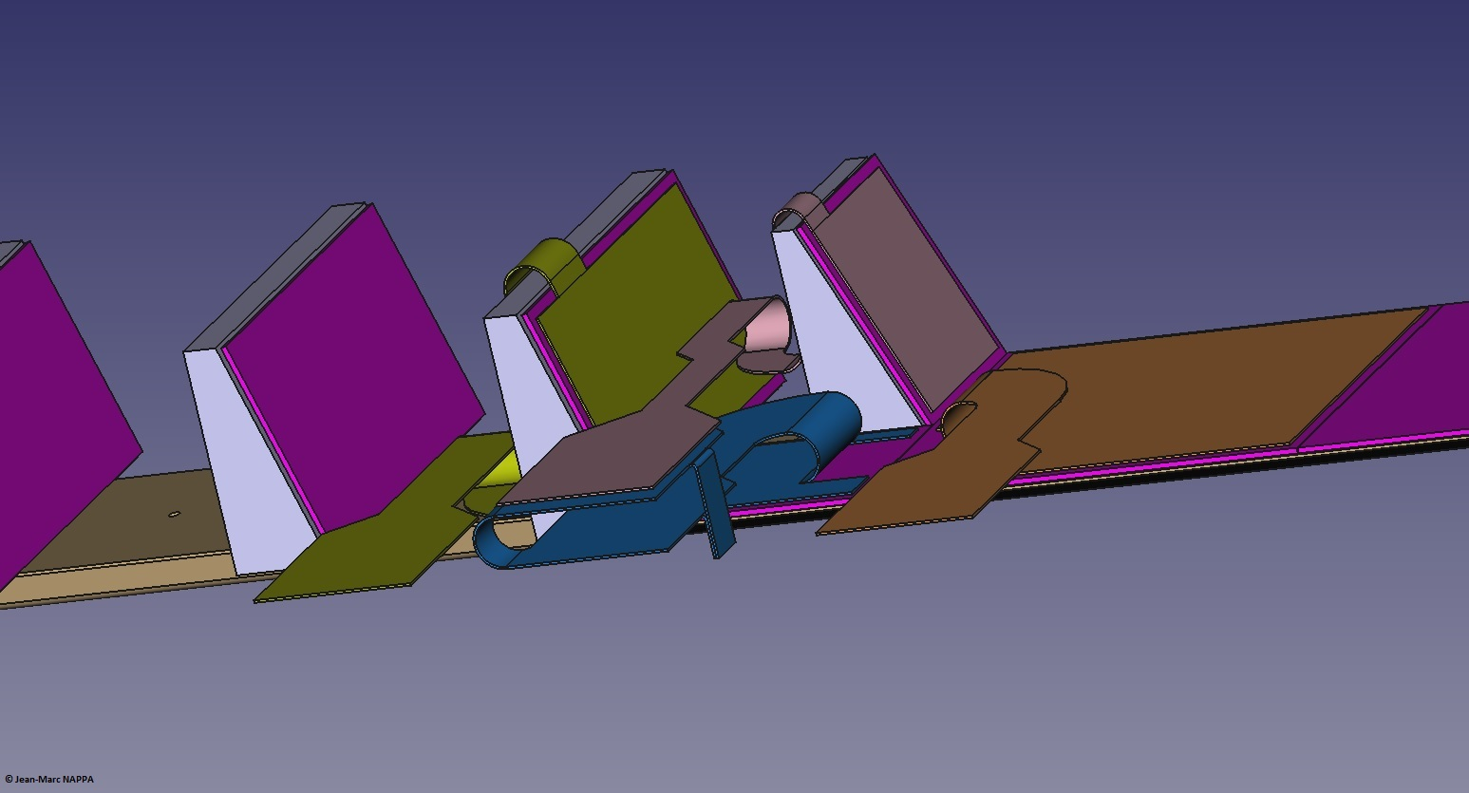

Slide 4
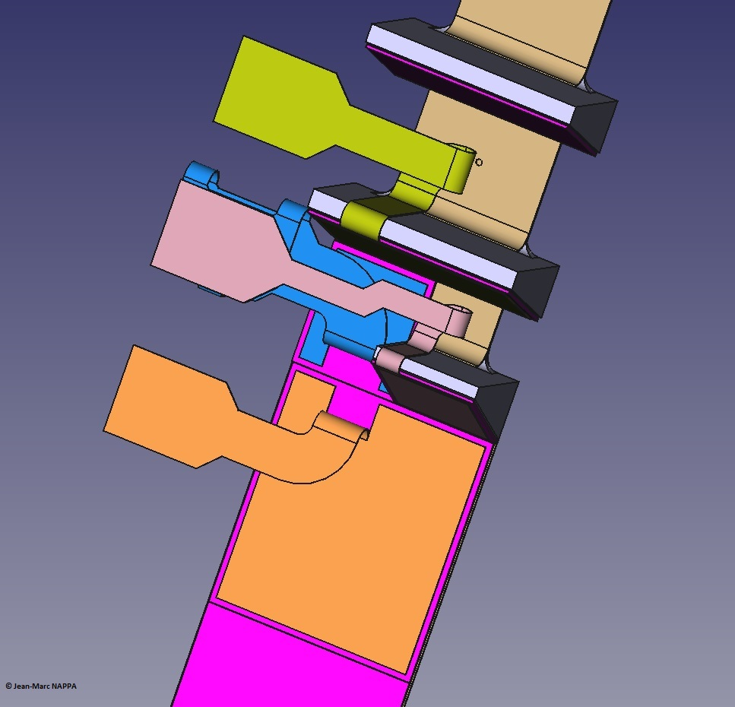

Slide 5
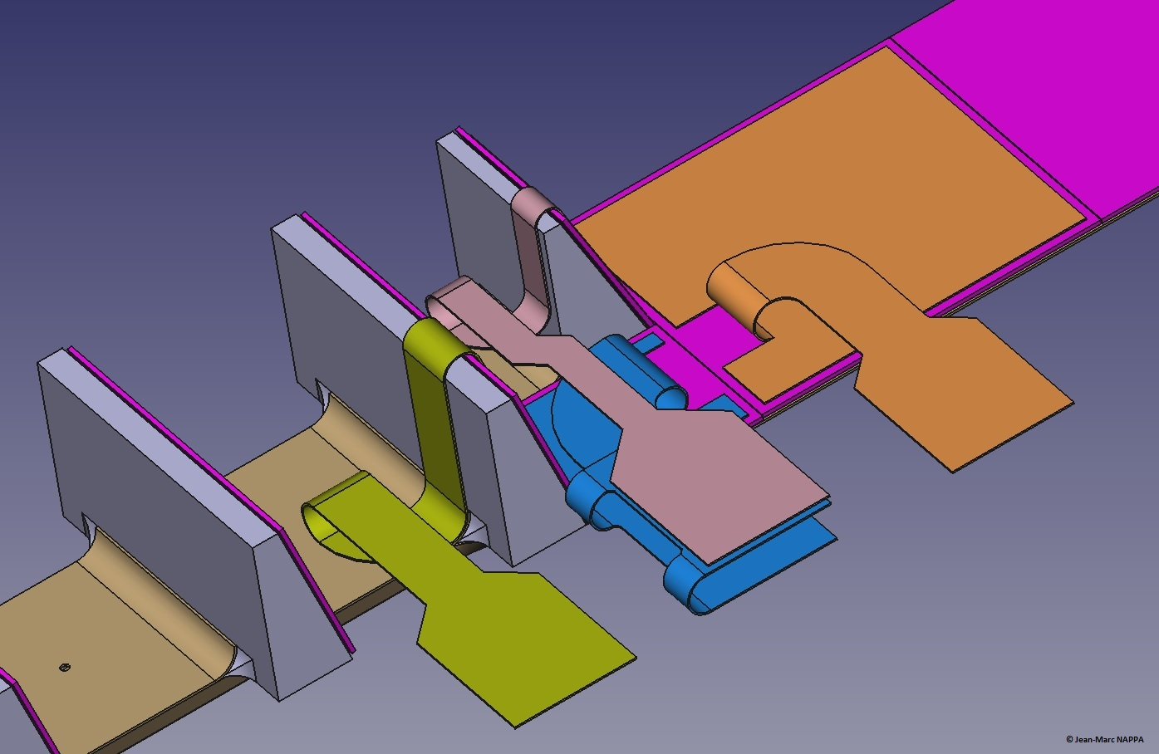

Slide 6
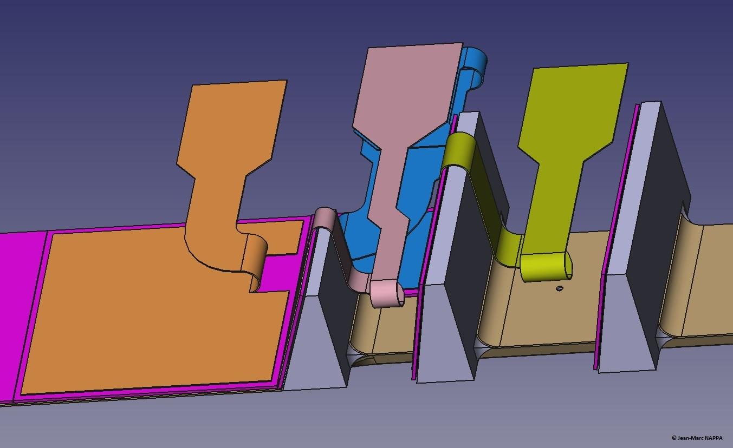

Slide 7
