Slide 1
Comments on Slider and Baskets
François Vazeille
Tile Upgrade Demonstrator Weekly meeting
2015 April 8th
● Why did we design the Mini-Drawers
with polyethylene sides ?
● Impact on the Slider and on the Baskets.

Slide 2
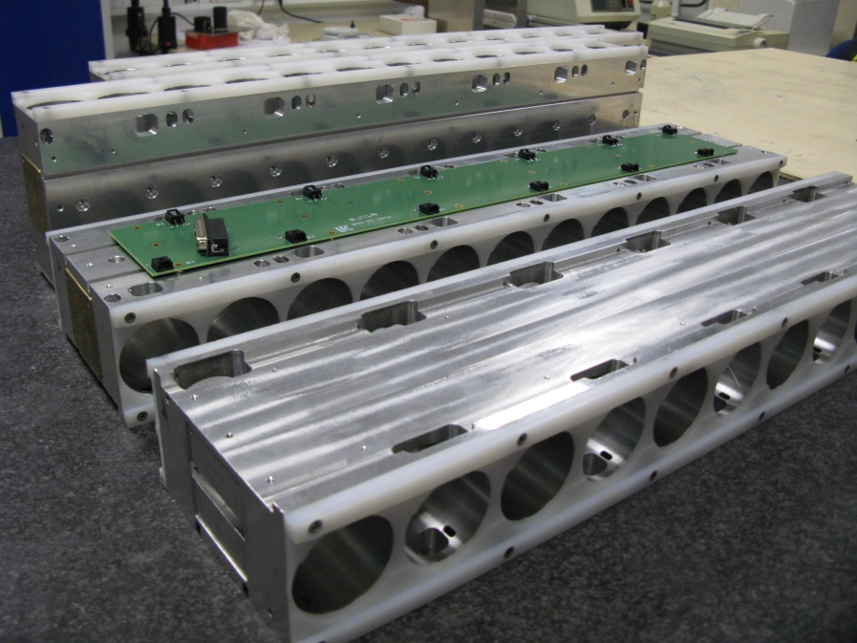
Why did we design the Mini-Drawers
with polyethylene sides ?
▪ To improve the Sliding inside the Tile Modules (on the Girder Rings).
▪ To prevent the damages of the Girder Rings (made of Noryl™)
by sharp metallic sides (Aluminum) of Mini-Drawers.

Slide 3
Impact on the Slider and on the Baskets
From Jeff Dandoy/Giulio Usai
2015 April 1st
The worst solution:
sharp metallic contact with polyethylene
→ Damaging the Drawer sides.

Slide 4
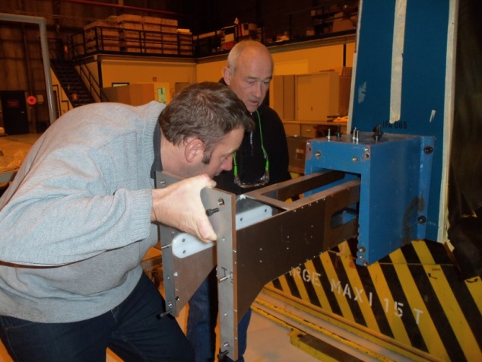
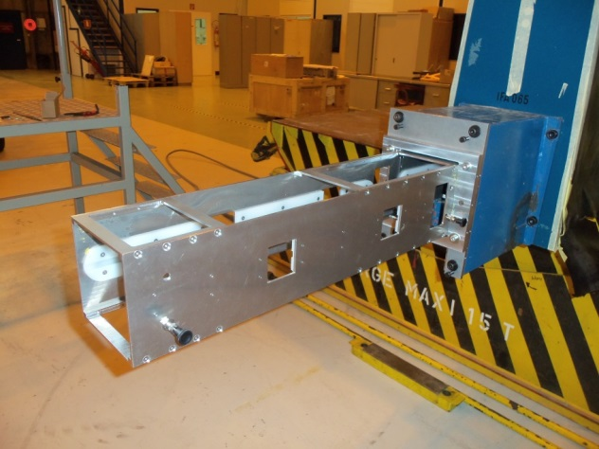
WHY NOT USING THE CLERMONT WORKS
ON THE SLIDER AND ON THE BASKETS ?
→ Polyethylene guides in Slider and in Baskets
Slider at 90°
Basket
A very good sliding without any damage on the Mini-Drawer sides.
No needs of movable pieces (rollers).
When the guides are worn, it is cheap and easy to replace them,
because the tools are always accessible (Slider + Baskets).
It is not the case of the Drawers if they are damaged !
⇒ This solution is also valid for a very long Basket.
Comment: It is not forbidden to search materials better than polyethylene.

