Slide 1
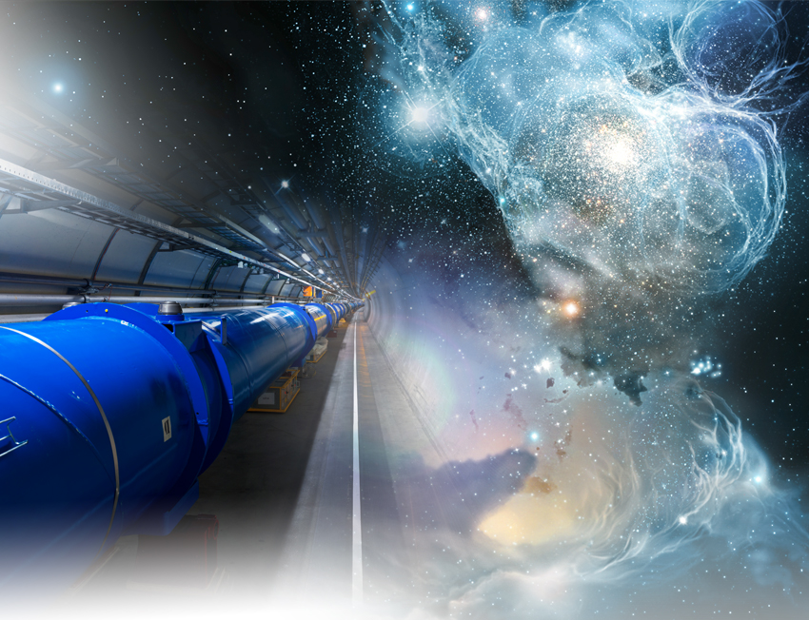
Futurs collisionneurs de haute énergie:
HL-LHC, ILC, FCC, …
Olivier Napoly
CEA/Irfu
Ecole GIF 2015
24 septembre 2015

Slide 2
Introduction
Avenir de la physique des particules sur accélérateur: les quatre derniers laboratoires ‘accélérateur’ de physique des particules ‘HEP’ se mobilisent pour assurer leur pérennité.
* Projets non-approuvés
 | Présent / Court terme | Projet à Moyen terme | Projet à Long terme
Fermilab | Source de Neutrino LBNE | Source de neutrinos LBNF/PIPII* | Collisionneur de Muons*
KEK | Source de neutrino JPARC | Usine à B (e+e-) Super-KEKB | Collisionneur e+e- ILC*
IHEP Beijing | BEBC | ? | Collisionneur e+e-/pp CEPC/SppC
CERN | Collisionneur pp LHC 14 TeV | Collisionneur pp HL-LHC | Collisionneur e+e-/pp FCC*

Slide 3
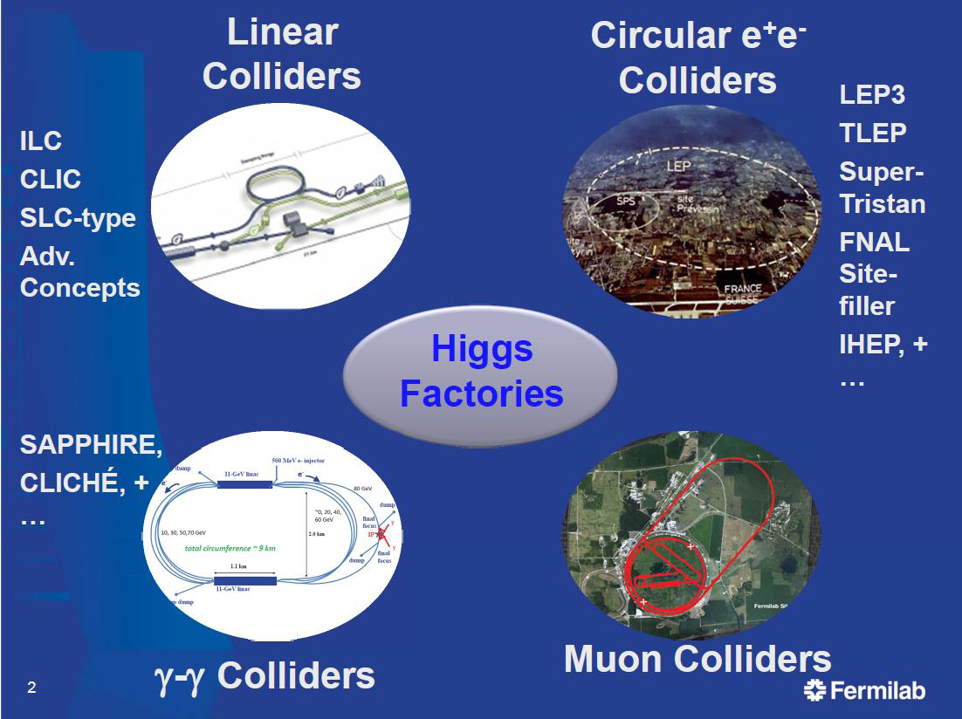
Usine à Higgs : nouveau projets

Slide 4
Sommaire
Luminosité des collisionneurs
Concept d’émittance de faisceau
Collisionneurs proton-proton (pp)
Collisionneurs électron-positon (e+ e-)
Collisionneurs de photon (γγ)
Collisionneurs de muons (µ+ µ-)

Slide 5
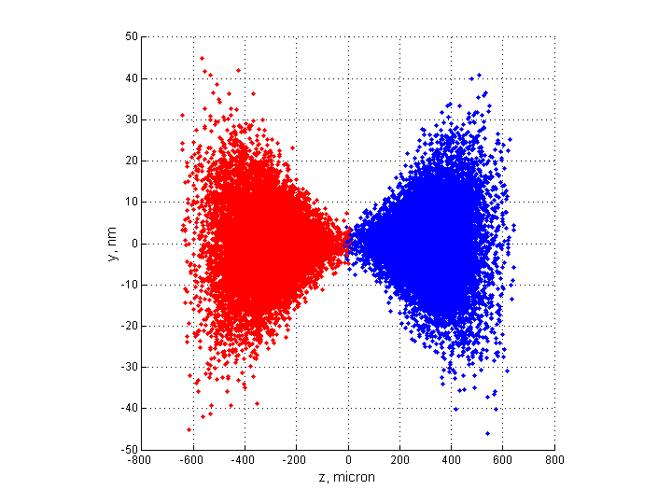
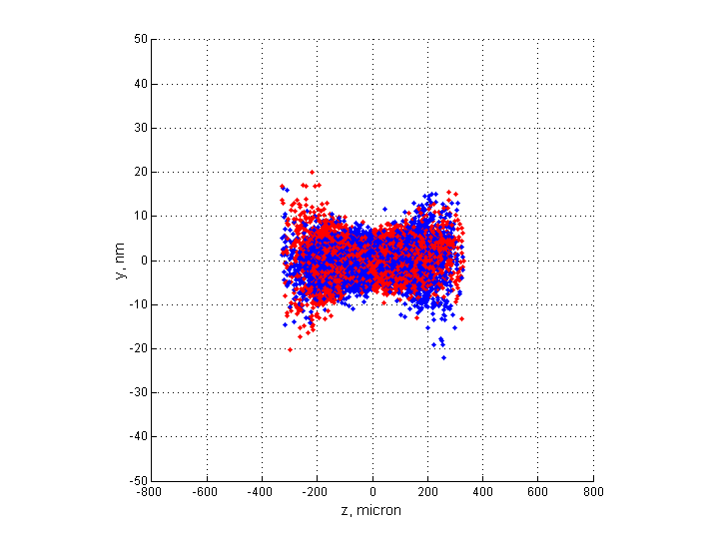
L’Energie de Collision
t
e+
e-
e-
e+
D’après l’expression de la force de Lorentz, l’énergie d’une particule chargée est donnée par la composante longitudinale du champ électrique:
Le champ magnétique accélère transversalement, mais ne travaille pas !
L’énergie relativiste de collision est donnée par le module de la résultante des quadrivecteurs de quantité de mouvement:

Slide 6
La Luminosité d’un collisionneur
t
e+
e-
e-
e+
Le taux de comptage N_{E} d’ évènements E de physique générés pendant la durée d’une collision de deux paquets, est donné par:
où
σ_{E} est la ‘section efficace’ de l’évènement E
L est la ‘luminosité’ intégrée pendant la durée de la collision.
N_{E} , σ_{E} , et L sont des quantités invariantes de Lorentz.

Slide 7
Luminosity for Fixed Target Collision
ρ₁
vdt
d³x
ρ₂
The integrated luminosity of an elementary volume element d³x of particle density ρ₂ moving through a fixed target of density ρ₁ during the time dt , is given by:
The particle densities are defined such that:

Slide 8
The Luminosity for Mono-kinetic Beams
e-
ρ₁
v₂
ρ₂
v₁
d³x
e+
The integrated luminosity generated by the elementary volume element d³x of particle density ρ₁ moving through ρ₂ with homogeneous velocities v₁ and v₂ , is:
with the Lorentz current 4-vector.
The integrated luminosity is expressed by :

Slide 9
The Luminosity for Mono-kinetic Beams
e-
ρ₁
v₂
ρ₂
v₁
d³x
e+
Proof :
Hence

Slide 10
The Luminosity for Mono-kinetic Beams
ρ₋
e⁻
ρ₊
v₊
v₋
e⁺
For relativistic beams , this simplifies to:
Conditions for high luminosity:
High particles densities .
Good overlap of the particle densities, particularly in the high density region.
Head-on collisions .

Slide 11
The Luminosity for Mono-kinetic Beams
e⁻
ρ₊
v₊
ρ₋
v₋
e⁺
First example: the head-on collision of Gaussian bunches
leads to with
Nota Bene : no dependence on the bunch lengths, since the two bunches are crossing each other throughout their entire length.

Slide 12
The Luminosity for Mono-kinetic Beams
2nd example: head-on collision of mirror Gaussian bunches
e⁺
e⁻
ρ₊
ρ₋
c
-c
⇒ average luminosity over the bunch trains and collider pulse:
Conditions for high luminosity:
High particles densities .
Good overlap of the particle densities, particularly in the high density region.
Head-on collisions
High repetition rate : 40 MHz at LHC, 11 kHz at ILC*

Slide 13
The Luminosity for Mono-kinetic Beams
2nd example: head-on collision of mirror Gaussian bunches
e⁺
e⁻
ρ₊
ρ₋
c
-c
⇒ average luminosity over the bunch trains and collider pulse:
3rd example: idem with transverse offsets δx , δy :
e⁺
ρ₊
c
e⁻
δx
ρ₋
-c

Slide 14
The Luminosity for Mono-kinetic Beams
4th example: case n°3, with a crossing angle
x
e⁺
e⁻
ρ₊
ρ₋
c
-c
s
with , ‘Piwinski’s angle’
5th example: case n°3, with a crab crossing angle
e⁺
x
e⁻
ρ₊
ρ₋
c
-c
s

Slide 15
Flat Beams : Luminosity and Horizontality
5th example: error on ‘horizontality’ of flat beams
y
e⁺
ϕ
x
e⁻
The horizontality of flat beams is inherited from their respective Damping Rings.
In case of an error, the overlap of their distributions is not perfect and induces a reduction of the luminosity:s
for large aspect ratios
Tolerance:

Slide 16
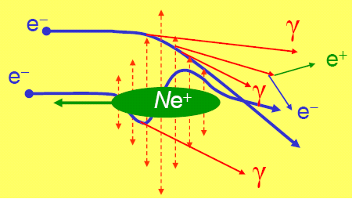
The Luminosity of Realistic Colliding Beams
β* = “depth of focus”
+Θ*
y
±σ*
e+
z
–Θ*
The above “academic” results are modified by the reality of two hard factors of Linear Colliders
Real beams are not mono-kinetic: include angular distribution (cf. left pict.)
Real particle trajectories are not straight during the collision: they are strongly deviated by the electromagnetic field generated by the opposite beam, the so-called “Beam-Beam Forces” (cf. right pict. and Beam-Beam section)

Slide 17
The Luminosity for Colliding Beams
e-
ρ₁
v₂
ρ₂
v₁
d³x
e+
Introducing time and velocity dependent distributions such that:
the integrated luminosity for colliding relativistic beams is given by:

Slide 18
The Hour Glass effect
β* = “depth of focus”
+Θ*
Beams are naturally converging to their focus point, reaching their minimum sizes σ_{x}∗ , σ_{y}∗ , and diverging from there, with angular spreads : Θ_{x} , Θ_{y} .
The focus point is described by a local ‘parabola’ of finite ‘depths of focus’
y
±σ*
e+
Introducing the angle variables
and assuming Gaussian bunches:
z
–Θ*

Slide 19
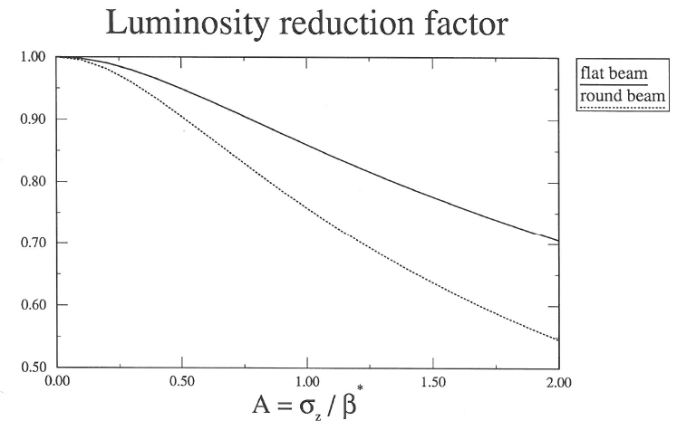
The Hour Glass Reduction Factor
It is desirable to fulfil the condition in order to longitudinally contain most of the bunch particles within the depths of focus β_{x}∗ and β_{y}∗ , hence the 1st need for a longitudinal bunch compression system to reduce σ_{z} .
• ILC (A_{y} =3/4)

Slide 20
Sommaire
Luminosité des collisionneurs
Concept d’émittance de faisceau
Collisionneurs proton-proton (pp)
Collisionneurs électron-positon (e+ e-)
Collisionneurs de photon (γγ)
Collisionneurs de muons (µ+ µ-)

Slide 21
Single Particle Dynamics: Summary
The motion of individual trajectories in an external electromagnetic field
derives from Newton’s law with the Lorentz Force:
with , and particle momentum.
It obeys the laws of Hamiltonian Mechanics:
(Hamilton-Jacobi equations)
with
and is the conserved energy,
where is the electromagnetic potential 4-vector.
Hamilton equations derives from a Least Action Principle based on the Action:

Slide 22
Hamiltonian Mechanics and Beam Properties
Hamiltonian Mechanics is valid as long as
There is no collective effects (space charge, wake fields)
Synchrotron Radiation is ignored
There is no beam collimation and no beam losses
These conditions are realized, as a first approximation, along accelerators.
Hamiltonian Mechanics allows a powerful description of the beam dynamics using Symplectic Transformations of the beam particle 6-dimensional Phase Space
Coordinates .
Introducing the 6D Skew Matrix , with the 3D unit matrix,
Hamilton-Jacobi equations read:
Solving this system of equations amounts to deriving the time evolution of particle
trajectories, and therefore the expressions of the transformation which maps the
coordinates at the initial time , into at a later time .
This map is noted , for convenience.

Slide 23
Symplectic Maps
1st property: Symplecticity of Maps
The transformation which maps the particle coordinates at t₀ , into the particle coordinates at t , is symplectic in the sense that its Jacobian matrix is a symplectic matrix.
Proof:
Let us note the Jacobian matrix of the map .
Since is a symplectic matrix,
If we show that , then
Proof:
since is symmetric.

Slide 24
Symplectic Maps
Proof of the proof:

Slide 25
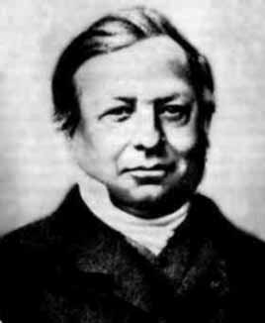
Liouville Theorem
2nd property: the Phase Space Volume occupied by a beam population is invariant of motion
Joseph Liouville, 1809-1882

Slide 26
Liouville Theorem
2nd property: the Phase Space Volume occupied by a beam population is invariant of motion
3rd property: Particle Densities are invariant of motion
Given a particle density distribution such that , then following the motion of the particles from t₀ to t :
P₀
P
P
YES
NO
t₀ → t
Q₀
Q
Q

Slide 27
Liouville Theorem
Global Phase Space Volumes (‘areas’) are invariant of Motion:
Gaussian-like ellipsoid
linear motion
non-linear motion
P₀
P
P
t₀ → t
Q₀
Q
Q
Rectangular collimated
P₀
P
P
t₀ → t
Q₀
Q
Q

Slide 28
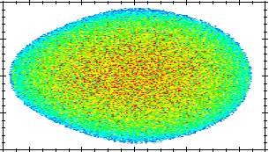
The Particle Density and its Moments
The beam is modelled by a particle density distribution which generates a set of characteristic real numbers, its Moments.
The first three moments
0th order moment, beam charge (or population):
1st order moment, centre of mass (or 6-vector beam centroid):
2nd order moment, beam matrix (6x6 matrix):
are widely used to characterize the beam transport.
P
Q

Slide 29
The Gaussian Particle Density
The Gaussian density distribution, in even D dimensions (D=2,4,6)
is fully characterized by its 3 first moments .
It simplifies to the ‘usual’ Gaussian distribution, assuming
a centred beam at a waist (upright ellipse):
in D=2 dimensions.
Then
.
It is the beam distribution mostly used in Beam Tracking simulation codes
to probe the beam transport properties.
P
Q
P
Q

Slide 30
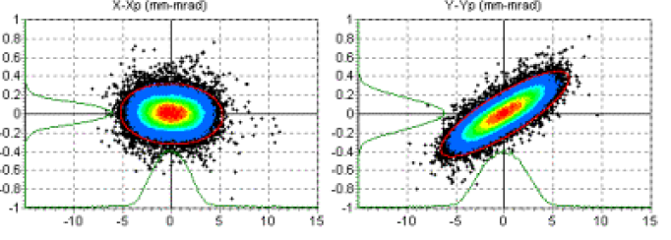
The Concept of Beam Emittance (bis)
Emittance represents the phase-space volume occupied by beam particles.
It is one of the most important concept of Accelerator Physics, because:
Emittance is an invariant of motion in Hamiltonian systems (no collimators, no synchrotron radiation)
Emittance characterizes the “disorder” (or “temperature”) of the beam distribution.
The lower the emittance, the easier it is to manipulate the beam through beam pipe apertures, collimators, focus points, RF buckets, etc...
Beams with too large transverse emittance must be “cooled” either with “cooling rings” with synchrotron radiation, or “electron cooling” using intra-beam scattering with an external low emittance electron beams.
However, in practice, no single definition of a calculable Emittance can apply to all real or to modelized beam distributions. Hence a variety of definitions :
full or RMS emittances
invariant or projected emittances, etc…

Slide 31
Emittance for the Gaussian Particle Density
For the Gaussian density distribution, in 2 dimensions
the full emittance is infinite because the beam distribution extends to infinity and its volume is not compact.
Another (practical) definition is the 1-σ emittance, or RMS emittance, given by the volume enclosed by the 1-σ ellipse:
.
This definition generalizes to even D dimensions
with .
P
Q
P
Q

Slide 32
Some Algebra about the Beam Matrix
1st property: is a symmetric definite-positive matrix
2nd property: is strictly positive (except for the point-like distribution) and can be inverted.
3rd property: Normal form of :

Slide 33
Some Algebra about the Beam Matrix
Proof:
Introducing the Square Root Matrix such that , and the anti-symmetric matrix , one can find an orthogonal matrix O such that
(kind of Jordan normal form for anti-symmetric matrices)
Then, introducing
one can show that
1)
2)
6D generalized
Twiss parameters
Phase Advance
Emittance

Slide 34
Intrinsic Emittances
The 3 quantities are called the Intrinsic Emittances : they are invariant of the motion, in the linearized motion approximation.
To calculate these intrinsic emittances, one uses the 2 properties:
D=6 dimensions: ???
D=4 dimensions:
D=2 dimensions:
where A is the area of the 2D ellipse

Slide 35
The Beta Functions of the Beam (D=2)
The 2D beam matrix is parameterized as follows:
with
.
By definition since .
The 2D beam ellipse is defined by:
i.e.
The remarkable points of the
beam ellipse can be recovered from the above equation, e.g.:
The beam ellipse is a graphical representation of the 1-σ RMS enclosure of the beam distribution.

Slide 36
Sommaire
Luminosité des collisionneurs
Concept d’émittance de faisceau
Collisionneurs proton-proton (pp)
Collisionneurs électron-positon (e+ e-)
Collisionneurs de photon (γγ)
Collisionneurs de muons (µ+ µ-)

Slide 37
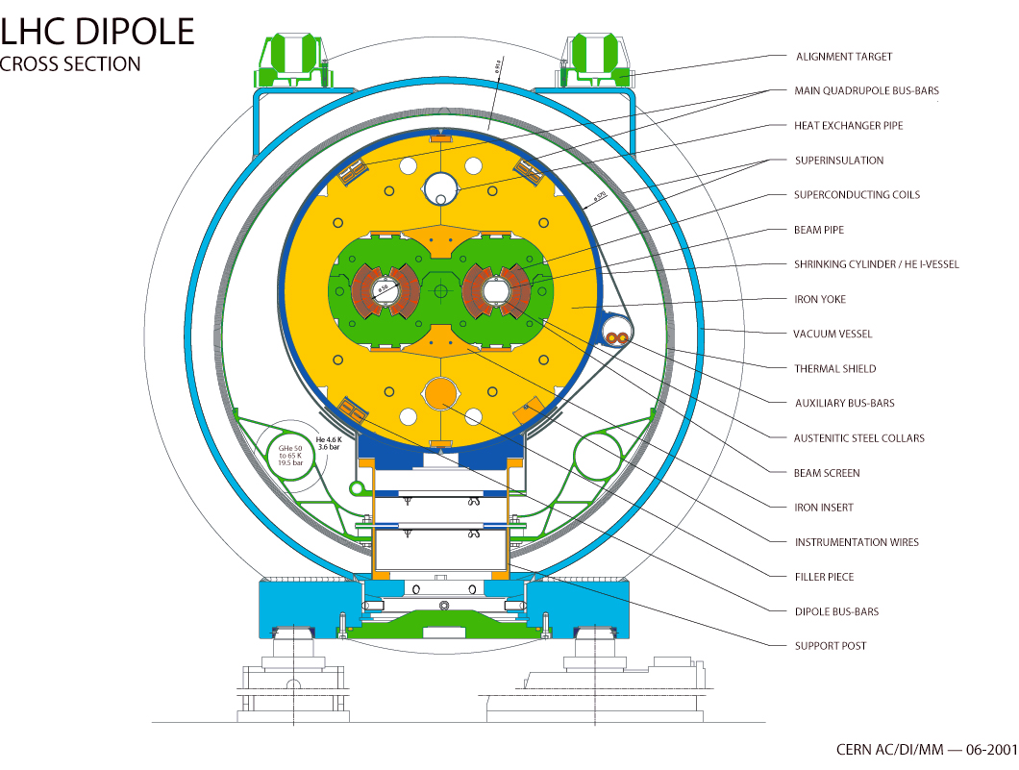
The LHC Reference
27 km, p-p at 7x7 TeV
3.5x3.5 TeV in 2011, 4 x 4 TeV in 2012
1232 dipoles of 15 m
Magnetic field: 8.3 T for 7 TeV
Cooled by superfluid Helium at 1.9 K (130 tons He).
Field Homogeneity: 10⁻⁵

Slide 38
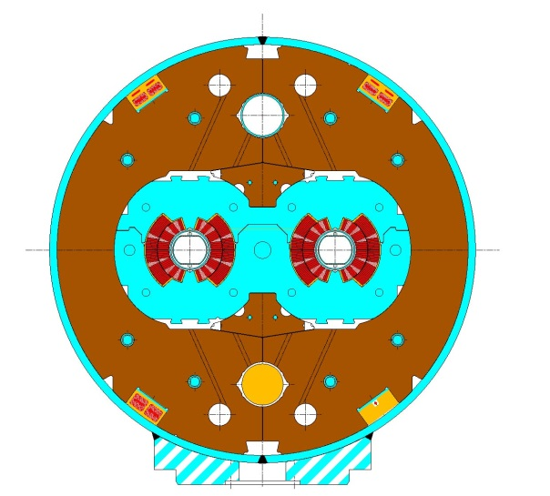
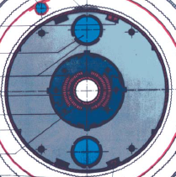
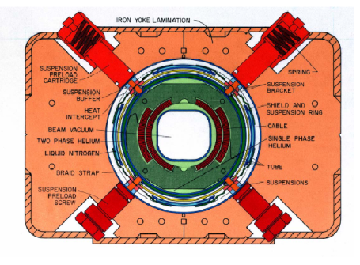
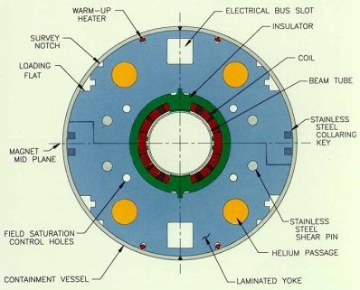

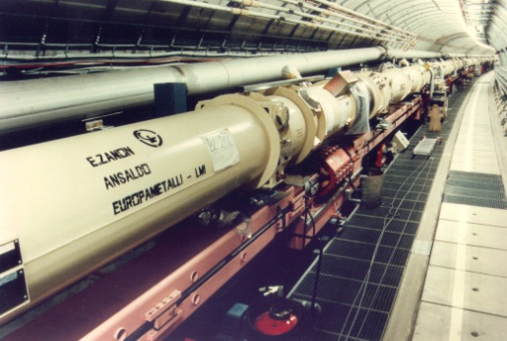
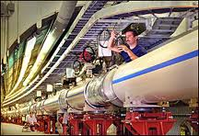

Dipole Structures
Collier en Acier austén.
Noyau en fer à 300 K
Colliers en alliage AL
Noyau en fer 4 K
Colliers en acier austén. Noyau commun en fer 2K
Noyau froid
Tevatron
HERA
RHIC
LHC
L. Rossi , CERN

Slide 39
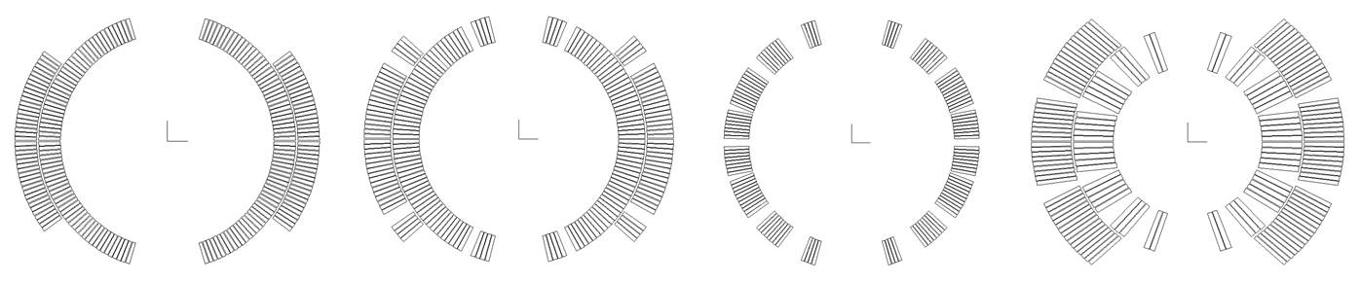
Dipoles of existing (or past) colliders
Rutherford cable
SC coils (~cosϑ)
Tevatron
HERA
RHIC
LHC
L. Rossi , CERN

Slide 40
The Single Wire Magnet
The simplest electromagnet is given by longitudinal current line transporting a total current .
By rotation symmetry : .
From Ampère’s law : .
The complex magnetic field is then given by
y
B
I
•
x
Nota Bene: This ‘magnet’ is creating an infinite electric capacitor at !

Slide 41
Un dipôle et ses harmoniques naturelles
La configuration dipolaire la plus simple est donnée par une paire de conducteurs:
y
−I
+
+I
−
•
Cette expression peut être développée pour :
x
B
R₀
Dipole : ;
Sextupole: ;
Décapole :
(2m+1)-pole :
Nappe en cos(θ) pour supprimer les harmoniques naturelles:

Slide 42
Progress in B-field
Tevatron
RHIC
LHC
HERA
LHC
LHC
HERA
TEVATRON
TEVATRON
RHIC
Année de mise en service
Luminosité pic [nb⁻¹s⁻¹ ou 10³³cm⁻²s⁻¹]

Slide 43
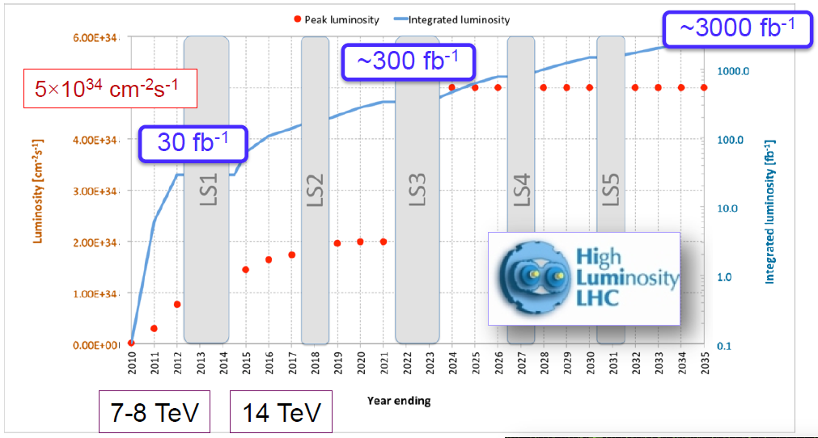
The LHC 20-Year Roadmap
1st Transformation : HL-LHC :
High Luminosity LHC

Slide 44
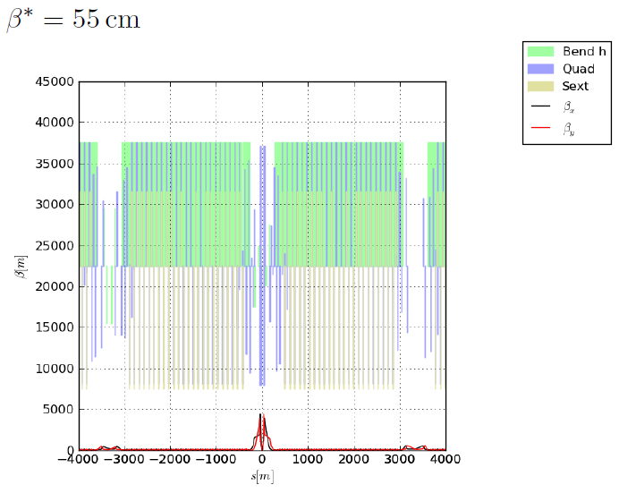
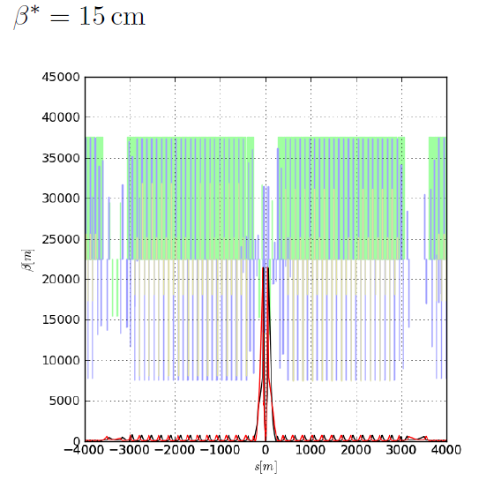
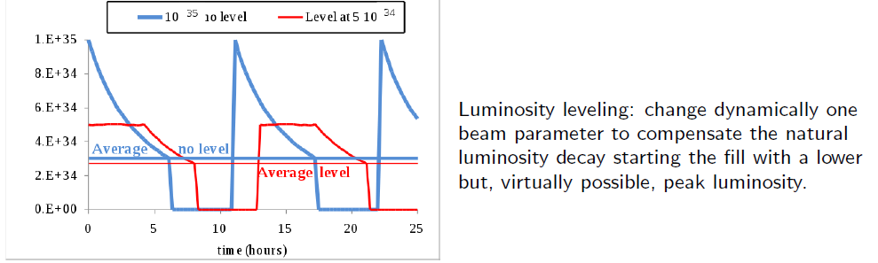
HL-LHC : Final Focus
‘Achromatic Telescopic Squeezing’ (S. Fartoukh) prepares the beams in the arcs to achieve low-beta at the interaction point with chromaticity correction
ATS
Peak luminosity is controlled by tuning the colliding beam conditions: the new concept is ‘crab kissing’.

Slide 45
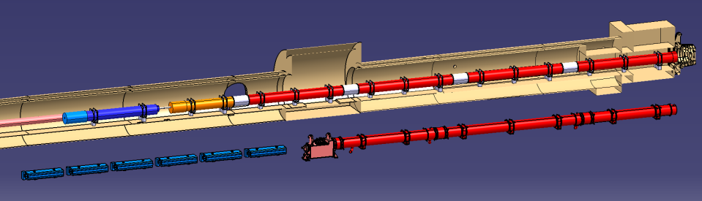

HL-LHC: Quadrupole Triplet and Dipole Separators
HL-LHC
SC D1
Nominal LHC
Final focus Q1-Q3 et Q4-Q6 quadripoles and D1 dipole will be changed in 2022 for 2 reasons:
  Radiation damage
  β* = 15 cm needs larger apertures
D2
Q4

Slide 46
Supraconducting Cables: J_{c} vs. B
Nb-Ti
HTS
Nb₃Sn
Matériau | T_{C} (K)
Nb | 9.2
NbTi | 9.5
Nb₃Sn | 18.3
HTS | > 30

Slide 47
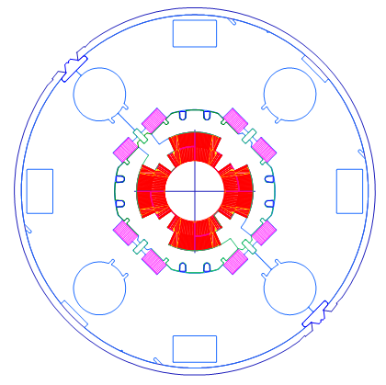
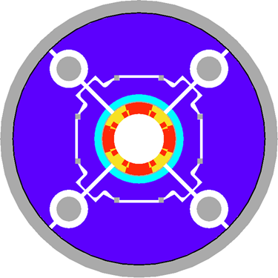
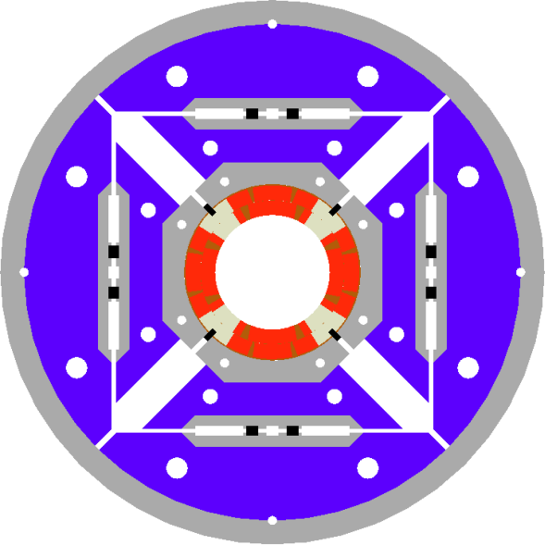
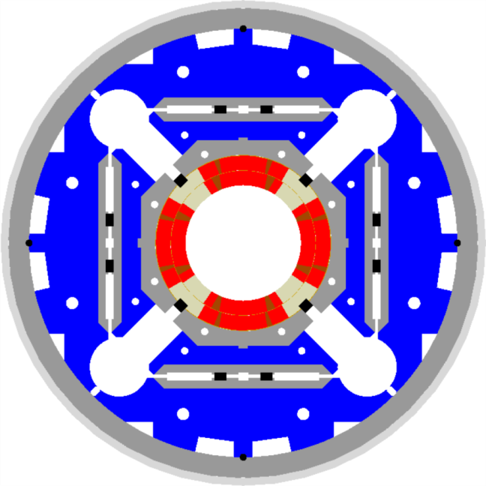
cos(2θ) Quadripole from LHC to HL-LHC
LHC (USA & JP, 5-6 m)
∅70 mm, B_{peak}∼ 8 T
1992-2005
G=215 T/m
LARP TQS & LQ (4m)
∅90 mm, B_{peak}∼ 9 T
2004-2010
G=200 T/m
LARP HQ
∅120 mm,
B_{peak}∼ 12.5 T
2008-2014
G=200 T/m
LARP & CERN
MQXF
∅150 mm,
B_{peak}∼ 12.3 T
2013-2020
G=164 T/m
Clé: maîtrise des forces et les énergies magnétiques ∼ R×B²

Slide 48
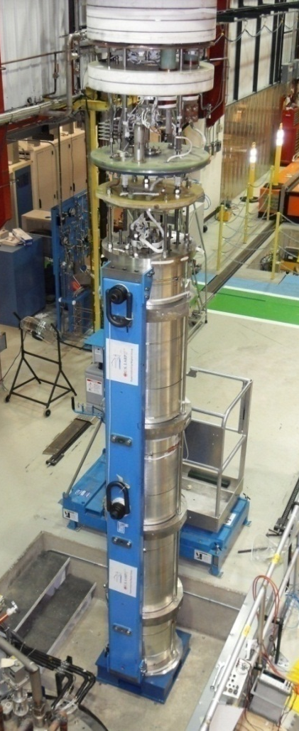
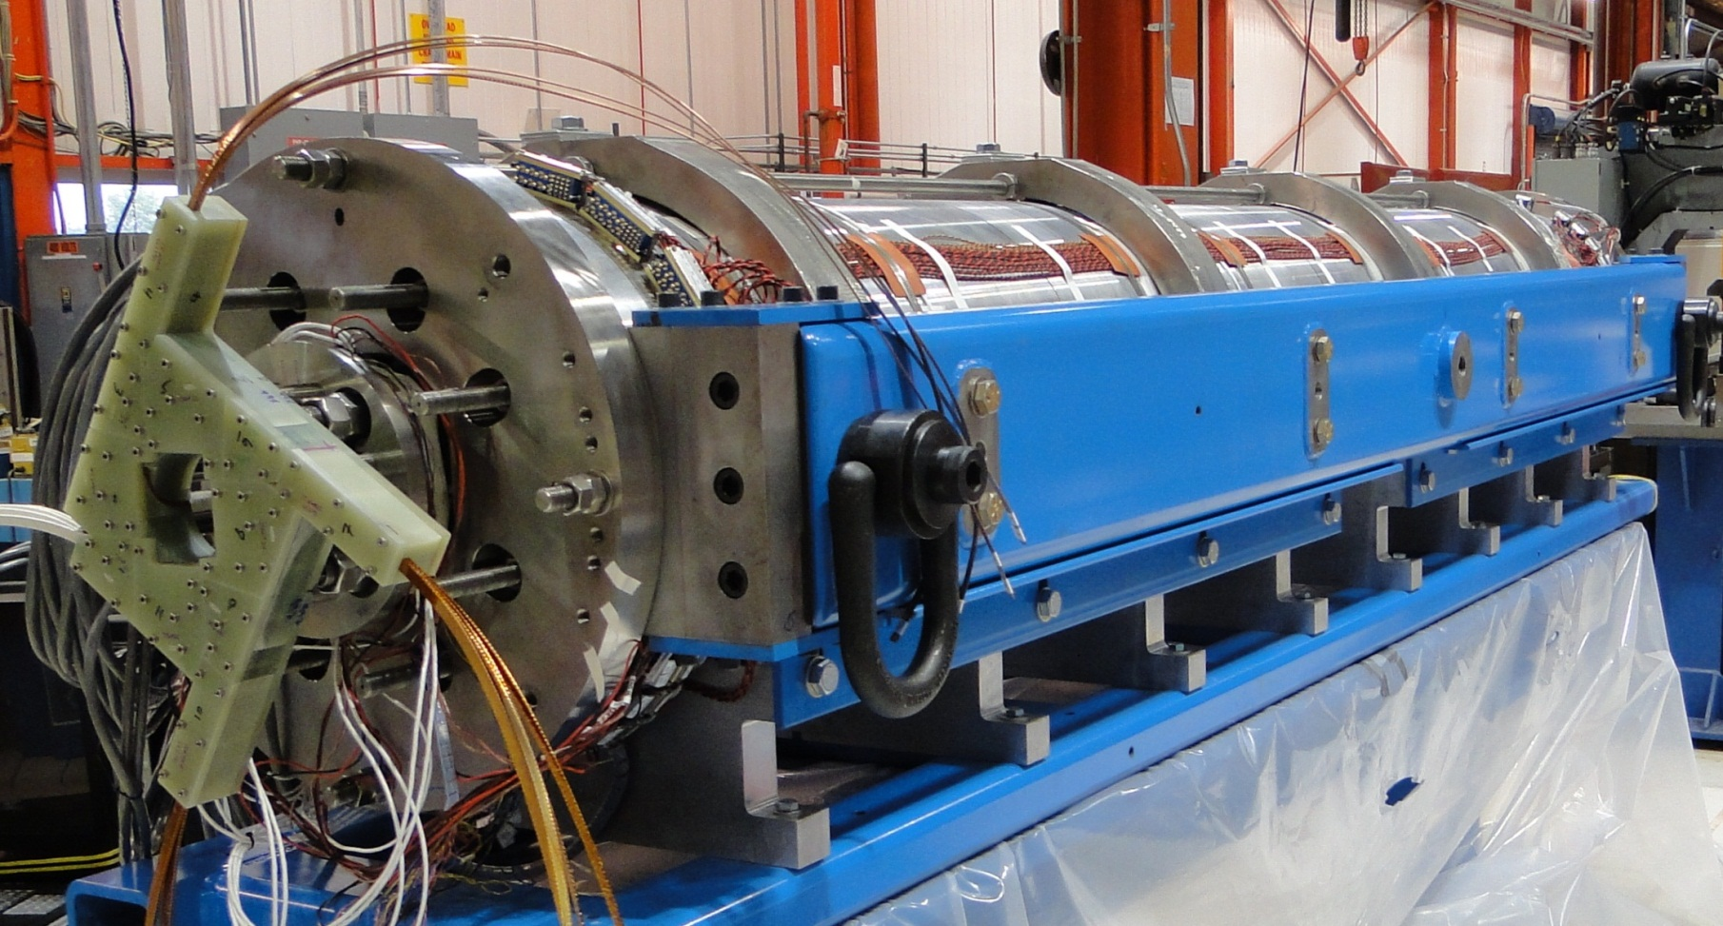

LQS (US-LARP) : step forward to HL-LHC
4m longueur, 90 mm diamètre, 200 T/m à 1,9 K
LQS01a: 202 T/m à 1.9 K
LQS01b: 222 T/m à 4.6 K
227 T/m à 1.9 K
LQS03: 208 T/m à 4.6 K
210 T/m à 1.9 K
1st quench: 86% limite des protos courts

Slide 49
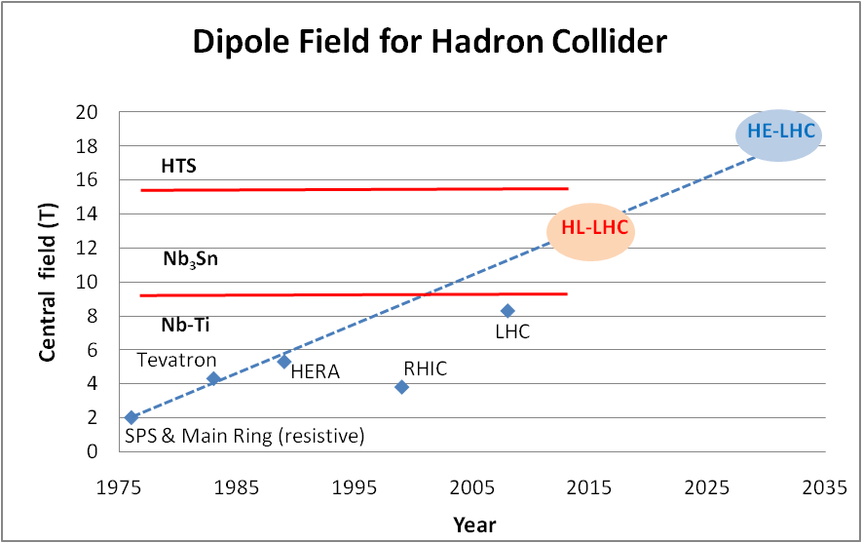
Nb₃Sn: peak fields 11-13 T pour HL-LHC
Nb3Sn cosϑ LARP QUADs
Nb-Ti operating dipoles;
Nb3Sn cosϑ test dipoles
Nb3Sn block test dipoles

Slide 50
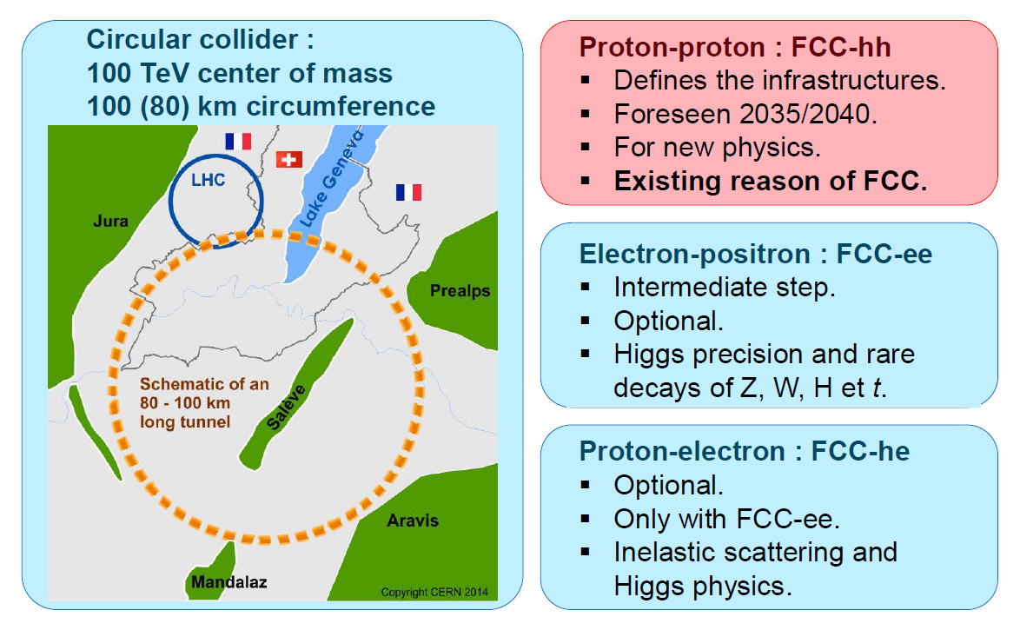
Future Circular Collider (pp) at CERN

Slide 51
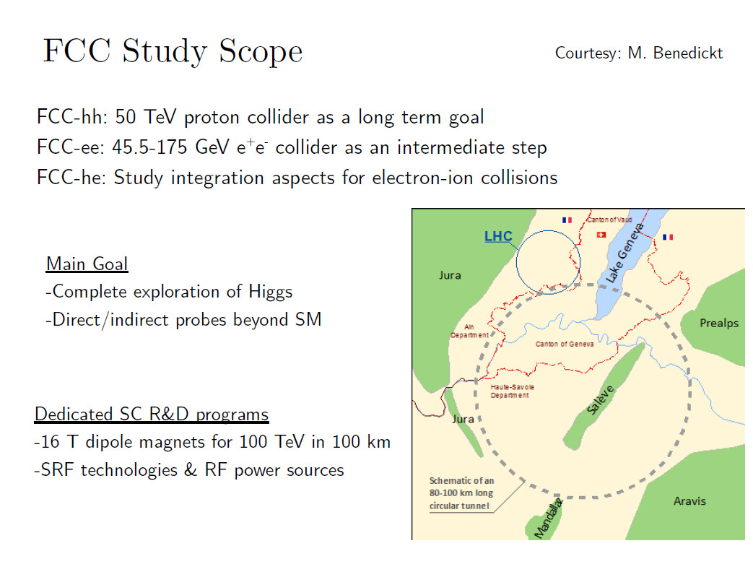
Future Circular Collider (pp) at CERN

Slide 52
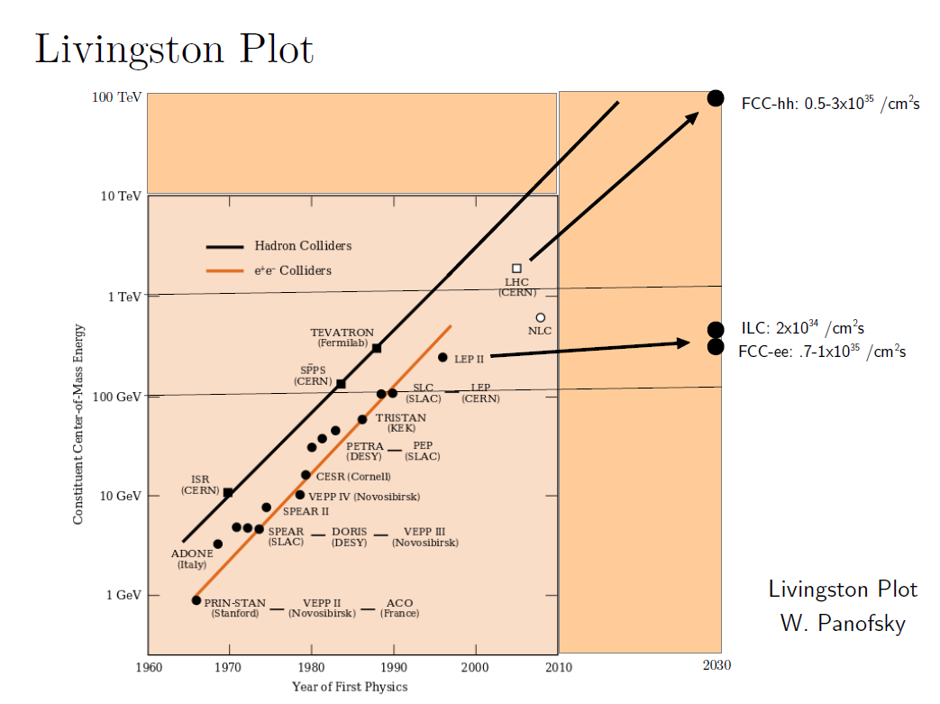
Future Circular Collider (pp) at CERN

Slide 53
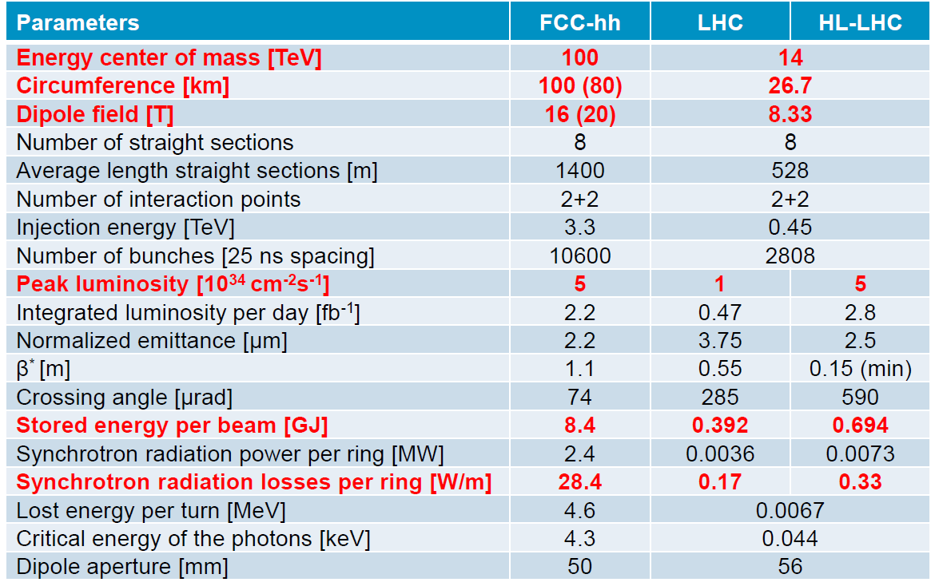
Future Circular Collider (pp) at CERN

Slide 54
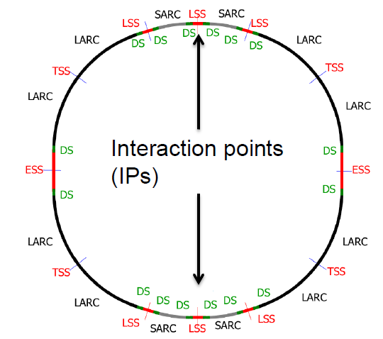
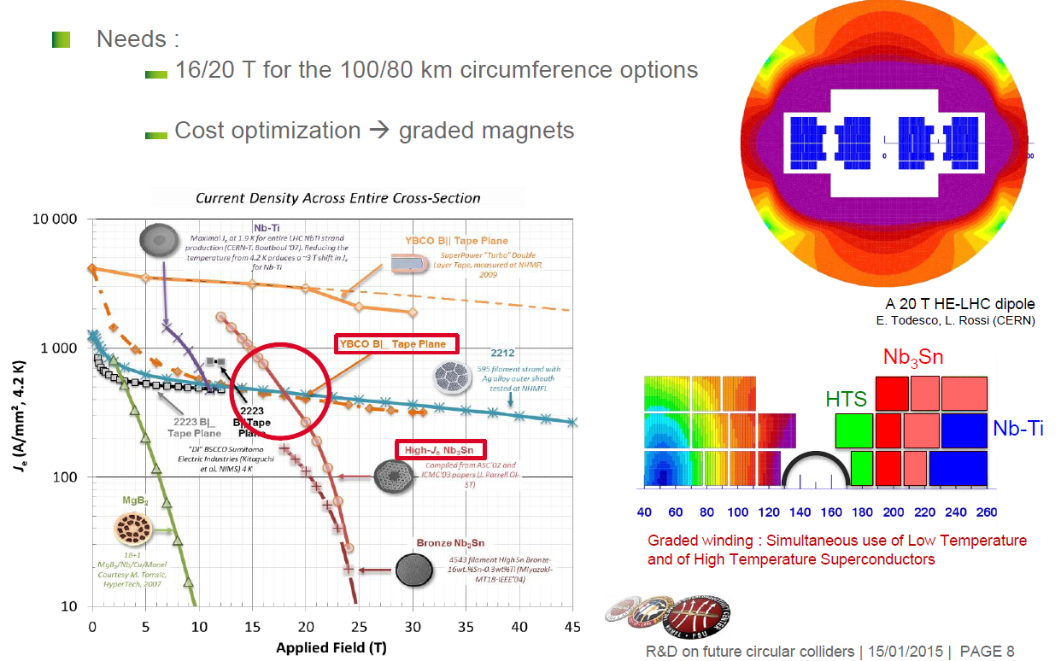
Future Circular Collider (pp) at CERN

Slide 55
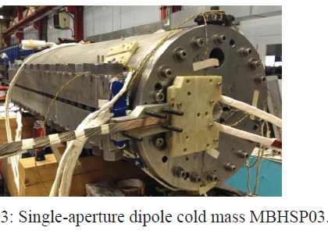
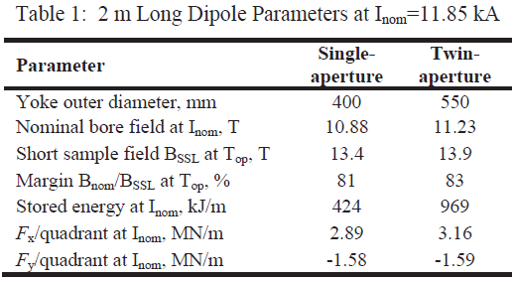
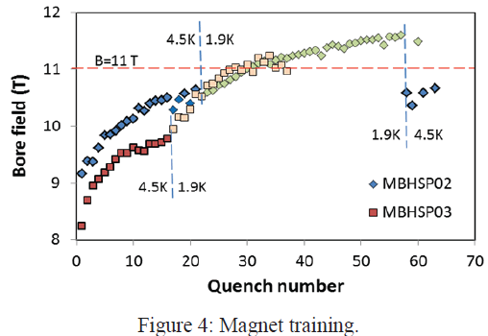
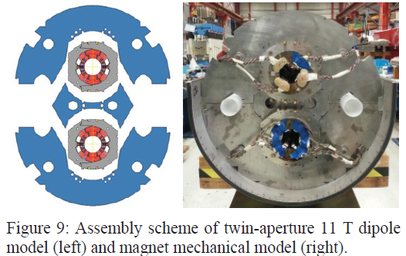
Nb₃Sn 11 T Dipole Test at FNAL

Slide 56
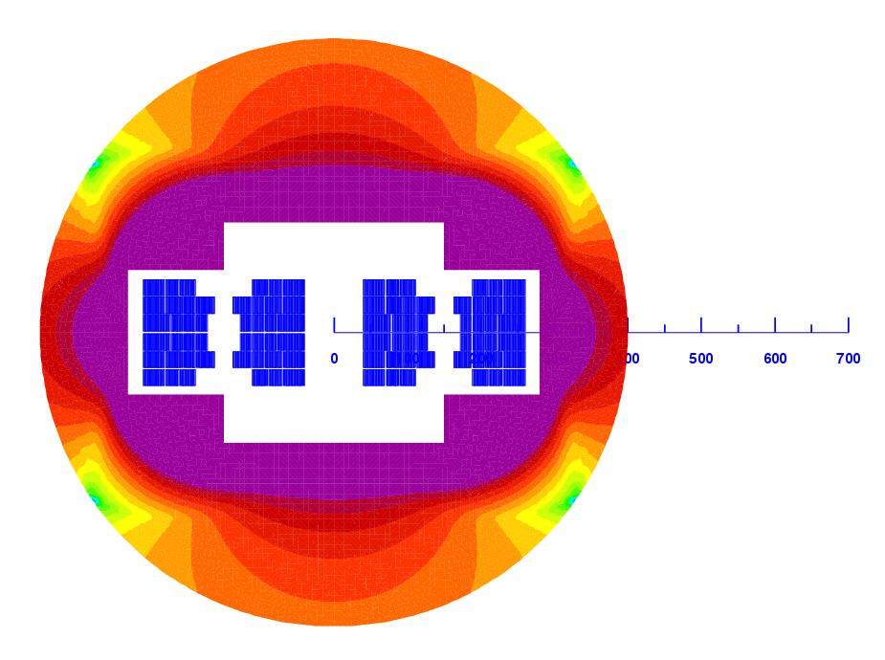
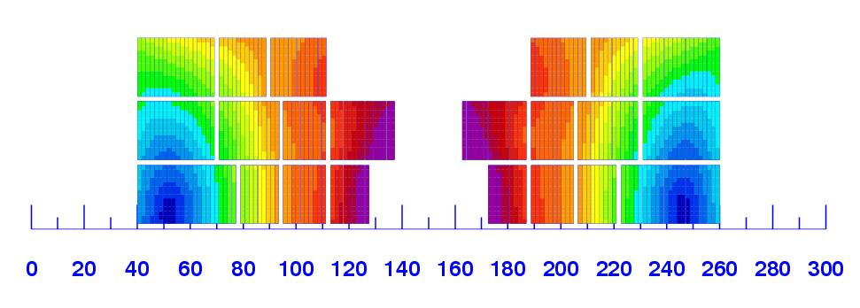
20 T Hybrid Magnet 2D Model
L. Rossi and E. Todesco
Conclusions de L. Rossi (CERN)
HE-LHC déclenche des idées et des programmes de R&D pour repousser les limites technos.
HE-LHC: 1000 t de Nb-Ti, 1500 t de Nb3Sn, 500 t de HTS (ITER 400 t Nb3Sn@700 A/mm² 2K)
10-15 années de R&D ne seront pas du luxe

Slide 57
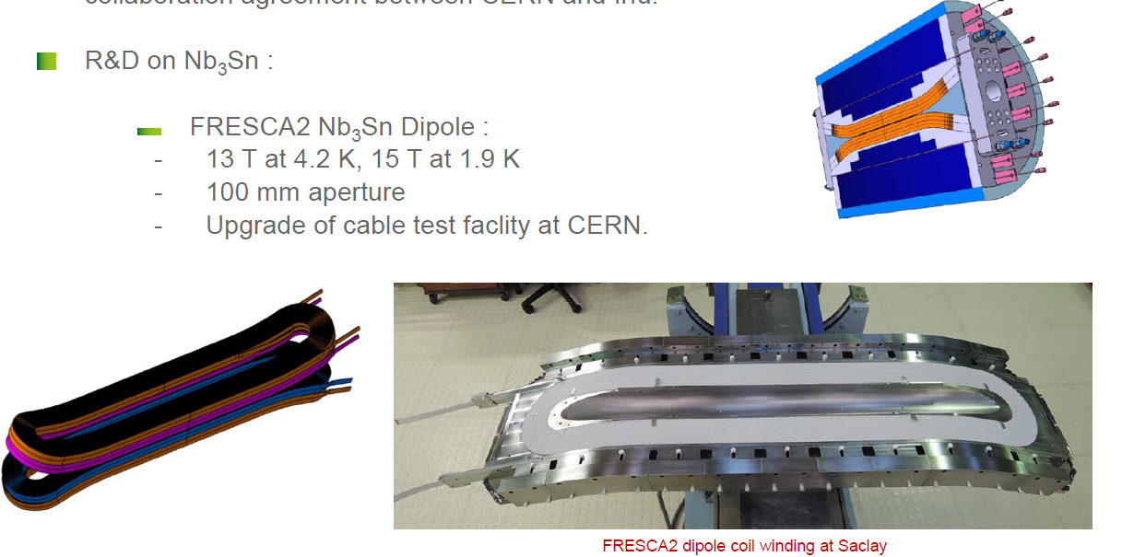
Nb3Sn R&D at CERN and CEA

Slide 58
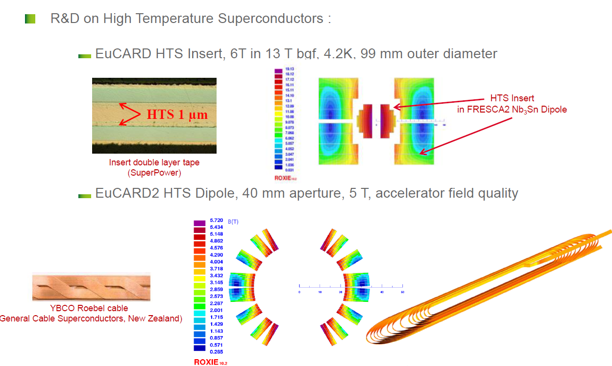
HTS R&D at CERN and CEA

Slide 59
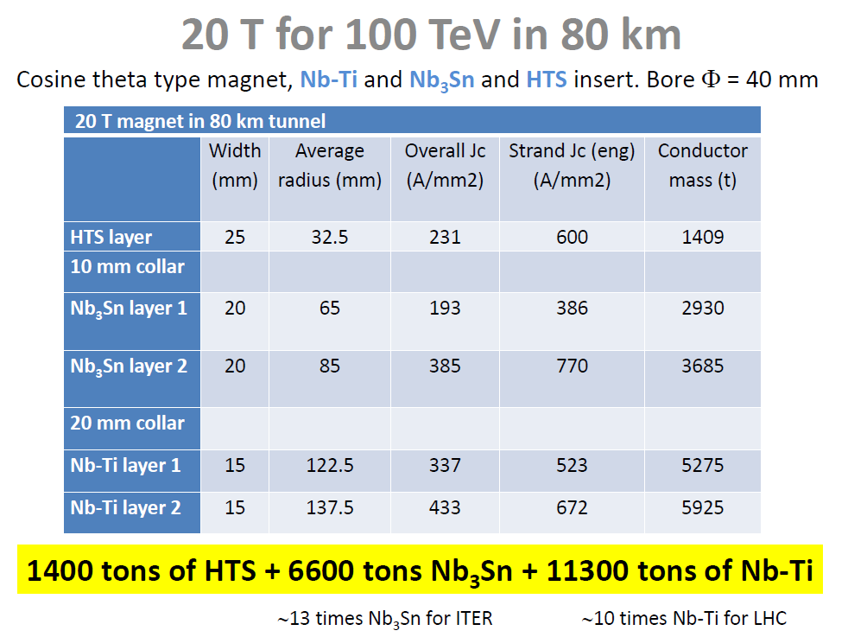
from Amalia Ballarino

Slide 60
Sommaire
Luminosité des collisionneurs
Concept d’émittance de faisceau
Collisionneurs proton-proton (pp)
Collisionneurs électron-positon (e+ e-)
Collisionneurs de photon (γγ)
Collisionneurs de muons (µ+ µ-)

Slide 61

The International Linear Collider ILC

Slide 62
Linear Collider Systematics
This is ½ of a Linear Collider:
→ luminosity L ~10³⁴ cm⁻²s⁻¹
Collisions of beams directly from RF Linac → luminosity L ~ 5 10²⁸ cm⁻²s⁻¹
Electrons
IP
X
Positrons

Slide 63
Collisions of Linac Beams
Electrons
IP
X
Positrons
Luminosity:
Typical electron Linacs are producing:
Q = 1 nC bunch charge (N = 6⋅10⁹) at γε_{x}⋅γε_{y} =1 µm² normalized transverse emittances, transported through a FODO lattice with L = 38 m cell length, leading to β_{x}⋅β_{y} ≈ 38² m² .
Assuming n_{b} = 2625 bunches at f_{rep} = 5 Hz and E = 250 GeV per beam
⇒ L = 5 10²⁸ cm⁻²s⁻¹ luminosity
generated by σ_{x}*⋅σ_{y}* = 80 µm² round beam sizes at the IP.

Slide 64
Collisions of Linac Beams from Dedicated Sources
Electrons
IP
X
Positrons
Luminosity:
Adding powerful electron and positron sources with
Q = 3.2 nC bunch charge (N = 2⋅10¹⁰)
⇒ L = 5 ⋅ 10²⁹ cm⁻²s⁻¹ luminosity
assuming γε_{x}⋅γε_{y} =1 µm² normalized emittances (not realistic for 3.2 nC, especially for the positron source !!)

Slide 65
Linac Beams from Dedicated Sources and Damping Rings
Electrons
IP
X
Symetric layout
for Positrons
Adding Damping Rings to reduce the normalized transverse emittances of the high charge electron and positron beams, to γε_{x}⋅γε_{y} =0.4 µm²
⇒ L = 8.5 ⋅ 10²⁹ cm⁻²s⁻¹ luminosity
generated by σ_{x}*⋅σ_{y}* = 50 µm² flat beam sizes at the IP

Slide 66
De-magnification from Final Focus Systems
IP waist
Electrons
X
l*
β*
Final Focus Systems are implementing the necessary ~10⁴ demagnification factors to reduce the σ_{x}*⋅σ_{y}* = 50 µm² flat beam sizes to 0.0036 µm²
⇒ L ~ 10³⁴ cm⁻²s⁻¹ luminosity
The final focusing lens is implemented via a doublet (or triplet) of strong Quadrupole Magnets located at distance l* from the IP, typically 3 to 4 m.

Slide 67
Depth of Focus and Chromaticity
IP waist
Electrons
X
l*
β*
The Beam Waist is realized over a finite region of longitudinal space called the Depth of Focus (like for a camera), measured by the β* parameter.
The collision with the opposite beam is optimum only within this region.
Like all magnets (cf. spectrometer magnets) the final quadrupoles create an energy dependant focusing effect, a 2nd order effect called Chromaticity.
As a consequence, the sizes and positions of the beam waist vary with the energy of the particles : this is called Chromatic Aberrations.

Slide 68
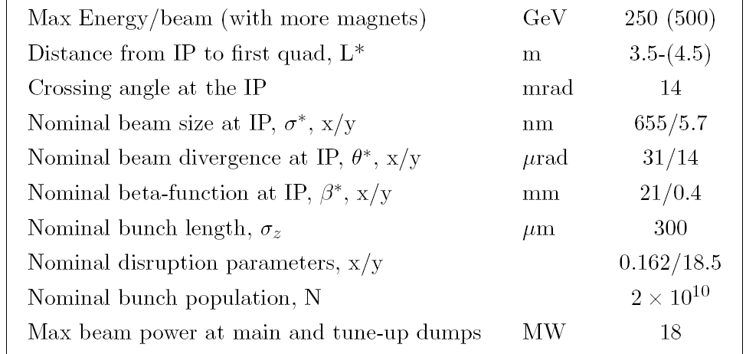
ILC Beam Delivery System Parameters
Notice:
‘Razor blade’ transverse aspect of the beams at collision:
  aspect ratio (cf. next page)
The 14 mrad crossing angle is larger that Piwinski angle
The reduction of luminosity is too large: , hence crab-crossing is mandatory.

Slide 69
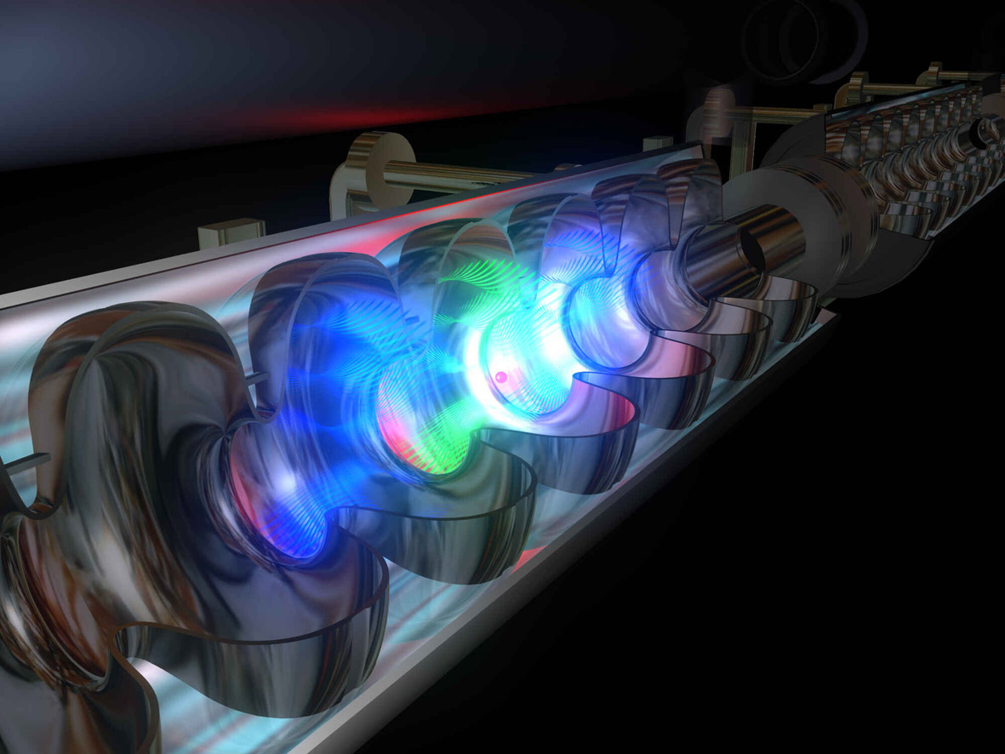
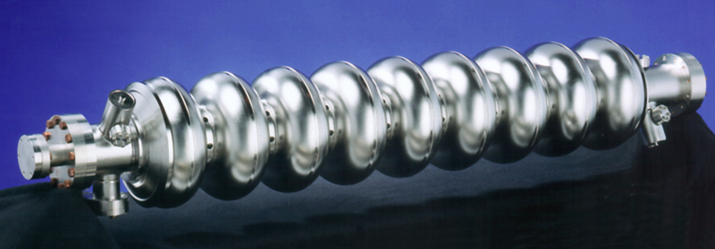
TESLA Accelerating Cavities
9-cell RF superconducting cavities @ 1.3 GHz
Accelerating field= 25-35 MV/m
1 m

Slide 70
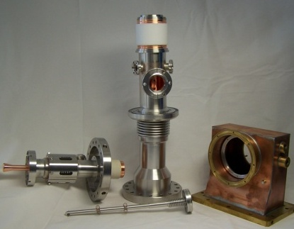
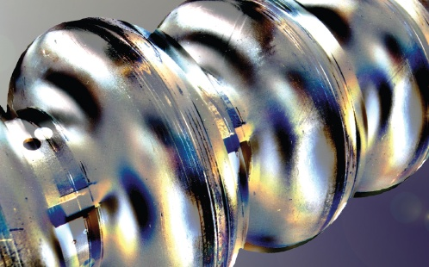

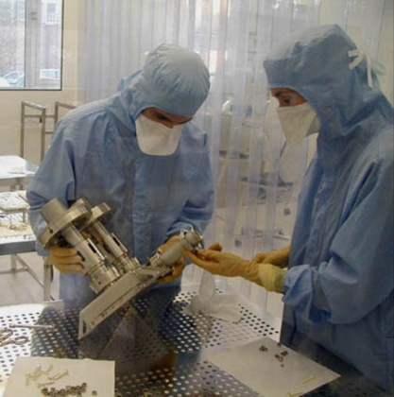




Superconducting RF and TTC Collaboration
FNAL, ANL
◉
Cornell
DESY
◉
JLAB
◉
◉
KEK
SLAC
◉
Orsay
Saclay
◉
◉
◉
INFN Milan
◉
◉
IHEP, PKU,
Tsinghua U.
IMP
70

Slide 71

FLASH@DESY uses TESLA Cryomodules

Slide 72




Progress in long-bunch train operation
2007: 800 bunches, average SASE power 55 mW
800 µs @ 0.6nC
max.
average
charge (nC)
1 MHz, 800 bunches
Lasing at 6.5 nm
2010: lasing at 4.8 nm, 160 mW
Energy (µJ)
2012: 500 bunches at 31 nm with 400 mW
Bunch number

Slide 73










XFEL Supraconducting Accelerator
101 cryomodules
808 cavities
1.3 GHz / 23,6 MV/m
808 RF couplers
120 kW @ 5 mA
26 RF stations (10 MW) operating at 5,2 MW
1
1
7
18-38 m s/sol
1 cryogenic sector (12 modules) : 120 W @2K, 204 W @5-8K, 1,4 kW @40-80K

Slide 74

XFEL Superconducting Accelerator

Slide 75

Module Tunnel Installation: 1+37 modules
The energy reach of the 56 modules tested so far is 12.7 GeV (94% of VT average gradient)

Slide 76


E-XFEL: Cavity String Assembly at CEA

Slide 77


E-XFEL: Two Strings in the Roll-out Area

Slide 78

E-XFEL: String / Cold Mass Assembly

Slide 79


E-XFEL: RF Power Coupler Assembly

Slide 80



E-XFEL: Transport Caps, Final Checks, Shipment

Slide 81


CEA-Alsyom Cryomodule Production Rate
5 day throughput was reached mid-October 2014 with XM15
⇒ the design of the Assembly Infrastructure was sound
Courtesy
Sept. 2015: XM60
March 2014: XM1
4-day throughput was reached in January 2015 with XM25
This ‘accelerated’ rate is needed to close the XFEL tunnel mid-2016:
  XM80 to be delivered at the end of December 2015
  XM100 to be delivered at the end of April 2016

Slide 82

Performance du Cryomodule E-XFEL XM59
Le champ accélérateur moyen des cavités est ⟨E_{acc}⟩ = 35,4 MV/m
Après intégration, le champ moyen du cryomodule est limité ‘administrativement’ à 31 MV/m pour ne pas endommager les composant de la distribution de puissance RF.

Slide 83

E-XFEL Cryomodule Performance (57 modules)
Individual cavities are voluntarily RF-power limited to 31 MV/m in AMTF tests.
Significant gradient degradation from XM6 to XM23, while CEA and Alsyom put all their effort in achieving production goal of 1 CM/week.
Pairwise RF distribution, initially foreseen, must be taylored to individual cavity RF distribution to compensate the large inequal gradient losses.
All but 2 of 57 tested modules are on XFEL specs (23.6 MV/m)
Average usable gradient is 16 % above specs : ⟨E_{acc}⟩= 27.4 MV/m.

Slide 84



Japan XFEL: SACLA Facility
5 m
SACLA 8.5 GeV electron beam is produced by C-Band (6 GHz RF frequency) Copper structure operating at 35 MV/m: this accelerating field is twice the SLC Linac field !
The electron beam is produced by a 500 kV photoinjector.

Slide 85
e+e- Colliders: Luminosity vs. Energy
At low energy, circular colliders are more ‘luminous’ than the linear colliders.
For 100 MW
synchrotron r
radiation power:
Yokoya, Arlington, Oct.2012

Slide 86

Future Circular Colliders (FCC) at CERN

Slide 87


Circular Colliders (CEPC-SppC) in China
from Jie Gao and Yifang Wang
Qinhuangdao

Slide 88

Circular Colliders (CEPC-SppC) in China
from Jie Gao and Yifang Wang

Slide 89

Circular Colliders (CEPC-SppC) in China
from Jie Gao and Yifang Wang

Slide 90
R&D for e+e- Circular Colliders
Most themes deal with 50 MW synchrotron radiation power management :
CW RF cryomodules at very high gradient (22 MV/m) and high power (600 cavities 700 MHz for TLEP)
Low emittance optics and large energy acceptance with energy ssawtooth management
Vacuum chamber shielding
Top-up injection
Cost and power estimate

Slide 91


FCC-e+e- @175 GeV in numbers
 | $704 \text{MHz}$ 5-cell cavity
Gradient | $$20{\text{MV}}/{\text{m}}$$
Active length | $$1.06 \text{m}$$
Voltage/cavity | $$21.2 \text{MV}$$
Number of cavities | $$568$$
Number of cryomodules | $$71$$
Total length cryomodules | $$902 \text{m}$$
$R/Q$ | $$506 Ω$$
$Q_{0}$ | $$2.0∙{10}^{10}$$
Dynamic heat load per cavity @ $1.9 \text{K}$: | $$44.4 \text{W}$$
Total dynamic heat load | $$25.2 \text{kW}$$
CW RF power per cavity | $$176 \text{kW}$$
Matched $Q_{ext}$ | $$5.0∙{10}^{6}$$
$$\begin{aligned}V_{RF}=12 \text{GV} \\ P_{beam}=100 \text{MW}\end{aligned}$$
cf. LEP2: 812 m
cf. LHC cryoplant capacity @ 1.9 K: 18 kW
Input power couplers!

Slide 92



High Q0 (3e10) CW Cryomodules
Possible breakthroughs on High Q0 (cryogenic loss factor) cavities and cryomodules (cf. TTC Meeting) from
    800°C baking with N2 doping
    Large grain cavities
    Thermal cycling of cryomodules
    Improved magnetic shields
E-XFEL XM-3 cryogenic losses
FNAL cavity with N2 doping
KEK cavity with double layer of magnetic shield
New cryogenic Mu-metal CRYOPHY
C. Reece
TTC High-Q0 Working Group
Alternative is active shield by SC coil

Slide 93
LCLS-II @ SLAC: CW Linac Layout for 4 GeV
L0
ϕ = *
V₀ =94 MV
I_{pk} = 12 A
L_{b} = 2.0 mm
L1
ϕ =−21°
V₀ =223 MV
I_{pk} = 12 A
L_{b} =2.0 mm
L2
ϕ = −21°
V₀ =1447 MV
I_{pk} = 50 A
L_{b} = 0.56 mm
L3
ϕ = 0
V₀ =2409 MV
I_{pk} = 1.0 kA
L_{b} = 0.024 mm
HL
ϕ =−165°
V₀ =55 MV
CM01
CM2,3
3.9GHz
CM04
CM15
CM16
CM35
LH
E = 95 MeV
R₅₆ = -14.5 mm
σ_{δ} = 0.05 %
BC1
E = 250 MeV
R₅₆ = -55 mm
σ_{δ} = 1.4 %
BC2
E = 1600 MeV
R₅₆ = -60 mm
σ_{δ} = 0.46 %
LTU
E = 4.0 GeV
R₅₆ = 0
σ_{δ} ≈ 0.016%
2-km
GUN
0.75 MeV
100-pC machine layout: Oct. 8, 2013; v21 ASTRA run; Bunch length L_{b} is FWHM
* L0 cav. phases: ~(3.4°, -15.2°, 0, 0, 0, 15°,15°)
P. Emma, L. Wang,
C. Papadopoulos
Linac Sec. | V (MV) | ϕ (deg) | Acc. Grad. (MV/m) | No. Cryo Mod’s | No. Avail. Cav’s | Spare Cav’s
L0 | 94 | * | 13.2 | 1 | 8 | 1
L1 | 220 | −21 | 14.3 | 2 | 16 | 1
HL | −55 | −165 | 14.5 | 3 | 12 | 1
L2 | 1447 | −21 | 15.5 | 12 | 96 | 6
L3 | 2409 | 0 | 15.4 | 20 | 160 | 10

Slide 94

LCLS-II SRF Linac
4 GeV up to 300 µA CW SC linac based on TESLA/E-XFEL 1.3 GHz technology
Key topics:
  Cavity process for high-Q0 production
  Industrial capability for 1) dressed-processed-cavity, 2) coupler, and 3) vacuum-vessel/cold-mass production
  Single RF-source single-cavity

Slide 95
Outline
Introduction
Proton Beams
Proton-proton colliders (pp)
Electron-positron colliders (e+ e-)
Muon colliders (µ+ µ-)
Photon colliders (γγ)

Slide 96

Collisionneur de muons
Utilise la plupart des systèmes des collisionneurs, sauf
  Linac à Protons multi-MW (cf. ESS)
  Cible W ou Hg multi-MW (cf. SNS, ESS)
  Refroidissement des faisceaux de muons par ionisation
    ~10⁶ dans l’émittance 6D, 10³ dans ε_{L} ~1mm.rad
  Gestions de la radioactivité induite dans les anneaux par la décroissange des muons stockées.
Nécessite plusieurs décennies de R&D sur ces thèmes.

Slide 97

Muon Colliders
Possible layout of µ+µ- Higgs Factory at Fermilab, based on PIPII

Slide 98


PIP-II Site Layout (provisional)

Slide 99
PIP-II Linac Technology Map
IS
LEBT
RFQ
MEBT
β=0.11
β=0.22
β=0.51
β=0.61
β=0.9
RT
SC
162.5 MHz
0.03-11 MeV
325 MHz
11-177 MeV
650 MHz
177-800 MeV
Section | Freq | Energy (MeV) | Cav/mag/CM | Type
RFQ | 162.5 | 0.03-2.1
HWR (β_{opt}=0.11) | 162.5 | 2.1-11 | 8/8/1 | HWR, solenoid
SSR1 (β_{opt}=0.22) | 325 | 11-38 | 16/8/ 2 | SSR, solenoid
SSR2 (β_{opt}=0.51) | 325 | 38-177 | 35/21/7 | SSR, solenoid
LB 650 (β_{G}=0.61) | 650 | 177-480 | 30/20/5 | 5-cell elliptical, doublet
HB 650 (β_{G}=0.9) | 650 | 480-800 | 24/10/4 | 5-cell elliptical, doublet
All components CW-capable

Slide 100





SRF R&D at FNAL
HWR
SSR1 SSR2
LB650
HB650

Slide 101
Sommaire
Luminosité des collisionneurs
Concept d’émittance de faisceau
Collisionneurs proton-proton (pp)
Collisionneurs électron-positon (e+ e-)
Collisionneurs de photon (γγ)
Collisionneurs de muons (µ+ µ-)

Slide 102



Higgs Factory: γγ collider
Principle n°1: backscattered photons at 180° carry up to 80% of the impinging electron
e⁻ γ_{laser} → e⁻ γ
Principle n°2: Higgs production is direct, with high cross-section

Slide 103

HFiTT – Higgs Factory in Tevatron Tunne
ASTA =
Advanced
Superconducting
Test
Accelerator
RF (1.3 GHz, 8 insertions, 5 cryomodules 1.25 GV /set)
RF
RF
e⁻ (80 GeV)
2000 m
Fiber Laser
(0.351 μm, 5 J, 47.7 kHz)
γγ collision
(125 GeV)
2.438 m
(8 ft)
e⁻ (80 GeV)
RF
RF
e⁻ (0.75-8 GeV)
Project X or ASTA
e⁻ (0.75-8 GeV)
E = 80 GeV
= 800 m
U = 4.53 GeV/turn
I = 0.15 mA x 2
P(rf) = 27 MW
Tunnel Cross Section
(16 permanent magnet beam lines,
B = 0.05 – 3.3 kG)
RF
RF
3.048 m (10 ft)
RF

Slide 104
Primary Parameters
Parameter | HFiTT (FNAL) | Sapphire (CERN) | SILC (SLAC)
cms e-e- Energy | 160 GeV | 160 GeV | 160 GeV
Peak γγ Energy | 126 GeV | 128 GeV | 130 GeV
Bunch charge | 2e10 | 1e10 | 5e10
Bunches/train | 1 | 1 | 1000
Rep. rate | 47.7 kHz | 200 kHz | 10 Hz
Power per beam | 12.2 MW | 25 MW | 7 MW
L_ee | 3.2e34 | 2e34 | 1e34
L_gg (Eγγ > 0.6 Ecms) | 5e33 | 3.5e33 | 2e33
CP from IP | 1.2 mm | 1 mm | 4 mm
Laser pulse energy | 5 J | 4 J | 1.2 J
γ_{laser}: In all designs a laser pulses
of a several Joules with a λ~350nm (3.53 eV) for E_{e-} ~ 80 GeV
Total electric power < 100 MW

Slide 105



Cost of HFiTT
< 1Billion US$

Slide 106
Sommaire
Luminosité des collisionneurs
Concept d’émittance de faisceau
Collisionneurs proton-proton (pp)
Collisionneurs électron-positon (e+ e-)
Collisionneurs de photon (γγ)
Collisionneurs de muons (µ+ µ-)

Slide 107
Conclusion (1/2)
We should be ambitious and modest at the same time in planning future colliders.
My personal opinion: 30 years is the minimum time for building future colliders based on outstanding technologies:
  10 years for R&D and prototyping to identify the right technical concepts
  10 years for producing a Technical Design Report, a Cost Estimate and a Collaboration
  10 years for construction until physics runs

Slide 108
Conclusion (2/2)
Examples:
  LHC : 1985 – 2015
  TESLA/E-XFEL (17.5 GeV) : 1990 – 2017
  S&C Band RF/SACLA (Japan XFEL): 1985 – 2012
For the RF Acceleration, XFELs are leading the developments:
  E-XFEL and LCLS II for Superconducting RF
  SACLA and SwissFEL for S&C Band RF
For High Field Magnets, a world-wide collaboration is in place for long standing developments with Nb3Sn and High Tc superconductors
For Laser-Plasma Acceleration, inter-laboratory collaboration, including accelerator labs, is a new paradigm.

Slide 109
Merci de votre attention.

