Slide 1
Status of the Clermont-Ferrand
R&D works on Mechanics
Tilecal upgrade meeting on mini-drawer mechanics
CERN (25 March 2015)
Clermont-Fd team

Slide 2
Tile Module envelop
Concept Validated
Drawings available including envelope
=> evolution of the design: CLuj

Slide 3
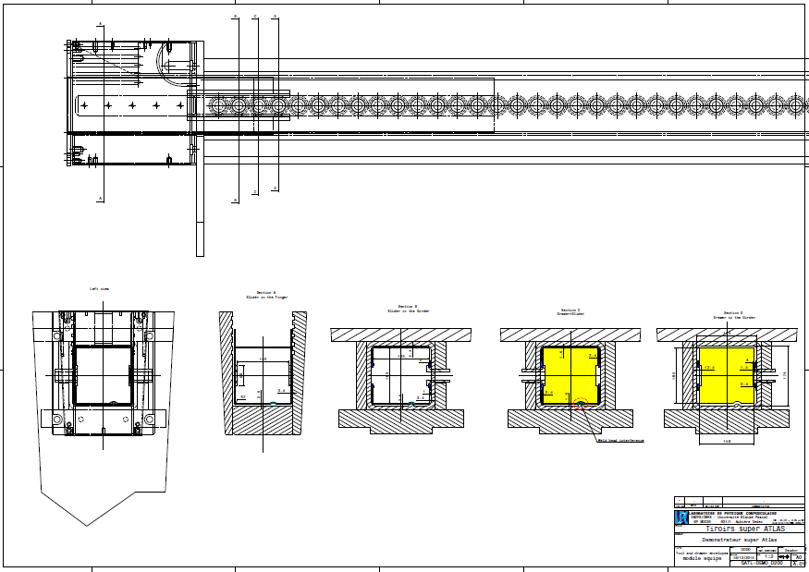
Tile Module envelope

Slide 4
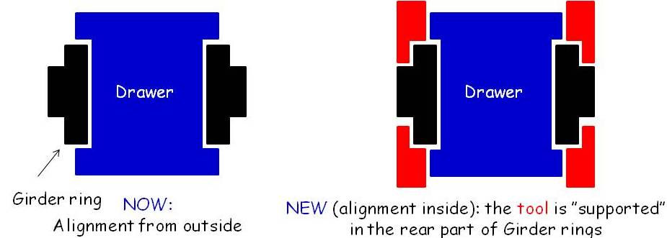
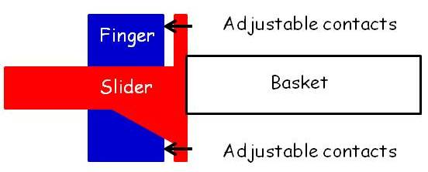
New Concept of handling tools :
SLIDER+ BASKET
Alignment from outside => alignment from inside
(from external girder refs) ( using 4 girder-rings in the girder)
Perfect alignment, no locking of the basket on the finger (no constraints)
No damage on rings
Easy sliding of the mini-drawers
Alignment tool: SLIDER on the external side of Girder-Rings
Slider at 90°
Basket
The slider is the support of the basket receiving
the mini-drawer

Slide 5
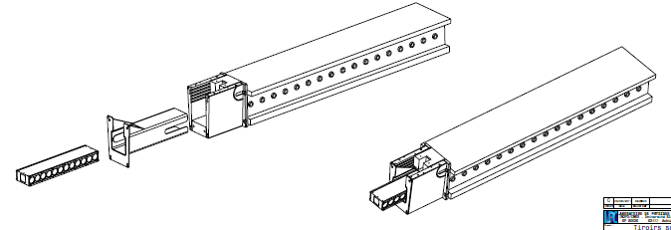
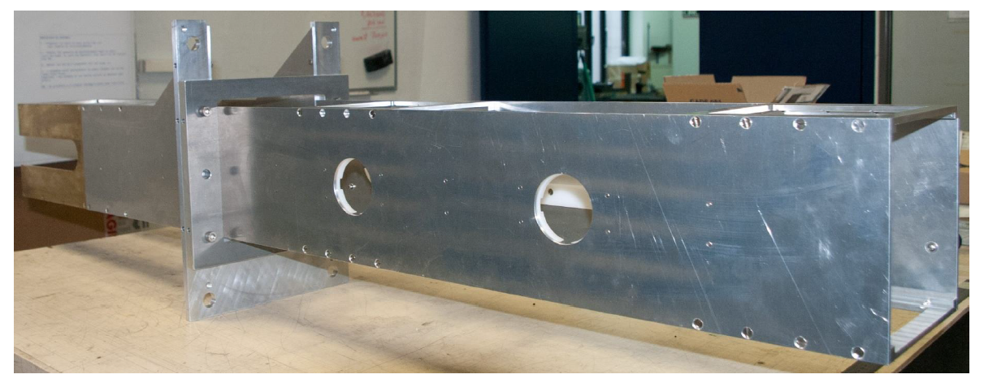
BASKET
New Rings added

Slide 6
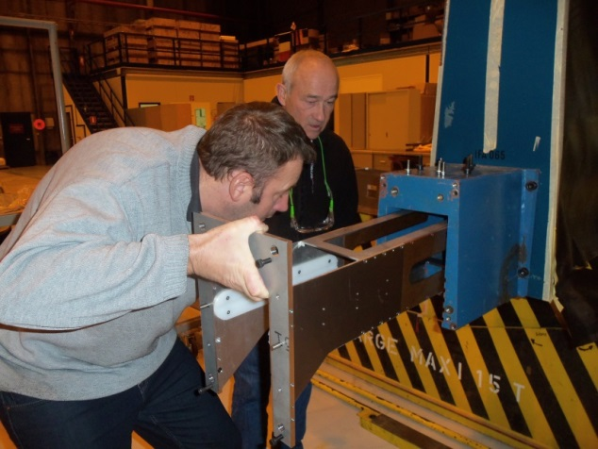
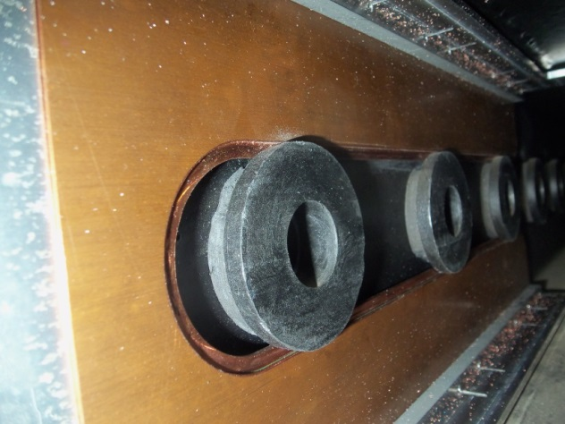
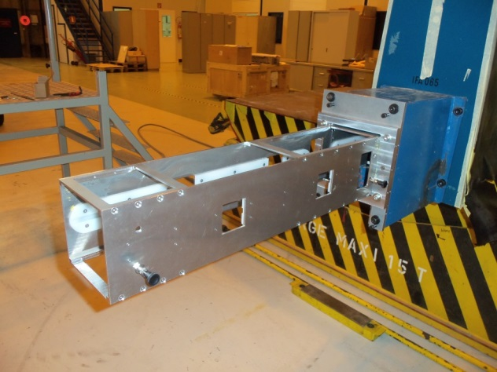
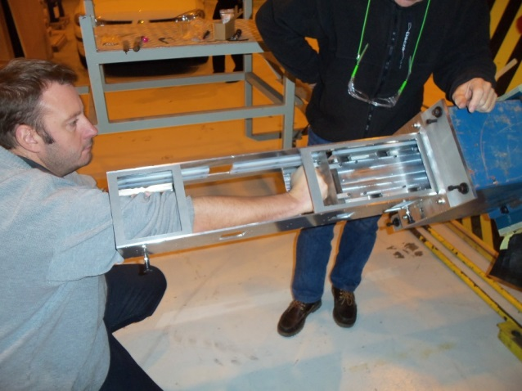
New Concept of handling tools
● Clermont-Ferrand tools operational & validated at CERN in various positions
Slider at 90°
Basket
Concept validated.
To be done (LPC):
Modifications to be made with respect to services designed by IFAE (integration of spools?)
Evolution of basket (design part?)

Slide 7
Towards a production for phase II
● 4 objects :
Mini-drawer
Slider
Basket
Services - Spolls
A lot of good ideas, various proposed solutions at various labs
=> Global evaluation needed to progress without duplication of efforts
● At Valencia meeting, it becomes clear that:
Integration of each object to build a full apparatus is needed
Role and responsibilities on R&D sharing to be defined
A coordinating person is mandatory
Specification have to be defined (envelope is one of the important specification; special cases also;…)
Procedure for handling/inserting/extracting a drawer to be defined in parallel
Documentation in EDMS
…
A draft proposal aimed to start the discussion on these items has been sent by F Daudon(LPC engineer) end of last year….
See additional material to this talk

Slide 8
BACKUP

Slide 9
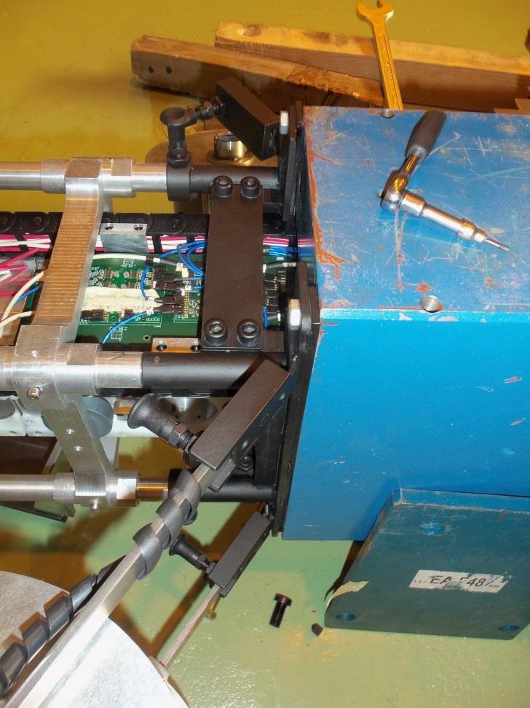
● Not compatible with the Barcelona developments
▪ Patch Panel and Service tools.
Strongly screwed
▪ No bearing screw on the Slider
⇒ Strength fully on the Girder Rings.
Clermont-Ferrand proposition
(Several times explained)
9
▪ Poor and damaging contact of the Slider
Alignment and contact on the small Ring
where glue and foam are located
→ No accuracy.
→ Damages of the foam.
Responsibilities
must be clarified.

