Slide 1
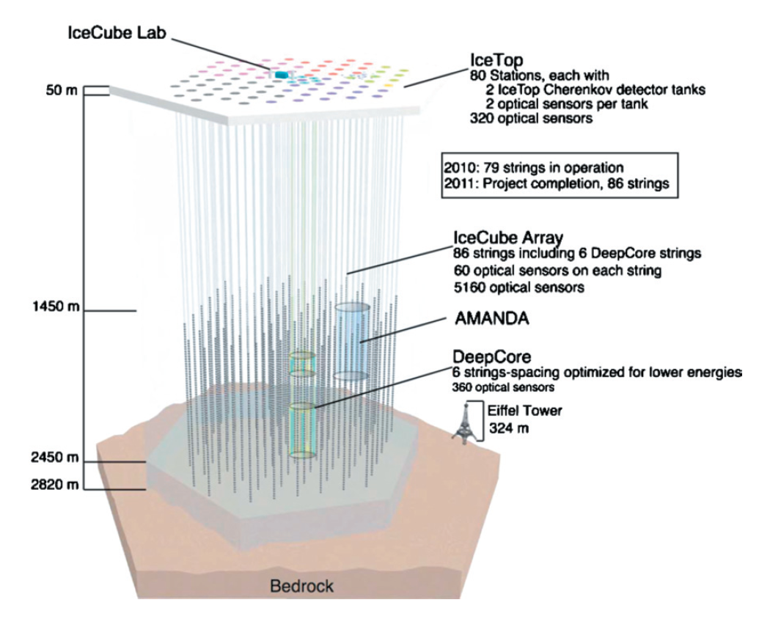
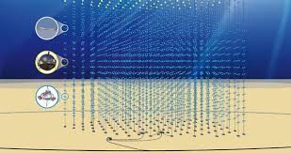
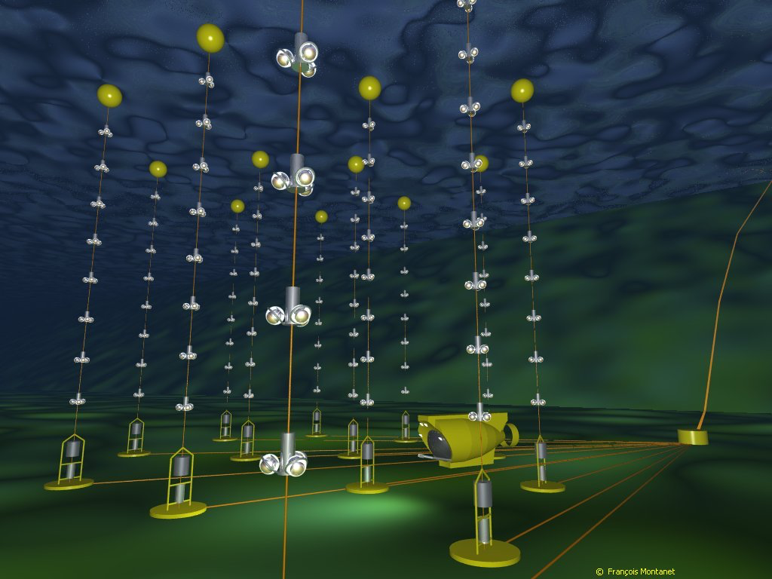
High Energy Neutrino Experiments
(TeV-PeV)
IceCube
ANTARES
KM3Net

Slide 2
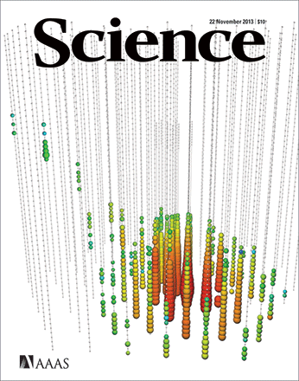
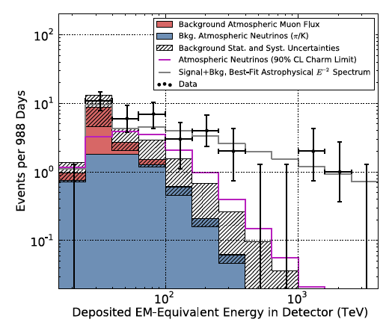
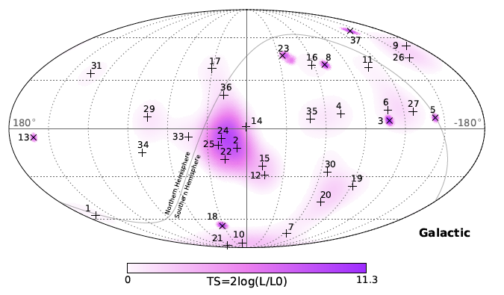
The Dawn of Neutrino Astronomy
What are the Sources?
Galactic or Extragalactic?
Are they UHECR or HE Gamma-rays accelerators?
Higher IceCube statistics to determine:
Isotropic or some anisotropies? Counterparts?
Spectrum? Breaks? Flavor ratios?
Hints of new Physics? Dark Matter?
IceCube
22 Nov 2013
37 events in YR 3 data;
30 TeV to 2 PeV

Slide 3
The Dawn of Neutrino Astronomy
What are the Sources?
Galactic or Extragalactic?
Are they UHECR or HE Gamma-rays accelerators?
Higher IceCube statistics to determine:
Isotropic or some anisotropies? Counterparts?
Spectrum? Breaks? Flavor ratios?
Hints of new Physics? Dark Matter?
IceCube
22 Nov 2013
Next steps:
Extension of sensitivity: IceCube-Gen2
Complete coverage of the sky: KM3Net
Multimessenger studies
CTA, HAWC, LHAASO
AUGER, TAx4, JEM-EUSO
Grav. Waves, X-rays, Radio…
37 events in YR 3 data;
30 TeV to 2 PeV

Slide 4
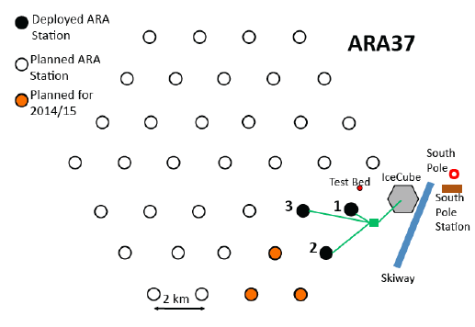
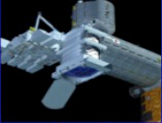
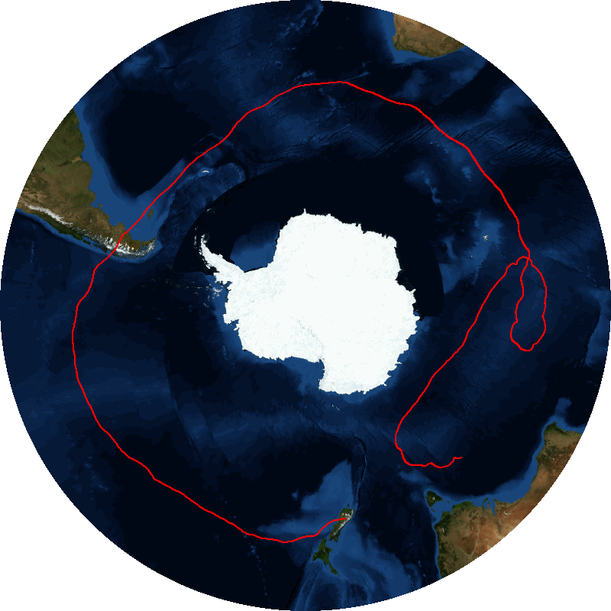
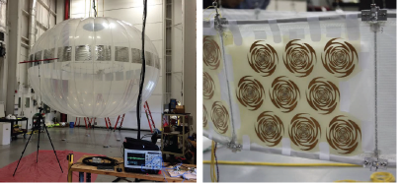
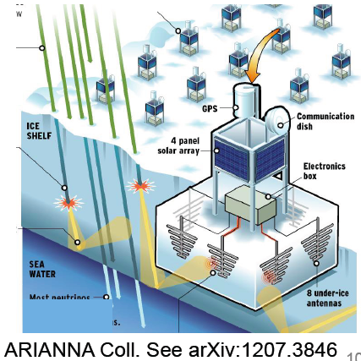
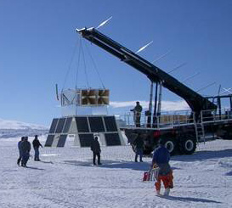
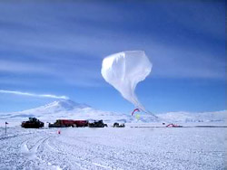
UtraHigh Energy Neutrino Experiments
(EeV-ZeV)
ARA: Askaryan Radio Array
JEM-EUSO
EVA
IceCube
ANITA

Slide 5
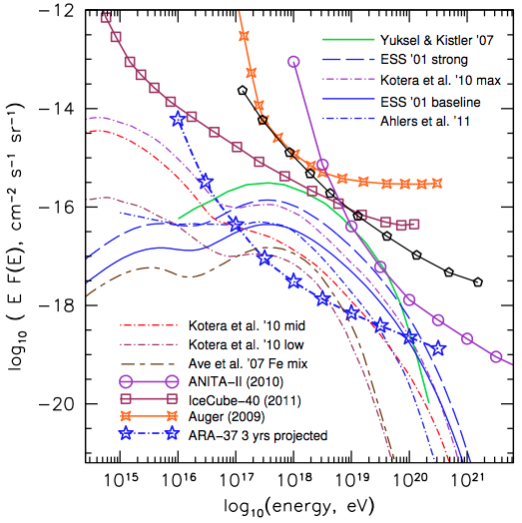
EeV Neutrino Detectors
Current Limits
Ground: IceCube, Rice, Auger
Space: ANITA
Models range,
above flux Lower Limit by
UHECR comp. (Kotera et al ‘10)
Next Generation
Ground:ARA, ARIANNA,INO,…
Space: EVA, JEM-EUSO

