Slide 1
Introducing Particle Physics
Particle Physics
FOR
Pablo del Amo Sánchez

Slide 2
Aim of this lecture:
Particles and Forces of the Standard Model
The particle zoo
Qualitative Feynman diagrams

Slide 3
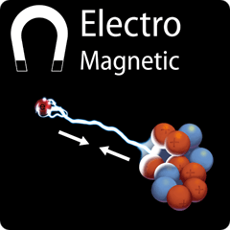
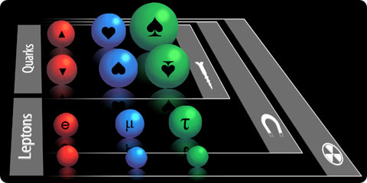
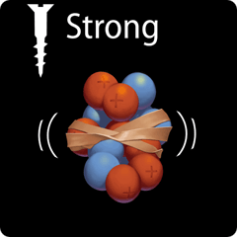
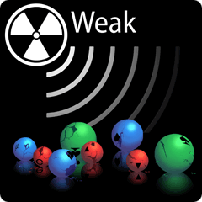
The Standard Model: elementary particles and their interactions
Notes:
Planck mass: the mass whose Compton wavelength and Schwarzschild radius are equal

Slide 4
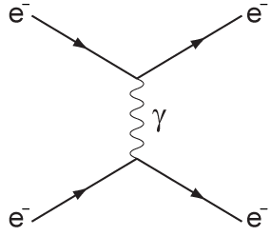
Example of EM interaction
e⁻- e⁻ collision, transferring momentum q by exchange of photon, quanta of EM field
space
Feynman diagram
for e⁻-e⁻ collision
time

Slide 5
Example of EM interaction
e⁻- e⁻ collision, transferring momentum q by exchange of photon, quanta of EM field
Feynman diagrams are calculational tools: will sketch computation of QM amplitude
space
Feynman diagram
for e⁻-e⁻ collision
time

Slide 6
Example of EM interaction
e⁻- e⁻ collision, transferring momentum q by exchange of photon, quanta of EM field
Feynman diagrams are calculational tools: will sketch computation of QM amplitude
space
i
f
Feynman diagram
for e⁻-e⁻ collision
Remember the probability current j_{k} conserved by the Schrödinger equation
?
This one’s similar except relativistic (Dirac’s equation!)
time

Slide 7
Example of EM interaction
e⁻- e⁻ collision, transferring momentum q by exchange of photon, quanta of EM field
Feynman diagrams are calculational tools: will sketch computation of QM amplitude
space
Feynman diagram
for e⁻-e⁻ collision
time

Slide 8
Example of EM interaction
e⁻- e⁻ collision, transferring momentum q by exchange of photon, quanta of EM field
Feynman diagrams are calculational tools: will sketch computation of QM amplitude
space
Feynman diagram
for e⁻-e⁻ collision
time

Slide 9
Example of EM interaction
e⁻- e⁻ collision, transferring momentum q by exchange of photon, quanta of EM field
Feynman diagrams are calculational tools: will sketch computation of QM amplitude
space
Feynman diagram
for e⁻-e⁻ collision
time

Slide 10
Example of EM interaction
e⁻- e⁻ collision, transferring momentum q by exchange of photon, quanta of EM field
Feynman diagrams are calculational tools: will sketch computation of QM amplitude
space
Feynman diagram
for e⁻-e⁻ collision
Cross sections,
decay rates
proportional
to |A|²
time

Slide 11
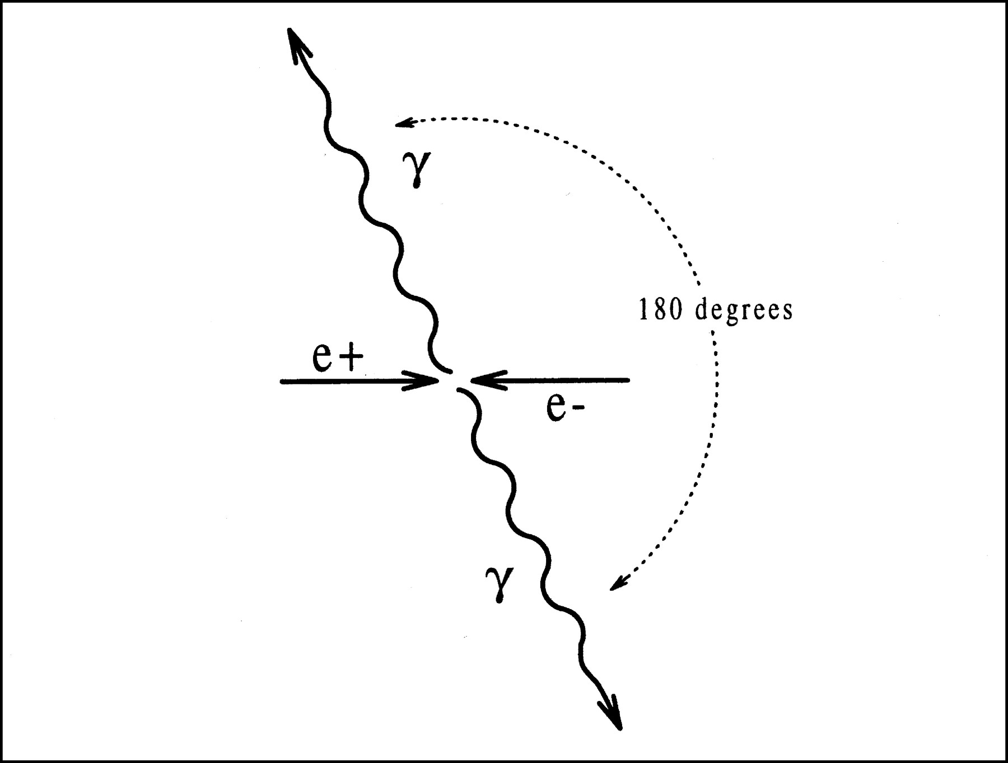
Example of EM interaction: matter-antimatter annihilation
Antiparticle: same properties (mass, spin) as particle, but all “charges” reversed (electric, weak force, strong force)
Particle + antiparticle = radiation (E=mc²!)
positron = anti-electron = e⁺

Slide 12
Example of EM interaction: matter-antimatter annihilation
Antiparticle: same properties (mass, spin) as particle, but all “charges” reversed (electric, weak force, strong force)
Particle + antiparticle = radiation (E=mc²!)
where m is “relativistic invariant mass” of system:
positron = anti-electron = e⁺
c = 1!

Slide 13
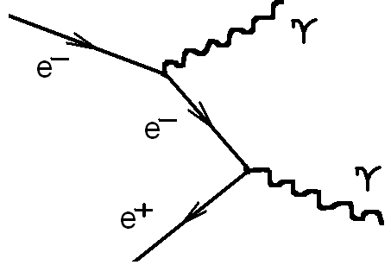
Example of EM interaction: matter-antimatter annihilation
Antiparticle: same properties (mass, spin) as particle, but all “charges” reversed (electric, weak force, strong force)
Particle + antiparticle = radiation (E=mc²!)
Feynman diagram

Slide 14
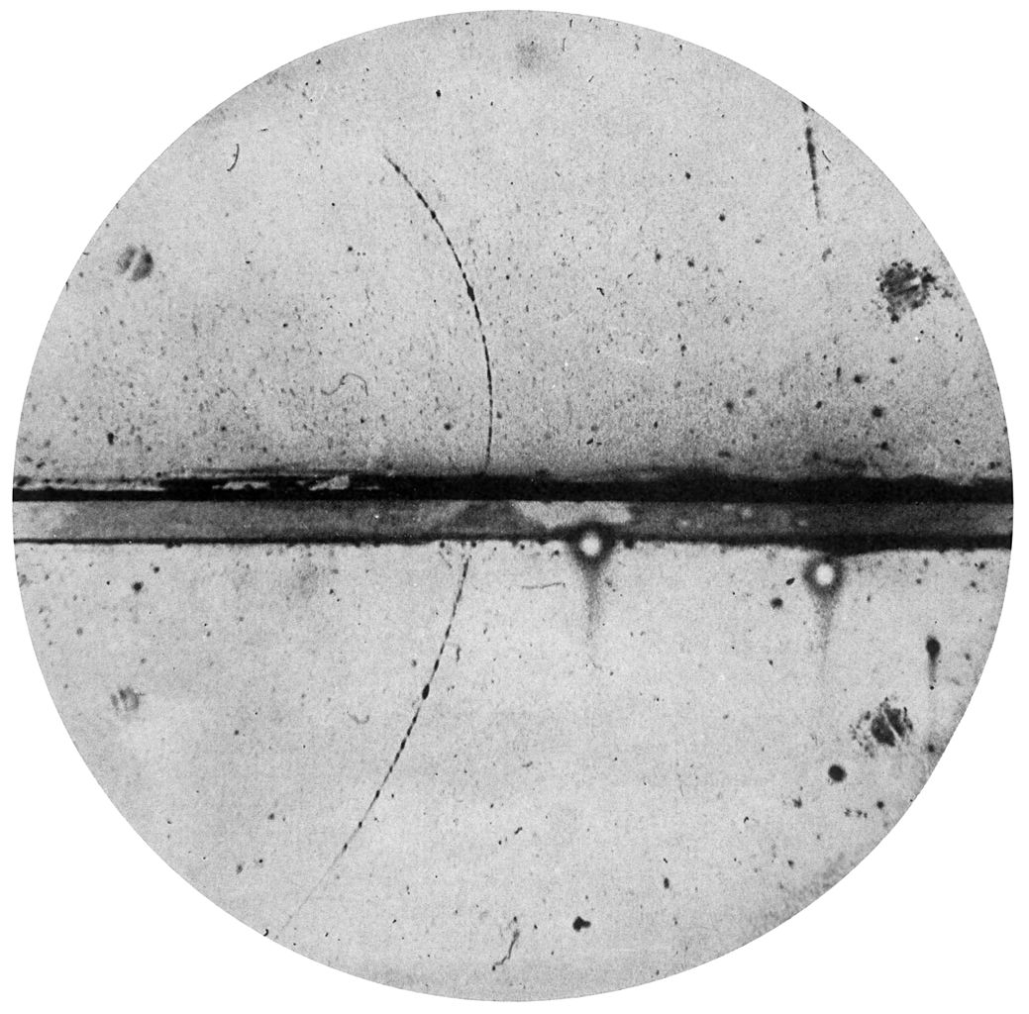
Antiparticles: the positron
1932, Anderson: picture of
cloud chamber in magnetic field
Track crosses lead plate,
looses energy, going upwards
Positive charge (curvature),
mass < 20 m_{e}
… A POSITIVE ELECTRON!
Actually predicted by Dirac’s
equation (Oppenheimer 1930)!
Antiparticle has same mass, spin, etc
but opposite charge
Notes:
Cloud chamber: supersaturated vapor (often water or alcohol). Charged particle ionizes fluid. Ionized molecules become condensation nuclei around which a mist will form.

Slide 15
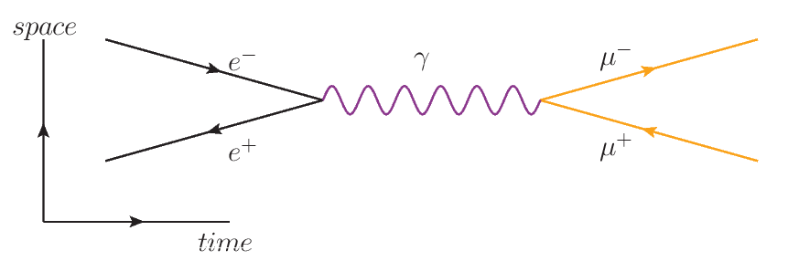
Example of EM interaction: pair production
The inverse of matter-antimatter annihilation: particle-antiparticle pair production
For instance: μ⁺ μ⁻ production:
Antiparticules pictured as arrows opposite to flow of time
Emission of e⁻ = absorption of e⁺
Possible only if invariant mass m²_{e+e−}= q² > (2m_{μ})²
Internal particles are called “virtual particles”. Note: m²_{γ} = q² ≠ 0 !!!
Notes:
Virtual particles are analgous to intermediate states in sums over all states appearing in standard QM time independent perturbation theory.

Slide 16
Quantum ElectroDynamics (QED)
Many higher order diagrams possible for μ⁺ μ⁻ production:
Feyman diagrams part of a perturbation series in powers of coupling constant α
All this, and much more, described by Quantum ElectroDynamics (QED),
a consistent Quantum Field Theory
(Tomonaga (1946), Schwinger (1948) and Feynman (1948) based on Dirac 1928)
+
+
+…
Notes:
10 significant figures precision agreement between QED and experiment in g-2 of the electron

Slide 17
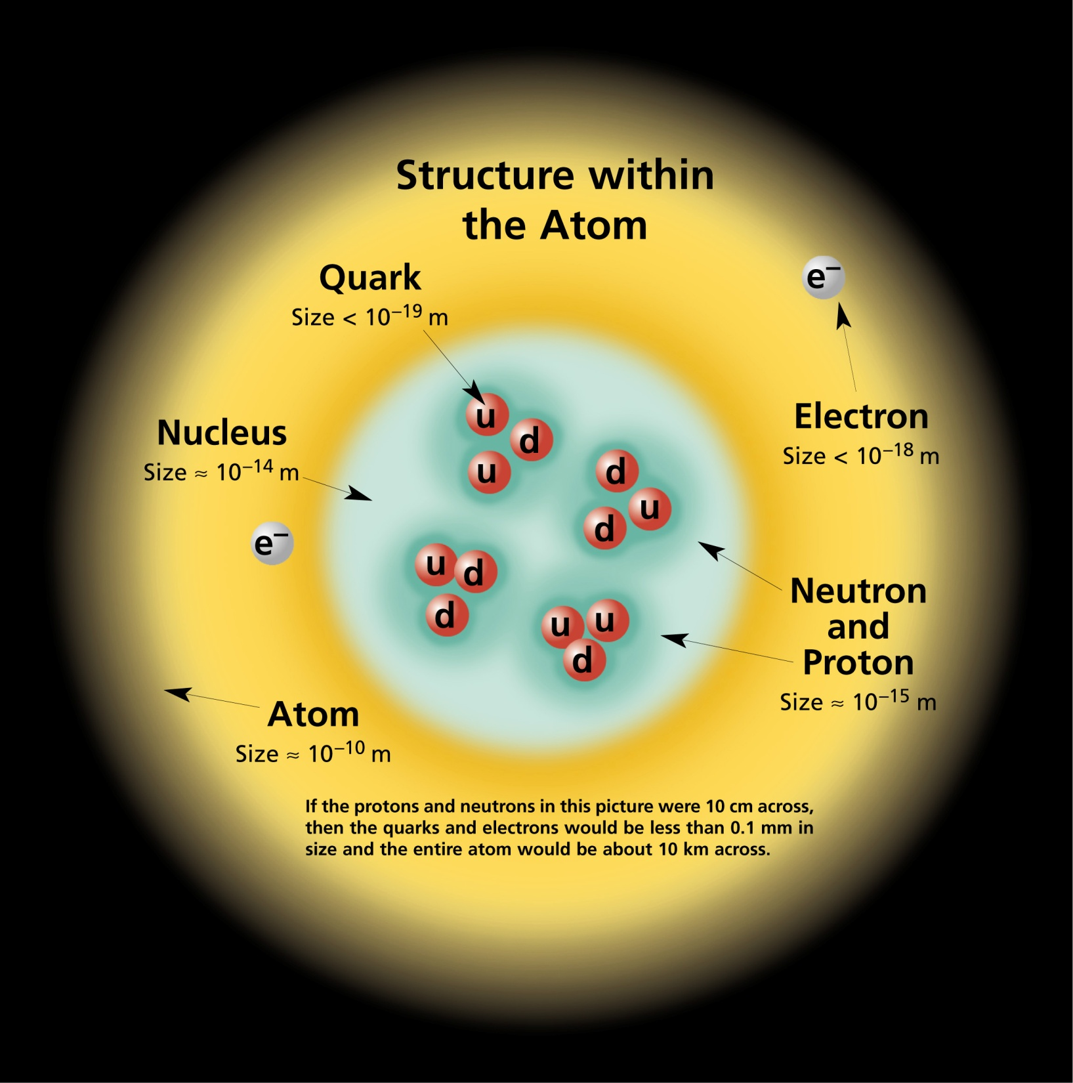
Protons are composite
Nucleons composed of 3 point-like particles: quarks
=1 Angström
=1 fm

Slide 18
Quarks and the Strong Force
Strong force like EM but with three different types of charge instead of just one
Let’s call them red, green, blue, just for fun…* “Positive” charge is then red whereas “negative” is anti-red (cyan, in this analogy).
This kind of charge called “color”
➔ theory called Quantum Chromodynamics (QCD)
Call “quark” a particle with color charge. Leptons don’t have color.
EM
Strong Force
* Particles with color not responsible for colours of light!

Slide 19
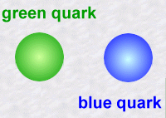
Quantum ChromoDynamics (QCD)
Charges repel(attract) if same(different), e.g. red and red repel, red and anti-red attract, red and blue attract.
Force carriers are called gluons
Gluons must carry color charge ➔ far-reaching consequences, very different from QED!
Consequences:
Very short range force
Force gets stronger when quarks pulled apart
Only see color-neutral free particles in Nature (quark confinement)

Slide 20
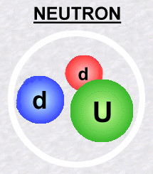
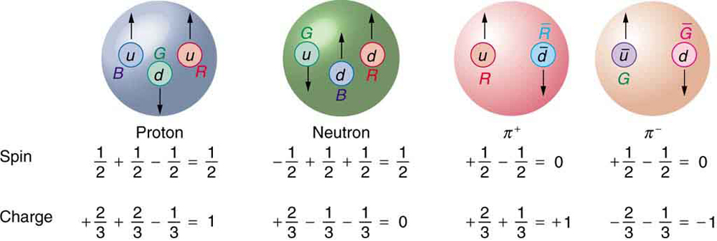
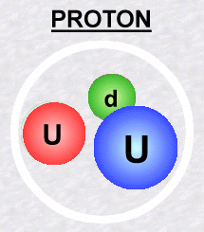
Quarks make up hadrons
Can get color-neutrality (neither excess nor defect) with following combinations:
color+anti-color
red+green+blue since anti-red=cyan=green+blue
So the quarks arrangements found in Nature are:
quark+antiquark’ (meson)
quark+quark’+quark’’ or 3 antiquarks (baryon)
Hadrons

Slide 21
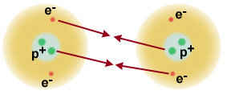
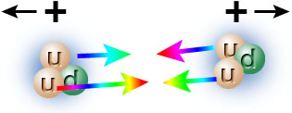
QCD → Strong nuclear force
Protons and neutrons bound in nucleus by residual force between quarks, same as atoms in molecules

Slide 22
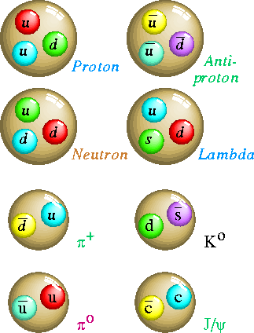
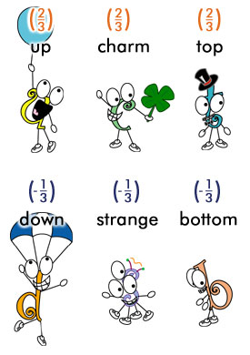
How many different quarks?
Experimentally find 6 quarks (flavours) , 3 up-type and 3 down-type quarks
All the same in QCD, except different masses
A few important mesons: pions, kaons (s quark), D (c quark), B(b quark)
Light
Stable
Heavy
Unstable

Slide 23
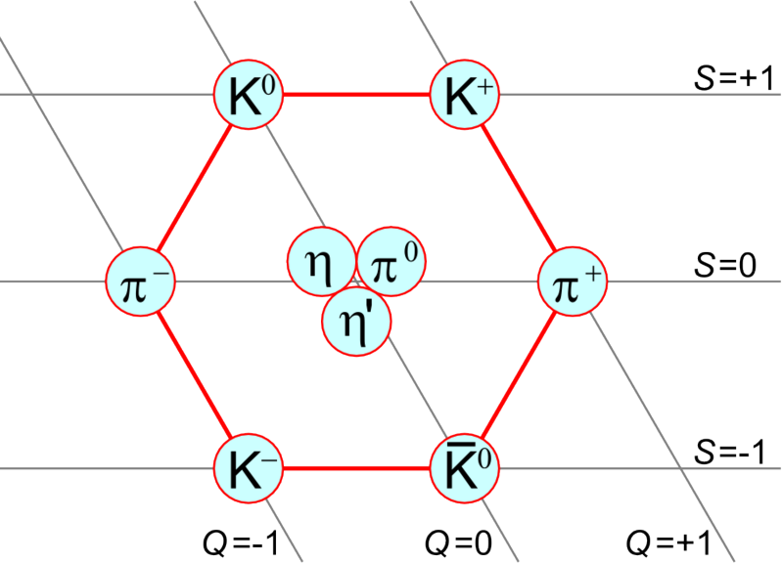
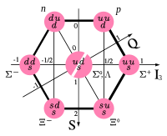
Symmetries
Classification and description of hadrons thanks to symmetries (group theory)

Slide 24
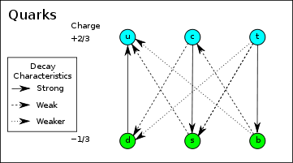
Heavy flavours
Heavy quarks unstable… How? Up to now, always creating/annihilating pairs of particle-antiparticle of same type
Weak force:
induces decays of unstable elementary particles

Slide 25
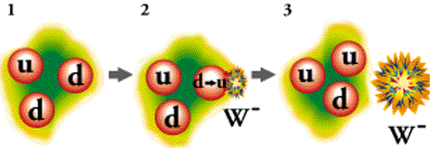
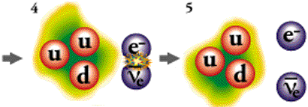
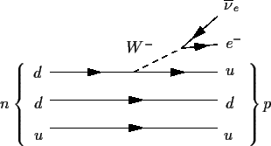
Weak Force
Neutron beta decay: n → p + e⁻ + ν_{e}
Weak force responsible for decays of unstable elementary particles
Mediated by Z⁰ and W± bosons
Contrary to photons and gluons, Z⁰ and W± have non-zero masses
Propagators proportional to 1/M²_{Z}, 1/M²_{W}
➔ Weak Force very weak!
1/M²_{W}

Slide 26
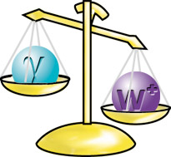
Why are Z and W so heavy?
Z and W are 100 and 85 times heavier than proton
But photons and gluons massless!
It’s the Higgs boson’s fault!

Slide 27
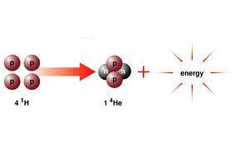
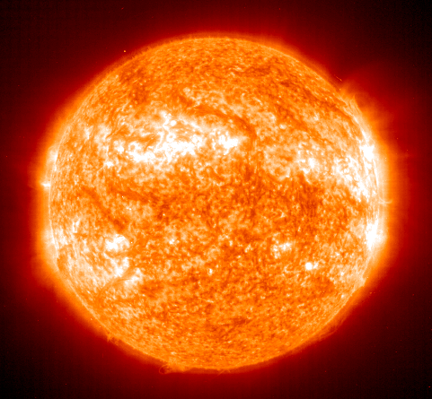
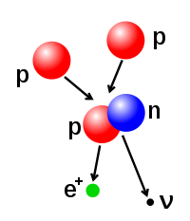
Weak Force
Governs rate of energy production in the sun (inverse beta decay a step in fusion process)

Slide 28
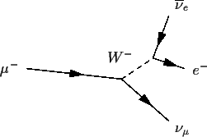
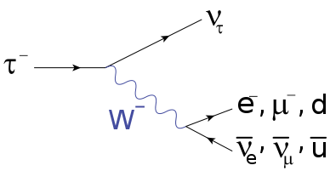
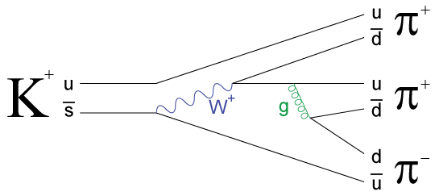
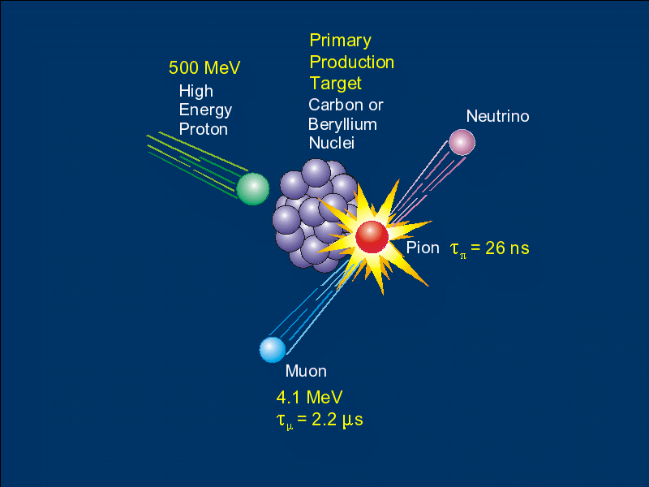
Weak Force: other examples
Pion decay: important way of making neutrinos

Slide 29
Neutrinos?
Nearly zero masses (but not quite!)
No electric charge, no color charge, only interacts through Z et Ws
So very hard to study…
Electron also light and without color ➔ leptons
Plenty of open questions…

Slide 30
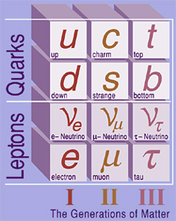
Three families or generations
3 times the u, d quark couple, except heavier and less stable
Same story about leptons:
muon is just an unstable, heavy electron
Columns of table are called generations
Why more than one? Why three?

Slide 31
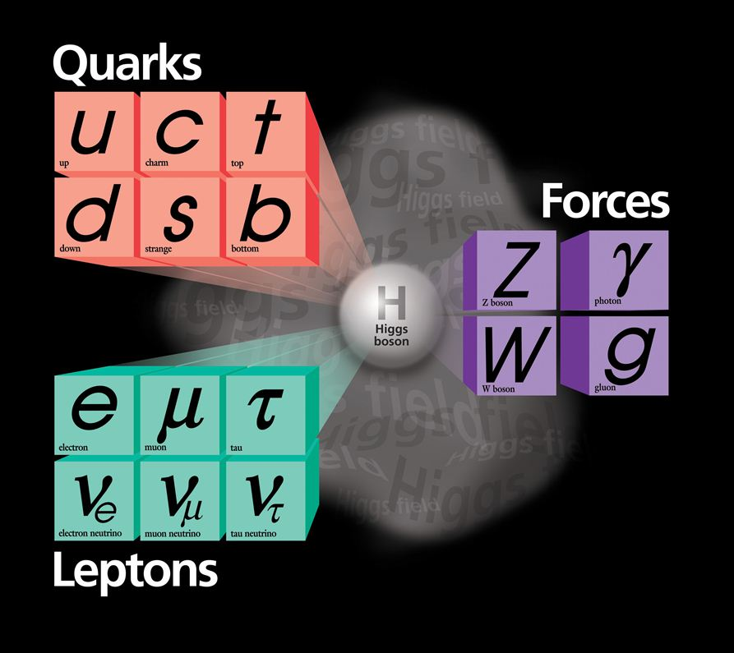
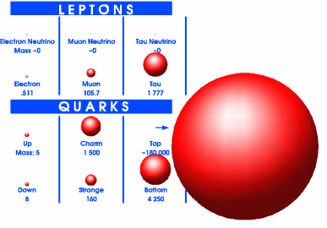
The Standard Model
Are they all elementary?
Are there any more?
Why 3 generations?
Why this mass pattern?

Slide 32
Summary
Plenty of open questions; much learnt!
Electromagnetisme, γ: all particles except ν’s
Strong force, gluon: only quarks
Weak force, W± et Z: all particles

Slide 33
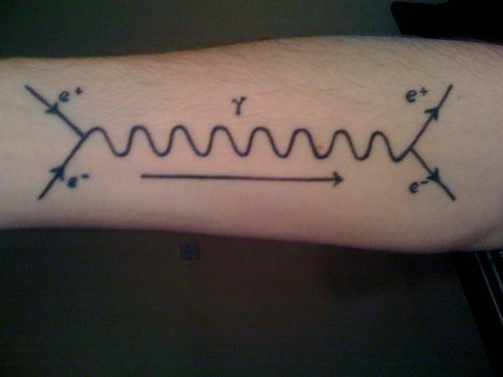

Slide 34
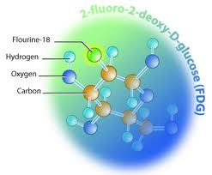
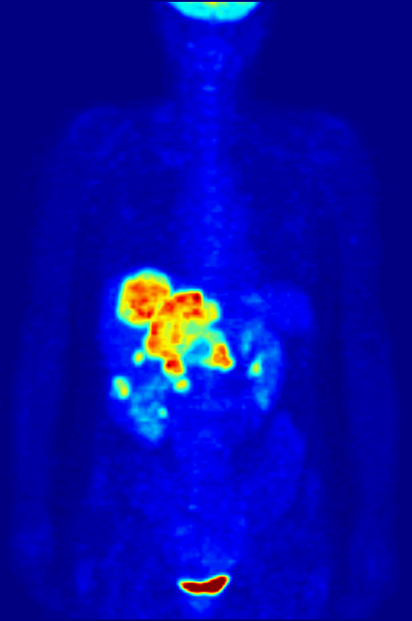
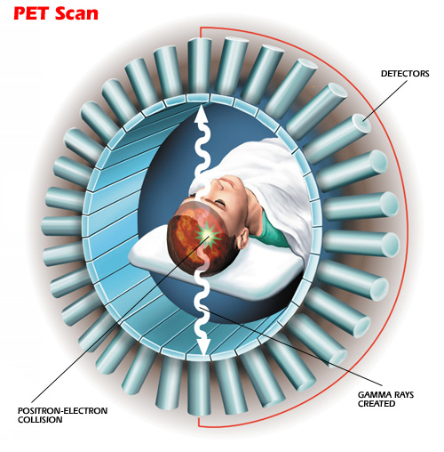
Applications
Positron emission
tomography (PET)

Slide 35
Photon propagator
Can derive it from standard QM time-indep. perturbation theory:
Two possibilities (two different time orderings):
This is the term that concerns us: scattering via an intermediate state (the photon)
a
c
a
c
b emits photon X,
a absorbs it
a emits photon X,
b absorbs it
X
X
d
d
b
b
i
j
f
i
j
f

Slide 36
Photon propagator
Can derive it from standard QM time-indep. perturbation theory:
Two different time orderings:
a
c
a
c
b emits photon X,
a absorbs it
a emits photon X,
b absorbs it
X
X
d
d
Use energy conservation:
E_{a}+E_{b}=E_{c}+E_{d}
b
b
i
j
f
i
j
f

Slide 37
Photon propagator
Special relativity doesn’t preserve simultaneity, have to sum over two time orderings:
and we’ve used
Photons are massless, m²_{X} = 0 and their propagator is 1/q²
where q = p_{a} – p_{c} is the transferred 4-momentum

Slide 38
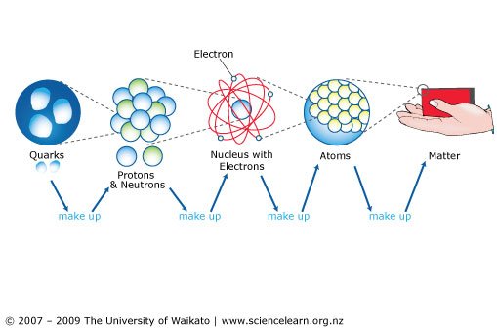
A VERY brief history of particles
1968-69 SLAC, Bjorken, Feynman
1911 Rutherford, Geiger, Marsden

Slide 39
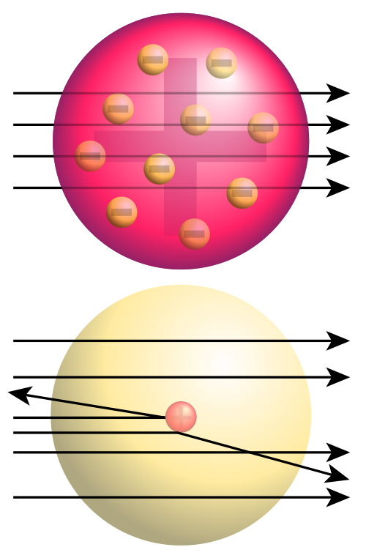
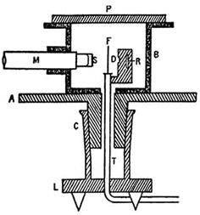
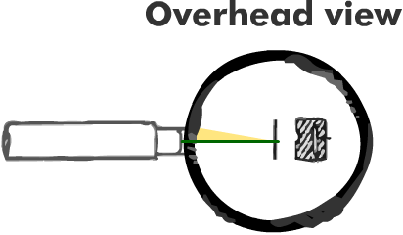
The nucleus: Rutherford scattering
1906, J.J. Thomson: plum pudding model of the atom
Rutherford set to test it by firing α particles into a thin foil
1909, Geiger & Marsden: ~1/8000 alpha particles bounce off!
1911, Rutherford: nucleus small within atom, surrounded by e⁻ cloud

Slide 40
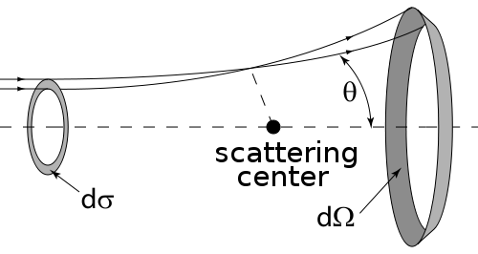
The nucleus: Rutherford scattering
Notion of Cross Section dσ/dΩ : particles crossing transverse area dσ are scattered into a solid angle dΩ at an angle θ with the beam direction
Can find out about force between target and bullet by looking at xsection,
e.g. stronger forces → bigger xsections; range of force ↔ dependence on θ
Ex, scattering of spinless charged particles off a spinless charged target (Rutherford):

Slide 41
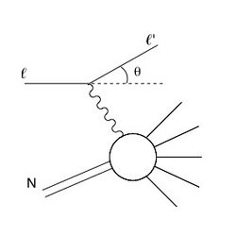
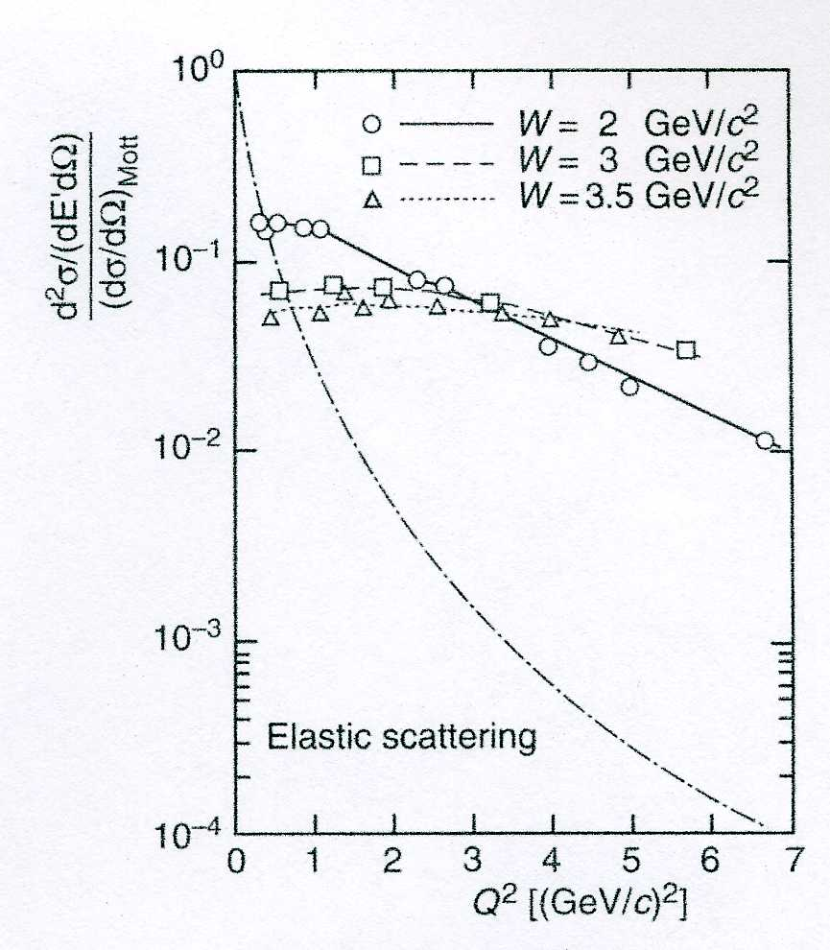
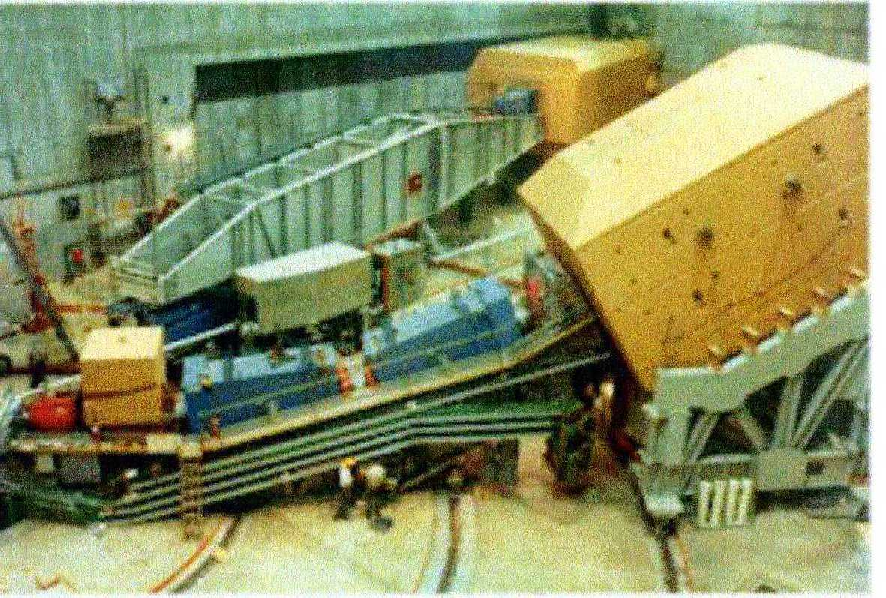
Back to history: protons are composite
Post WWII: accelerator era
1968 SLAC: shoot e⁻ to proton target
High energies: λ_{electron}<<R_{proton}
pc=hc/λ_{electron}>>1 GeV
W
As in Rutherford,
large angle scattering!

Slide 42
Orders of magnitude, units
E_{I}(H)=13,6 eV
1eV=1,62 x 10⁻¹⁹J
~0,5 GeV
=0,5 x 10⁹ eV
S_{p}(⁴⁰Ca)=8,3 MeV
=8,3 x 10⁶ eV
Masses in energy units (E=mc² !)
e.g. m(proton) = 938 MeV, m(electron) = 0,511 MeV

Slide 43
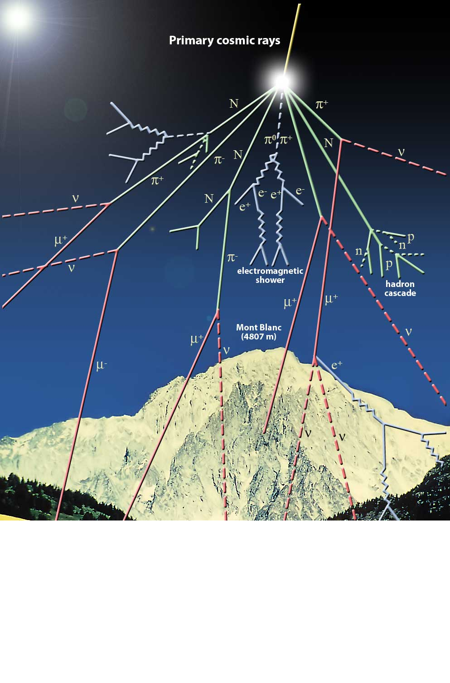
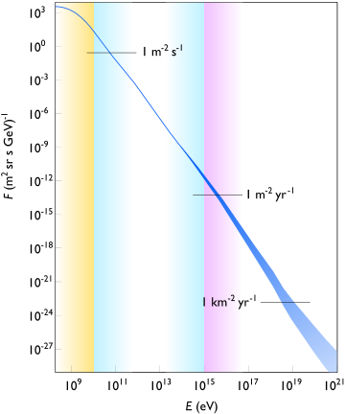
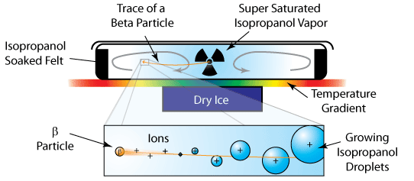
Cosmic rays
Particles from outer space constantly in collision with upper atmosphere
Source of exotic (unstable) particles from early times (pre WWII)
Cloud chambers (or Wilson chambers):
supersaturated vapor, passage of charged
particles slightly ionizes medium,
condensation occurs track
Photographic emulsions also used

Slide 44
More cosmic rays: the muon
1936 Neddermeyer, Anderson:
unit charge particle, spin 1/2
heavier than electron, lighter than proton
like electrons, does not induce nuclear reactions
unstable but long-lived (10⁻⁶ s)
Just like electron but heavy and unstable
“Who ordered that?” (I.I. Rabi)

Slide 45
Applications
Radiothérapie

Slide 46
Applications
Le World Wide Web a été inventé au CERN ! (1990)
La grille de calcul

