Slide 1
Charm-less decays of beauty-full hadrons
Highlights and outlook
Eduardo Rodrigues
LPNHE, Paris, March 2nd 2015

Slide 2
A bit on my research career
1998 – 2002 : PhD @ University of Bristol
Study of azimuthal asymmetries in deep inelastic ep scattering
2002 – 2004 : Marie Curie Fellow @ CERN
First-level trigger optimisation, author of TDR section on it
2004 – 2007 : Postdoc @ NIKHEF
Responsible for track fitting
Sensitivity studies for LHCb’s physics roadmap document
2007 – 2012 : core Research Associate @ Glasgow University
Vertex detector – deputy project leader, software coordinator, DQ coordinator
Convener of 2 physics sub-WGs (both on hadronic decays)
Analysis: B_{s} → D_{s} K/π branching fractions, searches for LFV τ decays
2012 – present : core Research Fellow @ Manchester University
Convener – physics WG on charmless b-hadron decays
Coordinator – physics analysis software project
Analyses: CP analysis of B_{s} → D_{s} K, 1st evidence for B⁰ → p p, search for τ → μμμ, etc.
ZEUS
LHCb
-

Slide 3
Charmless b-hadron decays programme (not comprehensive)
CKM matrix
Generalised
factorisation
Dynamics of
heavy flavour decays
Quark mixing
b → (d,s) loop
Discovery channels
CP violation
b → u tree
Charmless
b-hadron
decays
Theory
Experiment
B → P P
B → P V
Time-(in)dependent
measurements
Branching fractions
B → V V
3-body
CP asymmetries
baryonic
2-body
many-body
Lifetimes

Slide 4
Charmless b-hadron decays – some triumphs and puzzles
Triumphs
1st observation of CP violation in B_{s} mesons
Observation of the largest CP violation effects, in 3-body B⁺ decays
1st evidence for CP violation in baryonic B decays
Puzzles / features
K-π puzzle in 2-body B decays
Polarisation puzzle in B → V V decays
- Unexpectedly small longitudinal polarisation component in B → φ K* decays
Threshold enhancement in baryonic B decays

Slide 5
2-body decays

Slide 6
2-body B decays – « diagrammatica »
T
Tree
C
colour-suppressed Tree
P
gluonic Penguin
PA
Penguin Annihilation
P_{EW}
electroweak Penguin
P^{C}_{EW}
colour-suppressed electroweak Penguin
E
Exchange
A
Annihilation
Gronau et al., Phys. Rev. D 50, 4529 (1994)

Slide 7
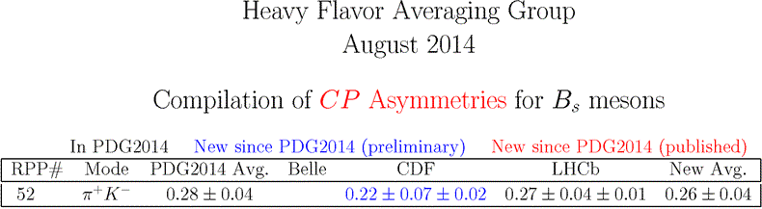
2-body decays of B_{s} mesons
CDF had a word to say, unlike the B factories
LHCb now leading …
1st observation
of CP violation
in B_{s} mesons

Slide 8

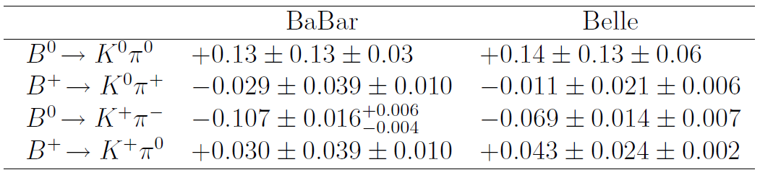
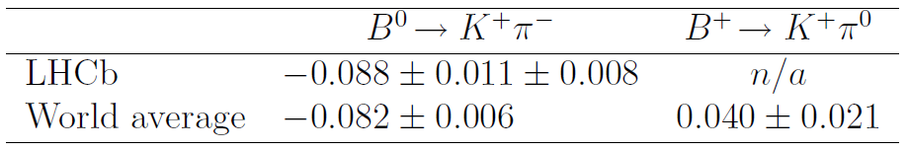
The « Kπ puzzle » in 2-body B decays
Theory predicts equality of DCPV of B⁺ → K⁺ π⁰ and B^{0 →} K⁺ π⁻ , i.e. ΔA_{CP} = 0
But experimentally one rather obtains a value ~5σ away from 0
A_{CP} (B → K π) measurements :

Slide 9
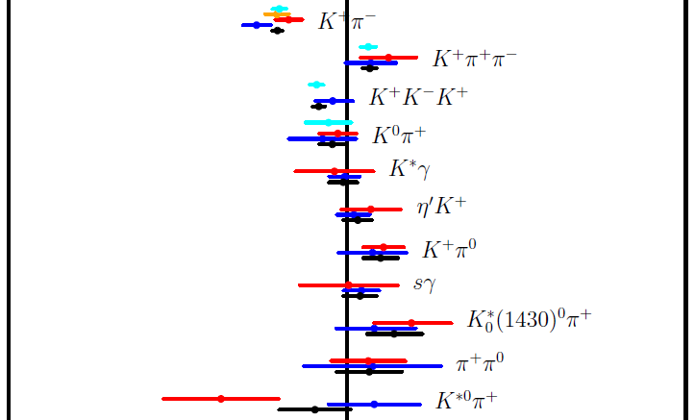
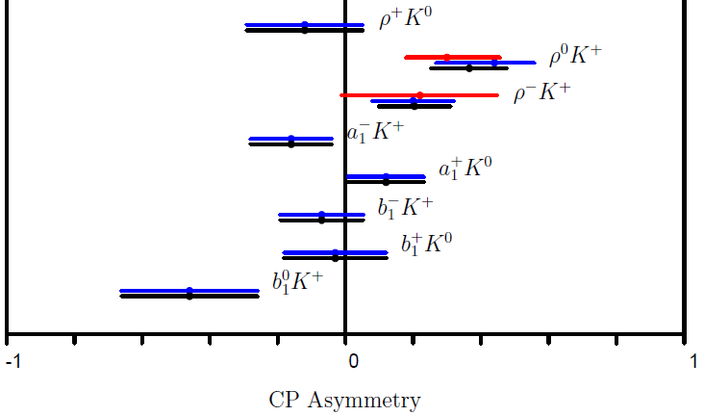
The « Kπ puzzle » - route(s) forward
Belle II will be able to measure all modes
LHCb already dominating measurements in the charged B⁰ mode …
… can it do more … ?
Study similar 2-body modes B → P V such as B → K* π, ρ K
Various results available from the B-factories
HFAG

Slide 10

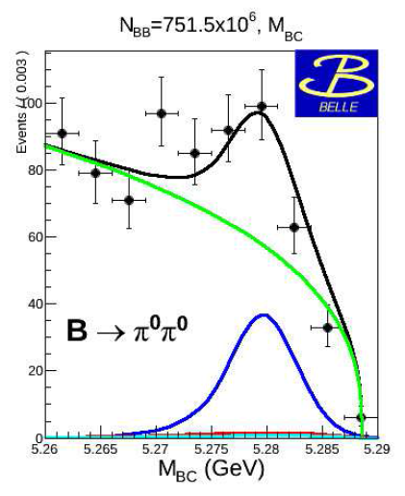
B⁰ → π⁰ π⁰
“New” preliminary result from Belle
Significantly lower than their previous result
- Bug in analysis found due to non-exclusion of
peaking background from off-time calorimeter hits
Result still in tension with BaBar result
Resolution will require Belle II …
M. Sevior, CKM 2014 Workshop, Vienna

Slide 11
3-body decays

Slide 12

CP asymmetries in 3-body B decays
Decay modes involving non-negligible penguin diagram contributions
LHCb has published a series of measurements of CP asymmetries
in charmless 3-body B decays of the type B± → h± h⁺ h⁻ (h=K,π,p)
CP asymmetries measured inclusively (i.e. averaged across the Dalitz plane)
and in localised regions of the DP
All analyses on the 2011 data sample (1 fb⁻¹)
Measurements in the following decays:
- B± → K± π⁺ π⁻ and B± → K± K⁺ K⁻ decays [PRL 111, 101801 (2013)]
- B± → π± π⁺ π⁻ and B± → π± K⁺ K⁻ decays [arXiv:1310.4740 [hep-ex]]
- Baryonic mode B± → p p K± [PRD 88, 052015 (2013)]
Updates on full run-I data sample (3 fb⁻¹) published also
[PRD 90, 112--4 (2014), PRL 113, 141801 (2014]
_

Slide 13
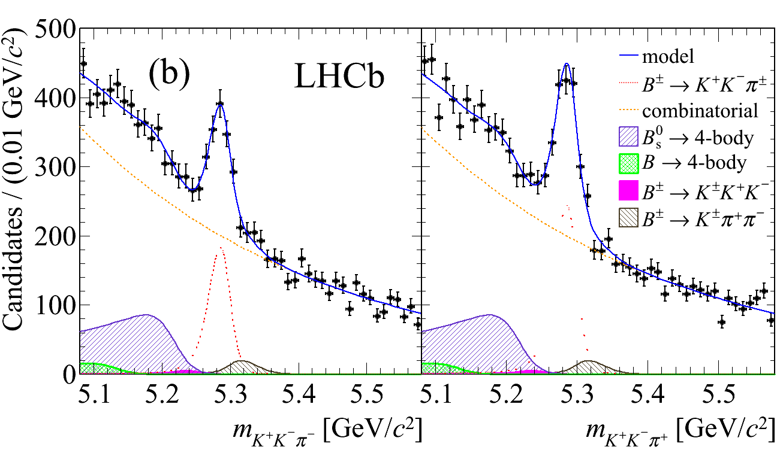

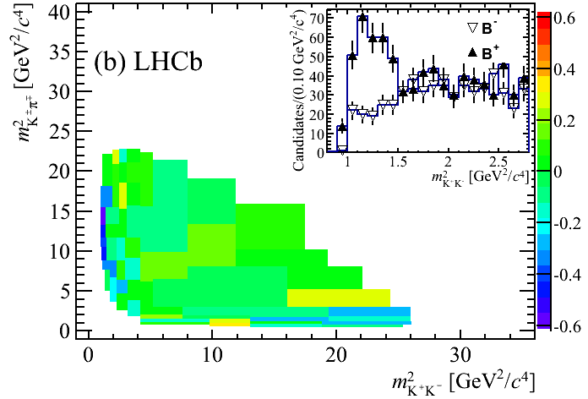
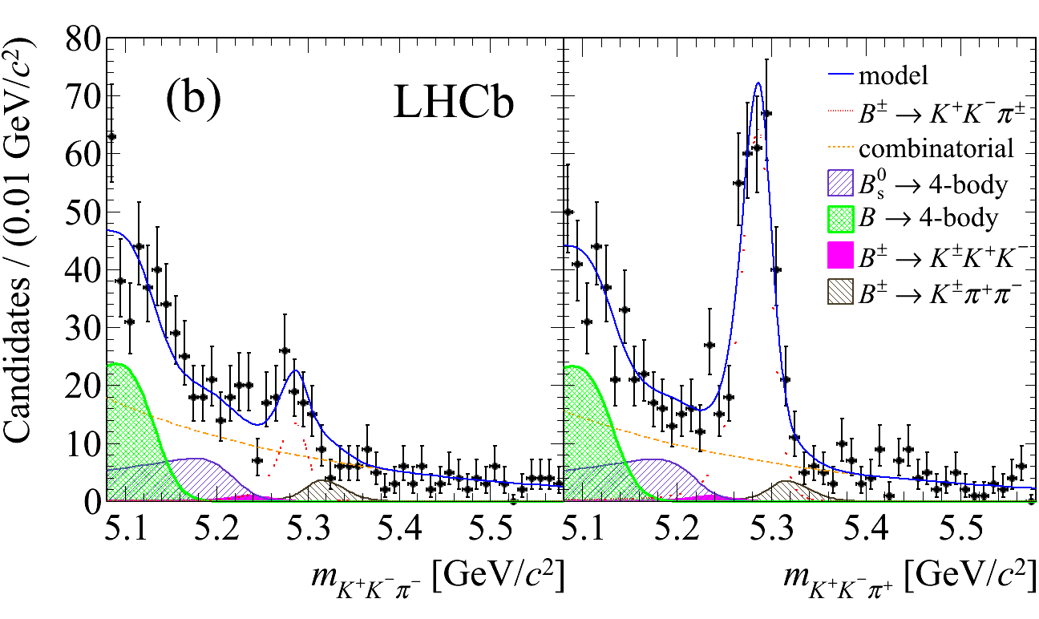

A_{CP} in B± → h⁺ h⁻ π± decays – example of B± → K⁺ K⁻ π±
Inclusive CP asymmetry:
Regional CP asymmetry:
B⁻
B⁺
(N.B.: raw asymmetries)
B⁻
B⁺
arXiv:1310.4740 [hep-ex]

Slide 14
A_{CP} in charmless 3-body B decays – outlook
Large asymmetries observed in localised areas in B± → K± h⁺ h⁻ decays !
In the meantime LHCb found first evidence for CP violation
in a baryonic mode, namely in B± → p p K±
There is for sure much more to come …
Other 3-body states are and should be investigated, eg. B → K_{S} h⁺ h⁻ , B → K_{S} h⁺ π⁰
_
LHCb has a rather strong and diversified 3-body programme
that would deserve a presentatin on its own …

Slide 15
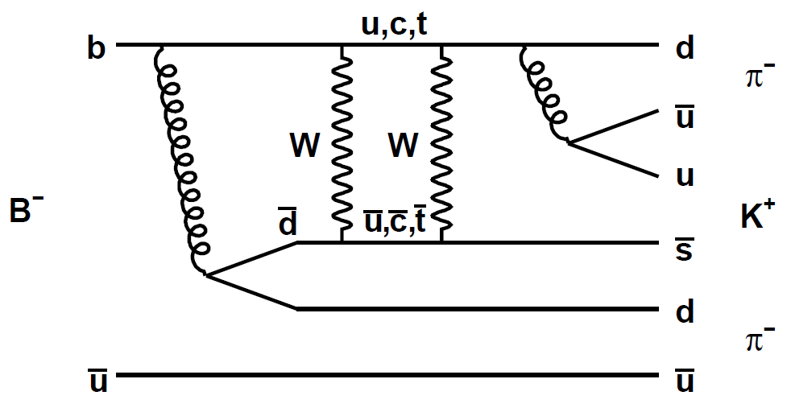
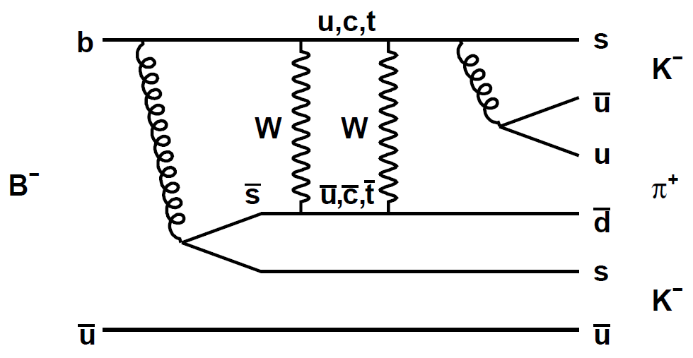
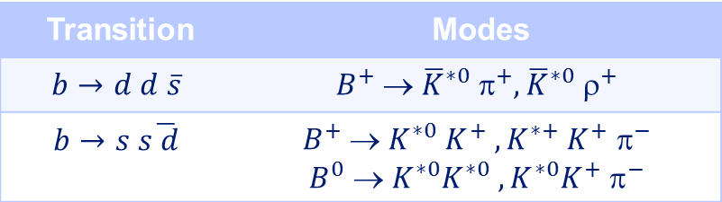



Very suppressed decays
Poorly studied very suppressed transitions ⇒ decay modes with BFs in range 10⁻¹⁶ - 10⁻¹¹
- Suppressed by $\left|V_{td}V_{ts}^{∗}\right|{≅3×10}^{−4}$ wrt Penguin processes
BaBar has probed the prototype decays B⁺ → K⁻ π⁺ π⁺ and B⁺ → K⁺ K⁺ π⁻ down to 10⁻⁷ - 10⁻⁶
- Also other decay modes
$b$ → $dd\overline{s}$ transition
$b$ → $ss\overline{d}$ transition
Transition | Modes
$$b→d d \overline{s}$$ | $$B^{+} → {\overline{K}}^{∗0} π^{+},{\overline{K}}^{∗0} ρ^{+}$$
$$b→s s\overline{ d}$$ | $$B^{+}  K^{∗0} K^{+} ,K^{∗+} K^{+} ^{−}$$ $$B^{0}  K^{∗0}K^{∗0} ,K^{∗0}K^{+} ^{−}$$
LHCb can contribute …

Slide 16
B → V V decays

Slide 17
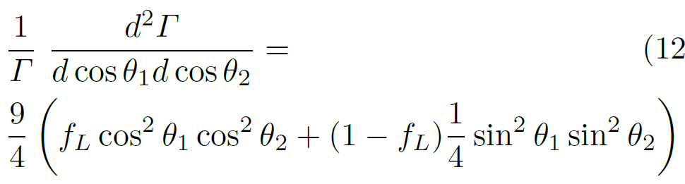
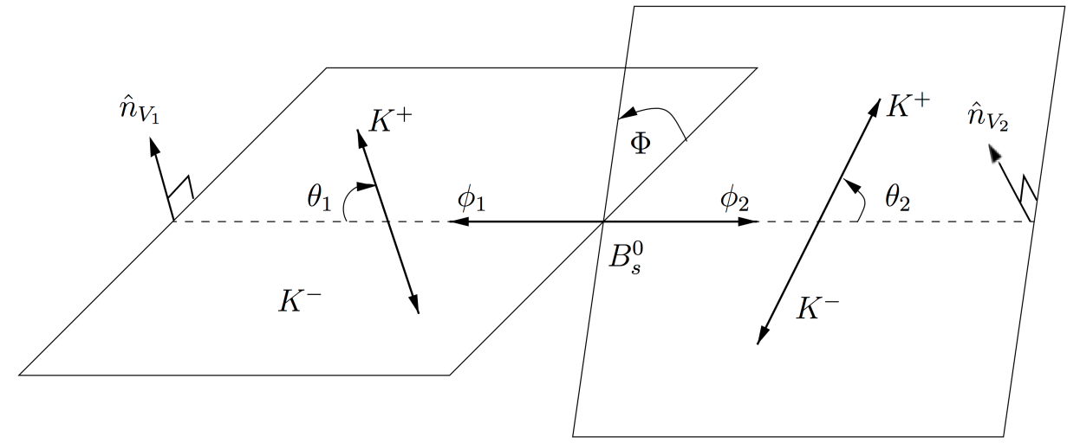
B → V V decays
Spin-0 meson decay to vector-vector final state requires angular analysis
Full angular analysis requires large statistics data samples …
Little statistics: measure the longitudinal polarisation fraction f_{L}
integrating over the angle between the 2 V-decay planes:
Large statistics:
full angular time-dependent analysis
employing B-flavour tagging

Slide 18
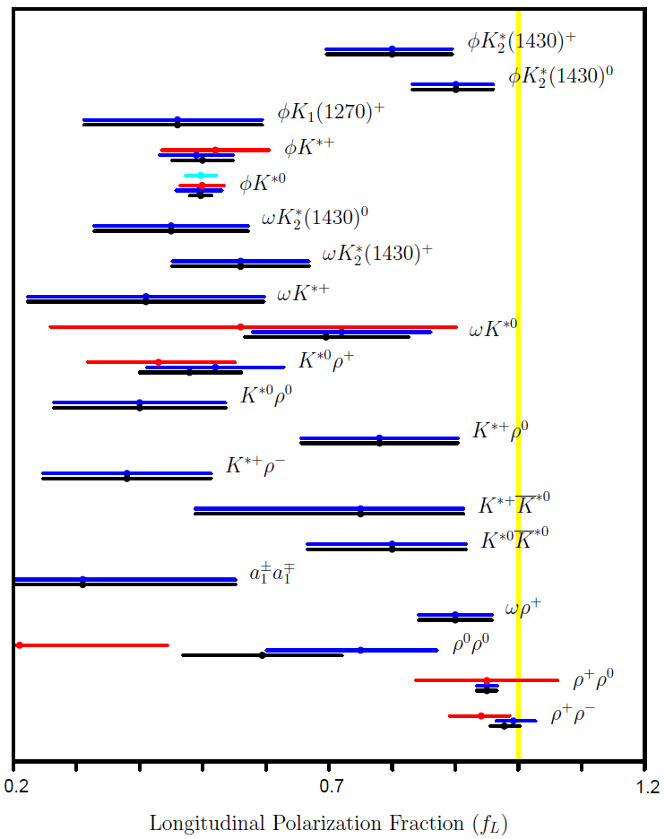
B → V V decays – the polarisation puzzle
B⁰ and B⁺ decay modes
Polarisation puzzle in B → V V decays:
Longitudinal-polarisation fraction
predicted to be large
Loop-dominated decays:
f_{L} found to be small
Tree-dominated decays:
f_{L} found to be large
Need to investigate broad
range of VV decays …

Slide 19
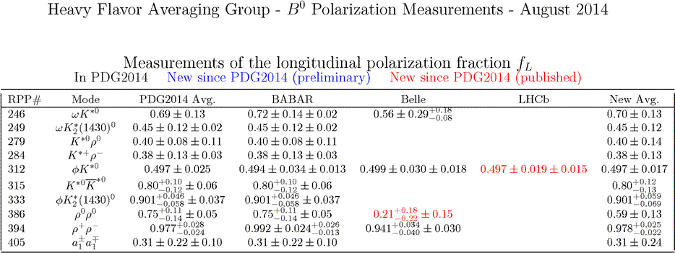
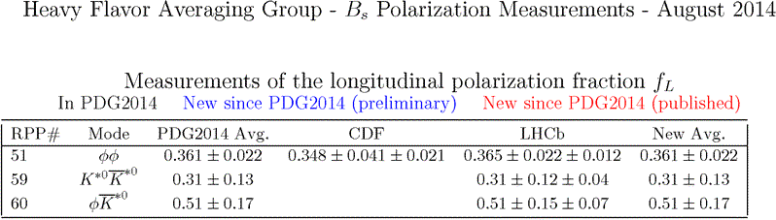
B → V V decays – LHCb contributing with major impact

Slide 20

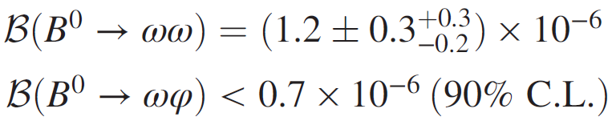
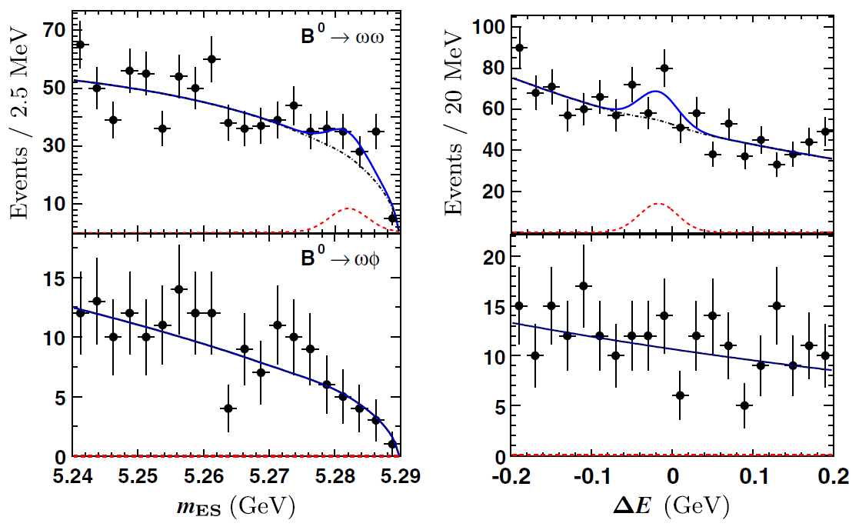
B → V V decays – looking elsewhere …
Important to look at other V V decays. Can use V = φ, K*, ρ, ω …
BaBar search for B⁰ → ω ω and ω φ
Full data sample: 471×10⁶ B Bbar pairs
First evidence
4.4 σ
B⁰ → ω ω
Both BFs in agreement
with SM expectations
B⁰ → ω φ
Phys. Rev. D 89, 051101(R) (2014)

Slide 21
Time-dependent CPV

Slide 22
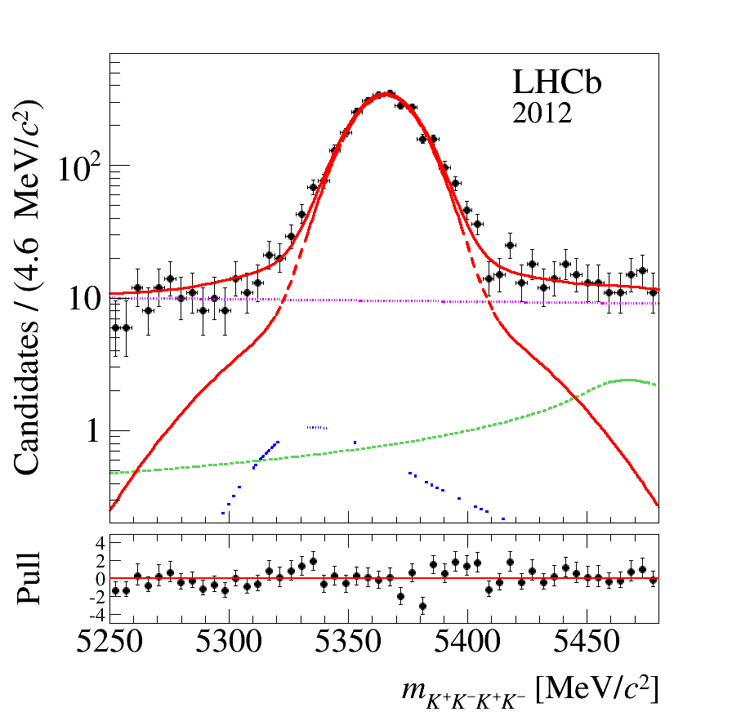
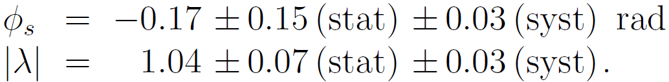
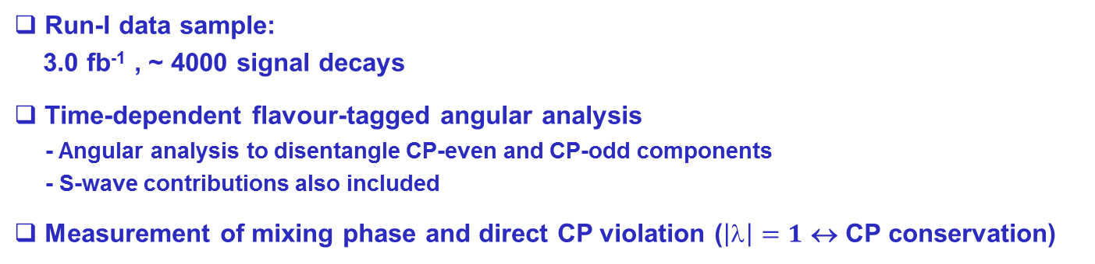


φ_{s} from B_{s} → φ φ in run I
Gluonic Penguin P → V V decay mode
b → s sbar s transition
Measurement of
- CP violating phase φ_{s}
- Direct CP violation parameter |λ|
$$☹_{b}^{0}  p K$$
$$B^{0}   K^{∗}$$
Run-I data sample:
3.0 fb⁻¹ , ~ 4000 signal decays
Time-dependent flavour-tagged angular analysis
- Angular analysis to disentangle CP-even and CP-odd components
- S-wave contributions also included
Measurement of mixing phase and direct CP violation ($\left|\right|=1$ ↔ CP conservation)
SM prediction: φ_{s} = 0.01 ± 0.02 rad
LHCb Collab., Phys. Rev. D 90 (2014) 052011

Slide 23
Baryonic B decays

Slide 24
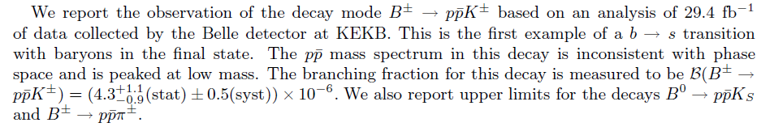
1st evidence for a B decay to a baryonic final state
Phys. Rev. Lett. 88, 181803 (2002)

Slide 25

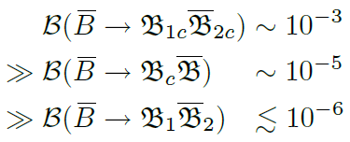
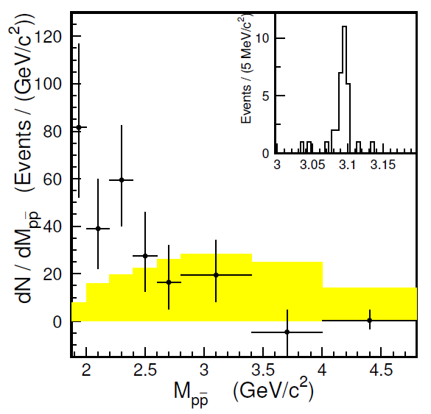

Baryonic B decays – experimental facts
Many-body final states tend to have a larger BF than 3- and 2-body final states
Observation of threshold enhancement
in baryon-antibaryon system
- Example in
⇒ fast recoiling meson
against baryon-antibaryon system
Prediction for
phase-space decay

Slide 26
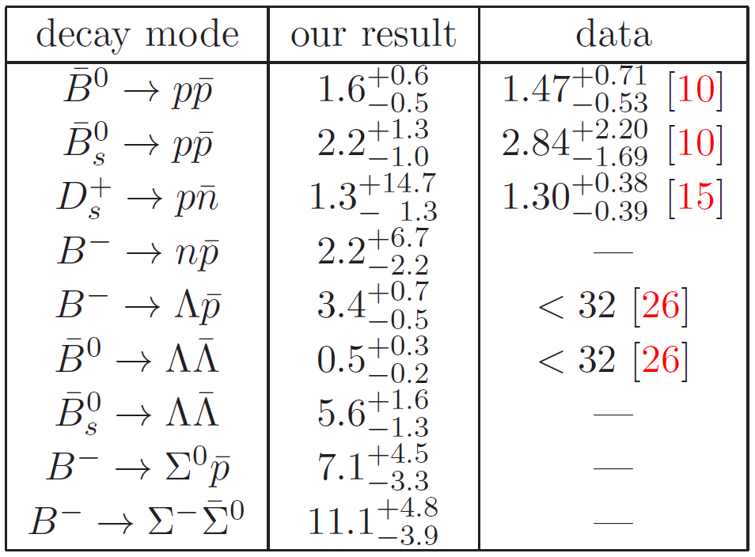
Baryonic B decays – searches and predictions
Many-body final states well studied at the B factories
LHCb rather turning to 2- and 3-body final states …
Predictions are not always the most
encouraging ones …
… but LHCb has had its first stab …
Predictions in units of 10⁻⁸
arXiv:1407.7639 [hep-ph]

Slide 27
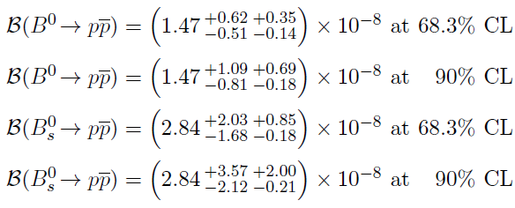
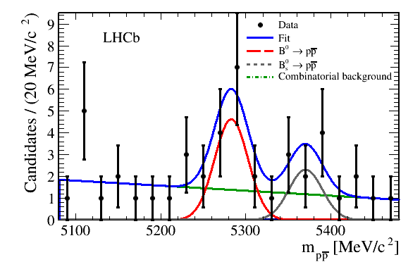
Baryonic B-meson decays – the rare B → p p
First evidence for a 2-body charmless baryonic B⁰ decay ! (significance: 3.3σ)
No significant B_{s} signal observed and published result improved previous search
by 3 orders of magnitude
This B⁰ → p p branching fraction excludes all
theoretical predictions by 1-2 orders of magnitude
- Motivates newer and more precise calculations
JHEP 10 (2013) 005

Slide 28
b-baryon decays

Slide 29

b-baryons – past and present
Past
Contributions to b-baryon studies from TeVatron
- CDF : BF and CPV measurements in Λ_{b} → p h decays [Phys. Rev. Lett. 113, 242001 (2014)]
Nothing from the B-factories
Present - LHCb
LHCb has a flourishing programme thanks to large dataset of b-baryon decays recorded
1st observation of a charmless hadronic 3-body b-baryon decay, the Λ_{b} → K_{S} p π
Due to conservation of baryon number, there can be no b-baryon mixing,
so no indirect CP violation
CPV studies in b-baryons will be CPV in decay !

Slide 30
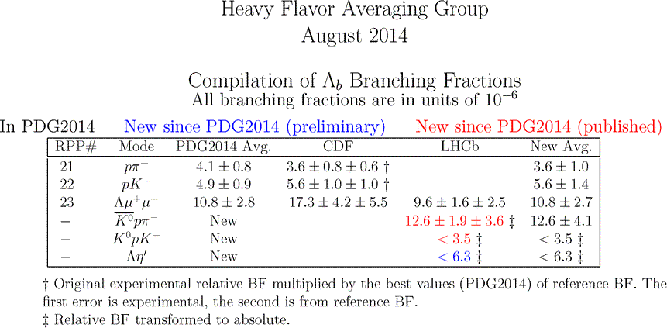
b-baryons – 1st observations and branching fractions
LHCb observed the first charmless 3-body b-baryon decay
HFAG – http://www.slac.stanford.edu/xorg/hfag/rare/2014/lb/index.html

Slide 31
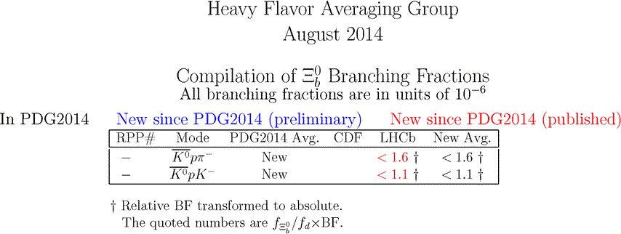
b-baryons – beyond the Λ_{b} …
LHCb is exploring ever heavier b-baryons …
First limits on charmless decays of Ξ_{b} baryons :
HFAG – http://www.slac.stanford.edu/xorg/hfag/rare/2014/lb/index.html

Slide 32
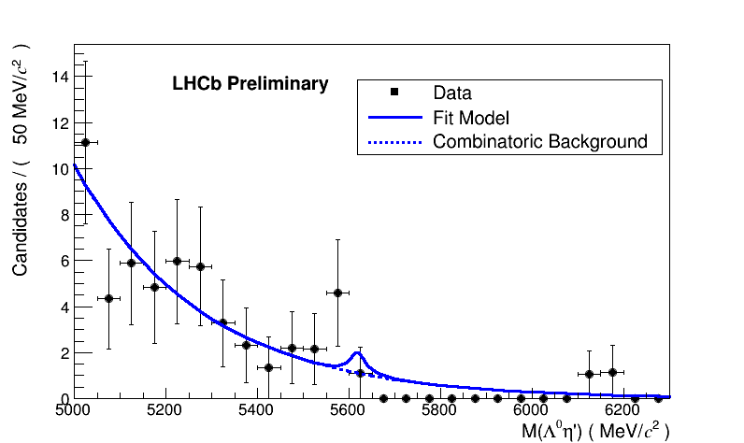
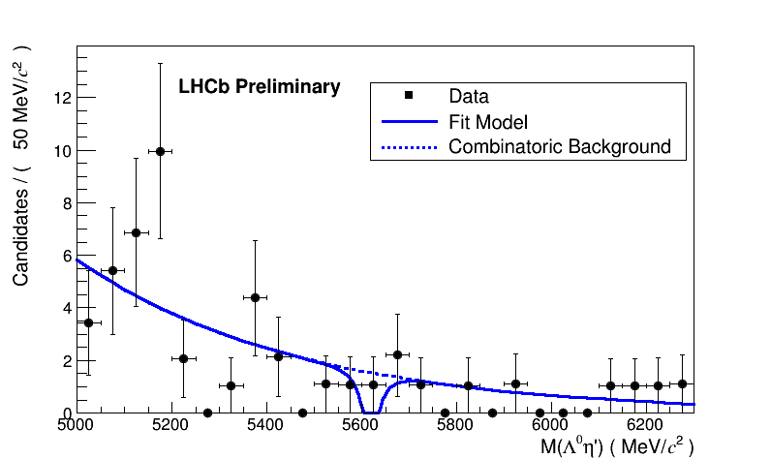
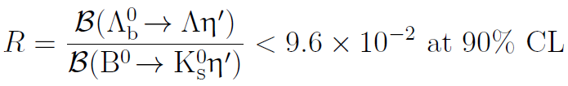
Search for Λ_{b} → Λ η’
Penguin decay
Means to study η-η’ mixing
BF estimated in range [ 1.8, 19.0 ] × 10⁻⁶
“LL”
Data sample: 2.0 fb⁻¹ @ 8 TeV
BF wrt normalisation mode B⁰ → K_{S} η’
- ~ 200 decays
η’ reconstructed in π⁺ π ⁻ γ mode
K_{S} (Λ) reconstructed as “LL” or “DD”
if it (does not) decay(s) in vertex detector
from
“DD”
LHCb-CONF-2013-010

Slide 33
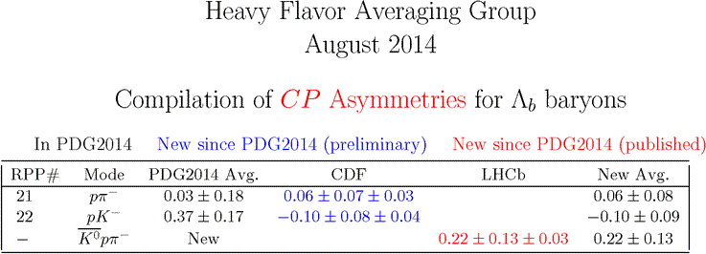
b-baryons – CP violation
Hardly anything is known about CP violation in b-baryons
In fact CP violation never observed in b-baryons !
HFAG – http://www.slac.stanford.edu/xorg/hfag/rare/2014/lb/index.html

Slide 34
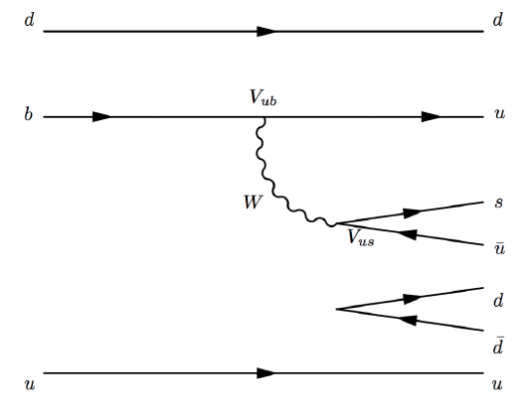
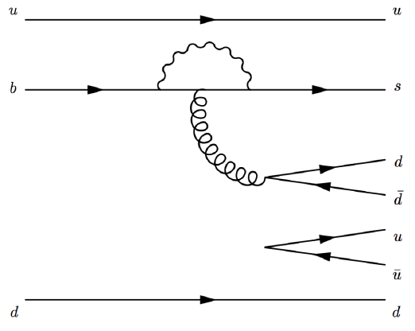
b-baryons – outlook for the future
Charmless decays are good candidates to search for CPV in b-baryons
since tree-level and Penguin amplitudes expected to be of approx. the sample magnitude
Modes below are self-tagging thanks to Λ decaying to a proton
Tree-level
Penguin loop-level

Slide 35
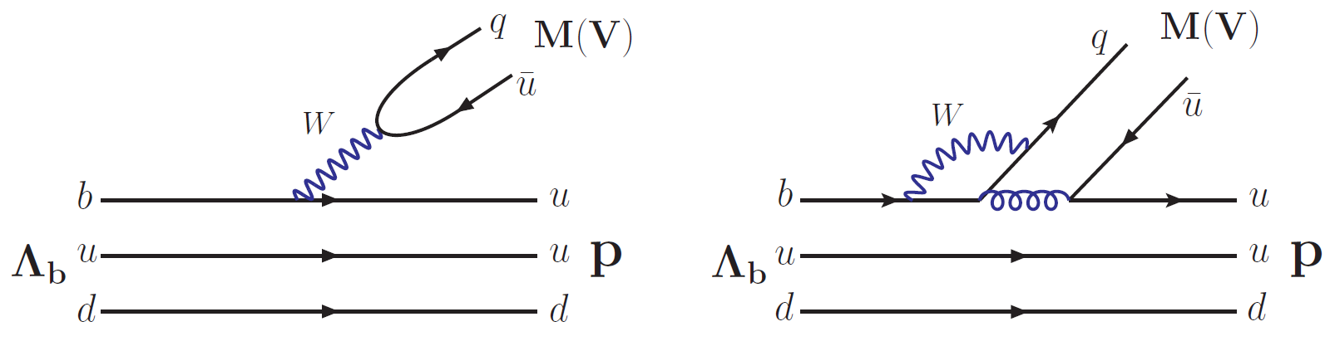
2-body b-baryons – some interesting predictions (1/2)
Tree-level
Penguin loop-level
2-body modes could also provide a means of observing CPV in b-baryons !
Predictions more reliable than in the case of 2-body mesonic B-meson decays
thanks to lack of annihilation process contribution
Large values for CP asymmetries in certain decay modes are encouraging ...

Slide 36
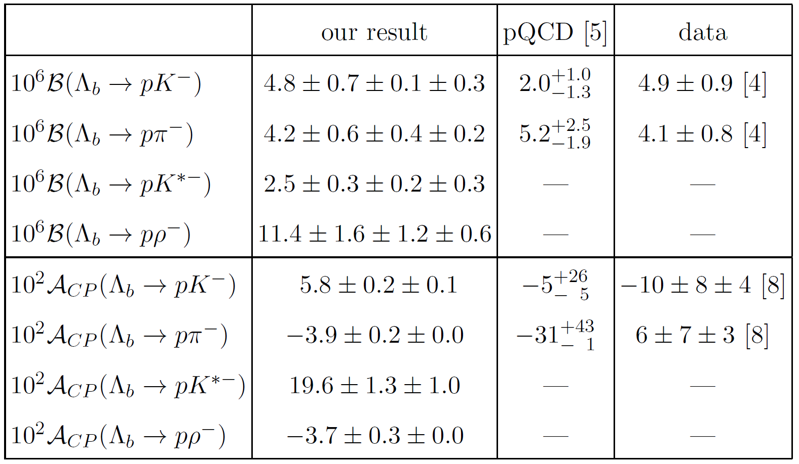
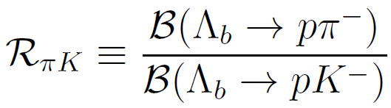
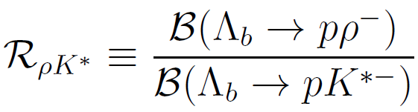
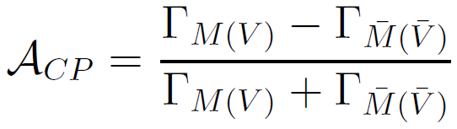
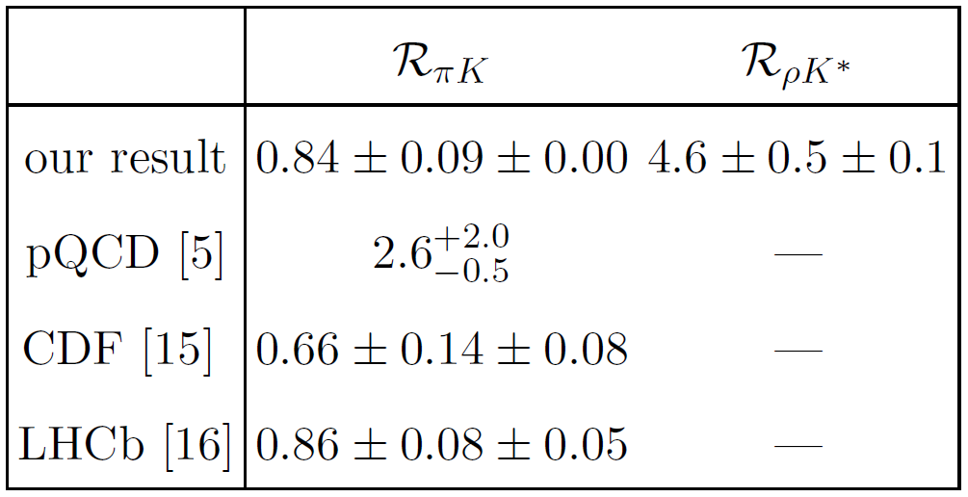
2-body b-baryons – some interesting predictions (2/2)
Generalised factorisation method
BFs and direct CP asymmetry
arXiv:1412.1899 [hep-ph]

Slide 37
B_{c} decays

Slide 38
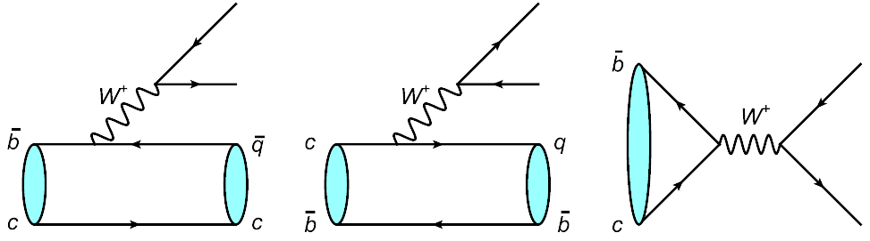
What about B_{c} mesons ?
b → c, u
c → s, d
cb annihilation
Charmless B_{c} decays proceed exclusively through annihilation !
Rather suppressed but natural ground to study annihilation processes …

Slide 39
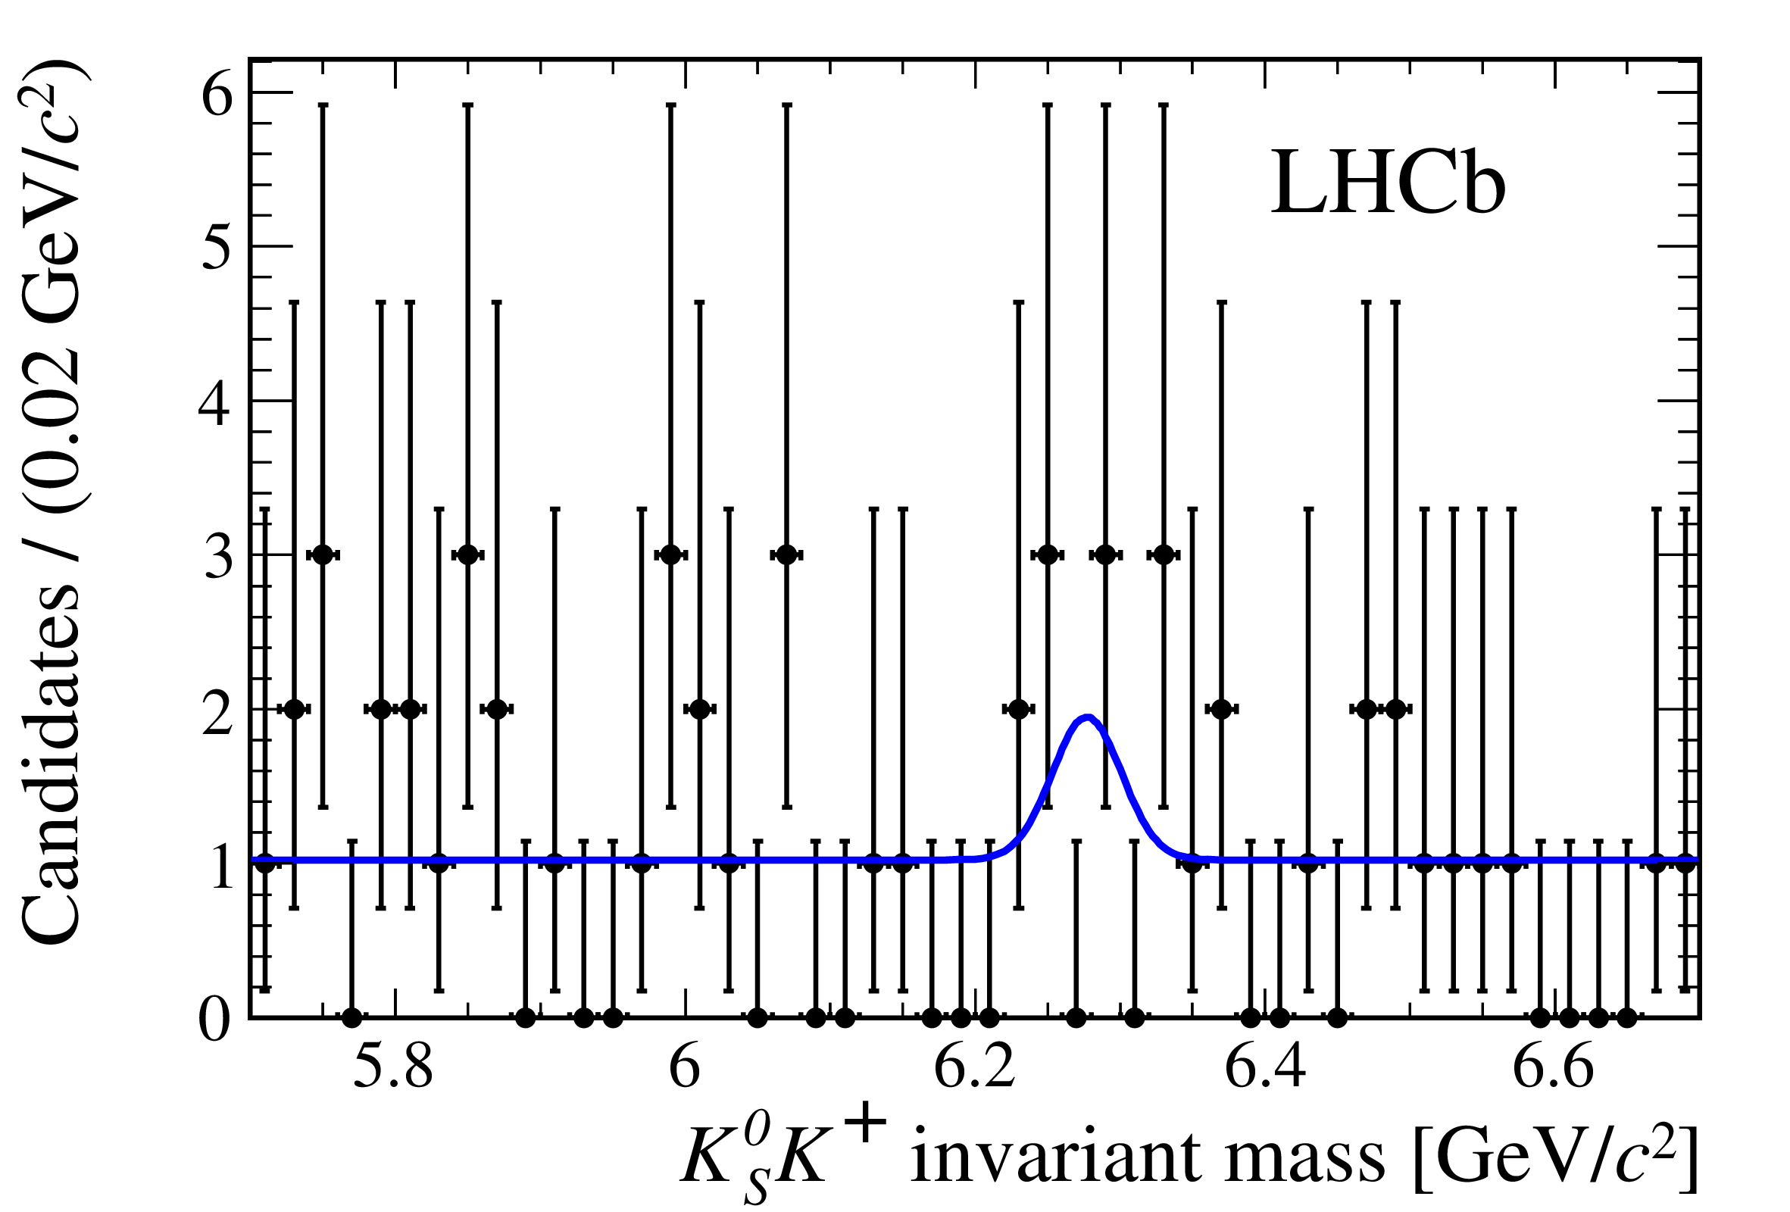

Charmless B_{c} decays – status
Phenomenology
The literature on (charmless) B_{c} decays is flourishing, see e.g.
- S. Descotes-Genon et al, Phys. Rev. D 80, 114031 (2009)
- X.Liu et al., Phys. Rev. D 81, 014022 (2010)
- Z.-J. Xiao, X. Liu, Chin. Sci. Bull. 59 (2014) 3748-3759; arXiv:1401.0151 [hep-ph]
- J. Sun et al., Phys. Rev. D 89, 114019 (2014)
Experimental studies
LHCb is the player
1st and only search for a charmless B_{c} decay
already published by LHCb !
At 90% C.L.:
Phys. Lett. B 726 (2013) 646-655

Slide 40
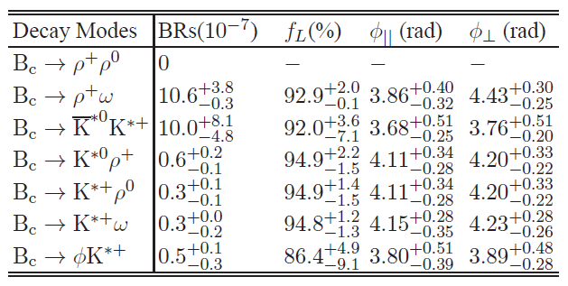
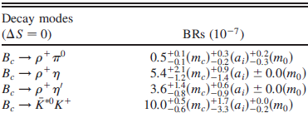
Charmless B_{c} decays … realistically …
pQCD approach
Chin. Sci. Bull. 59 (2014) 3748-3759; arXiv:1401.0151 [hep-ph]
Typical BFs for charmless modes
are in the range 10⁻⁸-10⁻⁶
- With large theoretical uncertainties
depending on the calculation approach
Assuming ~ 10⁹ B_{c} events produced per year at LHCb interaction point
And a selection efficiency ~ 1%
One cannot realistically probe below ~ 10⁻⁶
Modes B_{c} → K*⁰bar K⁺ , K_{S} K⁺ seen as most promising …
Phys. Rev. D 81, 014022 (2010)
A broad study of charmless B_{c} decays requires the LHCb upgrade …

Slide 41
Many-body decays

Slide 42
Many-body decays
Relatively little is known about many-body B-mesons decays
And essentially nothing about many-body b-hadron decays
Experimentally more challenging since :
- Branching fractions often suppressed
- Number of intermediate states can be daunting
- Reconstruction efficiencies are lower
Apart from searches and first observations,
CP violation studies are very promising thanks to …

Slide 43

Triple-product asymmetries (TPAs)
An interesting alternative to “standard” CP violation measurements !
Triple products of 3-momentum or spin vectors
Odd under T operation ⇒ CP violating assuming CPT conservation
TPAs ≠ 0 from CP violating phase or CP-conserving phase and final state interactions
⇒ requires care …
TPs for a 4-body final state:
Experimentally interesting since
- Require no time-dependent analysis with B-flavour tagging at production
- Systematic uncertainties tend to be small

Slide 44
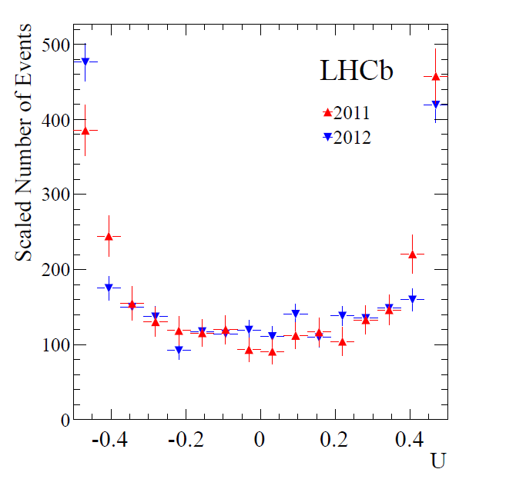



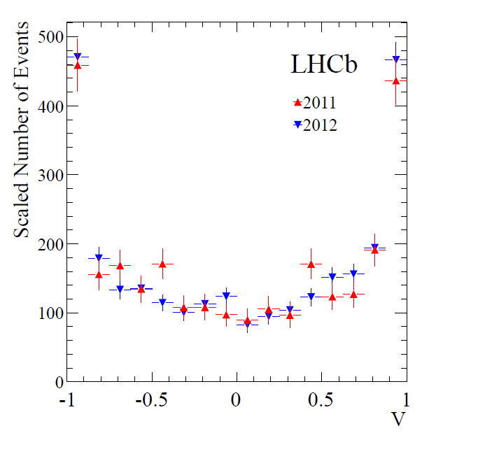
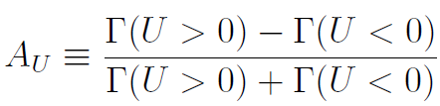


TPAs in B_{s} → φ φ
Studied for example in B_{s} → φ φ decays at LHCb
- TPAs in B_{s} → φ φ predicted to be negligible in the SM
2 observable TPs U and V
where + (-) depends on the sign of cos θ₁ cos θ₂
Measurement of the asymmetries A_{U} and A_{V}
Phys. Rev. D 90 (2014) 052011

Slide 45
Final remarks

Slide 46

The LHCb upgrade
Take quark flavour physics to the
precision and very high precision regime
- Towards experimental sensitivities
matching theoretical uncertainties
Upgrade detector and trigger system
- Full readout at 40 MHz and availability of full
event info from first-stage software trigger
Installation in 2018-19
⇒ ready for data taking in 2020
Collect ~ 50 fb⁻¹
Gain in collected yields from
(1) increased luminosity and (2) trigger
- Trigger efficiencies for hadronic decays
saturate with present trigger system
- Inst. lumi: 4×10³² cm⁻² s⁻¹ → 2×10³³ cm⁻² s⁻¹
LHC run I
∫L dt ≈ 3 fb⁻¹
LHCb 2018
∫L dt ≈ 8 fb⁻¹
LHCb upgrade
∫L dt ≈ 50 fb⁻¹
* Integrated luminosity always include lumi. from previous runs

Slide 47


Belle II @ super e⁺ e⁻ B-factory SuperKEKB
SuperKEKB
Design instantaneous luminosity 8×10³⁵ cm⁻² s⁻¹
Data mostly @ ϒ(4S) resonance
- 4 (7) GeV for the e⁺ (e⁻) beam
Deliver 50 ab⁻¹
Belle II
Upgrade of Belle detector
- In particular improvements in IP and secondary vertex resol., K/π separation and K_{S} & π⁰ efficiency
Physics run by (late) 2016 (?)
Very rich and complementary physics programme to that of LHC(b)
- LHCb: high stats of all B-mesons, and b-hadrons, will dominate all-charged final states
- Belle II: particularly suited for study of final states with neutrals (π⁰, neutrinos)
http://www-superkekb.kek.jp/
http://belle2.kek.jp/

Slide 48


Charmless B decays – expected sensitivities @ LHCb
Time-dependent analyses :
Observable | LHC run I | LHCb 2018 | LHCb upgrade | Theory
$_{s}^{eff}$ ($B_{s}^{0}→$ φ φ) (rad) | 0.15 | 0.10 | 0.023 | 0.02
$_{s}^{eff}$ ($B_{s}^{0}→ K^{∗0} {\overline{K}}^{∗0}$ ) (rad) | 0.19 | 0.13 | 0.029 | < 0.02
$2_{}^{eff}$ ($B^{0}→  K_{s}^{0}$) (rad) | 0.30 | 0.20 | 0.04 | 0.02
Note
Run-I sensitivities with $B_{s}^{0}→ K^{∗0} {\overline{K}}^{∗0}$and $B^{0}   K_{S}^{0}$ are best-guesses
since no time-dependent LHCb analyses exist
LHCb-PUB-2014-040

Slide 49
Conclusion, i.e. wish list
Observation of CP violation in b-baryons
Observation of CP violation in baryonic B decays
Observation of a charmless B_{c} decay
Observation of a baryonic B^{s} decay (to close the loop)
Amplitude analyses in 3-body decays and precise determination of γ angle
Full angular analyses in B → V V decays and understanding of polarisation puzzle
Precise measurements of BFs and CP asymmetries of 2-body B → h h decays
Etc. …
Oh … and a clear manifestation of New Physics, of course !!!

Slide 50
Thank you for your attention

Slide 51

Flavour physics – a matter of taste ?
The physics of flavor is the flavor of physics
Harald Fritzsch, Summary talk ICFP 2001,
Zhang-Jia-Jie. Hunan, China (5-6/2001)
Nima Arkani-Hamed,
Intensity Frontier Workshop,
11-12/2011
Whether or not you share these “strong” opinions …

Slide 52

Flavour physics is everywhere
Flavour lets us probe
very high scales …
… i.e. beyond the
Energy Frontier !
(word of honour: precision)
Production of New Physics particles if energy sufficient
Precision tests of the SM
- Can probe >> TeV scale
- Can provide info on
couplings *and* phases
of new particles, if observed
Typically require large stats
(3 complementary ways
of exploring HEP …)

Slide 53

LHCb upgrade – expected sensitivity on key observables
Assumptions
Cross sections for $b\overline{b}$ and $c\overline{c}$ production scale linearly with $\sqrt{s}$ (relevant for run II only)
Trigger efficiencies with the upgraded detector improve with respect to those of run I
- Largest gains for hadronic modes and especially for low-p_{T} modes such as charm
- Trigger efficiencies essentially unchanged for modes with muons
⇒ statistical uncertainties scale better than $1/{\sqrt{N}}$
References
Impact of the LHCb upgrade detector design choices on physics and trigger performance,
LHCb-PUB-2014-040, to be published
LHCb physics papers (specific paper given where relevant)
Upgrade sensitivities presented for key observables (see LHCb-PUB-2014-040)

