Slide 1
SiPM R&D status
CTA-LST meeting
February 2015

Slide 2
Outline
Characterization tests of a SiPM based detector.
Aim to conclude the readout circuit specifications
Readout electronics:
Read-out ASIC design and simulation…ALPS
Board test design and test facilities preparation
ASIC performance verification with & without the detector

Slide 3
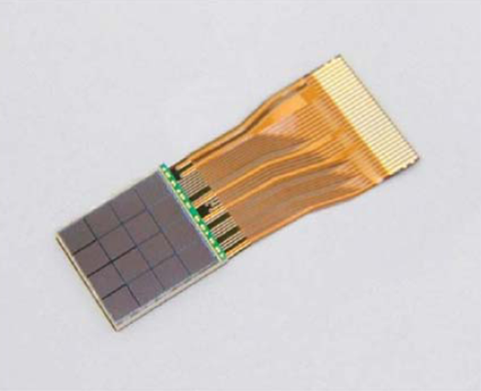
SiPM detector@ LAPP
Hamamatsu detector:
4x4 macro pixel array
1 macro pixel =3x3 mm² SiPM.
1 macro pixel = 3600 micro pixel(50µm).
1 macro pixel = an array of parallel-connected G-APDs
Goal:
to extract our ASIC’s specifications.
Notes:
Date d’obtention de 4x4SiPM ?

Slide 4
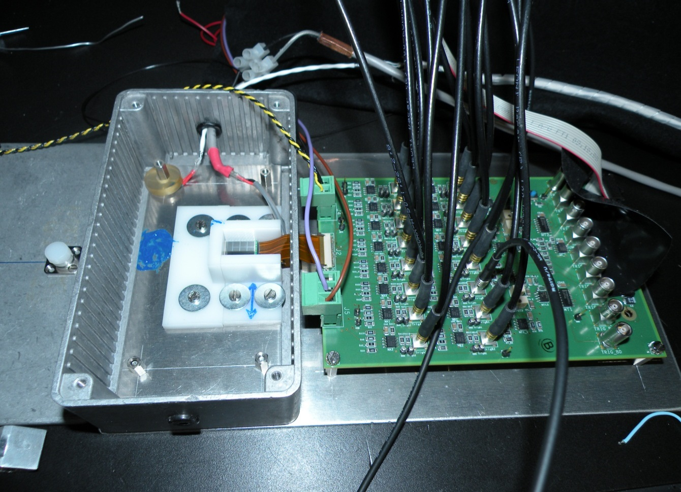
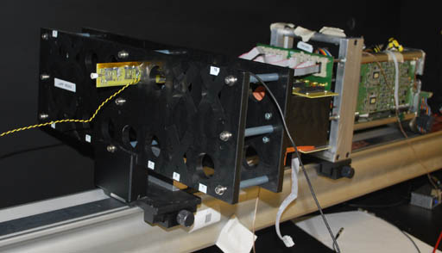
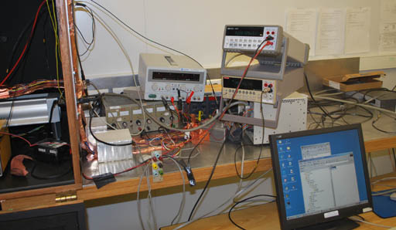
Test Bench
DAQ system
SiPM matrix
interface board
Test with light source.
An interface of gain stage and inversion => compatible with the HESS2 module.

Slide 5
Photodetector tested : 4x4 MPPC Hamamatsu matrix (16 3x3 mm² pixels) : one pixel spectrum measured at room temperature
Temperature ~ 25 °C
Measurement on 16 pixels - 4x4 SiPM matrix (16 3x3 mm² pixels)
with the LAPP test bench , using the HESS readout system
Optimal operating HV : 72V

Slide 6
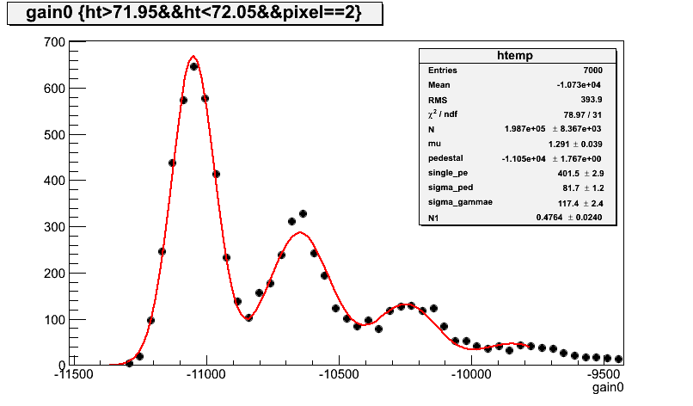
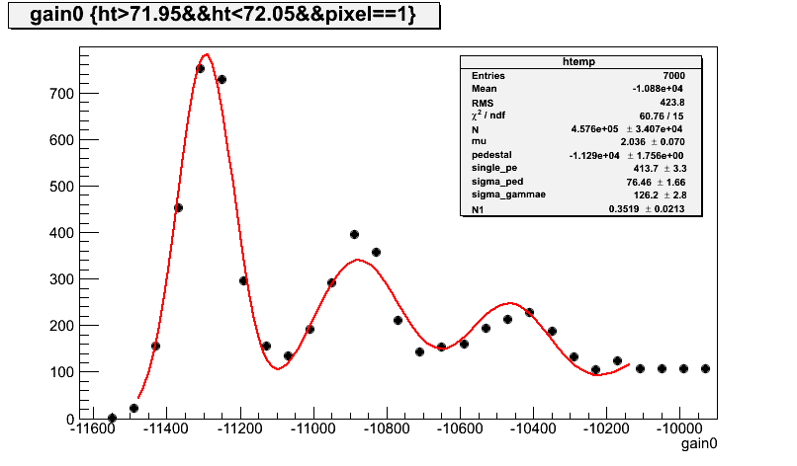
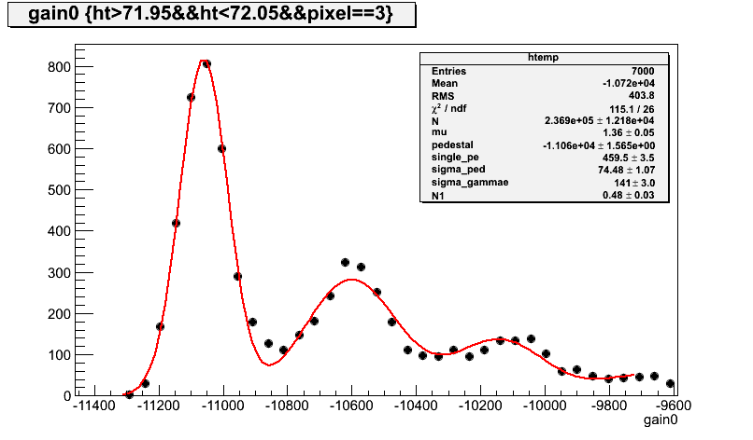
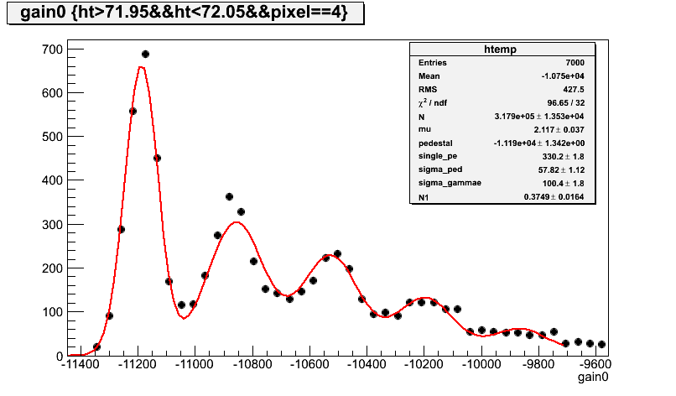
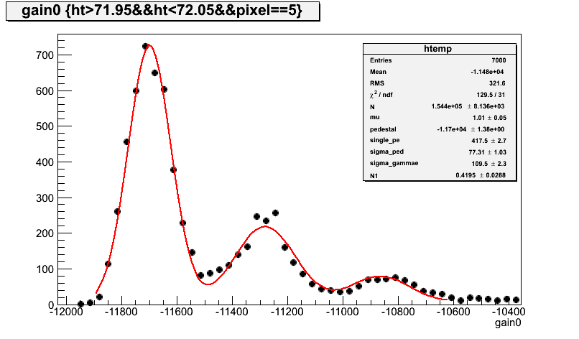
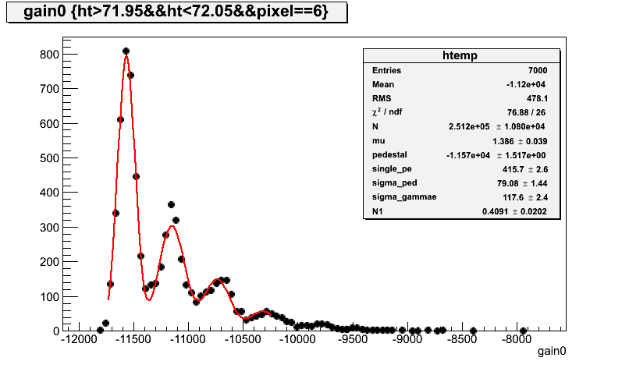
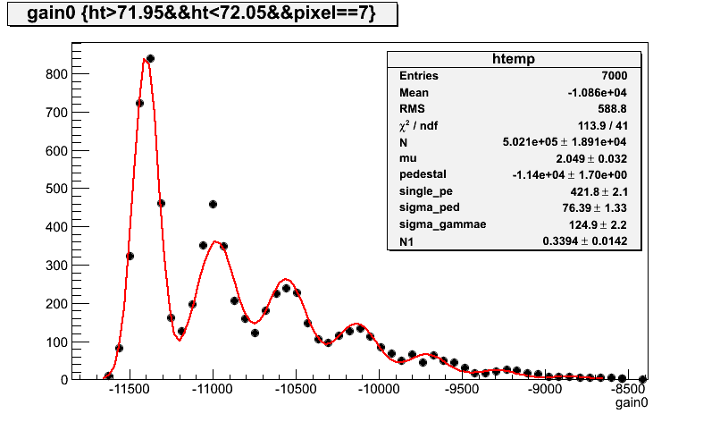
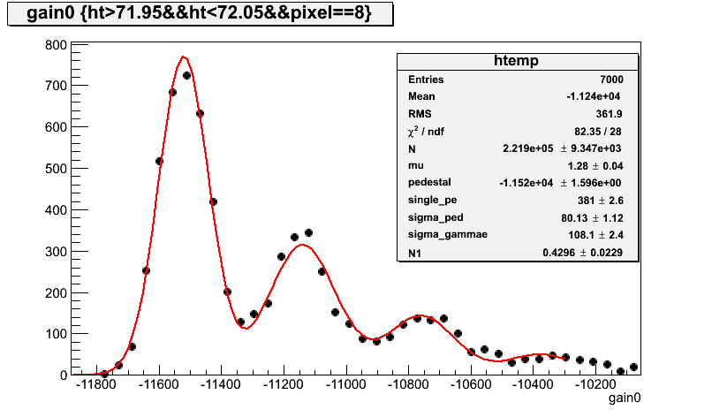
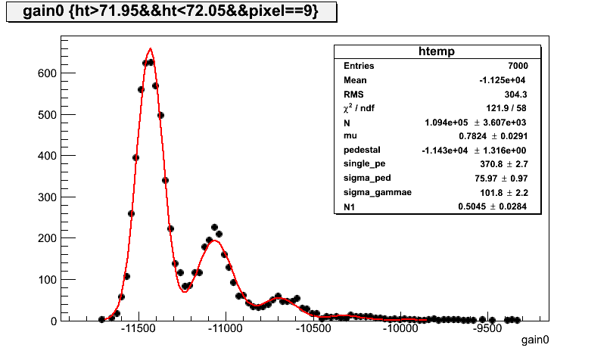
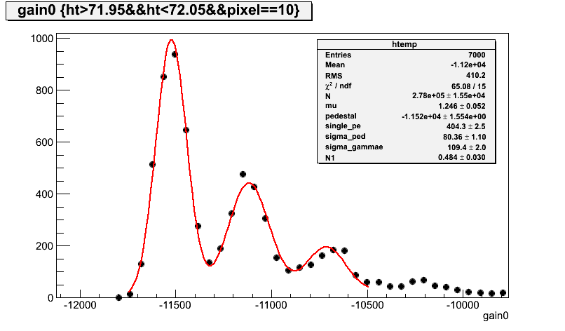
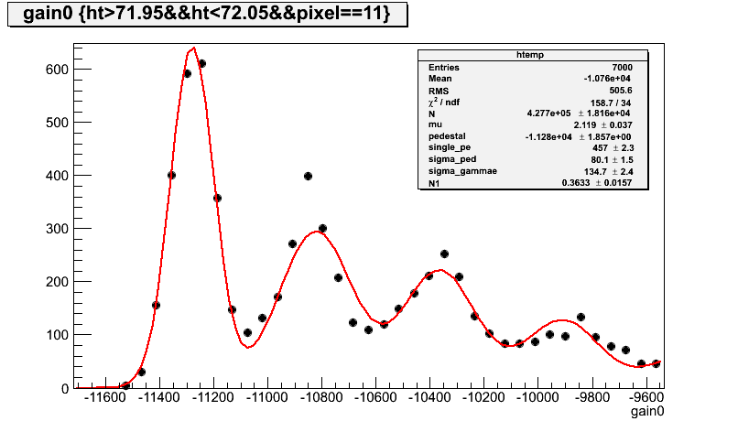
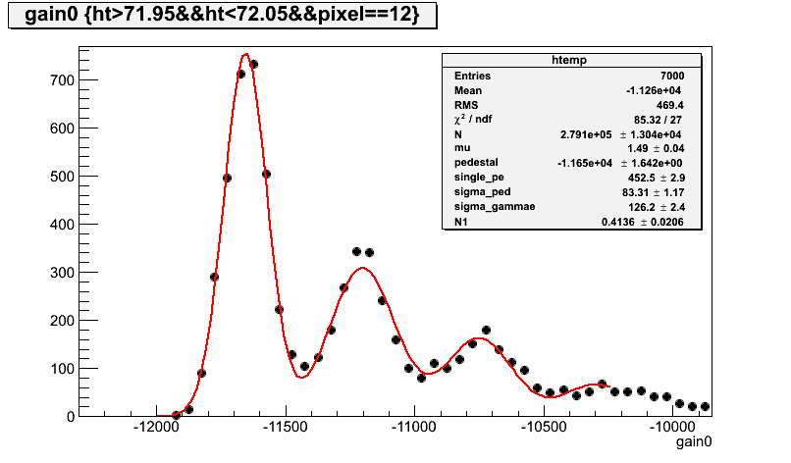
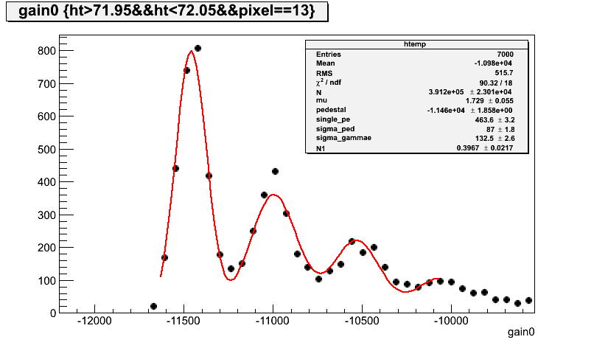
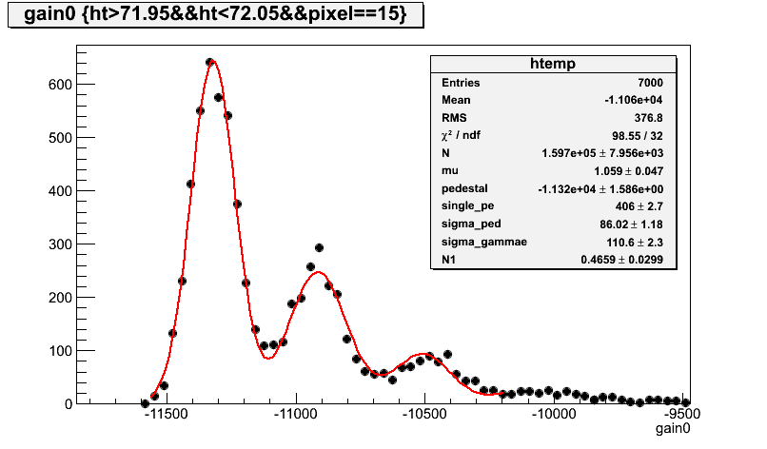
Photodetector tested: 4x4 MPPC Hamamatsu matrix (16 3x3 mm² pixels) : Measured spectra at room temperature
(Ref S11829-3344MF)

Slide 7
Photo detector characterization (conclusion)
@ room temperature ~25 degrees
Photoelectron ranging from : 371 to 490 (ADC counts) for HV=72 Volts, equivalent to a gain of 5 10⁵
Spread ~ 10 %
On-chip gain adjustment (pixel per pixel)
On chip pixel overvoltage adjustment
(performance optimization: gain and cross talk)

Slide 8
Read-out ASIC specification
16 readout channels per chip
1 p.e. measurement with S/N ≥ 5
2000 p.e. full scale split in 2 gains
On-chip gain adjustment
On-chip DAC for pixel overvoltage adjustment
Trigger :
Fast discriminator with programmable threshold
2 differential analog outputs
Interface with DRAGON / NECTAR
+ Service functions: Slow control registres, DACs, …

Slide 9
ALPS chip – bloc scheme

Slide 10
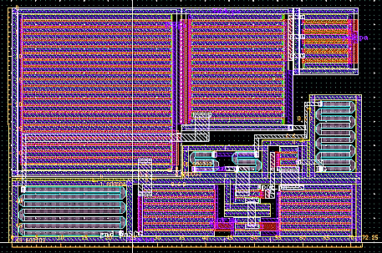
Pre-amplifier
16 channels: adapted to 4x4 SiPM matrix
Principle:
Low input Impedance about 20 ohm.
Fast response < 5ns
=> Current mode
Dynamic range:
From 1 up to about 2000 photoelectron (pe)
Signal to noise ratio (SNR) > 5
=> 2 Gains
HG covers from 1 to about 125 pe
LG covers from 11 to about 2000 pe
Gain ratio about 92, gain overlap 1 decade
Voltage output
Low power consumption < 30mW at this stage (from simulation)
Notes:
Now the preamplifier consists of 16 channels. It has a low input impedence of about 20ohm and a fast response below 5ns thanks to the current convoyor technique.
It measures a range between 1 and 2000pe with signal to noise ratio at least 5 so we made it by 2 gains, the HG covers the first part of the dynamic range and then comes the role of the LG.
The two gains overlap over a decade with a ratio of about 92, making it useful for calibration purposes.
this stage consumes less than 30mW

Slide 11
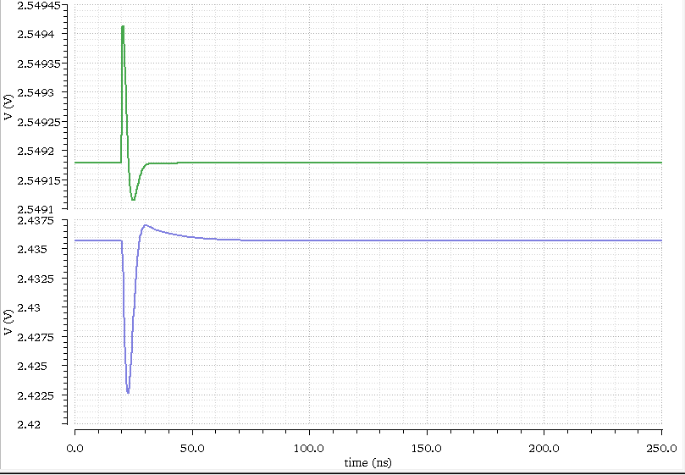
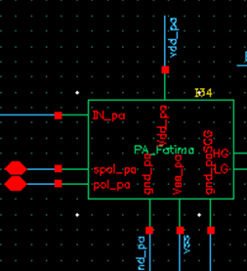
Pre-amplifier simulation (1)
Simulated SiPM signal 1pe
High gain response
t = 2.8 ns
Notes:
Here is in green a signal corresponding to 1pe simulated at the output of the SiPM model
In blue is the HG response to this signal, it has a fast rising time less than 3 ns and a good amplitude

Slide 12
Pre-amplifier – simulation (2)
SNR = 6.2
RMS = 2.08 mV
Notes:
Here is the simultaed performance of the pre amplifier
In red is the HG which is linear till 125pe then it saturates so we continue on the LG path in blue that covers a range between 11 and 2000pe
In green we see the constant gain ratio over 1 decade covered by both gains
In orange we see the noise level about 2mV and please notice the single pe detection with a SNR about 6 on the HG

Slide 13
Analog sums and gain control
Pa_1
R1
Rf
Pa_2
R2
+
Custom opamp
Out_sum
(to discri for HG)
Vref
-
Pa_16
R16
Schematic (principle)
Layout of 1 resistor
Weighted sum of the 16 preamp outputs by digitally controlled resistors
Each resistor has a R-2R like architecture :
Preamp always sees the same load (better for linearity)
8 bits resolution for gain adjustment
Noisy channels can be digitally removed
CR shaping included in each channel
Adjustable Vref to match the discriminator threshold
Notes:
As for the gain of each channel is adjustable by a R-2R net structure with 8 bits resolution so the preamplifier always sees (drives) a constant load of R, and an additional bit is used to eliminate the noisy channel (to eliminate the channel if noisy)
Voltage reference is used in order to fix the work point of the sum and to match the discriminator threshould

Slide 14
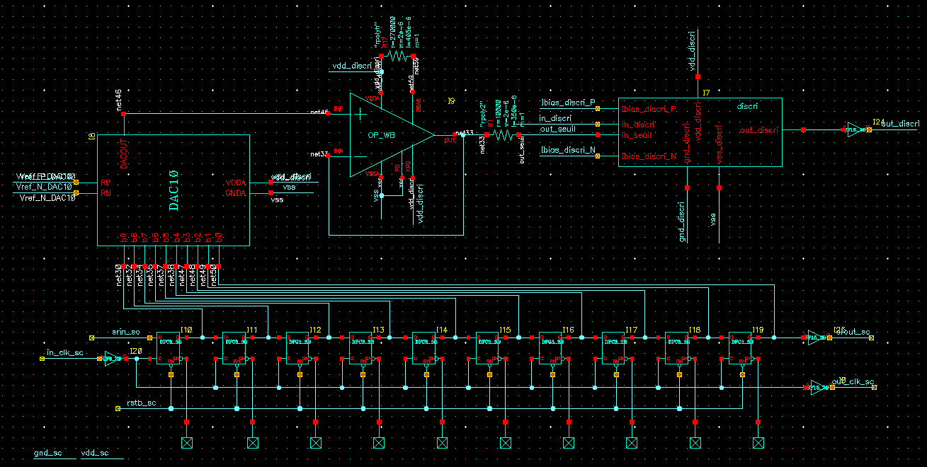
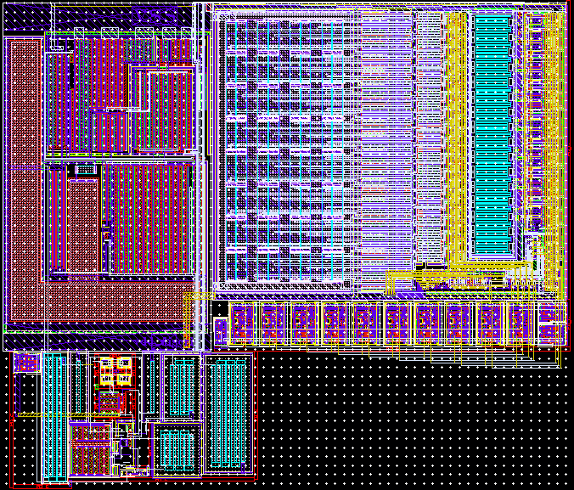
Trigger (DAC + discri)
DAC
Discri
Layout
Slow control
Discriminator (full custom) :
Dual bipolar input stage to minimize offset
Self-biased
Buffered digital output for trigger
10 bits DAC for threshold
AMS standard cell
Digitally controlled threshold
Notes:
Now To produce the trigger signal: discriminator with a bipolar input is used to minimize the offset
Self biased????
Threshould of 10 bits resolution is produced by std cell DAC. And it is slow controlled

Slide 15
ALPS chip– Layout sent to foundry 03/03/2014, received end July
AMS BiCMOS 0.35µm
96 I/O pins
Die size: 3.673 X 3.298 mm²

Slide 16
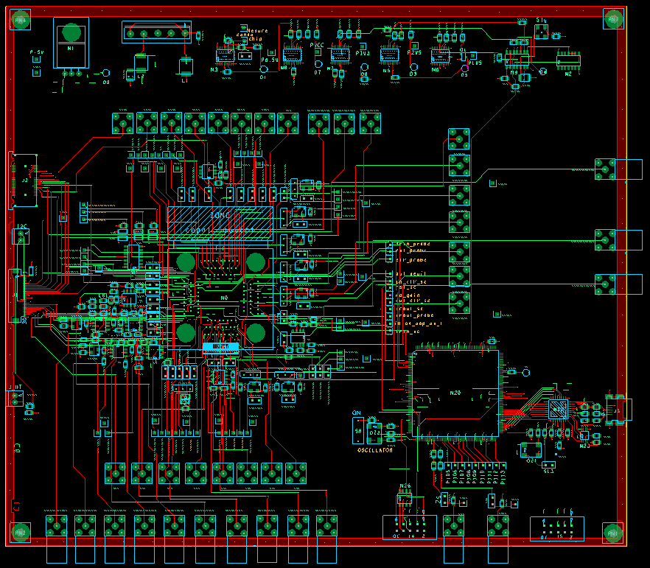
Test board- Scheme
Inputs:
Electrically generated
ALPS IC
FPGA Firmeware
USB connection
Labview➔FPGA
➔ALPS chip
Inputs:
Photo -generated (from SiPM)
Analog Outputs

Slide 17
Test board- Labview Interface
ALPS Slow Control registers
DAC: overvoltage adjustment
High/low gain adjustment
DAC: discriminator threshold
ALPS Probe Registers
High gain output
Low Gain output

Slide 18
Tests to perform on ALPS:
Planned tests:
Electrical tests
PA gains and dynamic range
Gain control tests
Sum function tests
Noisy channel suppression
Test and measurements with SiPM and light source
Starts on February 2015

Slide 19
PA gains and dynamic range
1 p.e. equivalent level on HG
Gain ratio lower than simulated (20 vs 80) : Effects of test board and signal injection parasitics
Better results expected with SiPM tests
All measurements shown with averaged signals

Slide 20
Gain control function - LG

Slide 21
Sum of 2 channels

Slide 22
Gain equalization

