Slide 1
Outils et methodes
A. Tilquin
Quelles statistiques:
-Frequentiste
-Bayesian
Quels outils:
-Minimiseur: Minuit
-MCMC
Notes:
wǒ xuéxí hàn yǔ / kěshì / wǒ búhuì shuō zhōngwén

Slide 2

Freqentist statistic
  Definition: Probability is interpreted as the frequency of the outcome of a repeatable experiment.
Central limit theorem
If you repeat N times a measurement, and for N->inf, the measurement distribution (pdf) will be a Gaussian distribution around the mean value with a half width equal to the error of your experiment.

Slide 3
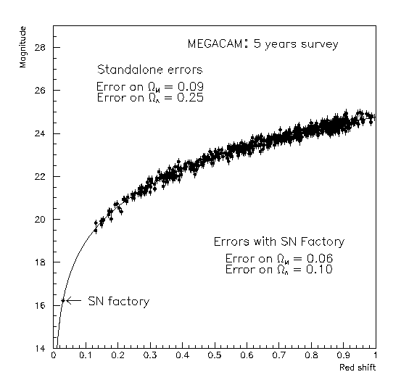
Maximum likelihood(ρ=0).
What is the best curve ?
Answer : The most probable curve !
The probability of the theoretical curve is the product of each individual point to be around the curve:
We have to maximze L with respect to Ω_{k} ⇒
Because it is simpler to work with sum:
We have to minimize with respect to Ω_{k}
⇒

Slide 4
Minimisation of χ² and bias estimate
We Tailor expand the χ² around Ω_{k}º:
We apply the minimum condition in Ω_{k}
We get the first order iterative équation:
If theoritical model is linear, this equation is exact (no iteration)

Slide 5
Computing errors
When the χ² is defined on measured variables (i.e magnitude), how to compute the errors on physical parameters, Ω_{k} ?
We perform a Tailor expansion of the χ² around minimum:
=0
If the transformation m(Ω_{k}) is linear, then:
The second derivative of the χ² is a symetric positive matrix
The error on Ω_{k} are Gaussian

Slide 6
Computing errors(2)
Simple case:
Jacobi
If m(Ω_{k}, z_{i}) is linear
Error on physical parameter are deduced by a simple projection on the Ω_{k} space parameter (linear approximation) Fisher analysis
Independant of the measured points
If m(Ω_{k}, z_{i}) is not linear: Fisher is a good approximation if:

Slide 7
Non-linéarity
If m(Ω_{k}) is linear in Ω_{k} then:
  If errors on m_{i} are Gaussian then errors on Ω_{k} will be
  χ²(Ω_{k}) is exactly a quadratic form
  The covariance matrix is positive and symetric
  Fisher analysis is rigorously exact.
On the contrary only χ₁² is rigorously exact: Fisher matrix is a linear approximation.
  The only valid properties are:
  Best fit is given by =>
  The « s » sigma error is given by solving: χ₁² = χ²_{min} +s²

Slide 8
Non-linearity: computing errors
If m(Ω_{k}) is not linear, errors on Ω_{k} is not gaussian. Fisher analysis is no more correct. If one use it, results should be verify a posteriori.
To estimated the errors we should come back to the first definition of the χ₁² and solve the equation χ₁² = χ²_{min} +1
If we want to estimate σ(Ω_{Λ}) what about Ω_{M} ? How to take care of correlation ? How to marginalize over Ω_{M} ?
Average answer (simulation)
Most probable answer (data)
It can be shown than both methods are equivalent for simulation if simulated point are not randomized. m_{mes} = m_{th}

Slide 9
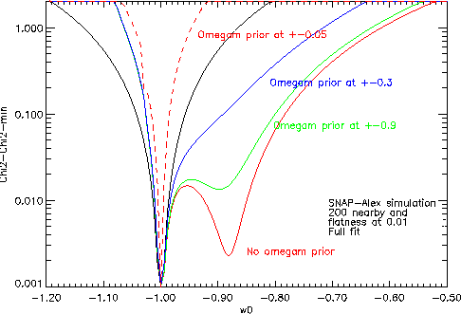
Non linearity: example
Evolution of χ₁²- χ_{min}² : SNAP simlation, flatness at 1 %
χ²=χ_{min}²+1
Fisher analysis
Secondary minimum
σ₋
σ₊
asymetric error
Rem:This secondary minimum is highly due to non linearity.

Slide 10
Non Gaussianity
When errors on observables are not Gaussian, only the minimum iterative equation can be use. So go back to the definition: “Probability is interpreted as the frequency of the outcome of a repeatable experiment” and do simulation: Gedanken experiments
  Determine the cosmological model {Ω_{k}⁰ } by looking for the best fit parameters on data. This set of parameters is assumed to be the true cosmology.
  Compute the expected observables and randomize them inside the experimental errors, taking into account non Gaussianity. Do the same thing with prior.
  For each “virtual” experiment, compute the new minimum to get a new set of cosmological parameters Ω_{k}^{i}
  Simulate as many virtual experiments as you can
  The distributions of these “best fit” value {Ω_{k}^{i}} give the errors:
    The error matrix is given by second order moments:
  U_{i,j}={<Ω_{i}Ω_{j}> - <Ω_{i}> <Ω_{j}>} positive define
    The error on errors scale as σ (σ _{Ω}) ~ σ _{Ω}/√2N

Slide 11
Statistique freqentiste
Mathématiquement parfaitement définie
  -Conservation locale des probabilités
  -Non linéarité et non Gaussianité résolus par simulation
  L’outil principal : MINUIT
  Limitations:
  Modele théorique doit être différenciable
  Difficile d’utiliser des « priors » i.e Ω_{m} >0
  Attention aux corrélations (instabilité numérique)
  Marginalisation (contour) gourmand en CPU

Slide 12
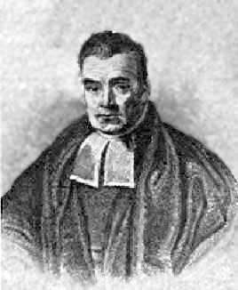
Bayesian statistic or
The complexity of interpretation
1702-1761 (paper only published in 1764)

Slide 13
Bayesian theorem.
Posterior to measurement
measurement
Prior to measurement
Normalization factor=Evidence
Normalization factor is the sum over all possible posteriors to ensure unitarily of probability.
Where > means after and < means before.

Slide 14
Example
Question: Suppose you have been tested positive for a disease; what is the probability that you actually have the disease?
-Efficiency of the test:
-Disease is rare:
What is the Bayesian probability?
Why a so small Bayesian probability (16%) compare to Likelihood probability of 95%? Which method is wrong?

Slide 15
Intuitive argument.
Over 100 people, the doctor expect 1 people has a disease and 99 have no disease. If doctor makes test to all people:
  1 has a disease and will probably have a positive test
  5 will have a positive test while they have no disease
  6 positive tests for only 1 true disease
  So the probability for a patient to have a disease when the test is positive is 1/6~16%
=>Likelihood is wrong?
In the previous argument doctor used the whole population to compute its probability:
  1% disease and 99% not disease before the test
  He have assumed that the patient is a random guy. The patient state before the measurement is a superposition of 2 states
    /patient> = 0.01*/desease>+0.99*/healthy>
But what about yourself before the test?
    /you> = /disease> or /healthy> but not both state in the same time
    /you> ≠ /patient>
=>Bayesian is wrong?

Slide 16
Which statistic is correct? Both!
But they do not answer to the same question!:
  Frequentist: If “my” test is positive what is the probability for me to have a disease? 95%
  Bayesian: If “one of the” patient has a positive test what is the probability for this patient to have a disease? 16%
Different questions give different answers!
Conclusion: In Bayesian statistic, the most important is the prior because it can change the question!
It’s the reason why statistician like Bayesian statistic, because just playing with prior can solve a lot of different problems.
On the contrary, in Scientific works, we should care about prior and interpretation of the Bayesian probability.

Slide 17
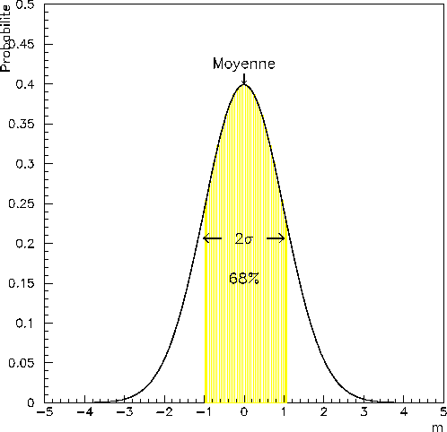

Baeysian and cosmology
In cosmology, a simplify version of Baye’s theorem is used:
$$L_{tot} \sim Likelihood ∗prior$$
Only useful for models comparison: Evidence or f-value
To estimate parameters and errors, normalization factor is useless.
Usual priors in cosmology are:
  Gaussian prior: Ω_{m} = 0.3 ± 0.05.
  -Usually refer to an experiment.
  -Equivalent to frequentist.
  Delta function prior : Ω_{k} = δ_{D}(0).
  -Constraints may be artificially tight!
  Flat prior or “top hat prior”:
  p(Ω_{m}>0)≠0 ; p(Ω_{m} < 0)=0
  P(w₀, w₁) ≠0 if -1.5 < w₀ < 0 ; -2 < w₁ < 1
    -If too narrow it can bias final results!
    -If wide enough, no influence. Only affect evidence.

Slide 18

Parameters estimate in Bayesian
$$−2Ln\left(L_{tot}\right)=−2Ln\left(Likelihood\right)−2Ln(prior)$$
${χ^{2}}_{post}$=$χ^{2}−2Ln(prior)$
But:
  posterior χ² is no more a quadratic form expect if Gaussian prior
  It may not be define, for example if prior is a step function (Ω_{m}>0)
  Derivative may not be define.
So:
  In general, we work on the posterior likelihood. But how to find maximum likelihood and how to compute error?
MCMC to explore posterior Likelihood

Slide 19
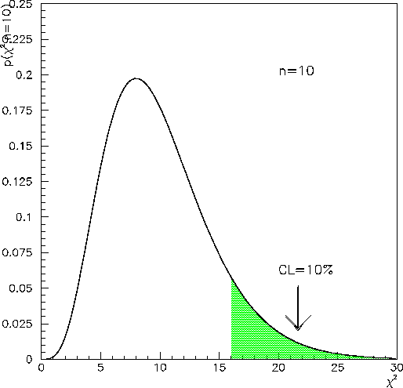
Monte Carlo Markov Chain for Bayesian statistic
MCMC explores the Likelihood with respect to cosmological parameters using a chain of correlated points.
It’s a random walk using metropolis method.
  How to simulate a set of points such that
  the points density is proportional to a given pdf ?
  Start from x₀ =x_{i}
  Simulate a random step ±s and compute x_{i+1}=x_{i}±s
  If p(x_{i+1})>p(x_{i}) keep the point x_{i+1} ->x_{i} goto 2
  If not we simulate a random number (r) between 0 and p(x_{i})
  If r>p(x_{i+1}) we reject the point and goto 2
  If r<p(x_{i+1}) we keep the point x_{i+1} ->x_{i} goto 2
  The central limit theorem tell us that for N the set of points {x_{i}} converge toward the true pdf. (typically 1 million for MCMC in cosmology)

Slide 20
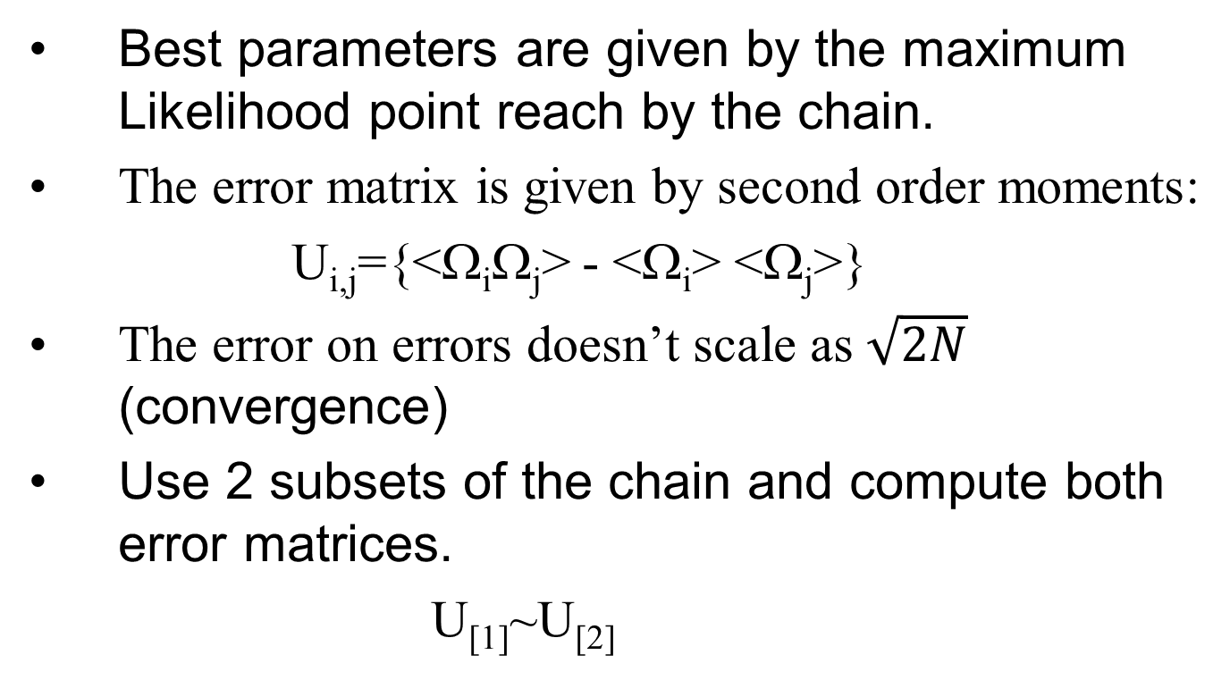
Computing errors
Best parameters are given by the maximum Likelihood point reach by the chain.
The error matrix is given by second order moments:
  U_{i,j}={<Ω_{i}Ω_{j}> - <Ω_{i}> <Ω_{j}>}
The error on errors doesn’t scale as $\sqrt{2N}$ (convergence)
Use 2 subsets of the chain and compute both error matrices.
  U_{[1]}~U_{[2]}

Slide 21
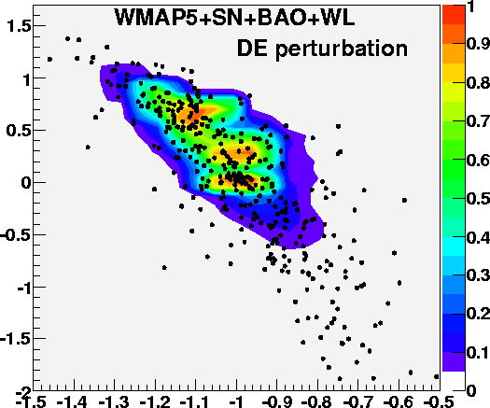
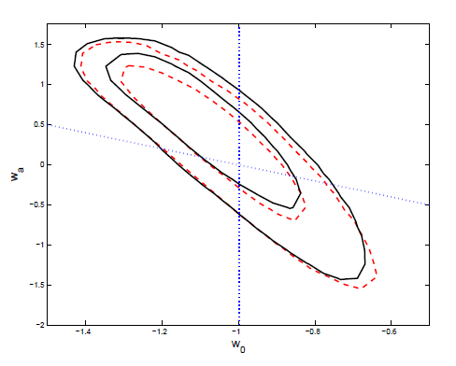
Methods comparison using
CMB+BAO+WL+SN: (w₀%w_{a})
Frequentist: χ²=χ²_{min}+s² and Gedanken
Bayesian with MCMC
MCMC
Li et al. 2009
68%+95% CI
Gedanken and MCMC give same results and require about same computing time (3 to 4 years on a single processor)

Slide 22
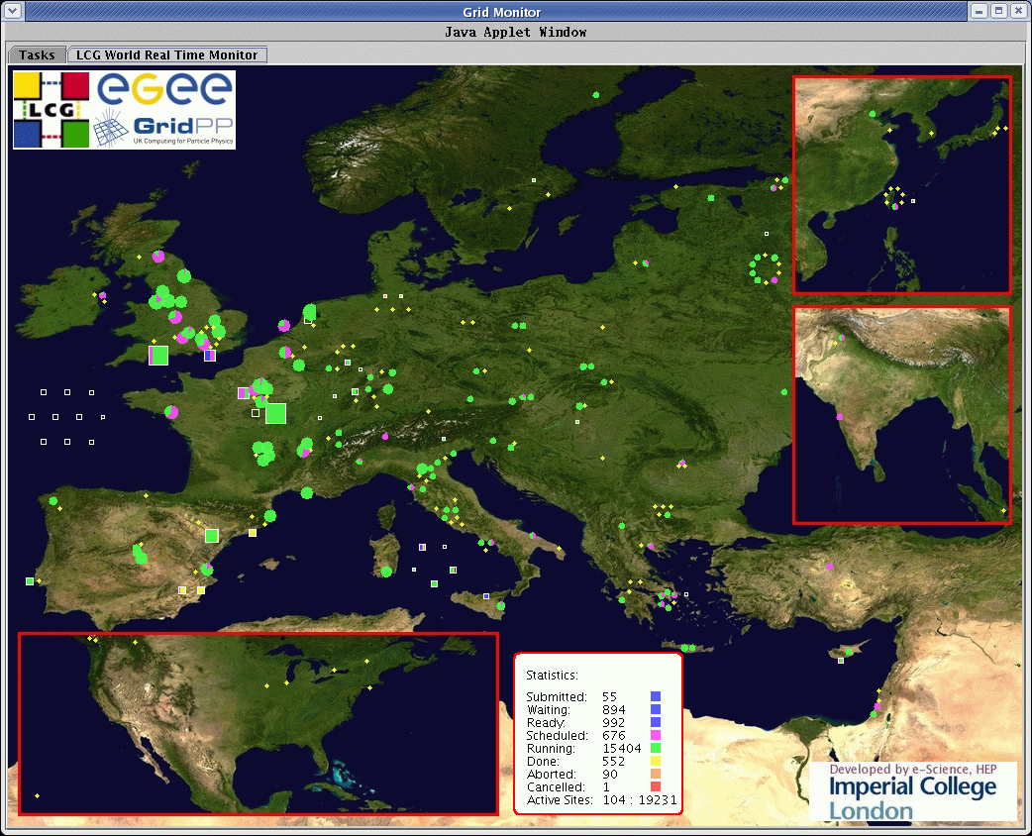
Datagrid (DIRAC)

Slide 23
Conclusions
Frequentist ou Bayesian?
Qu’importe: Les deux sont acceptables
Cependant, si le modele théorique n’est pas defini dans tous l’espace des paramètres ou si les corrélations sont importantes, la statistique Bayesian est mieux adaptée (MCMC)
Les outils principaux:
  Minuit: Très efficace, archi debugge, mais parfois instable.
  MCMC: C’est le buldozer mais attention a la convergence.
Dans les 2 cas CPU time scale = plusieurs années(>10)
Nécessite soit un gros serveur (au moins 128 CPU) soit la grille de calcul (difficile a utiliser)

Slide 24
Outlook
General problem
The frequentist statistic
  Likelihood, log-likelihood and χ²
  Property of the χ²
  Fisher analysis and limitation
  Gedanken experiments
The Bayesian statistic
  The Bayes theorem
  Example and interpretation.
  Prior in cosmology and consequences
  MCMC
Summary

Slide 25
General problem(1)
Let assumes we have N Supernovae at different redshift
and a given model:
How to find the best curve ?
We look for the closest curve with respect to the data points:
But the worst measured points should have less weight.

Slide 26
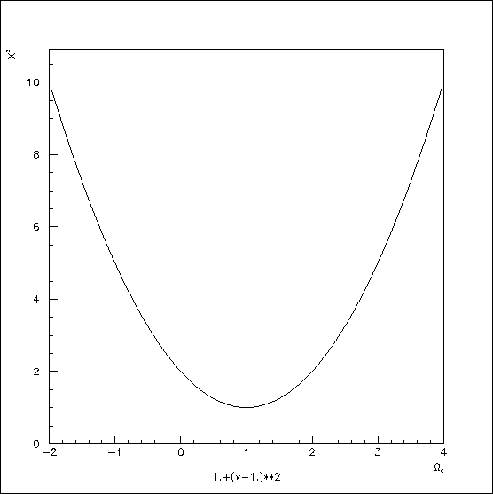
General problem(2)
The problem now is:
  Find the Ω_{k} value such that χ² is minimum
  Computed the errors on Ω_{k} starting from the errors on m_{i}
Statistic is necessary

Slide 27
Gaussian probability
In all the following I will assume errors are Gaussian, I.e if we repeat N time the measurement, the distribution of measurements follows a Gaussian distribution:
With an average value:
Variance or error²:

Slide 28
N variables case(correlation)
Assume « n » Gaussian measurement :
Correlationcoefficient.
Determinant
Example of 2 variables:
Si ρ=0
Si ρ=1
V is singular

Slide 29
Some χ² property
Probability and χ² : By definition
Definition in matrix form:
Second derivative:
The first χ² derivative gives le minimum
The second χ² derivative gives the weight matrix = inverse of the error matrix independent of the measured data points.

Slide 30
Probability density of the χ²
Probability density of the χ²: Assume we repeat N times the measurement of x. For each measurement we have :
In case of n degree of freedom
ndof is the number of independent observations minus the number of parameters that must be estimated from data sample.
We can show that:
  The average of the χ² is n
  The variance is 2n
So, the first test of the compatibility between a model and an experiment is to verify
Warning about the variance of 2n

Slide 31
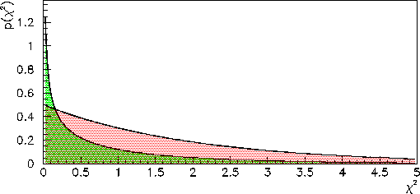
P-value and confidence level
We define p-value as the probability that all new experiment will give a higher χ² than the observed one:
10% of experiments will give a χ²>16
Definition of the standard deviation (confidence level):
A measurement with an error at « s » sigma.
n=1, p=68%
For more variables measured simultaneously, a result at « s » standard deviation is defined with the χ², but probabilities depend on the number of variables.
n=2, p=39%
n=2, p=68%
For many variables we prefer to talk about the probability !!!

Slide 32
P-value property
The Probability density function of the p-value h(ε) :
Using the probability conservation law
If the model is correct and if errors are statistical only and correctly estimated, the probability density function of the p-value should be flat, i.e ε_{k} measurements are uniformly distributed between 0 and 1.

Slide 33
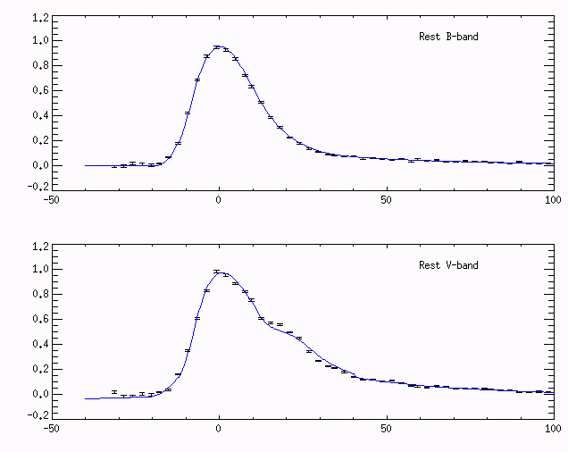
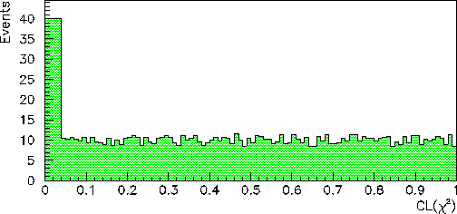
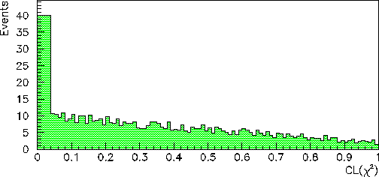
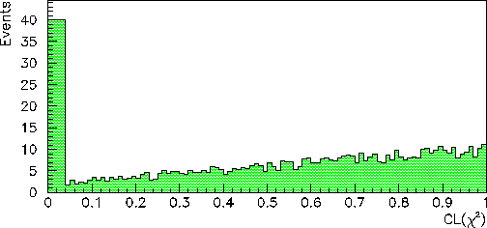
Application to light curve fit
Assume we have N light curve fitted with given templates.
Bad fit
Wrong SN
Bad template
Good light curves
Selection criteria:
Efficiency = 95%
Error are too small
Errors are too big
bad template

Slide 34
Exemple: variables change
Assume we know errors on Ω_{m} et Ω_{Λ} , (no correlation). We would like to compute errors on S=Ω_{m}+Ω_{Λ} et D=Ω_{m}-Ω_{Λ}:
  We construct the covariance matrix
  We construct the Jacobian:
  We project:
  We inverse V:

Slide 35
External constraint or prior
Problem: Using SN we would like to measured (Ω _{m},Ω_{Λ}) knowing that from the CMB we have :Ω_{T}=Ω_{m}+Ω_{Λ}=1.01±0.02.
This measurement is independent from the SN measurement. So we can add it to χ².
All the previous equations are still correct by replacing:
And the Jacobi:

Slide 36

Online demonstration of MCMC
Only if enough time!

Slide 37
Prior and new discovery
In 1999, 2 different groups (SCP and High-z teams) discovered the cosmological constant by using Sn1a at high redshift.
These 2 groups are mainly compose of particle physicists and were using freqentist statistic.
As a consequence they didn’t use prior like Ω_{m}>0… And they made a fundamental discovery!!!

Slide 38
Summary
Both statistics are used in cosmology and give similar results if no or week priors are used.
The frequentist statistic is very simple to use for gaussian errors and rather linear model. Errors can easily be computed using Fisher analysis.
Bayesian statistic might be the only method to solve very complex problem. But warning about probability interpretation!
For complex problem, only simulation can be used and are lot of computing time.
When using priors in both cases a careful analysis of results should be done

Slide 39
References
http://pdg.lbl.gov/2009/reviews/rpp2009-rev-statistics.pdf
http://www.inference.phy.cam.ac.uk/mackay/itila/
http://ipsur.r-forge.r-project.org/
http://www.nu.to.infn.it/Statistics/
http://en.wikipedia.org/wiki/F-distribution
http://www.danielsoper.com/statcalc/calc07.aspx
If you have any question or problem, send me an e-mail: tilquin@cppm.in2p3.fr

Slide 40
Why Baeysian statistic would have miss ☹ discovery?
Positivity of Ω_{m}

Slide 41
F-test and F-value
Way to compare 2 different models or hypothesis.
Consider two models, 1 and 2, where model 1 (p1 parameters) is 'nested' within model 2 (p2>p1)..
  Model 2 will give a better fit to the data than model 1. But one often wants to determine whether model 2 gives a significantly better fit to the data.
  One approach to this problem is to use an F test.
If there are n data points to estimate parameters of both models from, then one can calculate the F statistic, given by:
Under the null hypothesis that model 2 does not provide a significantly better fit than model 1, F will have an F distribution, with (p2 − p1, n − p2) degrees of freedom. The null hypothesis is rejected if the F calculated from the data is greater than the critical value of the F distribution for some desired false-rejection probability (e.g. 0.05) . The test is also known as likelihood ratio test. (see http://en.wikipedia.org/wiki/F-distribution, http://www.danielsoper.com/statcalc/calc07.aspx)

Slide 42
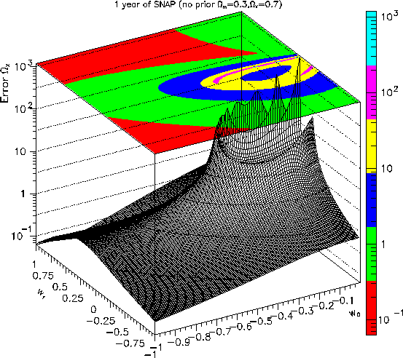
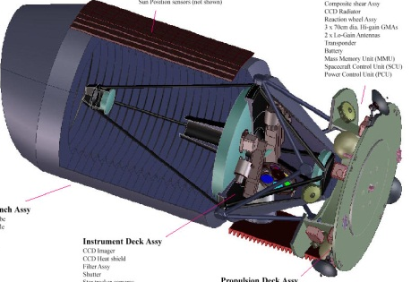
Statistical methods in cosmology
André Tilquin (CPPM) tilquin@cppm.in2p3.fr
Ω_{m}, Ω_{Λ},w₀,w₁
χ²

Slide 43
Bayesian evidence
Bayes forecasts
■ method:
■ define experiment configuration and models
■ simulate data D for all fiducial parameters
■ compute evidence (using the data from b)
■ plot evidence ratio B01 = E(M0)/E(M1)
■ limits: plot contours of iso-evidence ratio
■ ln(B01) = 0 (equal probability)
■ ln(B01) = -2.5 (1:12 ~ substantial)
■ ln(B01) = -5 (1:150 ~ strong)
■ Computationally intensive: need to calc. 100s of
evidences

Slide 44
Graphical interpretation (contour)
The equation: define an iso-probability ellipse.
39%
39%
π
π-π/4
68%

Slide 45
Systematic errors
Définition: Systematic error is all that is not statistic.
Statistic: If we repeat « n » the measurement of the quantity Q with a statistical error σ_{Q}, the average value <Q> tends to the true value Q₀ with an error σ_{Q}/√n.
Systematic:Whatever is the number of experiments, <Q> will never tends to Q₀ better than the systematic error σ_{S}.
How to deal with:
If systematic effect is measurable, we correct it, by calculating <Q-δQ> with the error σ_{Q’}²= σ_{Q}²+ σ_{δQ}²
If not, we add the error matrices: V’ = V_{stat}+V_{syst} and we use the general formalism.
Challenge:The systematic error should be less than the statistical error. If not, just stop the experiment, because they won !!!!

Slide 46
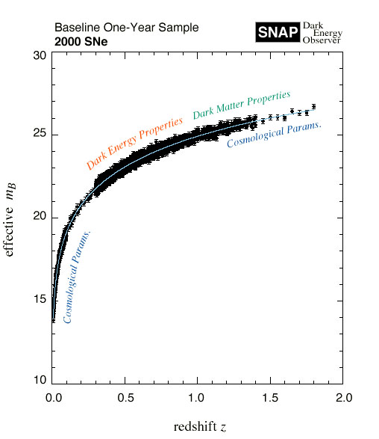
Error on the z parameter
SNAP mesure m_{i} et z_{i} with errors σ_{m} et σ_{z}. Redshift is used as a paremeter on the theoritical model and its error is not on the χ².
But the error on z leads to an error on m(Ω_{m},Ω_{Λ},z_{i})
Thus, the error on the difference m_{i}-m^{th} is:

