Slide 1
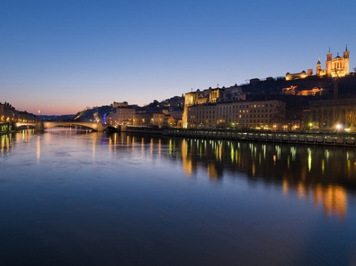
Journées top-LHC France
Troisième Edition
Lyon, 18-19 Mai 2015
Comité d’organisation
Jeremy Andrea
Roberto Chierici
Frédéric Déliot
Frédéric Derue
Arnaud Lucotte
Dominique Pallin
Mossadek Talby

Slide 3
Third edition of top-LHC France
The aim is to gather the HEP+TH community working on top physics in France
Precision measurements
Research of new physics
Increase the visibility of French labs in the frame of HEP in France
Exchange between ATLAS and CMS and EXP and TH. Presentation of new ideas and preparation for collaborations are particularly welcome
Presentations/discussions will be informal
Accent on the work done in French labs
Permanent discussion session, let us use the talks as introduction to discussing interesting topics
Participation of students in the discussion is particularly welcome

Slide 4
New in this edition
Organisation shared with the TH/phenomenology community in France
More balance between EXP and TH, more discussion on phenomenology issues expected
The format is 1-1.5 days: need to have “topical” discussions
This edition will touch subjects not covered in the previous edition, and those were the contribution of the French community is larger
Today: top mass, searches with the top quark
Tomorrow: searches-continuation-, differential measurements, ttH
The format is flexible
Plenty of additional time has been allotted for questions and comments
In-talk discussion also welcome

Slide 5
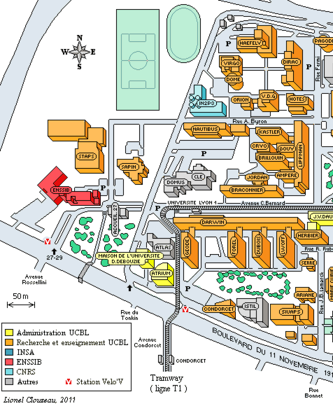
Logistic information
IPNL
Main venue
Wifi available in the whole building :
Network: Conference
Login: toplhcfrance
Password: drYxSgTs
Coffee breaks just outside this room
IPNL
Cantine
Cantine « Domus »:
Lunch tomorrow. Ask for lunch ticket to Roberto. They cost 11.5 euros each, for a 5 courses’ meal

Slide 6
Logistic information (2)
Dinner tonight: Leon de Lyon, 8PM (meet directly at the restaurant!)
http://www.leondelyon.fr/fr/brasserie-leon-de-lyon.php
1 Rue Pleney, 69001
Metro hotel de ville
Restaurant

Slide 7
Bienvenu(e)s !

