Slide 1
Common DAQ
Taikan Suehara
(Kyushu University, Japan)

Slide 2
CALICE DAQ Task Force
Members
SiECAL – R. Cornat, F. Magniette, TS
ScCAL – M. Reinecke, J. Kvasnicka
SDHCAL – L. Mirabito, C. Combaret
Quasi-Monthly meeting
10th Dec. – Kickoff
19th Jan. – Overview of each technologies

Slide 3
Mandate of TF
2 years
1st year: Solve the issues related to combined running with current hardware and summarize it to a document
2nd year (??): Run the combined tests

Slide 4
Personal comparison
 | SiECAL | ScE/AHCAL | SDHCAL
Manpower | ** | *** | *
Strategy | Minimal mod | Scratch build | Minimal mod
CCC | UK original | ZedBoard | DCC
CCC clock | 50 MHz | 40 MHz | 50 MHz
8b/10b encode | yes | No | yes
BX clock (TB) | 2.5 MHz | 250 kHz
DIF-LDA | HDMI | HDMI | USB+HDMI
LDA | GDCC | ZedBoard | Raspberry+DCC
LDA-PC | Ethernet raw | TCP | TCP
Software | Calicoes | Labview (will be C++) | DIM (from DELPHI)

Slide 5
Things to be considered
Common master clock frequency
To assure simultaneous BX counting
Common BX clock frequency
BUSY treatment
→ Common CCC? or just clock synchronization?
High level DAQ software (EUDAQ?)
Run control, event building, run number, monitoring,…
Common data format (LCIO class)
Partial or optional sharing of firmware and software
etc.

Slide 6
CALICE DAQ 3? must...
have common clock freq and master CCC
Slave CCC can be either common or individual
can run on both ILC and TB mode?
Needs busy treatment?
can be controlled via the same master
Maybe EUDAQ (with modification)
can store data in consistent way
LCIO with structure well-defined CALICE-wide
do work-sharing to live in minimal human resource!

Slide 7
Practical combined run

Slide 8
Si and Sc DAQ
SKIROC2
SPIROC2
Flexi cable
HDMI
Ethernet
Coaxial
Si DIFs
Sc DIFs
Spill
GDCC/LDA
Si CCC
Sc CCC
xLDA
Clock
Readout cycle
PC
PC
Sc CCC provides master clock of 50 MHz to Si CCC (Sc master clock is 40 MHz, converted)

Slide 9
Timing chart
~400 ms
spill
Sc
livetime
readout
Sc busy
Si
“spill”
readout
“Readout cycle” number is consistent, but Si busy not considered

Slide 10
Combined DAQ for Si + Sc
LCIO file(s)
EUDAQ
Run control
Event display (not finalized)
start/stop run #
Data collector
start/stop
Labview
Sc data
Si data
calicoes/pyrame
Sc hardware
Si hardware
Combined LCIO obtained in online DAQ

Slide 11
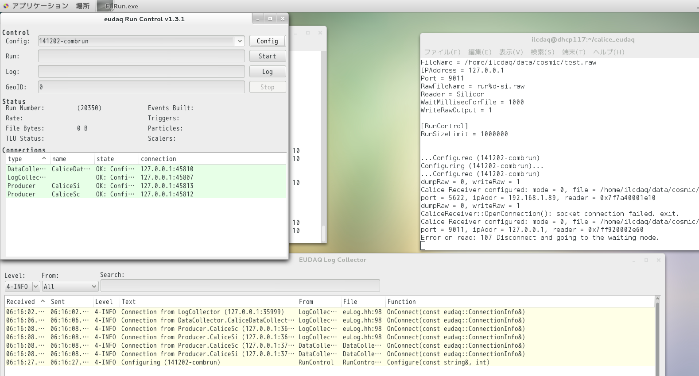
Screenshot of EUDAQ
Master PC (Linux): EUDAQ + CALICOES (Silicon)
Slave PC (Windows): LabView (Scintillator)
Successfully took data for more than a week

Slide 12
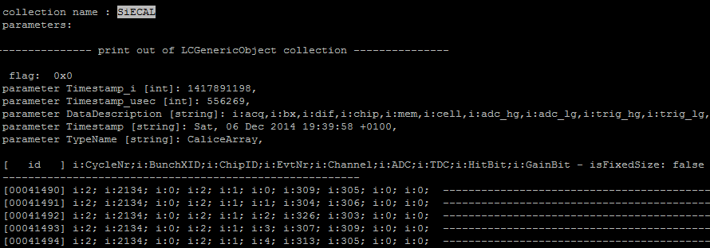
Output files

Slide 13
To do in silicon before next Si+Sc
Analysis
Data loss rate (seems small enough now...)
Combined tracking
Hardware
Supply BUSY
Sc can be faster next time
at least necessary in “parasitic” TB
More layers, new layers
UDP transfer??

Slide 14
Si+SDHCAL: to be addressed
Common clock
Si CCC can accept clock (50 MHz)
SDHCAL?
BX/acq# (readout cycle) consistency
How to assure?
BUSY? or only working in fixed periods?
Common start/stop + run number
Interface to EUDAQ
Event data to EUDAQ
TCP connection in the Si+Sc case

Slide 15
Appendix: To do for me
Integration of CALICOES2
Should be investigated very soon
Integration of EUDAQ2
And specify issues to be solved
BGA SKIROC test board
I must finish this in March (Japanese fiscal year)
Test of new FEB/sensor
I hope we can receive the new FEB asap... (and GDCC)

