Slide 1
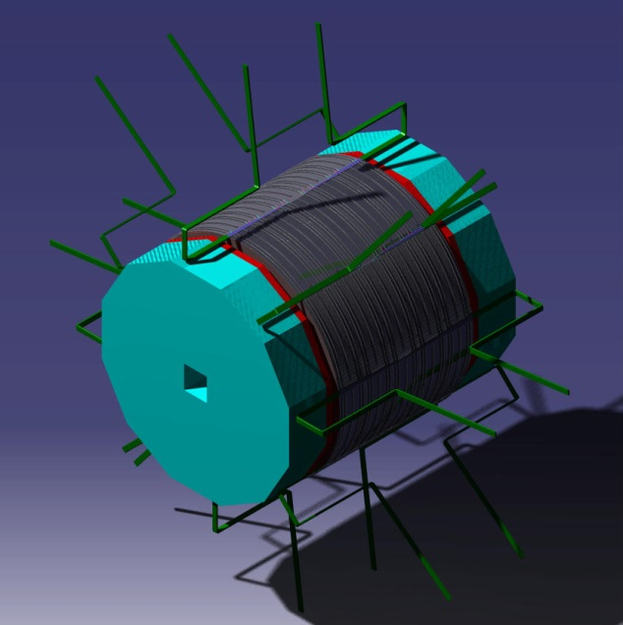
ILD Mechanical structure
DHCAL Barrel and Endcaps
Design, Integration & Services
J.C Ianigro
- IPN Lyon -

Slide 2
ILD mechanical structure Contents
Barrel design
Endcaps design
Thermal studies
Services
Perspectives

Slide 3
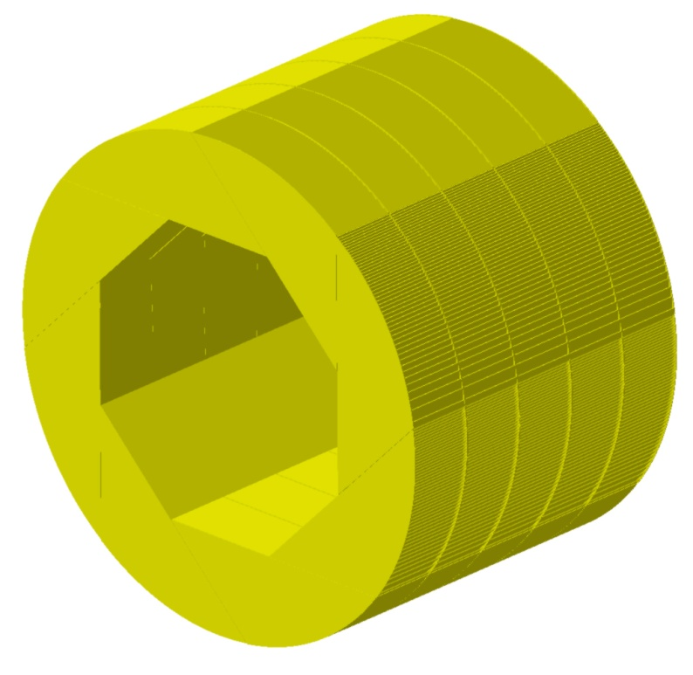
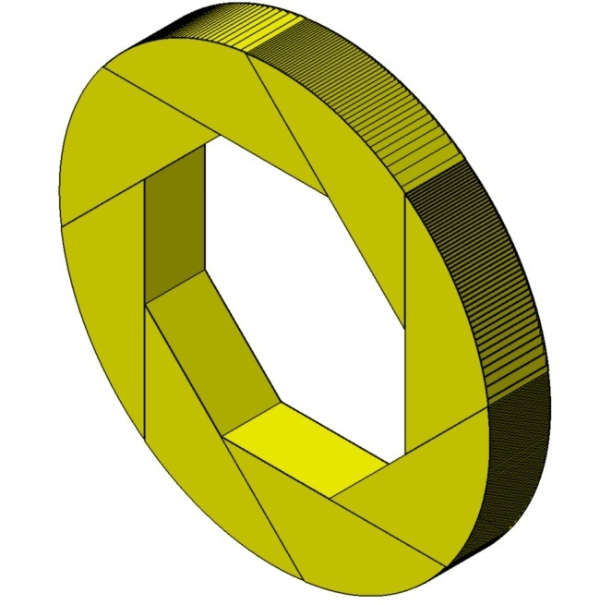
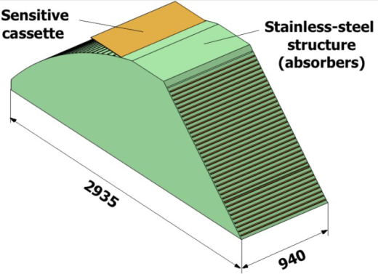
Barrel design
Ext. Diameter 6770 mm
Int. Diameter 4116 mm
Lenght 4700 mm
Thickness wheel face = 10 mm
Thickness absorbers= 15 mm
Ext. Diameter : 6770 mm
Int. Diameter :4116 mm
Lenght : 940 mm
x8
Stainless steel 1 wheel (8 mod.) 5 wheels
Weight (t): 88 t 440 t
Detectors W. (t): 36.8 t 184 t
Total Weight (t) : 124.8 t 624 t

Slide 4
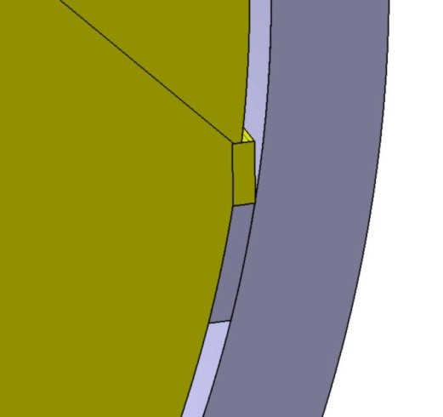
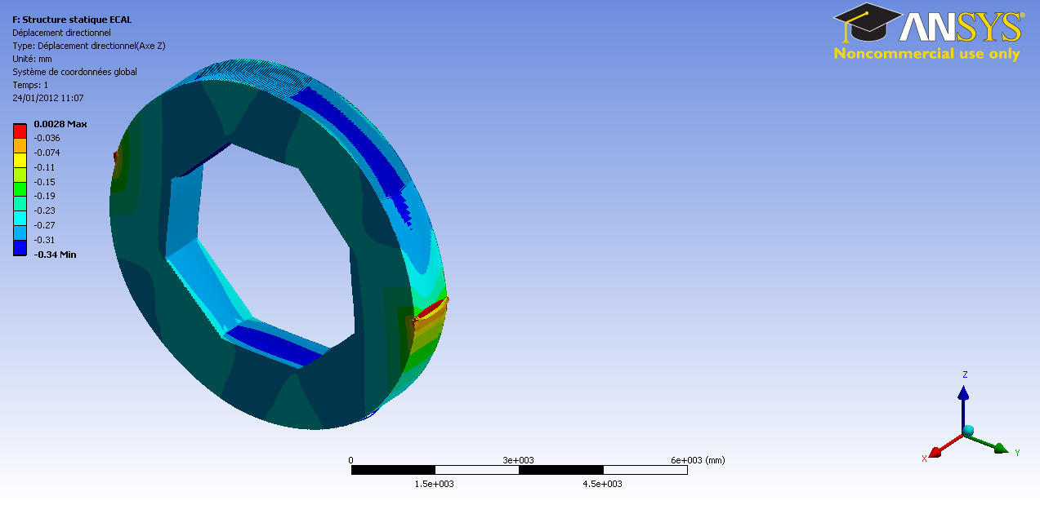
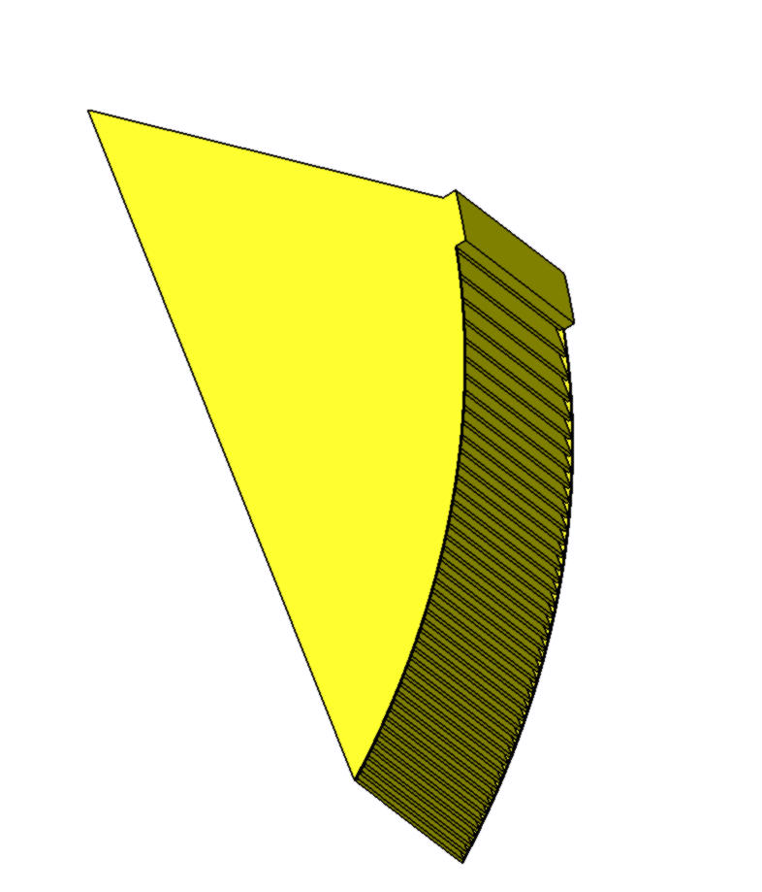
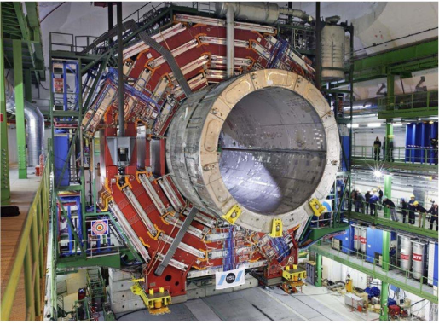
Barrel design
Barrel supports in the cryostat
Need to reduce 2 small chambers to integrate services
Modification 2 modules to support on rails

Slide 5
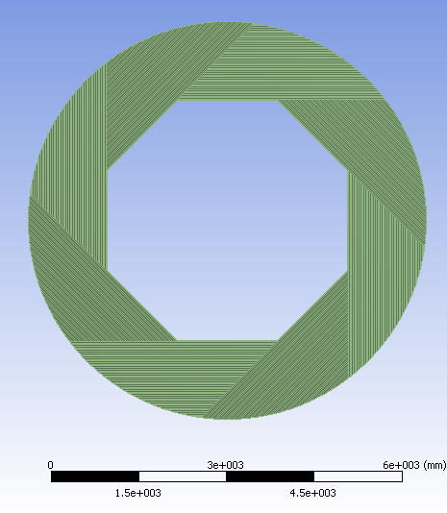
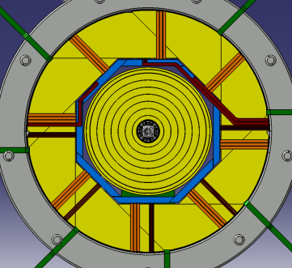
Barrel design – Support in cryostat
Gravity and Detectors mass
Directionnal deformation axis Z (// gravity) (mm)
Disymmetrical supports 9-15 H
Max deformation : 0.34 mm for position around 9-15H

Slide 6
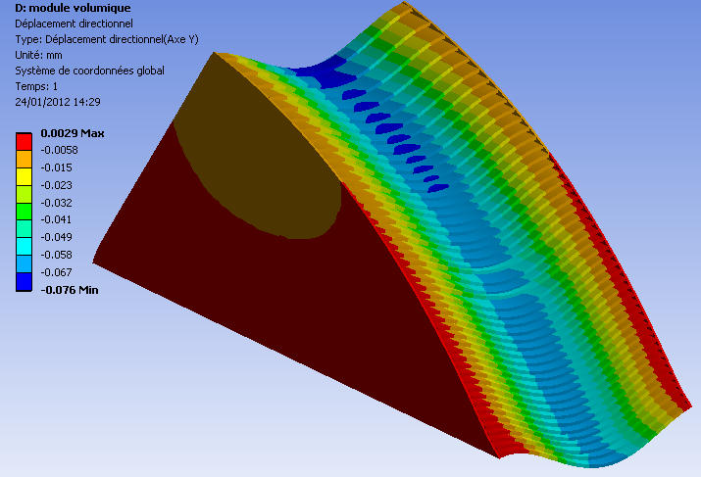
Barrel design - Support in cryostat
Gravity and Detectors mass
symmetrical supports
Directionnal deformation axis (// gravity) (mm)
Wheel Max deformation : 0.34 mm – 0.09 mm relative zone
Module Max deformation : 0.07 mm
Vision of the influence of absorbers deformation = no problem for GRPC

Slide 7
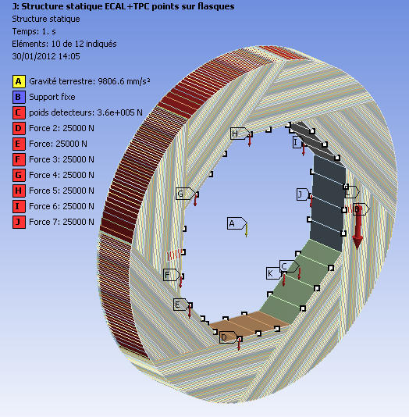
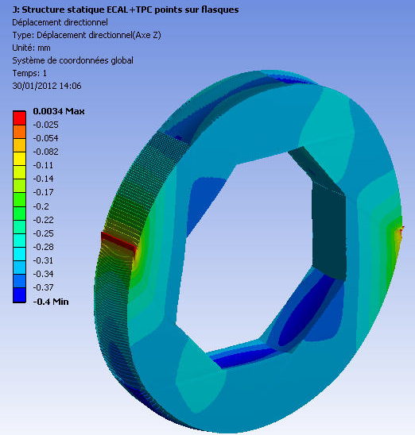

Barrel design
ECAL + TPC impact
ECAL Loads on points
9-15H supports
DHCAL with 8 x ECAL modules (8x2.5 t)
And TPC (4t)
Directionnal deformation axis (// gravity) (mm)
Deformation DHCAL + ECAL + TPC = 0.4 mm max

Slide 8
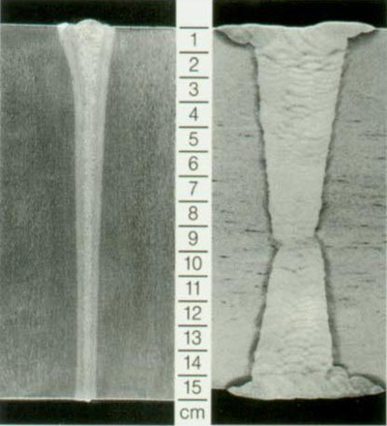
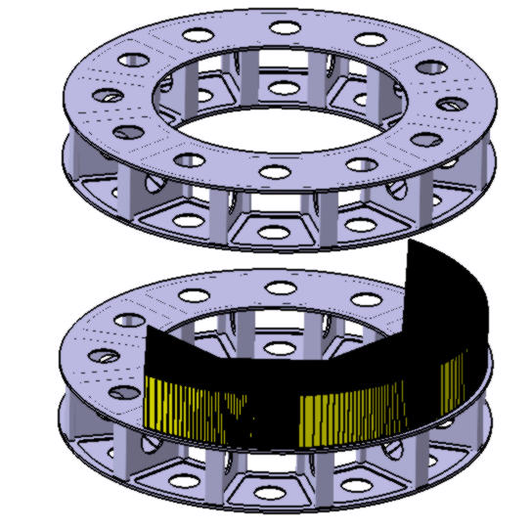
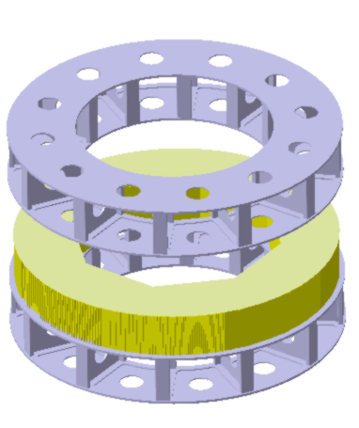
Barrel design : wheel assembly & detectors integration
Wheel Building
Welding method : EBW
Tight continuous weld
Low distortion
Narrow weld and narrow heat affected zone
Filler metal is not required
Collaboration with CIEMAT for test structure feasability
1.Module building
Building Method
Step 1 : Module building
  48 plates welded to make a module
Step 2 : Modules assembly to wheel
  8 modules in position on specific tool
  welding and rotation
Step 3 : wheel on specific tool for transport
180°
2. Module Assembly with rotation

Slide 9
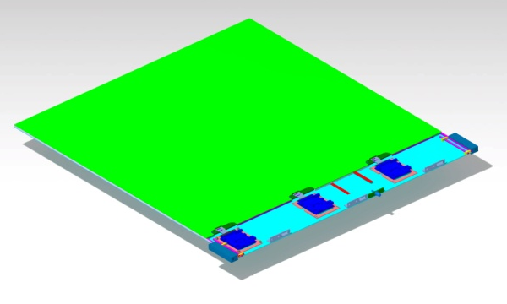
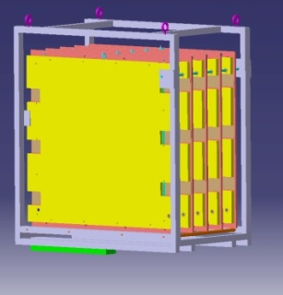
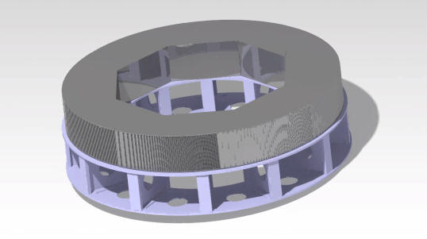

Barrel design : wheel assembly & detectors integration
Barrel Building & GRPC Detectors insertion
Transport of GRPC with specific structure to surface building point
GRPC insertion around the 5 wheels
Connection of gaz, HT, datas and cooling for each GRPC
Services installation on each 8 spaces in zone A, ready to be connected
Damper transport structure for GRPC
Zone A
GRPC insertion
with specific tool
Common services
Ready to be connected
Notes:
9

Slide 10
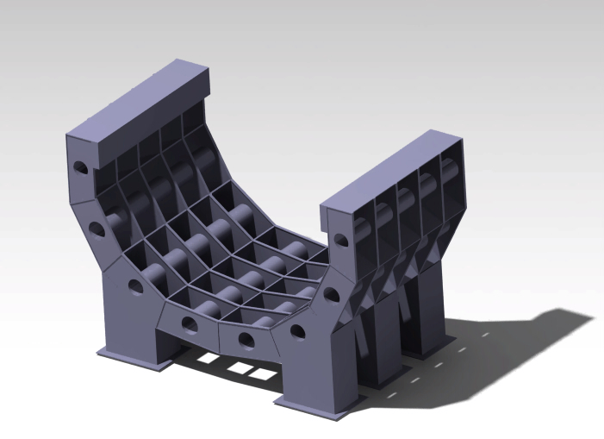
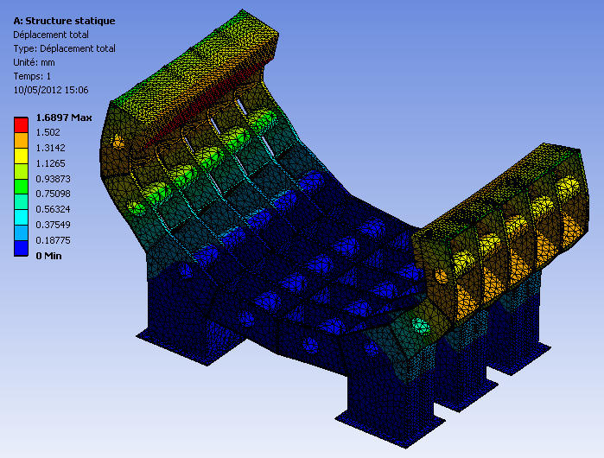
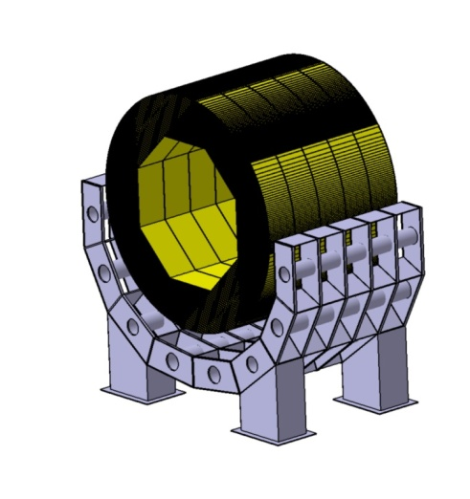
Barrel design : wheel assembly & detectors integration
Barrel Building & services connecting
Barrel insertion structure coud be divided in 5 parts screwed together
Welded barrel support structure - steel
Transport to the loading aera and area
weight = 76 t Cost : 600 K€
Barrel assembly
5 wheels going down separatly on specific structure
5 wheels linked together on the barrel insertion structure
Wheels linked and services connection in 32 zones
Notes:
10

Slide 11
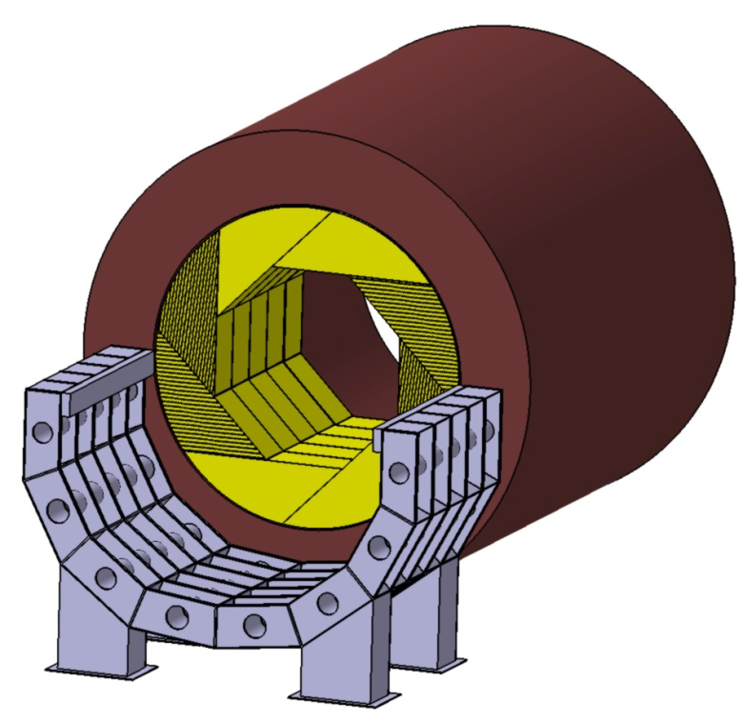
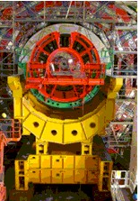
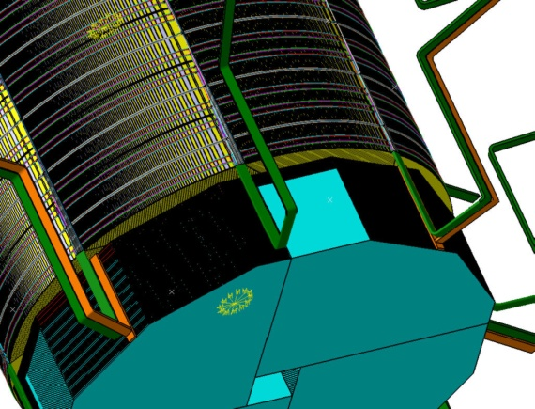
Barrel design : wheel assembly & detectors integration
Barrel Building & services connecting
Barrel insertion
Barrel with 5 linked wheels inserted
rails inside the yoke
fixation inside the yoke on both sides
services installation along the yoke to patch pannels
CMS « enfourneur »
Services issues to patch pannels
Notes:
11

Slide 12
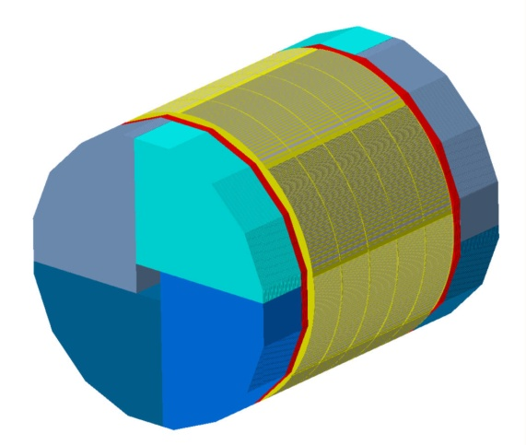
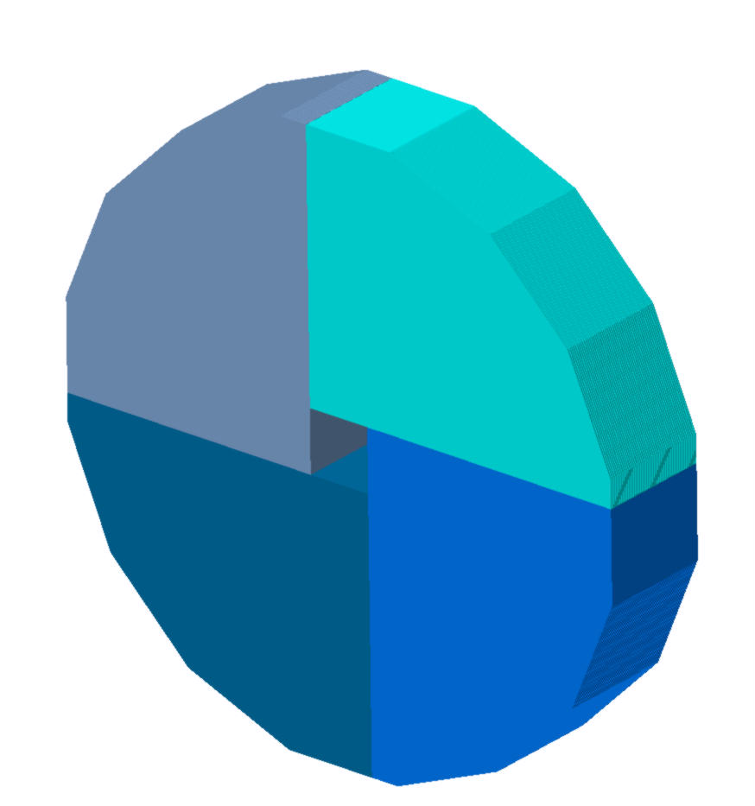
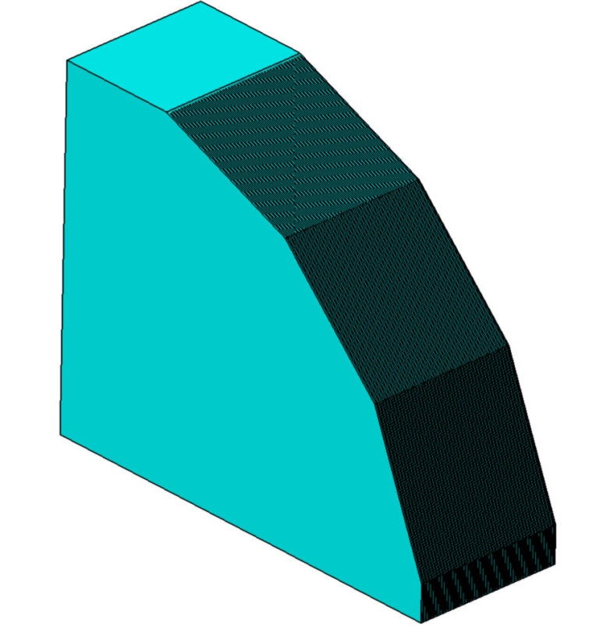
End caps design
8 sides -> 16 sides
Encap : 48 detectors
Endcap
2 endcaps
Material : stainless steel
Welded structure
Idem barrel
One module
Module Weight : 50 t
Detectors weight : 22.5 t
Total weight : 72.5 t
One endcap made of 4 modules
Endcap Weight : 200 t
Detectors weight : 90 t
Total weight : 290 t

Slide 13
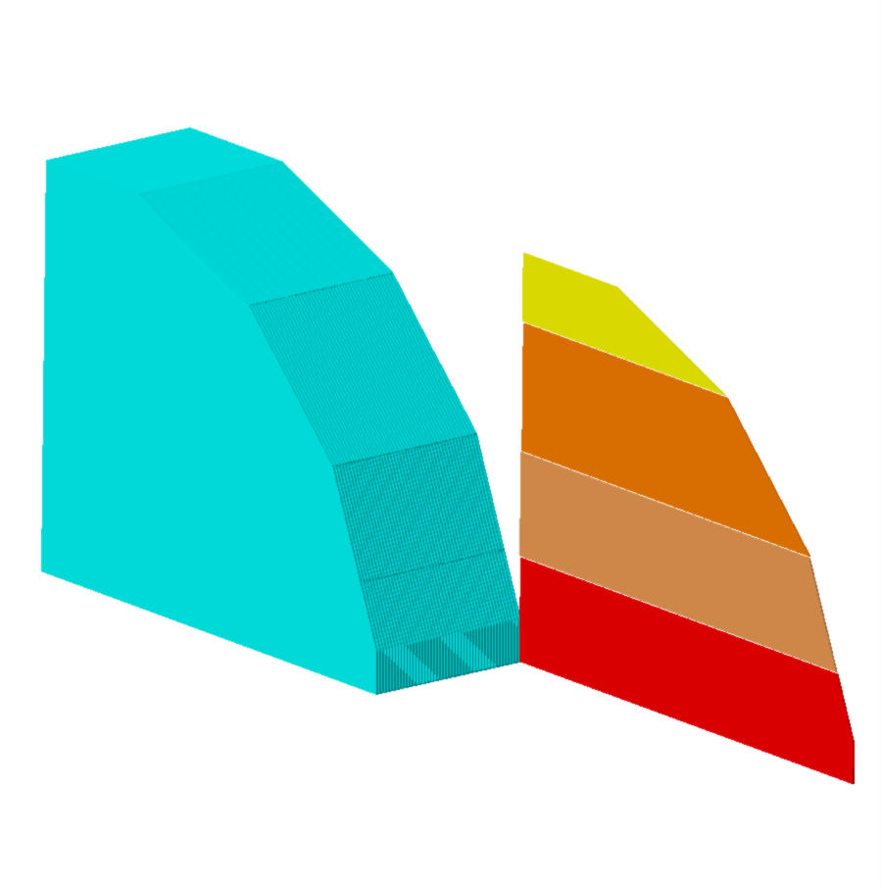
End caps design
One module composition
48 detection planes
One detection plane consisted of 4 detectors
3153
2218
493
GRPC plane : S = 8.5 m²
192 detectors
P = 467.5 Kg
P/module = 22.5 t
933
750
750
3655

Slide 14

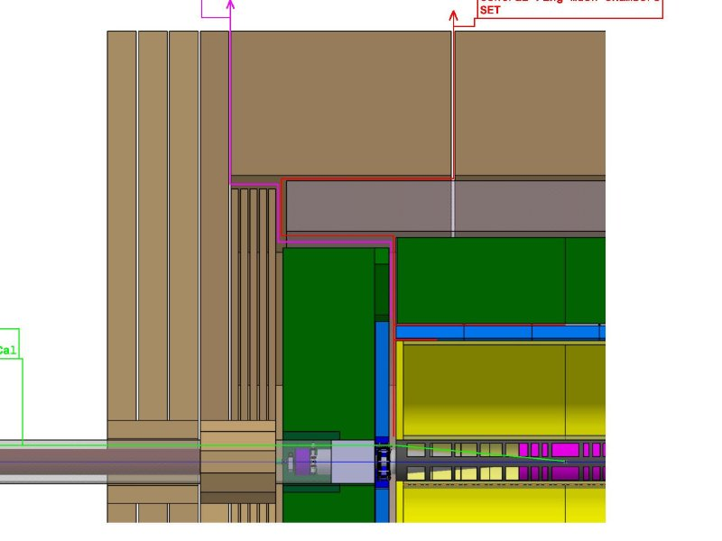
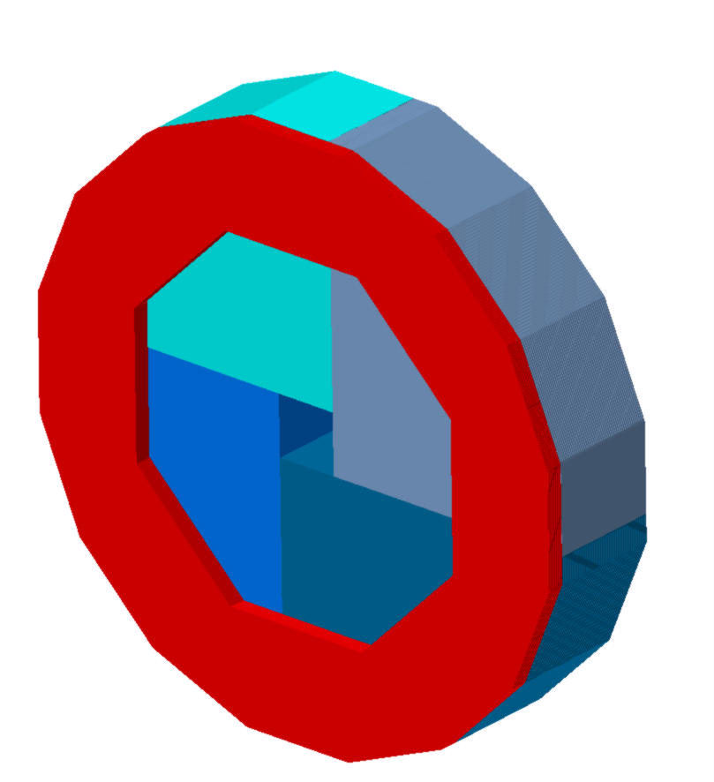
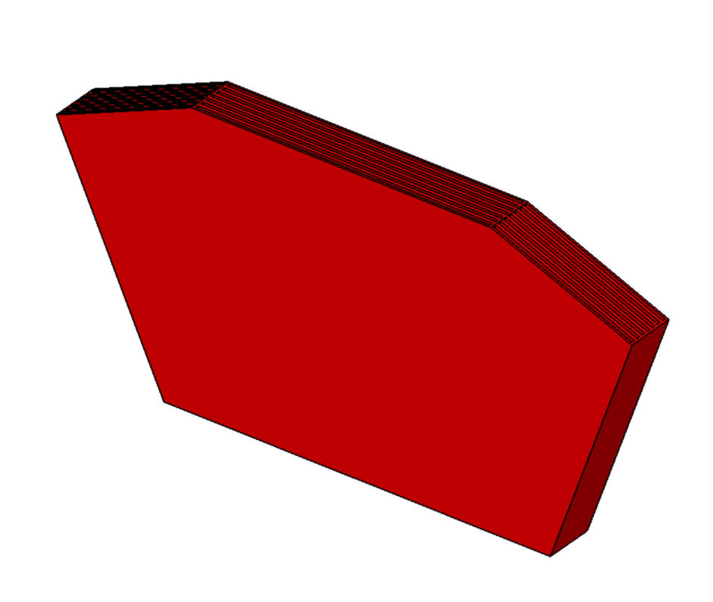
End caps design - Ring
2xrings
Ring between barrel and endcap
  Placed around the ECAL endcap
2541
8 modules
1092
Screwed on endcap
Ring weight = 18.4 t
1704
Ring ( 18.4 + 8 ) + Barrel endcap (290 ) = 316.4 t
Module weight = 2.3 t

Slide 15

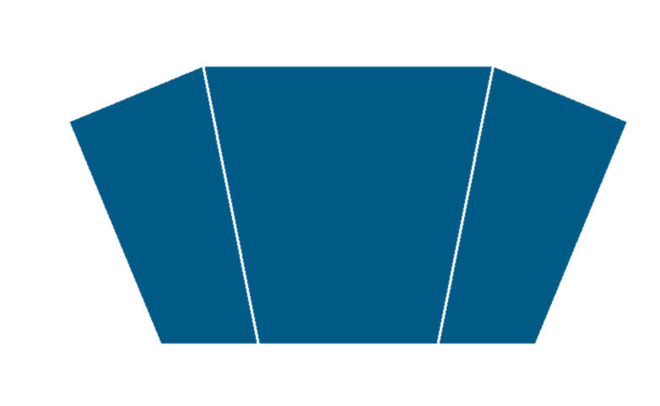
End caps design - Ring
Ring between barrel and endcap
  7 GRPC planes by modules 21/modules 168 /ring
1298
648
1086
1006
432
800
GRPC : S = 2.55 m² P = 140 Kg
P/module = 980 Kg

Slide 16
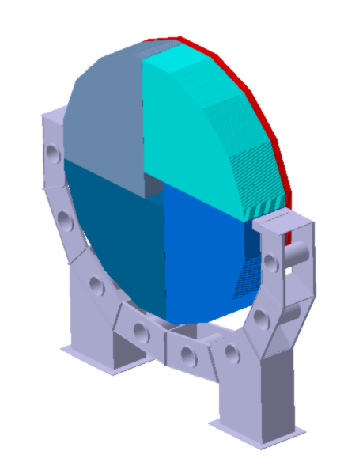
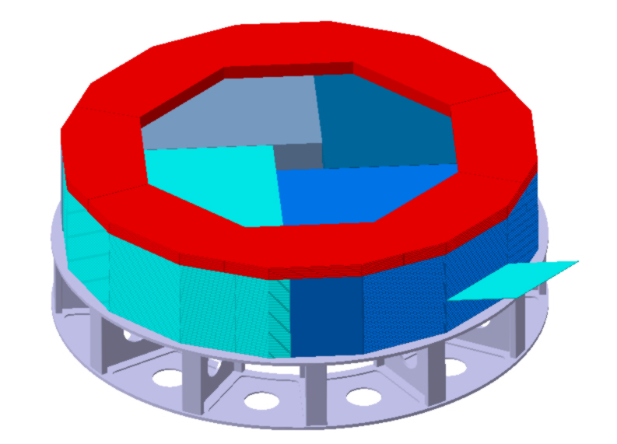
End caps design - Ring
Endcap : GRPC insertion + support tool
GRPC insertion
with specific tool
Same support for Barrel wheel
Support structure for
One endcap made of 4 modules
Total weight : 290 t

Slide 17
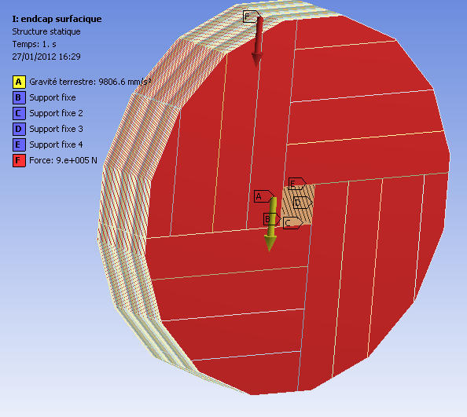
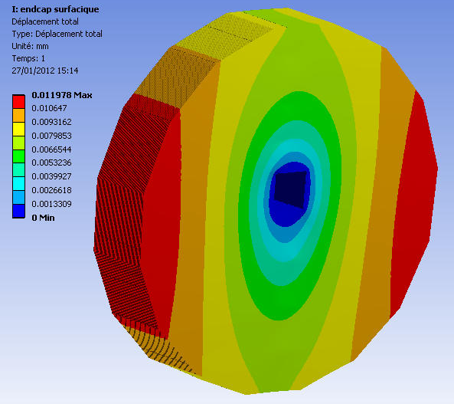
Endcaps design
Endcap deformation
  Fixed by center tube (no magnetic field)
Max deformation : 0.5 mm

Slide 18
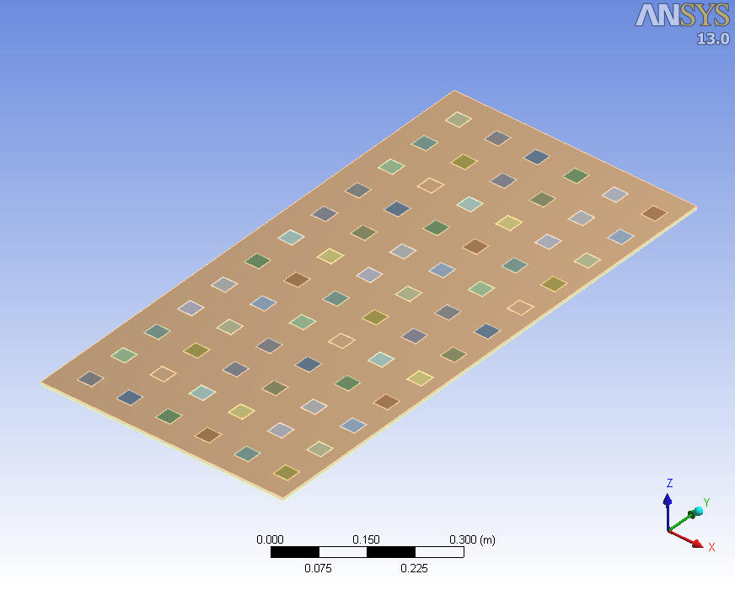
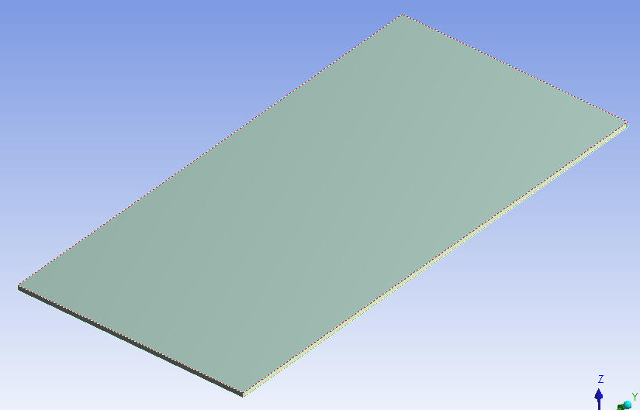
Thermal studies on GRPC
12 x 6 chipsets modelisation = 1/2 detector
2 absorbers steel stainless 2.5 mm
72 chipsets 1.4 mm
1 pcb plate 1.4 mm
1 spacer polycarbonate 1.4 mm
1 glass 0.7 mm
1 frame pcb 1.2 mm
1 glass 1.1 mm
Heat exchange with air ambient 22°C on 2 faces and 3 sides
Heat flux on chipset = 0.133 W x 72 = 9.6 W
Laminar flow in gap of 2 mm between GRPC and absorbers

Slide 19
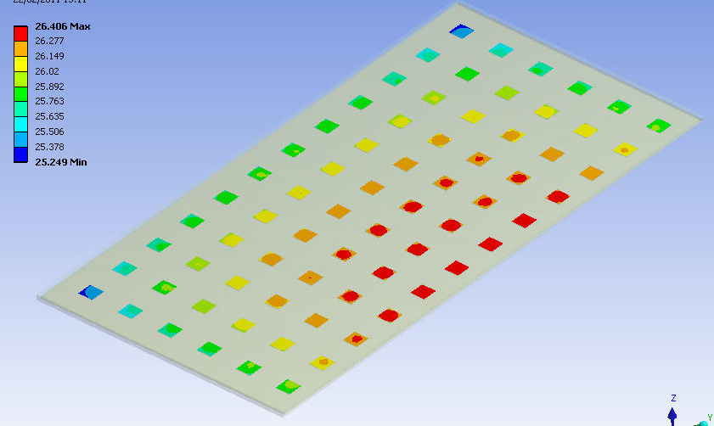
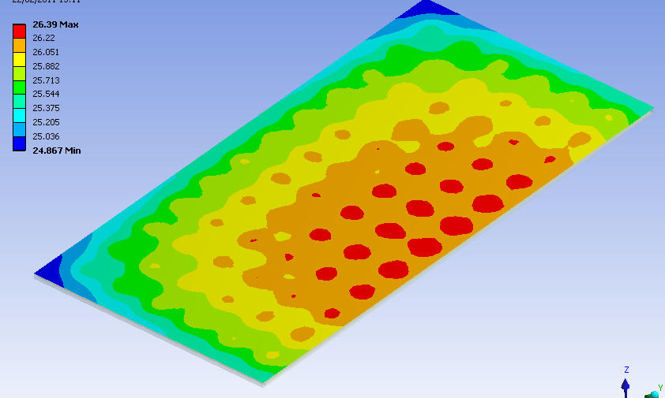
Thermal studies on GRPC
Tmax = 26.4°C
Chipset
Absorber in contact with chipset
Heat extraction on 1 side absorbers for one detector = 9.6 w (no P.P)
Air ambient is OK for a plate alone - for ILC M3 cooling placed around
Water cooling is needed for ILD Barrel – 0 W transmission to other detectors

Slide 20
Barrel Services
Cooling Options
Low heat to extract
Big exchange surface : material with acceptable conductivity
  Leak-less water cooling : no risk for electronic and other detectors, pressure between 0,8 and 1bar (cavitation), balanced network, pneumatic activators needed
  Bi-phasic gas like CO2 : High Pressure (100 bars), expensive connexions (no leak), small diameter tubes, important exchange coefficient
  Mono-phasic gas like C6F14
  Water cooling : probably the best solution with coper plate/tubes

Slide 21
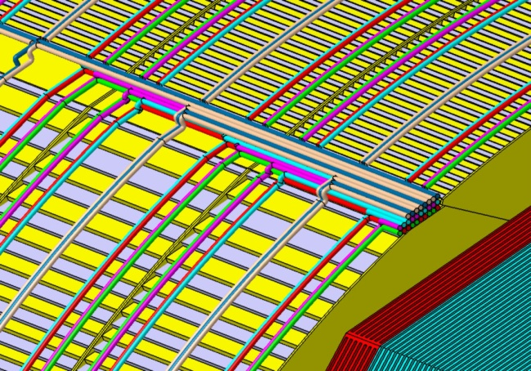
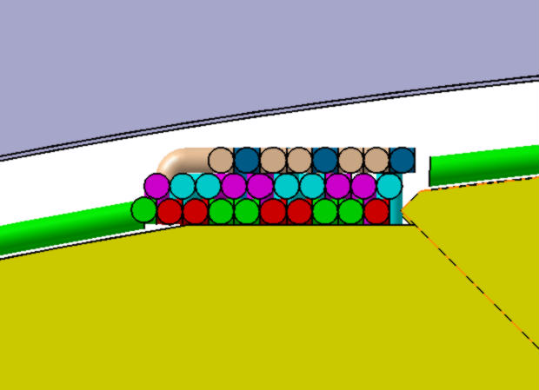
Barrel Services
Cooling for Dif : Blue / Red
  2 loops by module
  Ø14 for principal
  Ø2 for distribution alternative
Gaz For GRPC : green / pink
  2 loops by module
  Ø14 for principal
  Ø4 for distribution alternative
  High Tension : Brown
  Ø14 for supply
  Data acquisition : Beige
  Ø14 for collecting
  Issues : 8 zones 168 x 47
Services : Barrel
168
47

Slide 22
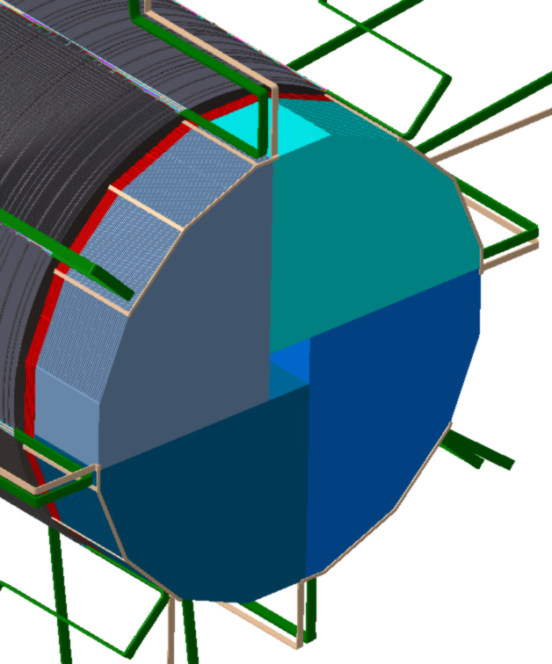
Endcaps Services
Cooling for Dif : Blue / Red
  2 loops by GRPC
  14 for principal
  Ø2 for distribution alternative
Gaz For GRPC : green / pink
  2 loops by GRPC
High Tension : Brown
  Ø14 for supply
Data acquisition : Beige
  Ø14 for collecting
Services : Endcap+ring
  Issues : 8 tubes outing 98 x 47

Slide 23
ILD mechanical structure. Perspectives
Simulations have to be done in this configuration
  Endcaps deformation with magnetic field
  Yoke deformation with endcap weight
  Flow studies
Design evolution
  Interfaces optimization
  Services optimization

