Slide 1


Si/W ECAL
Endcap structures and cooling
Design of the EM end-caps
2. Cooling system (end-caps + barrel)
3. Fastening on HCAL (ends-caps + barrel)
High Granularity Calorimeters workshop @ LLR – Feb 2-3
Denis Grondin, Julien Giraud

Slide 2
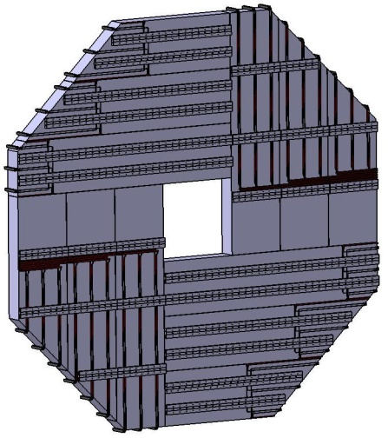
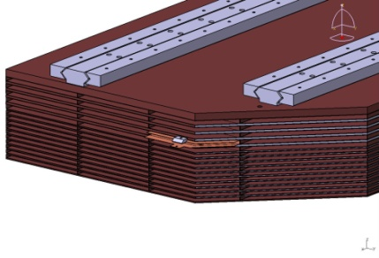
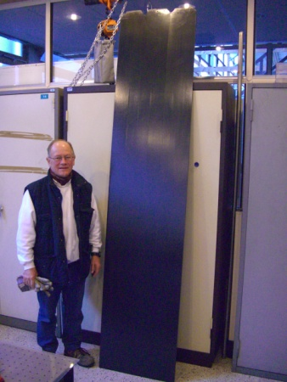
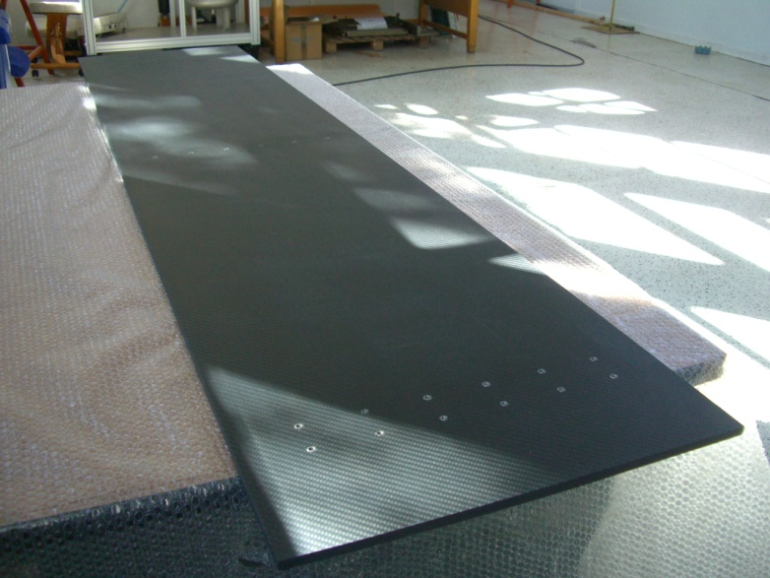
I - Towards full detector – End Caps
End-Caps: modular alveolar structure - composite W / Carbone HR - 25,5 t
2 x 12 independent modules - 2 x 540 alveoli
Ongoing developments 2015
Up to 2014…
- Moulding of 3 layers of 3 alveoli - 2,5m End-Cap
- Design of specific tools / long wrapping
- Optimization of deflection values / skin thickness
- Design of an assembly mould for End-cap demonstrator
Fastening system on HCAL: thick.3cm
185 mm
R~2050
Detector slab (Si)
End-Cap thick composite plate 13mm+ inserts for double row rails
Moulding of one layer / 3 alveoli
L = 2.490 m wall thick. = 0.5mm

Slide 3
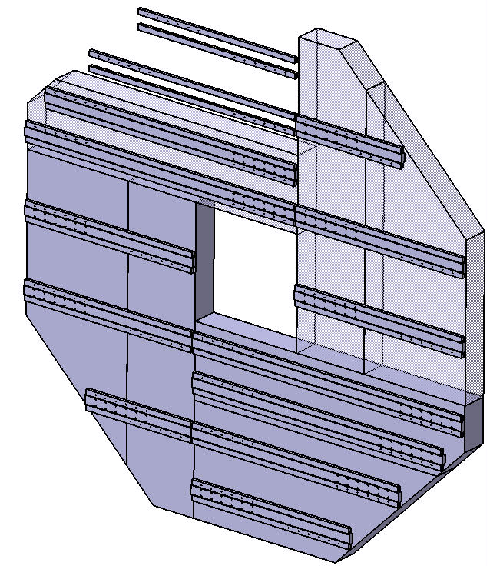
I.2- ECAL Geometry: Optimization impact
Possible new geometry (H.Videau): Barrel: 5 modules of 3 alveoli
– LBarrel = 3829mm (Z endcap = 3929mm).
Endcaps: Quadrants of 2 modules of 2 and 3 alveoli
– with R(ECAL Ring) = 40cm + Integer number of Wafers
⇒ R_{Endcap} ≈ 1726mm
Impact / Evolution of diameter
Infrastructure
Module‘s weight / deformation
Module‘s length / composite fab.
Cooling
Electronics in development
=> uncertainty on final power
(4.5 KW to 30 KW)
We must move forward with updated models and tests / re-adaptation of the full leak less loop
800
D=3424 or 3453 (~ 17 t)
ECAL End-cap D=4188 | Weight(kg)
 | 25208
Module 1 | 1585
Module 2 | 2164
Module 3 | 2553
General distribution for now:
Water circulation @ sub atmospheric pressure
Water temperature input: 18°c
- Water temperature output: 23°c
Maximal power per column: 150 W
Pipes diameter : 13 mm

Slide 4
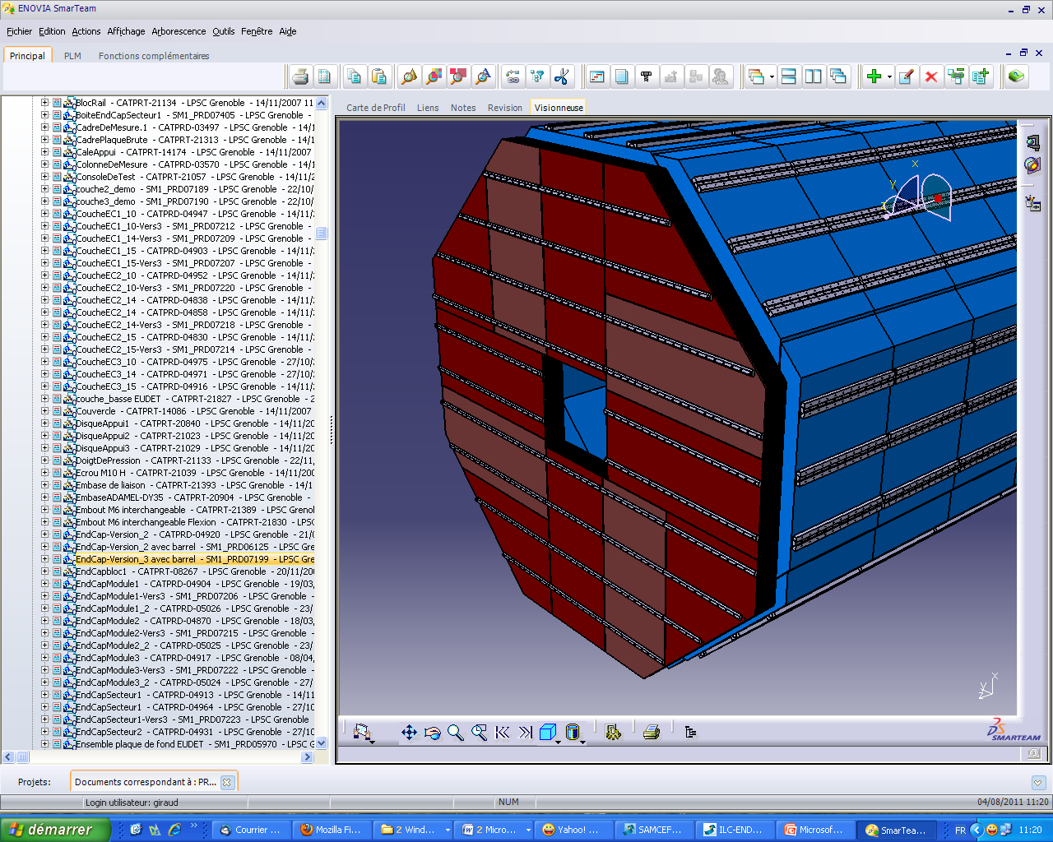
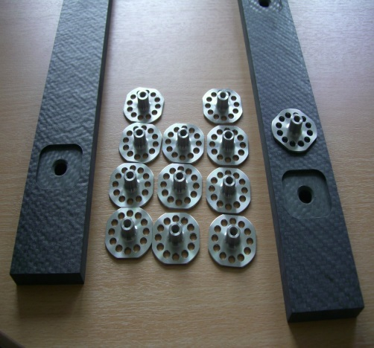
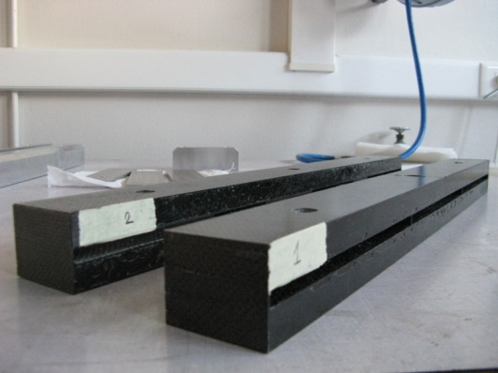
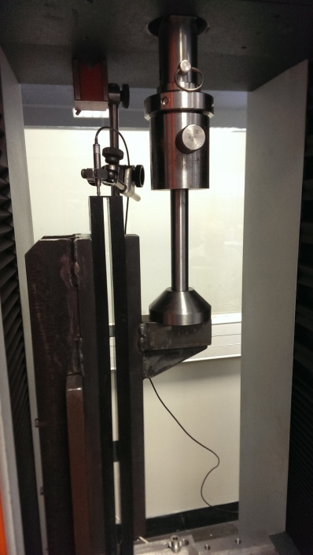
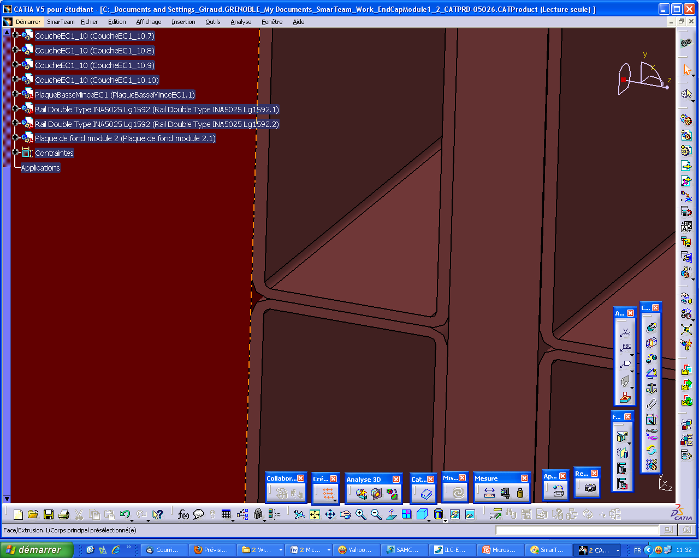
I.3- Composite structure: shearing tests
Problem of bending stress of alveoli skins: influence / evolution of thickness of outer plies
Impact on ECAL dead zone
w
Carbone
g
Dummy composite structures for plies’ thickness validation
Shearing tests
stress in the structure
Sample E4, decrease of effort at constant displacement
CC202-ET445
sample n°4 (after CRP cycles)
Progressive load
Charge & discharge cycles: hysteresis in specimens’ behaviour which evolves towards a progressive decrease in the force / displacement with the gradual breakdown of the resin before destruction of the composite

Slide 5
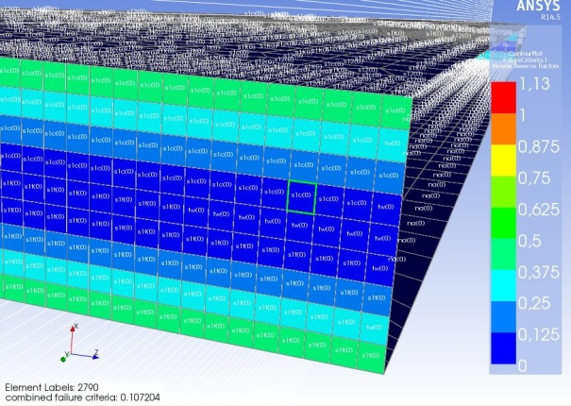

I.4- Composite structure: shearing tests
Safety coefficient
Static: Sufficient / to the stress induced by weight of modules
not sufficient / seism (s =3.2 for Japan?)
/ risks during integration and transport
-> increase nb of ext. plies... Impact on ECAL dead zone
Ongoing developments 2015
-Correlation of tests with FEA simulations
● Optimization of composite wrapping / long structure
● Shearing tests on demonstrator
-Ensure repeatability of process & characteristics
Tsaï wu criteria
MODULE
s = Cc / Cs = 2,8
Adapt FEA parameters to simulate the whole structure
S = 2,2
S = 1,5
Coming next: Reduction of diameter -> modification of all modules...
M2
M1
Progressive loss of stiffness for the dummy structure after each cracking level – Comparison @ constant displacement

Slide 6
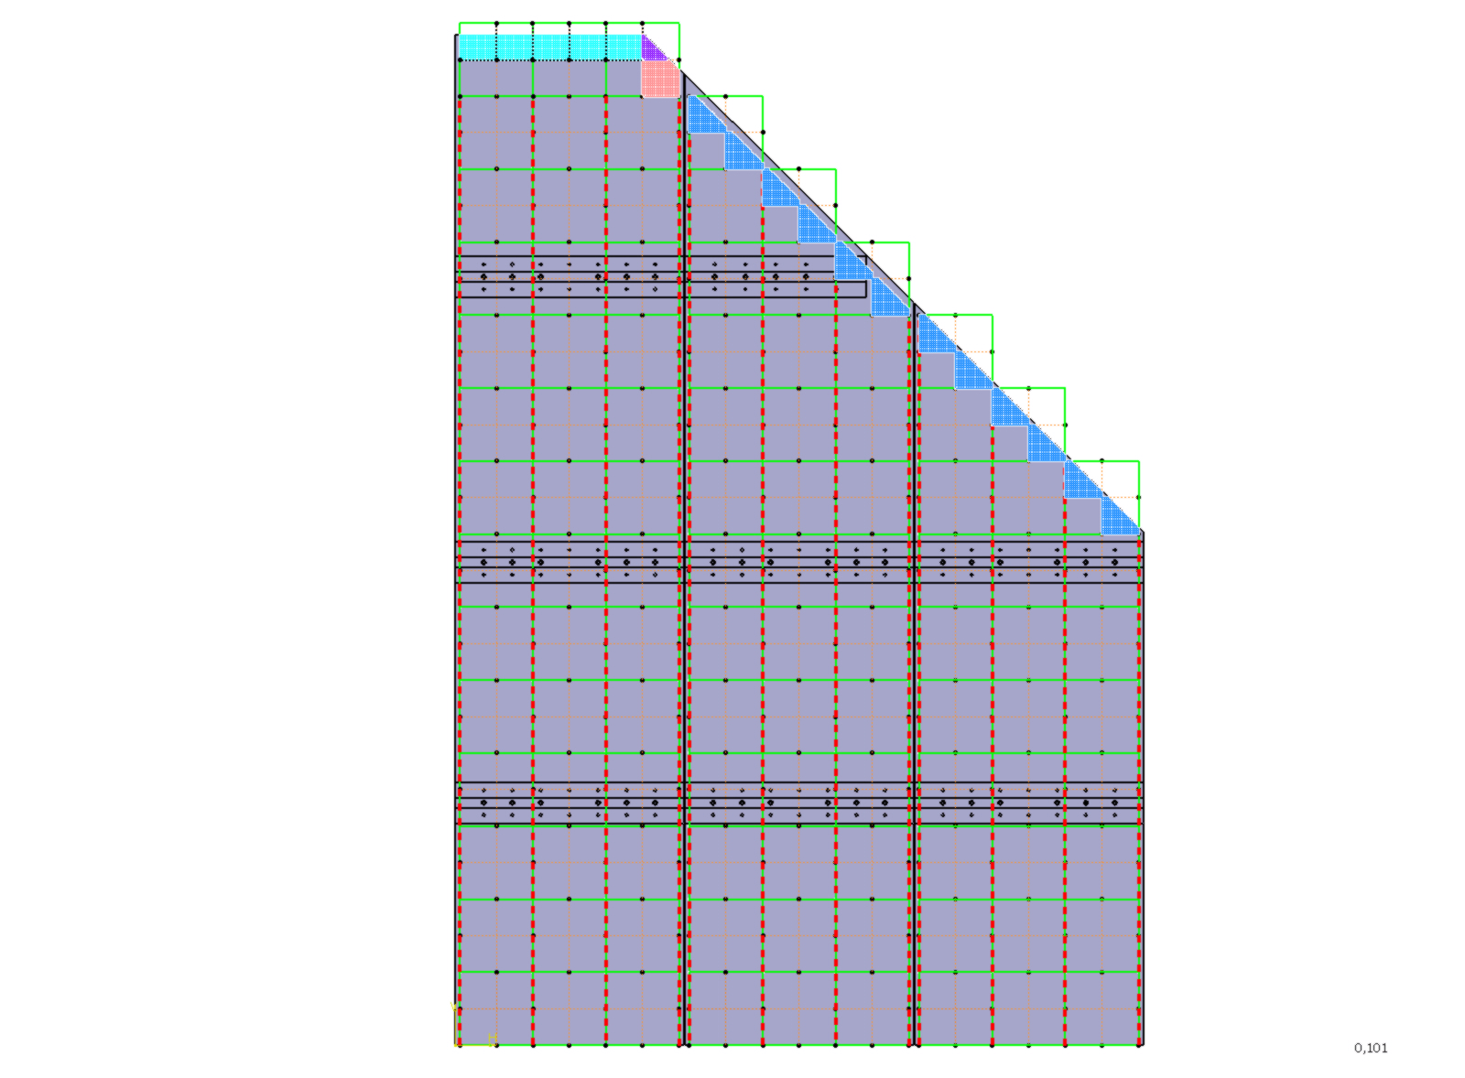
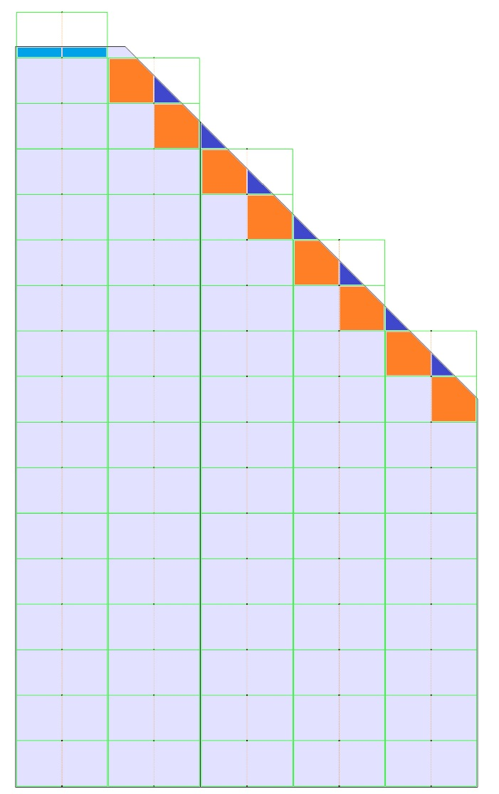
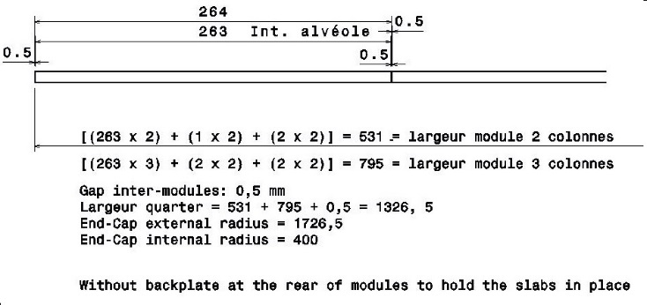
I.5- Geometry: electronic interactions
Model with Rext ≈ 2050
Wafer: 90 x 90 mm with gap of 0,1
2015
Model with Rext ≈ 2126
Wafer: 130,6 x 130,6 mm with gap of 0,1
5x Type 1
1x Type 2
3 types de wafers différents
Pour ¼ End Cap:
5x30 types 1
1x30 types 2
1x30 types 3
12x30 types 4
Size of End-Cap Slab’s front End ?
1x Type 3
18 x wafers partiels ?
12x Type 4
0,1 mm ?
124 wafers entiers
96x4 wafers entiers
+ 11
-> 1712
With central hole =770,8²
Wafers = 180 (90 + 90)
-> 385,4

Slide 7
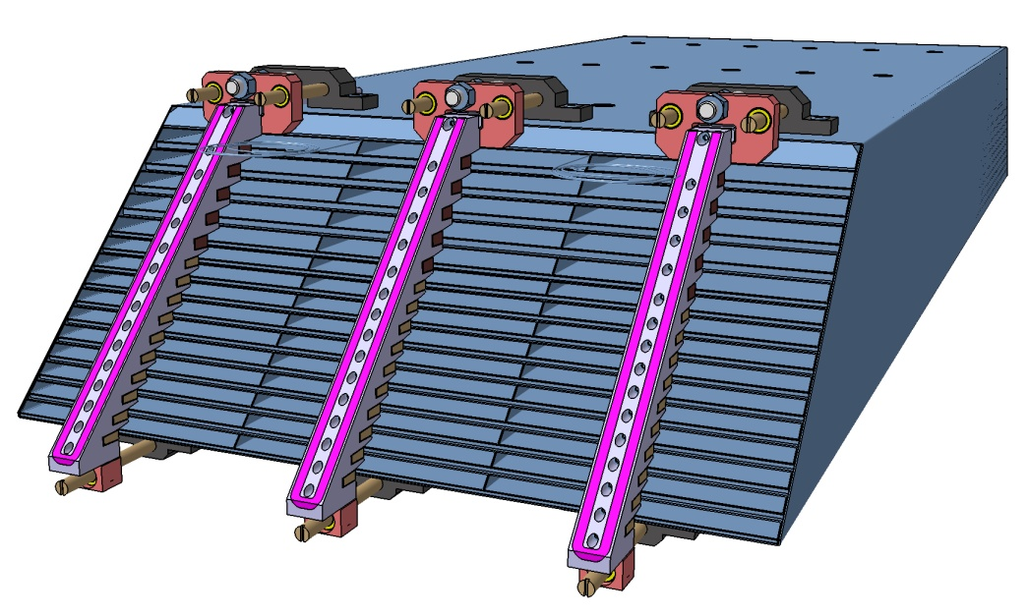
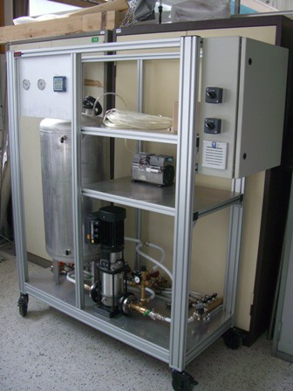
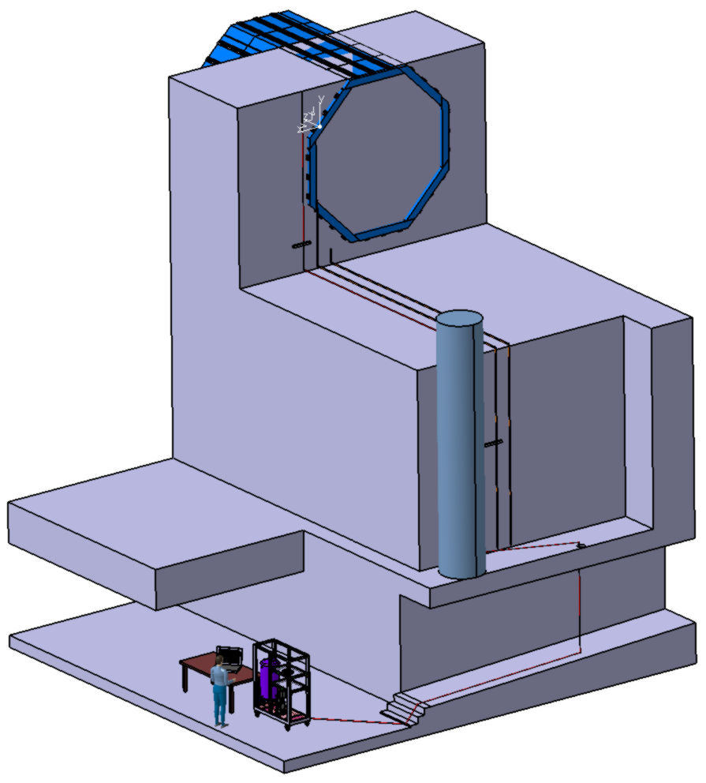
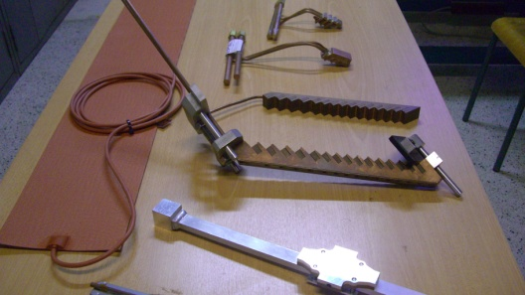
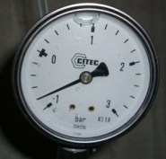
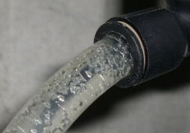
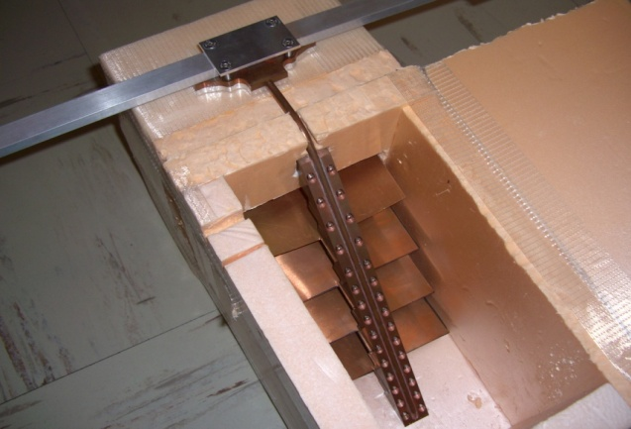
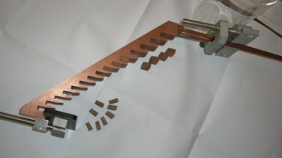
II – Cooling: leakless water system
Study from the power source to the global cooling
II.2-1Thermal tests of the heat exchanger
II.2-2 Full scale leakless loops
13m
High Line
10 m
Medium Line
4,5 m
9 m
Low Line
5,1 m
cooling station
2,5 m
Cooling station
Cooling Station
EUDET adaptation of Water heat exchanger
LPSC cooling test area with a drop of 13 m
Caloduc Prototype
Validation of leakless system (<1atm)
Ongoing developments 2015
-Full scale leakless loop Integration
-Cooling station integration+ network
Update of water heat exchanger / BGA
Thermal tests & simulations / power variations (limit of pulsing)
Water Heat Exchanger / EUDET
Thermal simulations / power variations (limit of pulsing)
Water heat exchanger design near detector

Slide 8
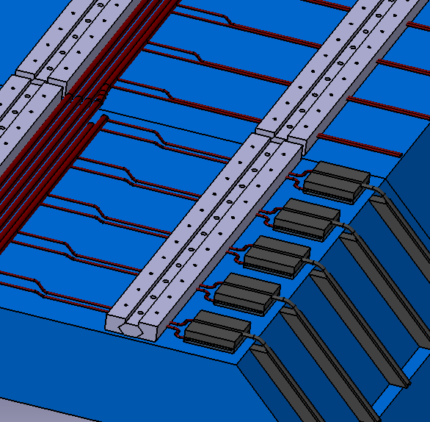
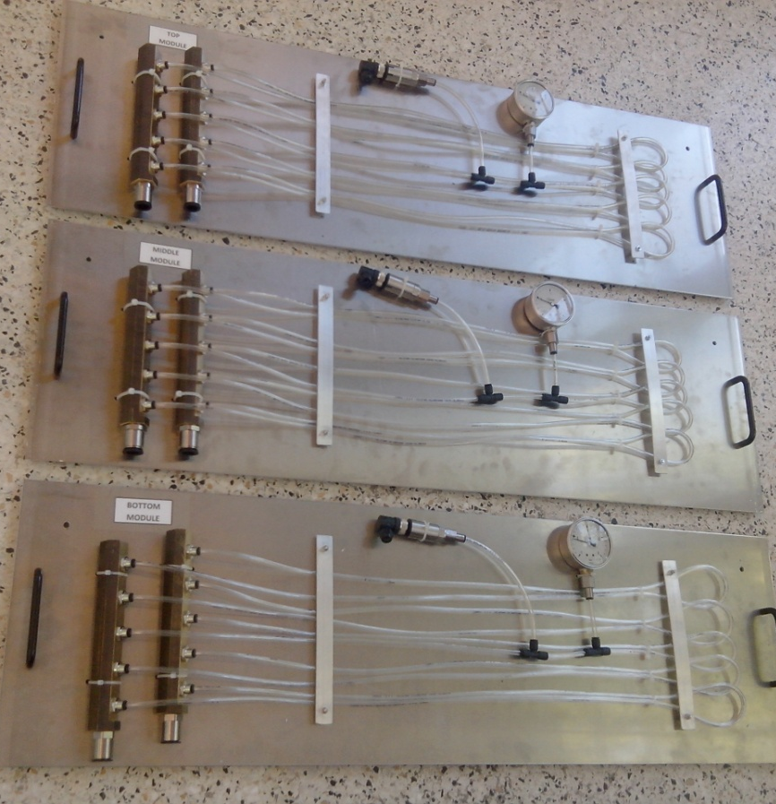
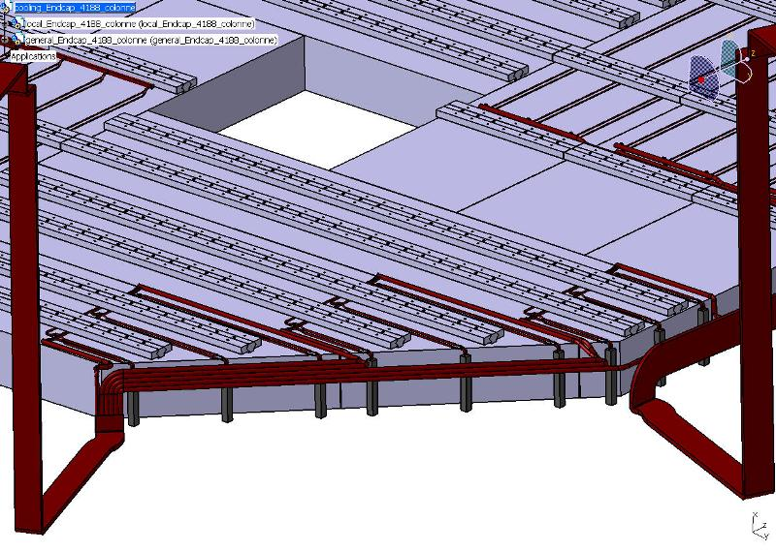
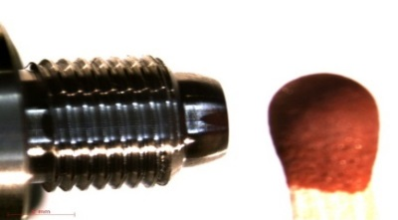
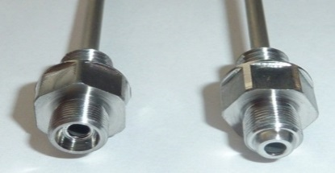
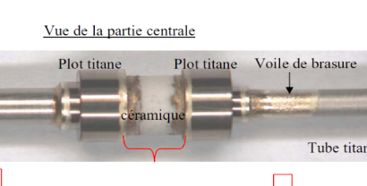
II.1 - Cooling: Full scale leakless loops
Leak less loops construction : Distribution test plate
3D Barrel distribution
ECAL End-Cap Intrados:
integration with cooling leak less lines
13m
High Line
Titanium Fitting LAPP / ATLAS IBL
10 m
Medium Line
4,5 m
9 m
Low Line
Link Tube Ti /fitting
electron beam welding Ti
5,1 m
Distribution test plate
cooling station
2,5 m
Insulator: Transition Ceramic/Titanium
Cooling Station
Goal : Pressure measurement / residual bubble…….
Connection integration

Slide 9
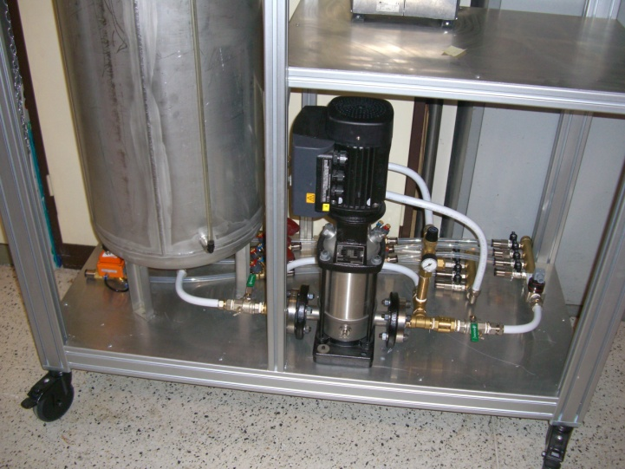
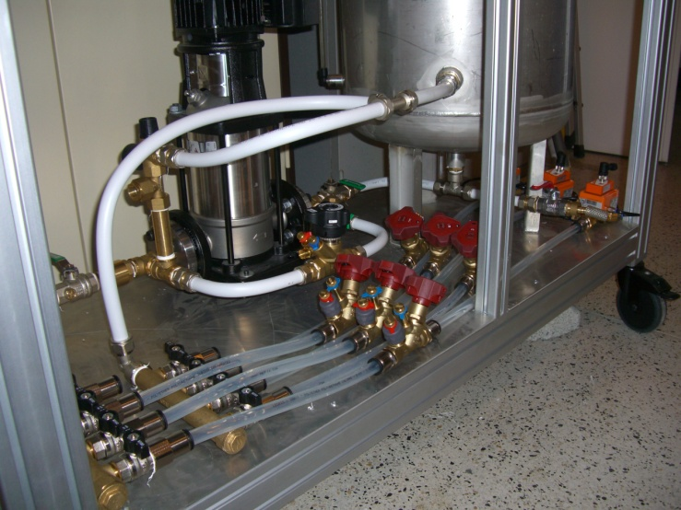
II.2 - Cooling: on going work
Full scale leak less loops :
13m
High Line
10 m
Medium Line
4,5 m
Cooling station assembling
9 m
Low Line
5,1 m
cooling station
2,5 m
Cooling Station
Cooling station assembling :
Pipe wiring => ok
Electrical wiring => to be done
Pipe /valve / flowmeter

Slide 10
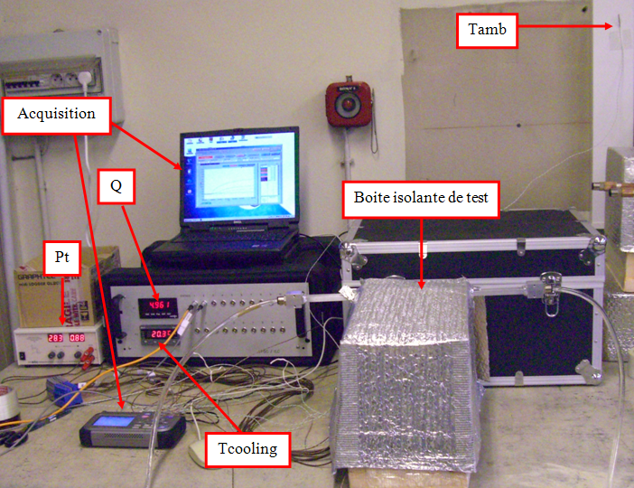
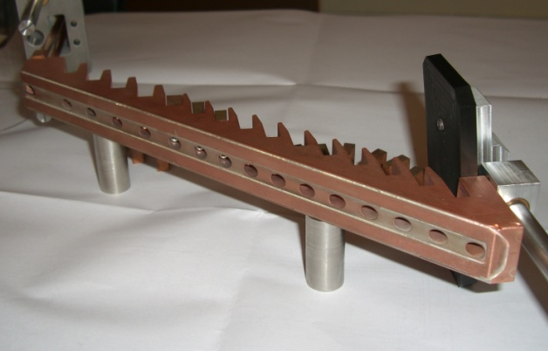
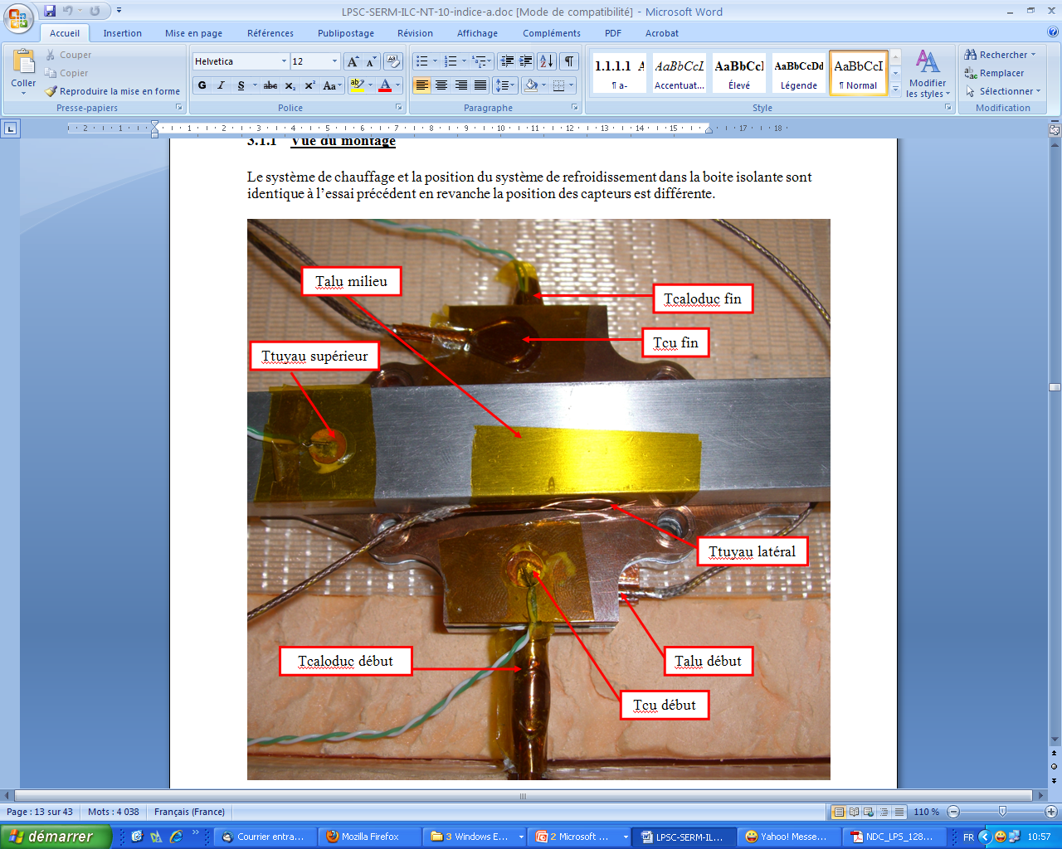
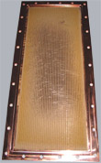
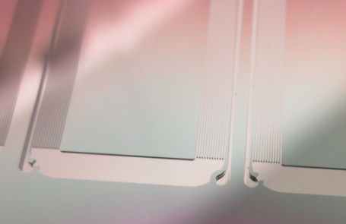
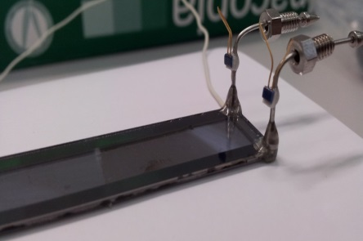
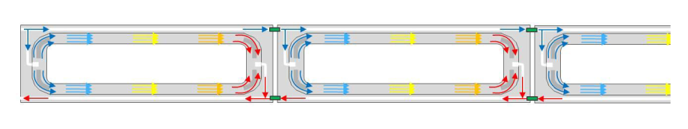
II.3 - Cooling: Thermal tests
Water Heat exchanger preferred
Test bench
EUDET adaptation of Water heat exchanger to BGA geometry - 2015
X
X
ALICE ITS IB stave Microchannels & ATLAS ITK R&D
?
Study & prototype of a flat two-phase thermal diffuser (spreader)
Test of a two-phase HEATPIPE

Slide 11
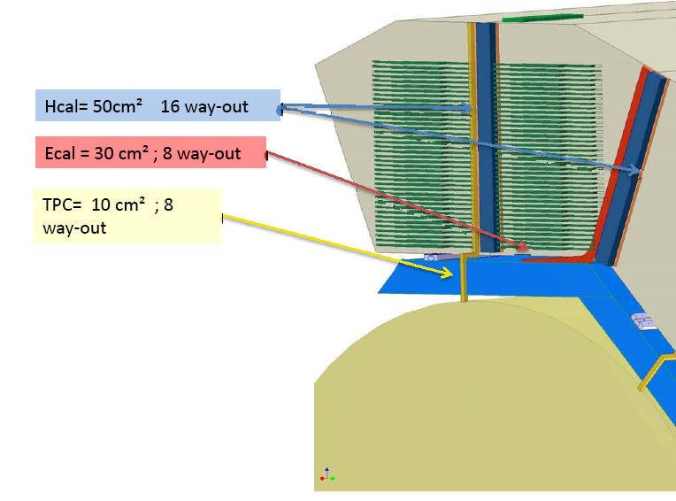
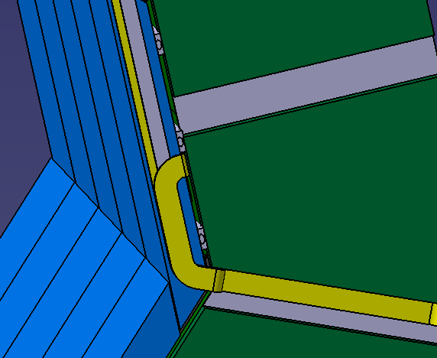
II.4 – ECAL Cooling Integration – Impact / HCAL
Thermal flux inside a column of 1 module
Results
Barrel : (1.5m)
Max T < 25,5 °C
ΔT = 2,2°C
End Cap : (2.5m) 2,1m if R_{Endcap} ≈1726mm
Max T = 29 °C
ΔT = 6°C
Power on PCB = 0,205 W (barrel) / 0,356 W (End-cap)
Boundary condition T = 23 °C
Leakless system :
- Low water speed
- Risk of spray limited
- Temperature and power range adapted
Power : 30*0,356 = 10,68 W
Space for pipes outwardly of the detector is limited but must be consolidated / other detectors
Reality => low power (3Kw) spread over large surfaces associated with a small
space between the detectors (3 cm) => influence of air via
important conduction => flux between detectors
=> Real T° of detector needs global modelling;
Conclusion: recalculation T.B.D. in 2015 if R_{Endcap}≈1726 confirmed
Cooling front –end to remove the power of ECAL
Low temperature gradient -> cooling system suitable for HCAL
→ Even with lower radius, volume of cooling pipes will stay equal

Slide 12
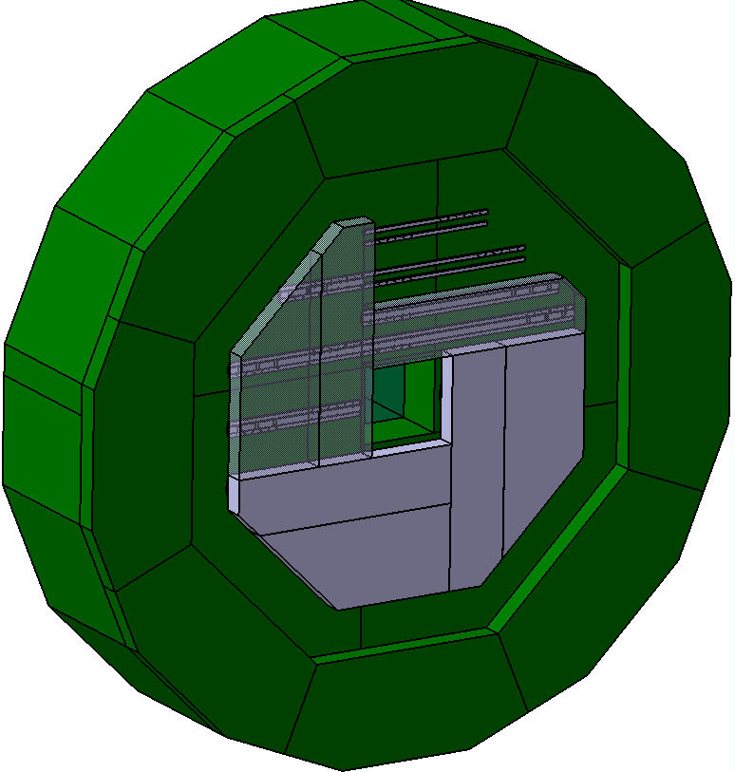
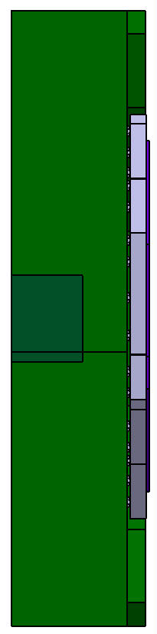
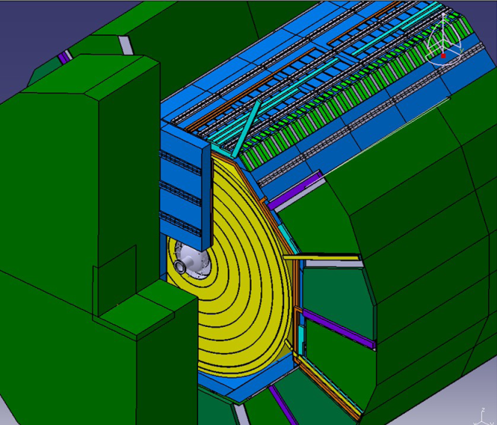
III - Fastening on HCAL Preliminary reminders
HCAL Ring
ECAL End-Cap
4188 mm -> 3453 mm
HCAL End-Cap
Alveolar W-Carbon HR modules with
Rails for Fastening system on HCAL
ECAL End-Cap fastened on HCAL End-Cap inner face with rails
ECAL Fully equipped End-cap weight : ~ 25.5 t -> ~17 t

Slide 13
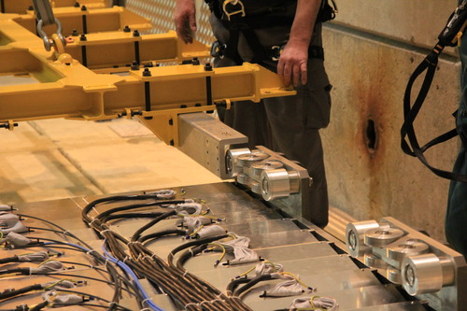
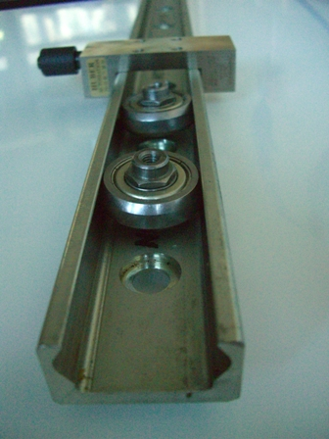
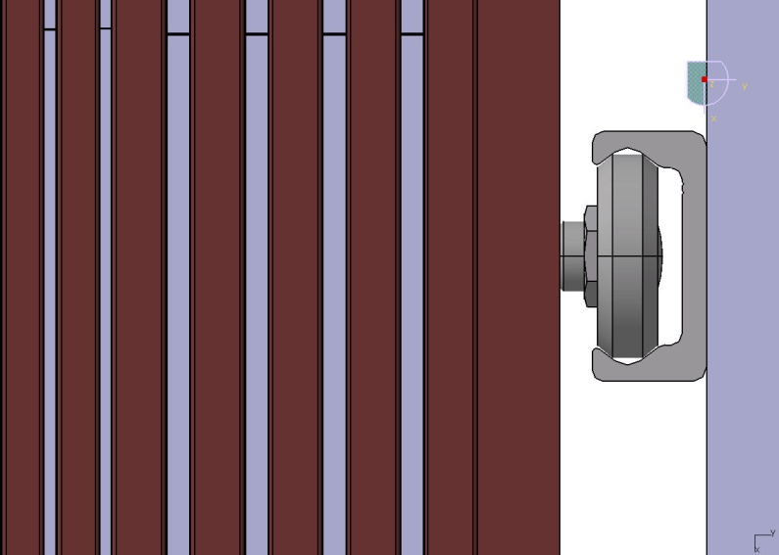
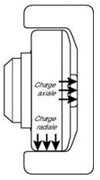
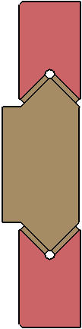
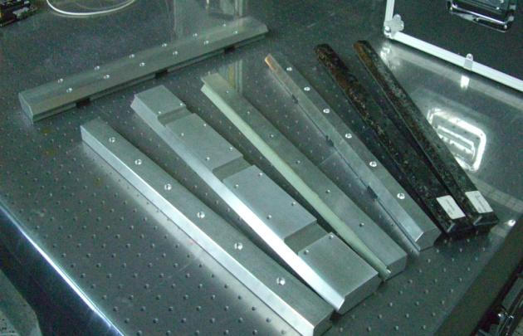
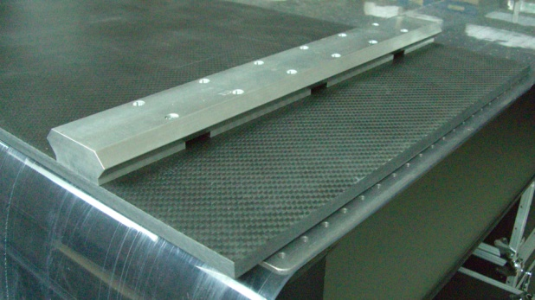
III.2 - Fastening system on HCAL
Guiding and fastening system of modules (ends-caps + barrel)
< 3 cm
7 mm
ECAL END-CAP
HCAL END-CAP
Example of ALICE integration tooling
Too large / 3 cm for CALICE
2 / Self-aligning rollers
1 / Specific shaped rails
87 mm
Double row sized rail on End cap thick plate

Slide 14
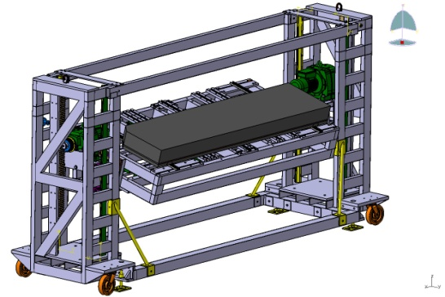


III.3 - Fastening system on HCAL
Guiding and fastening system of modules (ends-caps + barrel)
Ongoing developments 2015
Validation of technological solutions (bending of modules)
  Optimization / simulation of best localisation on modules
  Integration of heavy handling tool for modules’ tests / rails
HCAL END-CAP
Double row sized rail on End cap thick plate
specific handling and positioning tool for integration
Construction on going

Slide 15

ECAL End-Caps: weight and volume
Total Weight 1 EC
25426 kg
Fully equipped with slabs
ECAL End-cap |  | Dimensions |  |  |  |  |  |  |  |  | Rails | Services
 |  | Nb of modules | Volume / quarter |  |  | Volume / modules |  |  | Weight | Orientation | Weight | Weight
 |  |  | L (mm) _{/ Y} | l (mm) _{/ X} | H (mm)_{/ Z} | L (mm) _{/ Y} | l (mm) _{/ X} | H (mm)_{/ Z} | (kg) |  | (kg) | (kg)
D=4188 (1) |  | 12 | 4188 | 4188 | 185 |  |  |  | 25208 |  | 162 | 56
1.1 | Quarter 1 | 3 | 2492 | 1695 | 185 |  |  |  | 6302 | Horizontal / left | 57 | 13
 | Module 1.1 |  |  |  |  | 1828.85 (-563.4) | 563.4 | 185 | 1585 | Horizontal / left | 8 | 4.5
 | Module 1.2 |  |  |  |  | 2394.25 (-563.4) | 563.4 | 185 | 2164 | Horizontal / left | 22 | 4.5
 | Module 1.3 |  |  |  |  | 2492.2 | 563.4 | 185 | 2553 | Horizontal / left | 27 | 4
D=3453 (2) |  | 8 |  |  |  |  |  |  | ~ 17 t | Horizontal / left
1.2 | Quarter 1 | 2 | 2126 | 1326 | 185 |  |  |  | 3513 | Horizontal / left | 38 | /
 | Module 1.1 |  |  |  |  | 1910.14 (-795) | 531 | 185 | 1460 | Horizontal / left | 16 | /
 | Module 1.2 |  |  |  |  | 2126.5 (-216.3) | 531 | 185 | 2053 | Horizontal / left | 22 | /
T.b.c.
D=4188
12 modules
~ 25,2 t
D=3424 or 3453
8 modules
~ 17 t
M_{module} = L (mm) x l_{ext} _{alveolus} (mm) x Nb colonne x 1.8184x10^{e-3} + M_{rails} + M _{services}
M_{rails} ~ 0.005 kg/mm
M_{services} = cooling exchanger CU + piping Stainless Steel
without cabling !
M_{external services} = 160 kg around EC / trough detectors (Stainless Steel)

