Slide 1
SDHCAL STATUS
I.Laktineh
IPNL

Slide 2
Outline
Technological Prototype
Present activities
To-do List
Complementary R&D
SDHCAL for ILD
Simulation
Optimization study
Integration study
Conclusion

Slide 3
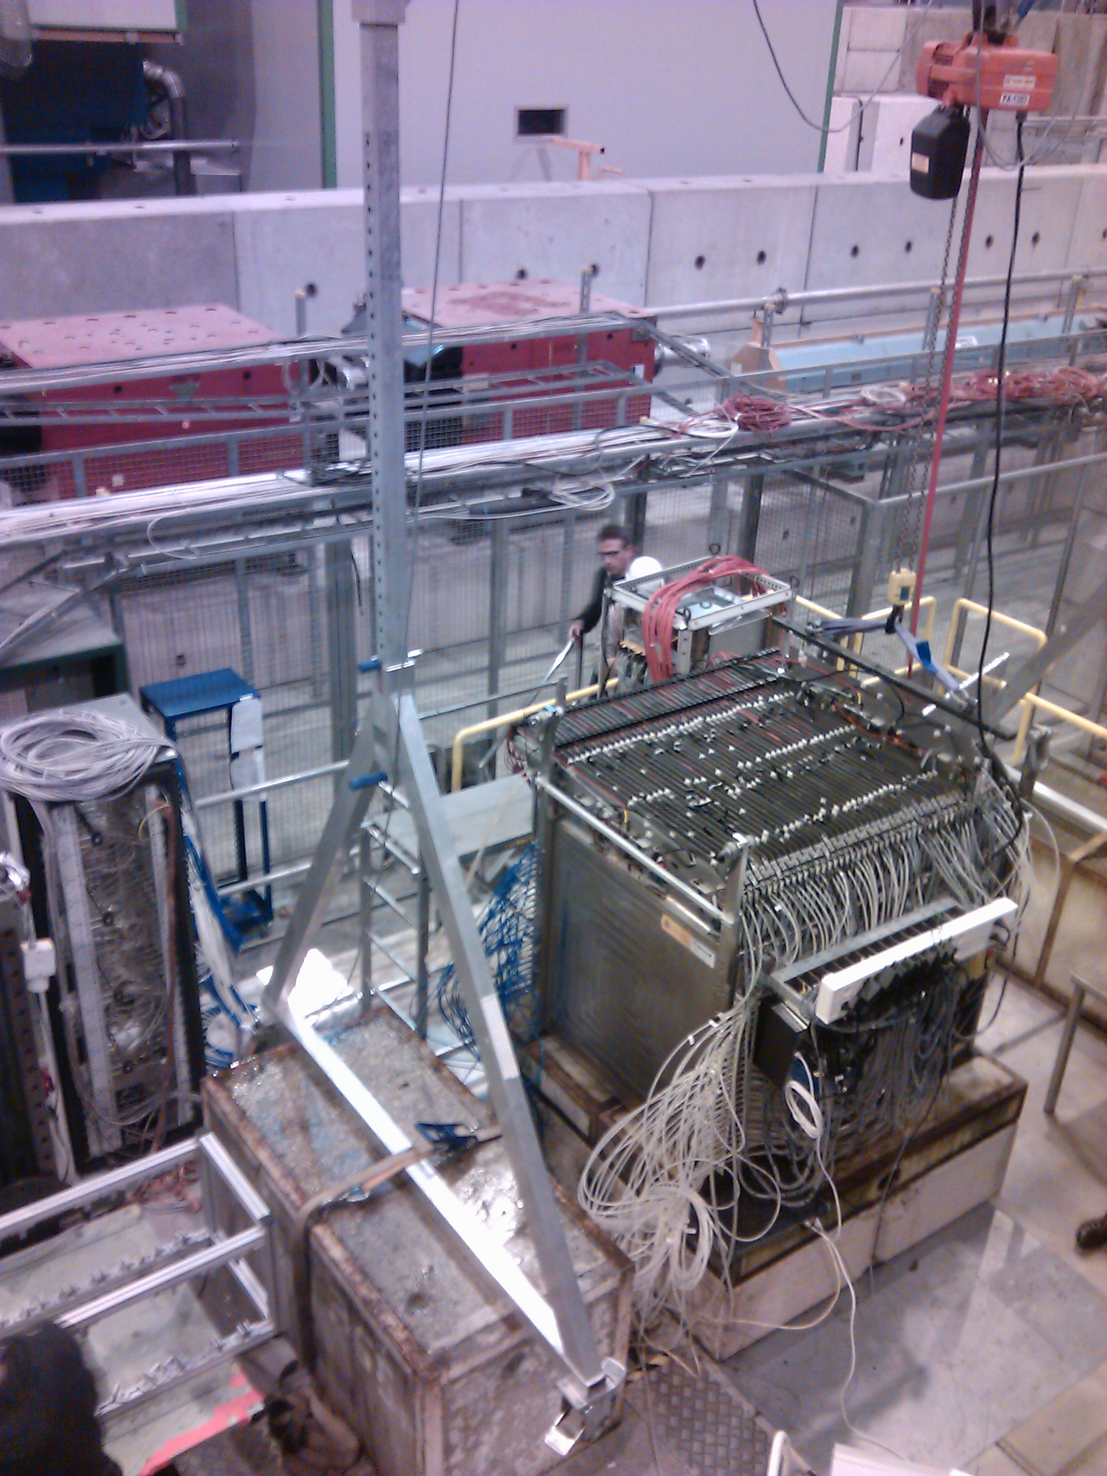

Slide 4
Technological prototype:
First high–granularity technological calorimeter
48 cassettes hosting GRPC+ embedded electronics
Cassettes inserted in a self-supporting mechanical structure
with tiny dead zones (< 2%) and volumes (2mm/cassette)
Trigger-less and power-pulsing modes
Services from one side and simple cooling system
DAQ based on HDMI(fast command) + USB2 (data transmission)
3 campaigns of data taking: 2 in 2012 and one late in 2014
Paper on the SDHCAL construction is in final phase

Slide 5
Technological prototype:
Energy resolution : good resolution based on “classical” calibration method (3 notes → paper soon)
More sophisticated methods could be applied (N.N, BDT,..)
Digitizer : based on muon and electron studies in the SDHCAL, a
digitizer wa worked out and used to simulate pion interaction in
the SDHCAL. Hadronic models at high energy could be
questioned (discrepancy data-simulation for E > 50 GeV).
Note in preparation
Track segments within hadronic showers based on Hough
Transform. 1 note→ paper (after the digitizer publication?)
Hadronic shower reconstruction and separation of close-by
showers. Comparison between Pandora and adapted version of
Arbor (note in preparation)

Slide 6
To-do List:
Separation electron-pion : few methods were developed but none
was finalized. Using Cerenkov counter (as in the 2014 campaign)
will make the study much more robust.
Gain correction to improve on the response homogeneity (partially applied in 2014 to reduce noise)
Study the effect of threshold values on the energy resolution and
hadronic shower separation (both in simulation and in TB)
→ Hadronic shower study at different angles and different positions.

Slide 7
Complementary R&D
To validate completely the SDHCAL option, large detectors equiped with the third generation of ASIC are to be conceived, designed and produced
Detector design is well advanced (gas circulation)
ASIC: 600 ASIC being produced to equip 2x2m²
DIF (one DIF for one detector) : well advanced
PCB for large detector : work has been initiated recently.
Cassette design is in the making: robustness should be enhanced
We aim to have 2 detectors built by the end of the year if funding could be found.
They could be used as a tail catcher of the Technological prototype..

Slide 8
ILD
Simulation:
Efforts were performed before the DBD. SDHCAL with two mechanical structure was simulated.
Only one channel (tth) at 1 TeV was produced for the SDHCAL. Comparison with AHCAL shows that SDHCAL without optimization could achieve the same performances as AHCAL.
information from the technological prototype were implemented making of the SDHCAL simulation a realistic one.

Slide 9
ILD
Optimization:
Recent optimization efforts by LLR on the ECAL (number of layers, radius,…) need to be accompanied by efforts from the SDHCAL part.
Granularity of the SDHCAL could probably help to reduce the impact of ECAL reduction.
We need to establish a working group to study the different scenarios. This is a place for Post-Doc and PhD students to contribute and get expertise.

Slide 10
ILD
Integration:
A detailed study of the mechanical structure (à la Videau) du SDHCAL was performed. Its integration in the ILD detector was studied.
Still few points still need to be addressed (END-CAP support…)
Services were foreseen more efforts that allow to have a clear vision of the whole integration is needed.

Slide 11
Conclusion
SDHCAL has proven to be a good technology for hadronic calorimeters.
The technological prototype is a good and advanced demonstrator.
Many analyses are ongoing. Some are in advanced phase.
Complete validation of the SDHCAL with large detectors with the last generation of readout electronics and DAQ has started.
Combined tests with ECAL will be of the utmost importance.
A common DAQ scheme is needed.
Optimization study of the SDHCAL&ECAL is an asset for both

