Slide 1
Mechanical structure of the new SDHCAL prototype
HGC4ILD - High Granularity Calorimeters for ILD WS
LLR (Paris) 2-Feb-2015
Enrique Calvo Alamillo

Slide 2
Index
Goal.
Previous SDHCAL prototype
Ciemat welded prototype.
Prototypes under study and fabrication.
Conclusions and Next steps.

Slide 3
1. Goal.
We must show that the SDHCAL technology is viable, not only in terms of physics performance and operation but also we should demonstrate the feasibility of a compact integrated detector design fulfilling the demands of compactness and hermeticity and the viability of its construction.
The goal of the SDHCAL for the next few years is to build few larger GRPC chambers with the final dimensions of the biggest one (~290x90 cm2) foreseen for ILD, equip them with a new version of electronics and insert them in an absorber mechanical structure, built with the same procedures than the final one, capable to host 4 or 5 of them.
This mechanical absorber will be produced by EBW (electron beam welding) process at CERN and measured at CIEMAT to study the deformation introduced by this method and extrapolate the result to a final module of the calorimeter.

Slide 4
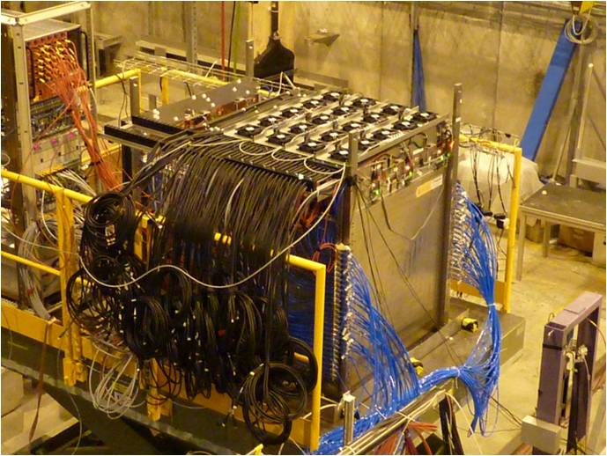
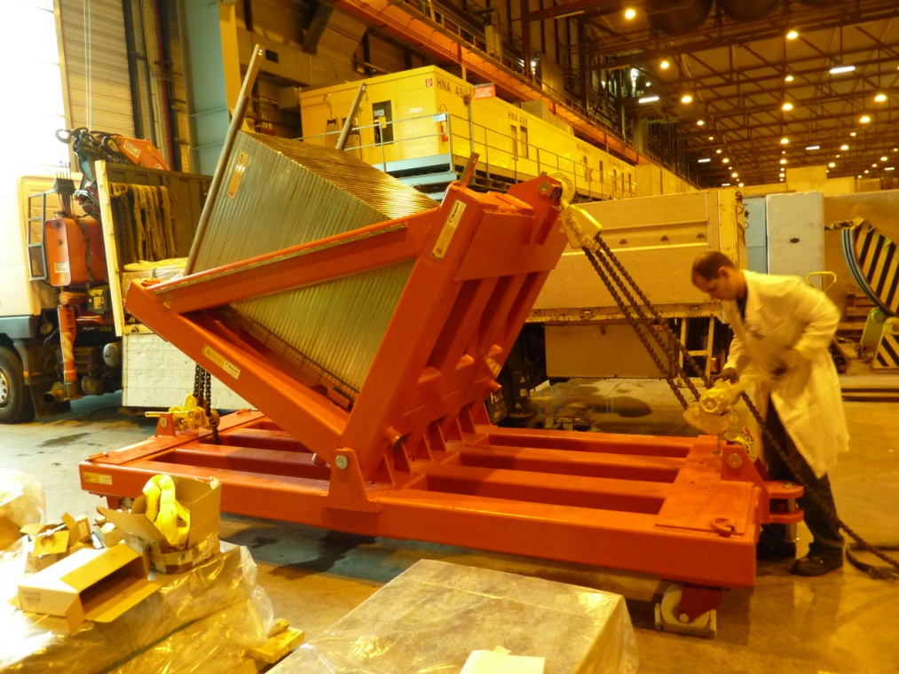
2. Previous SDHCAL prototype.
The M³ SDHCAL prototype concept:
It’s a sampling calorimeter with stainless steel as absorber, a gas detector (Glass Resistive Plate Chamber (GRPC)) as active medium and 1x1 cm2 readout electronics segmentation. Each layer is composed of 20 mm absorber + 3 mm GRPC + 3 mm readout electronics + 2 mm tolerances.
The prototype module is a self-supporting structure with 51 layers of stainless steel plates with dimensions 1010x1054x15 mm3. The gas detectors are assembled in independent readout cassettes and inserted in between the plates.
M³ SDHCAL prototype at CERN test beam.
Using both hand Pull-Lift together we can rotate the module with the rotation tool.

Slide 5
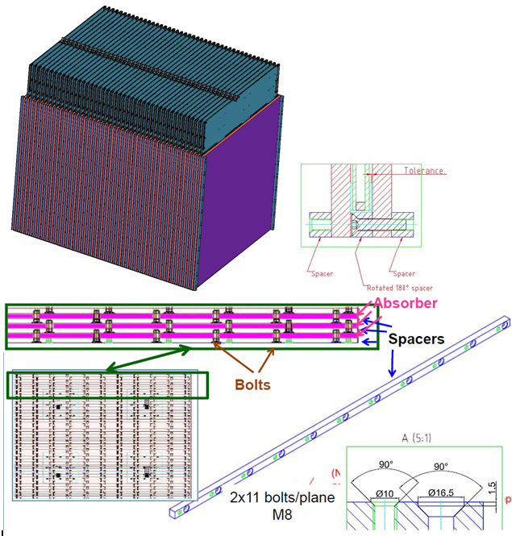
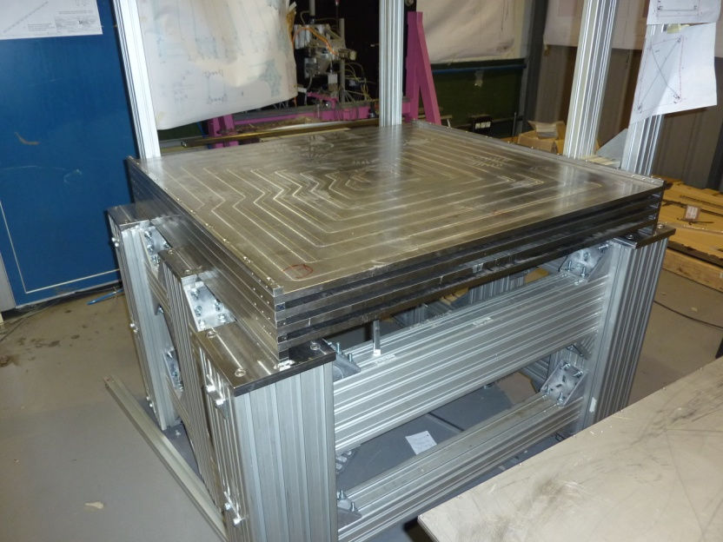
The mechanical structure is made of 51 stainless steel plates assembled together using lateral spacers fixed to the absorbers through staggered bolts. The thickness tolerance is 0.05mm and a surface planarity below ~500 microns was required. The spacers are 13mm thick with 0.05mm accuracy. The excellent accuracy of plate planarity and spacer thickness allowed reducing the tolerances needed for the safe insertion (and eventual extraction) of the detectors. This is important to minimize the dead spaces and reduce the radial size view of a future real detector where the calorimeter will be located inside the coil.

Slide 6
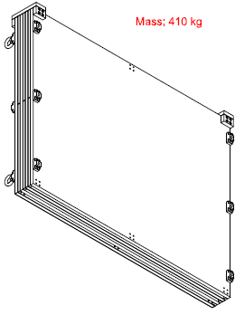
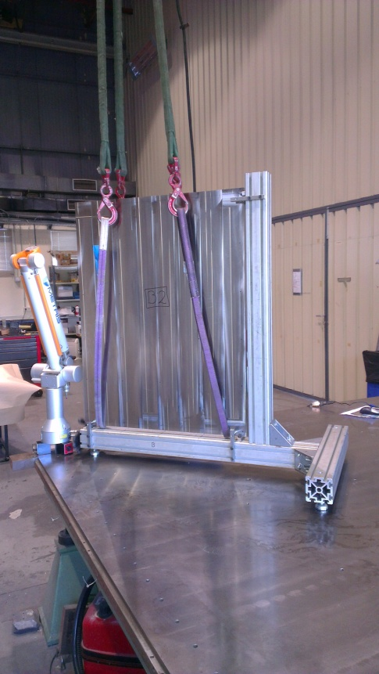
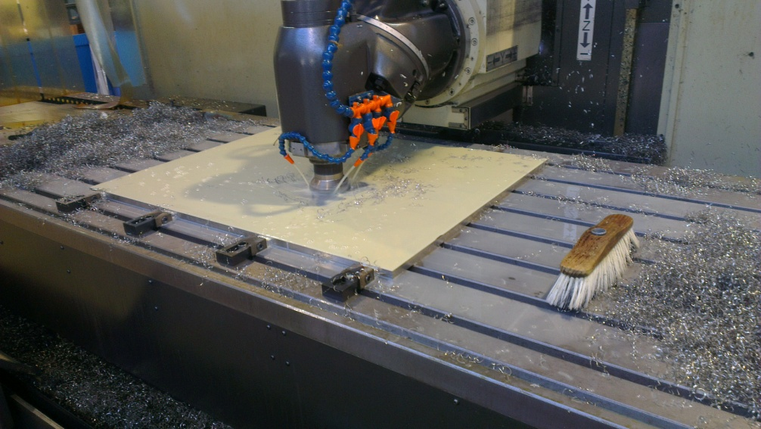
3. Ciemat welded prototype.
The plates of the 1m3 were assembled together with the spacers using bolts, but in the final module we plan weld them to reduce the lateral dimensions of the spacers to decrease the dead space. Welding process can introduce deformations and increase the depth due to the extra tolerances needed. Electron beam welding is probably the best but need vacuum conditions and could be not affordable for a big module, the Laser welding could be a better option. Standard, Electron beam and Laser welding will be tested at CIEMAT and external companies or CERN.
Quality tests as the planarity or position precision will be performed by using a 3D articular precision arm already used for the 1m3 prototype tests and the reference tables.
3.1 Machining Test for a small prototype (Ciemat workshop)
Due to the expensive cost to machine the plates, at Ciemat was performed several machining test to obtain the required tolerances for those plates.
+A small module structure was assembled (and EBW at CERN), compose of several layers:
-4 Plates of Inox AISI 304 of ~1000x800 and 15 mm thickness.
-Several spacers.
-Auxiliar pieces.
+Operational tool.
+Verification tool.
The plates where produce with a
planarity tolerance below 0.5 mm.
And thickness below +-0.05 mm.

Slide 7
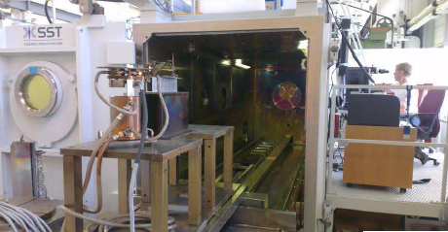
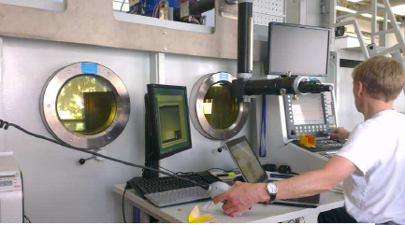
3.2. Welding Test for the small prototype (CERN workshop)
+This small prototype was welded by electron beam welding process at CERN.

Slide 8
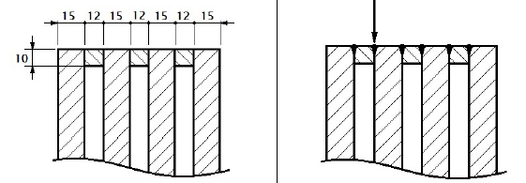
3.2.1. Welding sequence used at CERN.
Correspondence with the measured sides in RED
B1
F
Side A
C
E
A2

Slide 9
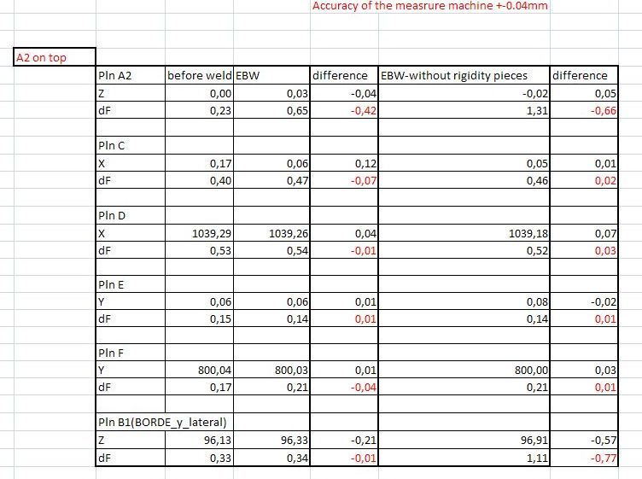
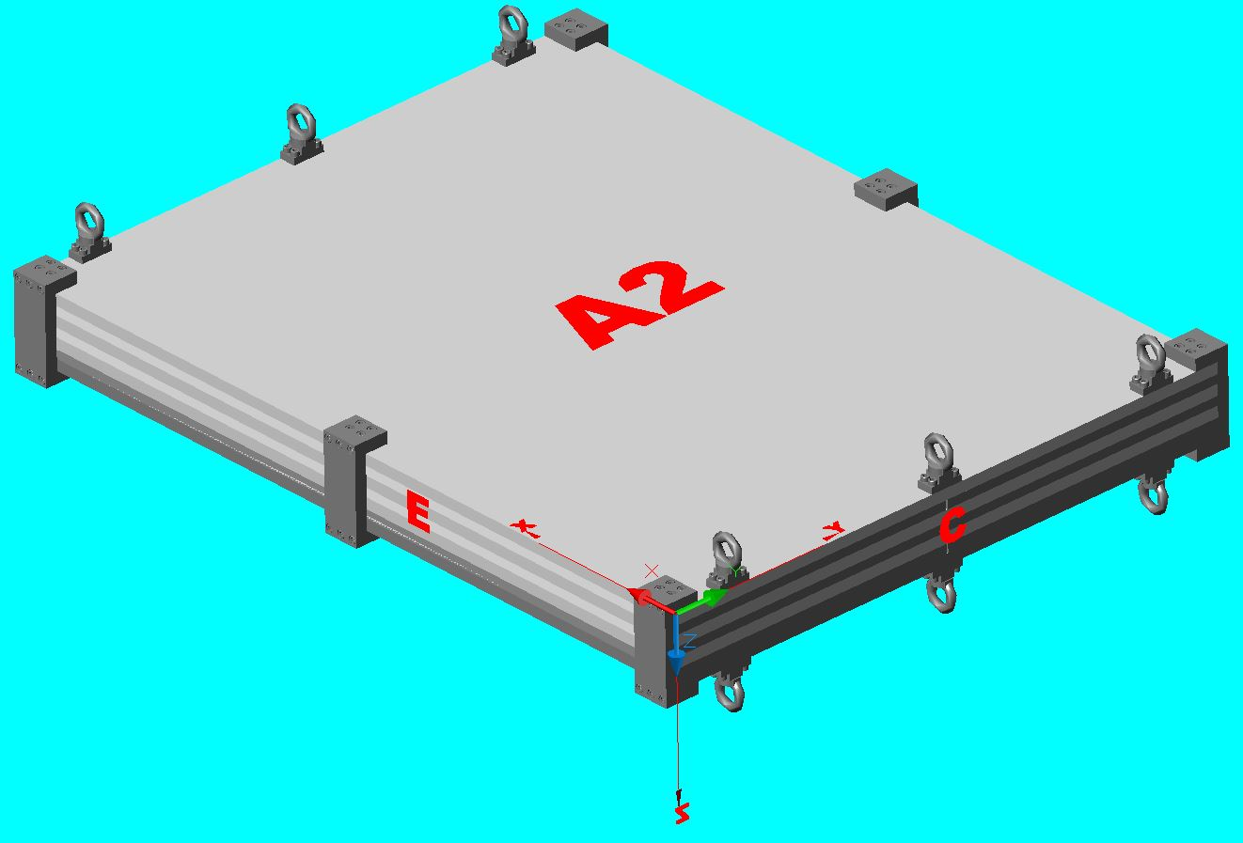
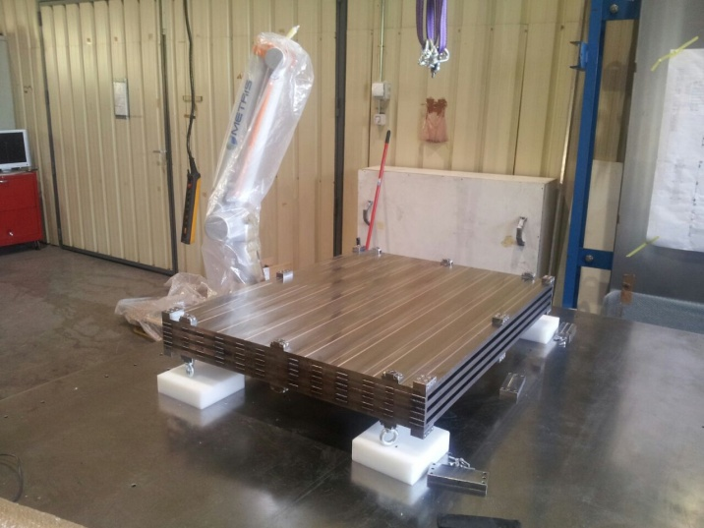
3.2.2. Results:
The tables shown the planarity
of different surfaces of the
calorimeter in mm and the
difference between them in three
different situations,
-Before welding.
-After EBW but with the auxiliary
pieces to rigidity the structure
during the manipulation.
-After EBW without the pieces.

Slide 10
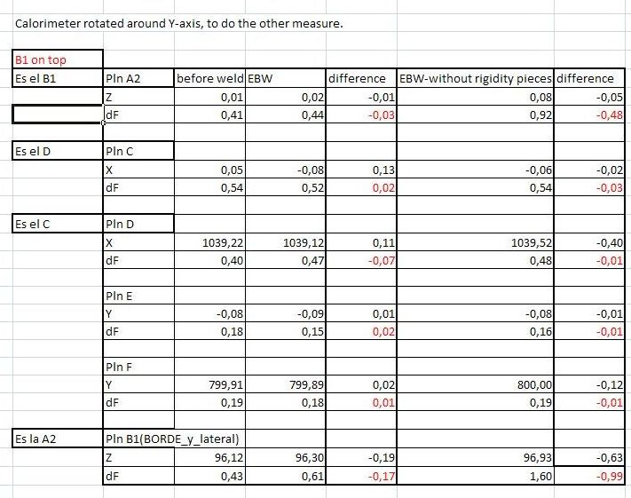
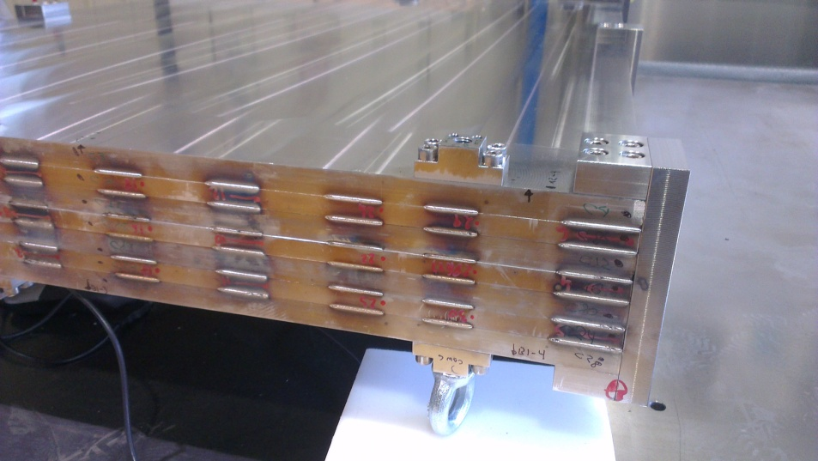
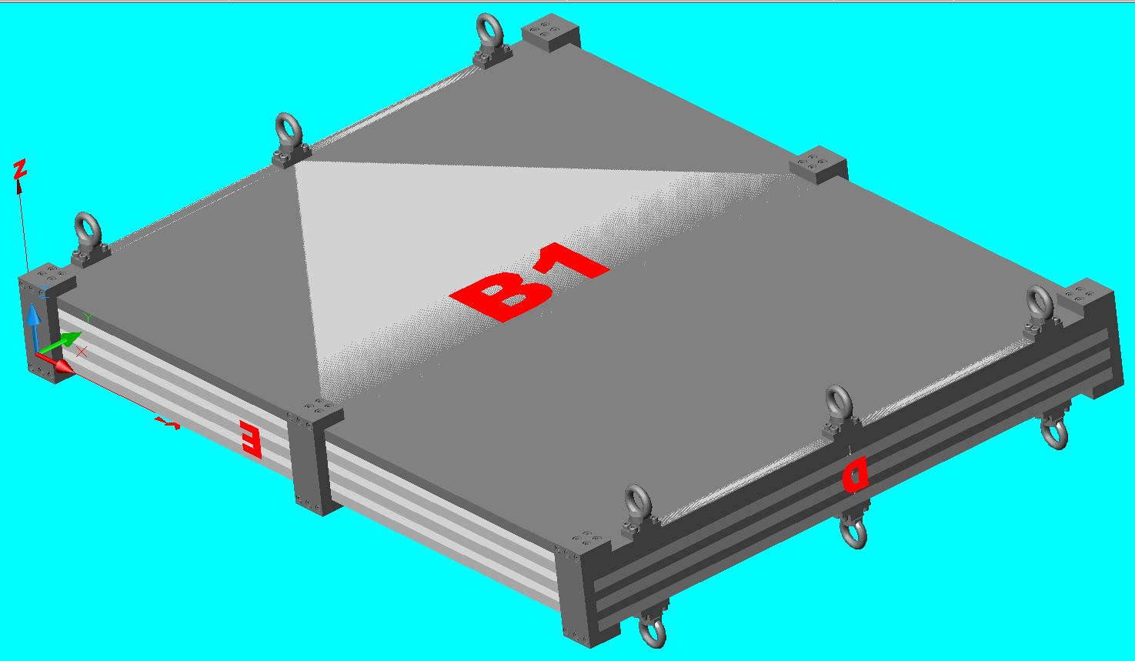
Measure of the calorimeter
rotated around Y-axis.

Slide 11
Top numbers on the plate A2-> difference with respect to the initial status of the plate in Z.
Lateral numbers on the calorimeter->difference with respect to the initial status of the
distance between plates on the calorimeter assembled before weld.
+0.26
+0.13
-0.56
+0.22
+1.01
+0.72
+0.5
-0.52
+0.59
+1.11
+0.73
-0.51
+0.43
+0.49
+0.53
+0.24
+0.1
-0.54
+0.07
+0.49
+0.51
-0.51
+0.1
+0.11
+0.16
+0.57
+0.57
+0.53
-0.50
+0.21
+0.81
+0.64
-0.49
+0.54
+0.62
-0.48
+0.85
+0.06
+0.14
+0.18

Slide 12
Top numbers on the plate A2-> difference with respect to the initial status of the plate in Z.
Lateral numbers on the calorimeter->difference with respect to the initial status of the
distance between plates on the calorimeter assembled before weld.
+0.1
+0.13
+0.24
-0.65
+0.41
+0.66
+1.03
-0.58
+0.49
+0.47
+0.65
-0.48
+0.96
+0.34
+0.48
+0.23
+0.19
-0.41
+0.28
+0.36
+0.37
-0.57
+0.15
+0.48
+0.35
-0.59
+0.14
+0.08
+0.8
+0.64
+0.43
+0.53
-0.57
+0.81
-0.49
+0.57
+0.6
+0.1
+0.1
+0.13
We can conclude that the distortion produce by the EBW process was bigger than expected. About 1 mm on the
center of the external plates, and less on the internals, but on the X-axis (950 mm) it is approximately the same that in
the bigger modules in the ILD. On the Y-axis is less critique because it looks like constant, and it is the ~3 m length .

Slide 13
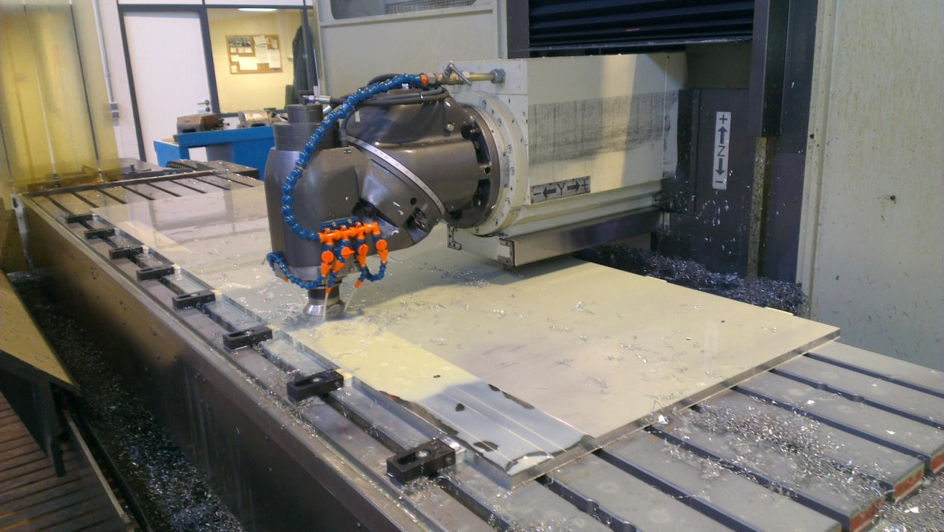
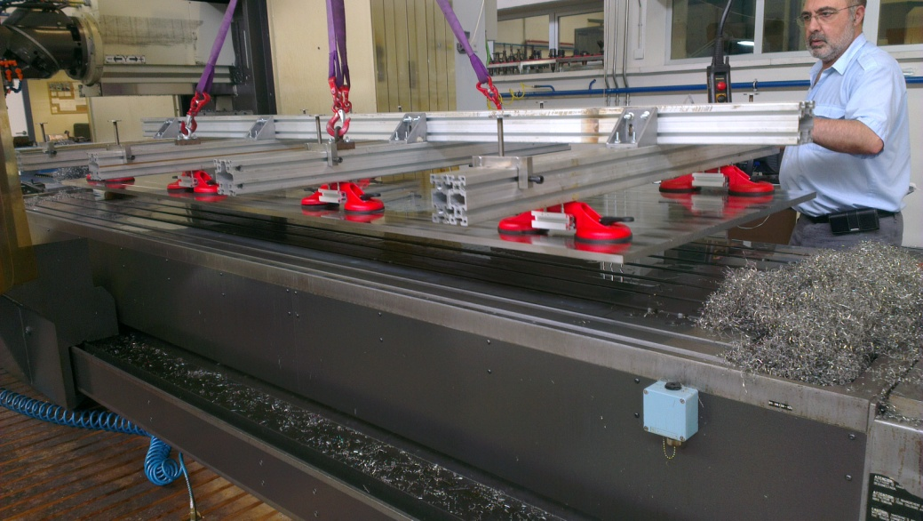
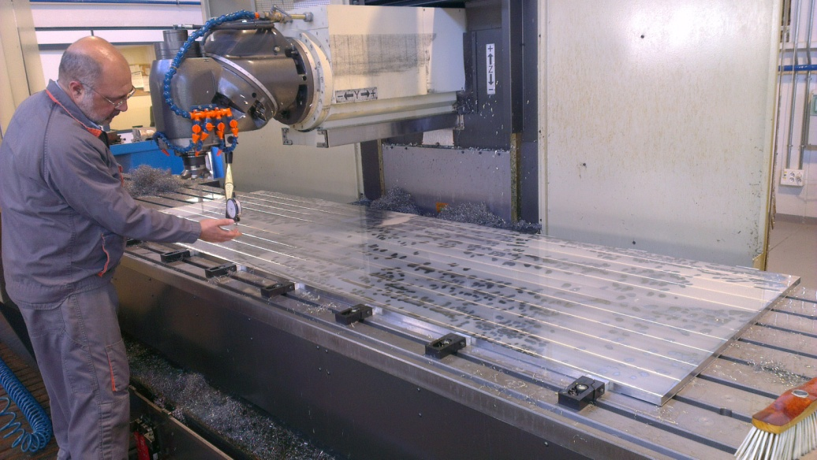
3.3. Machining test for the large prototype (Ciemat workshop)
The planarity required for the final prototype is <1mm, larger than we required for the 1m3 prototype but more difficult to obtain in a surface three times bigger
+We had produced one plate of Inox AISI 304 of 2900x950 and 15 mm thickness.
+Operational tool.
+Verification tool.
The plates where produce with a
Planarity tolerance below 1 mm in a
length of about 2.3 m, but in the rest
of the length was 3 mm.

Slide 14
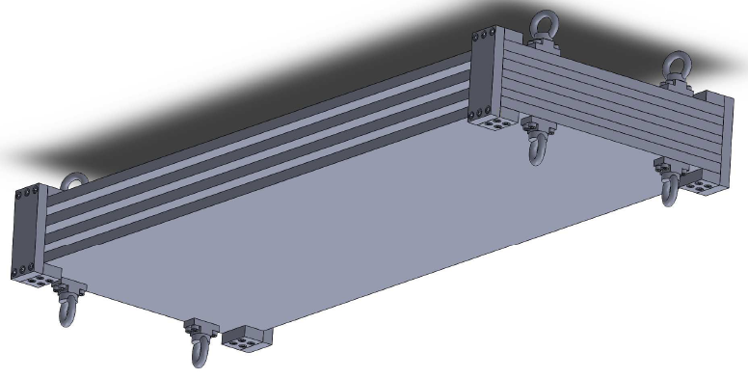
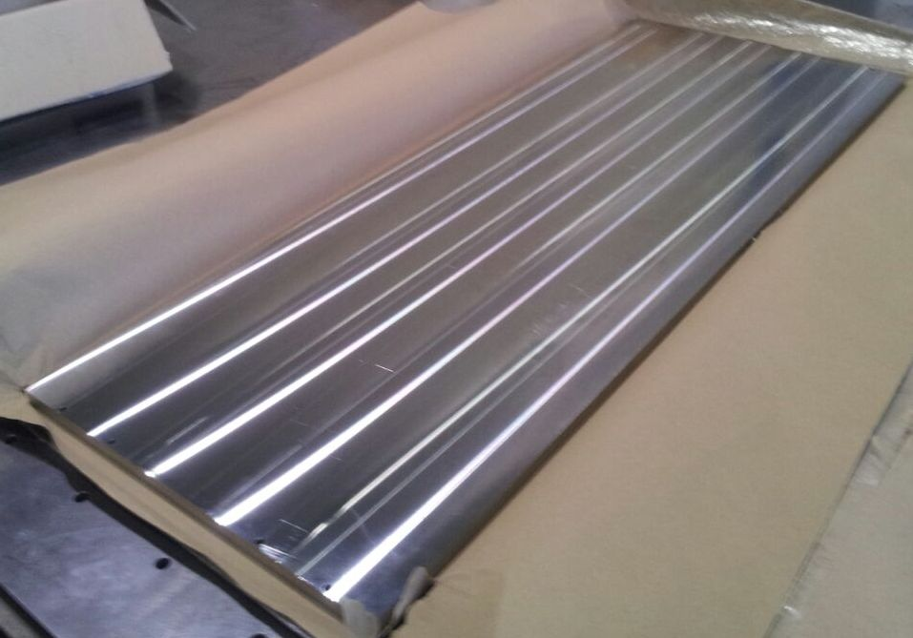
4. Prototypes under Study and fabrication. .
4.1. Machining and Welding Test for a smaller prototype (Ciemat workshop)
+A smaller machined and welded module structure compose of several layers. If with the EBW we can obtain the tolerances we will test with standard welding process using methods to minimize deformations, this should be the cheaper welding process, but probably it will not be viable according to the recent EBW results obtained last week:
-4 Plates of Inox AISI 304 of ~1000x400 and 15 mm thickness.
-Spacers and auxiliary pieces.
+Operational tool.
+Verification tool.
We have the pieces ready to verify the fabrication tolerances. After that do the assembly and the measure and finally weld and measure.
4.2. Laser Welding Test for a smaller prototype (external company)
+If with the standard we can’t obtain the required tolerances, to reduce production costs of the EBW, we will do a test with a smaller machined module structure , but with laser welded process, but probably will not be viable according to the EBW results:
-4 Plates of Inox AISI 304 of ~1000x400 and 15 mm thickness
-Spacers and auxiliary pieces.

Slide 15
4.3. Welding Test with two smaller prototypes
+Two smaller machined and welded modules structures compose of several layers will be welded with the EBW at CERN to study a method to conclude if it is possible or not to obtain the tolerances that we need .
-4 Plates of Inox AISI 304 of ~1000x400 and 15 mm thickness.
-Spacers and auxiliary pieces.
We will use the two previous mechanical prototypes (4.1 and 4.2), expected to be used for the standard and laser weld, to test with EBW. Because according latest EBW results standard and laser weld process will not be viable.
-One prototype will be welded using a more symmetric sequence during the EBW.
-The second using the symmetric sequence and changing machine parameters to reduce the energy on the module.

Slide 16
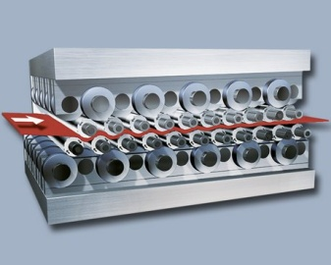
4.4. Survey market for the roller leveling
+ The roller leveling is essentially a bending process. The stick out area of the flatness part of one plate is deformed by a series of alternating bends. These alternating bends are created by passing the plate between upper and lower sets of leveling rollers. The leveling rollers are offset by half of the roller pitch in the direction of the travel. As a result, the sheet metal takes a wave-like path through the precision leveler. This wave should be greatest at the entry into the machine and smallest at its exit (comparable to a decaying sinusoidal curve). The elastic-plastic alternating bends and the constant decline of bending intensity thereby produce flat and nearly stress-free plates.
This method can reduce a lot the cost and time to produce the final plates, and should be used to the real calorimeter.
+ We are doing that from time ago, but not easy, because the companies aren’t interested in small quantities like our devices.
-test for the biggest plates of Inox AISI 304 and 15 mm thickness should be done in the future.

Slide 17
4.5. Design and construction of a mechanical structure to host GRPC with the largest dimensions of a ILD SDHCAL
+Design of the final mechanical structure.
+Produce a machined/roller leveling and welded module structure compose of several layers:
-4 to 6 Plates of Inox AISI 304 of between 2 and 3 m and 15 mm thickness. Currently as a say before we can not produce 3 m length plates at Ciemat with the planarity tolerances required, but we will tray to produce as longer as possible. At CERN the maximum length that can be welded it is about 2.5 m, bigger dimension will require a complicate welding and manipulation process.
-spacers and auxiliary pieces for this structure.
-reinforces.
+Operational tool.
+Verification tool.
This mechanical structure can be used to built a small prototype with few GRPC chambers with dimensions as close as possible to the largest ones needed for the ILD.

Slide 18
5. Conclusion and Next steps.
After discussed latest results from the EBW process with the CERN people, where the distortions of the module was bigger (~1mm) than we expected. We conclude that it will be necessary more tests with this method to can conclude results and to intent to minimize deformations.
Action:
- Change welding sequence instead of ABCDEF use ABFDEC.
- Change welding parameters: Weld with a more focalized and maybe pulsed beam. This will produce thin weld joint and consequently smaller distortions . But this imply tightest fabrication and assembly tolerances. Maximum gap of 0.1 mm between plates and misalignment between plates of 0.2 mm.
-If we obtain a prototype inside the tolerances , we need to repeat the same prototype with the same parameters to conclude.
- Assembly and weld several prototypes piles to verify the deformation in the complete assembly studying if the maximum deformation not change too much. This will imply to reduce fabrication cost and time in the future.
-As the distortion of the plate looks like being in the same direction during the EBW, this could be compensated during the fabrication and assembly process.
-It could be possible to simulate the distortion by finite element programs, and optimize the design, but it’s not easy because it needs several previous tests to obtain the simulation parameters.
-We will meet with ENSA which is a company expert in welding process with stainless steel next moth to present our problem and to present our result.

Slide 19
BACKUP

Slide 20
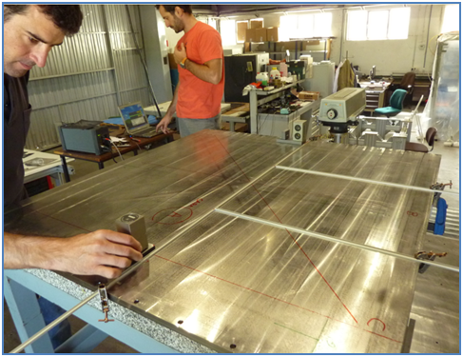
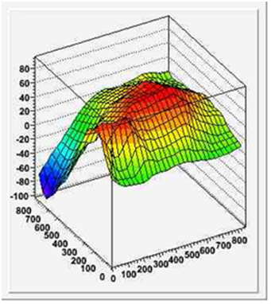
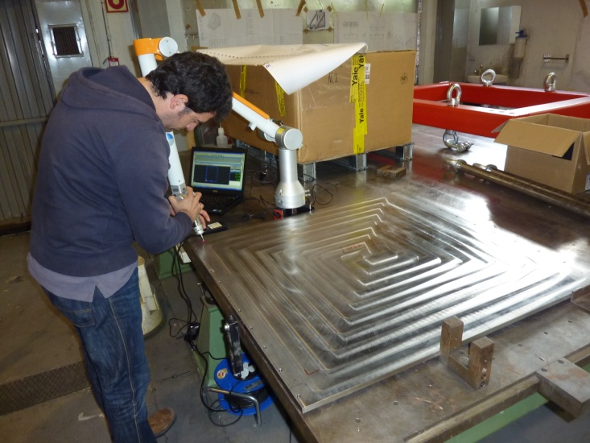
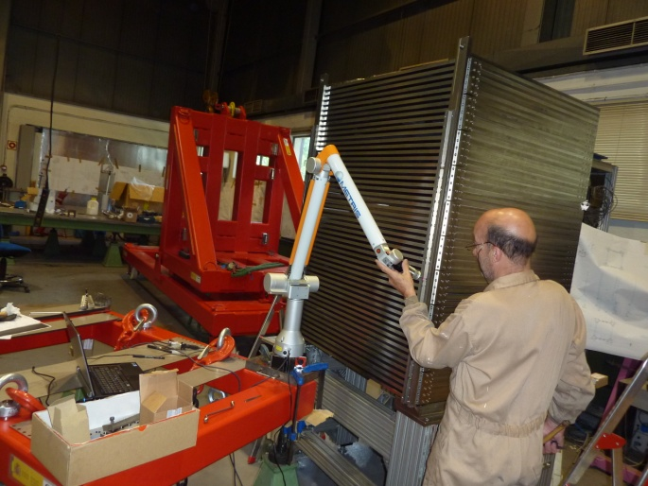
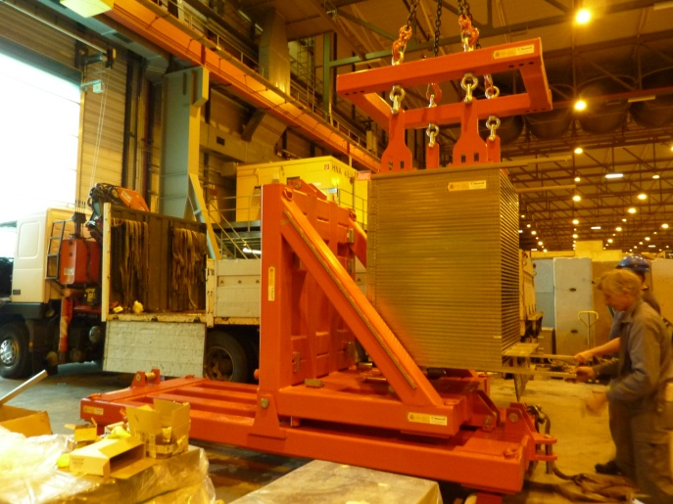
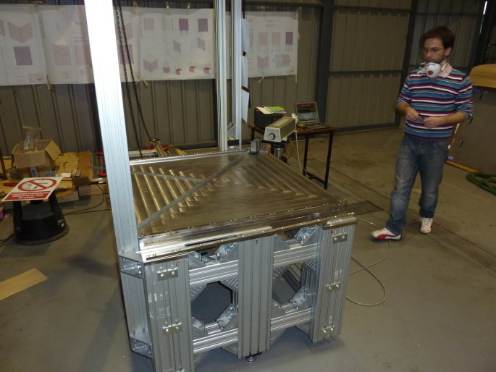
The design of this structure, machining of the spacers, final assembly and quality tests has been done at CIEMAT. This required also the design and construction of a precise assembling table and different tooling.
(Left-top) Measurement of a plate planarity using a laser interferometer system.
(Center-top) Planarity over the surface of a plate
(Rigth-top) Measurement of the plate using a CMM arm.
(Left-Bottom) Measurement of the m³ prototype using the CMM arm on the assembly table.
(Center-Bottom) Using the lifting tool.
(Right-Bottom) Assembly table.

