Slide 1
SKIROC Status
02 / 02 / 2014 - HGCAL - Calice Workshop
OMEGA microelectronics group
Ecole Polytechnique CNRS/IN2P3 , Palaiseau (France)

Slide 2

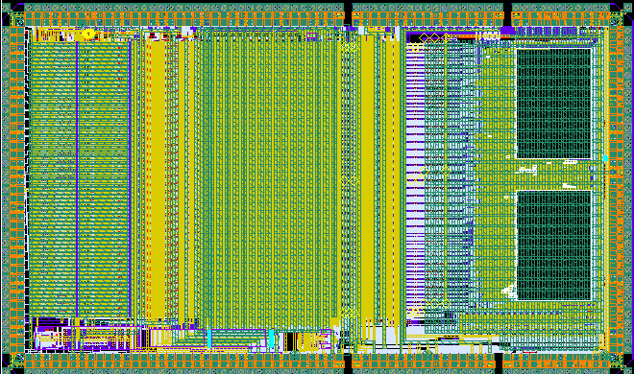
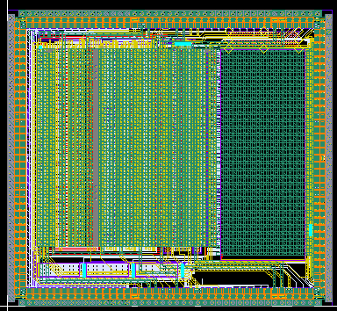


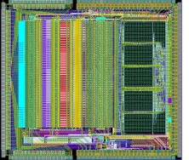
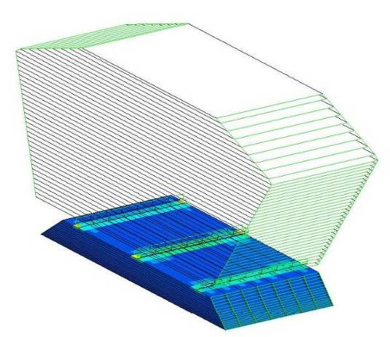
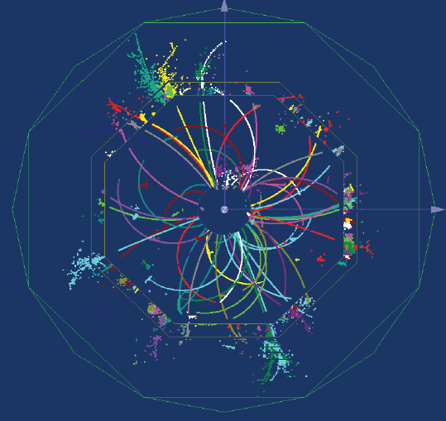
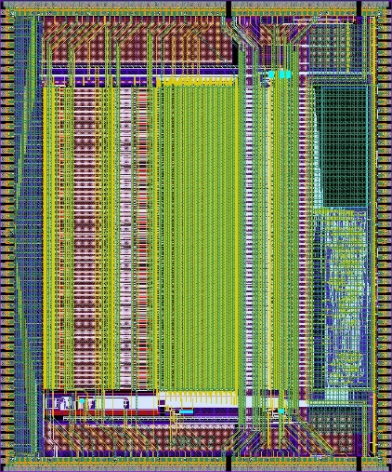







ROC chips for ILC prototypes
SPIROC2
Analog HCAL (AHCAL)
(SiPM)
36 ch. 32mm²
June 07, June 08, March 10, Sept 11
ROC chips for technological prototypes: to study the feasibility of large scale, industrializable modules (Eudet/Aida funded)
Requirements for electronics
  Large dynamic range (15 bits)
  Auto-trigger on ½ MIP
  On chip zero suppress
  10⁸ channels
  Front-end embedded in detector
  Ultra-low power : 25µW/ch
HARDROC2 and MICROROC
Semi Digital HCAL (sDHCAL)
(RPC, µmegas or GEMs)
64 ch. 16mm²
Sept 06, June 08, March 10
SKIROC2
ECAL
(Si PIN diode)
64 ch. 70mm²
March 10

Slide 3

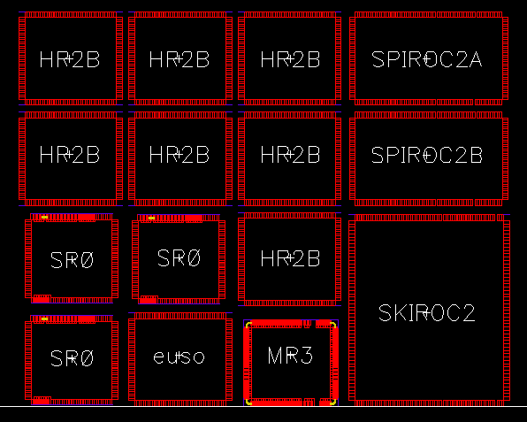



Production Run : Feb 2015
MAROC3A
MAROC4
HARDROC3B
SPIROC2D
SKIROC2B
PARISROC3
PETIROC2A
SPACIROC3A
CITIROC1A
CITIROC1B
EASIROC1B
DOSIROC1A
DOPIROC2
TRIROC1A
Technology :
0.35µm SiGe
Production Run 2010
  EASIROC
  HARDROC3B
  MAROC3
  SKIROC2B
  SPACIROC
  SPIROC2A
  SPIROC2B

Slide 4
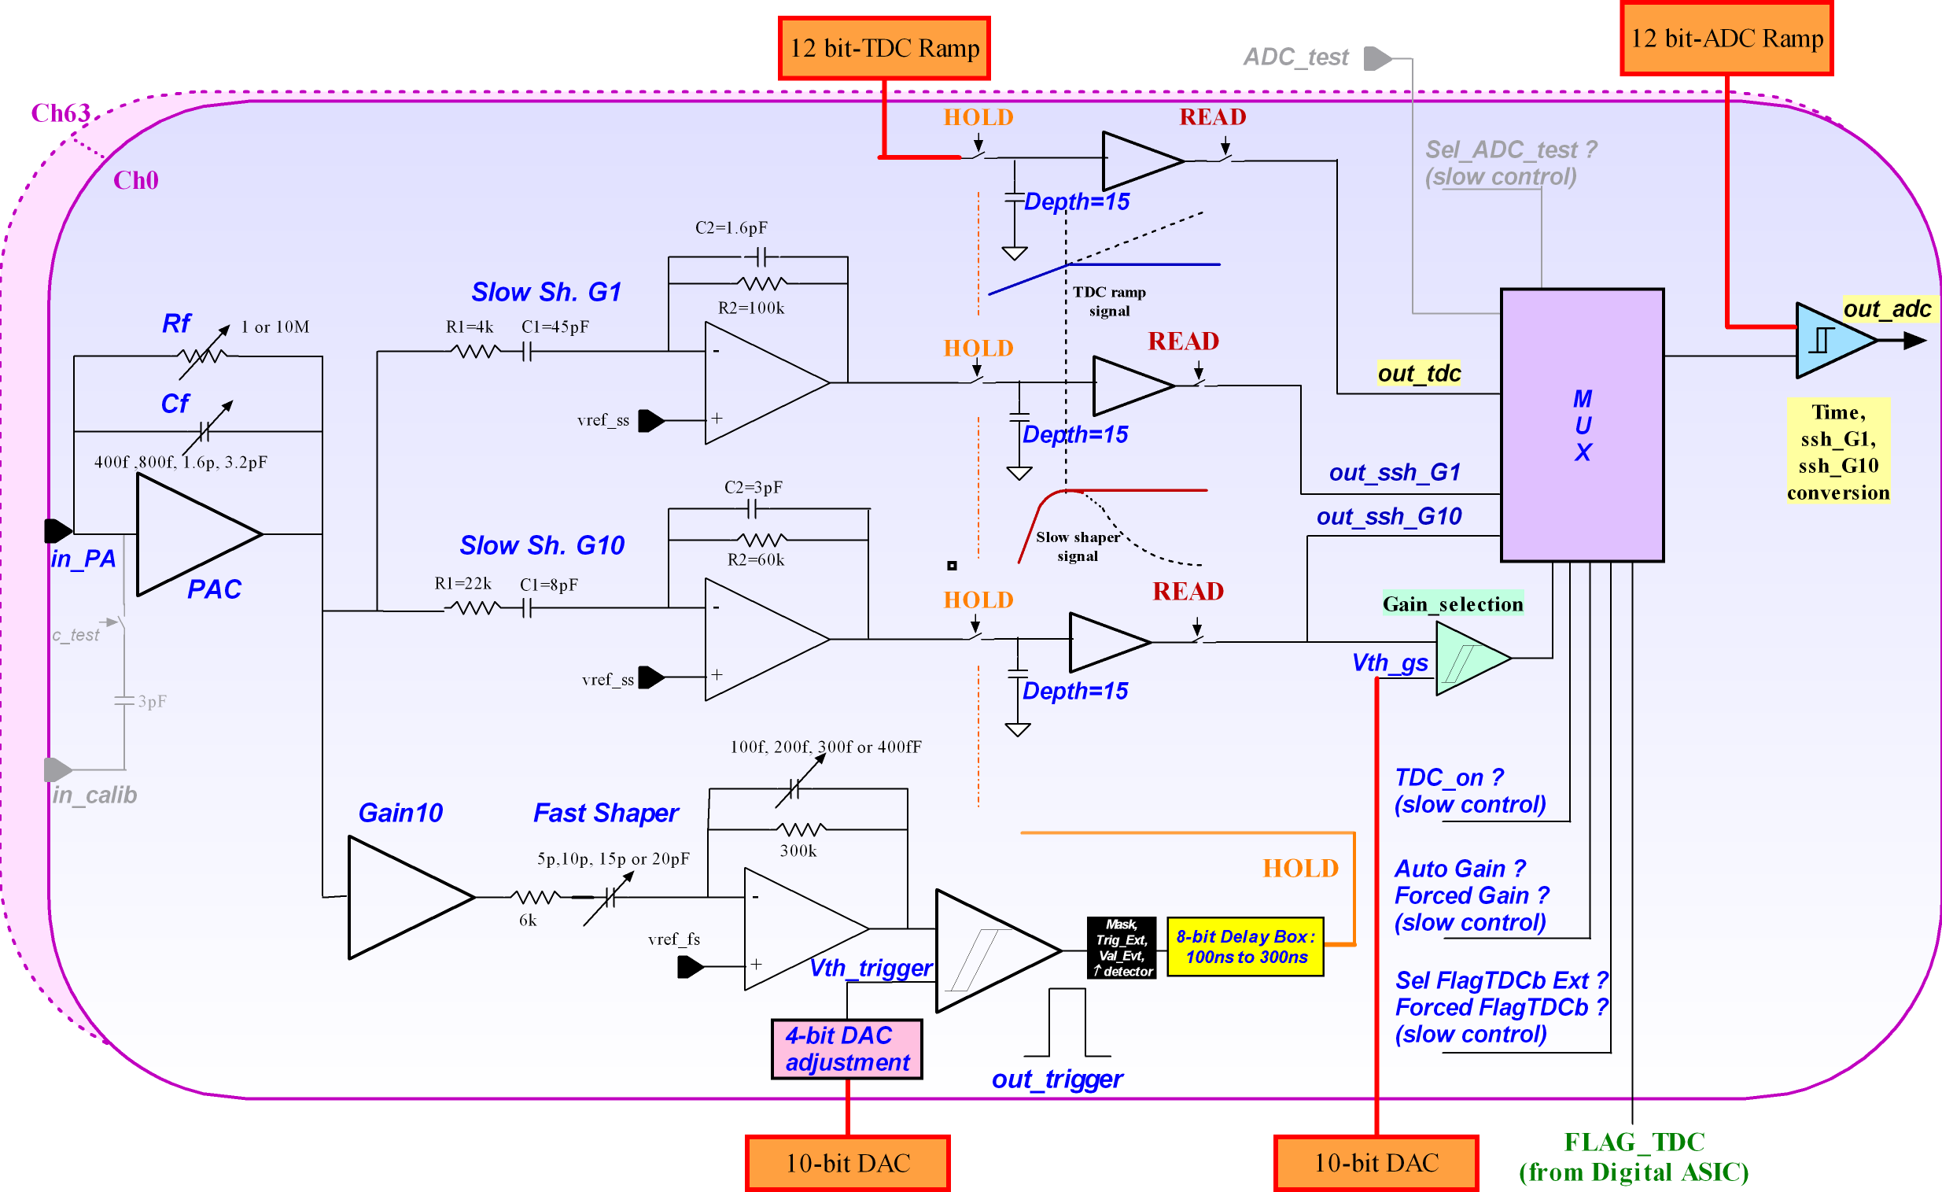
SKIROC2 Simplified schematic
64 channels
Trigger less mode (auto trigger from 1fC up to 10pC)
12 bits for Q measurement
12 bits for coarse time (BCID)
Power pulsing mode

Slide 5
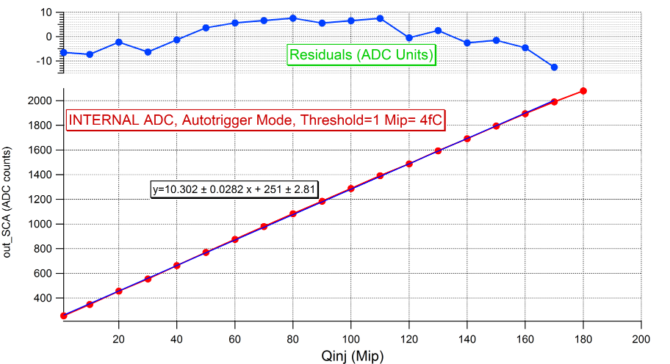
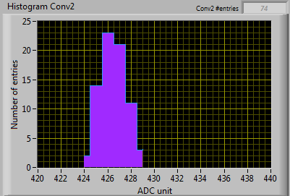
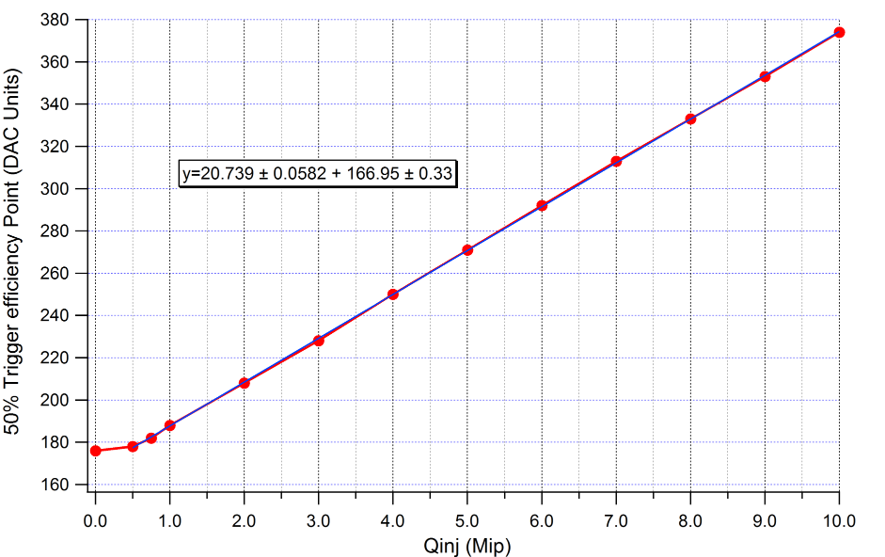
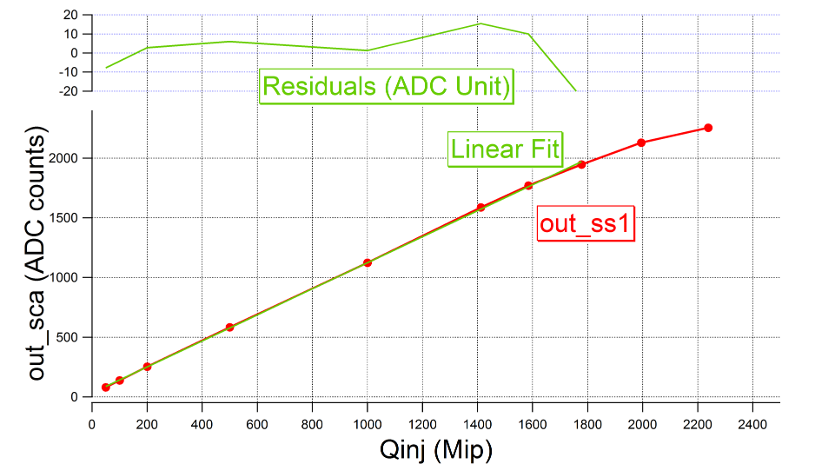
Linearity of Shaper (High + Low + Fast)
Noise = 630 µV
1 Mip gives 5.7 mV
S/N=9
SS10@20 MIP
Rms =1.16 ADC U=600µV
MEASUREMENTS using SCA and internal ADC
Autotrigger mode
1 MIP ( 4fC) threshold
« Real » Pedestal=167 DAC Units
1 Mip ≈4 fC = 20 DAC Units
Noise= 2 DAC Units
Minimum Threshold= 5 σ noise= 0.5 Mip
5σ Noise limit
1 MIP ≈ 4fC
5
5

Slide 6
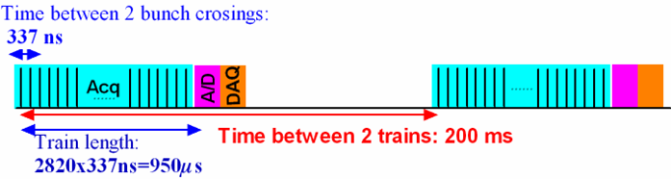
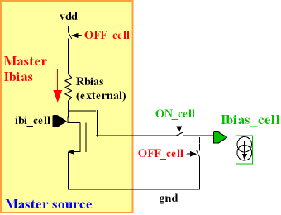
POWER PULSING in SK2
Requirement:
  25 µW/ch with 0.5% duty cycle
  500 µA for the entire chip
Power pulsing:
  Bandgap + ref Voltages + master I: switched ON/OFF
  Shut down bias currents with vdd always ON
SK2 power consumption measurement:
  123 mA x 3.3V ≈ 40 mW => 0.6 mW/ch
4 Power pulsing lines : analog, conversion, dac, digital
Each chip can be forced on/off by slow control
Measurements
Acquisition | 88 mA , 290 mW | Duty Cycle =0.5%, 1.45 mW
Conversion | 27.3 mA, 90 mW | Duty Cycle =0.25%, 0.225 mW
Readout | 8.0 mA, 26.4 mW | Duty Cycle =0.25%, 0.066 mW
  Skiroc2 power consumption with Power pulsing: 1.7 mW ie 27 µW/ch
6

Slide 7


From 2nd generation…
2nd generation chips for ILD
  Auto-trigger, analog storage and/or digitization
  Token-ring readout (one data line activated by each chip sequentially)
  Common DAQ
  Power pulsing : <1 % duty cycle

Slide 8
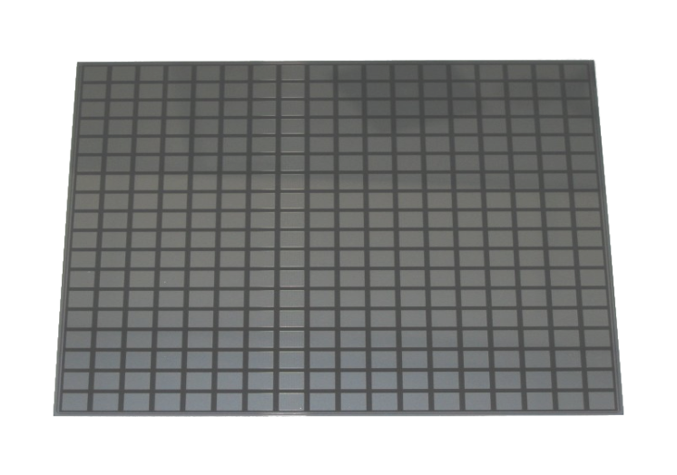
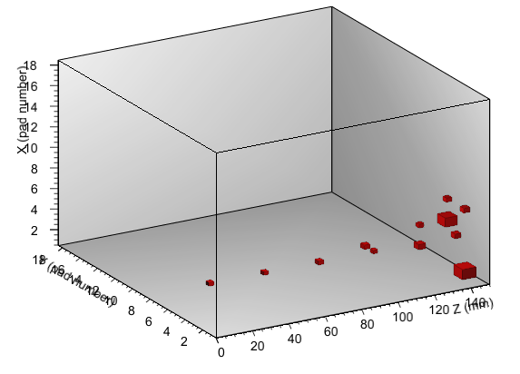
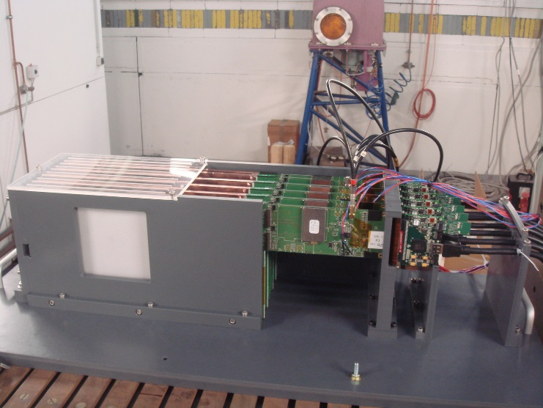
…To 3rd generation
3rd generation chips for ILD
  Technology used ? (depending on funding…)
    If within 2 years , still 0.35µm AMS SiGe …
  No major change in the analogue part
    MIP over Noise Ratio @ lower gain = 10
    TDC scheme will change (PETIROC like)
    Few optimization (Crosstalk, AutoGain, 4-bit DACs, external triggers, power consumption…)
  PLL provides the Fast Clock (mainly used for digitization) from the Slow Clock
    No Fast Clock to be provided to the ASICs !
  Independent channels (zero suppress)
    Huge change in digital part !!
    Digital part power consumption and size (+30 to 50% )
  I2C link (@IPNL) for Slow Control parameters and triple voting
  - configuration broadcasting
  - geographical addressing
256 P-I-N diodes
0.25 cm2 each
18 x 18 cm2 total area

Slide 9
Skiroc3 ?
Still far in the future, we have time to discuss about it !

