Slide 1
High Energy Isolate Charged Particle Identification

Slide 2
Samples: isolated particles
pi+, mu-, e-
Energy: 70GeV
Events: 10000
Model: ILD_o2_v06 (SDHCAL)
Reconstruction: ArborPFA
Angle cut: cosTheta<0.7 (Barrel)

Slide 3
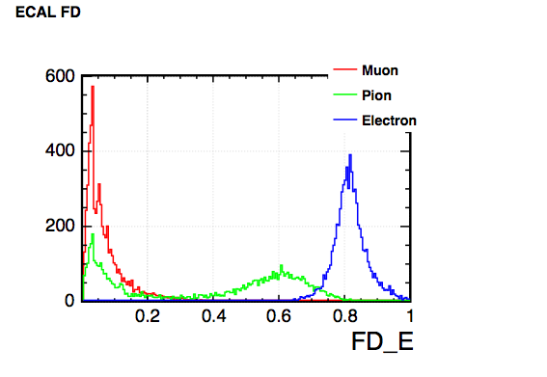
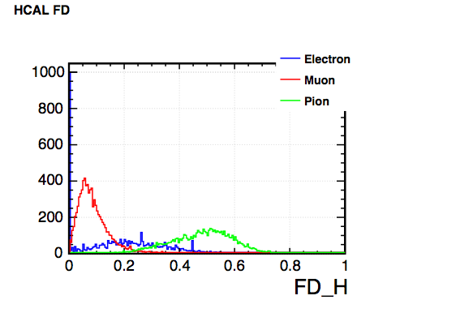
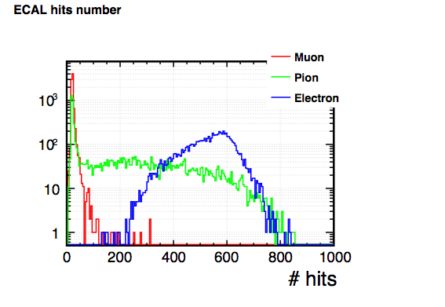
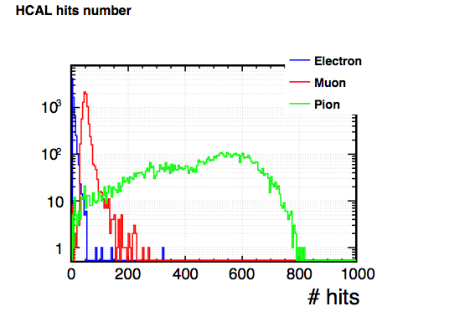
Input Variables

Slide 4
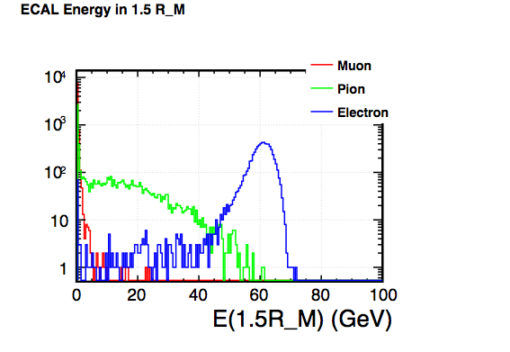
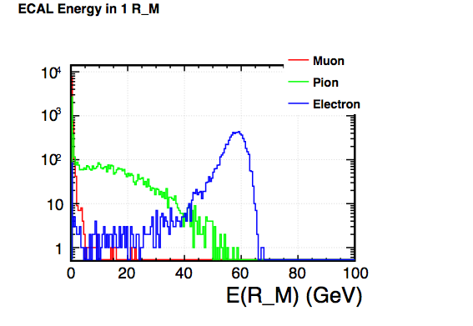
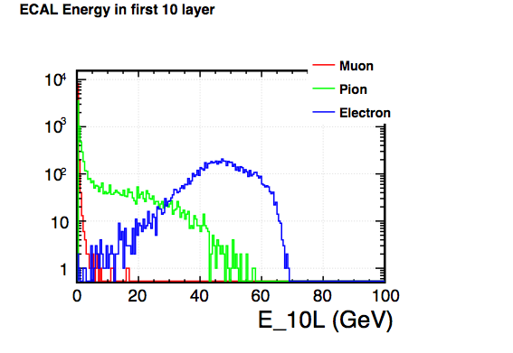
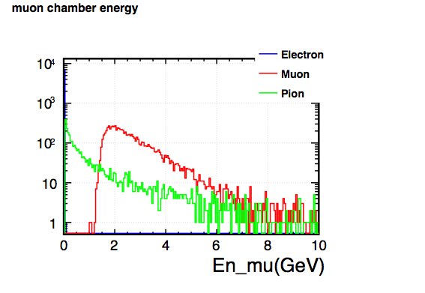
Input Variables

Slide 5
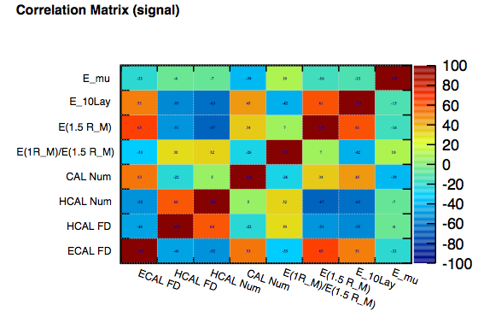
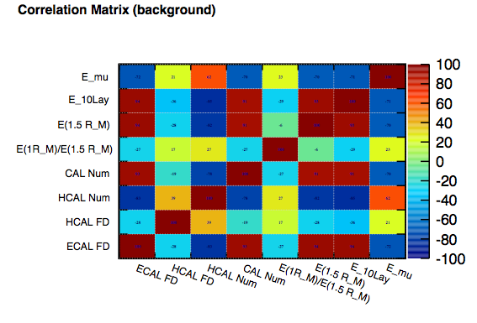
Correlation Matrix (pi+)

Slide 6
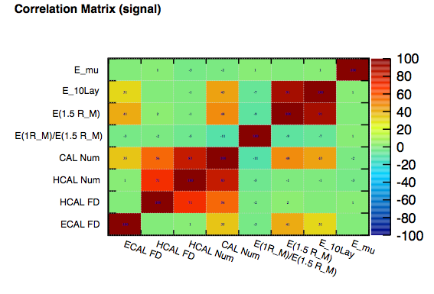
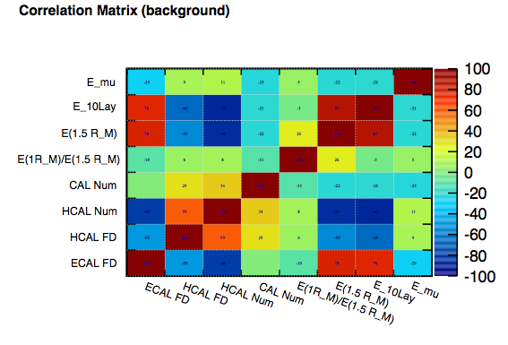
Correlation Matrix (mu-)

Slide 7
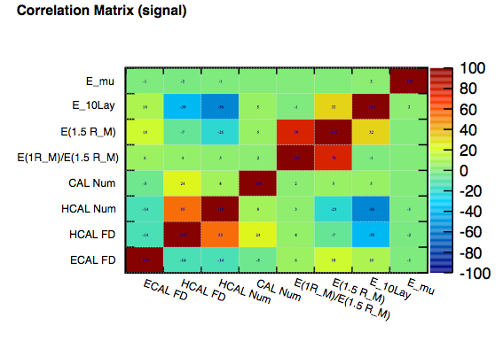
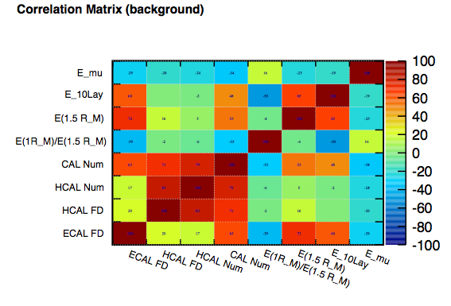
Correlation Matrix (e-)

Slide 8
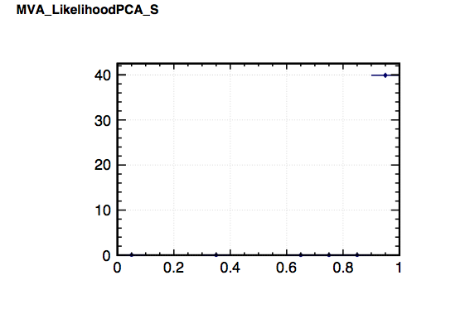
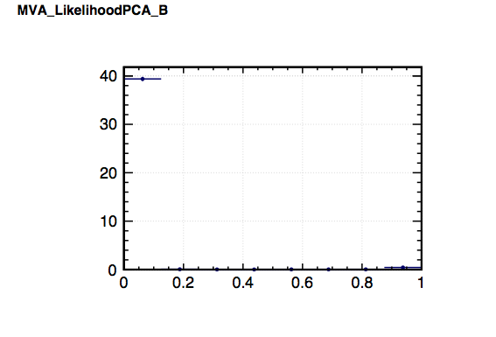
Likelihood PCA (mu)
Cut mu: LikelihoodPCA>0.5
Cut eff: 99.889±0.033%

Slide 9
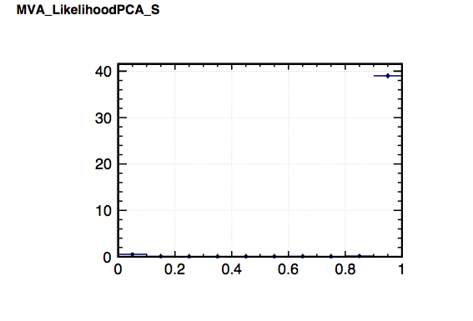
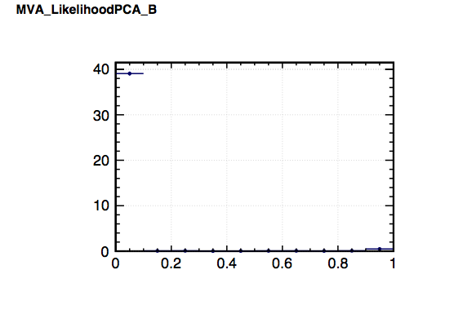
Likelihood PCA (pi)
Cut pi: LikelihoodPCA>0.5
Cut eff: 98.144±0.135%

Slide 10
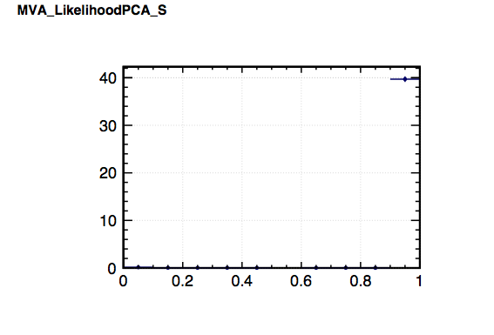
Likelihood PCA (e)
Cut e-: LikelihoodPCA>0.5
Cut eff: 99.372±0.079%

Slide 11
Cut Efficiency
Eff(%) | pi+ cut | mu- cut | e- cut
pi+ | 98.144±0.135 | 1.776±0.132 | 0.080±0.028
mu- | 0.110±0.033 | 99.889±0.033 | 0.001±0.003
e- | 0.556±0.075 | 0.072±0.026 | 99.372±0.079

Slide 12
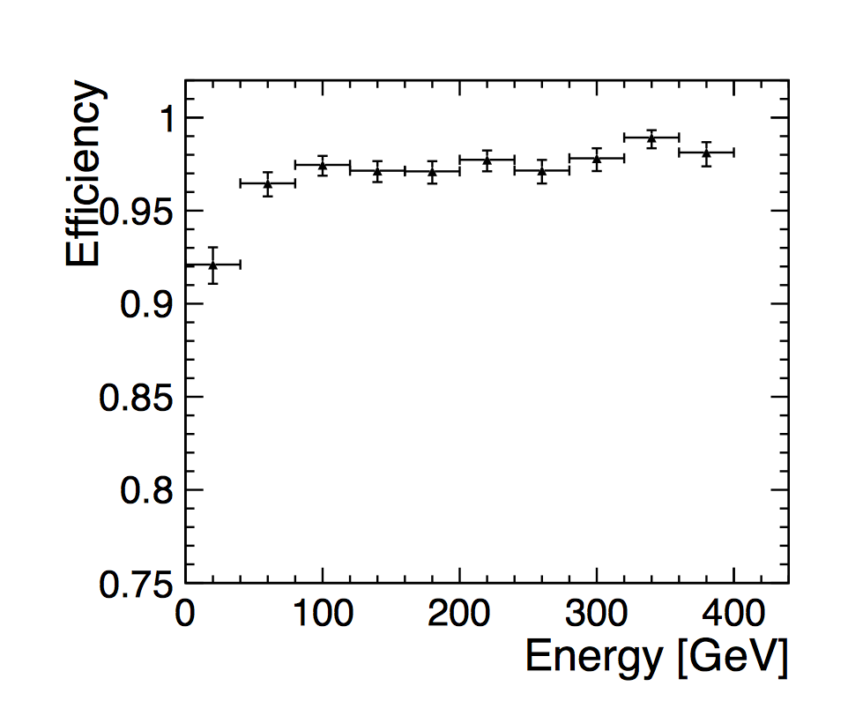
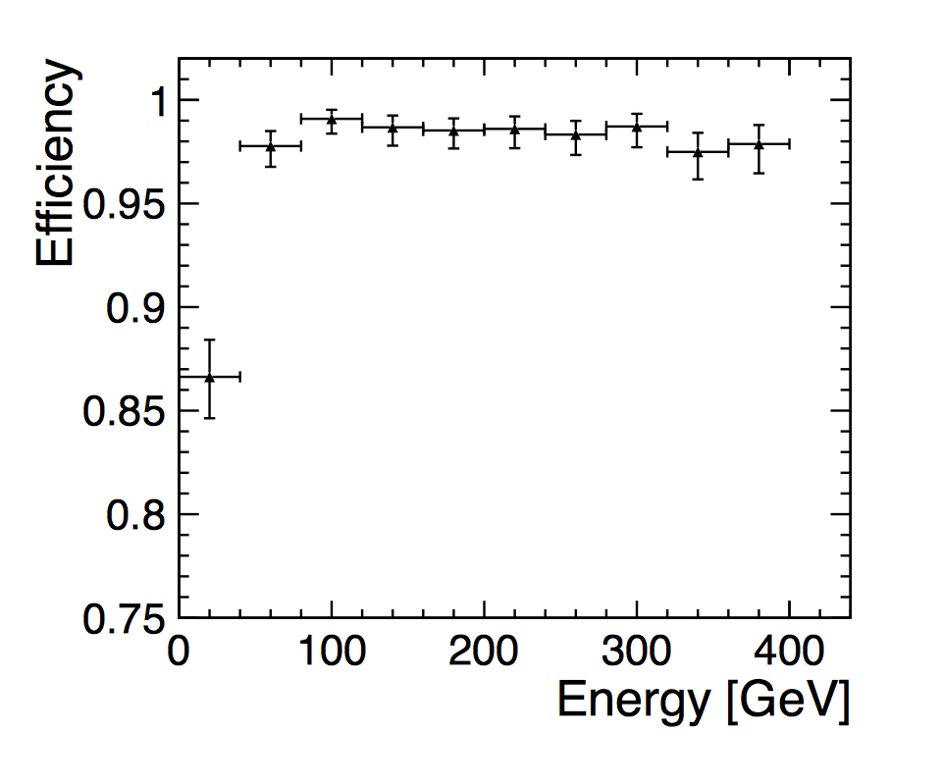
Comparison
Particle ID efficiency for single electrons (left) and pions (right) in the CLIC_ILD detector as a function of the generated particle energy
* From CLIC_CDR 2012

Slide 13
Thank for your attention !

