Slide 1
Revisit BG study 2010
Hiro Nakayama

Slide 2
BG study in 2010
Need to estimate SuperKEKB background
No SuperKEKB loss simulation, no GEANT4 model at that time
Only way is to extrapolate measurement at KEKB
Extrapolation is only based on design Touschek lifetime of SuperKEKB (and assumed vacuum level)
  Shielding effect, collimator efficiency were assumed to be same
Scaling factor is different for each background source
Each background source should be measured separately
→ A. Beam-size scan, B. Vacuum bump, C. luminosity scan was done
A&B: 2+1 days, by Nakayama et al
C: 3day, by C. Kiesling et al

Slide 3
Touschek study (LER)
⓪
Maskを探る
 | Beam size Max(4.3μm) | 3.5μm | 2.8μm | 2.2μm | Beam size Min(1.3mm)
Current Max (1450mA)
1100mA
750mA
Current Min (~300mA)
② （Mask V close）
③ （Mask OPEN）
④ （Mask H close）
⑧
ξ_{y} を変化
⑦ （Mask both open, varyN_{bunch} ）
3点だけ取った
①
Mask
OPEN
⑥ （Mask OPEN）
1.6μmも取った
⑤ （Mask OPEN）
1.6μmも取った
Beam size sweep by changing isizeBump
Currentを変えるとBeam sizeがふらついてしまう
~30 minutes for each run
Notes:
First, We took the data of size sweep at max current for three mask condition.
Then change current andd took data for mask open.

Slide 4
Touschek study:
LER Vopen-Hopen I=1450mA
16:23-16:49
run574 16:14:54-16:57:07
bhsm06:/h063/dstprod/dat/e000073/Rawdata/0000/energy/05/e000073r000574.raw
Event rate=427.84Hz, event num = 1043725
x6 x2

Slide 5
Vacuum bump study:
LER Vclose-Hopen 1450mA
LER(Run856)
22:26 Start
22:35 Mask set to the correct value
22:39-42 Injection, D03 ion-pump OFF
22:42 stop Injection
22:42-46 Run(D03 ion-pump OFF)
22:46 D03 ion-pump ON
22:46-56 Run(default)
22:56-23:51 Run(D02 ion-pump OFF,NEG ON)
23:30 NEG current (70%->80%)
23:51 Run stop
x2

Slide 6
Communication with machine group
Two pre-meetings for brainstorming (April, June)
  Detailed plan for each study item
  Which tuning knob should be used for our purpose?
Studies were performed only during day shifts
  night shifts were for vacuum baking
Report at KCG (machine-detector) meeting next morning after every study

Slide 7
Analysis of BG study data
DAQmon record(or Uehara-database)
  Specify day, hour, min, sec
  Beam life time (0 during injection)
  CDC current, TOF rate, etc..
  those stored every few seconds, sent to KEKB EPICS
Belle raw data
  Taken by Belle DAQ with random trigger
  Extract data from corresponding run
  SVD occupancy, ECL Edep

Slide 8
a. Touschek/Beam-gas machine study
Sugihara(Tokyo)
June 2010
Single beam(HER/LER only), random trigger
Vary vertical beam size to separate Touschek effect from beam-gas effect
Measure SVD,CDC,ECL background level and extrapolate for SuperKEKB based on assumptions

Slide 9
Extrapolation towards SuperKEKB
I: beam current, τ: life time
k: proportional constant
KEKB machine study results can be extrapolated for SuperKEKB
Extrapolation strategy
  Measure k and τ at KEKB by machine study
  Assume same k_{Touschek}, k_{beam-gas}, τ_{beam-gas} at SuperKEKB
  For τ_{Touschek} at SuperKEKB, use optics simulation result
  Other BG (SR, Rad.Bhabha, beam-beam BG) are not included

Slide 10
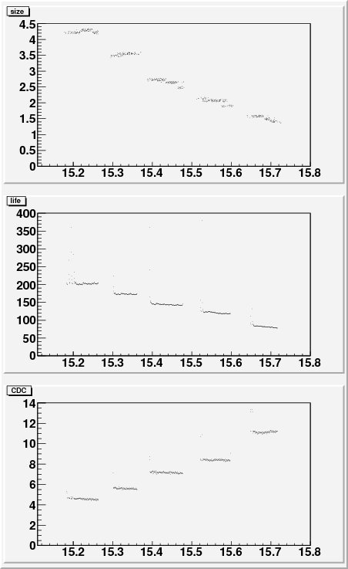
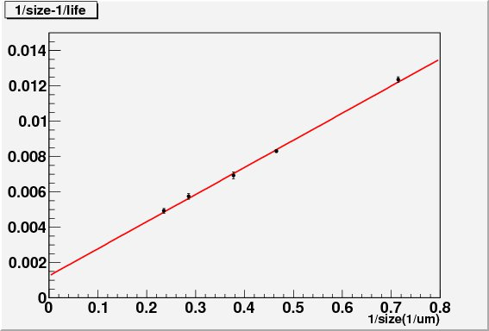
How to measure τ_{Touschek,} τ_{beam-gas}
Beam size(μm)
→smaller
size
Nominal
beam size
(~2um)
1/life (min⁻¹)
(hour)
Beam life(min)
→shorter
life
1/τ_{Touschek}
1/τ_{beam-gas}
(hour)
CDC current(μA)
1/σ_{y} (μm⁻¹)
→moreBG
σ_{y}→∞, Touschek→ 0
(hour)

Slide 11
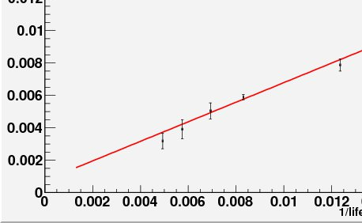
How to measure k_{Touschek,}k_{beam-gas}
Nominal
beam size
(~2um)
CDC BG/i (μA/mA)
slope: k_{Touschek}
slope: k_{beam-gas}
BG_{Touschek}
BG_{beam-gas}
1/life (min⁻¹)
1/τ_{Touschek}
160min→10min
1/τ_{beam-gas}

Slide 12
Extrapolated BG levels at SuperKEKB
Smaller results than DEPFET meeting @Valencia for SVD/PXD is due to >3000electron cut
Assumptions:
Use τ_{Touschek} from optics simulation: 8.7min(LER), 15.3min(HER)
Use same τ_{beam-gas} from KEKB machine study: 800min(LER), 3400min(HER)
Use same k_{Touchek,} k_{beam-gas} from KEKB machine study
CDC 400+-40 uA (cf. ~20uA@2003)
→ ~120 kHz/wire or less at layer 6 or outer
60+-5 GeV/event
→ wave form fitting (x1/7) → ~9 GeV/event
1300+-200 hits/event (>3000 electron)
→ shorter integration time (2μs→75ns)
→ ~400 event/trigger, occupancy: 0.7%+-0.01% <10% (SVD2)
(estimated from SVD, >3000 electron)
→ 3.2M pixels in 1st layer, integration time: 20μs
→ Occupancy = 1.0±0.1%
(not including low-pt tracks or <few keV gammas)
CDC
CDC
ECL
LER/total: 60~70%,
Touschek/total: >90%
SVD
PXD
SR, QED, beam-beam BG are not included
PXD 1st: 14mm
SVD2 1st : 30mm

Slide 13
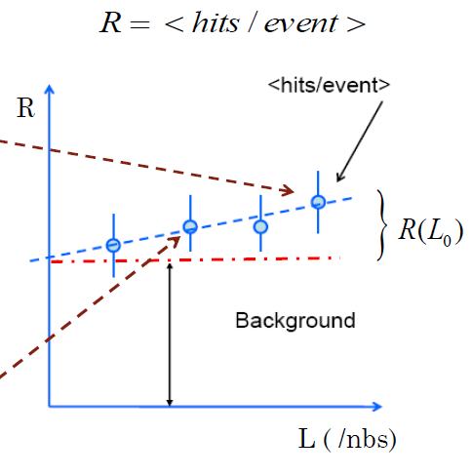
QED machine study
MPI
May 2010
Both beam colliding, random+Bhabha trigger,
Vary luminosity to separate lumi-dependent contribution
  Change vertical beam separation/vertical beam size/beam current
Measure SVD hit multiplicity
  Lumi-dependent but non-QED
  components are removed by
  correction using CDC currents.
  (we expect no QED hits on CDC)
Lumi-dependent

Slide 14
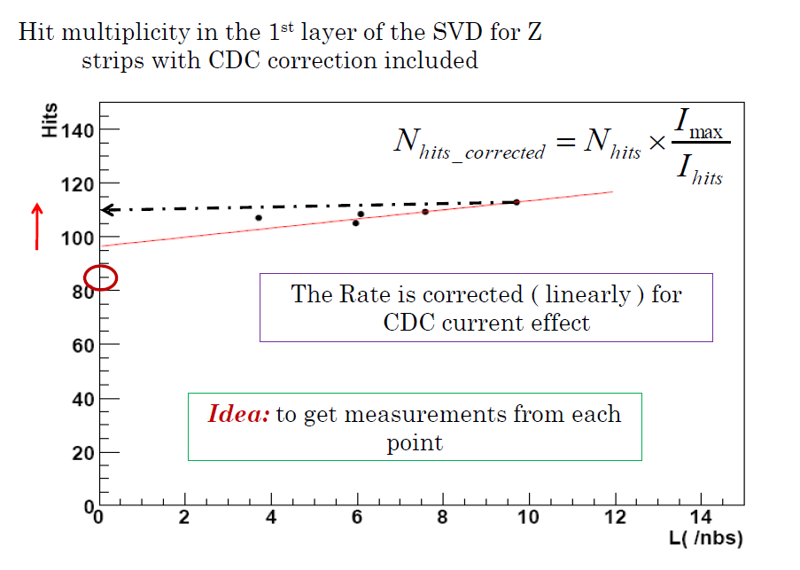
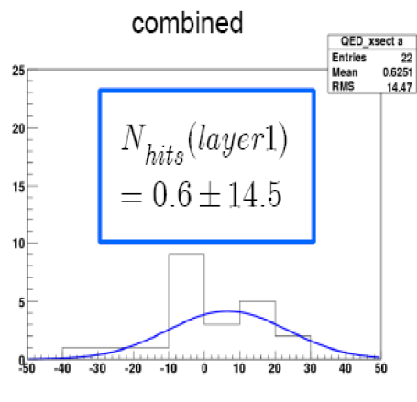
SVD hit rate vs. luminosity
z/phi
  Our MC expect 1.5 hits@ 1st layer at 10/nb, while SuperB MC expect 22hits
Elena (BG meeting 3rd Aug.)

Slide 15
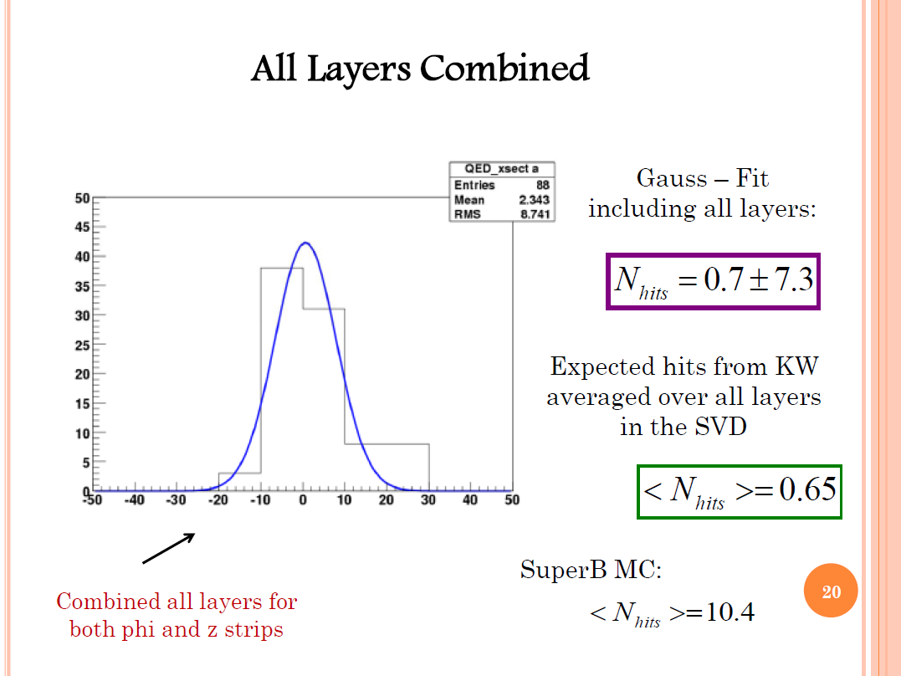
Another approach by reconstructed tracks is ongoing (A. Moll)
Elena (BG meeting 3rd Aug.)

Slide 16
literatures
Belle2notes for Touschek/Beam-gas study (chap. 3)
https://belle2.cc.kek.jp/~twiki/bin/view/Archive/Belle2note0005
Belle2notes for QED study
https://belle2.cc.kek.jp/~twiki/bin/view/Archive/Belle2note0012
Reports at BGM, daily report slides at KCG meetings, etc
https://www.dropbox.com/sh/ws2nyeju3q16jhw/AABhnahmhFyQ82lfC4mt1GZla?dl=0

Slide 17
Remarks for phase2 planning
Phase2 is most similar to physics run situation, but still different from it
  Smaller beta function (less Toucheck, Beam-gas)
  Worse vacuum level (more Beam-gas)
  Smaller luminosity (less RBB/2-photon)
  VXD only located at phi=0 (other directions are not checked by VXD)
We still need some extrapolation (based on simulation etc..), which is different for each background source.
Disentangle each contribution is still important for extrapolation
How beast sensors can contribute to more reliable extrapolation?
Sub-detector data-taking mode should also be cared
Other purpose of phase2
  “playground” for the functions needed for physics run
  Beam abort/interlock, collimator control (incl. feedback), SuperKEKB-Belle communication, etc…
  Whole Belle DAQ, ROI finding, Injection Veto, etc…

Slide 18
backup

Slide 19
BG study
S.Sugihara (Univ. of Tokyo)
2010.07.01
Notes:
I will report the BG study
To estimate BG of super KEKB

Slide 20
Beam background at superKEKB
BG sources :
Touschek effect
Beam-gas scattering
(SR light)
(Radiative Bhabha)
To estimate BG levels at superKEKB,
we need to know k_{vac,}k_{tou,} and τ_{vac}^{KEKB} ,τ_{tou}^{KEKB},τ_{vac}^{superKEKB} ,τ_{tou}^{superKEKB}
Notes:
Possible BG sources at superKEKB are touschek effect, beam-gas scattering, sinchrotron radiation, radiative bhabha scattering.
In this study, we estimate the BG from toudchek and beam-gas scattering.
Ignore the other BG
To estimate BG of super KEKB , we used this equation. This equation sais BG should be proportional to beam current over lifetime.
To estimate BG, we need to measure proportional constant and life time of current KEKb of each BG source.
For each BG source.
We measure 4 parameter and we know life time of super KEKB
We take the data of CDC current ,SVD PIN diode,TOF hit rates ,ECL hit count.

Slide 21
Previous BG study in 2009
2009
Touschek : beam size dependence only
Vacuum : life time decrease not enough to calculate k_{vac}
2010
Touschek :beam size dependence,
(bunch) current dependence,
N bunch dependence(LER),
mask dependence
vacuum : change vacuum level much worse
Notes:
This is the results of previous BG study.
For touschek BG, we took the data of beam size sweep only.
So we took bunch current dependence , number of bunch dependence, mask condition dependence this time.
For beam-gas BG, life time decrease not enough to calculate constant for beam-gas BG last year.
So we change vacuum level worse.

Slide 22
Touschek study
(2010/06/7-8)

Slide 23
Movable mask settings for Touschek LER
D06/D03, H1/H2/H3/H4/V1/V2/V3/V4
H_close=12
H_open=20
V_close=physics run setting
V_open=V_close+1.0(D03V4:V_close+0.5)
Notes:
This is a mask condition.
We changed the mask at D6 and D3.
Horizontal mask close ,we set the horizontal mask at 12 mm.

Slide 24
Mask dependence(LER)
CDC current(uA)
Current=1450mA
Both open
H close
V close
1/life(1/min)
Horizontal masks reduce Touschek BG when vertical masks are open.
Notes:
This is mask dependence of CDC currrent as a function of inverse size.
Red line is mask open,green s horizontal close,
This plot means, horizontal masks reduce touschek BG when vertical mask open.

Slide 25
Current dependence(LER)
CDC current per beam curret (uA/mA)
1/life(1/min)
mask: both open
1450mA
1100mA
750mA
1/life(1/min)
BG is proportional to the beam current.
Notes:
BG is proportional to the beam current.
1450
Similar BG level

Slide 26
N_{bunch} dependence(LER)
1/life (min)
N_{bunch}=1585(normal)
N_{bunch}=796(half)
1/size(1/μm)
same I_{bunch}
I_{bunch}=1485mA/1585
Notes:
Contaminant by injection
Even though life time is the same the N bunch changes

Slide 27
Movable mask settings for Touschek HER
D09/D12, H1/H2/H3/H4/V1/V2/V3/V4
H_close=13 (D12H4:19)
H_open=20 (D12H4:19)
V_close=physics run setting
V_open=V_close+1.5(D09V1,D12V1:V_close+1.0)

Slide 28
Mask dependence(HER)
CDC current(uA)
Both open
H close
V close
Negative slope
in case of H close
1/life(1/min)
Current=850mA
Notes:
When beam size is large, beam hits horizontal mask (when closed) and generates more BG.
Negative slope in case of H close

Slide 29
Current dependence(HER)
CDC current per beam curret (uA/mA)
850mA
650mA
400mA
BG is proportional to the beam current.
1/life(1/min)
mask: both open
Notes:
Within 30 % error

Slide 30
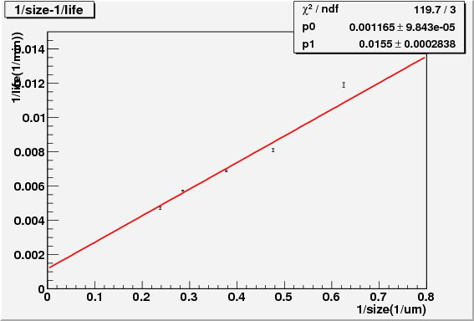
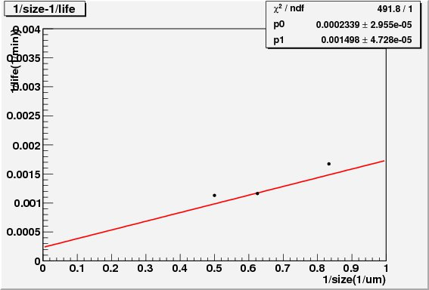
Summary(1) – Touschek
1/life(1/min)
1/life(1/min)
LER 1450mA
V close
HER 850mA
V close
1/τ_{Touschek}
1/τ_{Other}
1/τ_{Touschek}
1/τ_{Other}
1/size(1/um)
1/size(1/um)
When size=~2um(nominal),
1/τ_{Tou} = 0.87 x 1/τ_{total}
When size=~1.5um(nominal),
1/τ_{Tou} = 0.81 x 1/τ_{total}
Notes:
This graph shows the inverse
Error of each data is error of mean at each beam size.
If beam size is smaller life of touschek become small although 1/lief_other is the same value
From this fitting , we get the life time of touschek and other BG.
Nominal beam size of KEKb is 2 um,
Inverse life time of touschek BG is 7.4 times larger than other BG.

Slide 31
Summary(1) –cont.
CDC cur./beam cur.(μA/mA)
CDC cur./beam cur.(μA/mA)
LER 1450mA
V close
HER
850mA
V close
1/life(1/min)
1/life(1/min)
K_{tou}=0.67(μA/mA*min)
K_{tou}=0.89(μA/mA*min)
Notes:
傾き=slope
Ten to the power of fifth = 10^5

Slide 32
Vacuum bump study
(2010/06/23)

Slide 33
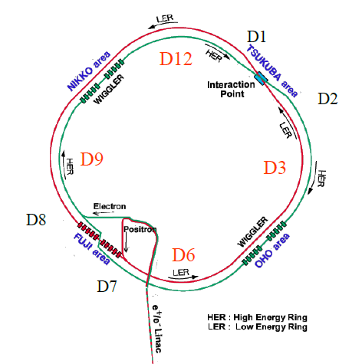
We changed vacuum level at
  D12(ion pump),D1(ion pump ,NEG) :HER
  D3(ion pump),D2(ion pump,NEG) :LER
To calculate k_{vac}(=Δ BG/Δ(1/τ)) ,
we made vacuum level much worse than 2009
(*beam energy changed from Touschek study)
Notes:
LER:3.5892→3.6438
HER:8.2038→8.3286GeV)

Slide 34
Mask settings for Vacuum bump study
D09/D12, H1/H2/H3/H4/V1/V2/V3/V4(HER)
D06/D03, H1/H2/H3/H4/V1/V2/V3/V4(LER)
H_open=20(D12H4:19)
V_close=physics run setting
Notes:
This is a mask condition.
We opened Horizontal mask, annd use vertical mask of physics run setting

Slide 35
HER vacuum
K_{vac (D1)}=50±(1E-4) μA*min/mA
CDC current/beam current(uA/mA)
D1 NEG
current= 850mA
1/life(1/min)
Current=850mA
Notes:
K vac

Slide 36
LER vacuum
K_{vac(D2)}=9.2±(3.4E-5) μA*min/mA
CDC current/beam current(uA/mA)
D2 NEG
current= 1450mA
1/life(1/min)

Slide 37
summary
 | K_{vac}(CDC) | τ_{vac} | K_{tou} (CDC) | τ_{tou} | τ_{total} | CDC current
HER(KEKB) | 50 | 4275 | 0.89 | 1002 | 811 | 10.5
LER(KEKB) | 9.2 | 858 | 0.67 | 129 | 112 | 23.1
From this BG study
Total:33.6
 | K_{vac}(CDC) | τ_{vac} | K_{tou} (CDC) | τ_{tou} | τ_{total} | CDC current
HER(superKEKB) | 50 | 4275 | 0.89 | 10 | 10 | 262
LER(superKEKB) | 9.2 | 858 | 0.67 | 5 | 5 | 521
From latest optics simulation
Same as KEKB
Total:783
→Total BG is 23 times higher than current KEKB BG.

Slide 38
To do
Analysis for BGs on other detectors
  SVD PIN diode
  TOF rates
  ECL hit count

Slide 39
backup

Slide 40
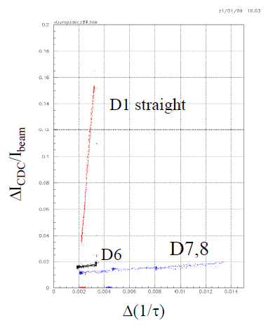
Comparison with 2003
 | K_{tou}(LER) | K_{vac}(HER D1)
2003 | 0.11 | 120
2010 | 0.67 | 50
2003 vacuum bump study
Notes:
If mask setting is difference, this slope changes. we are now checking the setting of 2003 setting

Slide 41
2009 result(Touschek)
2009.12.7 18:10-18:53(HER)
2009.12.8 15:30-16:00(LER)
1/τ min
1/τ min
KLER = 0.037
KHER = 0.0012
1/σy μm
1/σy μm
cut for fit
Ratio of touschek and others
We can see Touschek effect for both HER and LER
Notes:
Touschek 効果が見えました。

Slide 42
2009 result(vacuum)
Life time/min
2009/12/07 19:00-21:20(HER)
D12
D1
CDC current/μA
Life time didn’t change enough to calculate K_{vac}
Average vacuum 10⁻⁹Pa
Notes:
Beam life time didn’t change enough to calculate k_vac
Life time が変化しなかった。

Slide 43
run summary(LER Touschek)
Run No. | time | mask | Current(mA) | σ_{y}(μm) | Ring
564 | 12:04-13:15 | open | 350-1450 | 1 | LER | Current sweep
567 | 15:12-15:43 | V close | 1450 |  | LER | Size sweep(1450mA Vclose)
574 | 16:23-16:49 | open | 1450 |  | LER | Size sweep(1450mA open)
575 | 17:04-17:43 | H close | 1450 |  | LER | Size sweep(1450mA H close)
576 | 18:34-19:10 | open | 750 |  | LER | Size sweep(750mA open)
577 | 19:31-19:57 | open | 1100 |  | LER | Size sweep(1100mA open)
580 | 21:05-21:28 | open |  |  | LER | Size sweep(Nbunch=half open)
584 | 22:15-22:35 | open |  |  | LER | ξ_{y}sweep

Slide 44
run summary(HER Touschek)
Run No. | time | mask | Current(mA) | σ_{y}(μm) | Ring
594 | 12:37-13:12 | open | 850 |  | HER | Size sweep(850mA open)
595 | 13:40-14:05 | V close | 850 |  | HER | Size sweep(850mA V close)
596 | 14:40-15:01 | H close | 850 |  | HER | Size sweep(850mA H close)
597 | 15:28-15:58 | open | 400 |  | HER | Size sweep(400mA open)
598 | 16:51-17:20 | open | 650 |  | HER | Size sweep(600mA open)

Slide 45
LER touschek

Slide 46
Touschek study (LER)
⓪
Maskを探る
 | Beam size Max(4.3μm) | 3.5μm | 2.8μm | 2.2μm | Beam size Min(1.3mm)
Current Max (1450mA)
1100mA
750mA
Current Min (~300mA)
② （Mask V close）
③ （Mask OPEN）
④ （Mask H close）
⑧
ξ_{y} を変化
⑦ （Mask both open, varyN_{bunch} ）
3点だけ取った
①
Mask
OPEN
⑥ （Mask OPEN）
1.6μmも取った
⑤ （Mask OPEN）
1.6μmも取った
Beam size sweep by changing isizeBump
Currentを変えるとBeam sizeがふらついてしまう
Notes:
First, We took the data of size sweep at max current for three mask condition.
Then change current andd took data for mask open.

Slide 47
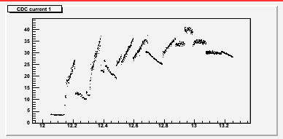
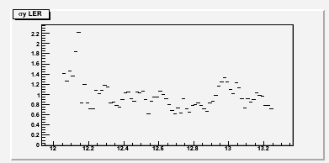
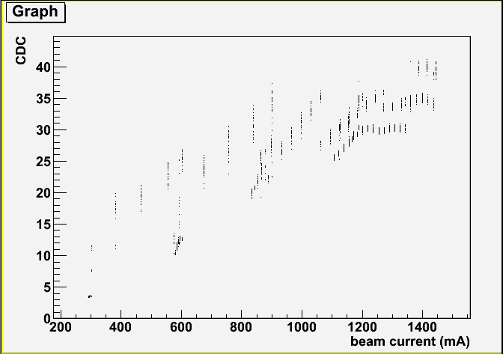
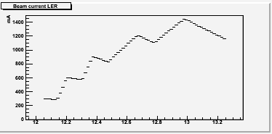
① Current sweep
I: 300→1450mA
σ: 1.5μm
Mask: both open
CDC current
Very unstable beam size
→ Difficult to see current dependence only
Beam size
Beam Current

Slide 48
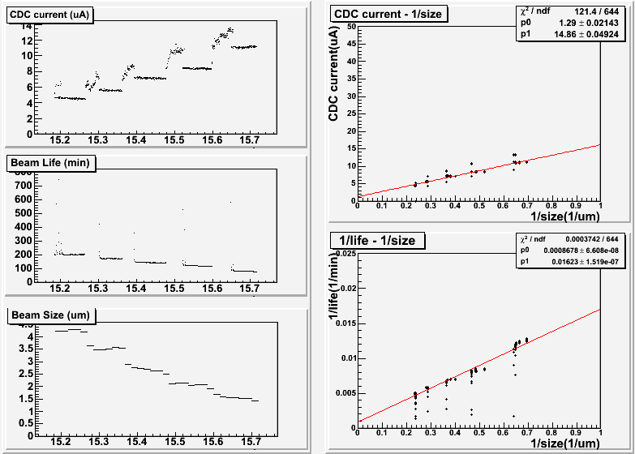
② Size sweep (V close)
I: 1450mA
σ: 4.3→1.0μm
Mask: V close
hour
hour
hour

Slide 49
② Size sweep (V close)
I: 1450mA
σ: 4.3→1.0μm
Mask: V close
Horizontal beam size(um)

Slide 50
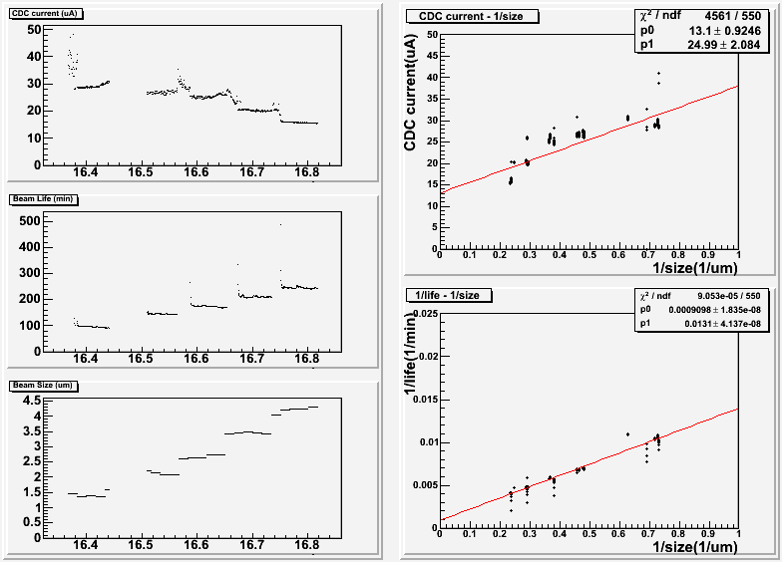
③ Size sweep (both open)
I: 1450mA
σ: 1.4→4.2μm
Mask: V/H open
hour
hour
hour

Slide 51
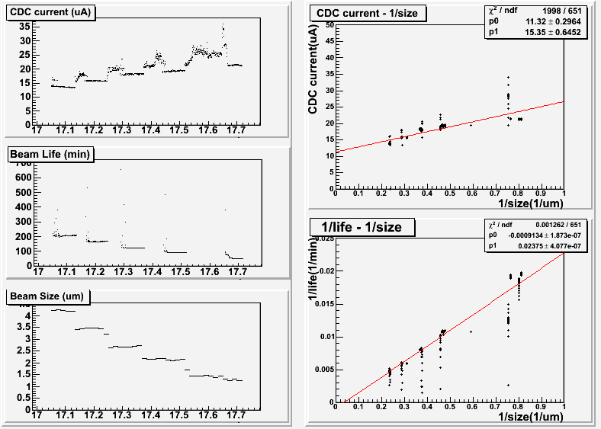
④ Size sweep (H close)
I: 1450mA
σ: 4.2→1.0μm
Mask: H close
hour
hour
hour

Slide 52
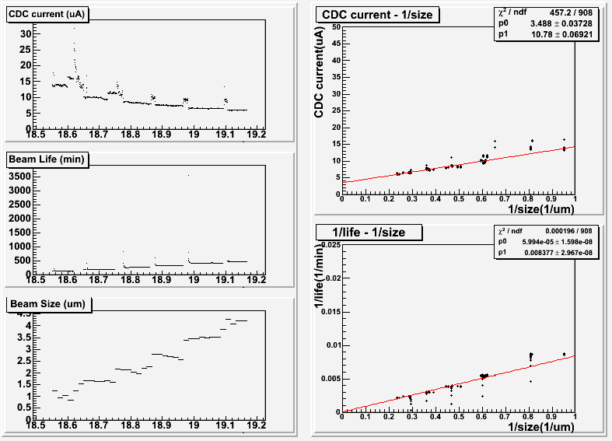
⑤ Size sweep (@750mA)
I: 750mA
σ: 1.1→4.2μm
Mask: V/H open
hour
hour
hour

Slide 53
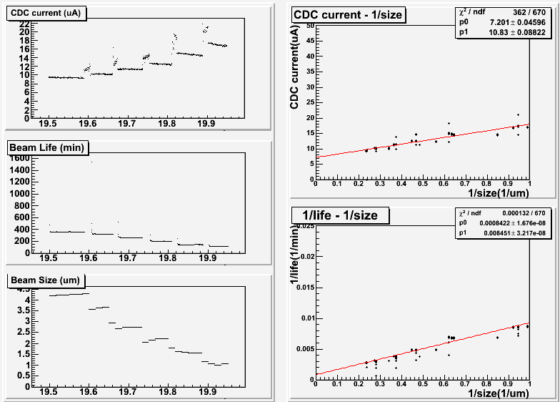
⑥ Size sweep (@1100mA)
I: 1100mA
σ: 4.3→1.2μm
Mask: V/H open
hour
hour
hour

Slide 54
Mask dependence(LER TOF)
TOF rates(Hz)
Both open
H close
V close
1/life(1/min)
Notes:
Vcloseを1/life=0に外挿すると、０になる。CDCも同じ

Slide 55
HER touschek

Slide 56
Touschek study (HER)
⓪
Maskを探る
ibumpを探る
 | Beam size Max(3.4μm) | 2.8μm | 2.1μm | 1.7μm | Beam size Min(1.2mm)
Current Max (850mA)
650mA
400mA
Current Min (~200mA)
① （Mask OPEN）
② （Mask V close）
③ （Mask H close）
⑤ （Mask OPEN）
④ （Mask OPEN）

Slide 57
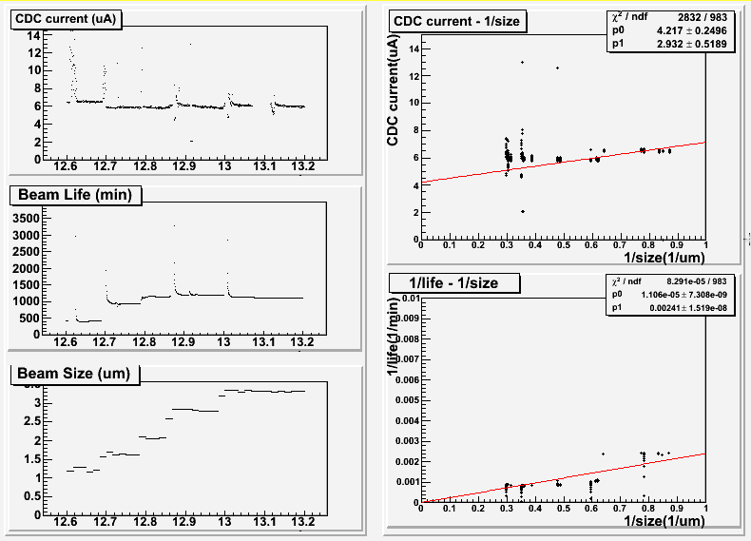
① Size sweep (both open)
I: 850mA
σ: 1.2→3.4μm
Mask: V/H open
1/life

Slide 58
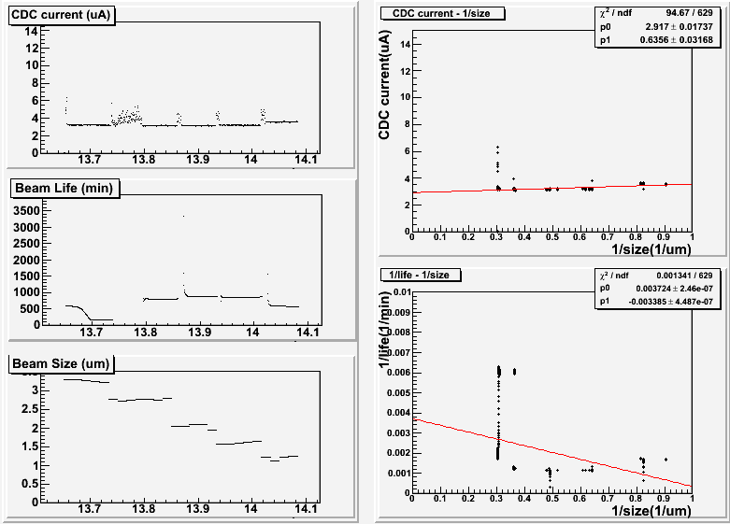
② Size sweep (V close)
I: 850mA
σ: 3.3→1.2μm
Mask: V close
Negative slope?

Slide 59
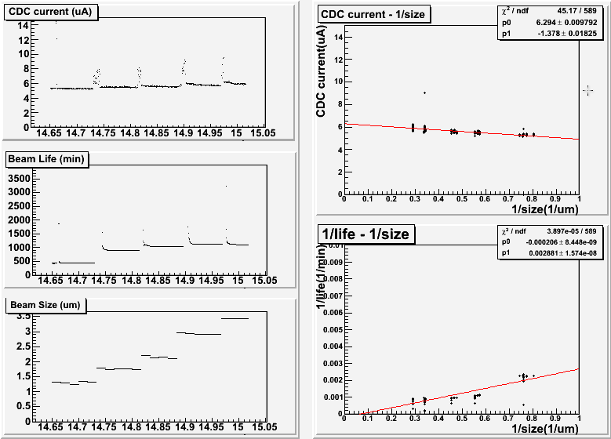
③ Size sweep (H close)
I: 850mA
σ: 1.4→3.4μm
Mask: H close
BG increase with larger beam size?
Negative slope?

Slide 60
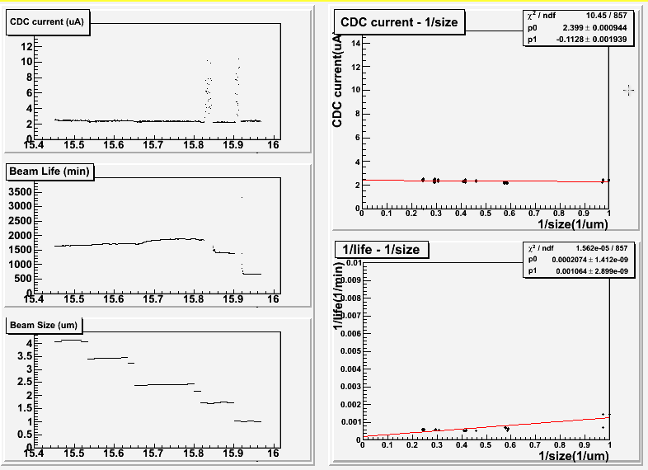
④ Size sweep (@400mA)
I: 400mA
σ: 4.0→1.0μm
Mask: V/H open
Negative slope?

Slide 61
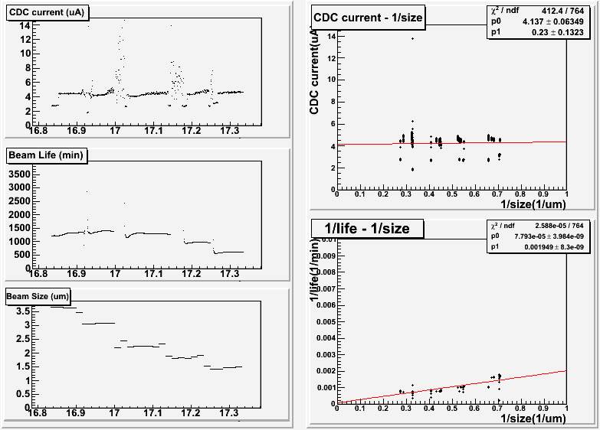
⑤ Size sweep (@650mA)
I: 650mA
σ: 3.6→1.4μm
Mask: V/H open

Slide 62
Summary (1) (touschek ,LER vclose)
1/life(1/min)
LER 1450mA
Vclose
1/size(1/um)
Projection,
Notes:
This is the inverse life of LER when vertical mask close as a function of inverse size.
To fit the graph, I split the data by each beam size region ,then calculate mean and error of mean at each beam size.

Slide 63
vacuum

Slide 64
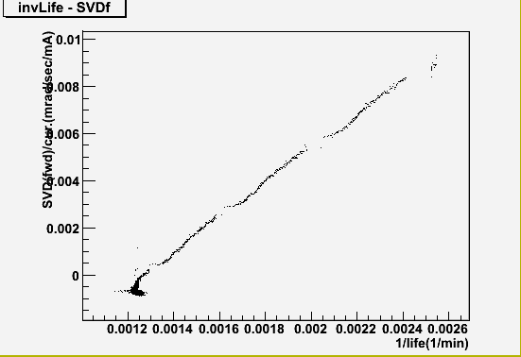
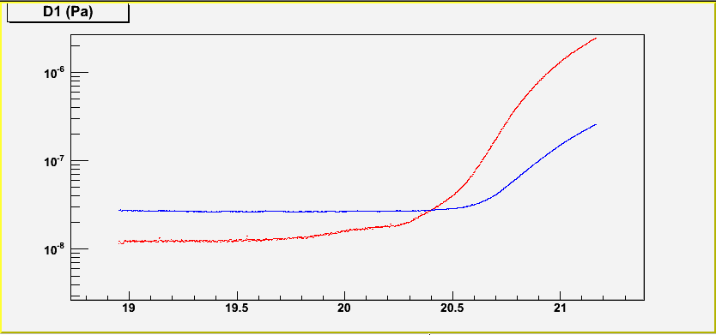
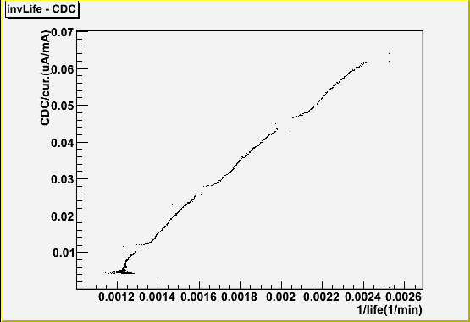
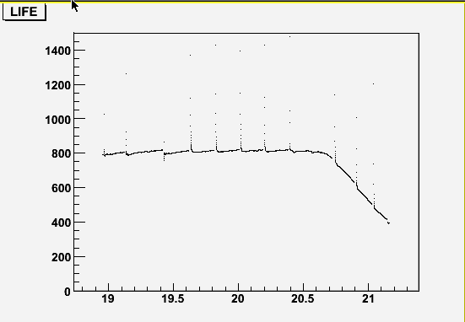
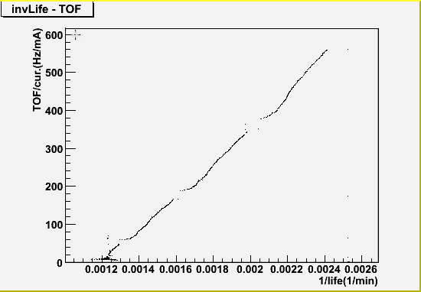
HER Vacuum bump
Run 854 (6/23 18:37-21:10)
I=850mA, σy=2.1um, Mask: V close
SVD
D1 NEG ON
D1
Average
CDC current =40uA, stop
CDC
TOF

Slide 65
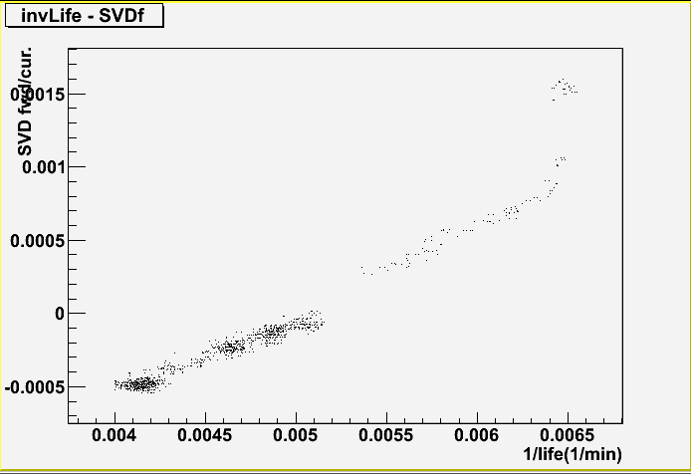
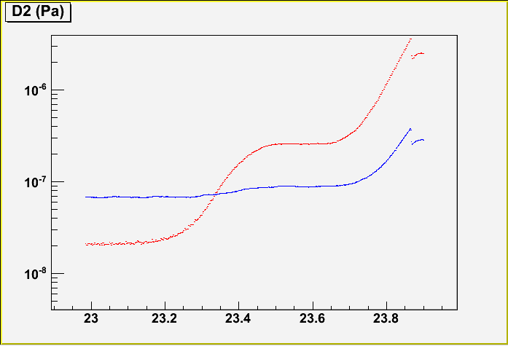
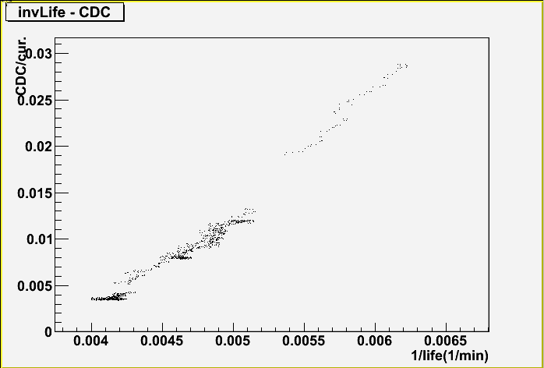
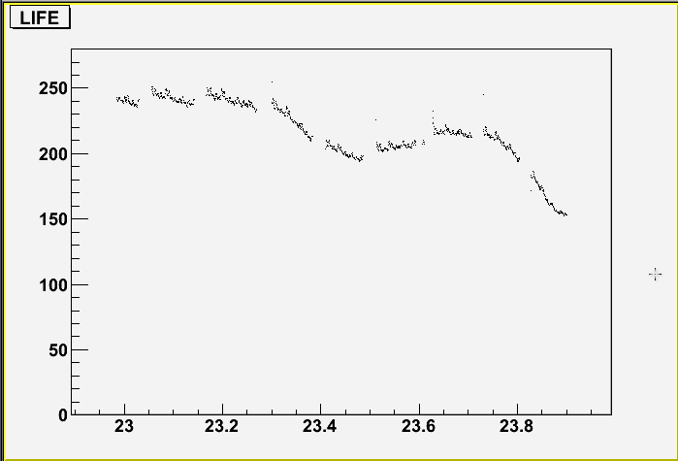
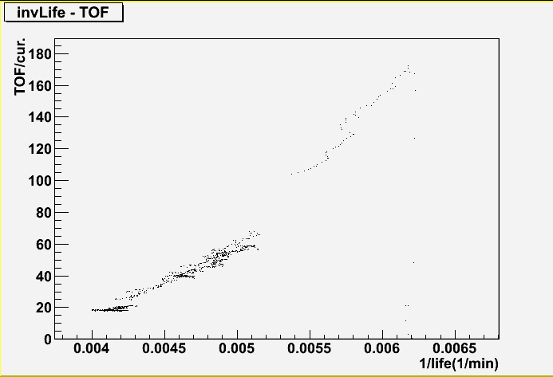
LER Vacuum bump
Run 856 (6/23 22:26-23:51)
I=1450mA, σy=4.2um, Mask: V close
SVD
D2 NEG ON
D2
Average
CDC current =40uA, stop
CDC
TOF

Slide 66
Summary(LER)
 | K_{vac}(CDC) (μA/mA*min) | K_{tou} (CDC)(μA/mA*min) | τ_{vac} / τ_{tou}
HER | 50 | 0.89 | 4.3
LER | 9.2 | 0.67 | 6.7
HER : 800min→ 10min
LER : 110min → 5min
If touschek is dominant
LER 1/τ :0.0093◊0.2
1/τ_{tou} :0.0078→ 0.2 1/τ_{other} 0.001165→ 0.001165(assumption)
BG is 23 times higher than KEKB
superKEKB/KEKB
=(0.2*0.67 + 0.001165*9.2 ) * 3600 / (0.0078*0.67 + 0.001165*9.2) * 1450
=521/23.1 = 22.6

Slide 67
Summary(HER)
 | K_{vac}(CDC) (μA/mA*min) | K_{tou} (CDC)(μA/mA*min) | τ_{vac} / τ_{tou}
HER | 50 | 0.89 | 4.3
LER | 9.2 | 0.67 | 6.7
HER : 800min→ 10min
LER : 110min → 5min
If touschek is dominant
HER 1/τ :0.0017◊0.1
1/τ_{tou} :0.000997→ 0.1 1/τ_{other} 0.000234→ 0.000234(assumption)
BG is 24 times higher than KEKB (HER)
SuperKEKB/KEKB
=(0.1*0.89 + 0.000234*50)*2600 / (0.000997*0.67+0.000234*50) * 850
=262/ 10.5 = 24.6

Slide 68
Summary(total BG)
KEKB LER + HER = 23.1 + 10.5 = 33.6
SuperKEKB LER + HER = 521 + 262 = 783
23 times higher than current KEKB

Slide 69
Worst case(injector limit)
HER : 600min→ 3min
LER : 110min → 2min
HER
SuperKEKB/KEKB =(1/3*0.89 + 0.000234*50 ) * 2600 / (0.000997*0.67 + 0.000234*50) * 850
=801/ 10.5 = 76
LER
superKEKB/KEKB =(0.5*0.67+0.001165*9.2)*3600 / (0.0078*0.67 +0.001165*9.2) * 1450
=1245/23.1 = 54
Total
(1245+801)/(23.1+10.5) = 61

