Slide 1
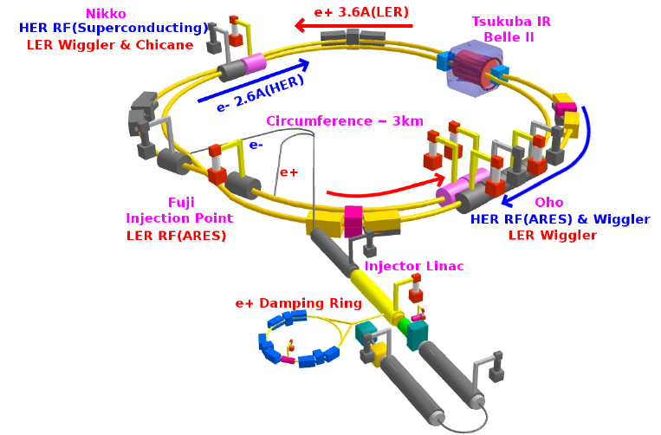
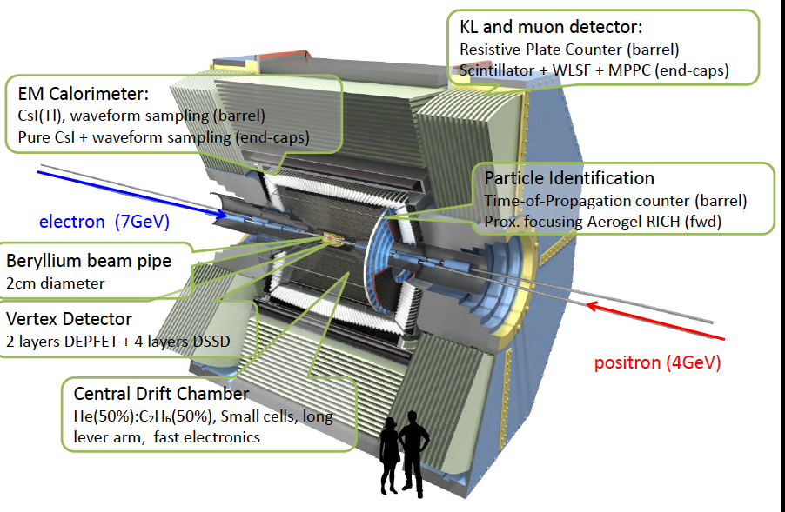
SuperKEKB background simulations
7GeV(e-), 4GeV(e-)
Hiroyuki Nakayama (KEK)
Strasbourg, Jan. 19th, 2015

Slide 2
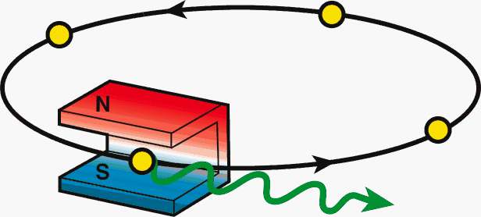
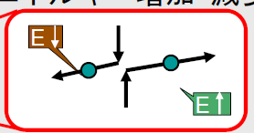
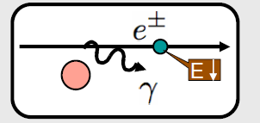
Beam background at SuperKEKB
At SuperKEKB with x40 larger Luminosity, beam background will also increase drastically.
Touschek scattering
Beam-gas scattering
Synchrotron radiation
Radiative Bhabha event: emitted γ
Radiative Bhabha event: spent e+/e-
2-photon process event: e+e-→e+e-e+e-
etc…
Beam-origin
Luminosity dependent
e⁺
e⁻
e⁻
Notes:
In this slide, I have listed up variety of possible beam background sources at SuperKEKB.
Among these background sources, so-called “Touschek scattering” will be the most difficult one to cope with, which I will explain in more detail in the following slides.

Slide 3
1.Touschek scattering
Intra-bunch scattering : Rate∝(beam size)⁻¹,(E_{beam})⁻³
Touschek lifetime: assume 600sec (required by injector ability)
→ total beam loss: 375GHz (LER), 270GHz(HER)
Horizontal collimators to reduce loss at IR (|s|<4m)
collimators before IP (|s|<200m) are very effective
Collimator width
Initial values:
Further optimization to balance IR loss and beam lifetime
Smaller loss rate on the final collimators (|s|<20m) is preferred
After careful optimization of collimators, IR loss is <0.3GHz now
3 orders smaller than ring total loss

Slide 4
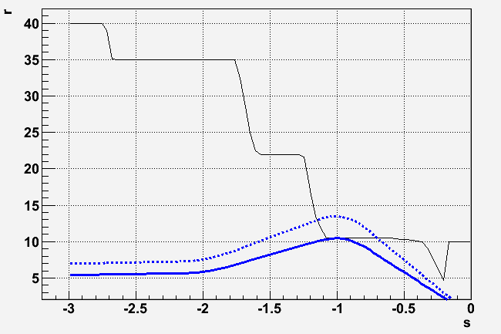
2.Beam-gas scattering
Brems
Coulomb
Scattering by remaining gas, Rate ∝IxP
Due to smaller beam pipe aperture and larger
maximum βy, beam-gas Coulomb scattering could be more dangerous than in KEKB
mm
SuperKEKB LER
 | KEKB LER | SuperKEKB LER
QC1 beam pipe radius: r_{QC1} | 35mm | 13.5mm
Max. vertical beta (in QC1): β_{y,QC1} | 600m | 2900m
Averaged vertical beta: <β_{y}> | 23m | 50m
Min. scattering angle: θ_{c} | 0.3mrad | 0.036mrad
Beam-gas Coulomb lifetime | >10 hours | 35min
Physical aperture
(vertical)
e+
85σ
66σ
[m]

Slide 5
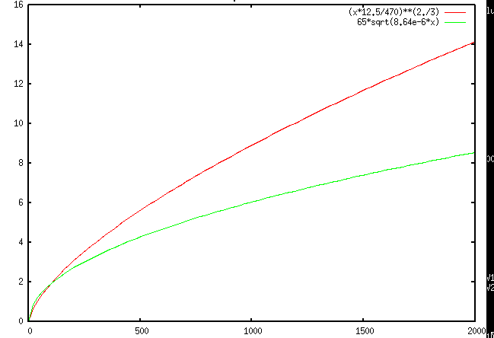
Where we should put vertical collimator?
Collimator position
Collimator aperture should be narrower than QC1 aperture.
d[mm]
TMC:
TMC instability should be avoided.
Aperture
Assuming following two formulae:
> 1.44 mA/bunch (LER)
beta[m]
taken from “Handbook of accelerator
physics and engineering, p.121”
Kick factor
(in case of rectangular collimator window)
We should put collimator where beta_y is SMALL!
For more details , please check out following paper:
H. Nakayama et al, “Small-Beta Collimation at SuperKEKB to Stop Beam-Gas Scattered Particles and
to Avoid Transverse Mode Coupling Instability”, Conf. Proc. C 1205201, 1104 (2012)
Notes:
d[mm], beta[m]
beta* 12.5/sqrt(d^3) < 470 → sqrt(d^3) < beta * 12.5 / 470 → d < (beta*12.5/470)^(2/3)
d/1000/sqrt(8.64e-12*beta)) > 65 → d > 65 * sqrt(8.64e-6*beta)
betax8, dx4,Nsigmaxsqrt(2)

Slide 6
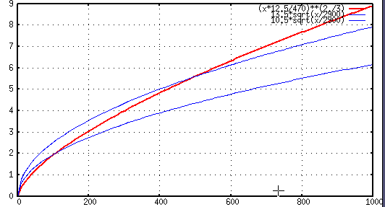
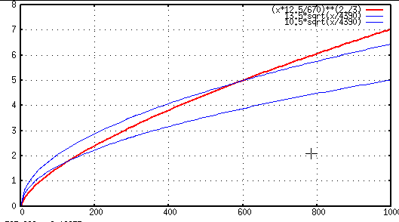
Candidate collimator locations
TMC condition
r=13.5mm
r=13.5mm
Collimator width d[mm]
TMC condition
(r=10.5mm)
(r=10.5mm)
LER
HER
beta_y [m]
beta_y [m]
lerfqlc_1604
herfqlc5605
V1 collimator @ LLB3R (downstream)
(s=-90→-82m, βy=30→146m)
βy=125m, 2.23mm<d<2.81mm
V1 collimator @ LTLB2 (downstream)
(s=-63→-61m, βy=81→187m)
βy=123m, 1.74mm<d<2.26mm
Ny(V1)= 42.82, Ny(QC1)= 44.32
Ny(V1)= 1.25, Ny(QC1)= 0.25
Collimator position should satisfy beta_y condition above,
need space(at least 1.5m), and the phase should be similar to QC1

Slide 7
Vertical collimator width vs. Coulomb loss rate, Coulomb life time
ler1604, V1=LLB3R downstream
V1 width[mm] | IR loss [GHz] | Total loss[GHz] | Coulomb life[sec]
2.40 | 0.04 | 153.9 | 1469.8
2.50 | 0.05 | 141.8 | 1594.8
2.60 | 0.09 | 131.0 | 1724.9
2.70 | 0.24 | 121.4 | 1860.2
2.80 | 1.65 | 111.4 | 2000.5
2.90 | 11.48 | 100.8 | 2014.3
3.00 | 21.98 | 90.3 | 2014.3
Based on element-by-element simulation considering causality the phase difference (by Nakayama)
Up to 100turns
her5365,V1=LTLB2 downstream
V1 width[mm] | IR loss [GHz] | Total loss[GHz] | Coulomb life[sec]
2.10 | 0.0007 | 49.6 | 3294.0
2.20 | 0.001 | 45.2 | 3615.2
2.30 | 0.357 | 41.0 | 3951.3
2.40 | 7.99 | 33.0 | 3985.9
2.50 | 13.1 | 27.9 | 3985.9
IR loss rate is VERY sensitive to the vertical collimator width.
(Once V1 aperture>QC1 aperture, all beam loss goes from V1 to IR
Typical orbit deviation at V1 : +-0.12mm (by iBump V-angle: +-0.5mrad@IP )

Slide 8
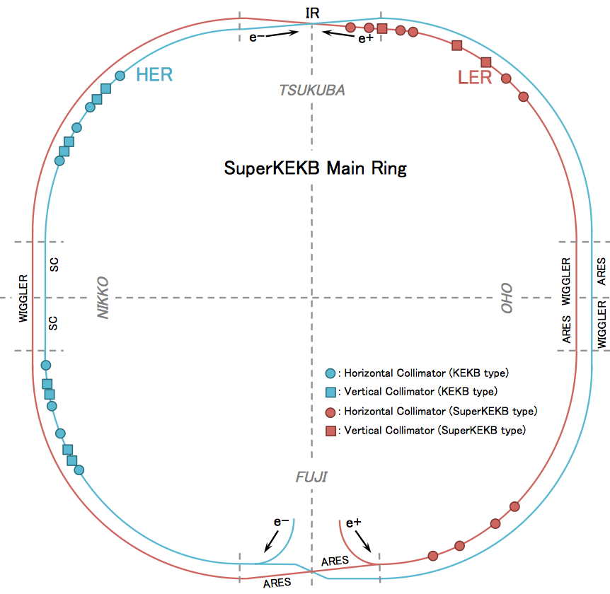
SuperKEKB Collimators Location
T. Ishibashi (KEK)
HER
D01: H1, H2, H3, H4, H5,
V1 for Beam-gas
LER
D02: H1, H2, H3, H4,
V1 for Beam-gas
D01
D02
HER
D12: H1, H2, H3, H4
(V1, V2, V3, V4)
D12
D03
LER
D03: H1, H2
(V1, V2)
~20 Horizontal collimators and 2 Vertical collimators
Each collimator can be asymmetric
Need to control ~50 parameters!
D11
D04
D10
D05
HER
D09: H1, H2, H3, H4
(V1, V2, V3, V4)
D09
D08
D07
D06
LER
D06: H1, H2, H3, H4
Hiroyuki Nakayama (KEK)
Higgs Factory 2014, 10th Oct. 2014, Beijing
8

Slide 9
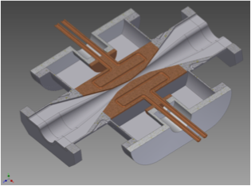
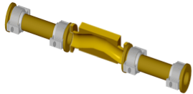
Collimator Design Concepts
T. Ishibashi (KEK)
SuperKEKB type
Part of the movable heads is hidden inside the antechambers to reduce the impedance.
Need to get space for installations of HOM absorbers and bellows up/downstream of the collimators.
Have to avoid the trapped-modes.
Total length ~ 1000 mm.
KEKB type
Hiroyuki Nakayama (KEK)
Higgs Factory 2014, 10th Oct. 2014, Beijing
9

Slide 10
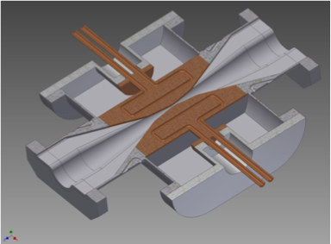
Basic Collimator Structure
T. Ishibashi (KEK)
SLAC PEP-II collimators as a reference.
The chamber and the heads are made from copper.
The strokes of the movable heads are d=5-25 mm in horizontal and 2-12 mm in vertical. (“d” refers to the distance between the central beam axis and the tip of the head.)
Tungsten is jointed at the tip of the head with Hot Isostatic Press(HIP, already succeed in the test).
RF fingers are attached between the heads and chambers.
ramp ~12°
tungsten on tip
cooling channel
tapered beam pipe
bellows
Hiroyuki Nakayama (KEK)
Higgs Factory 2014, 10th Oct. 2014, Beijing
10

Slide 11
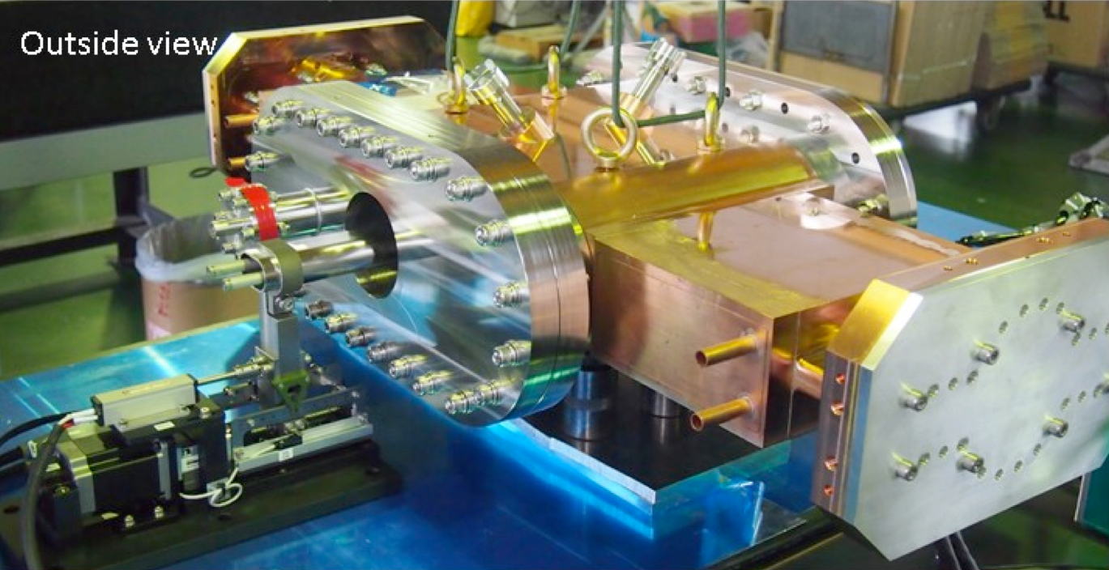
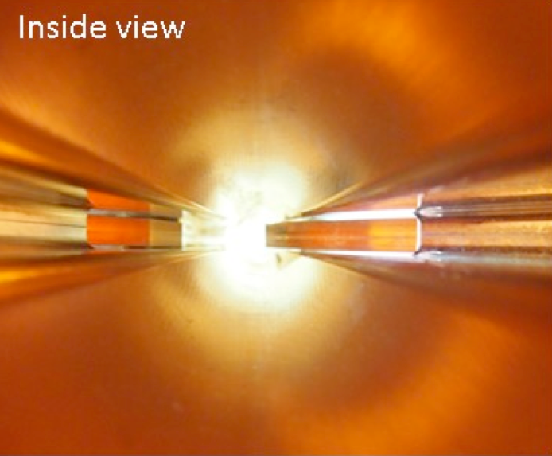
Collimator Prototype
T. Ishibashi (KEK)
A prototype of the SuperKEKB type horizontal collimator was manufactured.
We’ve improved supports for the movable heads, RF fingers and so on through tests.
Hiroyuki Nakayama (KEK)
Higgs Factory 2014, 10th Oct. 2014, Beijing
11

Slide 12
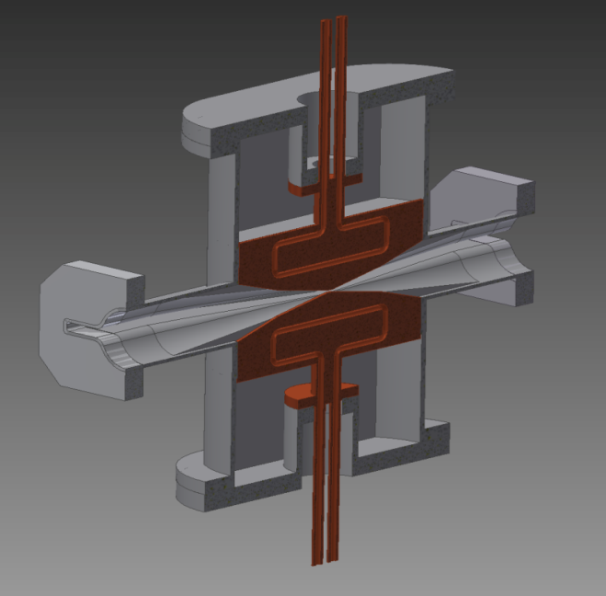
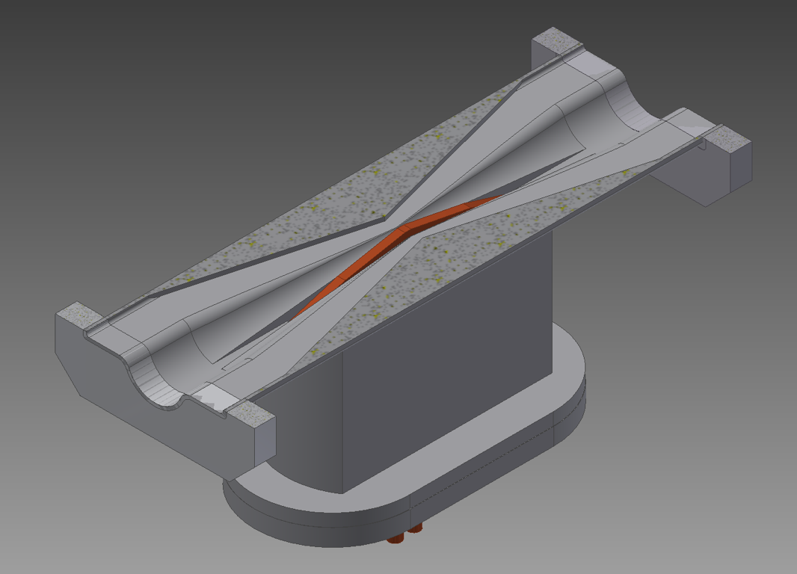
Vertical Collimators
To reduce IR loss of beam-gas Coulomb BG, very narrow (~2mm half width) vertical collimator at βy=~100m is required
TMC instability is an issue, low-impedance design of collimator head is important
Only one collimator per ring, so precise (~50um) control of collimator width is important (otherwise IR loss rapidly increases)
Should withstand ~100GHz loss (tungsten)
Secondary shower (tip-scattering) study is important
Hiroyuki Nakayama (KEK)
Higgs Factory 2014, 10th Oct. 2014, Beijing
12

Slide 13
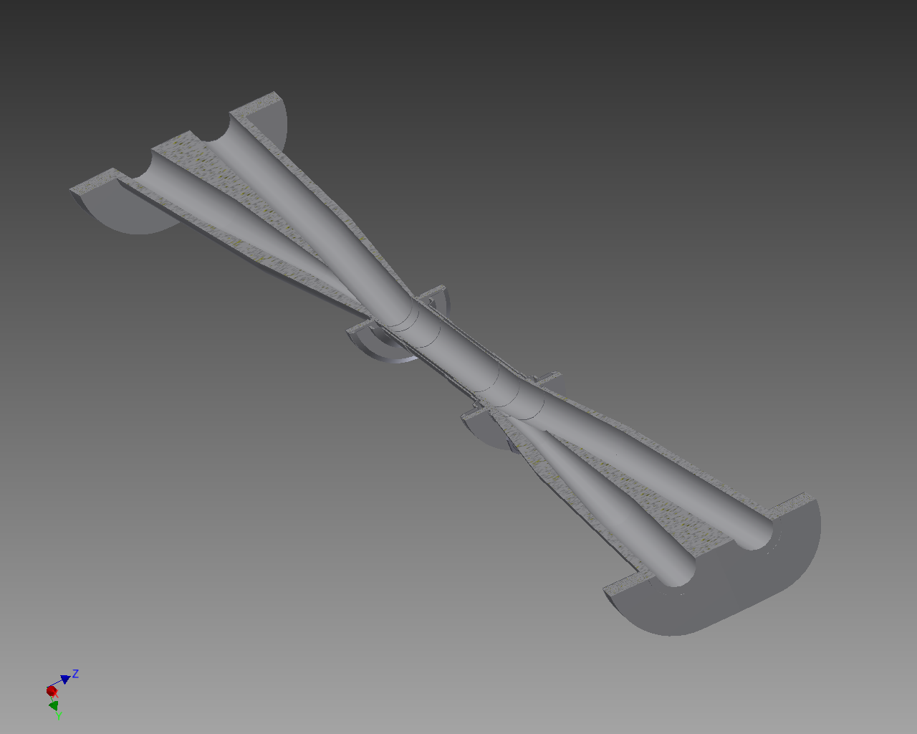
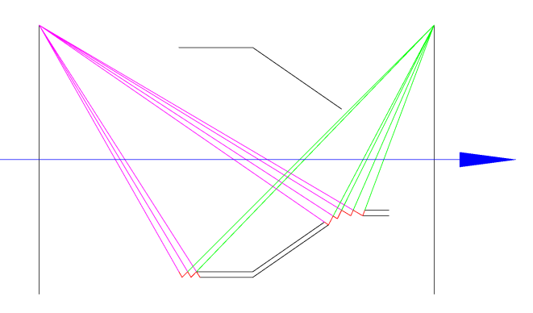
3. Synchrotron radiation
φ20mm→φ9mm collimation on incoming beam pipes (no collimation on outgoing pipes)
Most of SR photons are stopped by the collimation and direct hits on IP beam pipe is negligible
HOM can escape from outgoing beam pipe
To hide IP beam pipe from reflected SR, “ridge” structure on inner surface of collimation part.
Beam pipe design
e-
φ20mm
IP beam pipe (Ti/Be/Ti)
φ9mm
incoming/outgoing beam pipe (Ta)
e+
Ridge structure
13
Notes:
Moving on to the next, I would like to show our optimized beam-pipe design to stop SR background.
Incoming part of beam pipe is collimated from f20mm to f9mm, therefore most of SR photons coming from upstream can be stopped by this collimation and direct hits on IP beam pipe, made of Beryllium, are negligible.
We don’t have to worry about HOM trap, since the outgoing pipes are made straight and HOM can escape .
It is also worthwhile to note that “ridge” or “saw-tooth” structure is set on the inner surface of collimation part to avoid the reflected SR hitting the IP beam-pipe.
The expected SR background of the inner detector is much smaller than the minimal requirement, so we are satisfied with this clever design of beam-pipe.

Slide 14
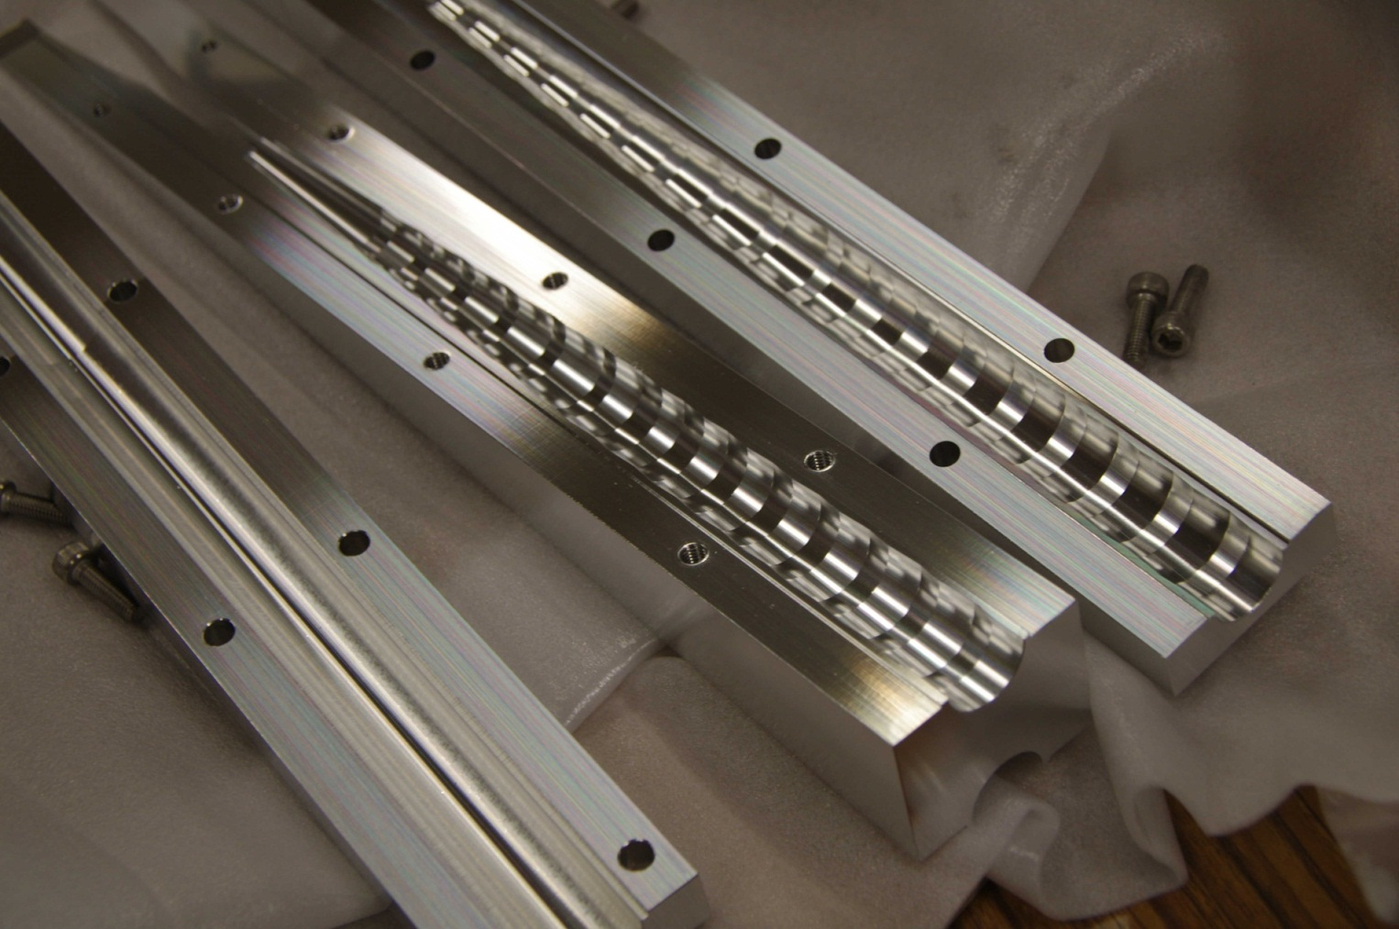
“Ridge” structure
Al mockup
To hide IP beam pipe from reflected SR

Slide 15
4. Luminosity-dependent background
Radiative Bhabha
Rate∝Luminosity (KEKBx40)
Spent e+/e- with large ΔE could be lost inside detector
Neutrons from emitted γ (hitting downstream magnet)
BBBREM (beam-size effect included)
2-photon process
Generated e+e- pair might hit PXD (or SVD)
Confirmed to be tolerable, according to
KoralW/BDK simulation and KEKB machine study
Notes:
Touschek/beam-gas background is coming from each beam.
Next background source is coming from collision of two beams,
proportional to Luminosity.
After radiative Bhabha collision at IP, both spent beam particle and emitted gamma contribute to background.
2-photon process via this Feynman diagram is simulated to be small enough.
The simulation validity is confirmed by machine study at KEKB.

Slide 16
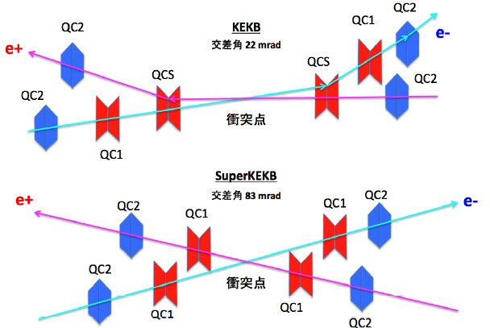
Final focusing magnets
θ =22mrad
IP
θ =83mrad
Solenoid axis
IP
QC2LP
QC1LP
QC1RE
QC2RE
QC1RP
QC2LE
IRON
IRON
QC1LE
QC2RP
IRON
Larger crossing angle θ
Final Q for each ring→ more flexible optics design
No bend near IP→ less emittance, less background from spent particles
Notes:
Although there are a number of features of the accelerator upgrade, here, let me pick up the design of final focusing magnet.
The crossing angle is changed to be much larger than that of KEKB, so that each rings can have their own final q magnet.
This will lead to flexible adjustment of orbit design.
The another benefit from independent final q magnet is that the bend by downstream Q magnet which existed at KEKB will disappear.
This will realize less emittance without dispersion coming the bend close to IP,
and also lead to less background such as SR at downstream magnet or over-bent spent electron from Radiative Bhabha event, which is expected to be the dominant BG of Italian SuperB.

Slide 17
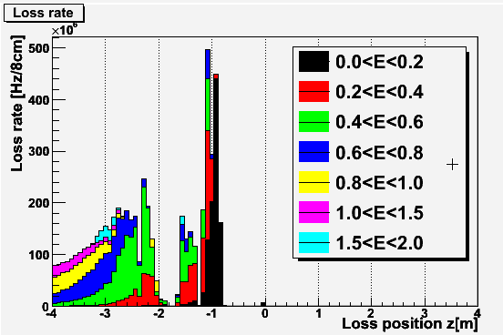
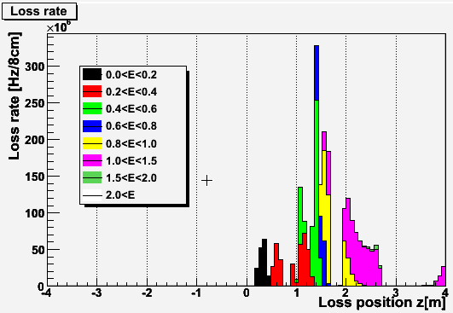
Spent e+/e- loss position after RBB scattering
LER(orig. 4GeV)
HER(orig. 7GeV)
e+
e-
If ΔE is large and e+/e- energy becomes <2GeV,
they can be lost inside the detector (|s|<4m)
due to kick from detector solenoid with large crossing angle

Slide 18
Beam orbit after RBB scattering
x : positive=ring outer, y: positive=downward
inner
lower
upper
inner
lower

Slide 19
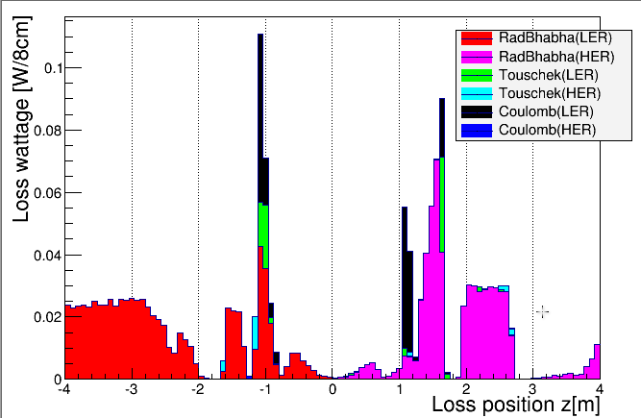
BG loss distribution
Ver. 2014.6.18
(9th campaign)
Loss wattage
= loss rate
* energy of loss particle
HER
(e-)
LER(e+)
1GeV ,1GHz
= 0.16W
 | LER (4GeV e+) | HER (7GeV e-)
Rad. Bhabha | 0.74 W (eff. 1.2GHz) | 0.59W (eff. 0.52GHz)
Touschek | 0.078W (0.12GHz) | 0.02 W (0.02 GHz)
Coulomb | 0.18 W (0.28GHz) | 0.001W (0.001GHz)

Slide 20
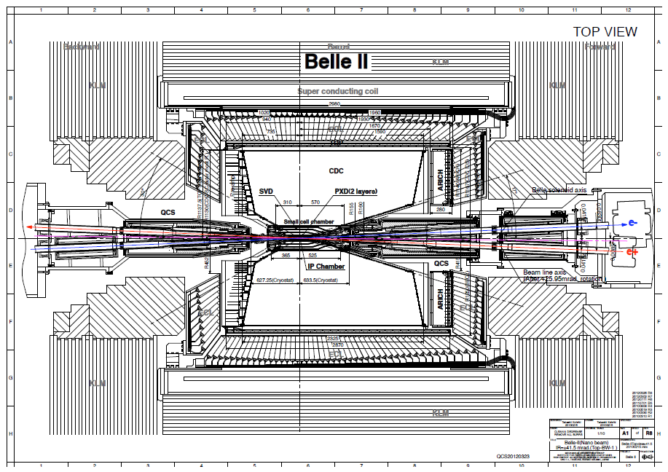
Background picture
Ver. 2014.6.18
←RBB LER
RBB HER→
Touschek HER→
SR
Coulomb HER→
←Touschek LER
HER(e-)
LER(e+)

Slide 21
Tungsten shields inside final-Q cryostat
tungsten (10mm t)
tungsten
(20~70mm t)
tungsten (50mm t)
QC2RE
e-
QC1RE
QC1RP
QC2RP
tungsten
e+
IP
1m
tungsten(~30mm t)
tungsten (10mm t)
e+
e-
-1m
IP
Major beam loss position
by Touschek or Beam-gas
Thick tungsten shields can significantly stop background showers originated from |s|>65cm.

Slide 22
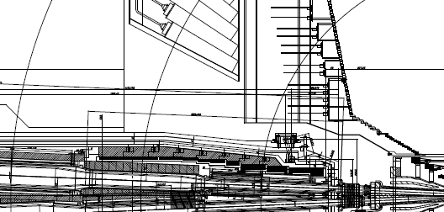
Other shielding
17°
Iron
VXD docks
Thick tungsten layers inside cryostat
Heavy metal shields to protect VXD
from showers generated in cryostat
ECL
Neutron shield to protect HAPDs in ARICH
CDC
(Bron-doped Polyethylene)
Iron
Neutron shield for FPGAs on CDC elec. board.(Polyethylene)
VXD docks
ECL shield, for included for (Lead + Polyethylene)
Remote Vacuum Connection structure in front of QCS reduces showers from RBB loss at |s|~60cm (6cm-thick SUS)
Notes:
<R-side>
ARICH: r>44cm, blue: 38<r<44cm, green: 44<r<50cm, ECL, r>44cm, red: 42<r<47cm, dock: r=39.9+-2.5cm
iron: r=50->36.7cm, QCS: R=39->34.7cm
<L-side>
ECL, r>45cm, red: 46.5<r<51.5cm, dock: r=35.5+-2.5cm
iron: r=50->27cm, QCS: R=39->25cm
Svd-dock: x=-135~103(235), y=-32~56(90), z-210~175(390)

Slide 23
Full-detector GEANT4 simulation
Whole Belle II detector implemented in our software framework based on GEANT4

Slide 24
Simulation tools
BG type | BG generator | Tracking (till hitting beam pipe) | Detector simulation
Touschek/Beam-gas | Theoretical formulae [1] | SAD [2] | GEANT4
Radiative Bhabha | BBBREM [3] | SAD (for e+,e-) GEANT4 (for γ) | GEANT4
2-photon | Diag36 (“BDK”) [4] | GEANT4 | GEANT4
Synchrotron radiation | Physics model inside GEANT4 | GEANT4 | GEANT4
[1] Y. Ohnishi et al., PTEP 2013, 03A011 (2013).
[2] SAD is a “Home-brew” tracking code by KEKB group, http://acc-physics.kek.jp/SAD/
[3] R. Kleiss and H. Burkhardt, Comput. Phys. Commun. 81, 372 (1994)
[4] F. A. Berends, P. H. Daverveldt and R.Kleiss, Comput. Phys. Commun. 40, 285 (1986).

Slide 25
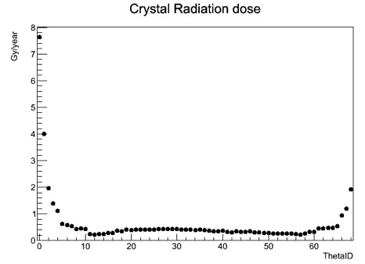
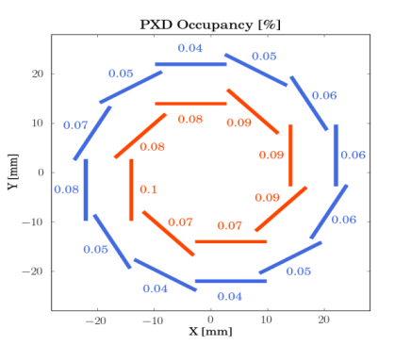
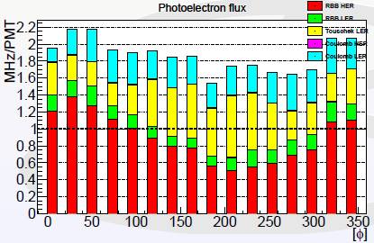
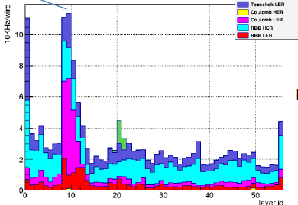
Background simulation check list
Dose on ARICH HAPD
Degrade data quality
Tracking precision (CDC hit rates)
Particle-ID precision (TOP, ARICH rates)
Eat-up readout bandwidth
PXD occupancy should be <2%
Damage components during years of operation
Radiation dose on electronics, crystals, etc..
Neutron fluence on Si devices (HAPD, FPGA error, etc..)
TOP-PMT photocathode lifetime (aging)
Dose on ECL Crystals
10Gy/year
PXD occupancy
TOP PMT p.e. flux
CDC wire hit rate

Slide 26
Summary of beam background impact
Assuming operation at the design luminosity, BG impact on detector performance(occupancy, tracking/PID performance etc..) is tolerable.
Assuming 10 years operation at the design luminosity, most of our detector components are safe for radiation dose and neutron fluence.
except for TOP PMT photocathode lifetime, which needs further x3 reduction.
Our PMTs (1C/cm2 life) will be killed in few years and should be replaced with recently-developed new PMTs (~7C/cm2).
Gammas in BG shower reach TOP quartz bar and generate electrons by Compton scattering and etc.. Those electrons emit Cerenkov photons and those photons reach PMT photocathode.

Slide 27
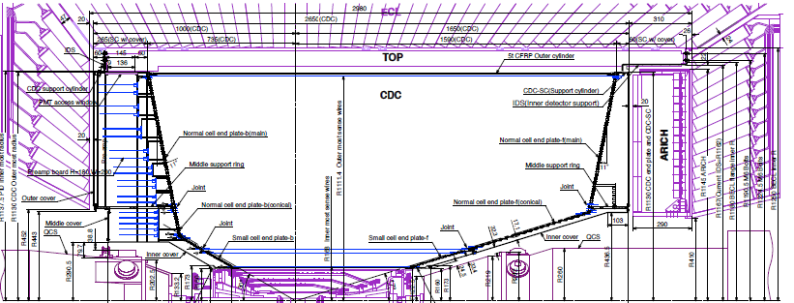
TOP quartz bars
IP
e-
e+
Beam loss distribution
IP
-1m
1m
2m
Thick tungsten shield
Limited shield
Thick tungsten shield
Beam loss distribution
which creates TOP PMT hits
IP
-1m
1m
2m

Slide 28
Closer look to IP vicinity area (|s|<65cm)

Slide 29
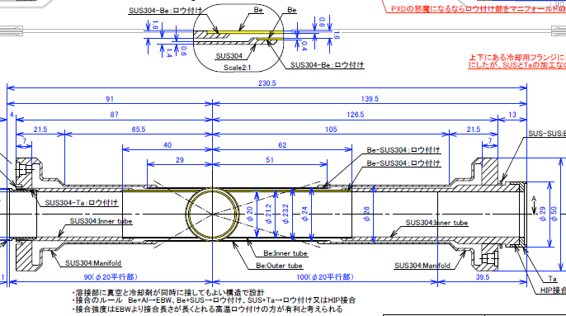
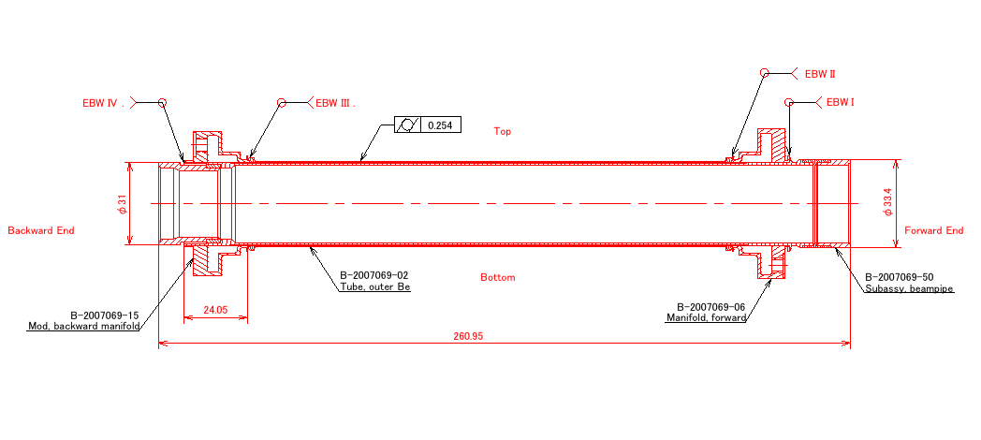
IP beam pipe
Belle-II
Light material (Be) inside detector acceptance
Paraffin (C₁₀H₂₂)flow to remove heat from mirror current (~80W)
Gold plating (~10um)
on inner wall to stop SR
Much simpler Be shape (also much cheaper) since we allow Paraffin and vacuum to attach both side of welding
Paraffin flow
Ti
Ti
Be
Ti
Belle
Al
SUS
Be

Slide 30
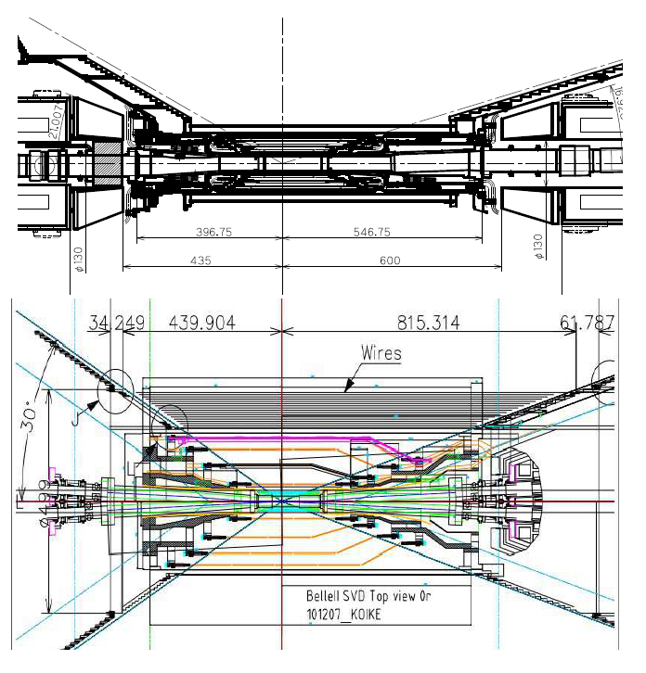
Interaction region
Belle
<Belle-II>
Smaller IP beam pipe radius
（r=15mm⇒10mm）
Wider beam crossing angle
（22mrad⇒83mrad）
Crotch part: Ta pipe
Pipe crotch starts from closer to IP, complicated structure
New detector: PXD
（more cables should go out）
Belle-II
Ta
Ta
Ti/Be/Ti

Slide 31
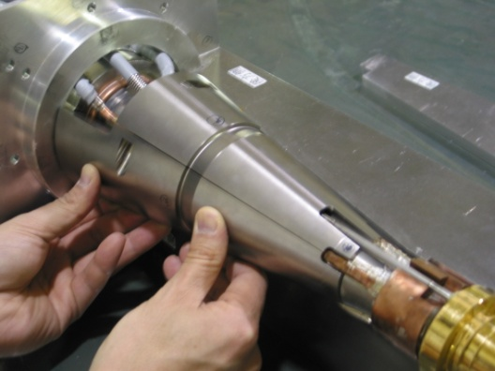
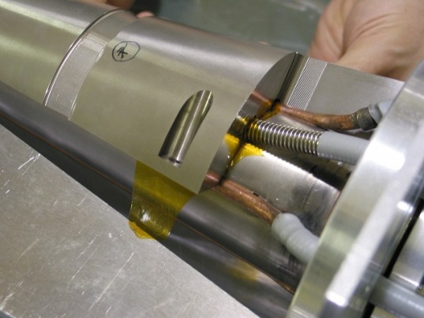
Tungsten shield
Heavy-metal shield to protect PXD/SVD from showers coming from upstream.
Belle-II IP design (obsolete)
Ta beam pipe
PXD
SVD
Shield design constrained by cabling space and total weight requirements
cf. Heavy-metal shield @ Belle
Notes:
Another countermeasure is to use heavy-metal shield to protect inner detectors, which was also used for current Belle.
“Heavy-metal” is specifically referring to Tungsten-alloy, with a very short radiation length and capacity to stop showers created by the Touschek scattered particles.

Slide 32
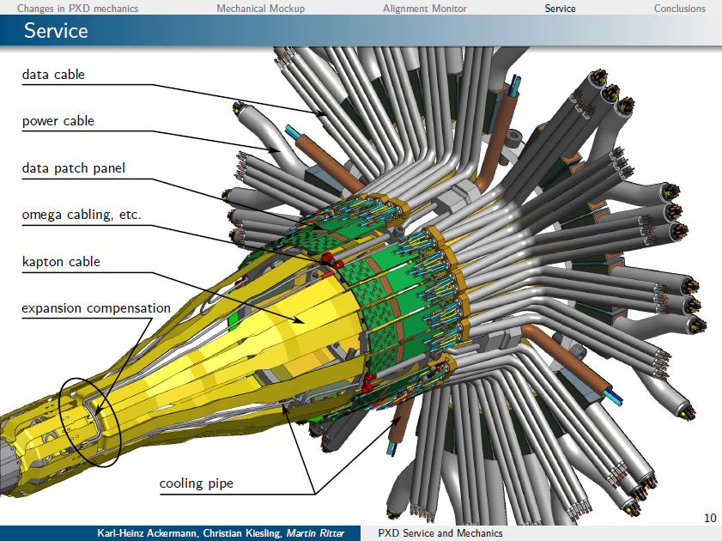
PXD cables & pipes

Slide 33
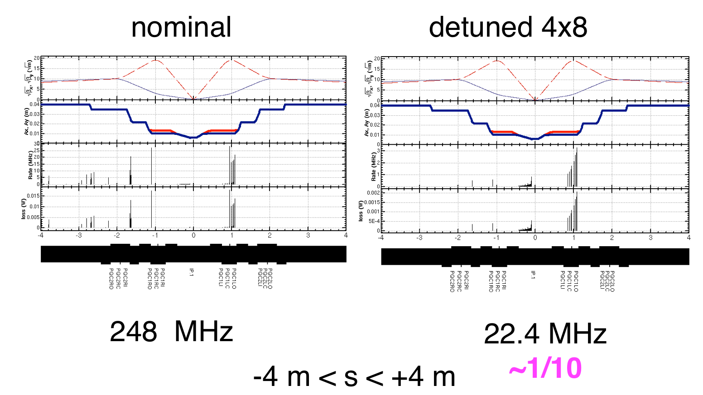
Phase-2 beams loss
Y.Ohnishi
(Phase 3)
(Phase 2)
“4x8” means
βx: x4 larger
βy: x8 larger
than phase3
Touschek
Touschek
“Detuned” optics for phase2: larger βx, βy
- H/V collimators can be wider than phase3
- Touschek: better collimation: ~1/10
- Beam-gas Brems/Coulomb: better collimation but worse vacuum level
- Rad. Bhabha: simply scale by luminosity

Slide 34
Summary
Touschek/Beam-gas well reduced by collimators
Radiative Bhabha spent particles are dominant BG
Thick tungsten shield inside cryostat stop showers
PMT photocathode aging for TOP counter is a remaining issue
Shielding at |s|<60cm is VERY difficult
Limited space (need cabling path), Limited weight to be supported
Phase2:
less background with detuned optics
need “extrapolation” for phase3
Machine study to disentangle each BG sources is very important
phase2 is also a “playground” for important functionality at phase3

Slide 35
Schedule, collaboration

Slide 36
Commissioning schedule
Phase 1 (Autumn 2015-, 5month)
No final Q magnets, no Belle-II detector
Machine study for low emittance beam
Vacuum baking with beam (>1month w/ 0.5-1.0A)
Phase 2 (Early 2017-, 4.5month)
Install Q magnets, Belle-II detector except VXD detectors
Machine study for final focusing, XY-coupling, collision
Beam background study
Phase 3 (Early 2018 )
Physics run
based on “desired budget scenario”,
as of Nov. 7 2014

Slide 37
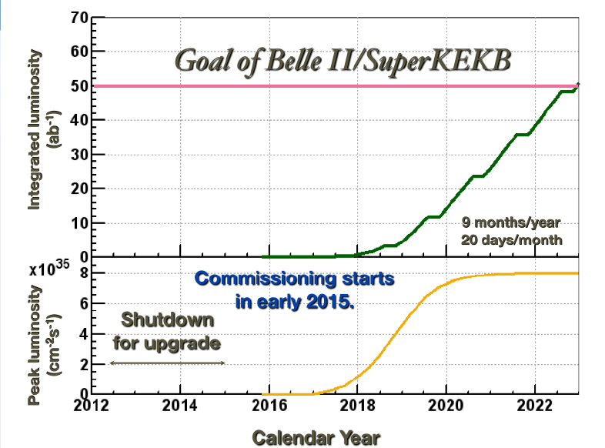

Slide 38
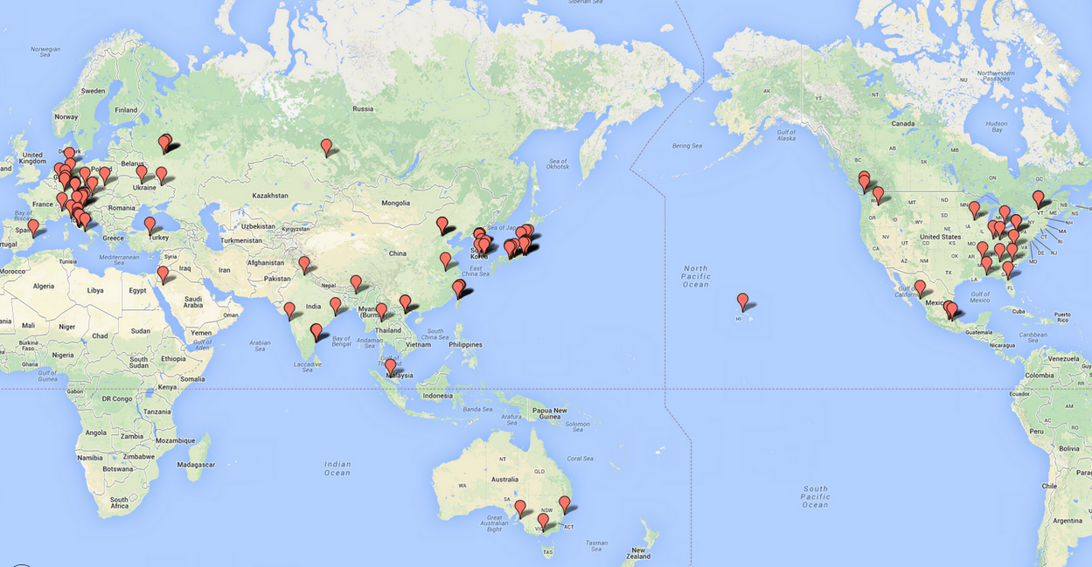
Belle II Collaboration
23 countries/regions, 97 institutes,
594 collaborators
Sep. 2014

Slide 39
Machine Design Parameters
parameters |  | KEKB |  | SuperKEKB |  | units
 |  | LER | HER | LER | HER
Beam energy | Eb | 3.5 | 8 | 4 | 7.007 | GeV
Half crossing angle | φ | 11 |  | 41.5 |  | mrad
# of Bunches | N | 1584 |  | 2500
Horizontal emittance | εx | 18 | 24 | 3.2 | 4.3 | nm
Emittance ratio | κ | 0.88 | 0.66 | 0.27 | 0.31 | %
Beta functions at IP | βx*/βy* | 1200/5.9 |  | 32/0.27 | 25/0.30 | mm
Beam currents | Ib | 1.64 | 1.19 | 3.6 | 2.6 | A
beam-beam param. | ξy | 0.129 | 0.090 | 0.087 | 0.081
Bunch Length | σz | 6.0 | 6.0 | 6.0 | 5.0 | mm
Horizontal Beam Size | σx∗ | 150 | 150 | 10 | 11 | um
Vertical Beam Size | σy∗ | 0.94 |  | 0.048 | 0.063 | um
Luminosity | L | 2.1 x 10³⁴ |  | 8 x 10³⁵ |  | cm⁻²s⁻¹

Slide 40
Lifetime/ IR loss summary
Life time | Touschek | Beam-gas Coulomb | Rad. Bhabha
LER | 10 min. | 25 min | 28 min.
HER | 10 min. | 46 min. | 20 min.
IR loss |s|<4m | Touschek | Beam-gas Coulomb | Rad. Bhabha
LER | 250 MHz | 90 MHz | 0.6GHz*
HER | 30 MHz | <10 MHz | 0.5GHz*
*Effective rate

Slide 41
Candidate collimator locations
TMC condition
r=13.5mm
TMC condition
r=13.5mm
Collimator width d[mm]
(r=10.5mm)
(r=10.5mm)
LER
HER
beta_y [m]
beta_y [m]
lerfqlc_1604
herfqlc5605
V1 collimator @ LLB3R (downstream)
(s=-90→-82m, βy=30→146m)
βy=125m, 2.23mm<d<2.81mm
V1 collimator @ LTLB2 (downstream)
(s=-63→-61m, βy=81→187m)
βy=123m, 1.74mm<d<2.26mm
Ny(V1)= 42.82, Ny(QC1)= 44.32
Ny(V1)= 1.25, Ny(QC1)= 0.25
Collimator position should satisfy beta_y condition above,
need space(at least 1.5m), and the phase should be close to IP

Slide 42
Vertical collimator width vs. Coulomb loss rate, Coulomb life time
ler1604, V1=LLB3R downstream
V1 width[mm] | IR loss [GHz] | Total loss[GHz] | Coulomb life[sec]
2.40 | 0.04 | 153.9 | 1469.8
2.50 | 0.05 | 141.8 | 1594.8
2.60 | 0.09 | 131.0 | 1724.9
2.70 | 0.24 | 121.4 | 1860.2
2.80 | 1.65 | 111.4 | 2000.5
2.90 | 11.48 | 100.8 | 2014.3
3.00 | 21.98 | 90.3 | 2014.3
Based on element-by-element simulation considering causality the phase difference (by Nakayama)
Up to 100turns
her5365,V1=LTLB2 downstream
V1 width[mm] | IR loss [GHz] | Total loss[GHz] | Coulomb life[sec]
2.10 | 0.0007 | 49.6 | 3294.0
2.20 | 0.001 | 45.2 | 3615.2
2.30 | 0.357 | 41.0 | 3951.3
2.40 | 7.99 | 33.0 | 3985.9
2.50 | 13.1 | 27.9 | 3985.9
IR loss rate is VERY sensitive to the vertical collimator width.
(Once V1 aperture>QC1 aperture, all beam loss goes from V1 to IR
Typical orbit deviation at V1 : +-0.12mm (by iBump V-angle: +-0.5mrad@IP )

Slide 43
Background reduction history
Beam-gas
Coulomb LER
Lossrate in IR
110GHz
Beam-gas
Coulomb HER
Touschek LER
40GHz
15 GHz
More horizontal collimators near IP
Vertical collimators at small beta_y
Extrapolation from machine study
Coulomb BG found to be dangerous
RBB LER(e+)
0.9GHz eff
1 GHz
RBB HER(e-)
0.7GHz eff
Touschek HER
0.2 GHz
0.2 GHz
0.1 GHz
0.1 GHz
Sep. ‘10
Dec. ‘10
Mar ‘11
Jun. ‘11
Sep. ‘11
Dec. ‘11
Focused review
Joint BG workshop with SuperB

Slide 44
Tunnel BG (|s|<30m)
75cm-thick concrete shield
Photon dump
Photon dump
LER last collimator
HER last collimator
30cm-thick polyethylene shield
Touschek LER loss at the last collimator has been suppressed by collimator optimization
 | LER (4GeV e+) | HER (7GeV e-)
Rad. Bhabha | 61 W (eff. 96GHz) | 23W (eff. 19GHz)
Touschek | 0.08W (0.1GHz) | 3.4W (3.1 GHz)
+ gammas emitted from Rad. Bhabha event
Hiroyuki Nakayama (KEK)
KEKB ARC (Mar. 4, 2013)
44

Slide 45
Summary for 9th campaign
listing SF<5 only
SF=Safety Factor
 | 9th campaign result | limit | SF
PXD occupancy | 2photon:0.8% , SR:~0.2% | < 3% | 3
CDC wire hit rate | 180kHz | <200kHz | 1.3↓
CDC Elec.Borad n-flux* | 0.58 | <1 | 1.5↓
CDC Elec.Board dose | 72Gy/yr | <100 Gy/yr | 1.4↓
TOP PMT rate | 3MHz/PMT | <1 MHz/PMT | 0.3↓
TOP PCB n-flux* | 0.2 | <0.5 | 3
ARICH HAPD n-flux* (w/ shield) | 0.35 | <1 | 3↑
ECL crystal dose (w/ shield) | 5.2 Gy/yr | <10 Gy/yr | 2
ECL diode n-flux* (w/shield) | 0.3 | <1 | 3↑
ECL pile-up noise (w/shield) | 4.2/1MeV | 0.8/0.2MeV at Belle-I | ?
With “combined” shield inside ECL
KLMs studies are not included
*neutron flux in unit of
10¹¹ neutrons/cm2/yr,
NIEL-damage weighted

Slide 46
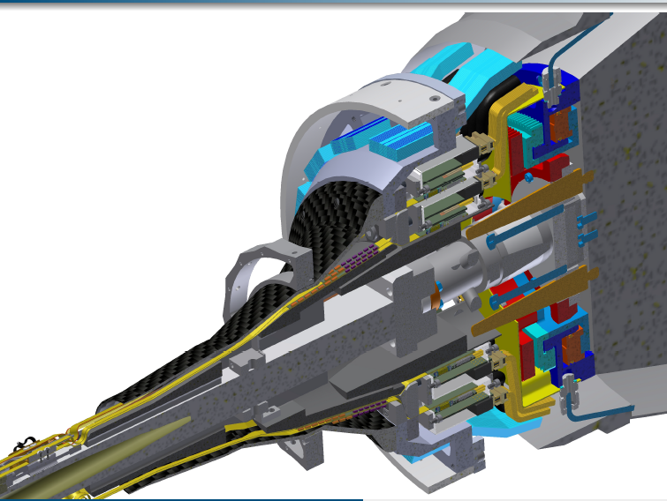
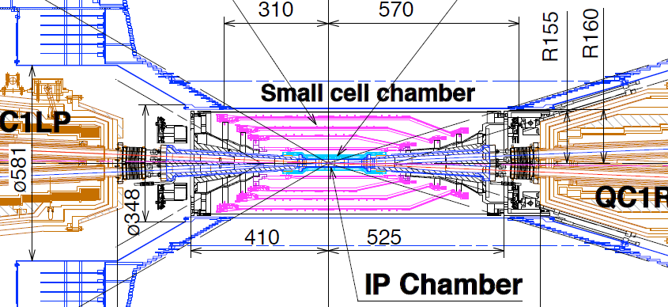
Beam loss position which create TOP PMT hits
R~
12cm
HER RBB loss at z=60cm is dominant source of TOP PMT background. Quick study shows material for Remote Vacuum Connection (RVC) gives ~20% TOP BG reduction, assuming RVC is equivalent to 60mm thick iron.
HER RBB loss
LER Touschek loss

Slide 47
=========Notice======== Next WG3 session starts from 13:30, not from 14:00. Please come back early. Thank you!

