Slide 1
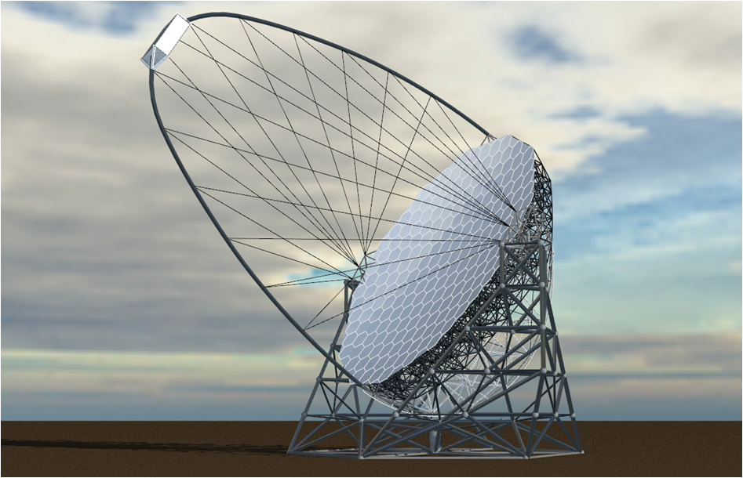
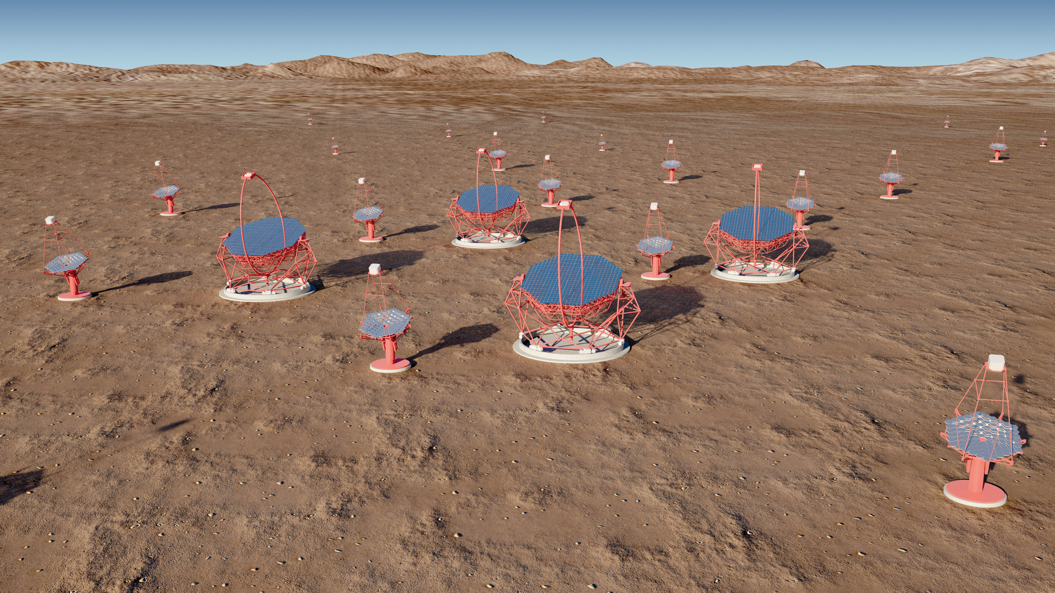
Les LST
Large Size Telescope de CTA
23m de diamètre
4 télescope par site
Rôle des LST
Réduire le seuil en énergie le plus bas possible en deça de 200 GeV
20 GeV – 1000 GeV
Augmenter l’horizon des rayons gamma
GRBs (z<4), AGNs (z<2)
Sources transitoires à basse énergie
Source galactiques ou AGNs
Particularité des LST:
Rotation rapide => repositionnement en 20 secondes

Slide 2
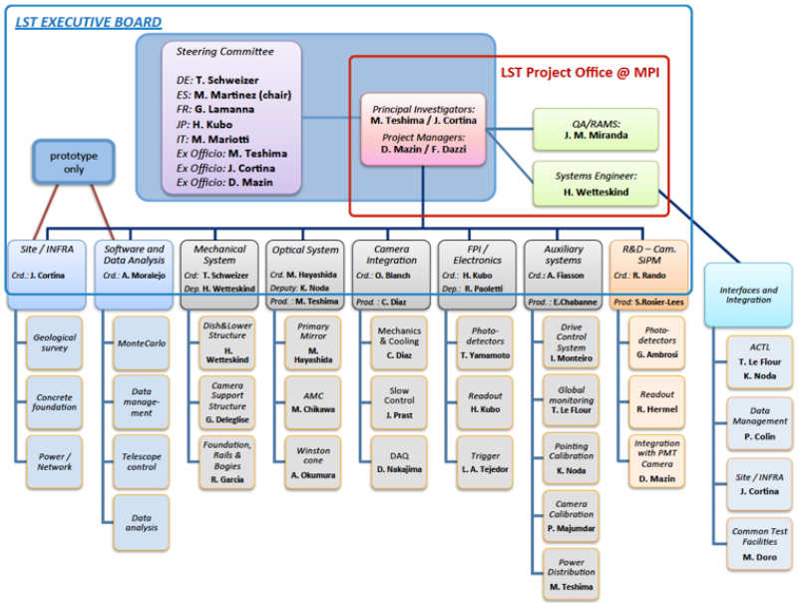
LAPP

Slide 3
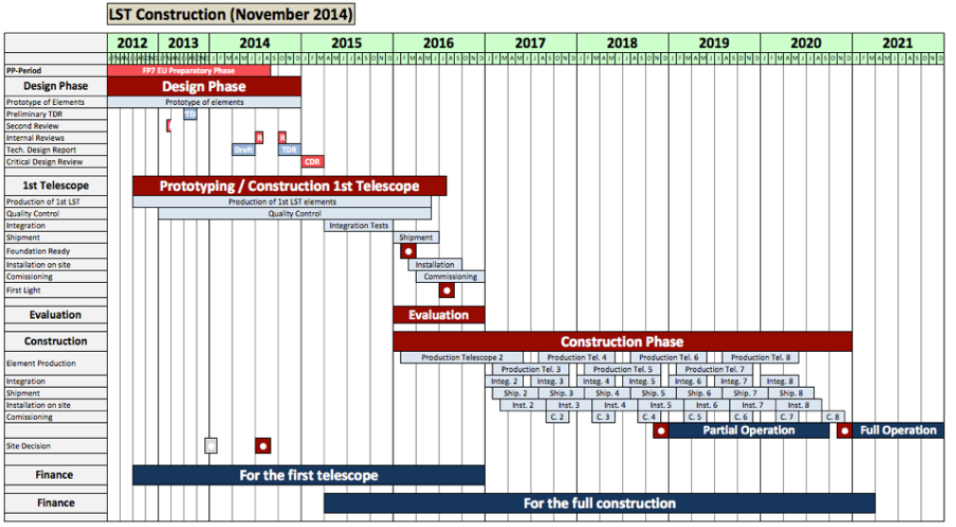
Schedule officiel

Slide 5
LST review 27/11/14
1. Change the definition of the 1st telescope from Prototype to Pre-Production. This assumption drives most of the following recommendations, because the 1st LST will be part of CTA Observatory.
2. Organize an external engineering review before placing the order of the 1st telescope structure.
3. Discuss with CTA management the position of the 1st LST, which can affect the layout of the whole array. Final blessing from CTA management.
4. Relax the schedule, extending the commissioning of the 1st telescope and delaying a little bit the construction of the 2nd one. This should allow the LST team to collect all the necessary feedbacks that must be implemented in the Production phase (2nd - 8th telescope).
5. Standardize the selected devices in order to minimize the number of different solutions that should be maintained for at least 30 years. An clear example was done for the embedded PCs.
6. Encourage for several and exhaustive tests of the camera (mainly electronics), starting with small set-up and going up to the full integration. It was clearly requested to include in the LST schedule the time necessary for testing the camera together with the CTF work-package.

Slide 6
Schedule officiel

