Slide 1
Flex studies status.
Module flexes: 4 types; M4, M2, M1plane, M1mountain.
constraint: components and bondings on the same side. Constraining for the wing geometry of the flex module.
Choice of the serial powering current (0,6 or 1,2A) to be done.
0,6A preferred but depends on the possible implementation on the VIP, available
voltage on services… limitations from ATLAS?
Technical discussion soon: final prototype for CAD design.
JMN identified to design the stave & module flexes.
Flat solutions with no mechanical bending: simpler process (cabling, loading).
Allows degree of freedom for thermal shrinkage.
To be tested with prototypes.
Missing: scheme, outline, DCS, … Outline determines the wings positions.
bonding protection: potting, arch… calculations and tests.
Test bench: USB pix? Module-USB pix conversion board…
Sebastien Vilalte, 01/12/2014

Slide 2
Stave flexes: 3 independent flexes on L2; 1 for 7M4, 1 for 7M2, 1 for 7 M2.
Stack up well defined: double sided 9/75/9 µm.
Tracks always on top, referenced on bottom.
Tracks distribution ok for a not serialized data transmission.
LOI estimated FE rate to 160Mb/s. 640Mb/s with a factor 4: still in the LVDS
domain. Tests will give a verdict. CTF3 boards and network analyzer available.
Discussions foreseen with CERN and with cabling company for prototype prod. Depends mainly on the availability of the material.
Details to discuss: VIP connectors, stave flex binding.
Radiation lengths will be estimated soon.
Stave flex-USB pix conversion board…
Steps and Priorities?:
Tests of the modules on table, tests of stave flex in parallel.
Tests of modules connected on stave flex, on table.
Module loading.
Tests of the full stave.
Sebastien Vilalte, 01/12/2014

Slide 3
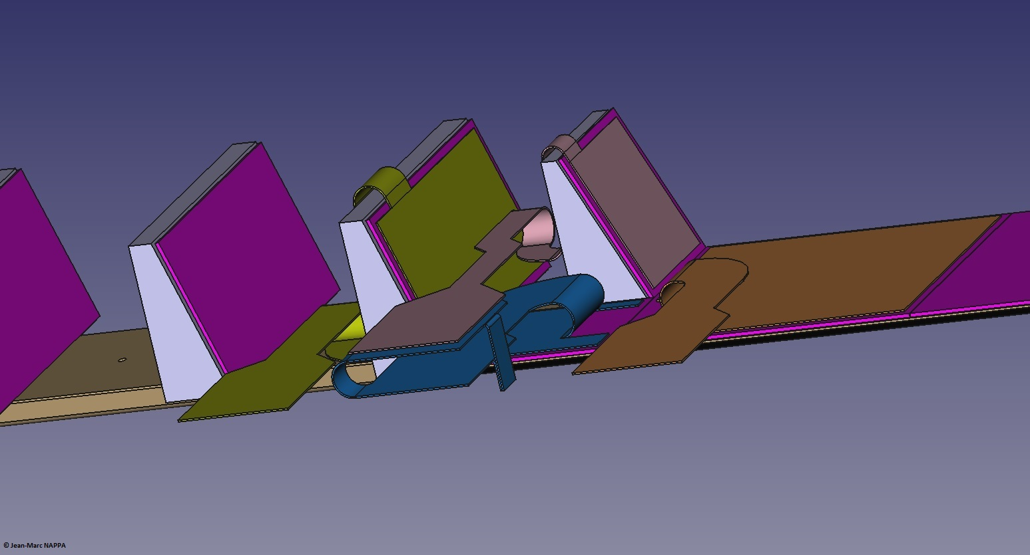

Slide 4
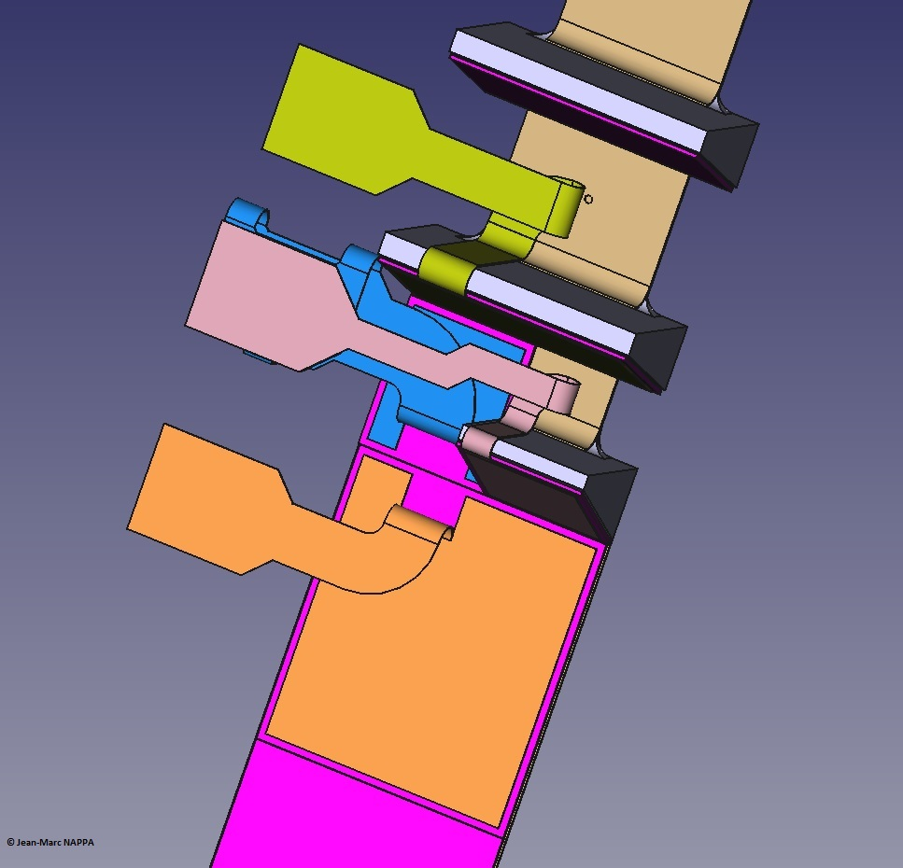

Slide 5
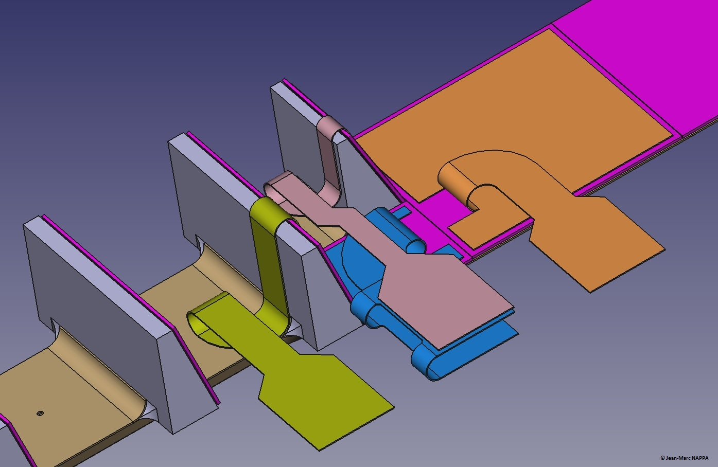

Slide 6
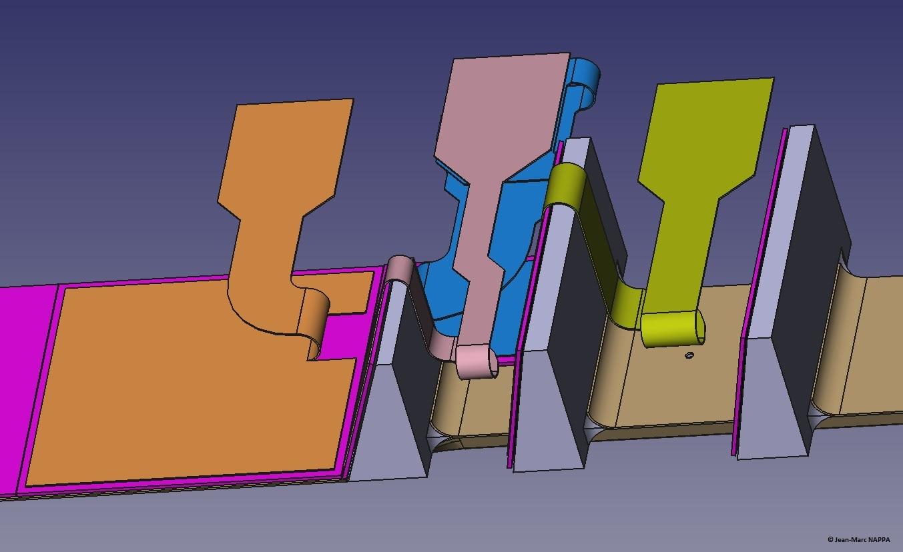

Slide 7
