Slide 1
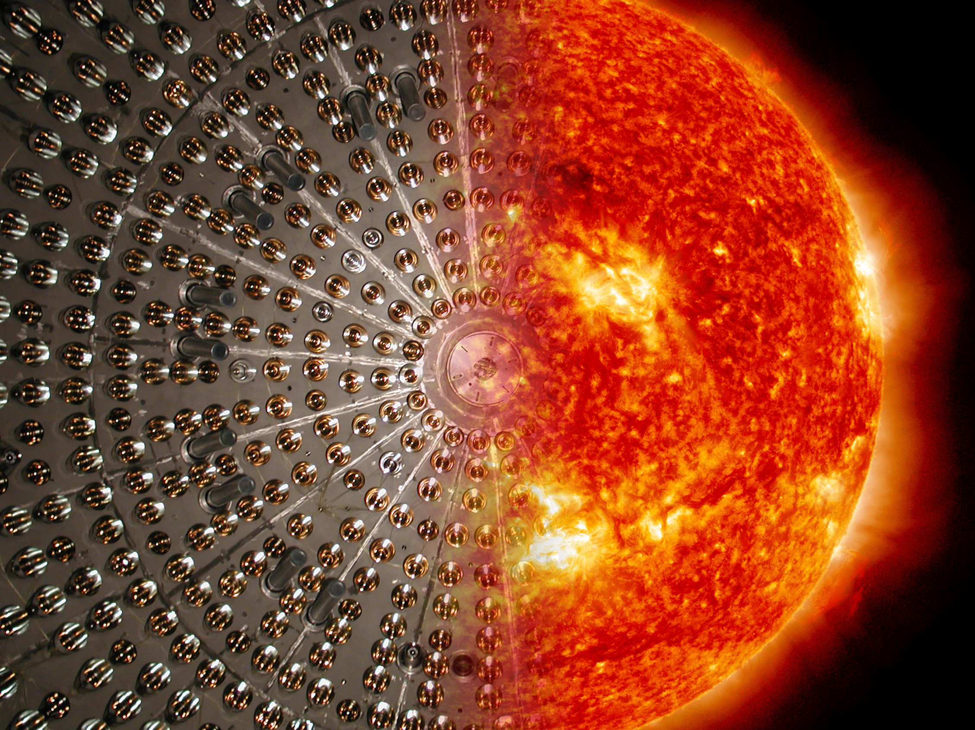
Recent results from Borexino
Barbara Caccianiga-INFN Milano
on behalf of the Borexino collaboration
50th Rencontres de Moriond- La Thuile, March 14th -21st 2015

Slide 2
pp-neutrino observation in Borexino
Published on Nature 512, 383-386 (2014)
Barbara Caccianiga-INFN Milano 50th Rencontres de Moriond- La Thuile, March 14th 21st 2015

Slide 3
Our Sun
Barbara Caccianiga-INFN Milano 50th Rencontres de Moriond- La Thuile, March 14th 21st 2015

Slide 4
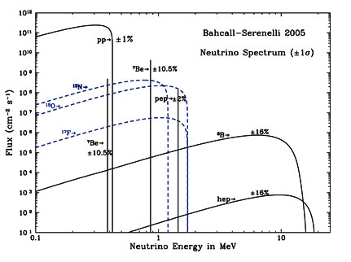
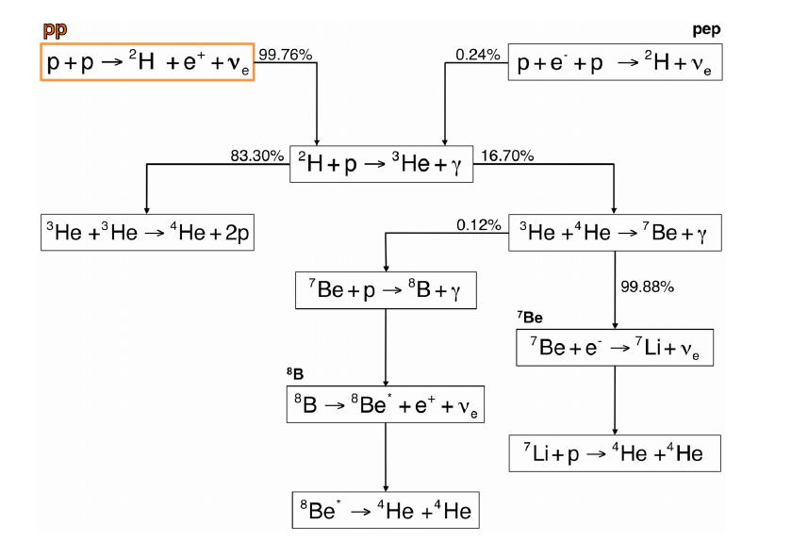

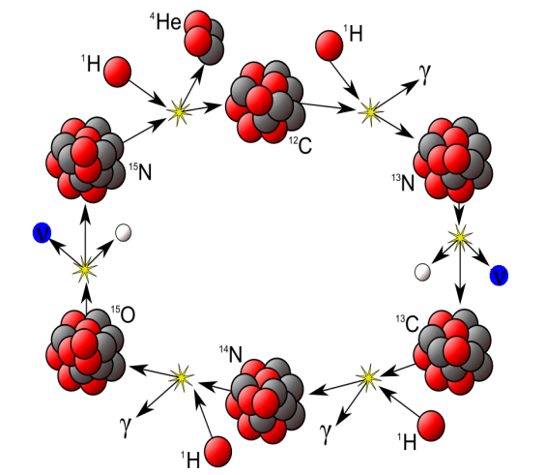
Our Sun
pp CYCLE:
~99% of the sun energy
CNO CYCLE:
<1% of the sun energy
Barbara Caccianiga-INFN Milano 50th Rencontres de Moriond- La Thuile, March 14th 21st 2015

Slide 5
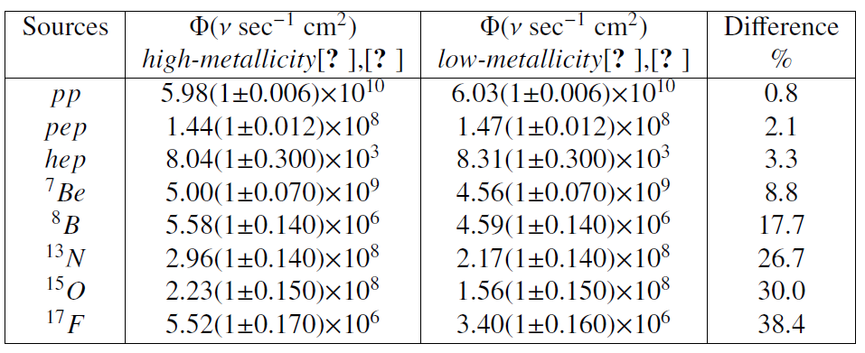
Our Sun
ASTROPHYSICS
Open Issues: solar metallicity
Metallicity is input in the Standard Solar Model;
Differences as large as 30-40% (for CNO);
Differences of ~9% for ⁷Be ν
Why studying solar neutrinos?
The standard Solar Model predicts the neutrino fluxes and their spectrum;
Studying solar neutrinos is interesting both for ASTROPHYSICS (comparison with predictions of the SSM) and for PARTICLE PHYSICS (neutrinos oscillations);
Solar Model: Serenelli, Haxton and Pena-Garay arXiV:1104.1639
High metallicity GS98 = Grevesse et al.S. Sci. Rev. 85,161 (‘98);
Low metallicity AGS09 = Asplund, et al, A.R.A.&A. 47(2009)481;
Barbara Caccianiga-INFN Milano 50th Rencontres de Moriond- La Thuile, March 14th 21st 2015

Slide 6
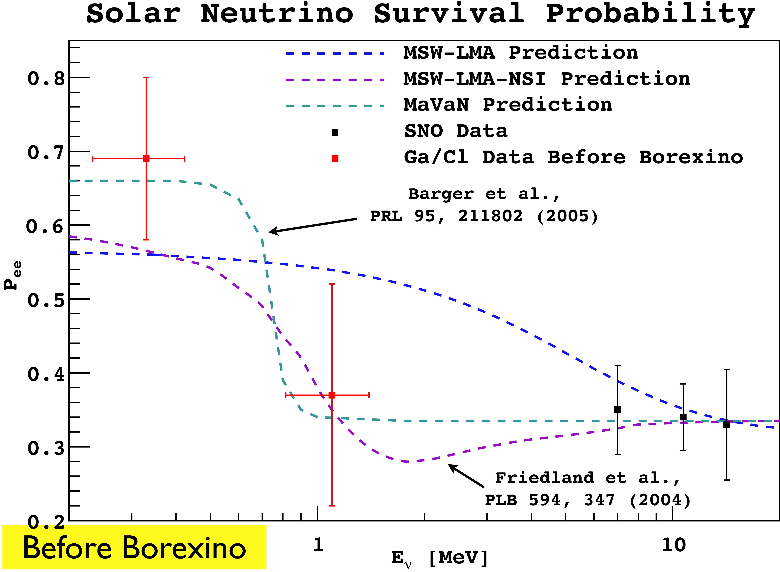
Our Sun
PARTICLE PHYSICS
The “solar neutrino problem” has provided one of the first hints towards neutrino oscillations;
Now we know that solar neutrinos oscillate:
“LMA solution”: Δm² =7.6×10⁻⁵ eV²; tg²θ = 0.468
Open issues: probe P_{ee} in the vacuum to matter transition region
sensitive to new physics;
Why studying solar neutrinos?
The standard Solar Model predicts the neutrino fluxes and their spectrum;
Studying solar neutrinos is interesting both for ASTROPHYSICS (comparison with predictions of the SSM) and for PARTICLE PHYSICS (neutrinos oscillations);
Barbara Caccianiga-INFN Milano 50th Rencontres de Moriond- La Thuile, March 14th 21st 2015

Slide 7

Our Sun
Why studying pp neutrinos?
pp neutrinos provide a direct glimpse into the main fusion process that keeps the Sun shining;
in fact, pp neutrinos are produced in the primary nuclear reaction of the pp-cycle;
A large fraction(~90%) of the solar luminosity in neutrinos is due to pp neutrinos
DIFFICULT TO DETECT
pp neutrinos have low energy → they are difficult to detect;
GALLEX and SAGE have performed an integrated measurement of the low energy solar neutrino flux (E>233 keV);
Only real-time detectors can single-out different components of solar neutrino spectrum;
pp neutrinos never observed in real time befor Borexino!
Barbara Caccianiga-INFN Milano 50th Rencontres de Moriond- La Thuile, March 14th 21st 2015

Slide 8
Our Sun
SOLAR (IN)VARIABILITY
pp neutrinos are “instant messangers” from the center of the Sun;
neutrinos take only few seconds to travel from the center of the Sun to the surface (and then 8 minutes to reach Earth);
photons take over ~10⁵ years;
Verifying that the solar luminosity in neutrinos is the same as the one in photons demonstrate the stability of the Sun on the 10⁵ years time scale;
Why studying pp neutrinos?
pp neutrinos provide a direct glimpse into the main fusion process that keeps the Sun shining;
in fact, pp neutrinos are produced in the primary nuclear reaction of the pp-cycle;
A large fraction(~90%) of the solar luminosity in neutrinos is due to pp neutrinos
Los Alamos Science 3 (2) (1982) 46
Barbara Caccianiga-INFN Milano 50th Rencontres de Moriond- La Thuile, March 14th 21st 2015

Slide 9
How can we study neutrinos from the Sun?
Barbara Caccianiga-INFN Milano 50th Rencontres de Moriond- La Thuile, March 14th 21st 2015

Slide 10
Borexino
Barbara Caccianiga-INFN Milano 50th Rencontres de Moriond- La Thuile, March 14th 21st 2015

Slide 11
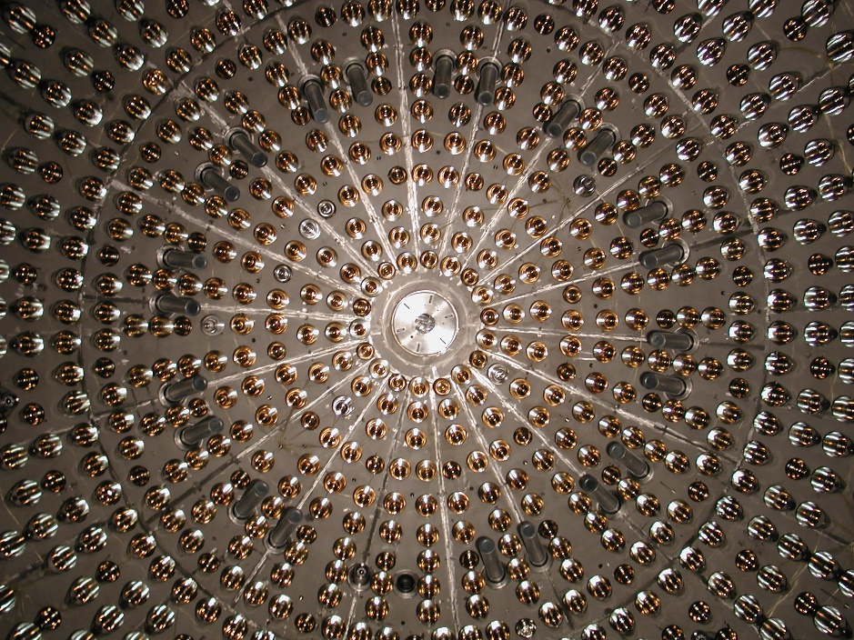
Borexino
Borexino
Barbara Caccianiga-INFN Milano 50th Rencontres de Moriond- La Thuile, March 14th 21st 2015

Slide 12
Borexino
Core of the detector: 300 tons of liquid scintillator contained in a nylon vessel of 4.25 m radius (PC+PPO);
1st shield: 1000 tons of ultra-pure buffer liquid (pure PC) contained in a stainless steel sphere of 7 m radius;
2214 photomultiplier tubes pointing towards the center to view the light emitted by the scintillator;
2nd shield: 2000 tons of ultra-pure water contained in a cylindrical dome;
Borexino is located under the Gran Sasso mountain in Italy
Barbara Caccianiga-INFN Milano 50th Rencontres de Moriond- La Thuile, March 14th 21st 2015

Slide 13
Borexino
Main goal: detecting low energies solar neutrinos, in particular ⁷Be neutrinos;
Detection principle: scattering of neutrinos on electrons ν_{x} + e⁻ → ν_{x} + e⁻
Detection technique: large mass of organic liquid scintillator;
Technique advantages: high light-yield (higher than Cerenkov)
Technique disadvantages: no directional information (unlike Cerenkov);
Signal is indistinguishable from background: high radiopurity is a MUST!
The expected rate of solar neutrinos in 100tons of BX scintillator is ~50 counts/day which corresponds to ~ 5 10⁻⁹ Bq/Kg;
Just for comparison:
  Natural water is ~ 10 Bq/Kg in ²³⁸U, ²³²Th and ⁴⁰K
  Air is ~ 10 Bq/m³ in ³⁹Ar, ⁸⁵Kr and ²²²Rn
  Typical rock is ~ 100-1000 Bq/m³ in ²³⁸U, ²³²Th and ⁴⁰K
BX scintillator must be 9/10 order of magnitude less radioactive than anything on earth!

Slide 14
Background suppression: 15 years of work
Internal background: contamination of the scintillator itself
(²³⁸U, ²³²Th, ⁴⁰K, ³⁹Ar, ⁸⁵Kr, ²²²Rn)
  Solvent purification (pseudocumene): distillation, vacuum stripping with low Argon/Kripton N2 (LAKN);
  Fluor purification (PPO): water extraction, filtration, distillation,N₂ stripping with LAKN;
  Leak requirements for all systems and plants < 10⁻⁸ mbar· liter/sec;
External background: γ and neutrons from surrounding materials
  Detector design: concentric shells to shield the inner scintillator;
  Material selection and surface treatement;
  Clean construction and handling;
Background suppression: achievements
Contamination from ²³⁸U and ²³²Th chain are found to be in the range of ~10⁻¹⁷ g/g and ~5x×10⁻¹⁸ g/g respectively;
More than one order of magnitude better than specifications!
Three backgrounds out of specifications: ²¹⁰Po, ²¹⁰Bi and ⁸⁵Kr.

Slide 15
History of Borexino
Purification 1
PHASE 1
Purification 2
PHASE 2
2007
2010
2012
2015
PHASE 1 (2007-2010)
Solar neutrinos
⁷Be ν : 1st observation+ precise measurement (5%); √
Day/Night asymmetry; √
pep ν: 1st observation; √
⁸B ν; √
CNO n: best limit √
Geo-neutrinos
Evidence > 4.5σ √
Limit on rare processes √
Study on cosmogenics √
PHASE 2 (2012-2015)
Improved radiopurity
⁸⁵Kr rate compatible with 0
²¹⁰Bi reduced by a factor ~3;
²³²Th and ²³⁸U negligible;
pp neutrinos
“Neutrinos from the primary proton-proton fusion process in the Sun” Nature, 512 383-386 (2014)
More to come!

Slide 16
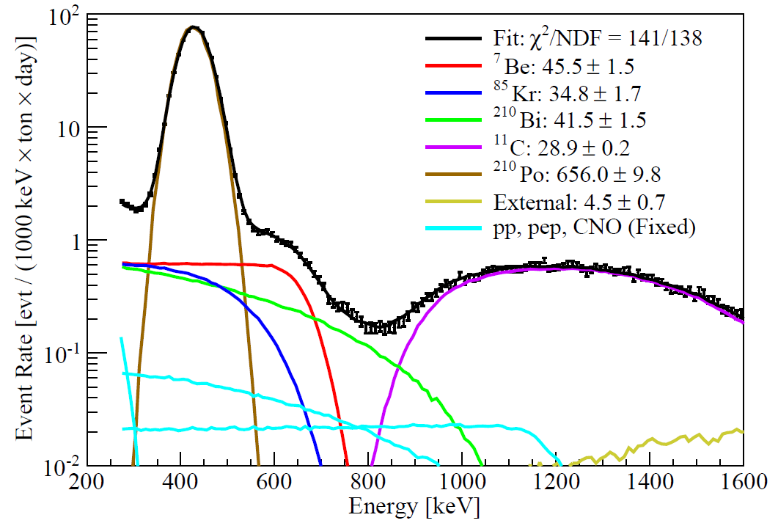
Borexino Phase 1 (2007-2010) results
⁷Be ν with 5% error
PRL 107, 1411302 (2011)
pep ν and limit on CNO ν
PRL 108, 051302 (2012)
More details on Borexino Phase I results in Phys.Rev.D 89, 112007 (2014)
Absence of Day/Night asymmetry
Phys.Lett.B 707, 22-26 (2012)
⁸B ν
Phys.Rev.D 82, 0330066 (2010)

Slide 17
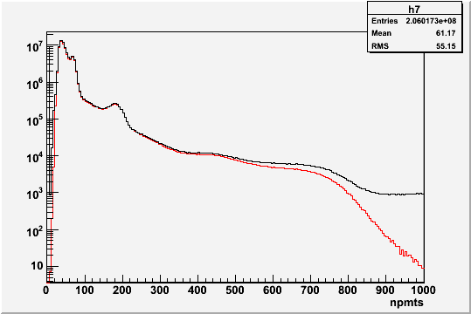
Borexino Phase 1 (2007-2010) results
Data after 750 days (normalized to 100tons)
¹⁴C, unavoidable in organic scintillator
-------------- no cuts
-------------- muon +muon daughter cut
-------------- FV cut
counts/(100tons x 5npmts)
²¹⁰Po (from the lines?)
-decays alpha (t ~200 day)
-not in equilibrium with U chain
1 MeV

Slide 18
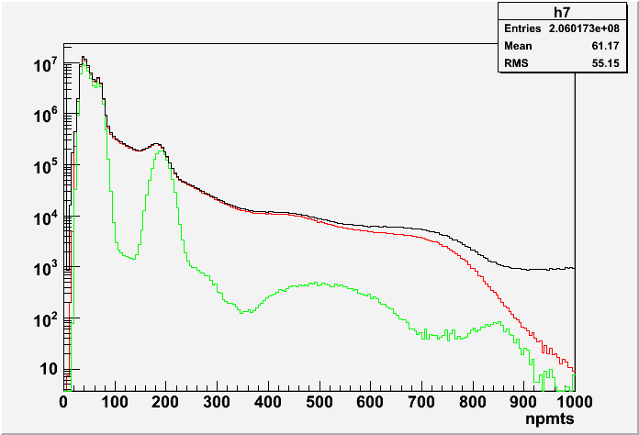
Borexino Phase 1 (2007-2010) results
Data after 750 days (normalized to 100tons)
¹⁴C, unavoidable in organic scintillator
-------------- no cuts
-------------- muon +muon daughter cut
-------------- FV cut
Residual backgrounds
¹⁴C
¹⁴C pile-up
⁸⁵Kr
²¹⁰Bi
²¹⁰Po
Spectral fit to disentangle contributions
counts/(100tons x 5npmts)
counts/(100tons x 5npmts)
²¹⁰Po (from the lines?)
-decays alpha (t ~200 day)
-not in equilibrium with U chain
⁷Be neutrino shoulder
1 MeV

Slide 19
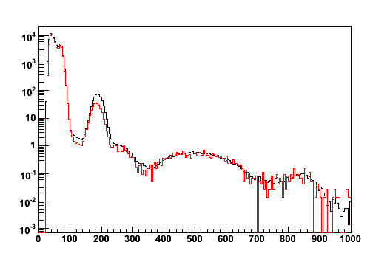
Borexino Phase 2: new challenges
Comparison between Phase 1 and Phase 2 data
¹⁴C, unavoidable in organic scintillator
-----Borexino Phase I (May 2007-May 2010)
-----Borexino Phase II (Jan 2012-Mar 2012)
The scintillator has never been so clean!
npmts
We are now able of exploring the low energy region where pp neutrinos are;

Slide 20
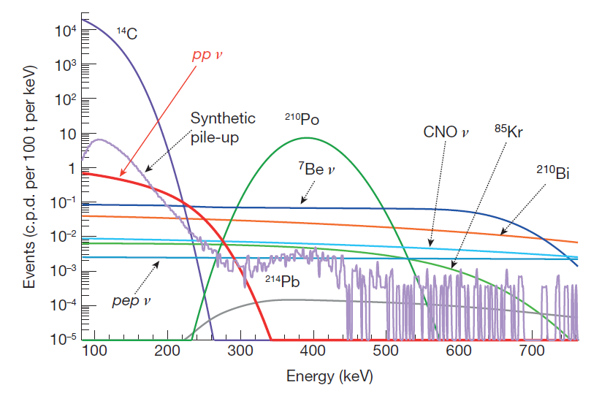
Search for pp-neutrinos: challenges
pp solar neutrinos induce electron-recoils up to ~300 keV ;
This region is vastly dominated by ¹⁴C (Signal/Background ~ 10 ⁻⁵ !);
Below ~150 keV (~60 npmts) ¹⁴C is overwhelming;
Pile-up of ¹⁴C events (2 events within the same acquisition window mainly ¹⁴C+¹⁴C but also other) is also a significant background in the sensitivity window for pp ν ;
Expected spectrum
A spectral fit is needed to disentangle the contributions of signal and background;
¹⁴C
It is crucial to know precisely the spectral shapes of signal and backgrounds;

Slide 21
Search for pp-neutrinos: challenges
Spectral shapes are affected by the detector response:
Spectral deformation (both signal and backgrounds) due to several effects (threshold, dark noise);
Energy scale and resolution issues at low energies (quenching..);
Detector response at low energy assessed by combining calibration data and MonteCarlo simulations;
Independent determination of the rate of the main backgrounds (¹⁴C and pile-up) in order to constrain them in the fit;
¹⁴C rate determined from an independent class of events less affected by the trigger threshold (2° cluster events);
Pile-up rate and shape determined by a data-driven method (synthetic pile-up);

Slide 22
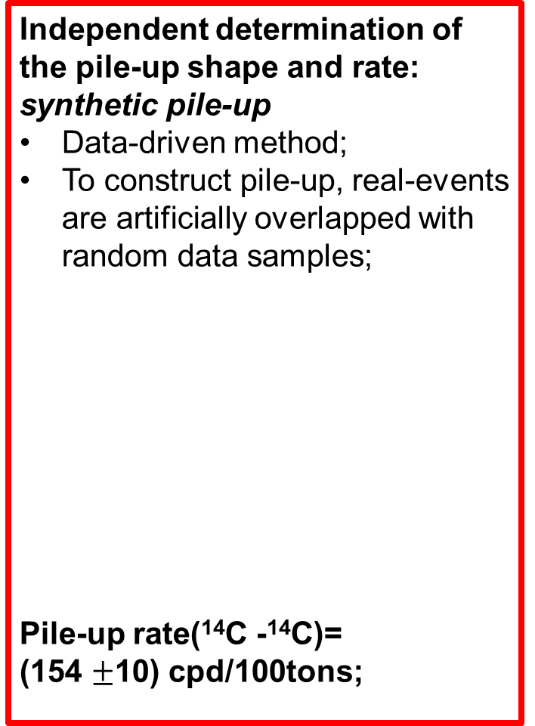
Search for pp-neutrinos : ¹⁴C and pile-up
Independent determination of the ¹⁴C rate: 2-nd cluster events
Events occurring in the last part of the acquisition window (triggered by the previous event);
Spectral shape is less affected by the trigger threshold;
Fit to extract the rate;
¹⁴C rate = (40 ± 1)Bq/100tons
Independent determination of the pile-up shape and rate:
synthetic pile-up
Data-driven method;
To construct pile-up, real-events are artificially overlapped with random data samples;
Pile-up rate(¹⁴C -¹⁴C)=
(154 $±$10) cpd/100tons;

Slide 23
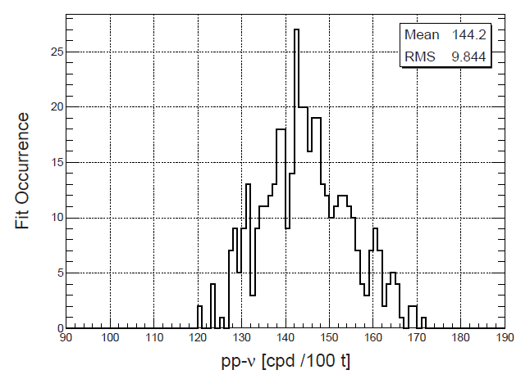
Search for pp-neutrinos: results
Evaluation of systematics
Fit range:165-590 keV
Distribution of the best fit values for pp-rate obtained varying some of the fit conditions (fit range, energy estimator...)
pp-ν rate= 144 ±13(stat) ±10 (sys) cpd/100tons
Predicted rate for SSM (High Metallicity) + MSW-LMA = 131 ± 2 cpd/100tons

Slide 24
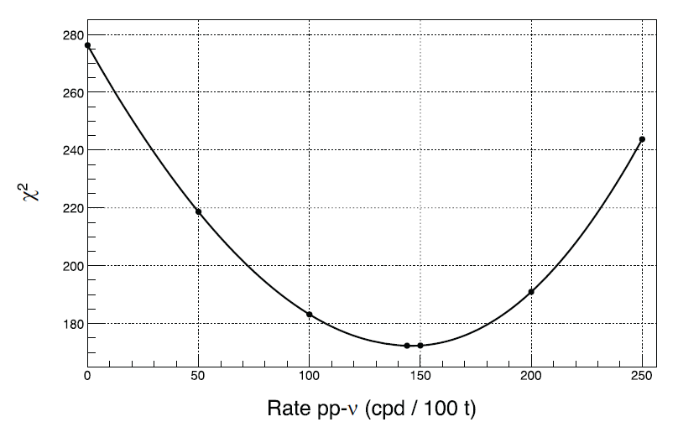
Results: pp neutrino flux
Zero pp count is excluded at 10σ
Luminosity in neutrinos consistent with luminosity in photons

Slide 25
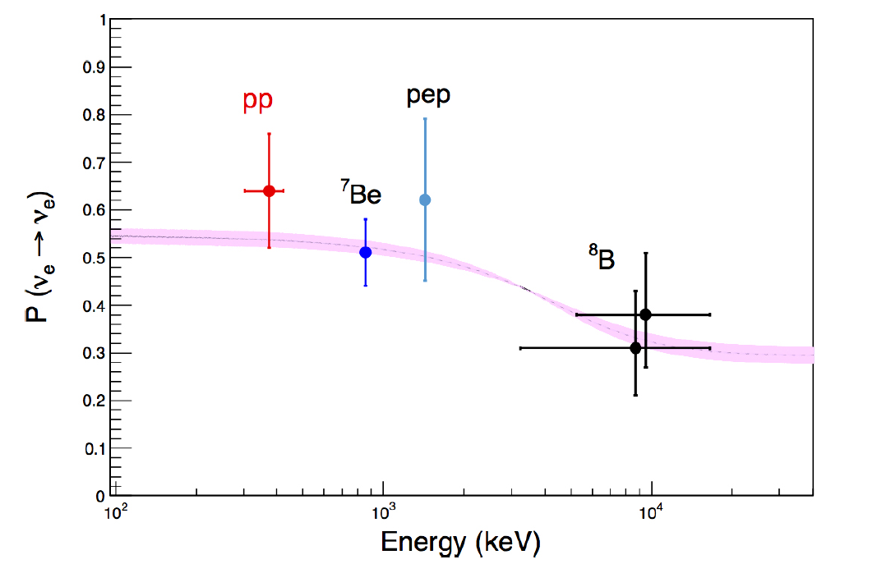
Results: pp neutrino survival probability
Survival probability for pp-ν can be calculated using the measured rate and the SSM predictions;
P(ν_{e} → ν_{e}) = 0.64 ± 0.12
Borexino results only!

Slide 26
Conclusions and outlook: what next?
PHASE 1
Purification 2
PHASE 2
Toward CNO ?
2007
2010
2012
2015
Toward SOX
Complete analysis of Phase 2 data
calibration campaign to further reduce systematic uncertainties;
improved measurement of ⁷Be ν (3% error? challenging!) and other solar neutrino families;
Attempt to measure CNO ν: very challenging!
Sterile neutrino program (SOX)
In 2016 the ¹⁴⁴Ce-¹⁴⁴Pr anti-neutrino source will arrive in Gran Sasso and the sterile neutrino program will start;

Slide 27

Thank you!

