Slide 1
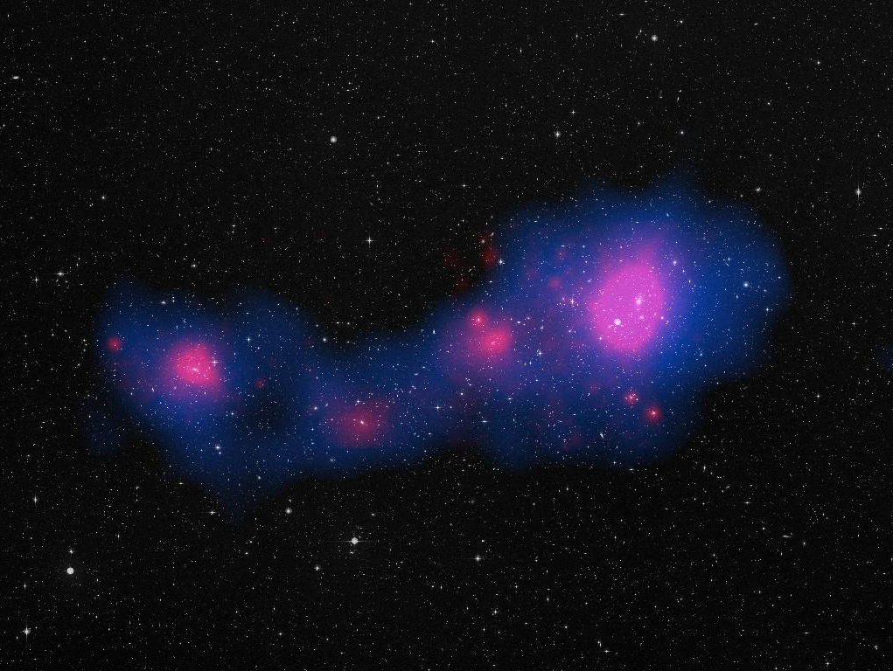
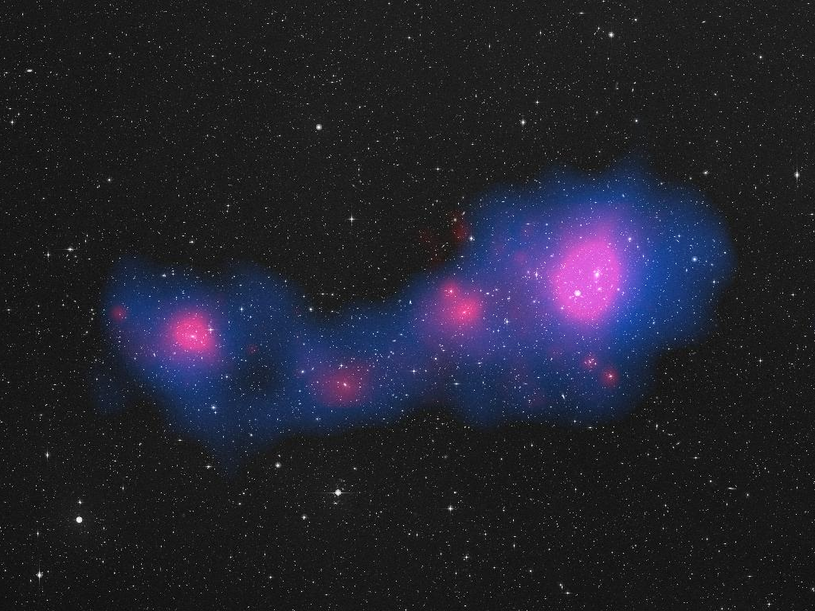
Cosmological constraints
from tSZ-X cross-correlation
G.Hurier

Slide 2
Why ?
X-ray and tSZ probe matter large scale structure, and thus cosmology
X-ray and tSZ are produced by the hot
intra-cluster medium
(13% of the galaxy clusters mass)
Complementarity with X-rays and tSZ only
dedicated analysis
X-ray and tSZ surveys present different background and foreground contaminations

Slide 3
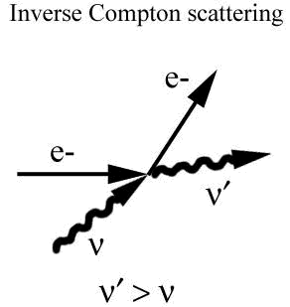
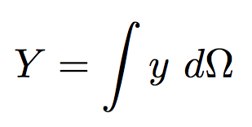
Introduction : The thermal Sunyaev Zel’dovich effect (tSZ)
The intensity of the tSZ effect is proportional to the integration of the pressure (T_{e}n_{e}) across the line of sight
Frequency dependence ΔT = y*f(ν)
electron pressure
Line of sight
Thomson cross section
Compton parameter
Integrated Compton parameter :

Slide 4
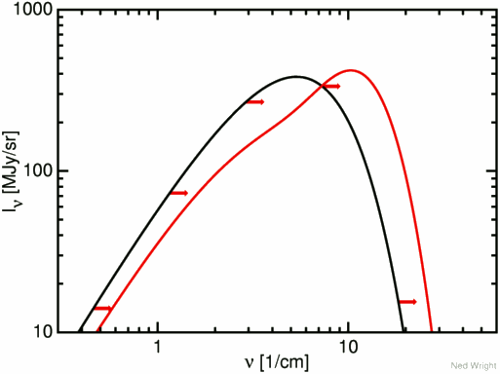
Introduction : The thermal Sunyaev Zel’dovich effect (tSZ)
The intensity of the tSZ effect is proportional to the integration of the pressure (T_{e}n_{e}) across the line of sight
Black-body modification (y = 0.15)
Frequency dependence ΔT = y*f(ν)
electron pressure
Line of sight
Thomson cross section
Compton parameter
Shift of the electromagnetic spectrum
Integrated Compton parameter :

Slide 5
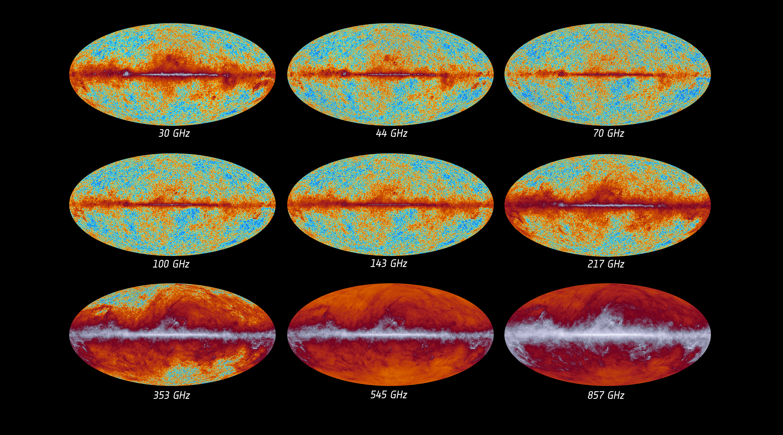
Planck :
full sky maps

Slide 6
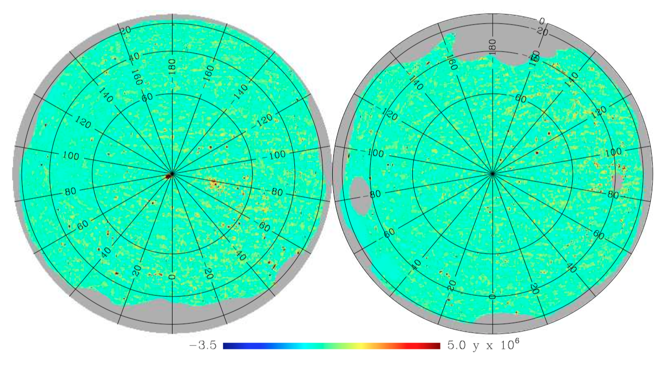
Component separation :
MILCA map
MILCA : Hurier et al. 2013 : A&A, 558:A118
Derived from a linear combination of Planck frequency maps

Slide 7
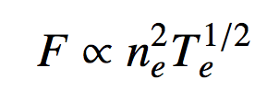
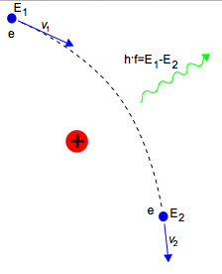
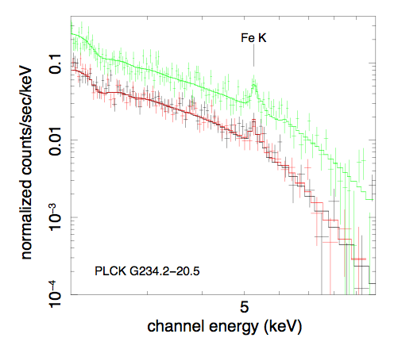
Introduction : Bremsstrahlung
electron density
This emission is produced by the deceleration of electrons when deflected by acharged particle
Electron temperature

Slide 8
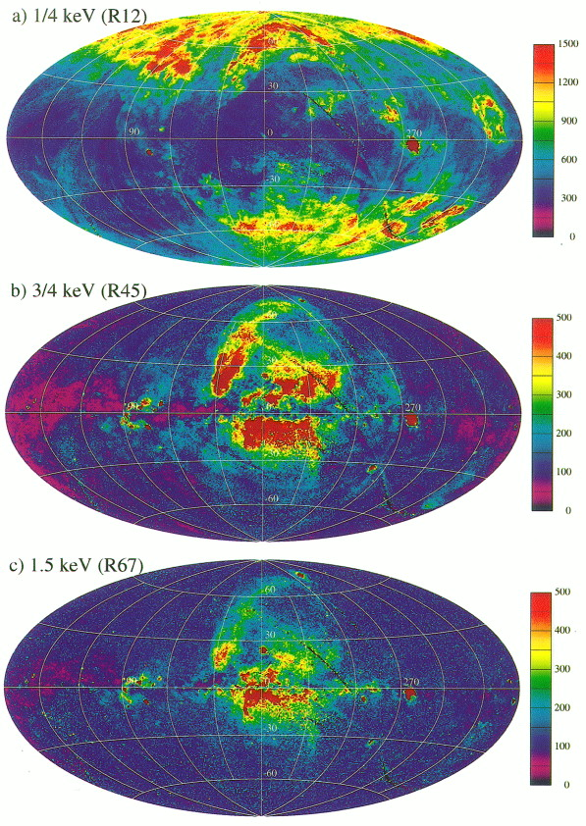
ROSAT All Sky Survey
(RASS)
Low energy band 0.1-0.4 keV,
dominated by n_{H} absobtion
High energy band 0.5-2.0 keV,
Less affected by n_{H} absobtion

Slide 9
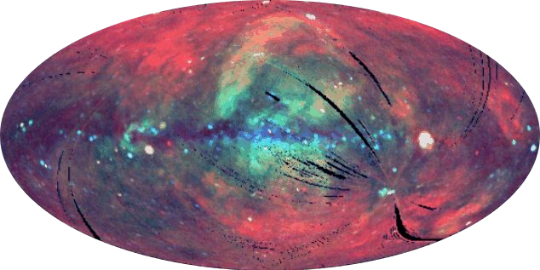
How ?
We have now access to both full-sky X-ray and tSZ surveys:
→Rosat All Sky Survey
→Planck tSZ survey
The cross correlation can be performed on the full-sky using angular power spectrum analysis:
→already tried with RASS and WMAP (Diego et al. 2003),
→already done using selected sample of X-ray clusters (Hajian et al. 2013),
→or using data maps (Hurier et al. 2014 to be submitted)

Slide 10
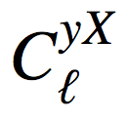
Modelling the X-SZ cross correlation
Hurier et al. 2014 : A&A
Cosmology
Mater power spectum
Mass-Function (Tinker et al. 2008)
Linear bias
(Kotmatsu & Kitayama 1999)
X-SZ
tSZ
M₅₀₀ - Y₅₀₀ scaling law
Pressure profile
X-ray
M₅₀₀ - L₅₀₀ scaling law
M₅₀₀ - T₅₀₀ scaling law
Abundance evolution
Density profile

Slide 11
Modelling the tSZ contribution
tSZ flux prediction:
(Planck collaboration XX, XXI 2013)
Pressure profile:
(Arnaud et al. 2010, Planck Intermediate results V 2013)
Fourrier transform of the profile:

Slide 12
Modelling the X-ray contribution
Mass-Luminosity relation:
(Pratt et al. 2010)
Mass-Temperature relation:
(Arnaud et al. 2005)
Metallicity evolution history:
Z =
(Andreon 2012)
Flux to count rate using Mekal model (Mewe et al. 1985).
The n(H) absorption has been accounted for by convolving the flux to count rate conversion factor with the n(H) distribution (LAB survey: Kalberla et al. 2005)

Slide 13
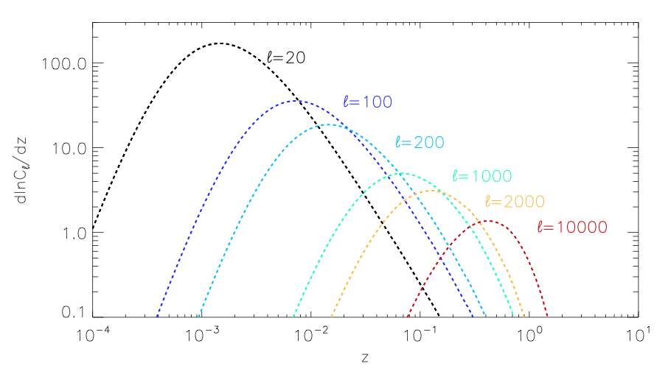
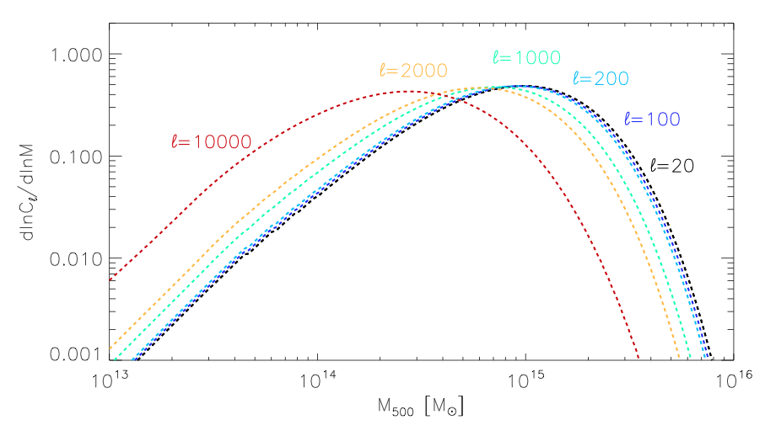
X-SZ power as a function of M₅₀₀ and z
The SZ-X correlation is dominated
by clusters at z < 1
Low mass clusters (M < 10¹⁴ M_{sun})
only contribute at small angular scales

Slide 14
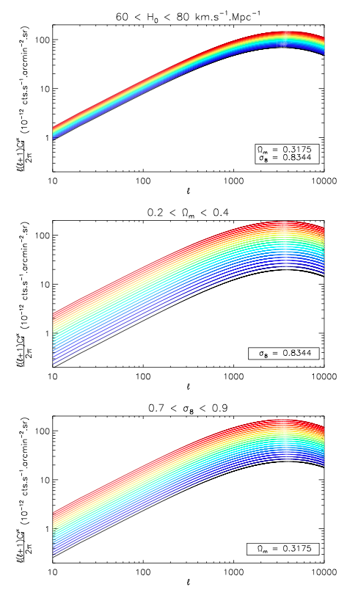
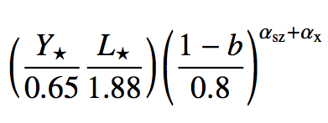
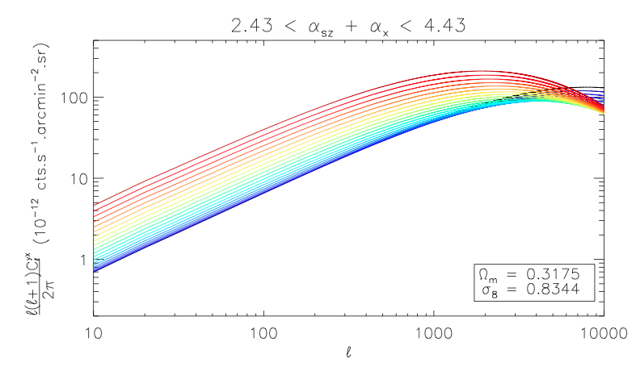
Sensitivity to parameters
Amplitude variations with cosmology:
α_{H} ≈ 2.38
Shape variation with scaling law :
α_{Ω} ≈ 3.42
α_{σ} ≈ 8.12

Slide 15
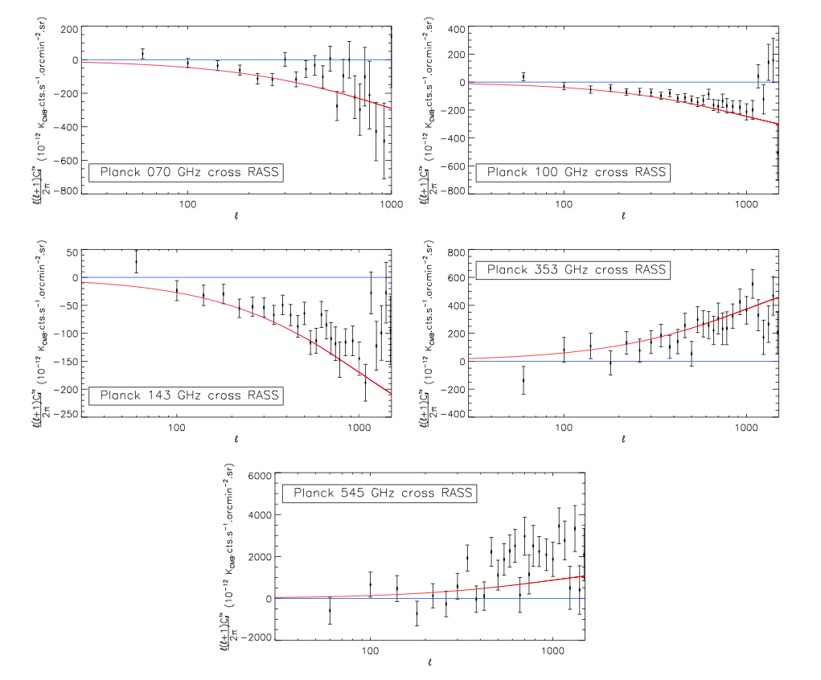
Data: RASS cross Planck
Contents:
→tSZ-X
→AGN
→CIB-X
Hurier et al. 2014 : To be submitted

Slide 16
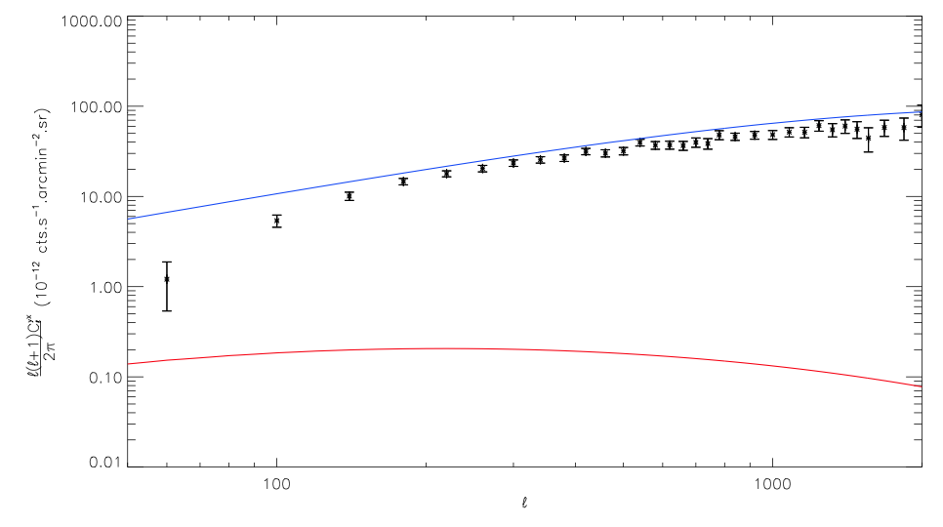
Data: RASS cross MILCA

Slide 17
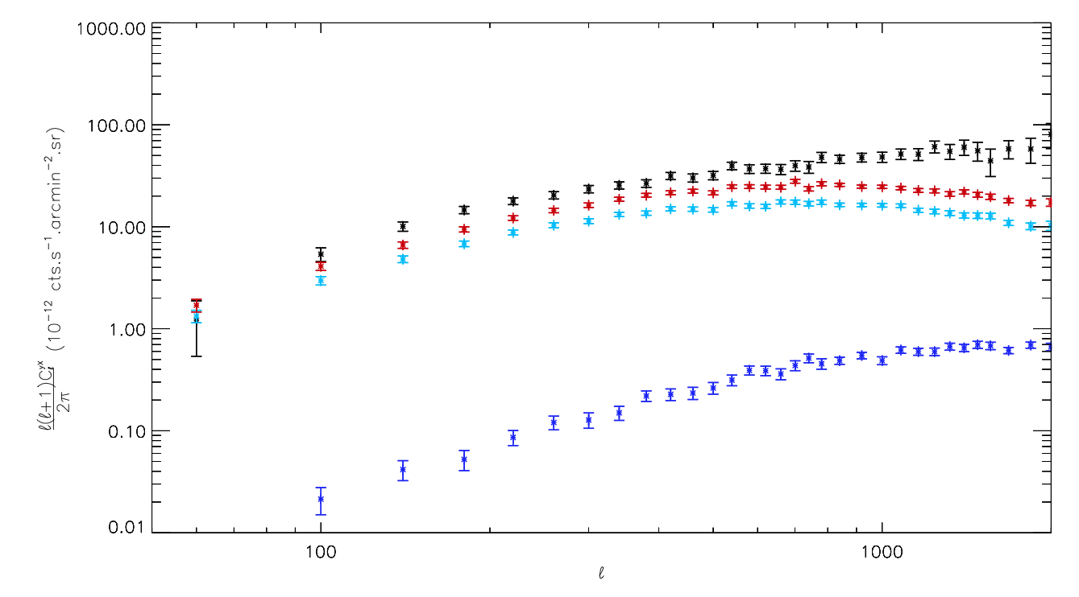
RASS cross Known clusters
Full cross-spectrum
MCXC
Planck PSZ1 2013
Planck 2013 cosmo sample
tSZ-X cross spectrum contains additional informations
compared to Planck cosmo sample

Slide 18
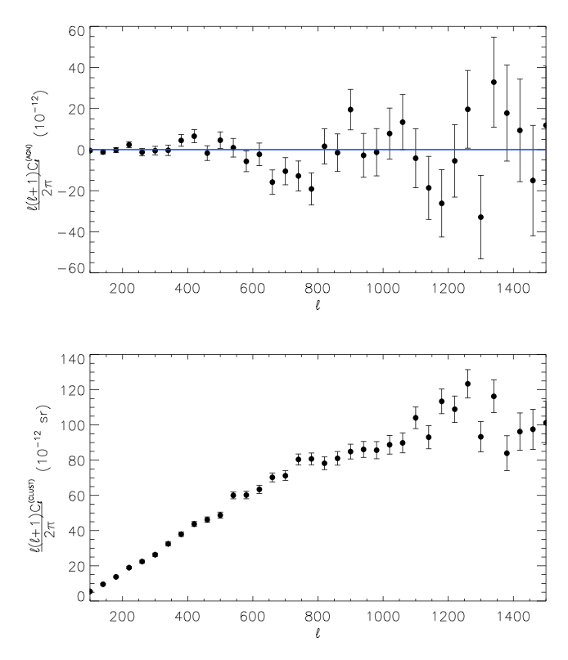
MILCA cross Known objects
MILCA cross X-ray AGN
MILCA cross X-ray galaxy clusters

Slide 19
Limitations of the tSZ-X correlation
Main modelling uncertainties:
→Mass function uncertainties (about 10%)
→Scaling laws uncertainties (about 5%)
→hydrostatic bias (about 10%)
From theory
Main statistical uncertainties:
→Instrumental noise
→CMB contamination
→Thermal dust contamination
From data
Main systematics uncertainties:
→radio loud AGN contamination
→CIB-X correlation

Slide 20
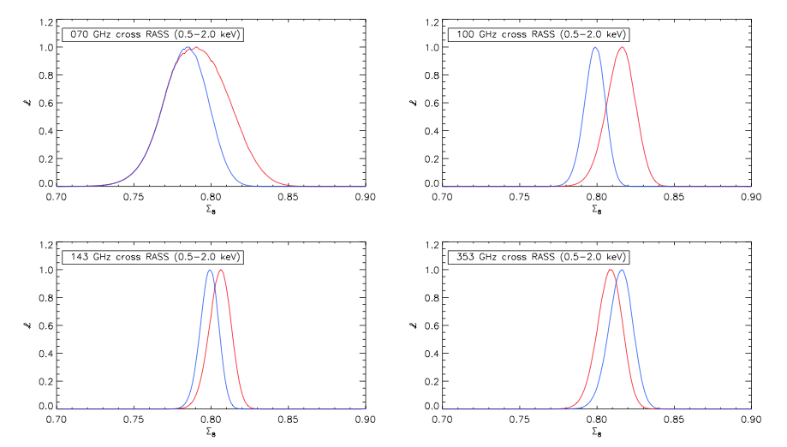
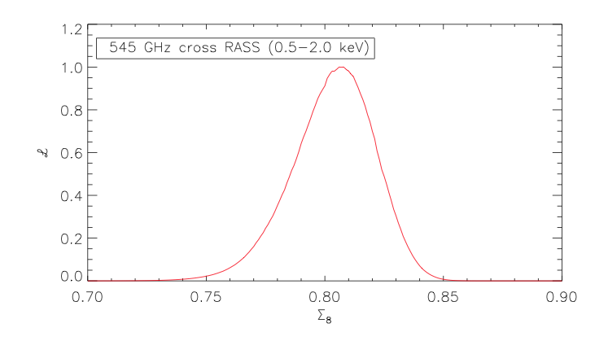
Constraints per frequency

Slide 21
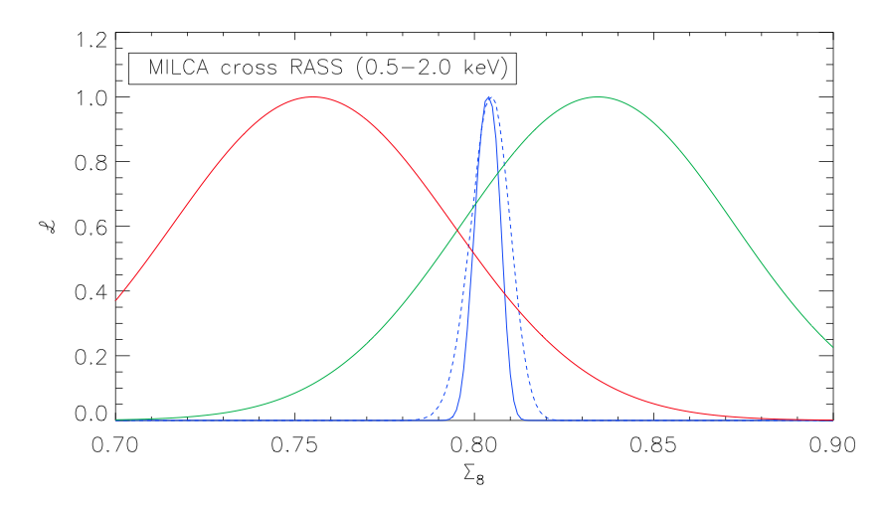
Combined constraints
Planck CMB cosmo
Planck SZ cosmo
tSZ-X cross-spectrum
Hurier et al. 2014 : To be submitted

Slide 22
THE END

