Slide 1

Le Labex ENIGMASS
General Meeting
28 Novembre 2014
Yannis Karyotakis

Slide 2
Objectives and scientific strategy
Search for new physics and new phenomena @ LHC.
  Data analysis : Higgs properties, direct and indirect searches for new physics.
  Upgrade of the ATLAS detector : Trigger, Tracker and LAr calorimeter.
  Develop a synergy with theorists
Develop a neutrino pole : mass hierarchy, CP violation, double β decays, sterile neutrinos
  Dark matter: Direct and indirect searches. Develop synergies between different experiments : AMS, HESS/CTA, theory
  Multi-messenger approach on gravitational waves
  Develop a cosmology pole in the future.

Slide 3
Objectives (more)
Support innovative education actions
  Instrumentation school in its 2nd year
  Graduate schooll GRASPA
  Nuclear platform
  Erasmus mondus ???
Support a limited number of valorisation projects
Organise internal lectures and workshops, support external events
Outreach

Slide 4
The labex Added value
Significant reinforcement of our teams
Have created momentum on neutrino physics
Created the instrumentation, ESIPAP and graduated, GRASPA, schools
Support 2 valorization projects

Slide 5
Long term strategy
Develop a strong cooperation between the 4 labs and create a strong group inside the Université de Grenoble and the pole PAGE.
We favor every project implying more than one laboratory

Slide 6
Organisation
Management board : meets every month, regularly extended to WP coordinators.
External committees
Scientific council and Steering board meet once per year

Slide 7
We hired 23 persons + 2 to come !

Slide 8
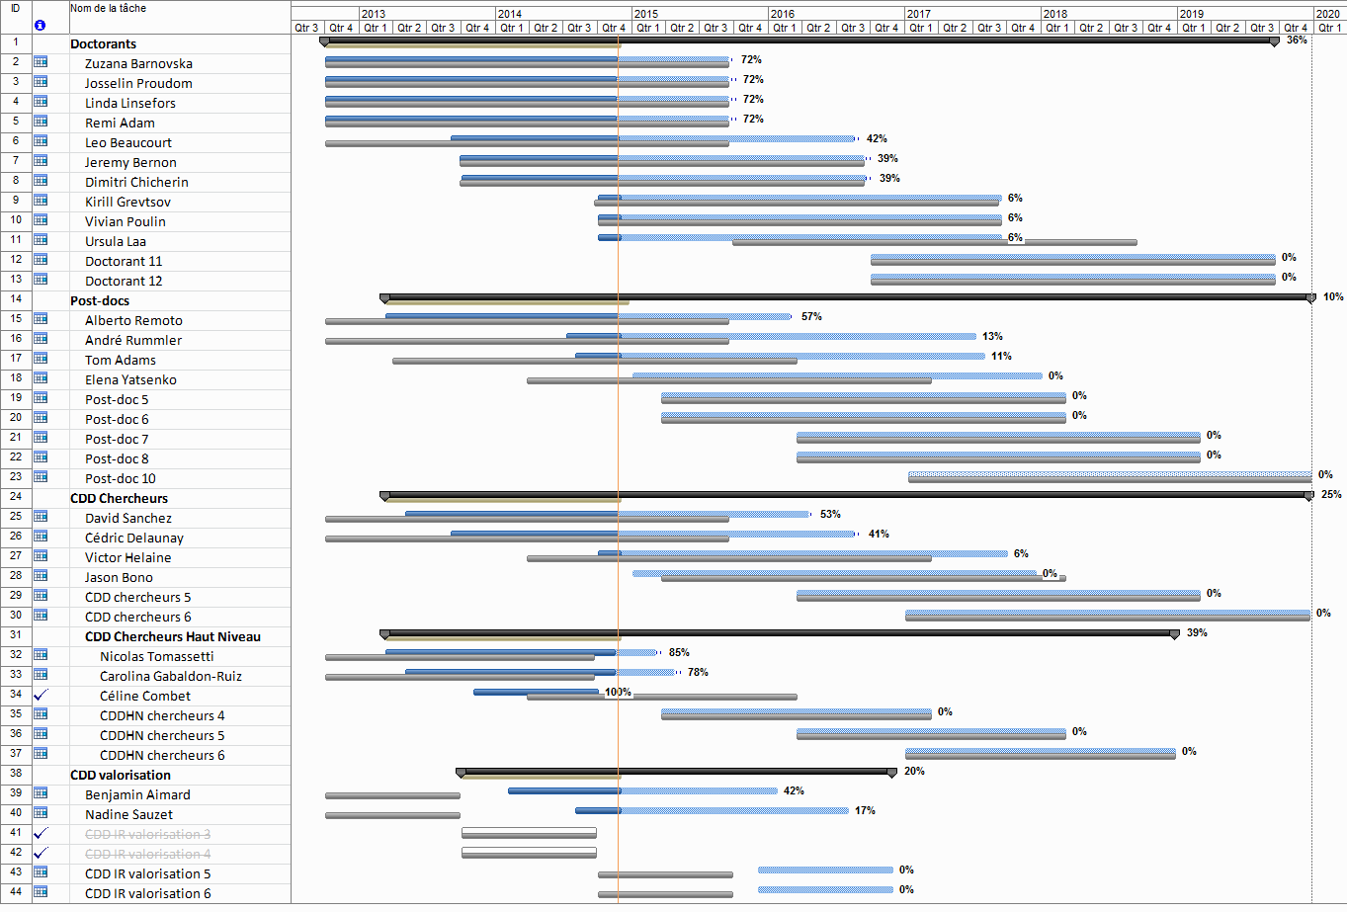

Slide 9
People to come
Two students
Post Docs:
  6 years High level
  ~5 post docs
One Engineer

Slide 10
Budget status
48% of our total budget is engaged

Slide 11
Remarks and messages
We are doing quite well in general
The program lasts until the end of 2019, therefore 2016 is the dead line to hire students and post docs with a 3 year term.
Visitors’ foreseen budget must be modified :
  Compensate ESIPAP expenses underestimated
  Add 2-3 more students and 1-2 extra post docs OR invest on materials
We can support ambitious outreach proposals

Slide 12
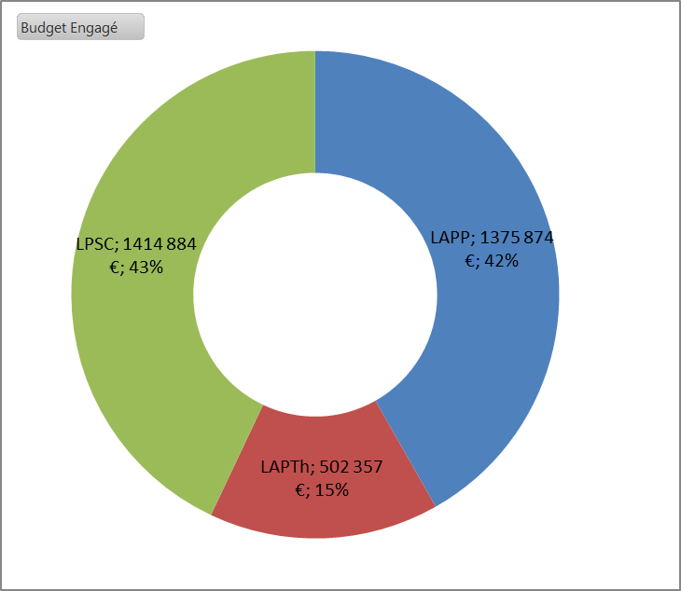
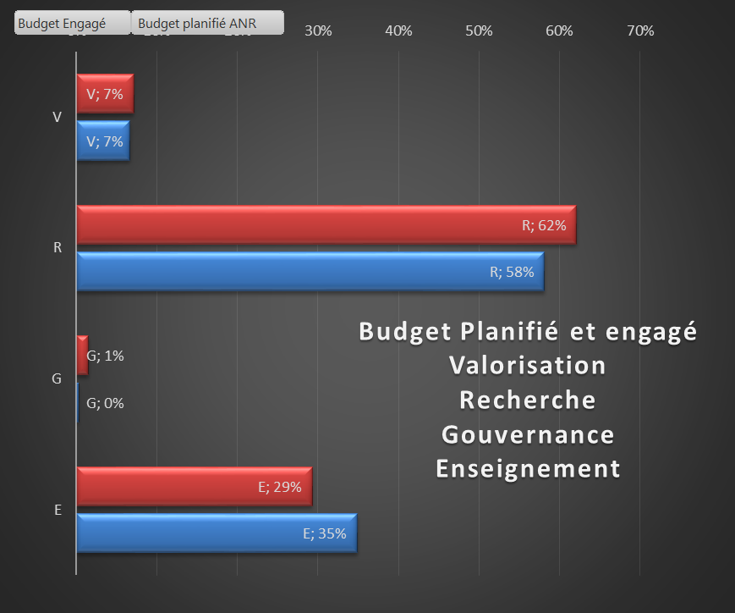
Budget analysis

Slide 13
What after the Labex ???
The horizon is unclear
  IDEX of Grenoble. In principle support to multi-disciplinary actions
  Poles scientifiques of UGA. Limited support
  Budgets are going down
Cooperation and optimisation of the resources

Slide 14
Conclusion
We are almost at mid term now and globally we are doing well
We start a 2nd phase of our program and our priority will be given to projects promoting synergies between labs
There is room and time for new or almost new ideas to support

