Slide 1



TMDs, offering opportunities at small k_{T} and small x!
Annual Meeting of the GDR PH-QCD (December 15-17, 2014)
Ecole Polytechnique, 16 December 2014
Piet Mulders
mulders@few.vu.nl

Slide 2
Outline
TMD’s: color gauge invariant correlators, describing distribution and fragmentation functions including partonic transverse momentum.
  Taking small p_{T} out of the perturbative regime
What are we talking about (definitions): gauge invariant description involves parton fields at different points, color-connected with gauge links/Wilson lines
They can be measured in azimuthal and spin asymmetries provided one carefully accounts for right factors/signs etc.
High/low energy, relations with small-x physics and diffraction

Slide 3
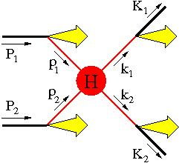
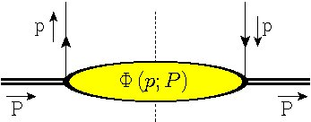
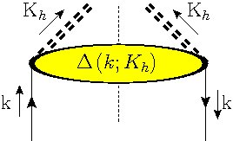
PDFs and PFFs
Basic idea of PDFs and PFFs (also for TMDs) is to obtain a full factorized description of high energy scattering processes
calculable
defined (!)
&
portable
Give a meaning to integration variables, including e.g. q_{T} = p_{1T} + p_{2T}!

Slide 4
(Un)integrated correlators
σ = p⁻ integration makes time-ordering automatic. The soft part is simply sliced at the light-front
Is already equivalent to a point-like interaction
Local operators with calculable anomalous dimension
unintegrated
TMD (light-front)
collinear (light-cone)
local
Notes:
Parton momentum has four components
Not-time-ordered
Integrate p-

Slide 5
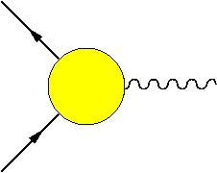
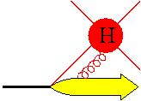
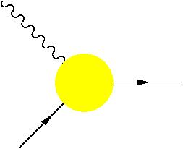
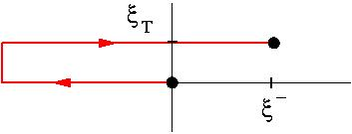
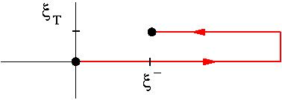
Simplest gauge links for quark TMDs
TMD
Essential feature is the color connection of parton fields: gauge links originating from dimension zero (not suppressed!) A.n gluons (gluons polarized along parton momentum), but this is ambiguous for TMDs leading to process-dependence:
DY
SIDIS
… A^{n} …
… A^{n} …
Φ^{[-]}
Φ^{[+]}
Time reversal
AV Belitsky, X Ji and F Yuan, NP B 656 (2003) 165
D Boer, PJM and F Pijlman, NP B 667 (2003) 201
Notes:
No unique way
Examples: DY & SIDIS
After integration: the same

Slide 6
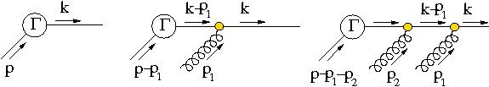
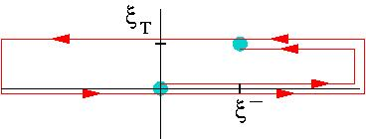
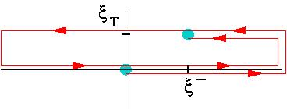
Some details on the gauge links (1)
Proper gluon fields (F rather than A, Wilson lines and boundary terms)
Resummation of soft n.A gluons (coupling to outgoing color-line) for one correlator produces a gauge-line (along n)
Boundary terms give transverse pieces
TMD’s may have complex gauge links involving loops (linked to color flow)
U□ = U⁺U^{−†}

Slide 7
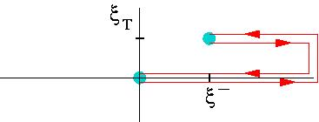
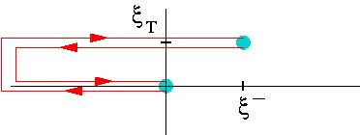
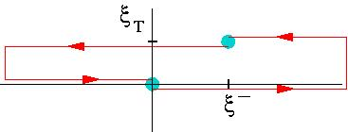
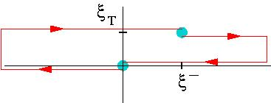
Simplest gauge links for gluon TMDs
The TMD gluon correlators contain two links, which can have different paths. Note that standard field displacement involves C = C’
Basic (simplest) gauge links for gluon TMD correlators:
gg ➔ H
Φ_{g}^{[+,+]}
Φ_{g}^{[-,-]}
Φ_{g}^{[+,-]}
Φ_{g}^{[-,+]}
C Bomhof, PJM, F Pijlman; EPJ C 47 (2006) 147
F Dominguez, B-W Xiao, F Yuan, PRL 106 (2011) 022301
in gg ➔ QQ

Slide 8
Color gauge invariant correlators
Including gauge links well-defined matrix elements for TMDs but this implies multiple possiblities for gauge links depending on the process and the color flow
Leading quark TMDs
Leading gluon TMDs:

Slide 9
Studying dependence on gauge links

Slide 10
Operator structure in TMD case
Operator product expansion takes you from local to nonlocal operator combinations.
For TMD functions one can investigate this through transverse moments
Upon integration, these involve collinear twist-3 multi-parton correlators, they remain highly non-local and are U-dependent
MGA Buffing, A Mukherjee, PJM, PRD 86 (2012) 074030 , Arxiv: 1207.3221 [hep-ph]
Notes:
Gauge link has richer structure
3 matrix elements

Slide 11
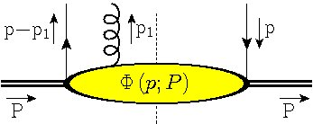
Operator structure in TMD case
For first transverse moment one needs (both) twist-3 quark-gluon correlators
In principle multi-parton, but we need ‘local’
Φ_{F}(p-p₁,p)
T-even (gauge-invariant derivative)
T-odd (soft-gluon or gluonic pole)
Efremov, Teryaev; Qiu, Sterman; Brodsky, Hwang, Schmidt; Boer, Teryaev, M; Bomhof, Pijlman, M
Notes:
Gauge link has richer structure
3 matrix elements

Slide 12
Operator structure in TMD case
Transverse moments can be expressed in these particular collinear multi-parton twist-3 (and higher) correlators (which are not suppressed!)
C_{G}^{[U]} calculable
gluonic pole
factors
T-even
T-odd
T-even
T-even
T-odd
Tr_{c}(GG ψψ)
Tr_{c}(GG) Tr_{c}(ψψ)
Notes:
+ or – gauge links this is just +1 or -1
Also be illustrated by looking at the parametrization in PDFs.

Slide 13
Distribution versus fragmentation functions
Operators:
Operators:
out state
T-even
T-odd (gluonic pole)
T-even operator combination, but still T-odd functions!
Collins, Metz; Meissner, Metz; Gamberg, M, Mukherjee, PR D 83 (2011) 071503

Slide 14
Classifying Quark TMDs
Collecting the right moments gives expansion into full TMD PDFs of definite rank
While for TMD PFFs

Slide 15
Classifying Quark TMDs
Only a finite number needed: rank up to 2(S_{hadron}+s_{parton})
Rank m shows up as cos(mφ) and sin(mφ) azimuthal asymmetries
No gluonic poles for PFFs
factor | TMD PDF RANK
 | 0 | 1 | 2 | 3
1
factor | TMD PFF RANK
 | 0 | 1 | 2 | 3
1
MGA Buffing, A Mukherjee, PJM, PRD2012 , Arxiv: 1207.3221 [hep-ph]

Slide 16
Explicit classification quark TMDs
Example: quarks in an unpolarized target are described by just 2 TMD structures
Gauge link dependence:
factor | QUARK TMD PDF RANK UNPOLARIZED HADRON
 | 0 | 1 | 2 | 3
1
T-even
T-odd
[B-M function]

Slide 17
Explicit classification quark TMDs
factor | QUARK TMD PDFs RANK SPIN ½ HADRON
 | 0 | 1 | 2 | 3
1
Multiple color possibilities
trace terms

Slide 18
Explicit classification quark TMDs
factor | QUARK TMD PDFs RANK SPIN ½ HADRON
 | 0 | 1 | 2 | 3
1
Three pretzelocities:
Process dependence in f_{1,} g₁and h₁
(U-dependent broadening made explicit)
B Boer, MGA Buffing, PJM, work in progress

Slide 19
Explicit classification quark TMDs
factor | QUARK TMD PDFs RANK SPIN ½ HADRON
 | 0 | 1 | 2 | 3
1
factor | QUARK TMD PFFs RANK SPIN ½ HADRON
 | 0 | 1 | 2 | 3
1
Just a single ‘pretzelocity’ PFF

Slide 20
Explicit classification gluon TMDs
factor | GLUON TMD PDF RANK UNPOLARIZED HADRON
 | 0 | 1 | 2 | 3
1
Note process dependence of unpolarized gluon TMD:
D. Boer (talk spin 20014): B Boer, MGA Buffing, PJM, work in progress

Slide 21
Multiple TMDs in cross sections

Slide 22
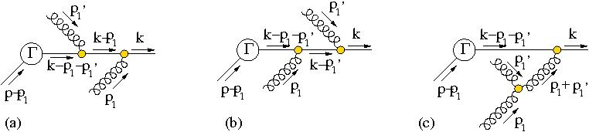
Some details on the gauge links (2)
Resummation of soft n.A gluons (coupling to outgoing color-line) for one correlator produces a gauge-line (along n)
The lowest order contributions for soft gluons from two different correlators coupling to outgoing color-line resums into gauge-knots: shuffle product of all relevant gauge-lines from that (external initial/final state) line.

Slide 23
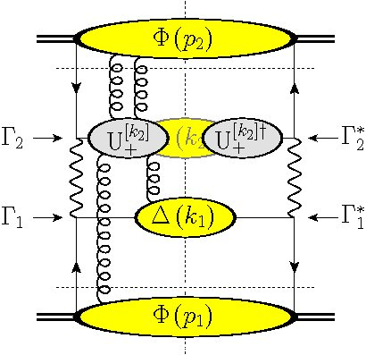
Which gauge links?
With more (initial state) hadrons color gets entangled, e.g. in pp
Gauge knot U₊[p₁,p₂,…]
Outgoing color contributes to a future pointing gauge link in Φ(p₂) and future pointing part of a gauge loop in the gauge link for Φ(p₁)
This causes trouble with factorization
T.C. Rogers, PJM, PR D81 (2010) 094006
Notes:
More complicated gauge links
Color-entanglement
Explicit calc: some contributions break factorizatn
On the right, a more detailed picture is visible. No factorization

Slide 24
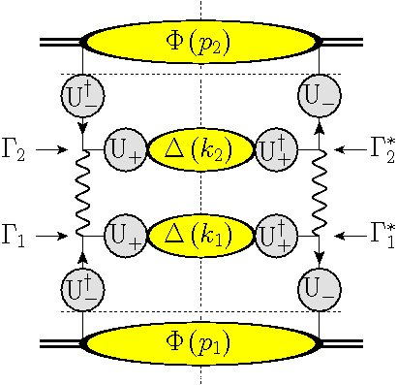
Which gauge links?
Can be color-detangled if only p_{T} of single correlator is relevant (using polarization, …) but must include Wilson loops in final U
MGA Buffing, PJM, JHEP 07 (2011) 065
Notes:
More complicated gauge links
Color-entanglement
Explicit calc: some contributions break factorizatn
On the right, a more detailed picture is visible. No factorization

Slide 25
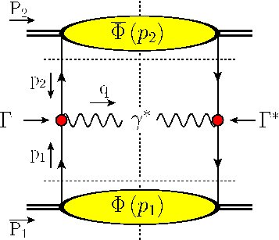
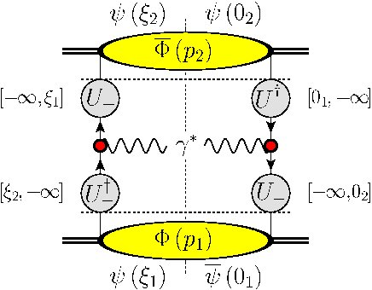
Correlators in description of hard process (e.g. DY)
Complications if the transverse momentum of two initial state hadrons is involved, resulting for DY at measured Q_{T} in
Just as for twist-3 squared in collinear DY

Slide 26
Classifying Quark TMDs
factor | TMD RANK
 | 0 | 1 | 2 | 3
1
MGA Buffing, PJM, PRL (2014), Arxiv: 1309.4681 [hep-ph]

Slide 27
Remember classification of Quark TMDs
factor | QUARK TMD RANK UNPOLARIZED HADRON
 | 0 | 1 | 2 | 3
1
Example: quarks in an unpolarized target needs only 2 functions
Resulting in cross section for unpolarized DY at measured Q_{T}
contains f₁
contains h₁^{perp}
D. Boer, PRD 60 (1999) 014012; MGA Buffing, PRL (2014) PJM, Arxiv: 1309.4681 [hep-ph]

Slide 28
TMDs and diffraction

Slide 29
A TMD picture for diffractive scattering
Preliminary
q’
q
X
p₂
k₂
p₁
GAP
GAP
P
P’
GAP
Y
Momentum flow in case of diffraction
x₁ → M_{X}²/W² → 0 and t → p_{1T}²
Picture in terms of TMDs and inclusion of gauge links
(including gauge links/collinear gluons in M ~ S – 1)
(Work in progress: Hoyer, Kasemets, Pisano, Zhou, M)
(Another way of looking at diffraction, cf Dominguez, Xiao, Yuan 2011 or older work of Gieseke, Qiao, Bartels 2000)
Notes:
More complicated gauge links
Color-entanglement
Explicit calc: some contributions break factorizatn
On the right, a more detailed picture is visible. No factorization

Slide 30
A TMD picture for diffractive scattering
Preliminary
q’
q
X
p₂
k₂
p₁
GAP
GAP
P
P’
Y
Cross section
involving correlators for proton and photon/…
Notes:
More complicated gauge links
Color-entanglement
Explicit calc: some contributions break factorizatn
On the right, a more detailed picture is visible. No factorization

Slide 31
Diffractive TMD correlator
Preliminary
no partons!
Simplest transverse moment is rank 2
Leading to

Slide 32
Conclusion with (potential) rewards
We study the (generalized) universality of TMDs via operator product expansion, extending the well-known collinear distributions (including polarization 3 for quarks and 2 for gluons) to TMD PDF and PFF functions, ordered into functions of definite rank.
Theoretical and experimental relevance
! Multiple operator possibilities for pretzelocity/transversity and linearly polarized gluons
! The TMD PDFs appear in cross sections with specific calculable factors that deviate from (or extend on) the naïve parton universality for hadron-hadron scattering.
! Applications in polarized high energy processes, but also in unpolarized situations (linearly polarized gluons) and possibly diffractive processes.

Slide 33
Thank you

