Slide 1

Is “interactive teaching” sufficient to promote conceptual development in physics?
Paula Heron
Department of Physics
University of Washington
Seattle, USA

Slide 2
UW Physics Education Group
Faculty
  Paula Heron
  Lillian McDermott
  Peter Shaffer
Lecturers and postdocs
  Ximena Cid
  Donna Messina
  Gina Passante
Physics PhD Students
  Paul Emigh
  Ryan Hazelton
  Alexis Olsho
  Brian Stephanik
  Marshall Styczinski
  Tong Wan

Slide 3
Outline
Investigating student learning in conventional and “interactive” classrooms
Using research as a basis for improving instruction
Focus on introductory physics – but PER is also highly relevant for advanced courses (ask me after the talk)

Slide 4
PART ONE
Investigating student learning in
conventional and interactive classrooms:
Probing student understanding with written questions that require qualitative reasoning

Slide 5
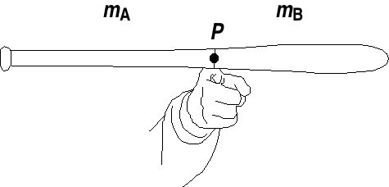
The “baseball bat” question
A student balances a baseball bat on a finger.
Is the center of mass to the right, to the left, or at point P?
Is the mass to the left greater then, less than, or equal to the
mass to the right?
Explain your reasoning.

Slide 6

Sample correct response
“If you were to consider each of the pieces to have a center of mass of their own, the x_{cm} on A would be at a farther distance from the break. m_{A} would be smaller than m_{B} whose x_{cm} is not as far away from the break.”
Correct response given by 20% of students (N > 1000) at UW

Slide 7
Sample incorrect responses
“To be able to balance the bat, the forces on the right of P
and the forces on the left of P cancel each other out…
the masses [to left and right of P] are equal.”
“m_{A} = m_{B}. The term ‘center of mass,’ when translated into everyday English means the ‘center of mass,’ i.e., if separated at the center, half will be on one side and half on the other.”

Slide 8
Maybe students responded incorrectly because:
they are not very smart
they had not been taught the relevant material
they had been taught the material, badly
they misunderstood the question or made unintended assumptions
they were misled by the term “center of mass”
they weren’t taking the question seriously
they ignored their correct intuition because it was a physics test
they haven’t had enough real-world experience (“kids today …”)
…
Most of these explanations, while reasonable, are not supported by evidence

Slide 9
Baseball bat question: Results
5 of students
% of students in class answering correctly
No university-level instruction on torque, equilibrium etc.
Class label

Slide 10
Baseball bat question: Results
5 of students
All instruction on torque, equilibrium etc., in intro physics
% of students in class answering correctly
Class label

Slide 11
On questions that elicit intuitive notions (e.g., about force, motion, charge, buoyancy, balancing, etc.), performance is often essentially the same before and after instruction.

Slide 12
More evidence: A question on acceleration
A ball rolls up and then down an incline as shown in a strobe photo. What is the direction of the acceleration of the ball at the top of its path?
Given in 79 classes of different size, that met at different times of day, used different textbooks, had different amounts of lecture instruction by different people…

Slide 13
A question on acceleration: Results
Results arranged chronologically
% of students giving the correct answer
Heron, 2014

Slide 14
A question on acceleration: Results
Results arranged according to whether or not instruction on acceleration had taken place.
% of students giving the correct answer
Heron, 2014

Slide 15
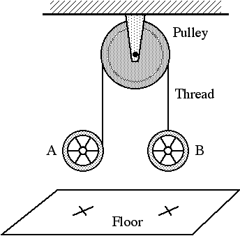
More evidence: A question on capacitance
that (apparently) requires more formal knowledge…
As the (oppositely charged, isolated) plates are moved closer together, does the capacitance of the arrangement increase, decrease or remain the same?
-σ₀
+σ₀
Metal plates on insulating stands
-σ₀
+σ₀
-σ₀
+σ₀
Figure 1. Figures shown to students.
Figure 1. Figures shown to students.
Metal plates on insulating stands
Metal plates on insulating stands

Slide 16
A question on capacitance: Results
% of students giving the correct answer
Heron, 2014

Slide 17
Still more evidence: A question on diffraction
Monochromatic light of wavelength λ is incident on a mask with a slit of width w. The diffraction pattern shown appears on a distant screen.
Is the width of the slit w greater than less than or equal to the wavelength λ?
-σ₀
+σ₀
-σ₀
+σ₀
Figure 1. Figures shown to students.
Figure 1. Figures shown to students.
Metal plates on insulating stands
Metal plates on insulating stands

Slide 18
A question on diffraction: Results
% of students giving the correct answer
Heron, 2014

Slide 19
Even on questions for which one might not expect students to have preconceptions (e.g., capacitance, flux, phase difference), the effect of instruction is often small.

Slide 20
Effect of perceived effectiveness of the instructor
Pairs of instructors teaching parallel sections with common exams
Difference in % of exam questions answered correctly
Difference in student rating of instructor effectiveness (out of 5)

Slide 21
So the solution is interactive teaching, right?
Maybe, sort of.

Slide 22
The effect of additional instruction:
Example from Introductory Physics
A demonstration based on the bat question was performed
by a professor familiar with our research
40% answered the bat question correctly several days later (N = 84)
Common incorrect response:
“m_{A} = m_{B} like Professor X showed us in class.
Also, if they weren’t equal, the bat would tip over.”

Slide 23
There is a strong tendency to “see” what one expects.
McCloskey, Sci. Amer. (1983).
“Confronting” incorrect ideas may be insufficient;
most students need help resolving the underlying conceptual difficulties.

Slide 24
The effect of additional instruction:
Example from second-year engineering statics at UW
Students had a three-hour session on centroids and center of mass
  Worked in small groups
  Made predictions about the location of the center of mass
  of assorted shapes
  Checked their predictions with real apparatus
15% later answered the bat question correctly (N > 70)

Slide 25
Certain conceptual and reasoning difficulties are not addressed by traditional instruction.
Even “pedagogically correct” instruction may not address serious and persistent difficulties.
Instruction should be evidence-based not ideology-based

Slide 26
Interactive teaching (aka “active learning”)
Most (all?) demonstrably effective instructional strategies are interactive; not all interactive instructional strategies are effective
Terms are not operationally defined
  How do we know learning is “active?”
  How can we tell whether students are “engaged?”
The form of instruction is only ONE ingredient

Slide 27
Evidence from decades of systematic research suggests that:
knowledge is developed through construction,
not accretion or absorption.
Students have already constructed considerable knowledge by the time they reach our classrooms.
Passive listening doesn’t
foster (re)construction of existing knowledge
(for most students).

Slide 28
Implications for instruction
Instruction needs to match
  How people learn
  What they already know
Research-based instruction differs from traditional instruction in:
  Style: Students must be actively engaged in learning
  AND
  Content: Instruction must meet students where they are

Slide 29
How can student difficulties be addressed
while respecting existing instructional constraints?
Need for flexible, research-based instructional materials.

Slide 30
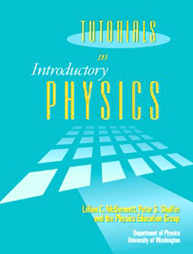
Tutorials in Introductory Physics
A set of instructional materials to supplement instruction
in large introductory courses
General goals:
Constructing concepts
Developing reasoning ability
Relating physics formalism to the real world
General instructional strategies:
Teaching is by questioning (not by telling)
Discussions among students are emphasized
Specific goals and strategies are determined by research
Notes:
We have developed materials for Galilean relativity in the context of both of the curriculum development projects underway in the PEG. Physics by Inquiry is a stand-alone, laboratory based curriculum designed to prepare precollege teachers to teach physics and physical science as a process of inquiry. Tutorials in Introducotry Physics is a supplementary curriculum desinged to improve student learning in theintroducotry course.

Slide 31
Introductory calculus-based physics at UW
~1500 students at any one time (physics & engineering majors)
Standard textbook
Weekly schedule:
  lectures (3 x 1hr)
  laboratory session (1 x 2hr)
  “tutorial” session (1 x 1hr)
  homework problems from textbook (online)
Instruction by faculty and graduate teaching assistants

Slide 32
Basic features of tutorial system at UW
  small groups (3-4) work through worksheets
  tutorial instructors (TAs) teach by questioning
  all course examinations include questions on tutorial
  material

Slide 33
Matching a tutorial strategy to a difficulty
Difficulty:
  Assumption that if there is equal mass (weight/force)
  on both sides of the fulcrum then the object will balance
Strategy:
  Help students recognize that equal mass on both sides of the fulcrum is neither necessary nor sufficient to ensure balancing

Slide 34
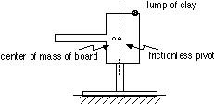
Example of a tutorial activity
Hang board from hole to right of center of mass.
Use clay to balance the board.
Predict how the total mass to the right
of the pivot compares to the total mass to the left.
a. Move the clay toward the pivot.
Does the board remain balanced?
Does the total mass to either side of the pivot change?
b. Balance board again, with larger piece of clay.
Does the total mass to either side of the pivot change?

Slide 35
How do we know if a tutorial helped?
Results from many questions administered under a wide range of conditions suggest that randomized control trials are not necessary for detecting instructionally significant effects.

Slide 36
Baseball bat question: Results
No student saw the same question twice*
5 of students
tutorial
% of students in class answering correctly
Bat demo
Class label
* The bat demo is an exception

Slide 37
PART TWO
Using research on how students learn and
what they know as a basis for improving instruction:
An iterative process.

Slide 38
The “free small ball” problem
A small ball moves without spinning or
interacting with any other objects.
At the instant shown, what is the direction
of the angular momentum of the ball
with respect to point B (L_{ball,B})?
If this quantity is zero, state so explicitly.

Slide 39
The “free small ball” problem
A small ball moves without spinning or
interacting with any other objects.
At the instant shown, what is the direction
of the angular momentum of the ball
with respect to point B (L_{ball,B})?
If this quantity is zero, state so explicitly.
p
r
Correct response given by 30% after instruction (N = 340)
“L_{ball,B} points into the page. By the right hand rule the angular momentum will be orthogonal to the plane of the position and momentum.”
“Out of page” also accepted

Slide 40
The “free small ball” problem
A small ball moves without spinning or
interacting with any other objects.
At the instant shown, what is the direction
of the angular momentum of the ball
with respect to point B (L_{ball,B})?
If this quantity is zero, state so explicitly.
p
r
Common incorrect response (20%)
“L_{ball,B} is zero. Since there is no rotation, the angular momentum is zero.”

Slide 41


Excerpt from initial tutorial on
Conservation of Angular Momentum
r_{A,C}
r_{A,C}
r⊥
p
p
r||
Apply definition: L_{A,C} = r_{A,C}×p
Students explore direction, reference-point-dependence,
and time-independence

Slide 42
The “free small ball” problem: Results
% of students in class answering correctly

Slide 43
Further assessment: “Ball and rod”
In two separate experiments a ball collides with and sticks to a rod on a level frictionless surface.
The center of the rod is initially at point A.
Draw linear momentum (p) vectors for the ball/rod system:
Indicate direction of L of
ball/rod system about point A:
zero
Out of pg
zero
Out of pg

Slide 44
“Ball and rod” problem: Results
correct
40%
zero
Out of pg
15%
zero
Out of pg

Slide 45
Angular momentum of a particle: Results
“no” context
Collision context

Slide 46
“Ball and rod” problem:
Common incorrect response (~ 50% of students)
zero
zero
zero
non-zero

Slide 47
Excerpt from interview based on the
“ball and rod” problem
I: What if I could show you photos that showed that the ball/rod system moves forward at the same rate in both experiments? What would you think of that?
S: That would be hard for me to figure out in my head because it seems like you’re not having a conservation type of situation. Seems like this one (Exp. 2) has more energy going into it than this one (Exp. 1).
I: How’s that?
S: Because that’s moving in more dimensions, therefore more is going on.

Slide 48
I: More is going on, OK. You mentioned
energy. Does it violate momentum
conservation?
S: Yes, I think it would, because what I’ve
been saying before is that I think angular momentum plus the translational momentum would have to equal some sort of constant.
I: What’s that based on?
S: What’s that based on? Empirical knowledge. I don’t know.
Just what I’ve seen in the real world.

Slide 49
Insight from written exams, corroborated by interviews
Students are applying the idea of conservation (but not to the right quantities)
This gives us something to work with

Slide 50
Outline of revised tutorial:
Students:
consider collisions like those in the “Ball and rod” problem and predict how forward motions (v_{cm}) compare
use photographs to check their predictions
discuss whether p and L are conserved separately or together (as a single, combined quantity).
THEN - the tutorial introduces angular momentum of a particle as a means of “saving” angular momentum conservation.

Slide 51
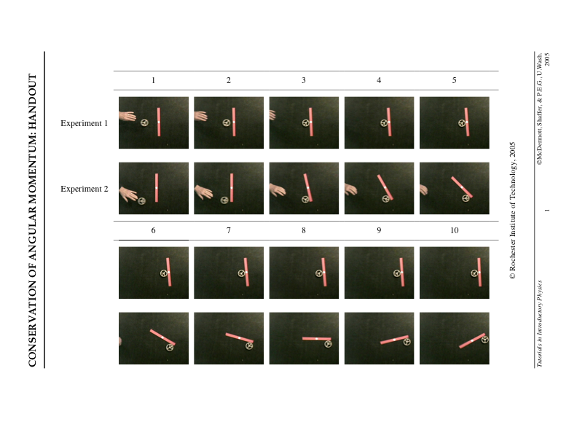
Photos from Bob Teese and Priscilla Laws

Slide 52
Results after revised tutorial
correct
original
revised
40%
70%
zero
Out of pg
15%
50%
zero
Out of pg

Slide 53
Understanding the purpose of particle angular momentum may help students apply the concept.
BUT, many students still do not treat angular momentum as a strictly conserved quantity.
Why not?…

Slide 54
Interview: “Ball and rod”
(same student)
I: Imagine that you saw photographs that did show them moving at the same forward rate. How would you make sense of that?
S: If I saw that, I would say, WELL, I have to
change my opinion about the world. Thank you for bestowing this wonderful knowledge, that’s why I’m here.
I: Ok.
S: And I learned something.
I: And what would that be?
S: That angular momentum and translational momentum are separate things completely, and I have to treat them as such.

Slide 55
Interview: “Ball and rod” (cont’d)
I: OK. What about energy? Isn’t there still the energy factor?
S: Yeah, I wouldn’t… I really don’t know
how to figure that out because [long pause].
I mean, like I said, it seems like more is going on, therefore more energy is being used, or something, rather than just translational motion. And so it couldn’t equal… like, I wouldn’t believe your pictures. They were doctored.
I: OK. Good to know.
Energy holds “veto power” in student thinking

Slide 56
Knowledge of student ideas in specific topic areas is essential for improving instruction.
Active learning may be necessary, but is not sufficient.

Slide 57
Physics Education Research
is not about promoting a particular teaching method
(and condemning others).
is not about dismissing knowledge of teaching and learning based on experience.
is about promoting the view that systematically gathering and analyzing data is a good way to understand and affect complex phenomena.

Slide 58


Two recent reports from the US National Academy of Sciences
FREE to download from nap.gov

Slide 59
Physics Education Research
Produces:
Documentation of student difficulties with specific topics
Generalizations about the student as a learner
Generalizations about effective instructional strategies
Effective instructional materials and strategies
Constitutes:
A basis for objective, efficient, and cumulative improvement in instruction

Slide 60
Physics Education Research
Requires:
Faculty, post-docs, and graduate students
  with expertise in the subject matter
  with access to the student population of interest
  who devote their scholarly effort to investigating student learning of their discipline
Culture of peer review & publication of findings
Intellectual infrastructure centered in physics departments

Slide 61
Baseball bat question: Results
5 of students
% of students in class answering correctly
All instruction on torque, equilibrium etc., in intro physics
Class label
Ortiz, Heron, and Shaffer (2005)

Slide 62
Baseball bat question: Results
5 of students
% of students in class answering correctly
Me – teaching to the test!
Class label

