Slide 1
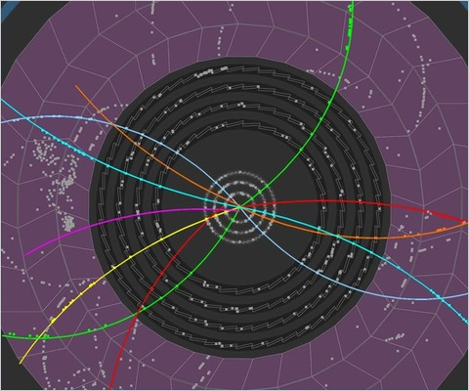
quarkonia SUPPRESSION in
High energy heavy ion collisions
Roland Katz
RPP 2015 – 15th of January 2015
Advisor: P.B. Gossiaux
and TOGETHER Pays de la Loire

Slide 2
Summary
Quark Gluon Plasma
Quarkonia suppression
Open questions and background
Dynamical view
The Schrödinger-Langevin equation
Conclusion
Roland Katz –15/01/2015

Slide 3
Quarks and gluons
Introduction Background Schrödinger-Langevin equation Conclusion
Strong interaction properties
(mediated by the gluons)
Coupling
Confines the quarks and gluons inside the hadron
« Asymptotic freedom »
Distance between
2 color charges
So in normal conditions: the quarks and gluons
can not leave their hadron !
Roland Katz –15/01/2015

Slide 4
But… The Quark Gluon Plasma (QGP)
Introduction Background Schrödinger-Langevin equation Conclusion
QGP = a new state of matter where
the quarks and gluons can leave their hadron !
Temperature
Phase diagram
They are deconfined
due the screening
of color charges
Early universe
175 MeV
QGP
HADRON GAS
Neutron star
NORMAL NUCLEAR MATTER
Baryonic Density
High temperature and/or density are required…
Roland Katz –15/01/2015

Slide 5
Experimental QGP ?
Introduction Background Schrödinger-Langevin equation Conclusion
By colliding heavy ions at very high energies
=> large system
=> high particle density (Lorentz contraction and particles creation)
=> high temperature
Collision scenario
seems to behave like a perfect fluid
Roland Katz –15/01/2015

Slide 6
QGP observables ?
Introduction Background Schrödinger-Langevin equation Conclusion
Problem: small ( ̴ 10^-14 m) and short life-time ( ̴ 10^-21 s) bubble of QGP
=> indirect observables to study its existence and properties
one of them: the « Quarkonia suppression »
Quarkonia ?
c
b
c
b
CHARMONIA
BOTTOMONIA
J/ψ : 1³S₁
mass = 3.096 Gev/c
: 1³P_{J}
mass ≈ 3.5 Gev/c
ψ‘ : 2³S₁
mass = 3.686 Gev/c
ϒ(1S), ϒ(2S) and ϒ(3S)

Slide 7
QGP observables ?
Introduction Background Schrödinger-Langevin equation Conclusion
Problem: small ( ̴ 10^-14 m) and short life-time ( ̴ 10^-21 s) bubble of QGP
=> indirect observables to study its existence and properties
one of them: the « Quarkonia suppression »
c
d
Suppression ?
If QGP:
If no QGP:
d
d
d
d
c
u
u
u
u
c
u
d
u
d
d
c
u
c
d
NO suppression
u
u
d
u
s
d
u
u
QGP
u
d
u
u
d
d
Hadrons
u
c
Quarkonia SUPPRESSED !
Roland Katz –15/01/2015

Slide 8
Quarkonia suppression
Introduction Background Schrödinger-Langevin equation Conclusion
Observed experimentally…
0% suppressed
(<- if no QGP)
1st surprise: same suppression at collision energies
17 GeV and 200 GeV
QGP size and T
100% suppressed
… but kinetic dependences still poorly understood
PHENIX, PRL98 (2007) 232301
SPS from Scomparin @ QM06
Roland Katz –15/01/2015

Slide 9
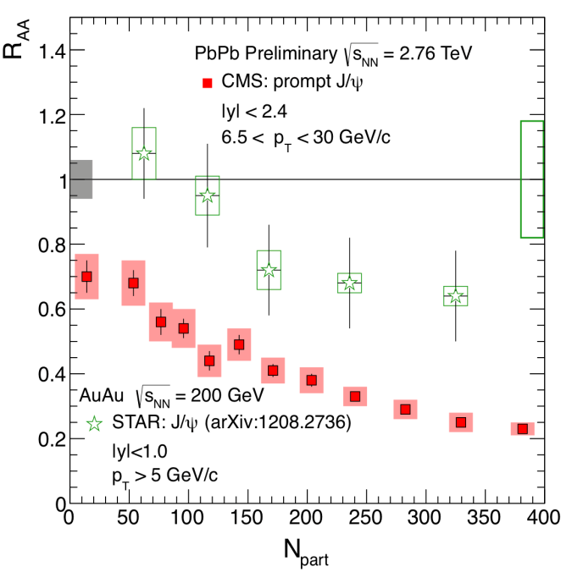
Quarkonia suppression
Introduction Background Schrödinger-Langevin equation Conclusion
Observed experimentally…
Low energy J/ψ
High energy J/ψ
0% suppressed
200 GeV
2.7 TeV
200 GeV
2.7 TeV
100% suppressed
less high energy J/ψ at 2760 GeV
2nd « surprise »: more low energy J/ψ at 2760 GeV
… but kinetic dependences still poorly understood
Roland Katz –15/01/2015
Bruno’s & PRL109 (2012) 072301 and JHEP05 (2012) 176 and CMS PAS HIN-10-006

Slide 10
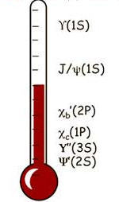
Common theoretical explanation
Introduction Background Schrödinger-Langevin equation Conclusion
Sequential suppression by Matsui and Satz …
Each state has a dissociation Tdiss
+ QGP early T
J/ψ : 1³S₁
: 1³P_{J}
ψ‘ : 2³S₁
̴ 20 %
= if T > Tdiss the state is dissociated for ever (« all-or-nothing »)
=> quarkonia as QGP thermometer
60 %
… and recombination
collision energy
number of QQ in the medium
probability that a Q re-associates with another Q
Roland Katz –15/01/2015

Slide 11
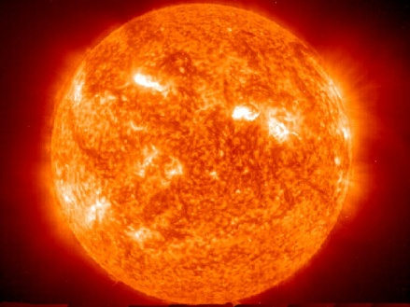
Sequential suppression VS dynamical view assumptions
Introduction Background Schrödinger-Langevin equation Conclusion
Stationnary QGP
-> Reality is closer to a cooling QGP
State formations at an early stage temperature
-> State formations only at the end of the QGP phase
Adiabatic evolution if formed; fast decorrelation if suppressed
-> Quantum description of the correlated QQ pair
Q
hadronization
Quarkonia or something else ?
QGP
Q
Roland Katz –15/01/2015

Slide 12
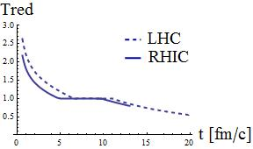
Ingredients ?
Introduction Background Schrödinger-Langevin equation Conclusion
Mean field: color screened binding potential V(r,T)
+
Temperature scenarios T(t)
+
Quantum Thermalisation
Cooling QGP
Direct interactions
with the thermal bath
Interactions due to
color charges
From hydrodynamics
Drag A(T)
From lQCD
Increased screening at larger temperatures
Effective Langevin-like approaches
Semi-classical
Results published in [1]
Schrödinger-Langevin (SL) equation
Roland Katz –15/01/2015
[1] R. Katz and P.B. Gossaiux J.Phys.Conf.Ser. 509 (2014) 012095

Slide 13
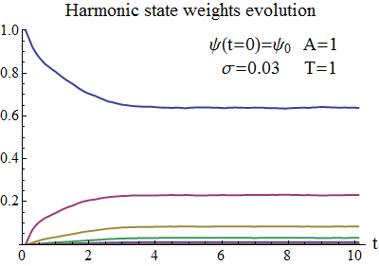
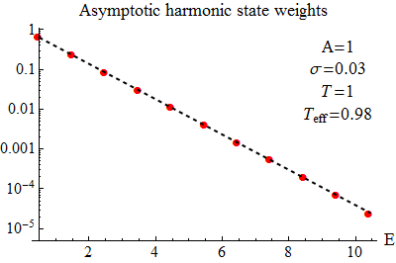
Schrödinger-Langevin equation ?
Introduction Background Schrödinger-Langevin equation Conclusion
Warming term:
dipolar stochastic operator
Cooling term: dissipative
non-linear potential
2 parameters: A (the Drag coef) and T (temperature)
Satisfies all the fundamental properties of quantum thermalisation:
Boltzmann distributions (soon to be published), Heisenberg principle ok…
- Easy to implement numerically
Boltzmann distribution line

Slide 14
Dynamics of QQ with SL equation
Introduction Background Schrödinger-Langevin equation Conclusion
First tests => simplifying assumptions:
1 cc pair in the heat bath
3D -> 1D
Effective white noise
Potential:
T=0
K|x|
Saturation (T)
T=∞
Linear approx
Roland Katz –15/01/2015

Slide 15
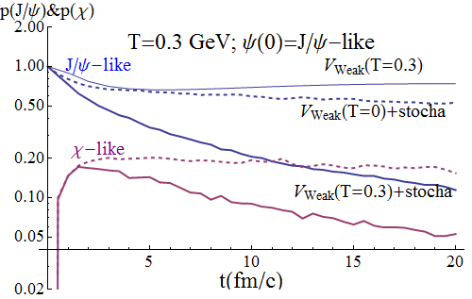
Introduction Background Schrödinger-Langevin equation Conclusion
Dynamics of QQ with SL equation
Transient phase: reequilibration of the bound eigenstates
Naïve exp(-Γt)
Decay of the global cc system with a common half-life
Roland Katz –15/01/2015

Slide 16
Conclusion
Introduction Background Schrödinger-Langevin equation Conclusion
First tests passed with success
Relevant suppression pattern related to experimental observations:
thermal effects -> less suppression of J/ψ, ψ‘…
RAA (J/ψ) > RAA (ψ’) for T>0.25 GeV
Assumptions of adiabatic evolution and fast decorrelation ruled out !
Implementation of 3D and evolution scenario of the QGP
Identify the limiting cases and make contact with other models
Make contact with experimental results
Future
Roland Katz – 15/01/2015 – katz@subatech.in2p3.fr – www.rolandkatz.com

Slide 17
BACK UP SLIDES

Slide 18
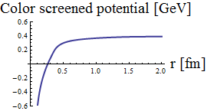
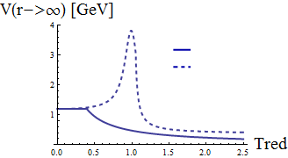
Mean color field: V(Tred, r) binding the QQ
Static lQCD calculations (maximum heat exchange with the medium):
F : free energy
S : entropy
U=F+TS : internal energy (no heat exchange)
T
“Weak potential” F<V<U * => some heat exchange
“Strong potential” V=U ** => adiabatic evolution
F<V<U
V=U
for Tred=1.2
Evaluated by Mócsy & Petreczky* and Kaczmarek & Zantow** from lQCD results
* Phys.Rev.D77:014501,2008 **arXiv:hep-lat/0512031v1
Roland Katz –15/01/2015

Slide 19
Dynamics of QQ with SL equation
Introduction Background Schrödinger-Langevin equation Conclusion
First tests => simplifying assumptions:
3D -> 1D
Drag coeff. for c quarks*:
white noise
Potential:
Typically T ∈ [0.1 ; 0.43] GeV => A ∈ [0.32 ; 1.75] (fm/c)⁻¹
Stochastic forces =>
feed up of higher states
leakage
Linear approx
Saturation (T)
Roland Katz –15/01/2015
* Gossiaux P B and Aichelin J 2008 Phys. Rev. C 78 014904

Slide 20
Introduction Background Schrödinger-Langevin equation Conclusion
Dynamics of QQ with SL equation
Naïve exp(-Γt)
Thermal effects lead to more suppression if
quarkonia initial states
T => Γ until saturation for large T>>Tc
Other initial states -> same long time decay

Slide 21
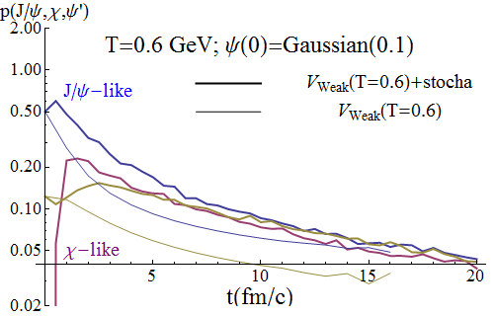
Introduction Background Schrödinger-Langevin equation Conclusion
Dynamics of QQ with SL equation
Thermal effects -> less suppression of J/ψ, ψ‘… components at intermediate times
Roland Katz –15/01/2015

Slide 22
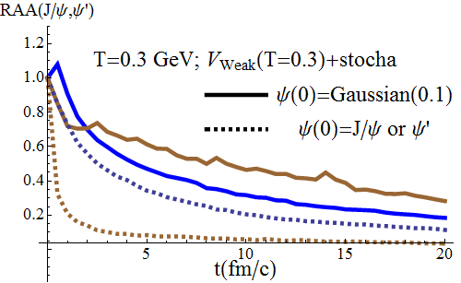
Introduction Background Schrödinger-Langevin equation Conclusion
Dynamics of QQ with SL equation
Ψ’
J/ψ
If initial gaussian cc -> RAA (J/ψ) > RAA (ψ’) for T>0.25 GeV
Roland Katz –15/01/2015

Slide 23
Introduction Background Schrödinger-Langevin equation Conclusion
Dynamics of QQ with SL equation
Ψ’
J/ψ
All these plots: kill the unjustified assumptions of very fast quantum decoherence
and adiabatic evolution
Roland Katz –15/01/2015

