Slide 1
ZToLL50- production status

Slide 2
Recipe: exclusive production + "sm no masses" model – status:
 | 0 jet | 1 jet | 2 jet | 3 jet | 4 jet
Gridpack | Ok | Ok | Ok | Ok | Ok
LHE | Ok | Ok | Ok | Expected number of events is not reached | Running during 1 week. Is it dead?
ROOT | Ok | Ok | Ok | Ok
Folders:
srm://sbgse1.in2p3.fr:8446/dpm/in2p3.fr/home/cms/Prod_13TeV/Gridpacks/ZToLL50-0Jet_sm-no_masses
srm://sbgse1.in2p3.fr:8446/dpm/in2p3.fr/home/cms/Prod_13TeV/Gridpacks/ZToLL50-1Jet_sm-no_masses
srm://sbgse1.in2p3.fr:8446/dpm/in2p3.fr/home/cms/Prod_13TeV/Gridpacks/ZToLL50-2Jets_sm-no_masses
srm://sbgse1.in2p3.fr:8446/dpm/in2p3.fr/home/cms/Prod_13TeV/Gridpacks/ZToLL50-3Jets_sm-no_masses
srm://sbgse1.in2p3.fr:8446/dpm/in2p3.fr/home/cms/Prod_13TeV/Gridpacks/ZToLL50-4Jets_sm-no_masses
Job 4-jets:
https://sbgwms1.in2p3.fr:9000/lsoAYok_EyG8wRCtUGbG8w

Slide 3
How to handle 3 jets and 4 jets contribution?
→ try to split the process into several processes. It is known that MG5 has some difficulties to gather several processes into one.
3 jets
4 jets
pp → ll qqq @31
pp → ll gqq @32
pp → ll ggq @33
pp → ll ggg @34
pp → ll qqqq @41
pp → ll gqqq @42
pp → ll ggqq @43
pp → ll gggq @44
pp → ll gggg @45
Folders:
srm://sbgse1.in2p3.fr:8446/dpm/in2p3.fr/home/cms/Prod_13TeV/Gridpacks/ZToLL50-3Jets_sm-no_masses_split
srm://sbgse1.in2p3.fr:8446/dpm/in2p3.fr/home/cms/Prod_13TeV/Gridpacks/ZToLL50-4Jets_sm-no_masses_split
Job step2 for 3-jets:
https://sbgwms1.in2p3.fr:9000/miBYpCmktqTlIqrpi8_R4Q
Job step1 for 4-jets:
https://sbgwms1.in2p3.fr:9000/PpZgPHWRR9Ywd8-1GqR3Yg

Slide 4
WToLNu production approval

Slide 5
Status
 | 0 jet | 1 jet | 2 jet | 3 jet | 4 jet
Gridpack | Ok | Ok | Ok | Ok | Ok
LHE | Ok | Ok | Ok | Ok | Ok
ROOT | Ok | Ok | Ok | OK | Ok
An adventure in Time and Space
 | 0 jet | 1 jet | 2 jet | 3 jet | 4 jet
LHE event size | 12.92MB | 19.19MB | 24.67MB | 28.91MB | 33.11MB
LHE sample time elapsed | 13mn | 10mn | 25mn | 16mn | 15h20mn
ROOT event size | 269.53MB | 231.75MB | 212.91MB | 177.39MB | 214.87MB
ROOT sample time elapsed | 1h35mn | 1h26mn | 1h53mn | 1h40mn | 1h27mn

Slide 6
Cross sections and ME/PS merging efficiencies:
xsection 0 jet =
Cross sections to use for the analysis:

Slide 7
ME/PS merging validation plots
Difficult to have better

Slide 8
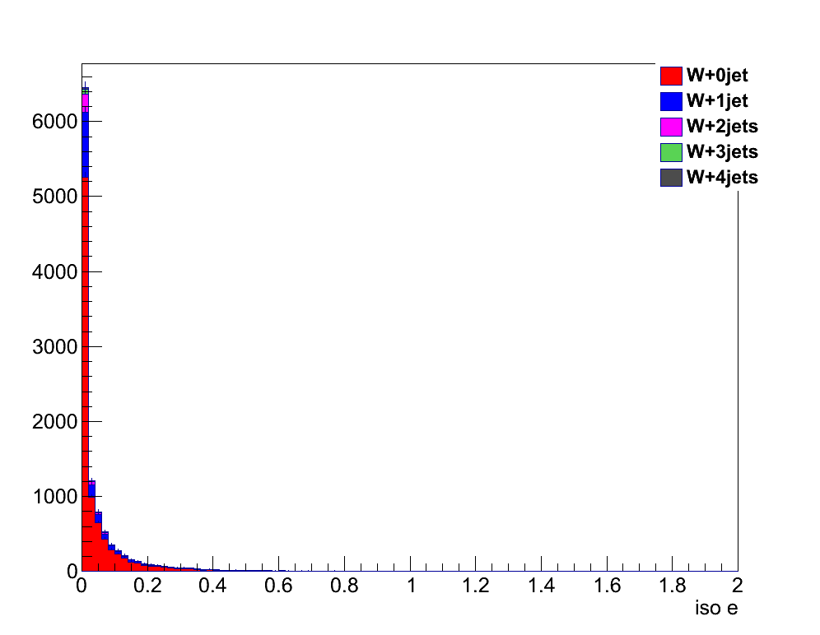
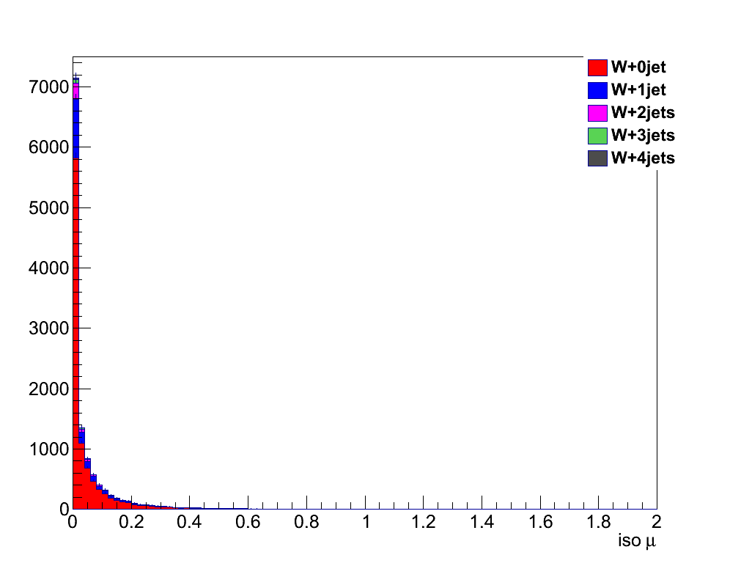
Validation plot @ ROOT level:
Setting used for Lepton isolation : new relIso implemented,
need to be checked for fakes.
Setting used for Jet cleaning :
remove jets in a cone of 0.5 around selected leptons
Implemented in the AnalysisHelper.

Slide 9
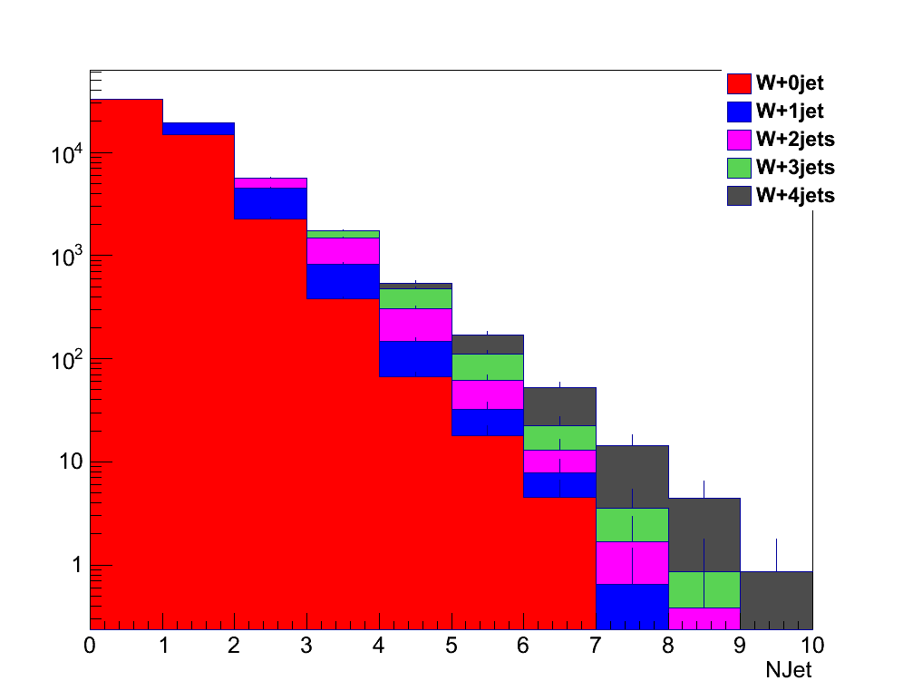
Validation plot @ ROOT level: multiciplicity of jets

Slide 10
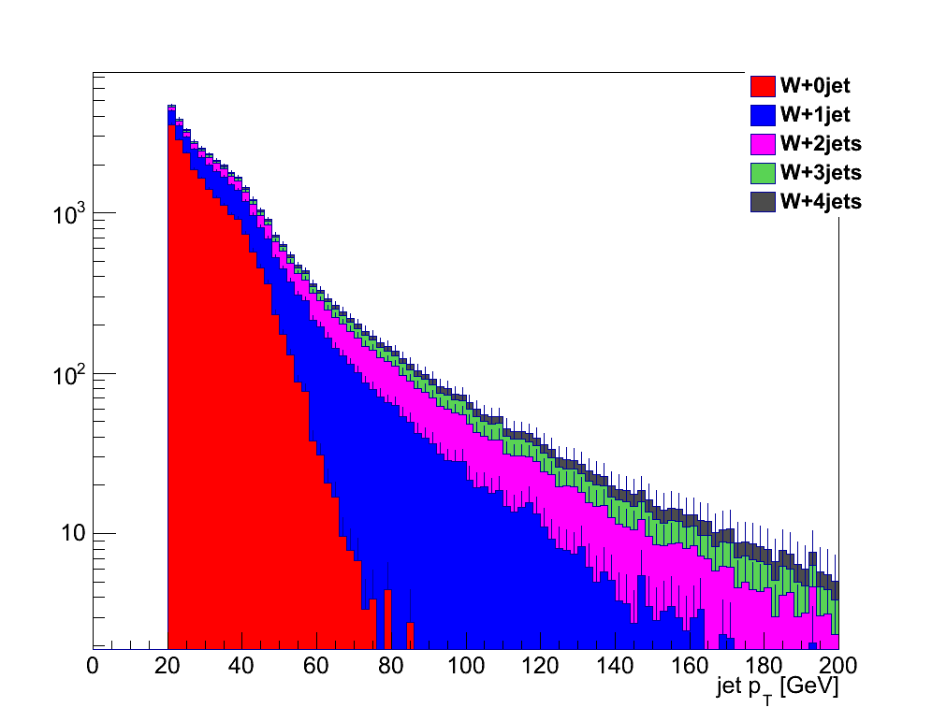
Validation plot @ ROOT level: PT of jets

Slide 11
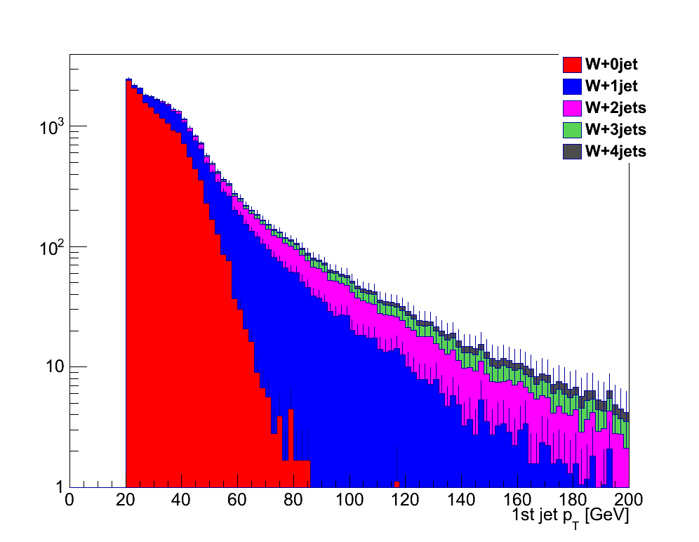
Validation plot @ ROOT level: PT of PT-rank-1 jets

Slide 12
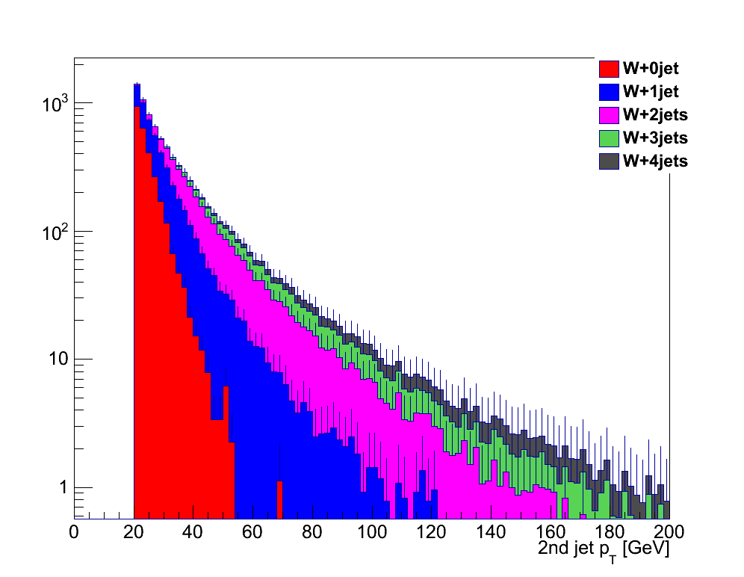
Validation plot @ ROOT level: PT of PT-rank-2 jets

Slide 13
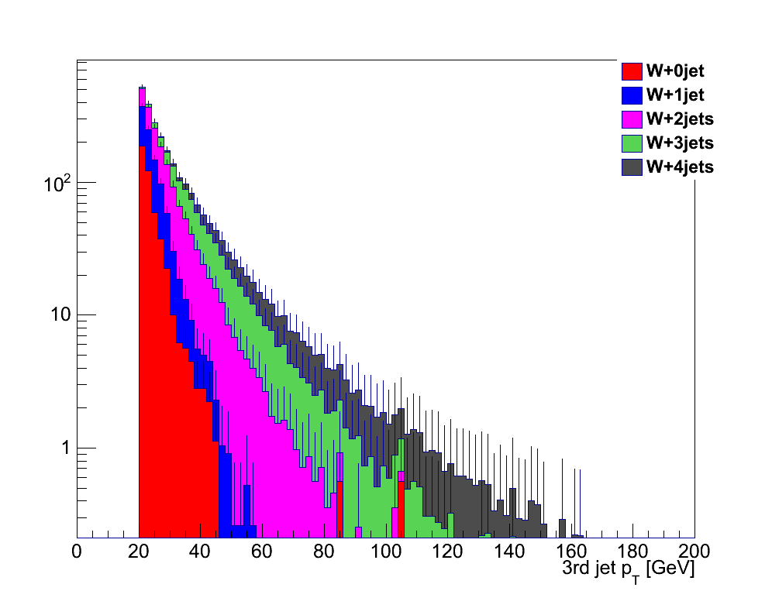
Validation plot @ ROOT level: PT of PT-rank-3 jets

Slide 14
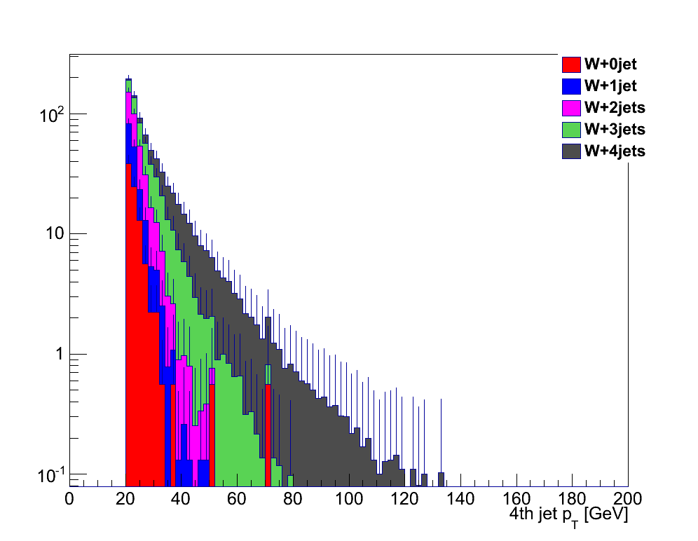
Validation plot @ ROOT level: PT of PT-rank-4 jets

Slide 15
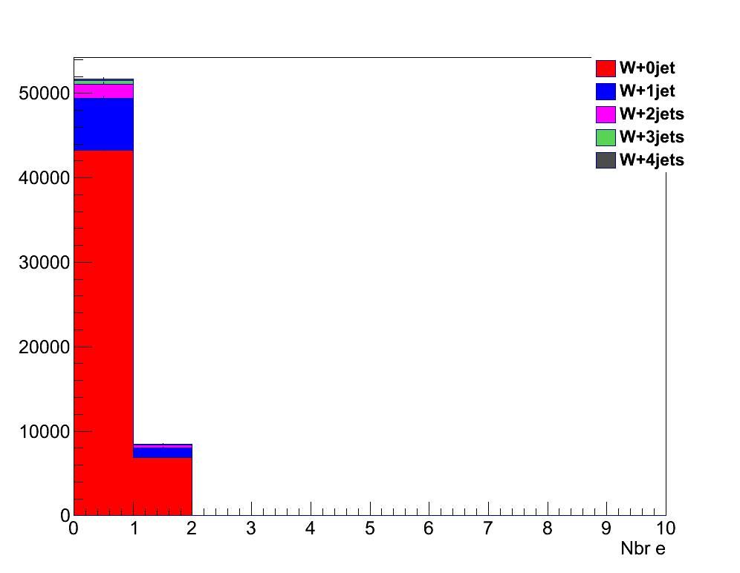
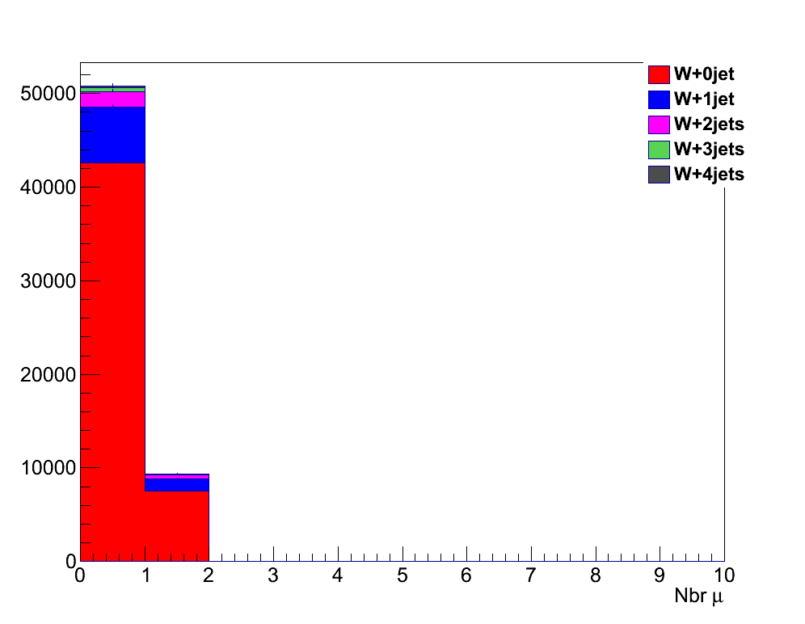
Validation plot @ ROOT level: multiciplicity of isolated leptons

Slide 16
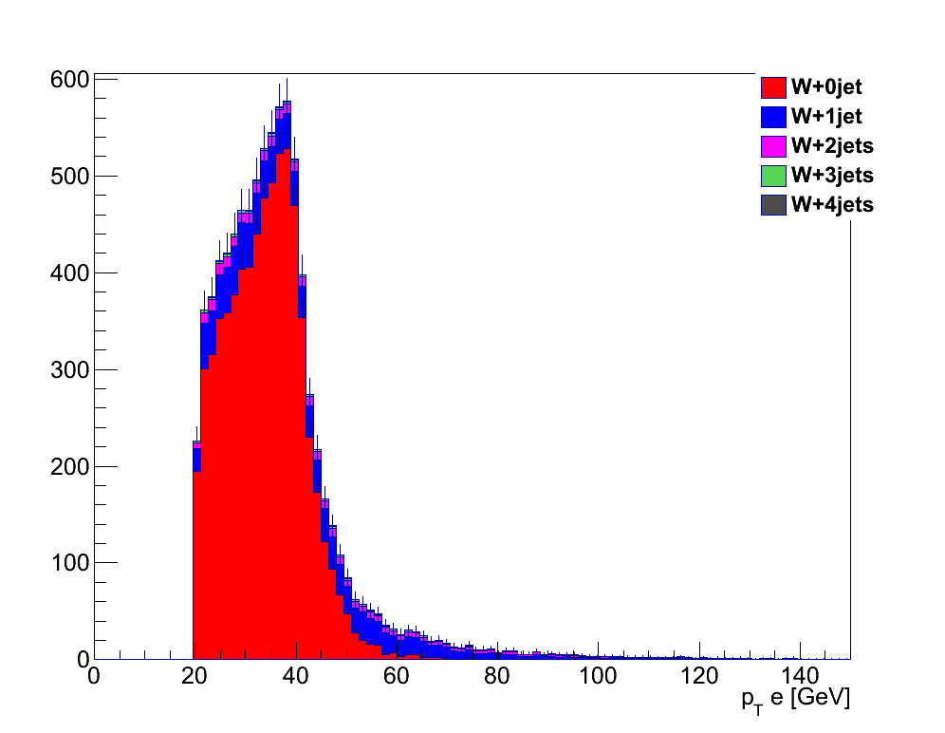
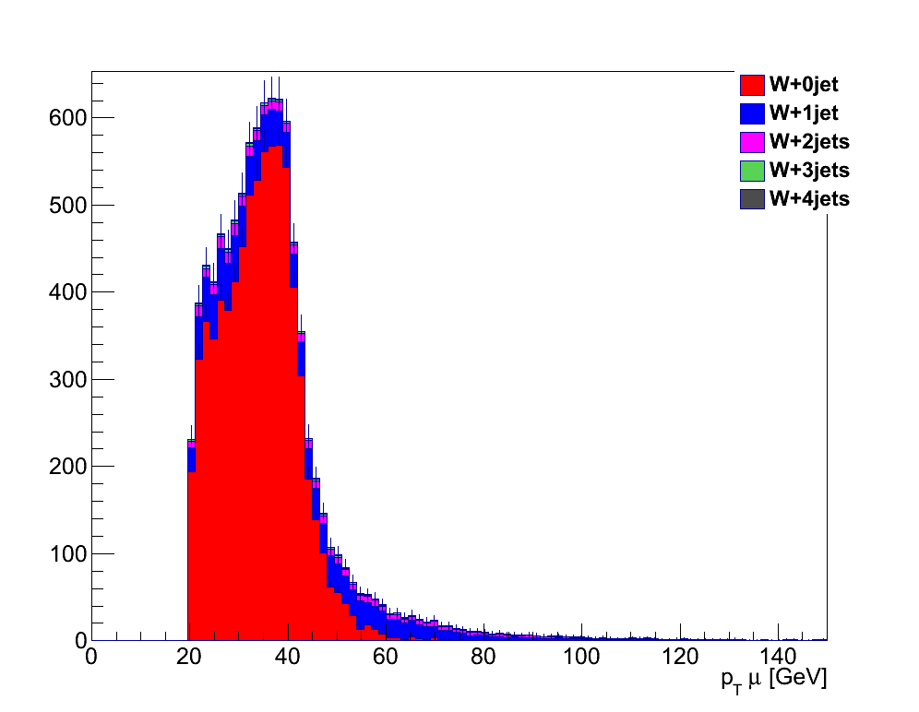
Validation plot @ ROOT level: PT of isolated leptons

Slide 17
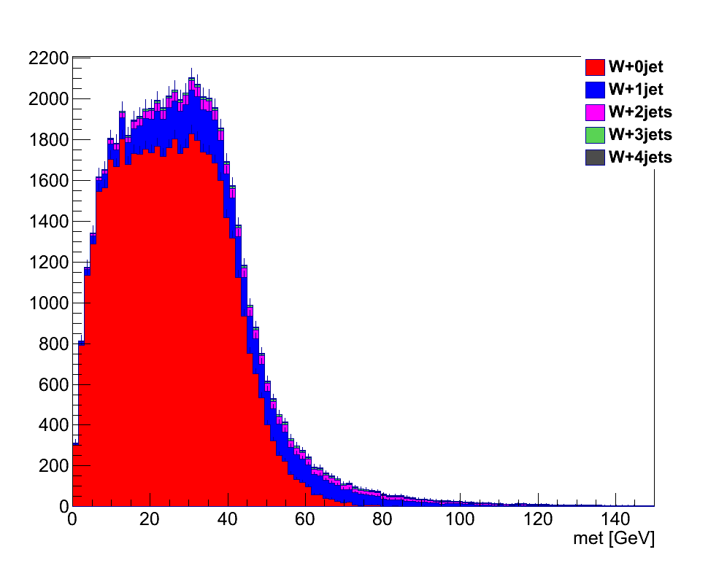
Validation plot @ ROOT level: MET

Slide 18
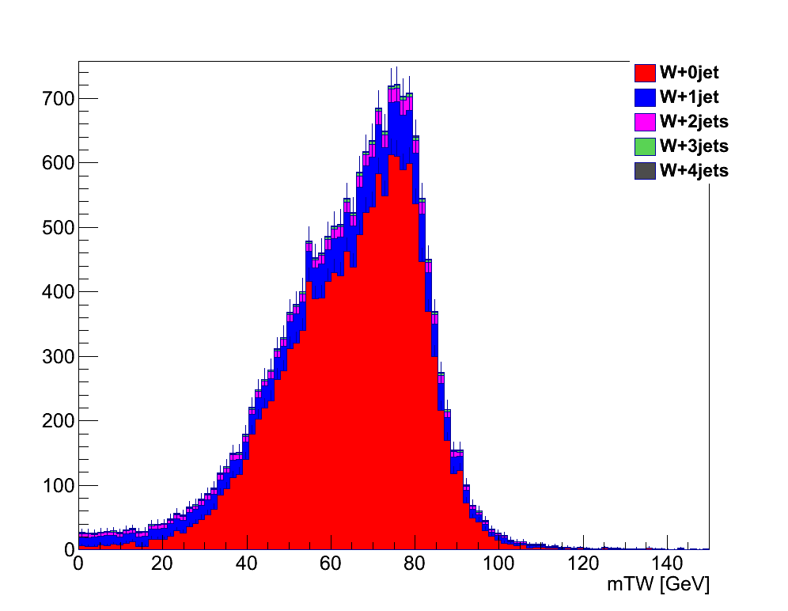
Validation plot @ ROOT level: W transverse mass

