Slide 1
Procedure and results of cavity baking in clean room for the high beta Spiral-2 QWRs
Guillaume Olry, Sébastien Bousson
CNRS/IN2P3/ IPN Orsay – Paris-Sud University

Slide 2
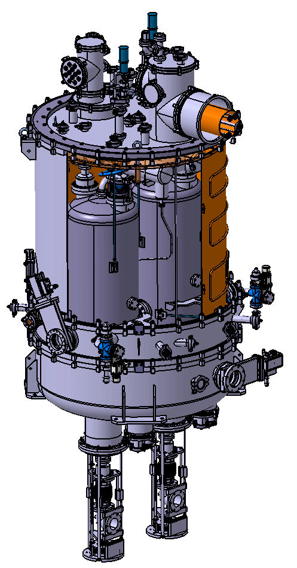
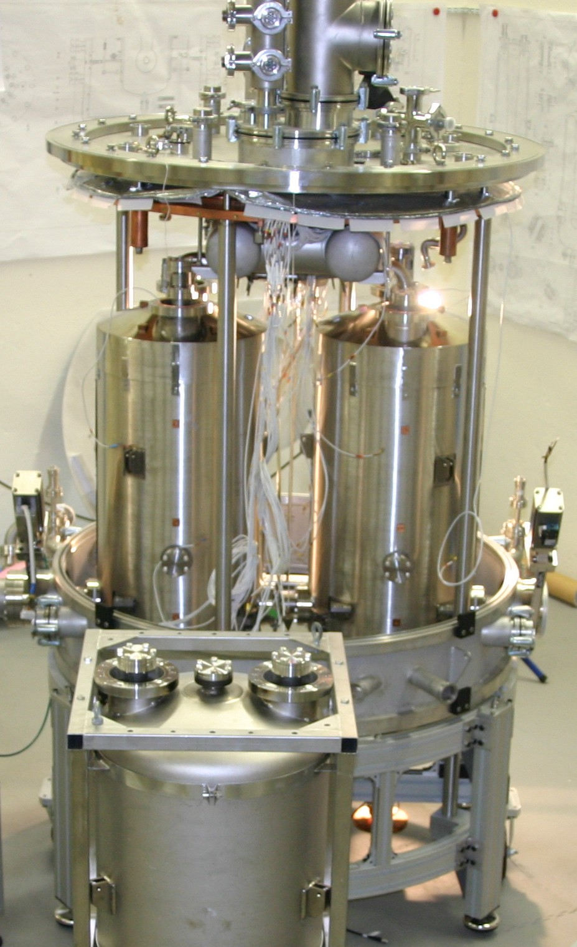
High β Spiral-2 QWRs
Cryomodules A section
Cryomodules B section
Cryomodule type | A | B
Valve-to-valve length [mm] | 610 | 1360
Nb cavities | 12 | 14
f [MHz] | 88.05 | 88.05
β_{opt} | 0.07 | 0.12
Epk/Eacc | 5.36 | 4.76
Bpk/Eacc [mT/MV/m] | 8.70 | 9.35
r/Q [Ω] | 599 | 515
Vacc @ 6.5 MV/m & β_{opt} | 1.55 | 2.66
Lacc (=Leff) [m] | 0.24 | 0.41
Beam tube ∅ [mm] | 38 | 44
Cryomodule B housing two beta 0.12 QWR
2

Slide 3
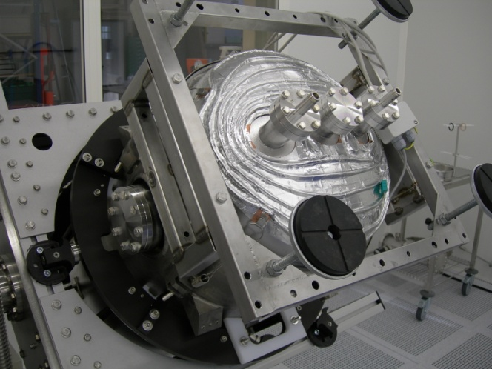
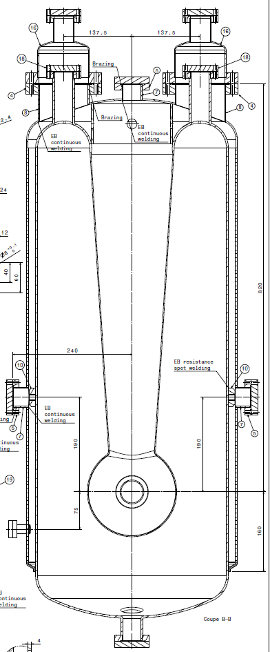
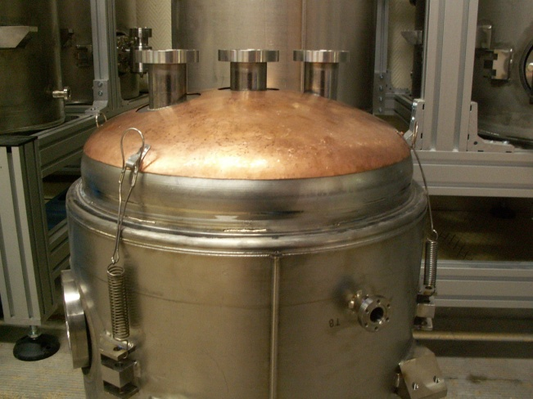
Cavity Baking Set-up
After 72h drying → 48 h baking @ 120°C
“Forced” air flow inside the helium vessel + heater on the cavity bottom
Cavity wrapped in a foil blanket
Heaters glued onto the copper cap
Input
~120°C
Output
~110°C
Heaters
~110°C
Cavity bottom copper cap

Slide 4
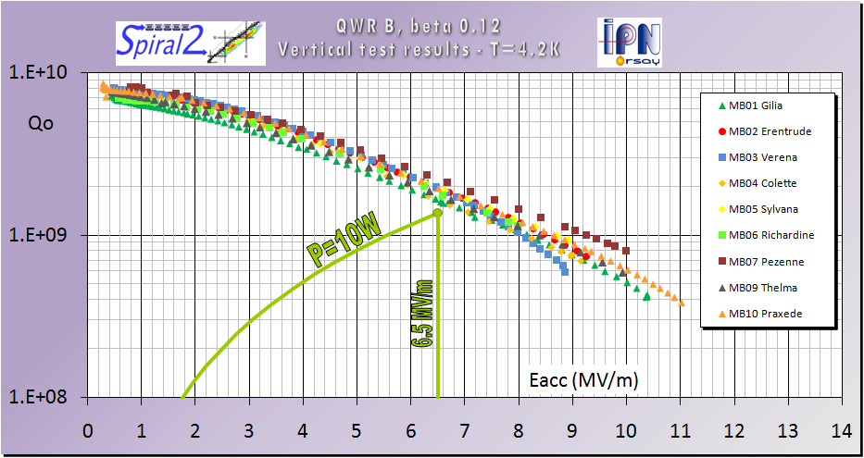
Baking Results
Cavity performances before baking
Cavity | Losses @ 6.5 MV/m [W]
MB01 | 8.5
MB02 | 6.9
MB03 | 7.0
MB04 | 8.4
MB05 | 7.2
MB06 | 7.5
MB07 | 6.9
MB09 | 8.9
MB10 | 7.1
Mean value | 7.6
Cavities: MB01, 02, 03, 04, 05, 06, 07, 09 and 10

Slide 5
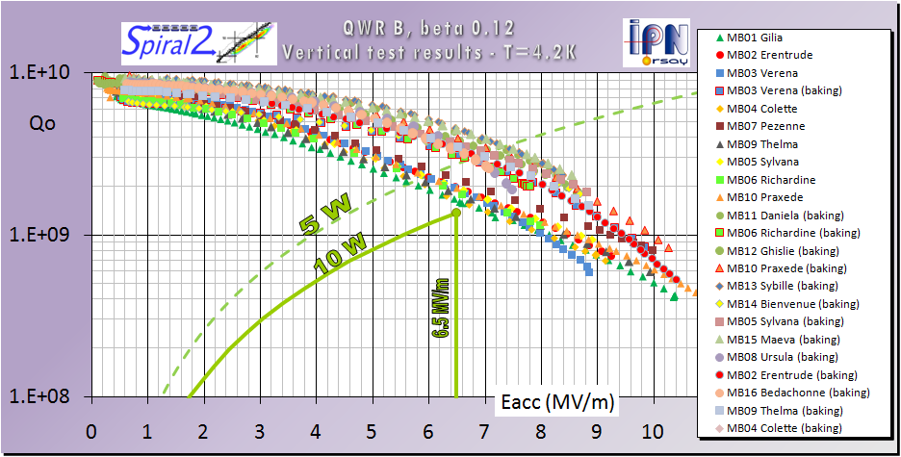
Baking Results
Cavity performances after baking
Cavity | Losses @ 6.5 MV/m [W] No baking | Losses @ 6.5 MV/m [W] With baking
MB01 | 8.5 | 3.7 (-56%)
MB02 | 6.9 | 4.1 (-41%)
MB03 | 7.0 | 4.4 (-47%)
MB04 | 8.4 | 3.6 (-58%)
MB05 | 7.2 | 3.5 (-51%)
MB06 | 7.5 | 4.8 (-36%)
MB07 | 6.9 | 3.4 (-51%)
MB08 | X | 4.0
MB09 | 8.9 | 3.9 (-56%)
MB10 | 7.1 | 3.5 (-51%)
MB11 | X | 3.1
MB12 | X | 3.8
MB13 | X | 3.0
MB14 | X | 4.0
MB15 | X | 3.1
MB16 | X | 3.9
Mean value | 7.6 | 3.7
Losses divided by ~2 @ Eacc=6.5 MV/m

Slide 6
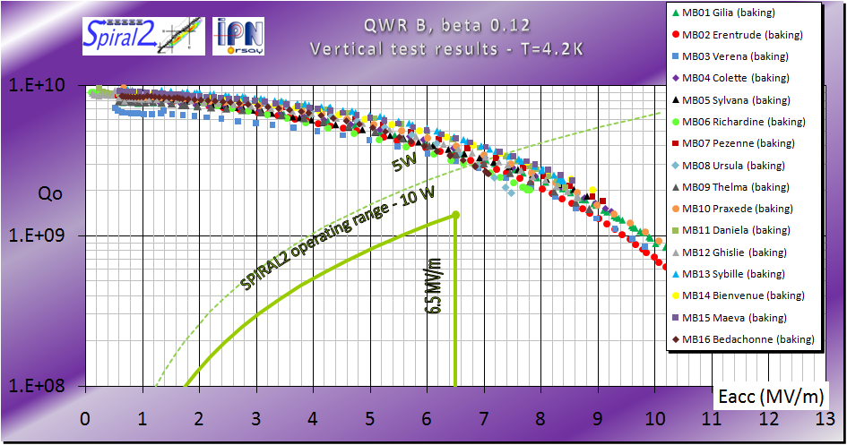
Baking Results
Cavity performances after baking

Slide 7
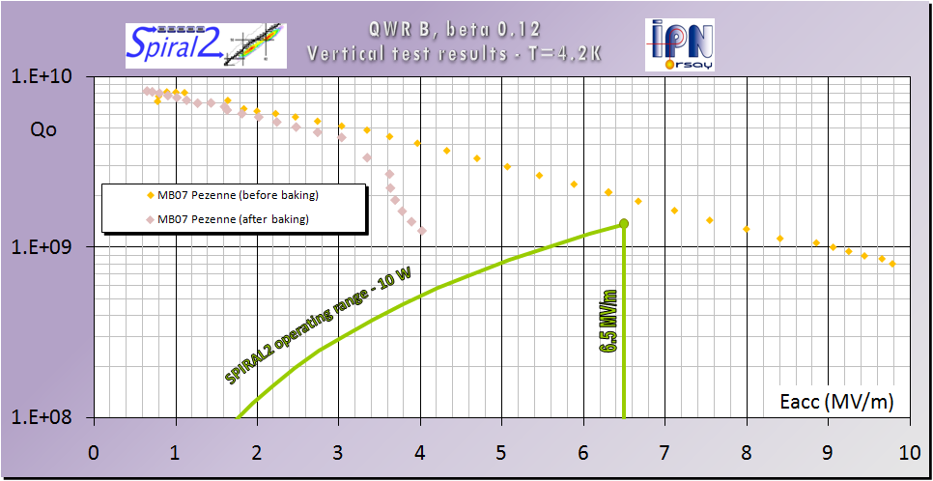
Baking Results
Cavity temperature homogeneity matters…
Heater “OFF” (accidental) for the first 24 hours of baking, then turn on for the last 24 hours → same Qo at low field and more field emission
Test stopped…
110°C
30°C

