Slide 1
Experience with hardware preparation for XFEL
TTC topical workshop on clean room assembly | Stéphane BERRY
QC of parts

Slide 2
sommaire
Ramp-Up QC versus routine QC
Cleaning Cleaning Cleaning Cleaning Cleaning
Controls: Hardness and roughness measurement
Accelerometer data records
Particles control of parts (DESY’s criteria)
Visual inspections
Leak test, RGA (see dedicated session)
Problems: fiber, oxidation, particles, NbTi filament
Water in CC cap, He tank or btw blind F & A Valve
Leak on component (see dedicated session)
Non conform temporary parts (long studs)
Illustration by NCR

Slide 3
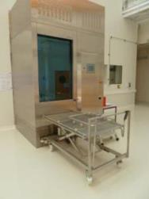
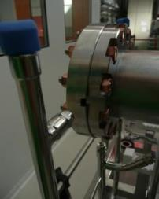
Ramp-Up QC & Cleaning Qualification
Hardness & roughness of aluminum seals
Seal Specifications: Meas.
Material AlMgSi0.5 F22
Brinell hardness 70 HB 2.5/62.5 Δ<10% with DESY
Roughness(Ra) 0.8 μm [0.8-1.6] μm
Washer parameters qualification
“Worse case”: cavity dusty and taped and written
with pencil
Qualification of fastening cleaning procedure

Slide 4
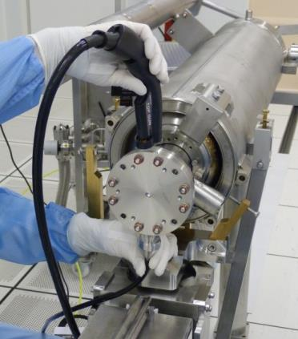
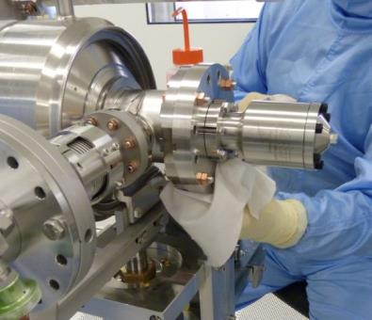
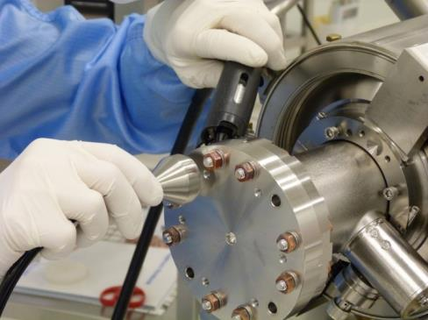
Cleaning of all components, tools
Wiping with clean room tissues and Isopropyl. Alc.
Blowing with ionized nitrogen
control step: counting particles with airbone particles counter
Counted are below 10 parts (size>0,3 µm) during 1 min
The fastening SS stud /copper nut should be check
Totally degrease tools made of the same material locked together very easily!! => SS/alu or brass/SS

Slide 5
Which QC on Which parts
 | Accelerometer Data | Part. count | Low level RF(Outside CR) | Visual Inspect° | Pressure Gauges | Leak Check | RGA
Pumping/flushing line |  | AC |  | IC |  | AC | M/IC
Angle valve (closing vacuum) |  | AC |  | AC
Cavity | on BQU |  | AC | AC |  | AC
Cav. flange’s hole |  | AC
TWG (CC by pair) |  |  |  | AC |  | AC
Gasket |  | AC |  | AC
Fastening |  | S
Cold Coupler (inside) |  | AC |  | AC
Cav w. CC |  |  |  |  |  | AC
Gate Valve |  | AC |  | AC
Bpm-Qpole-Unit | AC |  |  | AC | AC | AC
Bellows |  | AC |  | AC
String | CEA->DESY |  | AC |  | DT | AC | AC
Experience with hardware preparation for XFEL
QC of cavities, couplers, valves, bellows and general hardware
QC of cavity, coupler, valve, bellows and general hardware
(see dedicated session)
AC : All Components,
S : Sampling,
DT : During Transport,
M : Monthly,
IC : If Changed

Slide 6
Acceleration Data thresholds
“Wake up” of shock loggers so set to 1,5 g (No data recording below that)
Max value that can be detected is set to 4 g
Actions
Recording 1,5 -2 g: no action needed
Recording 2-3g: write NCR and analyze time of event (Location if possible) and impact parameter (G value and time of impact) --- but cavity can proceed
Recording 3-4 g write NCR and analyze time of event (Location if possible) and impact parameter --- cavity on hold until NCR is answered ( accepted or not).
>4 g write NCR Cavity cannot be accepted and we (whoever it is ) have to discuss with trans company.
On the max allowed impact (g*time): discuss with Matheisen

Slide 8
Particles CONtrol
Technical Specification, No.: Vacuum 005/2008, Version 1.0 / Nov. 13, 2008 ,”Guidelines for UHV-Components at DESY”
“The absence of particles has to be controlled with a particle counter using a particle-free, ionised nitrogen flow in a clean room class 100/DIN EN ISO 5 or better. After 5 minutes using a gas throughput of 28 l/min there should be at maximum 10 particles/minute ≥ 0.3 μm be detected.”
APPENDIX TO THE XFEL CAVITY SPECIFICATION: INFORMATION ON HARDWARE AND PROCESSES USED AT DESY (XFEL/APPENDIX I - I V ) REVISION B / J U N E 3 0 , 2 0 0 9 D00000001419691 Rev: B Ver: 2 Status: Approved Dat.: 30.06.2009
“The main means of QC is particle counting. For this the ionizing gun has to be held so that the gas flow is led directly to the iso-kinetic probe of the particle counter. The part to be controlled is held 90 deg per perpendicular to the air flow of the ionized nitrogen gas so that all particulates which are blown off from the probe are directed towards the opening of the iso-kinetic probe.
The particle counter is set to sampling rates of 10 seconds for analysis or one minute for the quality control. Parts are blown as long as the particle number detected is higher than >1 count per minute.” 28 l/min elsewhere in the doc.
CEA specifications for XFEL
Not more than

Slide 9
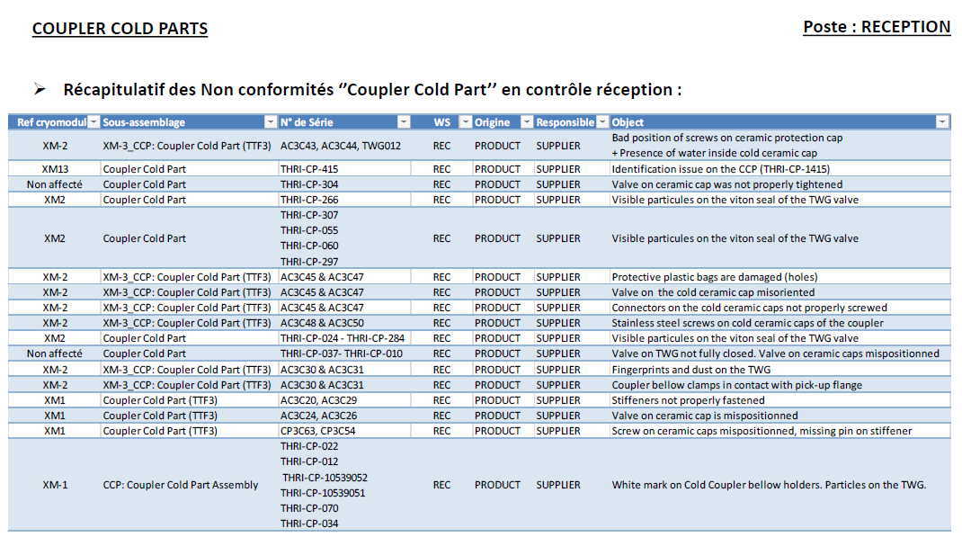

Slide 10
fiber

Slide 12
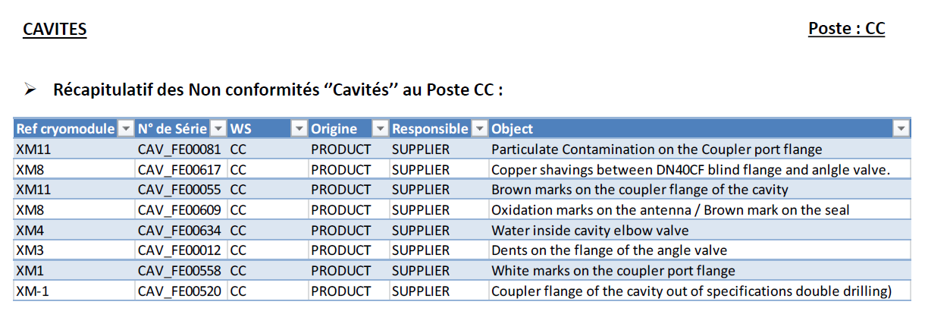

Slide 18
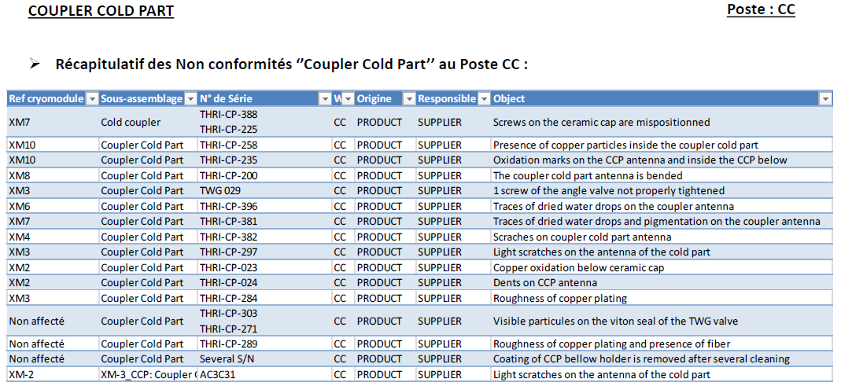

Slide 21
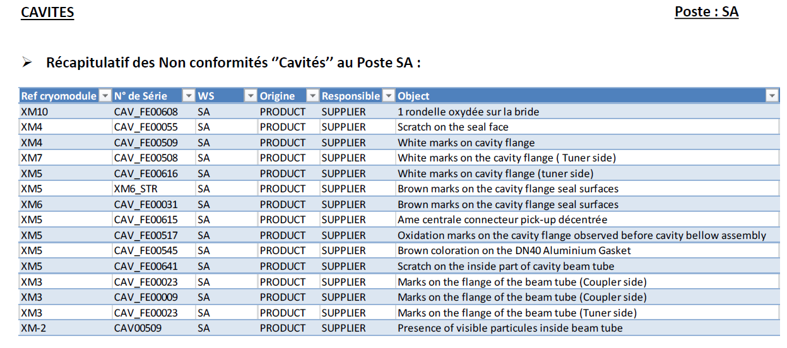

Slide 22
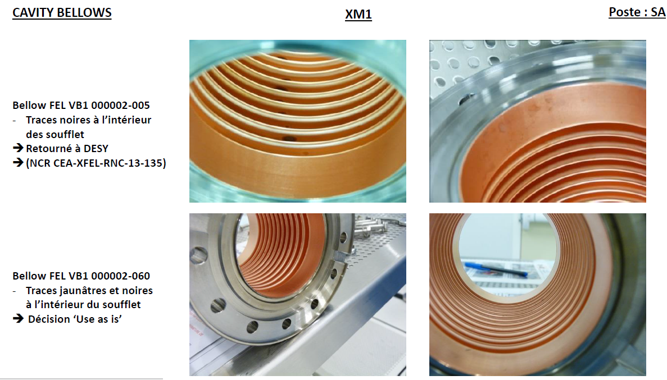

Slide 23
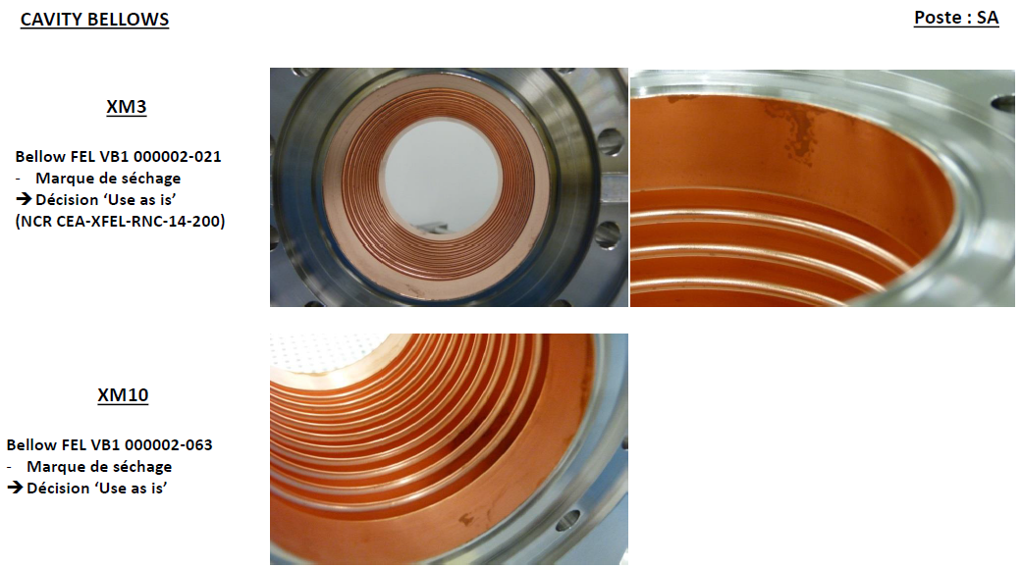

Slide 25
video

Slide 26
NCR status by type and WorkStations

Slide 27
Non conformity per module (!all WS)

