Slide 1
Clean room specifications for projects
TTC topical workshop on clean room assembly | Stéphane BERRY
XXX

Slide 2
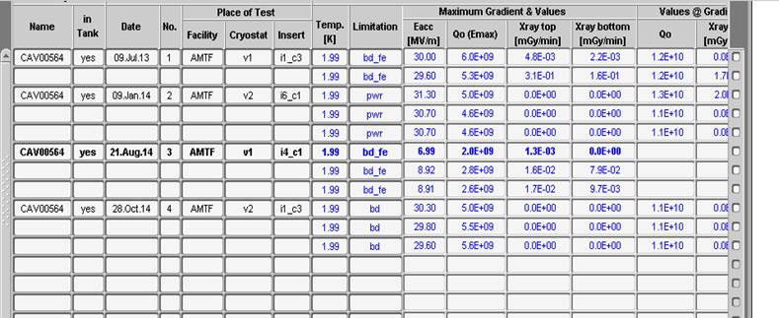
Test an assembly without flushing re-USED aN assembled cold coupler
CCC564 out of XM5 (N2 forgotten) !! Cold coupler taken out, N2 blown, re-assembled on Cav517

Slide 3
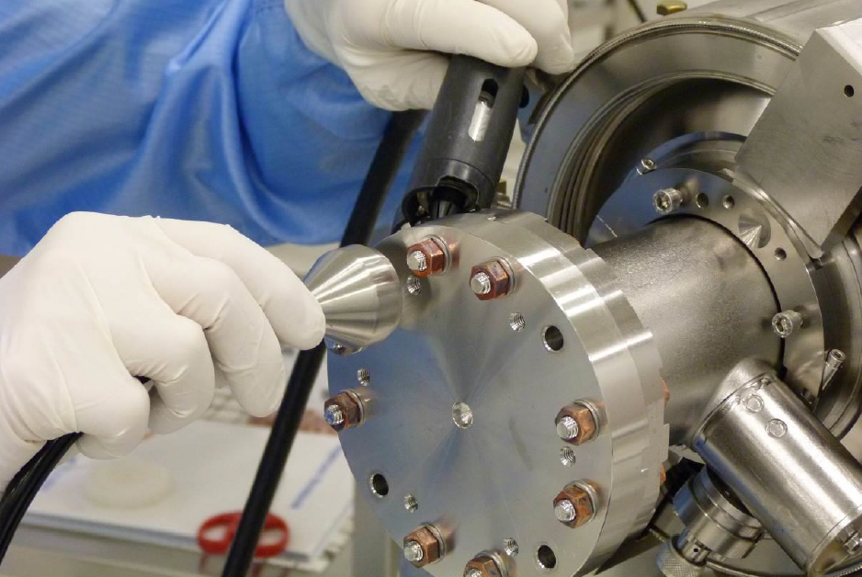

Slide 5
Wrong position of temporary studs

Slide 6
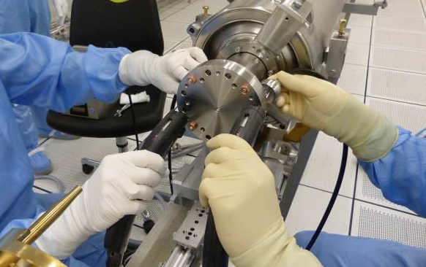
Last cleaning

Slide 7
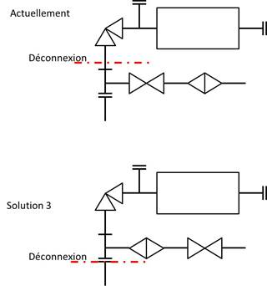
* One-week throughput at String Assembly
The key it to be able to work out two cavity conections per day.
To achieve this CEA and Alsyom are working on 2 solutions:
Bringing more venting connection services from the three underground CEA vacuum systems (primary + mass spectrometer)
Avoiding the cavity venting before the connection
Solution n°1 is being implemented
Solution n°2 is being tested: it is superior
because it avoids 8 valve close/open per
module, but it requires a different arrangement
filter and valve for the flushing.
Pumping through the filter has been
successfuly achieved with the Swagelock
filter reference: SS-SCF3-VR4-P-30
HIGH PURITY FILTER, 1/4" MALE VCR
ELEMENT FILTRANT CERAMIQUE MEMBRALOX - 10 CM2
Vacuum process time/module
reduction of operator time:8H
178 H
25H

Slide 8
Solution 3 qualification
Cavity08
5 solution 3 tested succesfully

Slide 9
Improved quality schemes
Needed: 8 coupler connections
17 string connections
13 vacuum connections
13 handling
23 leak tests
1 RGA
Tasks with added value per cryomodule
Actually done: 8 coupler connections
17 string connections
22 vacuum connections
29 handling
40 leak tests
9 RGA
As shown above* there is room for improvement

Slide 10
Temporary cap are they needed if yes which material Particle generation of different material

Slide 11
Learn from space equiment assembly (PAC)
Sous-titre
Niveau 1
Niveau 2
Niveau 1
Niveau 2
Niveau 3

Slide 12
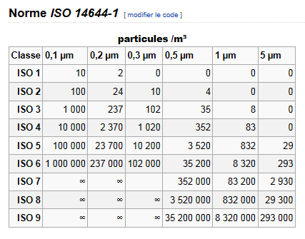
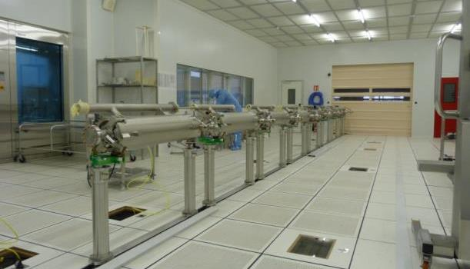
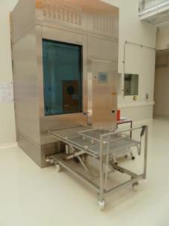
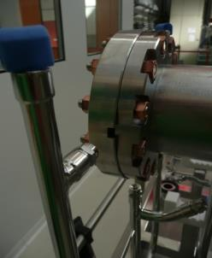
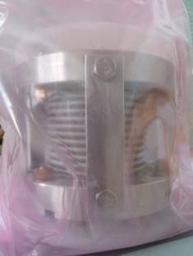
WHY Clean room assembly ?
Field Emission is often a limiting factor for cavities
Polishing to get smoother surface
High Pressure Rinsing with UltraPure Water
Cavity assembly in clean room
Clean Room
Low dust environment, pressure,
temperature et humidity monitored (ISO4-ISO5-ISO7)
Remove metallic dust
Outside of component
Fastening (*new *clean)
Gasket (*procurement)
Components clean on outer surface
Class 10

