Slide 1
JLab SRF Operations Staffing and Training
T.Reilly
JLab

Slide 2
SRF Operations Staff
Consist of a mix of Engineers, Computer Scientist, Associate Coordinators and Technicians
Technical disciplines include mechanical, electrical and chemical
Years of experience, both in total and in SRF, range from 2 to more than 30 years

Slide 3
SRF Operations Core Competencies
Areas of Expertise Include
Cryomodule Engineering and Design
Cryomodule Operations
RF Engineering
Quality Systems and Engineering
Ultra High Vacuum Systems
Chemical Process Engineering
Equipment Engineering
Electron Beam Welding
Brazing and Sputtering
Chemical Wet Etching
Clean Mechanical Assembly
Welding and Welding Certification (SS, Al, Ti, CS)
Experience base includes
SRF (JLab)
Automotive Industry
Semiconductor Industry
Traditional Trades

Slide 4
SRF Operations Staff
Work Center | Engineers | Scientist (Computer) | Associate Coordinators | Technicians | Total
QA/CMM/ Pansophy | 1 matrixed | 1 | 1 | 1 | 4
Fabrication |  |  | 2 | 1 | 3
Tuning/Heat Treatment |  |  | 0.5 | 0.5 | 1
Chemistry |  |  | 1 | 3 | 4
Clean Room Assembly |  |  | 0.5 | 1.5 | 2
CM Assembly |  |  | 1 | 9 | 10
Test & Measurement | 3 | 1 | 3 | 1 | 8
Ops Support |  |  | 1 | 1 | 2
SRF Engineering | 1 |  | 1 |  | 2
Production Support |  |  | 1 |  | 1
Technical Support | 1 |  | 1 | 3 (1 term) | 5
Leadership | 5 |  |  |  | 5
 | 9 | 2 | 12 | 23
47 Total

Slide 5
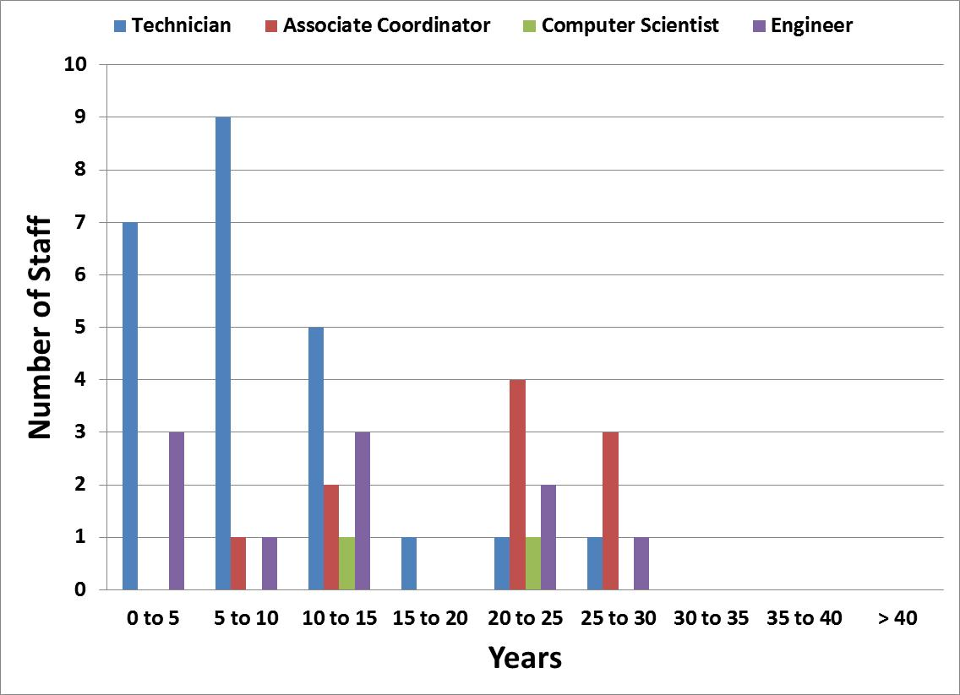
SRF Operations Staff Years of Experience at JLab

Slide 6
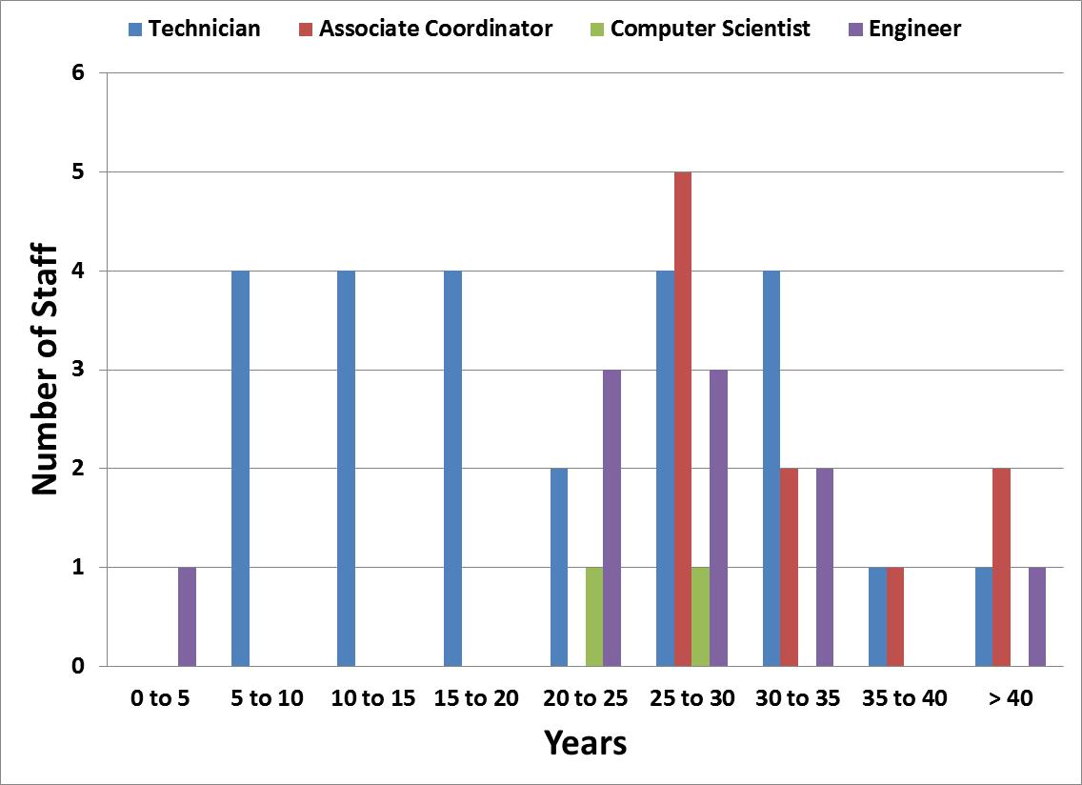
SRF Operations Staff Years of Experience in Total

Slide 7
SRF Ops Staff Comparison of Years at JLab to Total Years
SRF Operations Staff Years of Experience at JLab
SRF Operations Staff Years of Experience in Total

Slide 8
Complexion of Staff
High ratio of Associate Coordinators to technicians
Many staff members are senior
All AC have > 25 yrs work experience
Much of the existing staff has been through SNS, C50 Rebuild, and C100
The most senior Associate Coordinators have been in SRF since the original CEBAF build
Complexion of staff enables on the job training

Slide 9
Approach to Training
Composition of our staff enables us to leverage the experienced staff into the development of new or junior staff
Emphasize “On the Job Training”
Partner senior staff with junior staff
Create subgroups of 3 to 4 technicians with a mix of senior, junior and new
Group led by a senior AC
Can be line Supervisors or Work Center Lead
Incorporate the use of manuals, procedures and mockups
Prepare work control documents in advance to be used as training material
Hire staff as far in advance as budget will allow, consistent with needs of project (of course)

Slide 10
Approach to Staffing
Often difficult to find people with direct cryomodule experience
Hire the best talent available
Look for people with experience in the traditional trades
Completed an apprenticeship program
Machinist, auto/boat mechanics
Hs diploma, but AA degree is preferred
Vacuum experience is always a plus
Experience in a structured environment (procedures)
Look for balance in hiring (years of experience)

Slide 11
C100 Experience
Cavity Processing and Qualification
Segregated work into 4 Functional area
QC/CMM, Tuning/Heat Treatment, Chemistry, Assembly (cavity and string)
Each area had 3-5 full time employees
Associate coordinators placed as supervisors or WCLs
Developed initial set of processing procedures and travelers early, before arrival of 1st cavity
Practiced and further developed processing procedures on available 7-cell cavities
Completed several full loop process and test cycles over an 8 month time period in preparation for 1st cavity
Refined procedures and trained staff throughout process

Slide 12
C100 Experience
Cryomodule Assembly
Added 6 term staff members to existing 8 veteran staff 6 months in advance of first unit
Segregated into subgroups of 4 (1 supervisor to 3 technicians)
Started out by “Learning the Lingo”
Introduced to SRF Groups, Project Goals, Components, and Structures
Built Mock Ups
Exercised Tooling and any available Assemblies.
Developed initial set of procedures, travelers, and safety documents
For SNS built a Prototype Unit (SNS not C100)
Excellent Training Platform
Usually at a slower pace, can focus more on the details.

Slide 13
C100 Experience
Cryomodule Assembly
Developed several revisions of the work control documents which aided in training staff
Developed binders of reference information and placed at work centers
Bench Top Assembly Manual
Contains in chronological order; travelers, procedures, safety docs, modifications, and applicable Drawings.
Maintained a Document Control
On-line directory of Assembly drawings
Technicians became proficient by ~3rd unit
Timeline could have been reduced via a prototype unit, as was done for SNS

