Slide 1

Clean room specifications for projects
TTC topical workshop on clean room assembly | Stéphane BERRY
XXX

Slide 2
sommaire
Specifications of clean room infrastructure (ISO4 5, utilities), tools and consumables
Why clean environment ?
Projects and R&D
Tools to control environment
Consumables controls
IEST-RP-CC003 garment & change frequency
ISO 14644 certification (air velocity & particles)
High Pressure Rinsing (New design)
Water quality control (TOC, resist, particles)

Slide 3
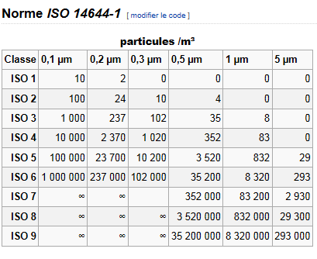
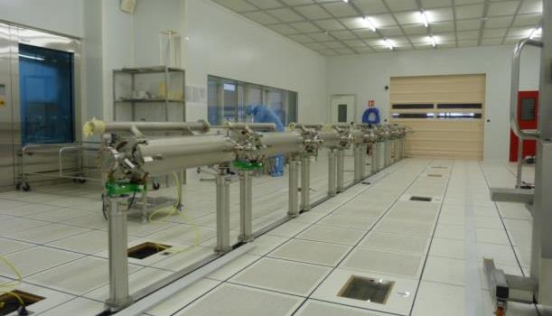
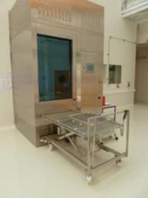
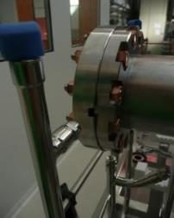
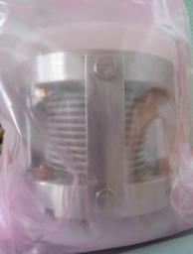


WHY a Clean room for cavities ?
  Field Emission is often a limiting factor for cavities
      Polishing to get smoother surface
      High Pressure Rinsing with Ultra
      Pure Water
      Cavity assembly in clean room
  Clean Room
      Low dust environment, pressure,
      temperature et humidity monitored
      (ISO4-ISO5-ISO7)
  Remove metallic dust, keep away human one
      Outside of component
      Fastening (*new *clean)
      Gasket (*procurement)
  Components clean on outer surface
Class 10

Slide 4
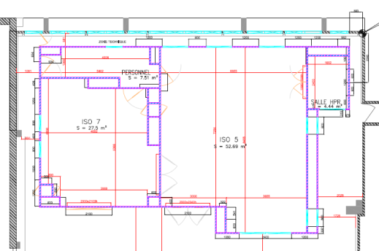
CEA-Saclay experience in building CR
Two clean rooms
  Both have been built with a MULTI-PROJECT approach:
  R&D, SOLEIL (in case of repair), SPIRAL2, HIPPI, SPL, XFEL, IFMIF, ESS,
Construction phase ends on May 13th 2014 and Nov 24th 2009
  Same scale
ISO 5
(class 100)
53 m²
H
P
R
ISO 7
(class 10000)
27 m²
4 m²
Measured ISO4 for 0.3µm
in may 2014
ISO 7
(class 10 000)
28 m²
5.92 m x 4.72 m
ISO 5
(class 100)
38 m²
7.72 m x 4.72 m
ISO4 (Class 10)
112 m²
7.8 m x (6.6+7.8) m
15.6 m
Measured ISO1 for 0.1µm in feb.2013
Notes:
Both have been built with a multi-project approach

Slide 5

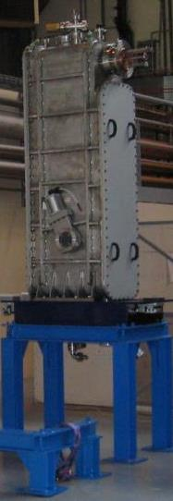
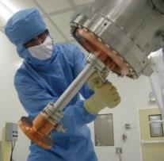
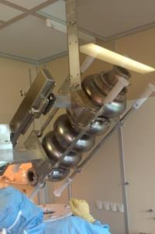
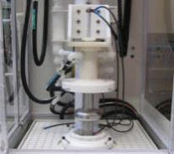

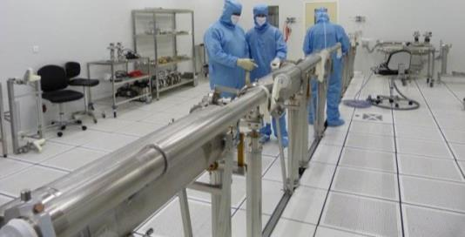

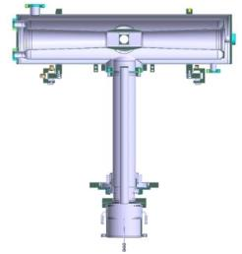
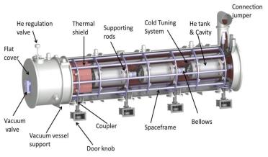
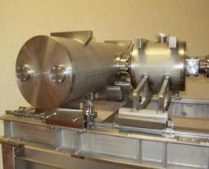



CEA-Saclay Cleanroom Activities
  SPIRAL2 : RF test preparation of QWR and final assembly of HPC after QWR qualification
  XFEL Ell. 1.3GHz: final assembly of Cold Coupler and String Assembly (3 prototypes and 103 series )
  IFMIF HPC&HWR : RF test preparation of preserie cavity and HPC for horizontal test (SATHORI)
  ESS : Elliptical cavity cryomodule Technology Demonstrator (ECCTD)
  R&D Activities
Cavity and coupler

Slide 6
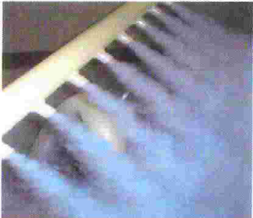
Controlling Tools
Airbone particle counter: LIGHTHOUSE SOLAIR
  6 counters with min. channel size 0.3 µm, flow 28.3 L/min (1CFM) (model 3100)
    To measure routinely particle on components to be assembled
  1 counter with min. channel size 0.1 µm, flow 28.3 L/min (1CFM) (model1100)
  To measure routinely particle on flushing/pumping lines
    Fog generator:
  To check laminarity of the air flow
  To check pressure difference between rooms
  To evaluate cross contamination during SPIRAL2 and protoXFEL co-activities
    UV light control: TECHNIFRANCE UV AHAND 250 GS H1/BL
  To investigate quality of consumables
  To control work of cleaning company
    Air Flow Meter: Thermal anemometer TESTO 425
  To measure the velocity of nitrogen flow out of flushing lines
  To measure the air flow according to ISO14644

Slide 7
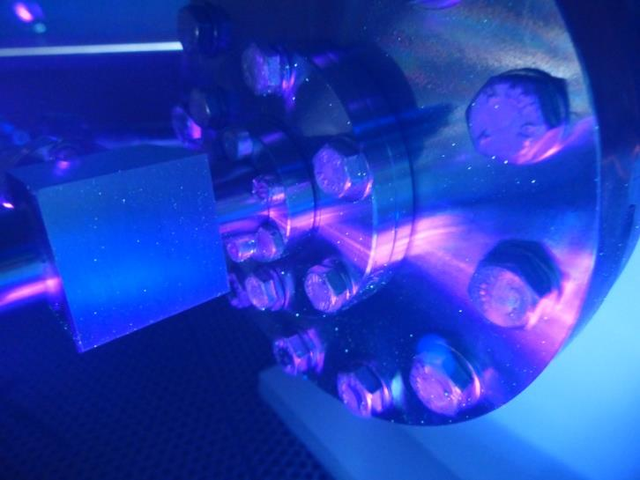
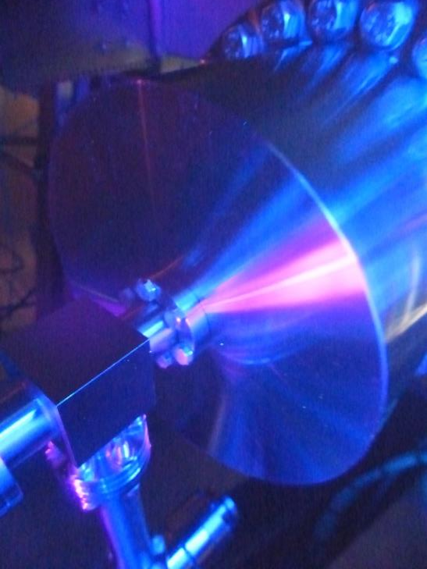
Consumables: contamination controls
UV light control
  Assembly with PVC Gloves
UV light control
  Assembly with LATEX Gloves
  Particles counting have been performed : As-received and with small friction between fingers
  (courtesy of C. Servouin)

Slide 8
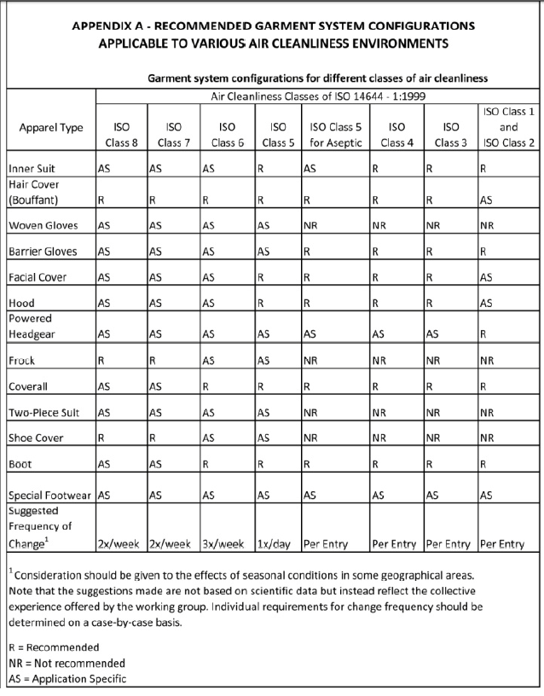



IEST-RP-CC003 garment & change
Contamination source | ISO 7 (classe 10000) | ISO 5 (classe 100) | ISO 4 (classe 10)
Body | Inner suit * | Inner suit * | Inner suit *
Head | Hair cover | Hair cover | Hair cover
Face |  | Masks | Masks
Body+ Head | Frock | Coveralls with hood | Coveralls with hood
Feet | Dedicated shoes | Dedicated shoes | New shoes & shoe covers
Hands | Gloves (12’’) | Gloves (12’’) | Gloves (12’’)
Eyes |  |  | Goggles $
Image des tenues en salle et tableau de fréqunece de changement
COMPLETER cf fichier de formation
1 per week
2 per week
5 per week

Slide 9
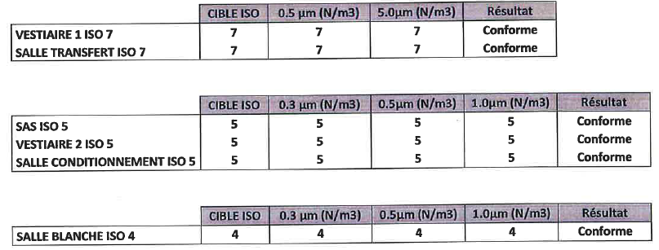
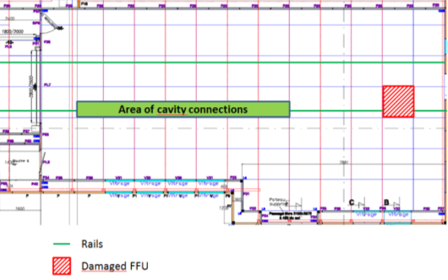
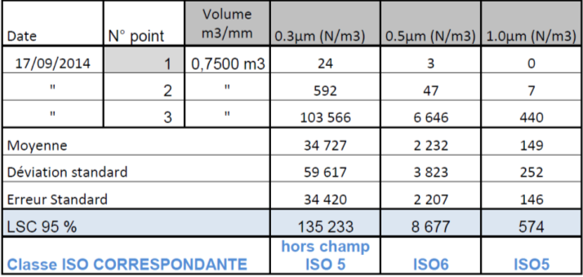
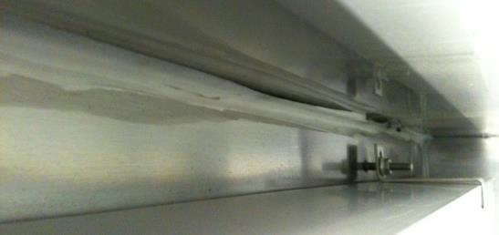
ISO certification (Air velocity and particles)
Large CR: 1FFU damaged by overvoltage on 16/04 repaired on 8/07 (delivery pb)
1 laminar flow repaired among 4 (delay 1 day)
11-07-2014
OK
Peripheral sealing

Slide 10
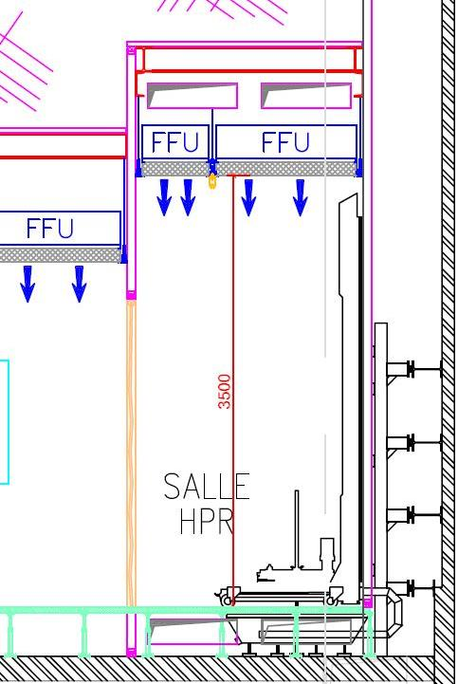
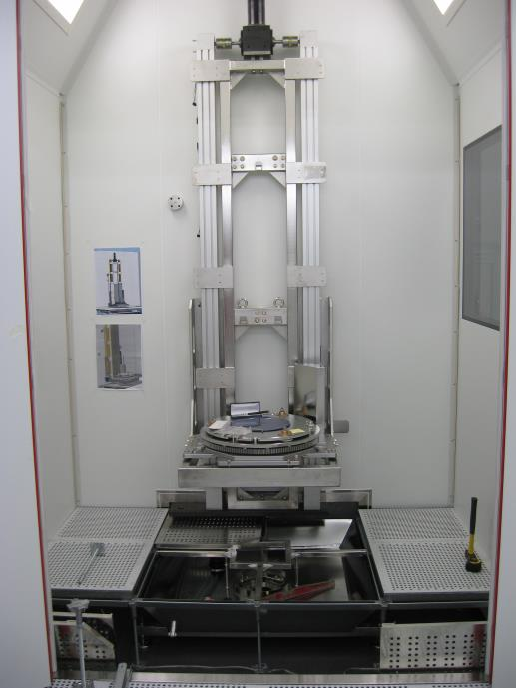
New High Pressure rinsing Characteritics
    In operation in January 2015:
  In a separate ISO5 laminar flow room
  No moving part between water filter and nozzles
  No mechanic between Cavity and Final Filter Unit
  Dissociation of rotation and translation moves
  Adujstable speed of moves
  Maximum capacity : length 1,70 m
  weight 200 Kg

Slide 11
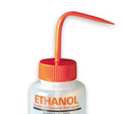
Water quality control
    Resistivity Measurement:
  To control on line the inorganic ions (e.g. Na+, Ca2+, Mg2+, Cl−, SO4 2−)
  18MΩ
    Total Organic Carbon (TOC): HACH LANGE PAT700 - SN 1640
  To control on line the organic ions (associated to bacteria development)
  Std : Eur. And US Pharmaopoeia <500ppb // ASTM (D1193-91) Type I* <50
  Our initial TOC value≈12ppb tends to decrease
    Liquid particle counter:
  First investigation made on particle in ethanol (12 samples ; 10mL)
 | 0,3 micron | 0,5 micron | 1,0 micron
Average | 287,0 | 111,8 | 0,0
Maximum | 337 | 137 | 0
Minimum | 250 | 88 | 0
Standard Deviation | 24,8 | 13,3 | 0,0

Slide 12
Back-Up slides

Slide 13
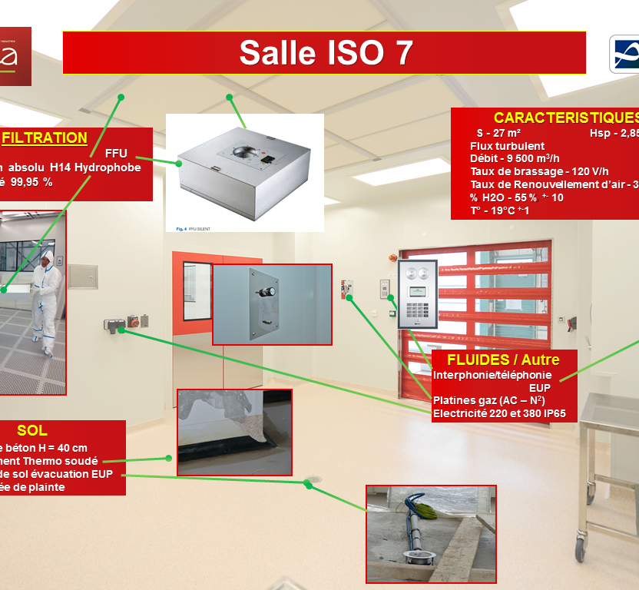

Slide 14
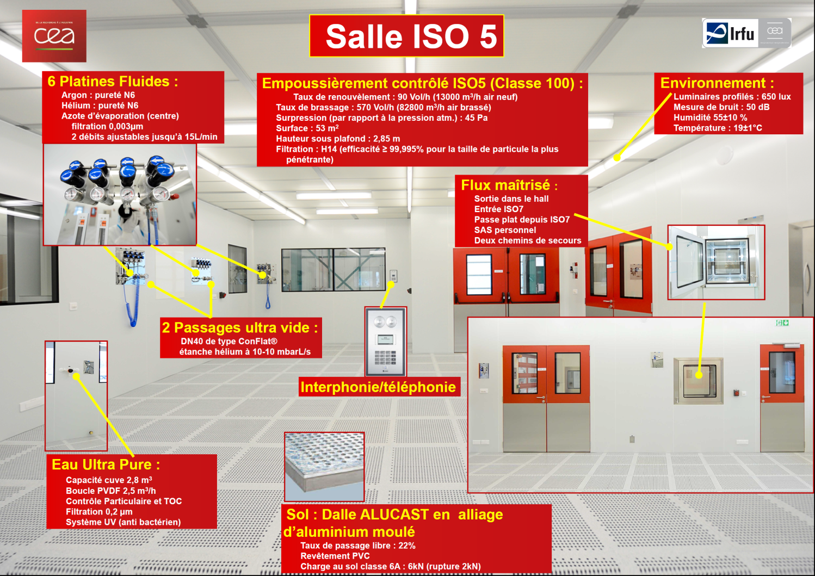

Slide 15
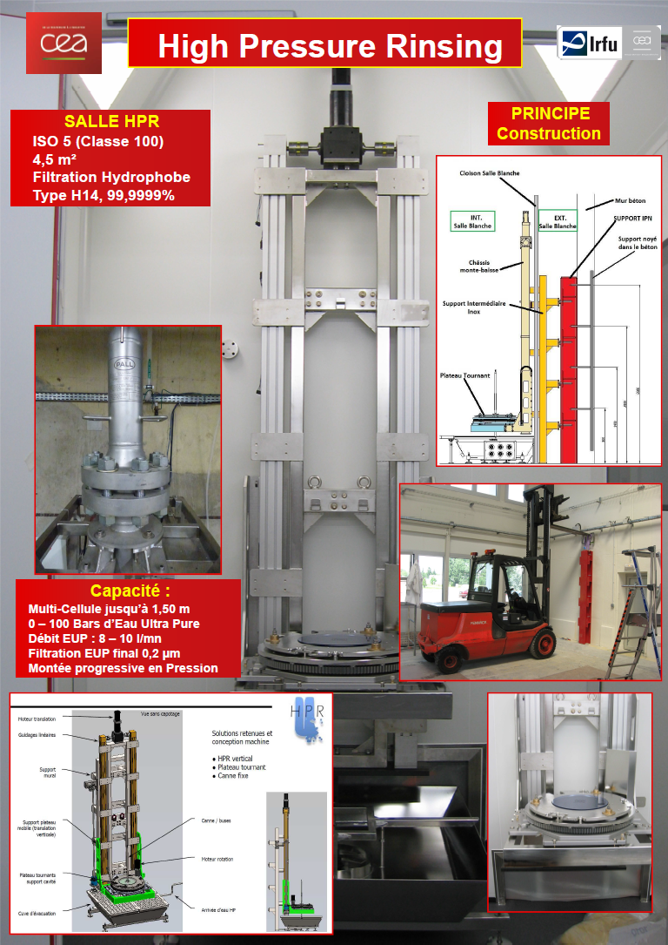

Slide 16
Surface Particle counter

Slide 17
Ethanol
Nombre de particules dans un prélèvement d’une pissette d’éthanol
 | 0,3 micron | 0,5 micron | 1,0 micron
15:17:05 | 250 | 88 | 0
15:17:15 | 271 | 115 | 0
15:17:25 | 275 | 114 | 0
15:17:35 | 312 | 121 | 0
15:17:45 | 268 | 108 | 0
15:17:55 | 288 | 129 | 0
15:18:05 | 298 | 108 | 0
15:18:15 | 258 | 102 | 0
15:18:25 | 308 | 97 | 0
15:18:35 | 297 | 112 | 0
15:18:45 | 337 | 137 | 0
15:18:55 | 282 | 111 | 0
Average | 287,0 | 111,8 | 0,0
Maximum | 337 | 137 | 0
Minimum | 250 | 88 | 0
Standard Deviation | 24,8 | 13,3 | 0,0
Volume environ : 10mL

Slide 18
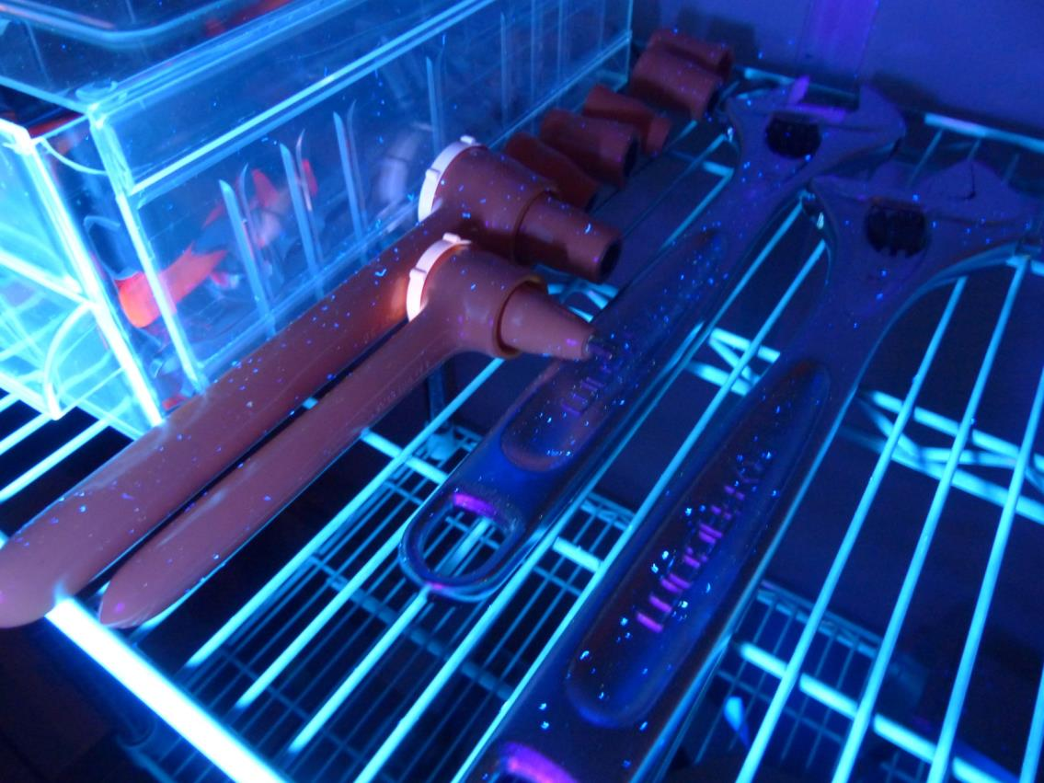
outils
Pour insérer une image :
Menu « Insertion / Image »
ou
Cliquer sur l’icône de la zone image

