Slide 1
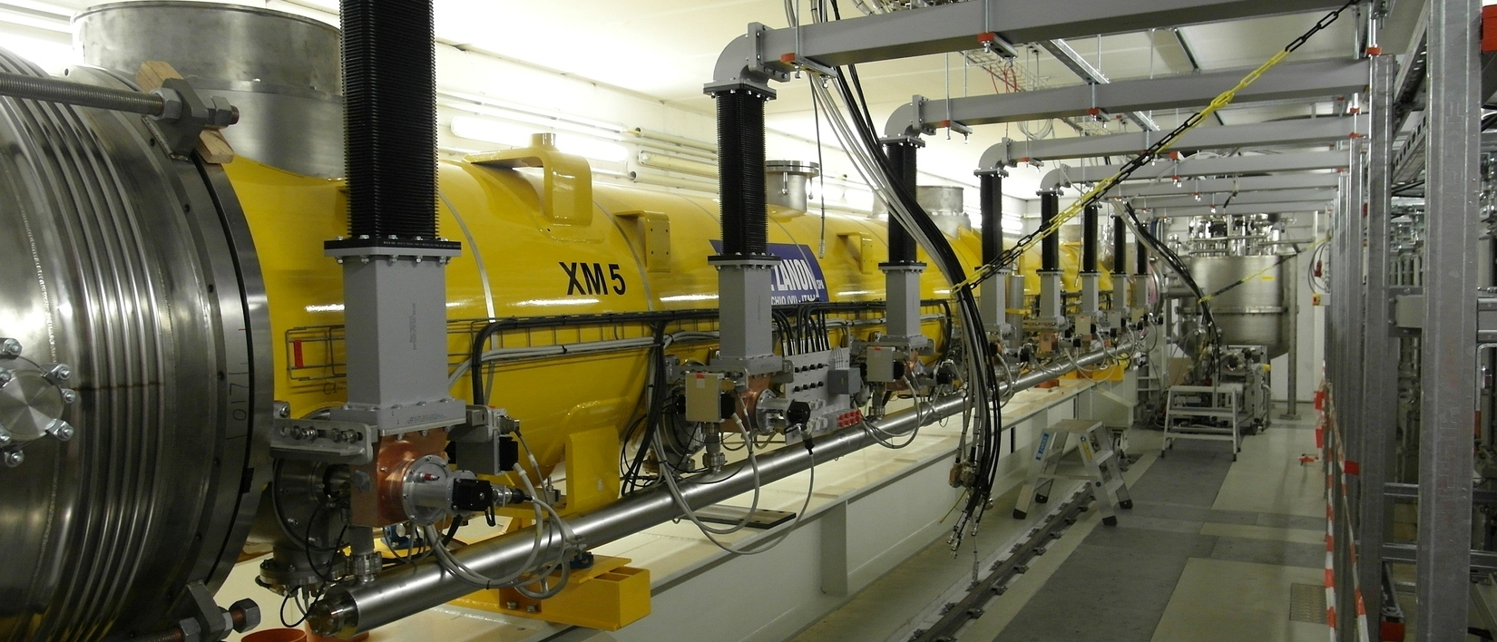

Cavity Gradient Degradation in XFEL Cryomodule Tests
Denis Kostin, DESY.
TTC Topical Meeting on SRF Cryomodule Clean Room Assembly. 12-14.11.2014

Slide 2
Outline
Cavity Operating Gradient and Degradation
XFEL Module AMTF Test Data
Cavity Gradient Degradation Statistics
Summary
Notes:
Before you start editing the slides of your talk change to the Master Slide view:
Menu button “View”, Master, Slide Master:
Edit the following 2 items in the 1st slide:
1) 1st row in the violet header:
Delete the existent text and write the title of your talk into this text field
2) The 2 rows in the footer area: Delete the text and write the information
regarding your talk (same as on the Title Slide) into this text field.
If you want to use more partner logos position them left
beside the DESY logo in the footer area
Close Master View

Slide 3
Cavity Operating Gradient and Degradation
Cavity Operating Gradient Definition:
  E_{acc.op} = min{E_{acc.BD}-0.5[MV/m], E_{acc.PWR}, E_{acc.FE}}
  E_{acc.FE} = E_{acc}(X-ray ≤ 10⁻² mGy/min)
  in a vertical cryostat test additional criteria Q₀≥10¹⁰ is used
  in a module test single cavity Q₀ mesurement is not possible
Cavity Gradient Degradation Definition:
  Module Test Gradient Measurement Error → 8.9%
  2×∆E(25 MV/m) → 5 MV/m, sure degradation limit.
  ∆E_{acc} = E_{acc.VT} ─ E_{acc.MODULE} ≥ 5 MV/m
  XFEL performance critical gradient degradation: E_{acc.OP} < 25 MV/m
Notes:
Before you start editing the slides of your talk change to the Master Slide view:
Menu button “View”, Master, Slide Master:
Edit the following 2 items in the 1st slide:
1) 1st row in the violet header:
Delete the existent text and write the title of your talk into this text field
2) The 2 rows in the footer area: Delete the text and write the information
regarding your talk (same as on the Title Slide) into this text field.
If you want to use more partner logos position them left
beside the DESY logo in the footer area
Close Master View

Slide 4
XFEL Module AMTF Test Data (1)
degraded cavities: 1
degraded cavities: 2
degraded cavities: 3
Notes:
Before you start editing the slides of your talk change to the Master Slide view:
Menu button “View”, Master, Slide Master:
Edit the following 2 items in the 1st slide:
1) 1st row in the violet header:
Delete the existent text and write the title of your talk into this text field
2) The 2 rows in the footer area: Delete the text and write the information
regarding your talk (same as on the Title Slide) into this text field.
If you want to use more partner logos position them left
beside the DESY logo in the footer area
Close Master View

Slide 5
XFEL Module AMTF Test Data (2)
degraded cavities: 4
degraded cavities: 1
degraded cavities: 1
Notes:
Before you start editing the slides of your talk change to the Master Slide view:
Menu button “View”, Master, Slide Master:
Edit the following 2 items in the 1st slide:
1) 1st row in the violet header:
Delete the existent text and write the title of your talk into this text field
2) The 2 rows in the footer area: Delete the text and write the information
regarding your talk (same as on the Title Slide) into this text field.
If you want to use more partner logos position them left
beside the DESY logo in the footer area
Close Master View

Slide 6
XFEL Module AMTF Test Data (3)
degraded cavities: 3
degraded cavities: 3
degraded cavities: 2
degraded cavities: 3
Notes:
Before you start editing the slides of your talk change to the Master Slide view:
Menu button “View”, Master, Slide Master:
Edit the following 2 items in the 1st slide:
1) 1st row in the violet header:
Delete the existent text and write the title of your talk into this text field
2) The 2 rows in the footer area: Delete the text and write the information
regarding your talk (same as on the Title Slide) into this text field.
If you want to use more partner logos position them left
beside the DESY logo in the footer area
Close Master View

Slide 7
Cavity Gradient Degradation Statistics (1)
Number of degraded cavities vs module:
E_{acc.op} < 25 MV/m (critical)
Notes:
Before you start editing the slides of your talk change to the Master Slide view:
Menu button “View”, Master, Slide Master:
Edit the following 2 items in the 1st slide:
1) 1st row in the violet header:
Delete the existent text and write the title of your talk into this text field
2) The 2 rows in the footer area: Delete the text and write the information
regarding your talk (same as on the Title Slide) into this text field.
If you want to use more partner logos position them left
beside the DESY logo in the footer area
Close Master View

Slide 8
Cavity Gradient Degradation Statistics (2)
Number of degraded cavities vs cavity position in a module:
E_{acc.op} < 25 MV/m (critical)
Notes:
Before you start editing the slides of your talk change to the Master Slide view:
Menu button “View”, Master, Slide Master:
Edit the following 2 items in the 1st slide:
1) 1st row in the violet header:
Delete the existent text and write the title of your talk into this text field
2) The 2 rows in the footer area: Delete the text and write the information
regarding your talk (same as on the Title Slide) into this text field.
If you want to use more partner logos position them left
beside the DESY logo in the footer area
Close Master View

Slide 9
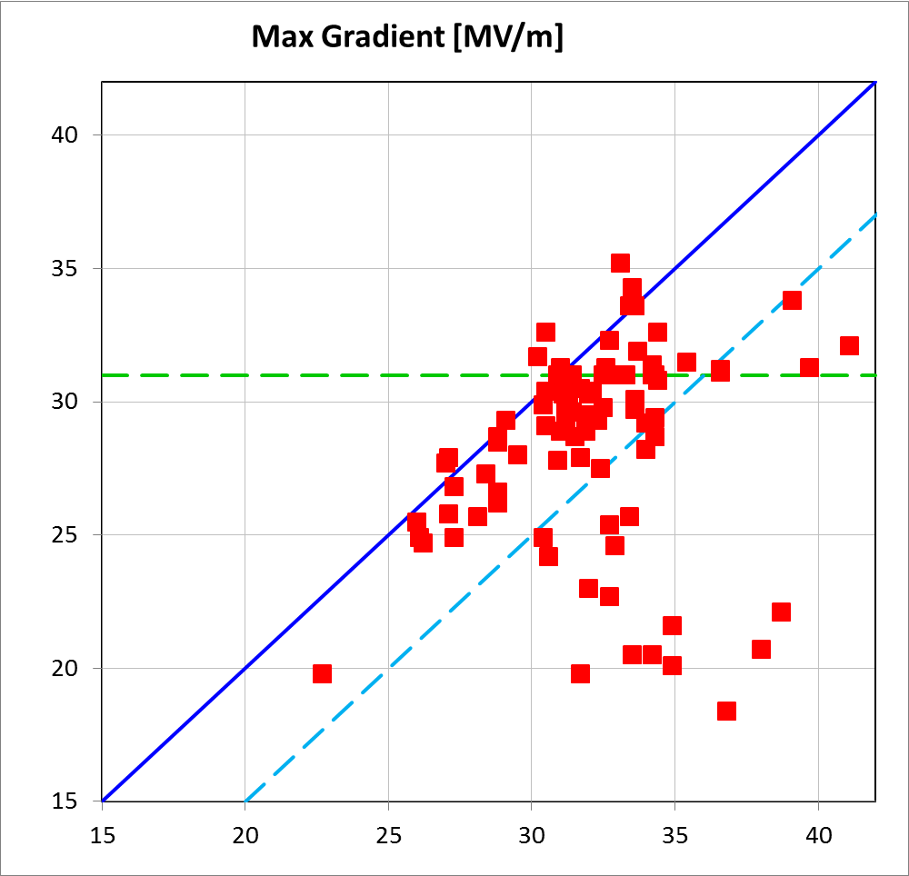
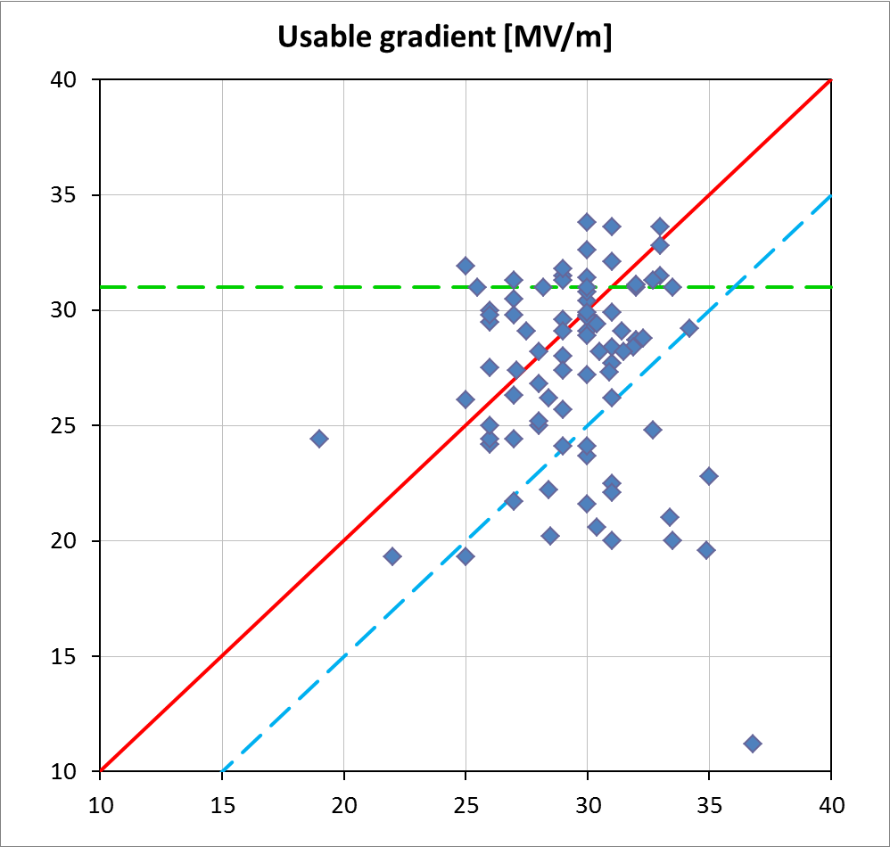
Cavity Gradient Degradation Statistics (3)
AMTF power limit
AMTF power limit
module test
module test
degradation/error limit
degradation/error limit
vertical test
vertical test
Notes:
Before you start editing the slides of your talk change to the Master Slide view:
Menu button “View”, Master, Slide Master:
Edit the following 2 items in the 1st slide:
1) 1st row in the violet header:
Delete the existent text and write the title of your talk into this text field
2) The 2 rows in the footer area: Delete the text and write the information
regarding your talk (same as on the Title Slide) into this text field.
If you want to use more partner logos position them left
beside the DESY logo in the footer area
Close Master View

Slide 10
Summary
Cavity gradient degradation was observed in AMTF XFEL cryomodule tests.
11 XFEL modules: XM-2, XM-1, XM1, XM2, XM3, XM4, XM5, XM6, XM7, XM9 and XM10 were tested to this date. 10 of them did show the cavity gradient degradation with E_{acc.VT} ─ E_{acc.MOD} > 5 MV/m.
Total number of degraded cavities is 23, or 26% (out of 88 cavities).
Critical cavity degradation to a gradient in a module less than 25 MV/m happened to 17 cavities, or 19% (out of 88 cavities).
Most degraded cavities are found in module XM4. Modules XM9 and XM10 having most of critically degraded cavities, while module XM9 presented strongest field emission related degradation and is parked now.
65% of degradations results in a cavity breakdown without field emission, rest are cavities with field emission caused degradation.
Cavities did degrade in every position in the module, but cavities in position 4 were degraded more often.
Inspite degraded cavities 11 tested in AMTF XFEL modules did show good average accelerating gradient ia range of 25 .. 30 MV/m.
Notes:
Before you start editing the slides of your talk change to the Master Slide view:
Menu button “View”, Master, Slide Master:
Edit the following 2 items in the 1st slide:
1) 1st row in the violet header:
Delete the existent text and write the title of your talk into this text field
2) The 2 rows in the footer area: Delete the text and write the information
regarding your talk (same as on the Title Slide) into this text field.
If you want to use more partner logos position them left
beside the DESY logo in the footer area
Close Master View

