Slide 1
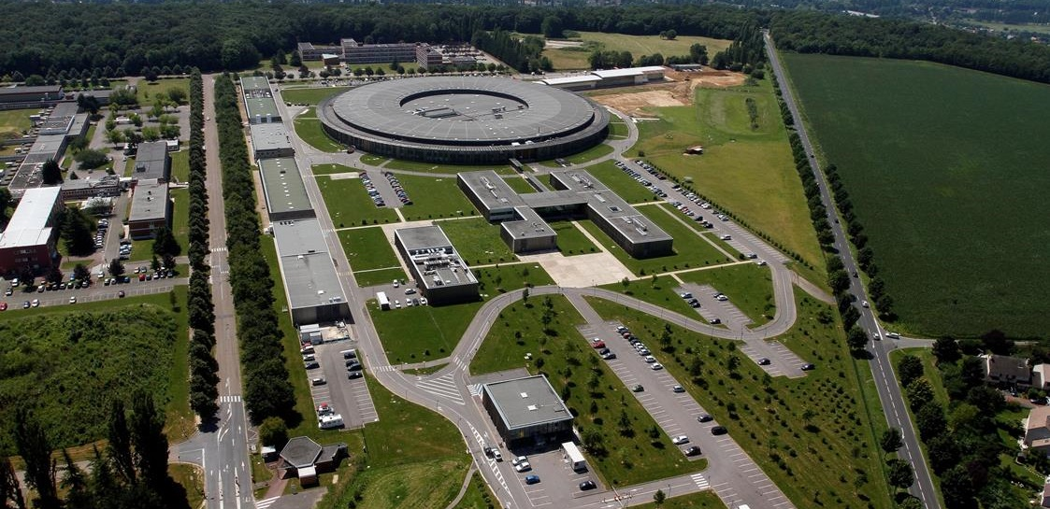
Upgrade of the superconducting RF cavities at soleil
K. Tavakoli
SOLEIL Synchrotron, France

Slide 2
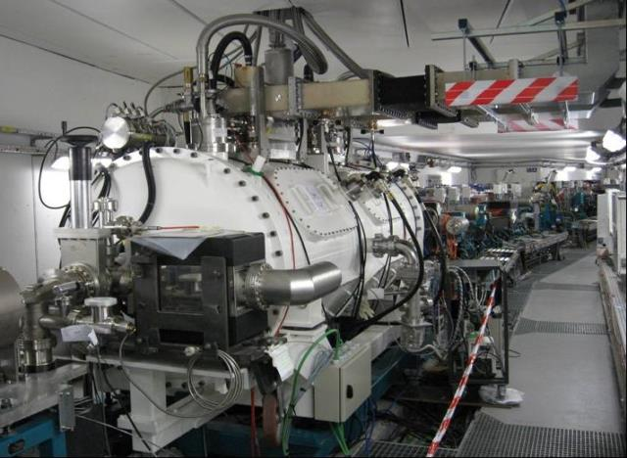
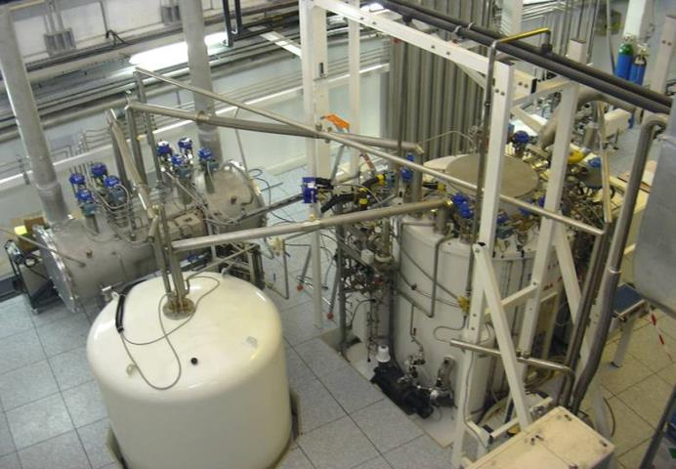
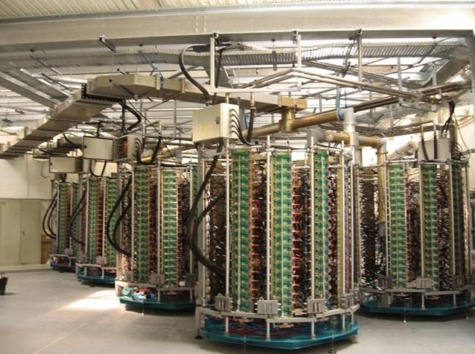
SOLEIL Cryomodule
E = 2.75 GeV, I_{b} = 500 mA
→ P_{RF} = 600 kW & V_{RF} = 4 MV @ 352 MHz
2 cryomodules (CM), each containing a pair of single-cell s.c. cavities (Nb/Cu)
Each of the 4 cavities is powered with a 180 kW solid state amplifier
Both CM’s are supplied with LHe (4.2 K) from a single cryogenic plant

Slide 3
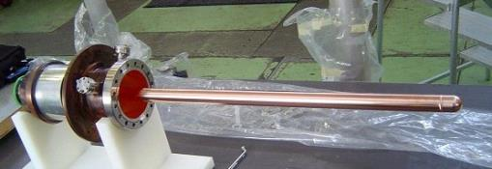
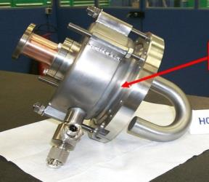
SOLEIL Cryomodule
IPC2
LHe cryogenic transfer line
HOM 4
IPC1
HOM 3
Tuner 2
Cavity 2
IPC :
Input Power Coupler
HOM 1 & 2
Cavity 1
Tuner 1

Slide 4
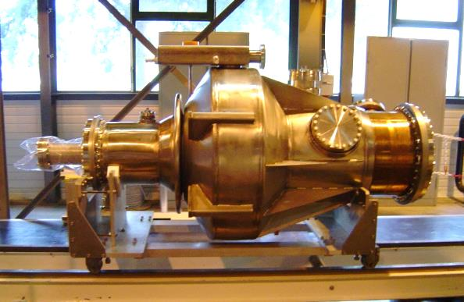
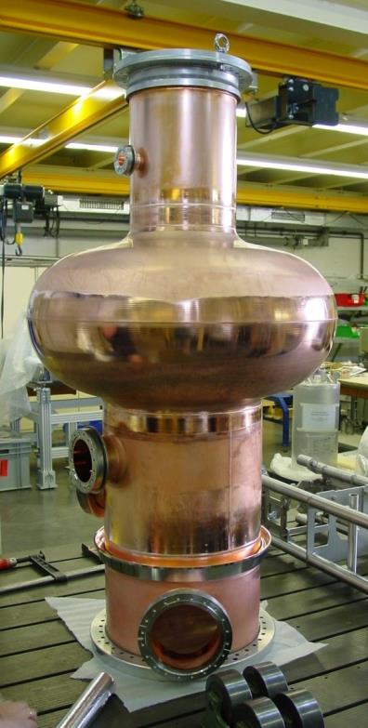
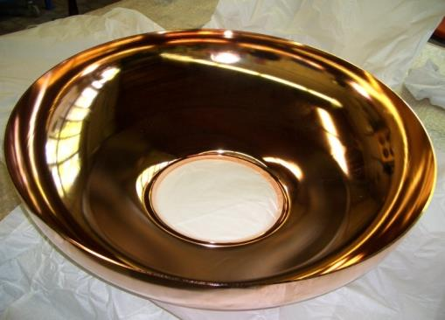
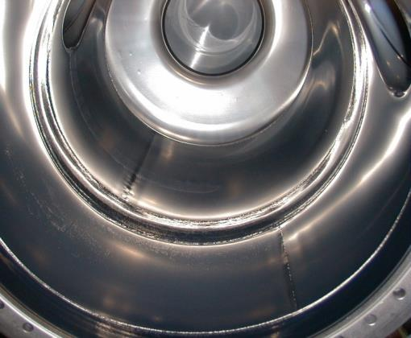
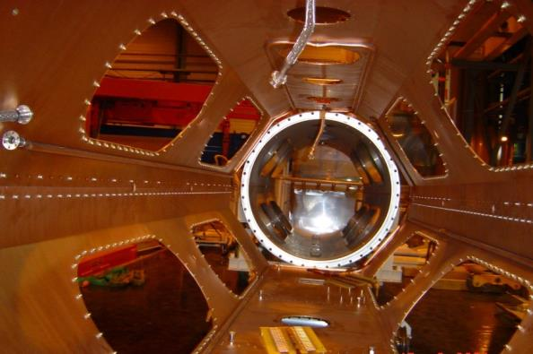
SOLEIL Cryomodule

Slide 5
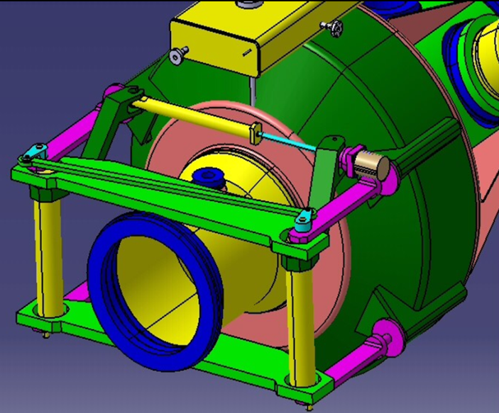
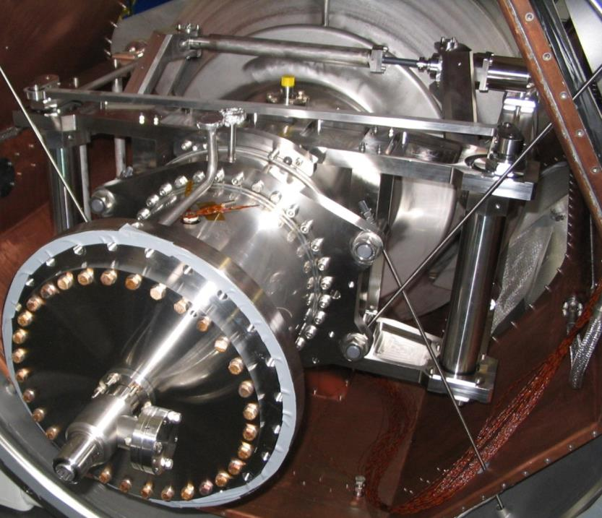
Frequency tuner system
Double lever
Helium tank
Gearbox
Nut-screw
Nut-screw
gear box
Lever
Step motor
step
motor
Thermal shield
Vacuum chamber

Slide 6
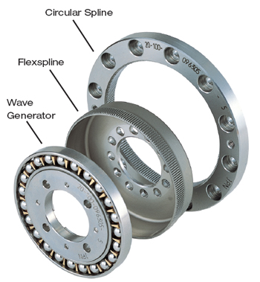
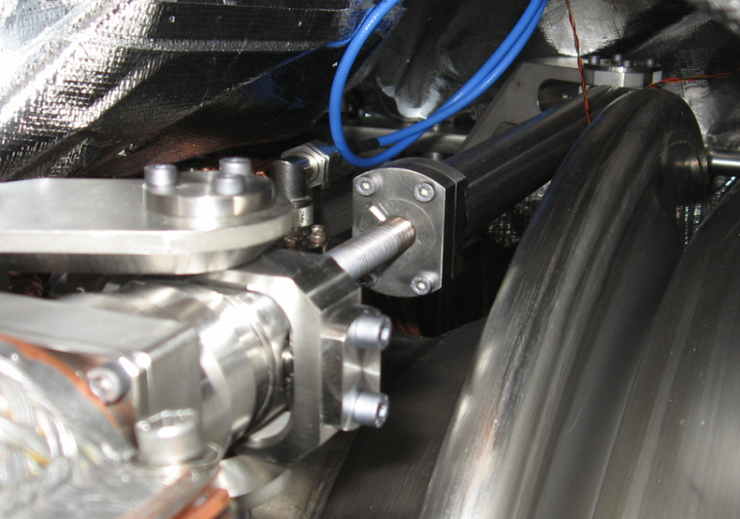
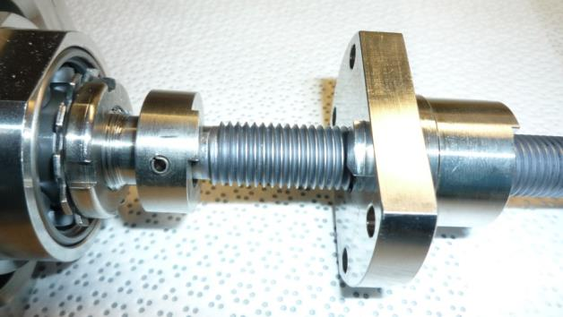
Frequency tuner system
Screw & nut
Harmonic drive Gearbox
gear
box
CuBe2 screw

Slide 7
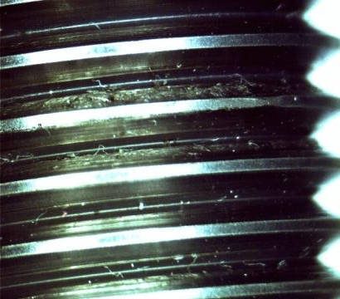
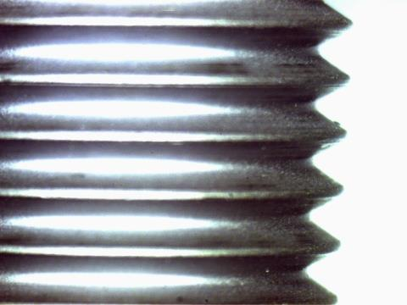
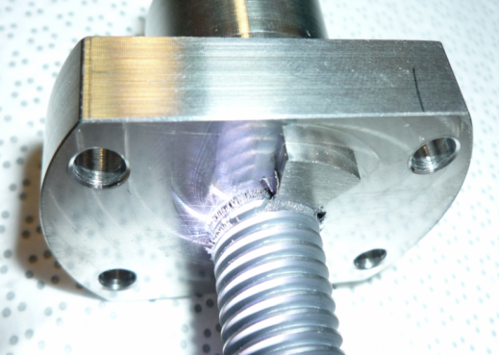
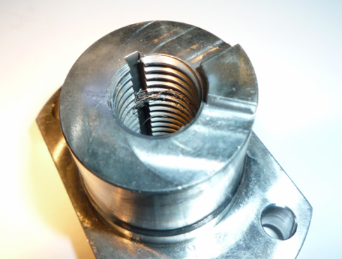
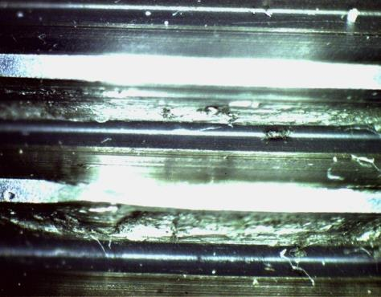
Repetitive jams of the tuners
BEFORE:
AFTER:

Slide 8
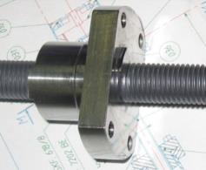
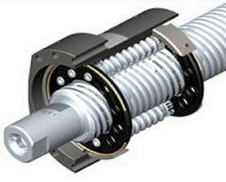
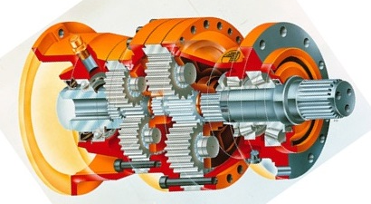
Repetitive jams of the tuners
The standard screw-nut assembly replaced by a planetary roller screw
NO MORE FAILURE SINCE !
ALMOST
The « harmonic drive » gear box replaced by a planetary gear box
Less friction and more robust → longer lifetime
A prototype was validated @4K on a test bench at CEA
with a reliability test equivalent to ~ 20 years of SOLEIL operation

Slide 9
IPC upgrade
Original SOLEIL IPC is a LEP2 type antenna limited to 200 kW
An improved version was later developed by CERN for the LHC
But why change something which works?
Some problems of ceramic aging with LEP type IPC’s at ESRF
Discharges in one of the IPC’s, when operating above 120 kW
@ 300 kW /cavity → SOLEIL can store 500 mA using a single CM
→ Redundancy

Slide 10
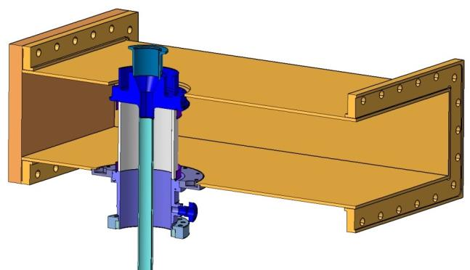
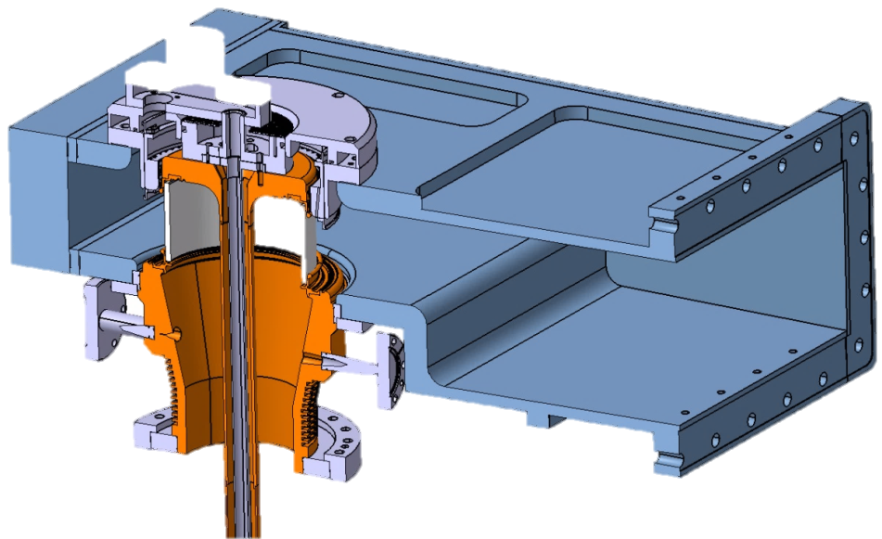
IPC upgrade
Conclusion of a collaboration agreement with CERN and ESRF in order to develop a new 352 MHz IPC, based on the LHC design, capable of handling up to 300 kW

Slide 11
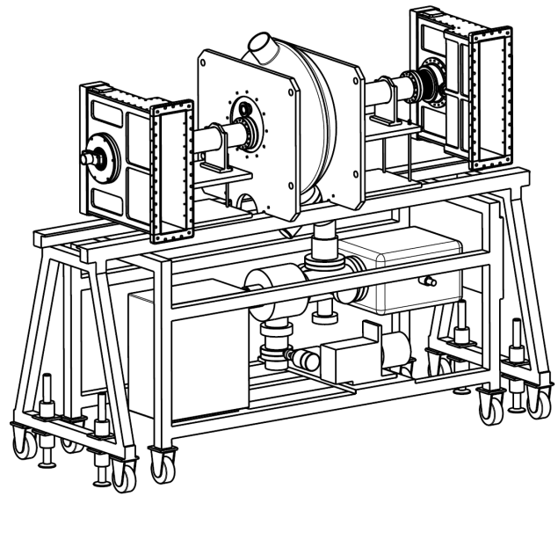
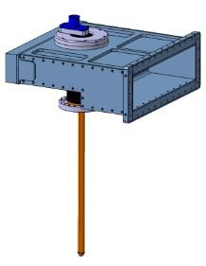
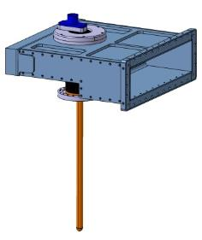
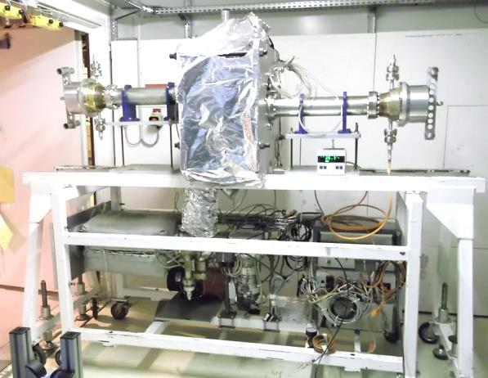
IPC upgrade
April 2013: the 1st pair of upgraded IPC, built at CERN for SOLEIL, is successfully conditioned @300 kW CW in the ESRF test-stand using a Cu cavity from CERN.
Coupler 2 : P_{out} toward dummy load or short circuit
352 MHz
cavity
Coupler 1 : P_{in}

Slide 12
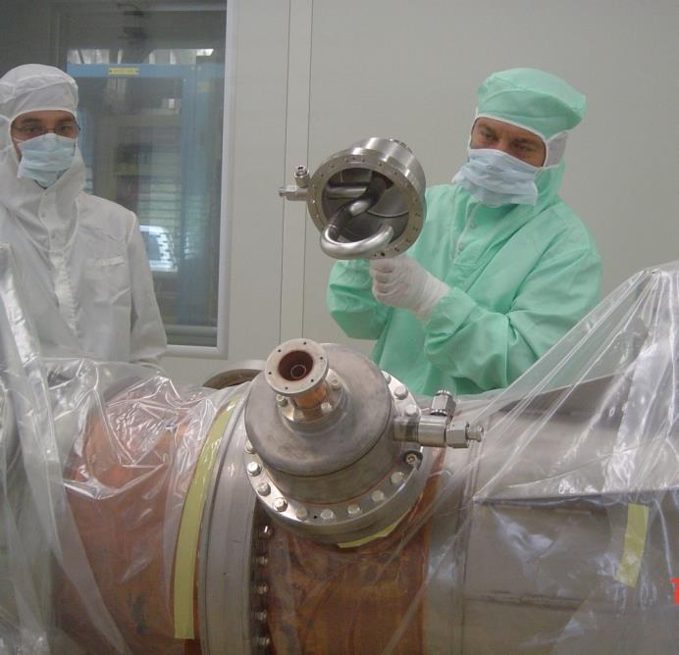
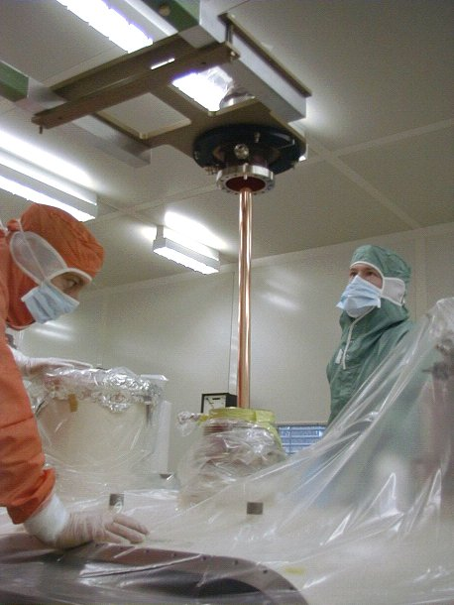
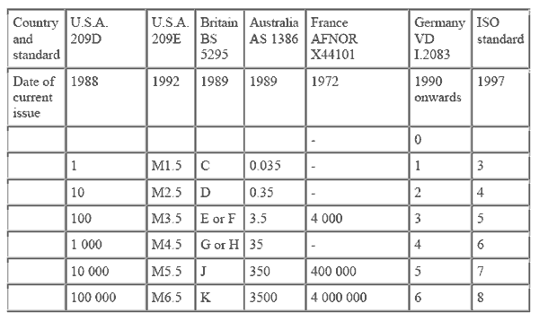
IPC upgrade
The initial assembly was done in a ISO-5 (US 100) clean room at CERN

Slide 13
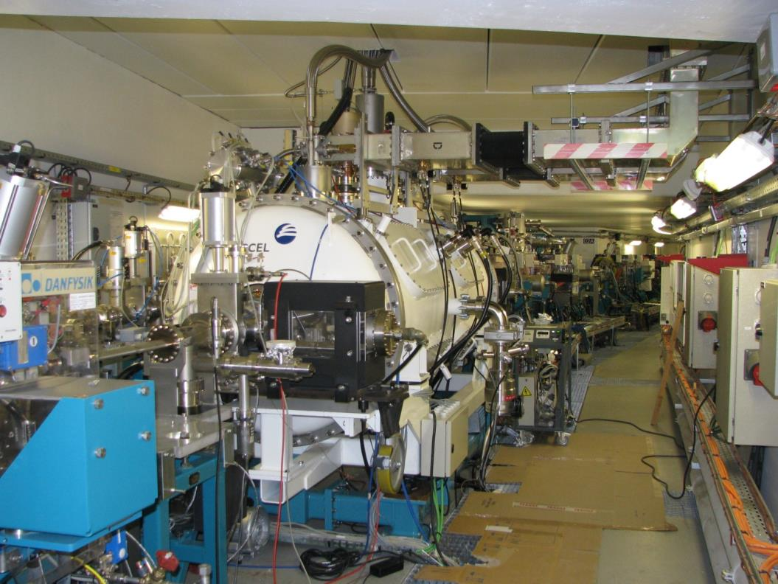
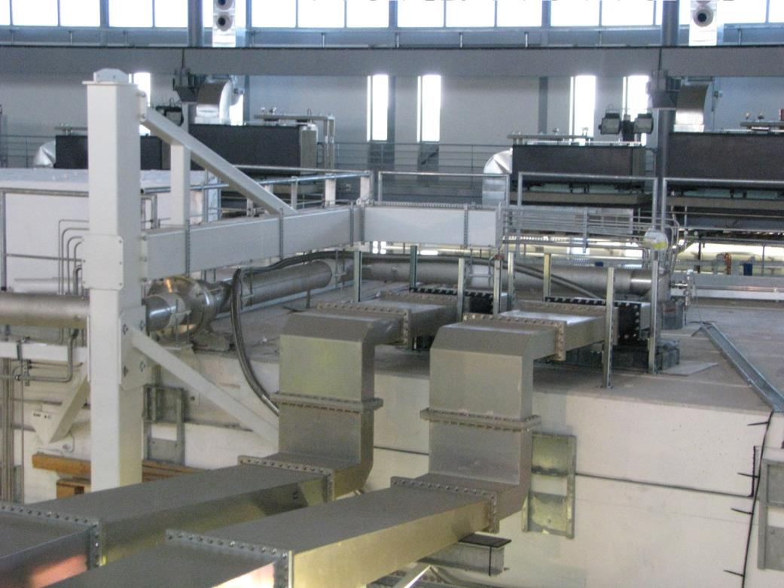
INSIDE
If we can not get the CM to the cleanroom, so we get the cleanroom to the CM !!
OUTSIDE

Slide 14
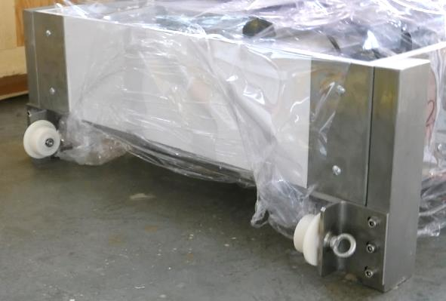
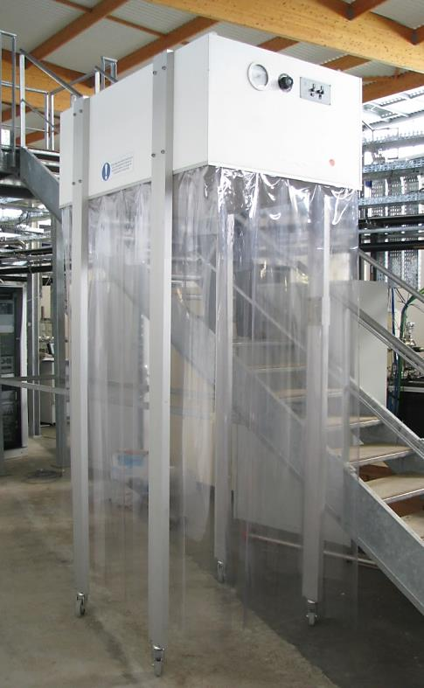
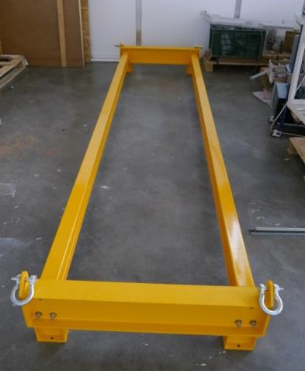
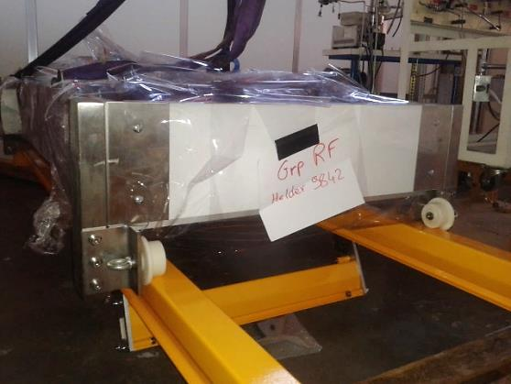
IPC upgrade

Slide 15
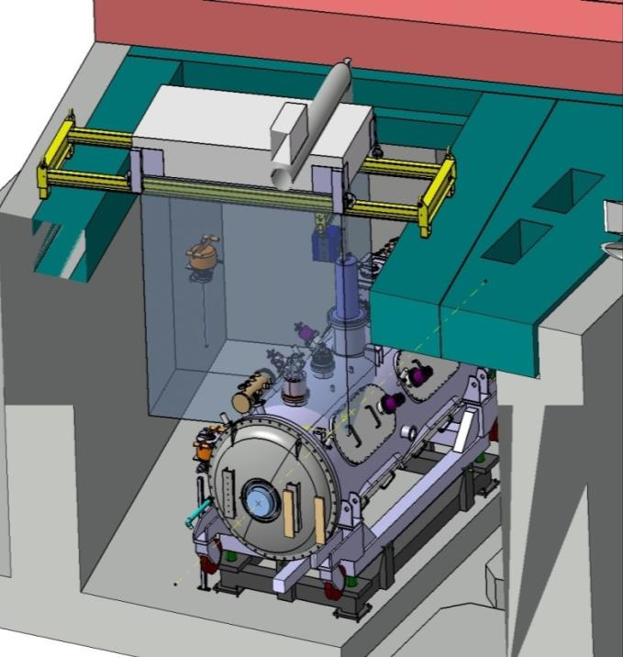
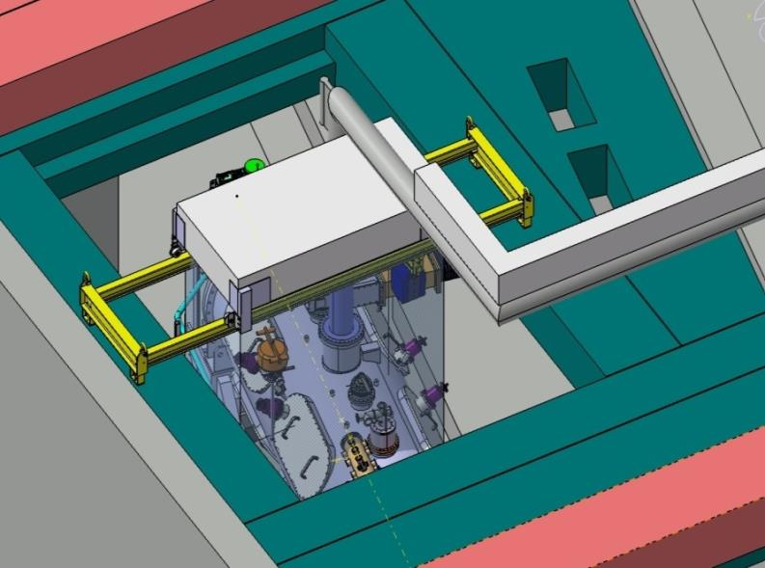
IPC upgrade

Slide 16
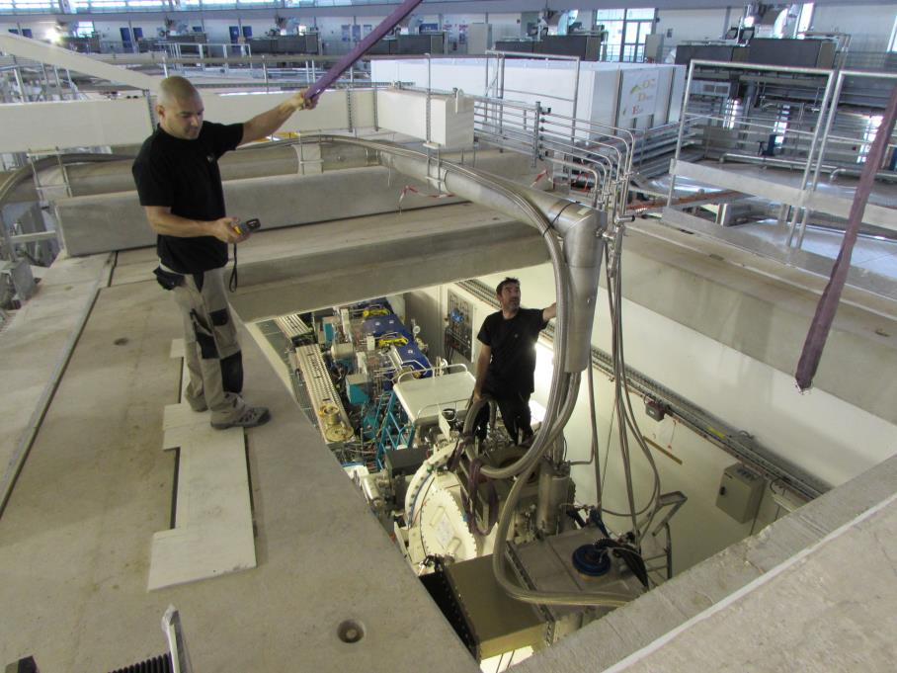
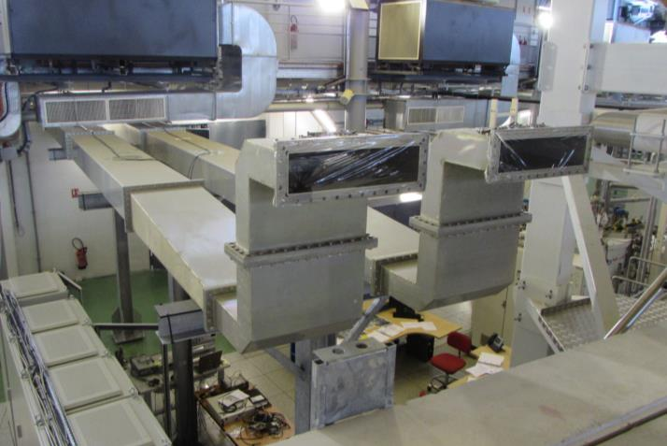

Slide 17
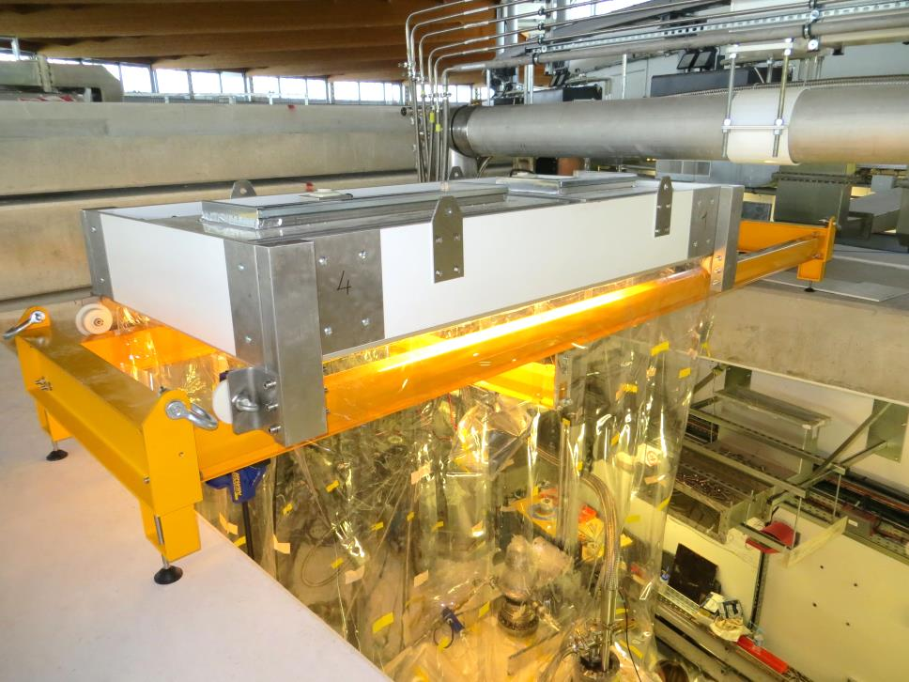

Slide 18
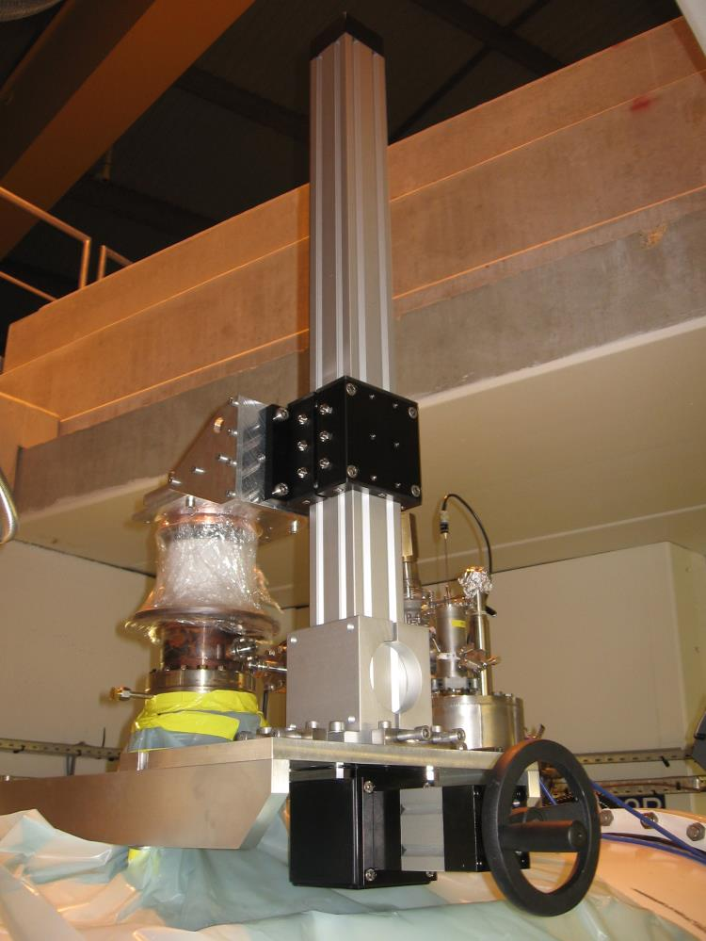
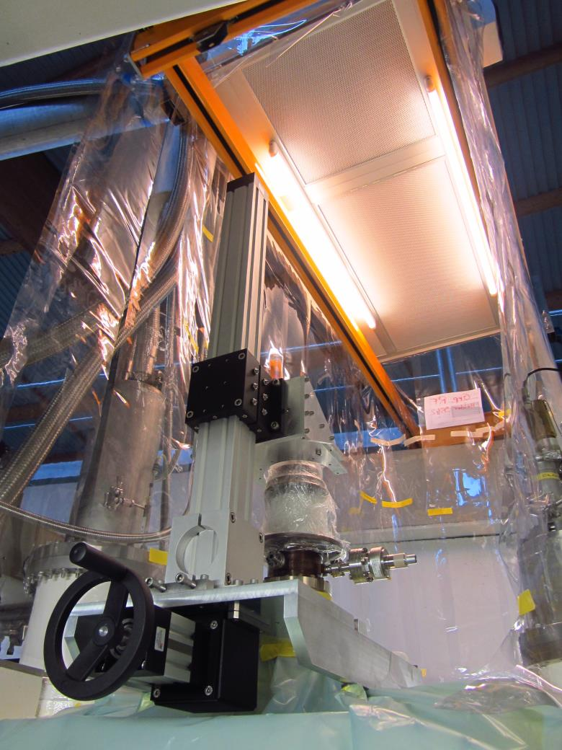

Slide 19
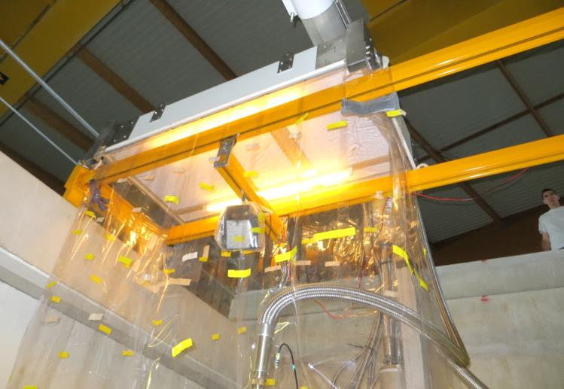
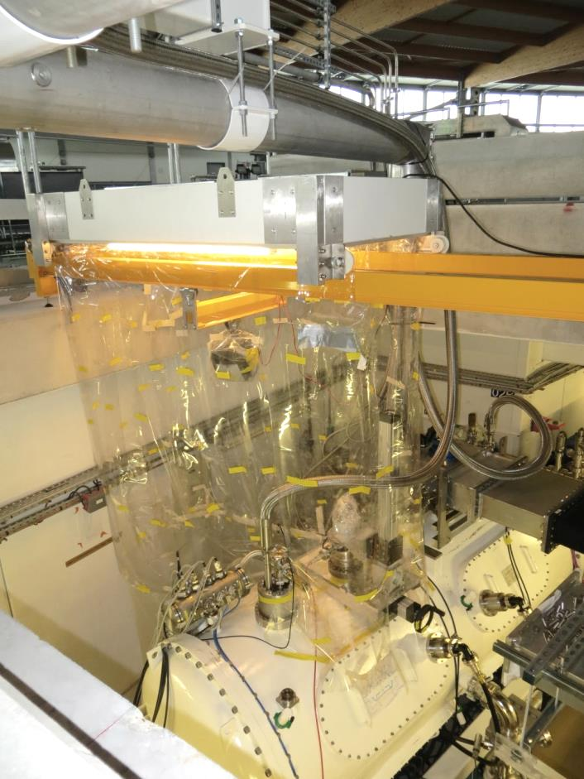
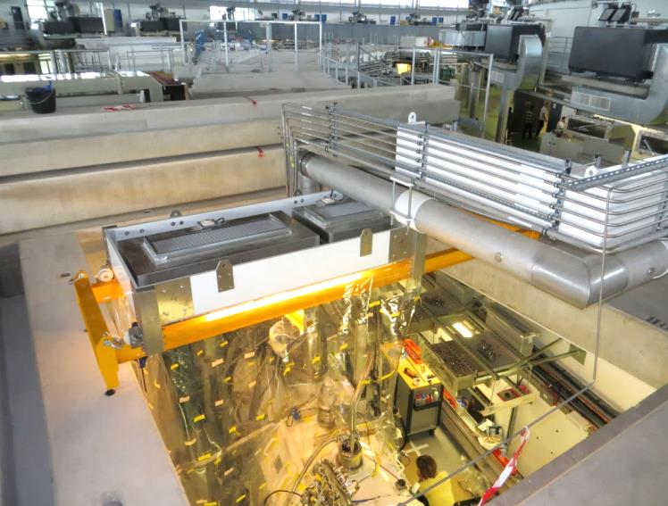

Slide 20
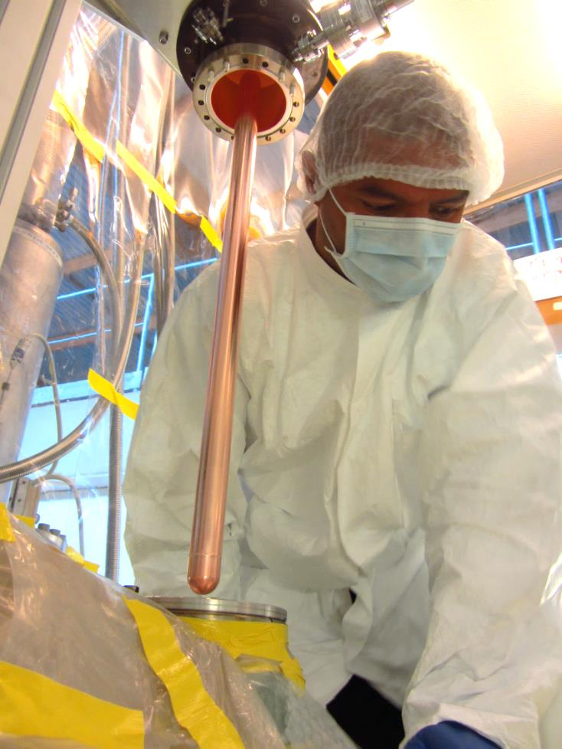
Remove the « old one »
Put on the « new one »

Slide 21
August 2013: one of the pre-conditioned IPC is mounted on CM1, under laminar air flow and slight N2 gas overpressure inside the cavity.
After only few days of RF conditioning, we could store up to 500 mA.
August 2014: The 2nd IPC has been changes.
January 2015: Both IPCs on the CM2 will be changed at the same time!

Slide 22
Conclusion
It is really important to have a deep understanding of the mechanical structure of the Cryomodule,
If the cavity works at ~2-3 MV/m, it would be possible to use standard laminar flow tent for some operations,
Keep the cavity under filtered dry Nitrogen overpressure during the operation and do it as fast as possible but without hurrying!

Slide 23
Acknowledgement
All these results have been possible by a strong involvement of all the SOLEIL team:
P.Marchand, M.Diop, A.Mary, H.Dias, F.Ribeiro, J.Labelle, R.Lopes, M.Louvet, C.Monnot, S.Morand & al.
And also:
E.Montesinos, S.Calvo (CERN), V.Serriere (ESRF), G.Devanz (CEA)

