Slide 1
RF as cleaning tool
Mircea Stirbet
Jefferson Laboratory
TTC Topical Workshop on SRF Cryomodule Cleanroom Assembly.
12-14 Nov 2014 CEA Saclay, France

Slide 2
Outline
Routine VTA RF qualification tests done at JLAB (Cavity LL02 used as example)
RF processing of LG650 MHz cavity
Conclusions
TTC Topical Workshop on SRF Cryomodule Cleanroom Assembly
12-14 Nov 2014 CEA Saclay, France
M. Stirbet 1

Slide 3
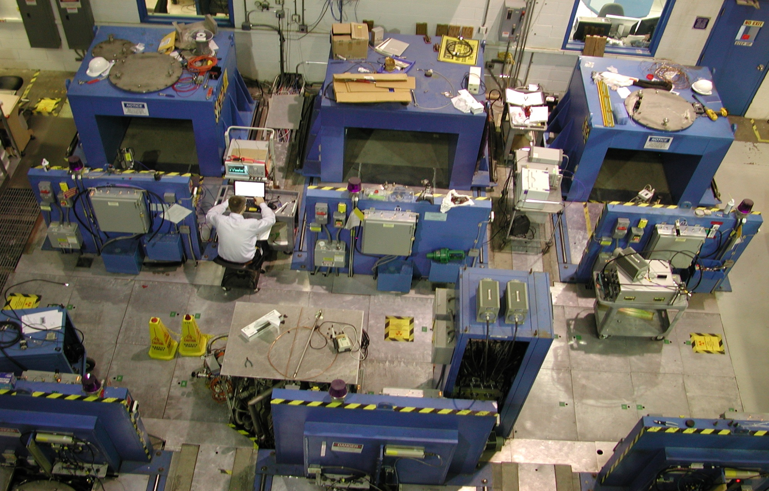
Vertical test Area (VTA): Dewars area
Open Collaboration Meeting on Superconducting Linacs for High Power Proton Beams (SLHiPP-1) 8/9 December 2011 CERN – Geneva Switzerland
TTC Topical Workshop on SRF Cryomodule Cleanroom Assembly
12-14 Nov 2014 CEA Saclay, France
M. Stirbet 2
Vertical test Area (VTA): Dewars and control room

Slide 4
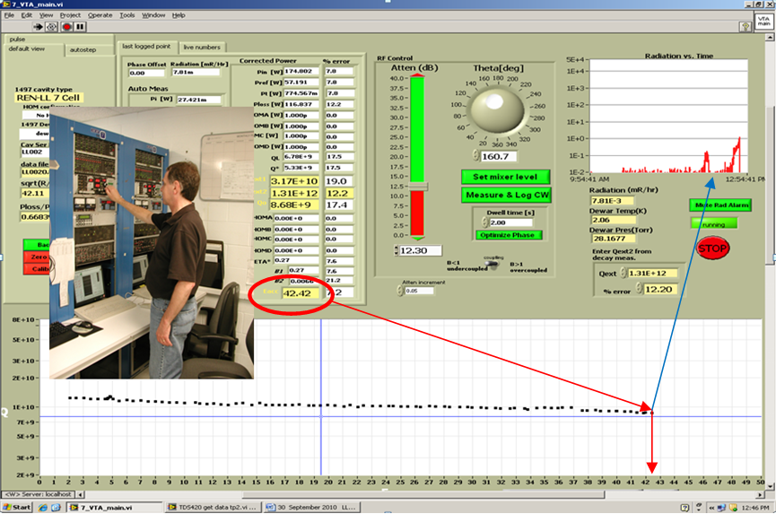
VTA Operator interface and low loss cavity LL002 at 42 MV/m
Quench
At 42 MV/m
TTC Topical Workshop on SRF Cryomodule Cleanroom Assembly
12-14 Nov 2014 CEA Saclay, France
M. Stirbet 3

Slide 5
Qo and radiation vs Eacc
TTC Topical Workshop on SRF Cryomodule Cleanroom Assembly
12-14 Nov 2014 CEA Saclay, France
M. Stirbet 4

Slide 6
Field emission onset 26.83 MV/m
TTC Topical Workshop on SRF Cryomodule Cleanroom Assembly
12-14 Nov 2014 CEA Saclay, France
M. Stirbet 4

Slide 7
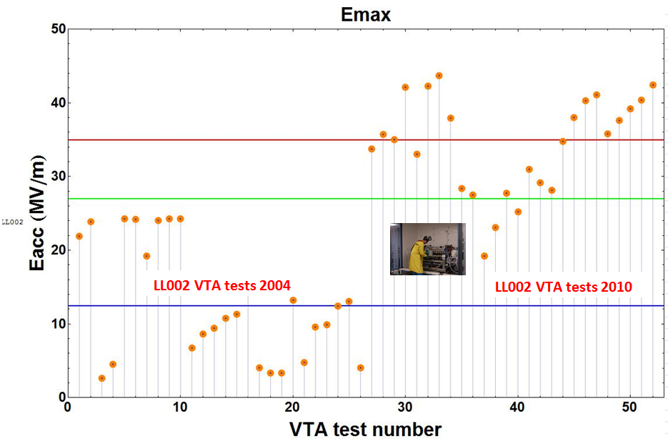
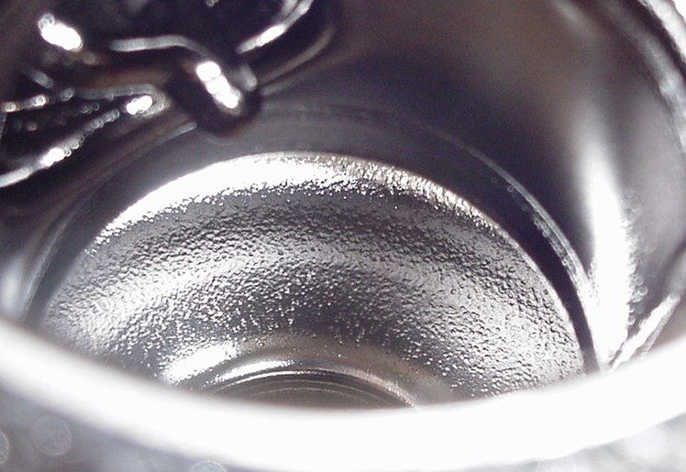
VTA tests done on LL02 in 2004 and 2010
ILC design requirements
27 MV/m C100 admin limit
12.5 MV/m C50 requirements
TTC Topical Workshop on SRF Cryomodule Cleanroom Assembly
12-14 Nov 2014 CEA Saclay, France
M. Stirbet 4

Slide 8
R&D on 650 MHz cavities
We have fabricated several cavities from different types of niobium in an investigation to learn more about performance differences based on material choices:
The first of the three was made from reactor grade niobium with RRR – value of ~ 50 (named “RG”)
The second cavity was made from the same material, but the sheets for deep drawing of the half cells were welded together by EBW from smaller pieces (“stitched”) – the motivation for this approach was to explore, if lower frequency cavities (< 400 MHz,) for which large enough sheets possible were not available by a manufacturer, could achieve reasonable performances, e.g. Eacc ~ 8 MV/m, which at the time was the specification for the BES/ICS proposed cavities(cavity is named “Stitched” )
The third cavity was made from high RRR, ingot material, which had to be enlarged to a larger diameter ( ~ 510 mm diameter) in order to be useable for deep drawing of a half cell (named “Ingot”).
TTC Topical Workshop on SRF Cryomodule Cleanroom Assembly
12-14 Nov 2014 CEA Saclay, France
M. Stirbet 4

Slide 9
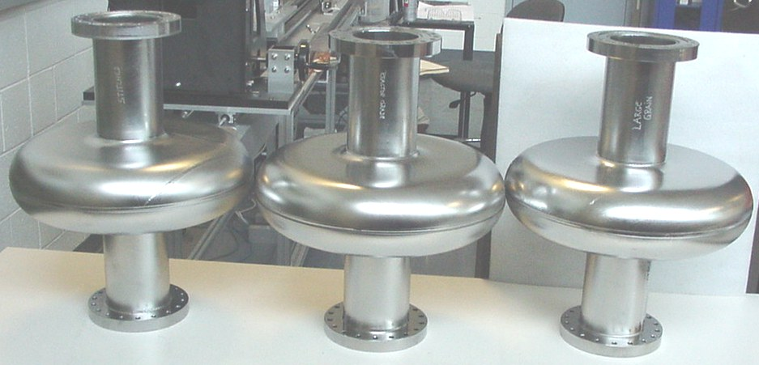
LG 650 MHz Cavity manufacturing
The large grains cavity will be used to demonstrate the efficacy of RF processing during VTA RF power testing.
TTC Topical Workshop on SRF Cryomodule Cleanroom Assembly
12-14 Nov 2014 CEA Saclay, France

Slide 10
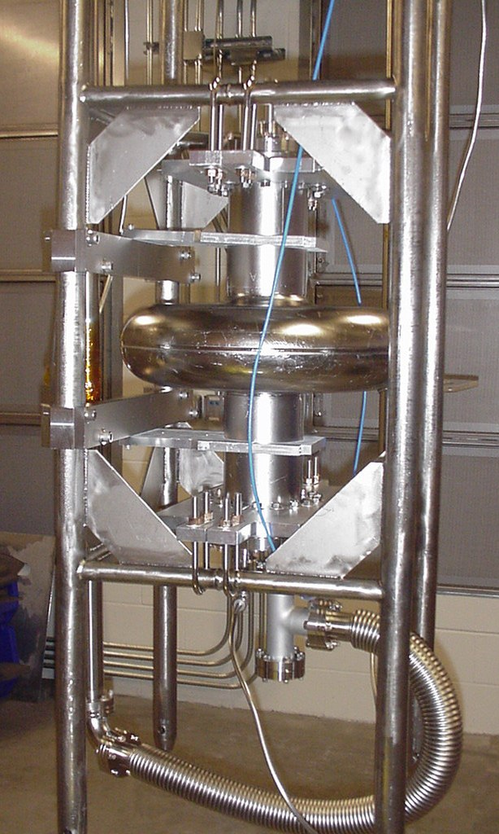
Cavity fixturing
Prior to the cryogenic testing, all cavities received the same final surface treatment after the hydrogen degassing:
an ultrasonic degreasing in soap/water solution (“Micro”) was followed by 50 μm of BCP, rinsing in hot and cold water and a subsequent high pressure ultrapure water rinsing (HPR).
The respective cavity was dried in our class 10 clean room for app. 12 hr before the auxiliary parts ( input coupling probe/pump-out port and transmission probe), which were carefully clean by blowing off remaining particles with nitrogen, were attached with AlMg-gaskets.
The cavity, which was fixed in a Ti - frame for stability and handling, was attached to the test stand (see figure 3) in front of a laminar flow wall and evacuated for > 12 hr.
In initial tests the cavity was not fixtures to the Ti- frame as shown in figure 3 and significantly deformed after evacuation. In particular, the “stitched” cavity ended up with a “re-entrant – type” shape after evacuation, the most likely cause being the annealing/softening of the material due to the “stitching” electron beam welds.
These deformations increased the cavity frequencies by several MHz
TTC Topical Workshop on SRF Cryomodule Cleanroom Assembly
12-14 Nov 2014 CEA Saclay, France

Slide 11
RF processing
TTC Topical Workshop on SRF Cryomodule Cleanroom Assembly.
12-14 Nov 2014 CEA Saclay, France

Slide 12
All data on the same graph for VTA tests done LG650D
TTC Topical Workshop on SRF Cryomodule Cleanroom Assembly.
12-14 Nov 2014 CEA Saclay, France
M. Stirbet 4

Slide 13
Final run on LG650D after RF processing
TTC Topical Workshop on SRF Cryomodule Cleanroom Assembly
12-14 Nov 2014 CEA Saclay, France
M. Stirbet 4

Slide 14
Radiation onset LG650D after RF processing
TTC Topical Workshop on SRF Cryomodule Cleanroom Assembly
12-14 Nov 2014 CEA Saclay, France
M. Stirbet 4

Slide 15
Conclusions for RF processing
RF processing is suitable for cleaning of SRF components if applied in a reasonable amount of time (several hours). If no progress is noticed after several hours of RF processing, the cavity performance could be affected by issues not related with cleaning.
Efficiency of RF processing:
CW mode – pretty good
Pulsed mode – not so efficient (change pulse duration, repetition rate) – take more time. Some limitation related with filling up/discharge the cavity. Help to minimize radiation output during RF processing.
Phase processing
In a cryomodule, consider He processing.
Plasma processing – take care.
TTC Topical Workshop on SRF Cryomodule Cleanroom Assembly
12-14 Nov 2014 CEA Saclay, France
M. Stirbet 4

Slide 16
Some references
T. Bass, K. Davis, C. Grenoble, M. Stirbet: Standardization of CEBAF 12 GeV upgrade cavity testing, In: IPAC2012, New Orleans, USA, http://epaper.kek.jp/IPAC2012/papers/weppc088.pdf
P. Kneisel, M. Stirbet, T. Powers, R.A. Rimmer, L.Turlington, B. Clemens, G. Slack: Performance of 650 MHz Single Cell Cavities Made From Various Types of Niobium, JLAB TN-14-018
O. Brunner, A. Butterworth, G. Cavallari, N. Hilleret, J. Jimenez, J. Tuckmantel: First experience with in situ Helium processing of the LEP superconducting modulesin: SRF 1997, Abano Terme, Padova, Italy, https://accelconf.web.cern.ch/accelconf/SRF97/papers/srf97a14.pdf
C.E. Reece, M. Drury, M.G. Rao, V. Nguyen-Tuong: Improvements of the operational performance of SRF cavities via in situ Helium processing and waveguide vacuum processing,, PAC1997 Vancouver, BC, Canada, http://epaper.kek.jp/pac97/papers/pdf/3P034.PDF
J. Mammosser, S. Ahmed, K. Macha, J. Upadhyay, M. Nikolic, S. Popovic, L. Vuskovic: Large-Volume resonant microwave discharge for plasma cleaning of a CEBAF 5-cell SRF cavity, IPAC2012, New Orleans, USA, http://accelconf.web.cern.ch/accelconf/ipac2012/papers/weppr094.pdf
J. Mammosser: Spallation Neutron Source Status and upgrade plans, SRF 2009, Berlin, Germany, http://accelconf.web.cern.ch/AccelConf/srf2009/papers/moodau01.pdf (reporting on plasma cleaning)
M. Doleans et al: Plasma processing R&D for the SNS superconducting LINAC RF cavities, SRF2013, Paris, France, http://ipnwww.in2p3.fr/srf2013/papers/tup057.pdf
TTC Topical Workshop on SRF Cryomodule Cleanroom Assembly
12-14 Nov 2014 CEA Saclay, France
M. Stirbet 4

