Slide 1
SPIRAL2
Qualification of procedure during warm section assembly to a Cryomodule B

Slide 2
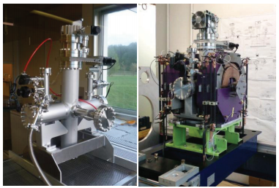
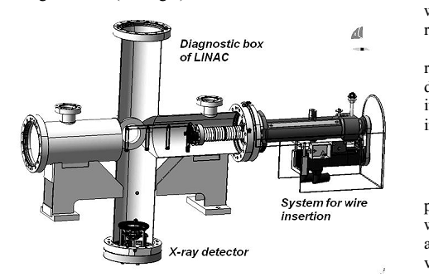
Cryomodule environnement
Linac layout
Warm section
2 QP’s
Steering magnets
1 BPM
1 BEM
Pumping & Vacuum diag. systems
Bunch Extension Monitor system inserted in the WS
Warm section (WS) = diagnostic box

Slide 3
Goals of the experiment
Connection @ IPN Orsay of a WS equipped with its BEM system to a CryoModule B (CMB)
MAIN OBJECTIVES
Qualification of the WS-to-cryomodule connection procedures
→ impact on the cavities performances (Eacc max, field emission…)
Measurement of the BEM background noise
impact of the X-rays emitted by the cavities on the electronics
X-ray measurements around the CMB for sizing (=concrete blocks thickness) the future test area for cryomodules @ GANIL

Slide 4
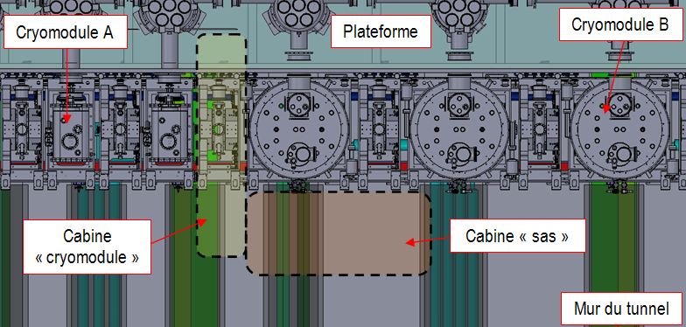
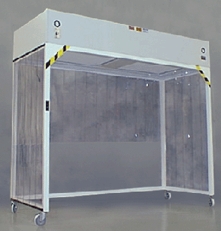
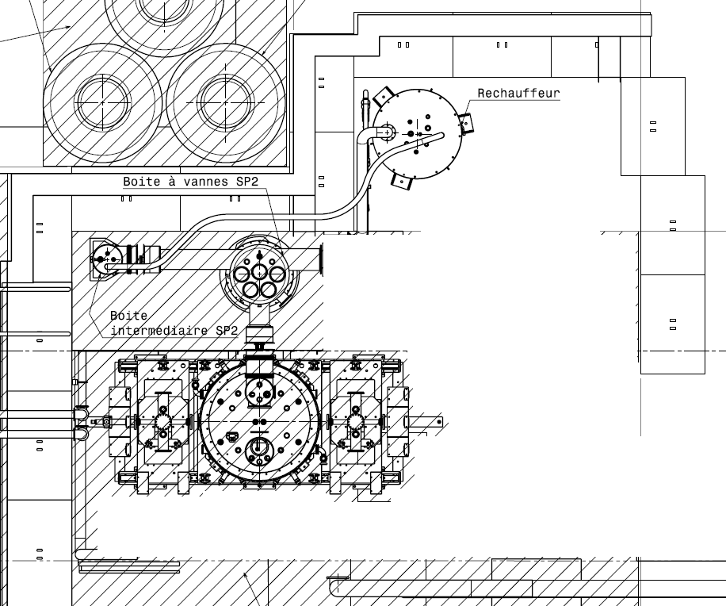
Configurations
Planned @ GANIL (top view in the tunnel)
ISO 5 laminar flow
ISO 7 laminar flow
Portable laminar flow
ISO 5 laminar flow
Adaptation to the test area @ IPN Orsay
(top view)
ISO 7 laminar flow

Slide 5
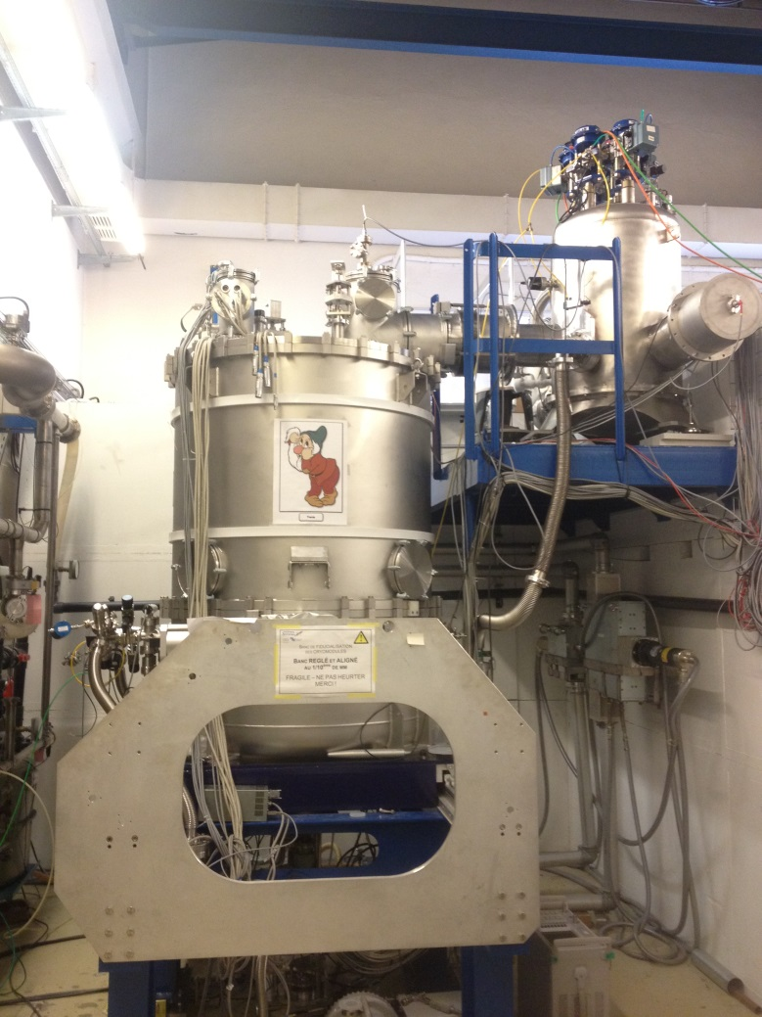
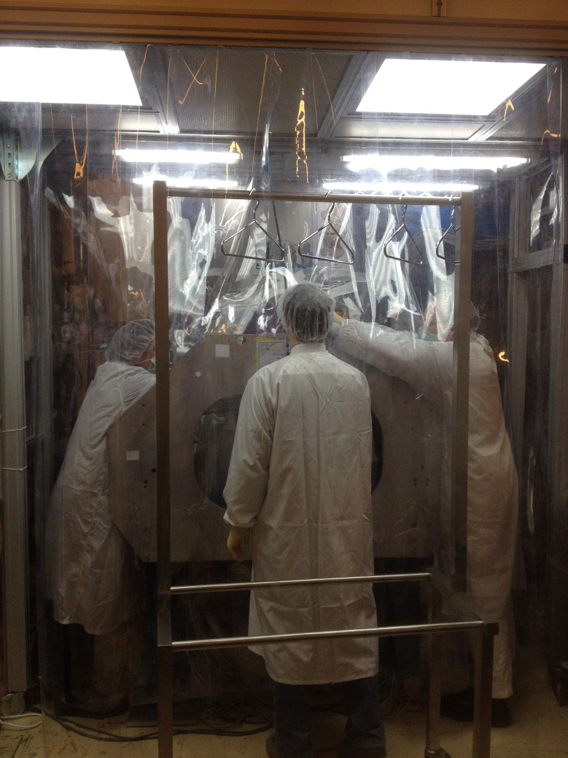
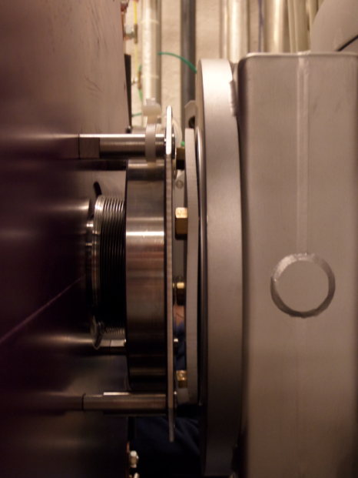
Installation @ IPN Orsay
BEFORE
AFTER
Connection area
WS flange
Cryomodule flange
10 cm
LIMITED SPACE!
WS has been prepared in ISO5 clean room @ Saclay

Slide 6
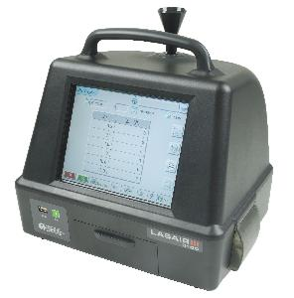
Some rules…
Cavities are @ 300K.
Main WS-to-CMB connection area: under ISO5 portable laminar flow
Anteroom: ISO 7 laminar flow for material, tools, clothes storage
Cleaning of the connection area with CL5 wipes and/or by blowing filtered Nitrogen @ 4 bars.
As cleaning is progressing, areas with lots of rough surfaces, corners, nooks… are wrapped up under plastic film (conditionned in clean room) to facilitate the cleaning process of the other parts.
Particles counting before any assembly by blowing filtered Nitrogen @ 2 bars.
The particle counter is set below the connection area.
Specifications:
0,5 µ: <100 particles.
5 µ (or >): none.
Clean, clean and clean until the specs are achieved!
Lasair III portable particle counter

Slide 7
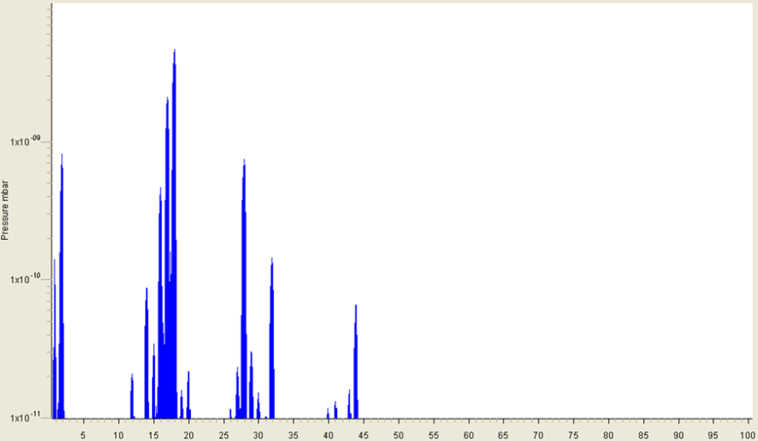
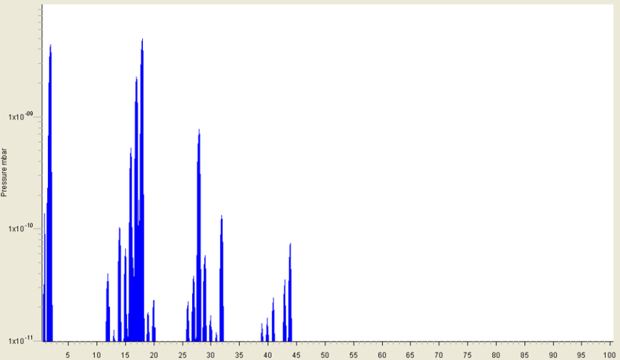
After the connection…
Once the connection is done:
The WS is pumped down (slowly), then the Turbopump is switched on.
Check of the tightness.
Wait for P_{WS} < P_{cavities}
Open the cryomodule valve
Check the residual gaz analyzer spectra
Cool-down the cavities
Check the cavities performances
→ It took 1 day with 2 operators for the all process
Before opening the valve, P=6.6E-8 mbar
After opening the valve, P=7.1E-8 mbar

Slide 8
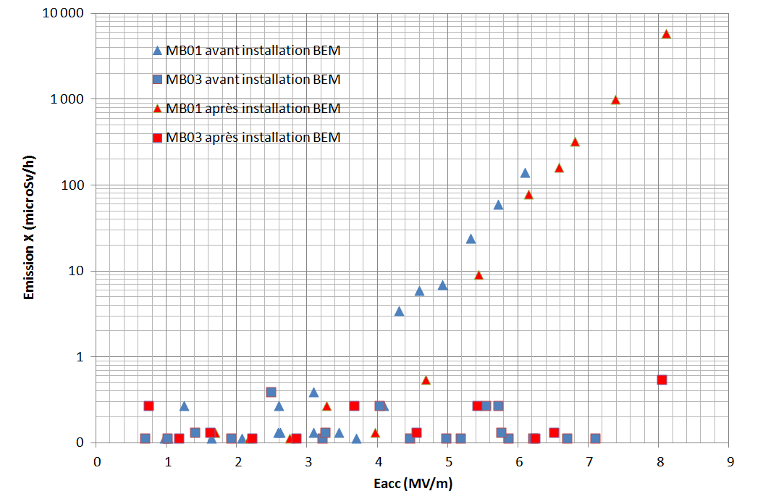
Results
No performances degradation:
Same Eacc max
Same X-ray doses
ASSEMBLY PROCESS APPROVED
Cav n°1: before assembly
Cav n°2: before assembly
Cav n°1: after assembly
Cav n°2: after assembly
X-ray dose (µSv/h)

Slide 9
Thank you for your attention

