Slide 1
Status of CMS
*Mostly based on information from CMS Offline & Computing Week
November 3-7
Matthew Nguyen
Recontres LCG-France
December 1st, 2014

Slide 2
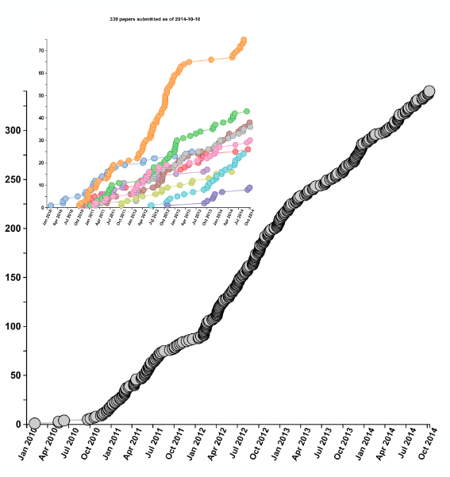
Winding down Run 1 physics
Mostly ‘discovery physics’ groups (Higgs, SUSY, exotica) winding down publication Run 1 publications this year
Others (standard model, b-physics, heavy ions) continue to publish Run 1 physics into 2015
No remaining large MC requests or reprocessing
No major software developments
Continued need or analysis resources into 2015
# of publications
Time

Slide 3
LHC schedule (as of today)
June 1: Start of collisions for physics
3 weeks of 50ns bunch spacing (as in Run 1)
Few week technical stop for “beam scrubbing”
6 weeks @ 25 ns, large β*
3 week technical stop / special runs
7 weeks @ 25ns, nominal β*
1 month heavy-ion run (PbPb)
LHC_Schedule_2015.pdf

Slide 4
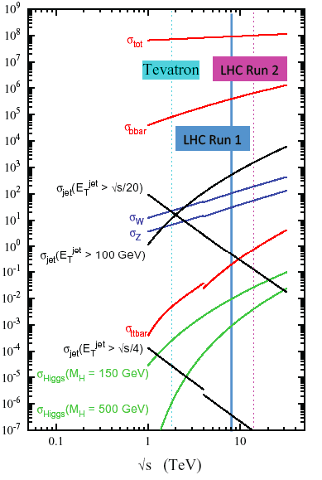
Run 2 physics goals
Energy = 13 TeV (still TBC)
Modest upgrades for CMS from LS1: muon coverage completed, new beampipe, etc.
Discovery potential depends on channel → specifically 13/8 TeV cross section
E.g., high mass dijet resonances will be interesting from Day 1
Precision Higgs meas. by the end of Run 2
In the early days will have to verify SM predictions at new energy

Slide 5
Challenges for Run 2
As for all expt’s, data volumes increasing faster than resources (Moore’s law, flat budgets, etc.)
Conditions are becoming more demanding, e.g, larger pile-up, with sizeable component coming ‘out-of-time’ at 25 ns
LS1 was dedicated to evolution of CMS computing model and software to meet these needs

Slide 6
CSA14
Computing, Software and Analysis challenge: large-scale tests of complete data processing, software and analysis chain
Injection of o large samples of simulated events, analyzed using new computing tools and data access techniques
Samples include different bunch spacing and PU conditions
Spanned July – September, with > 150 users

Slide 7
2014 Computing Milestones
Data Management milestone: 30 April 2014
More transparent data access
Disk and tape separated to manage Tier-1 disk resources and control tape access
Data federation and data access (AAA)
Developing Dynamic Data Placement for handling centrally managed disk space
Analysis Milestone: 30 June 2014
Demonstrate the full scale of the new CRAB3 distributed analysis tool
Reduce job failures in handling of data, improved job tracking and automatic resubmission
Organized Production Milestone: Ongoing…
Exercise the full system for organized production
Cloud-based Tier-0 using the Agile Infrastructure (IT-CC and Wigner)
Run with multi-core at Tier-0 and Tier-1 for data reconstruction
Done!
Done!

Slide 8
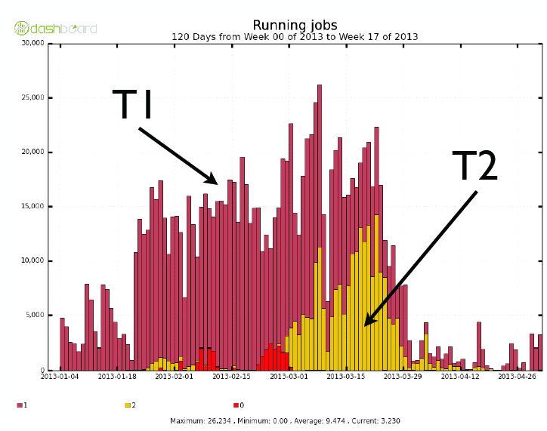
Data Federation
Relax paradigm of data locality, taking advantage of better bandwidth reliability than anticipated: Any data, Anytime, Anywhere (AAA)
Implementation:
xrootd data federation
‘Fall-back’ mechanism
Disk/tape separation at T1s
Advantages
Slight loss of CPU efficiency, but overall more efficient use of resources
Sites w/ storage failures can continue to operate
Can imagine disk-less T2s
An early example: “Legacy” reprocessing of 2012 data samples.

Slide 9
Federation scalability
GRIF_LLR scaling very well at least up to 800 jobs
Strategy to optimize performance depends storage system, i.e., may be different at our T2s (DPM) vs T1 (dcache)

Slide 10
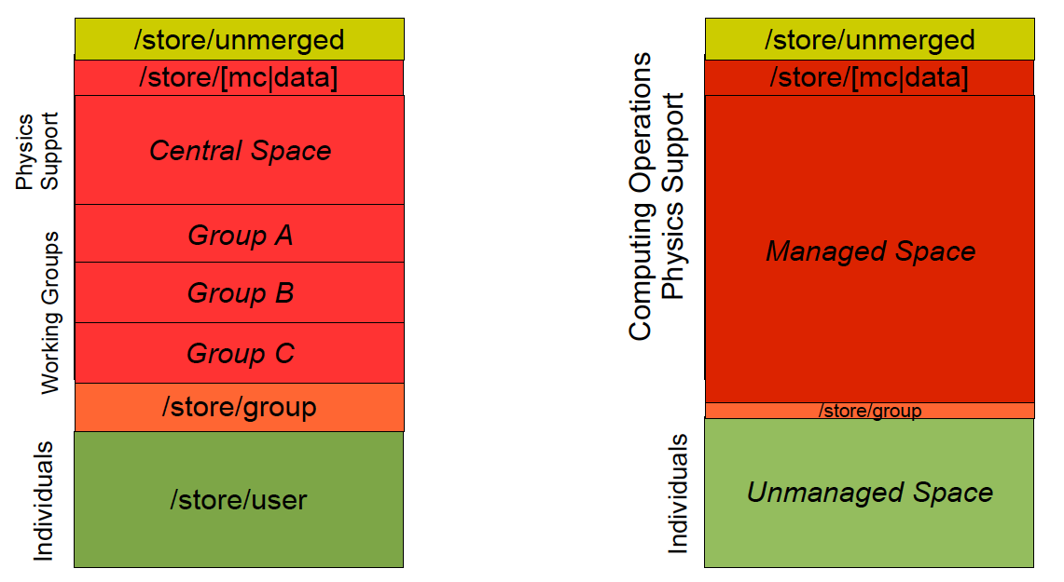
Dynamic Data Management
CMS manages 100 Pb of disk at 50 computing centers
~ 100k datasets (mostly MC), which were distributed essentially by hand
Idea: Instead use data popularity to determine dataset replication and deletion
Release least popular cached copies once 90% of space is used, until 80% usage
Create new copies when data becomes popular
CMSSW reports on file-level access as of version 6

Slide 11
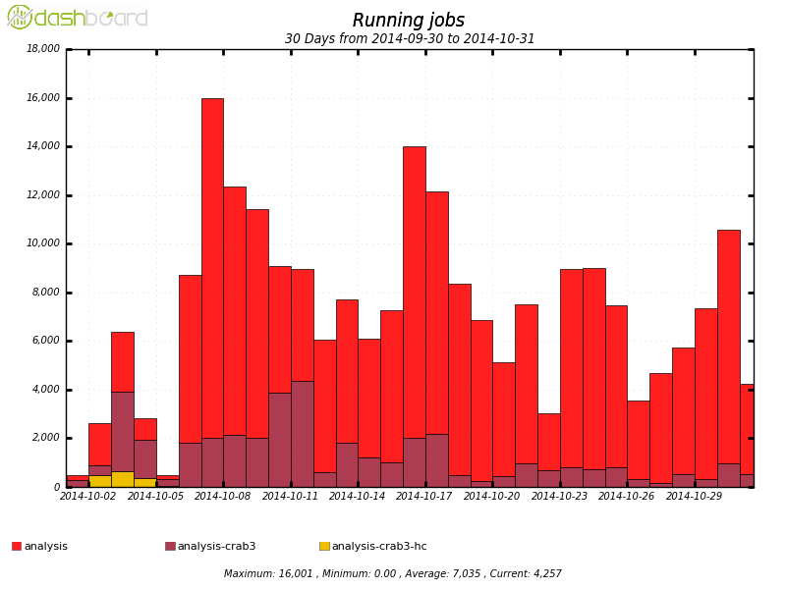
CRAB3
CMS Remote Analysis Builder
New grid submission tool enables option to ignore data locality, i.e., use AAA
Tested by artificially forcing jobs to run w/ remote access
During CSA14: 20k cores in production, 200k jobs/day, average of 300 users/week
Improves handling of read failures and monitoring

Slide 12
A new data-tier: mini-AOD
New thin data tier →10x compression, 30-50kB/event
Process 2B events w/ 100 slots in 24h
800M events produced in CSA14
Update centrally ~ monthly

Slide 13
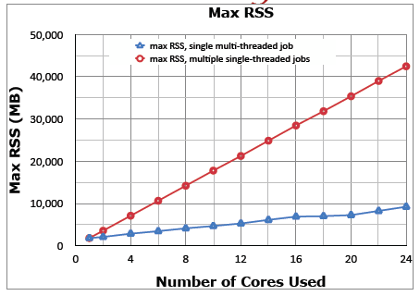
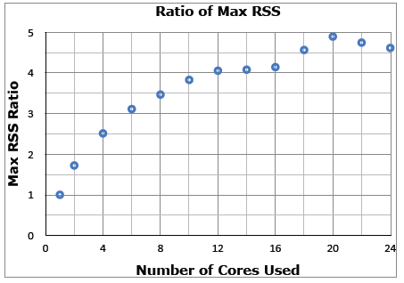
Multicore
Full thread-safety achieved in CMS software version 7
Different levels of concurrency: Module and sub-module level
TBB: threaded building blocks
Multi-core CMSSW available in nightly builds since July
Reconstruction using threads tested at Tier0
Work ongoing on simulation
Performance bottleneck
Modules that must be run sequentially
Lumi block and run boundaries
Substantial gains in memory consumption and network load
ACAT2014 talk, Sexton-Kennedy

Slide 14
Multicore deployment
Scaling to large-scale multi-core production not trivial
Production tool (WMAgent) still being tested
Many challenges: Pilot optimization, job monitoring, etc.
Muti-core pilots at the CCIN2P3 T1
Follow the projection here: CMSMulticoreSchedulingProject
I believe testing is also underway at GRIF

Slide 15
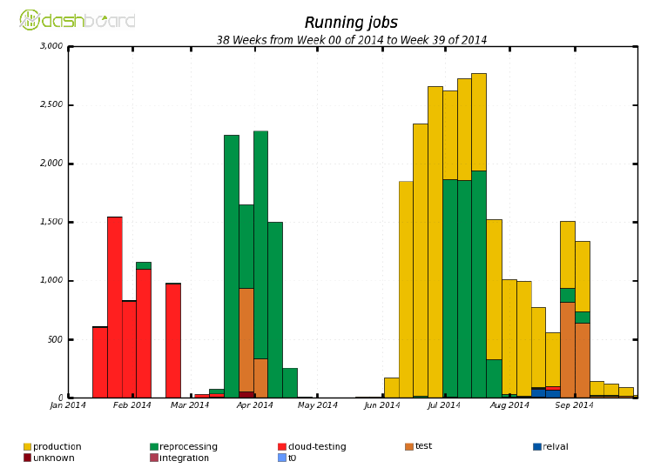
HLT as a cloud resource
With 10k cores, the HLT farm represents a massive resource
Implemented cloud middleware (OpenStack) to use HLT during downtime
Heavy ion reprocessing campaign in April 2014 successful test case
Steady use for production afterwards
Use of HLT during inter-fill periods under investigation

Slide 16
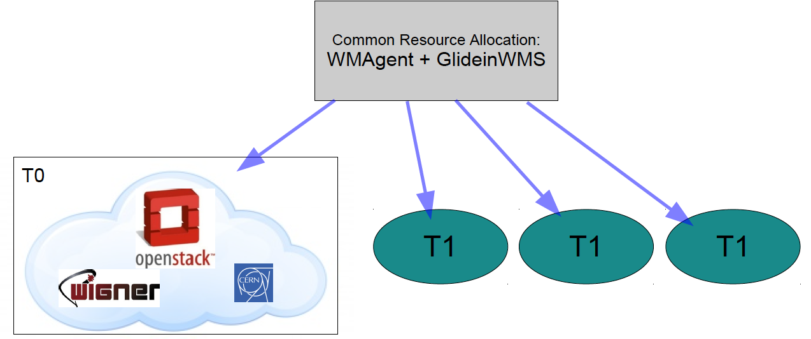
Prompt Reco on the cloud
Prompt reco requires nearly all of CPU resources and a good fraction of T1 CPU
Move to a Openstack based Cloud-like virtualized resources located at CERN (1/3 CPUs, 2/3 disk storage) and Wigner (2/3 CPUs, 1/3 disk storage)
Based on the Agile Infrastructure
New method of resource allocation: GlideinWMS
Work underway to commission this system

Slide 17
Towards physics
1B events simulated by June 1st
Digitized with both 25ns and 50ns bunch spacing
Reprocessing during technical stops, e.g., to update
Machine parameters
Alignment calibrations
Reconstruction developments
4B MC events by end of 2015

Slide 18
Resource Utilization
Tier 1
Tier 2
Utilization beyond WLCG pledges
Main usage: Mostly reprocessing
Now open for user analysis jobs
Mostly also beyond WLCG pledges
Main usage: Analysis and MC production

Slide 19
Resource demands
Evolution of resources demands
2015 T1 pledge breakdown

Slide 20
Conclusions
Run 2 is around the corner → Presents new challenges for computing
Lots of effort went into preparing for this challenge during LS1
Data federation
Multicore processing
New grid submission tools
Use of cloud resources
Large scale production of simulation is underway
Plenty of work left to in terms of commissioning

