Slide 1
Readout ASIC for SiPM detector of the CTA new generation camera (ALPS)
N.Fouque, R. Hermel, F. Mehrez, Sylvie Rosier-Lees
LAPP (Laboratoire d’Annecy le Vieux de Physique de Particules)
03/07/2014

Slide 2
ALPS chip – bloc scheme

Slide 3
ALPS chip– Layout sent to fabrication 03/03/2014
AMS BiCMOS 0.35µm
96 pin out
Die size:
about 3.673 X 3.298 mm²
We haven’t received it yet!
To be tested at the beginning of June

Slide 4
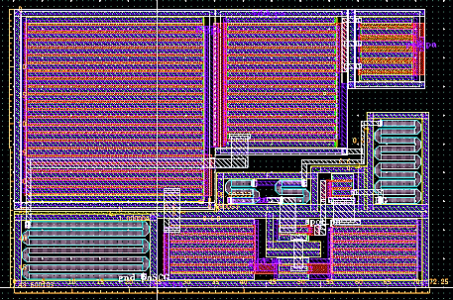
Pre-amplifier
16 channels: adapted to 4x4 SiPM matrix
Principle:
Low input Impedance about 20 ohm.
Fast response < 5ns
=> Current mode
Dynamic range:
From 1 up to about 2000 photoelectron (pe)
Signal to noise ratio (SNR) > 5
=> 2 Gains
HG covers from 1 to about 125 pe
LG covers from 11 to about 2000 pe
Gain ratio about 92, gain overlap 1 decade
Voltage output
Low power consumption < 30mW at this stage (from simulation)

Slide 5
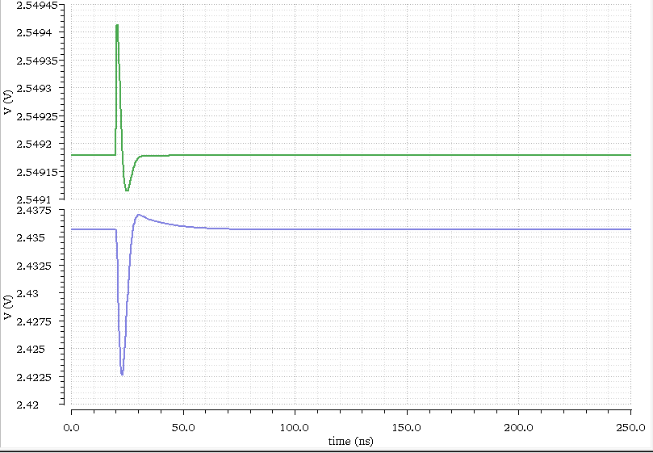
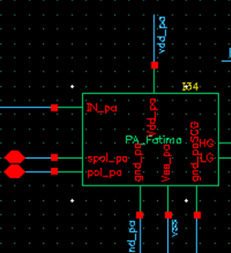
Pre-amplifier simulation (1)
Simulated SiPM signal 1pe
High gain response
t = 2.8 ns

Slide 6
Pre-amplifier – simulation (2)
SNR = 6.2
RMS = 2.08 mV

Slide 7
Analog sums and gain control
Pa_1
R1
Rf
Pa_2
R2
+
Custom opamp
Out_sum
(to discri for HG)
Vref
-
Pa_16
R16
Schematic (principle)
Layout of 1 resistor
Weighted sum of the 16 preamp outputs by digitally controlled resistors
Each resistor has a R-2R like architecture :
Preamp always sees the same load (better for linearity)
8 bits resolution for gain adjustment
Noisy channels can be digitally removed
CR shaping included in each channel
Adjustable Vref to match the discriminator threshold

Slide 8
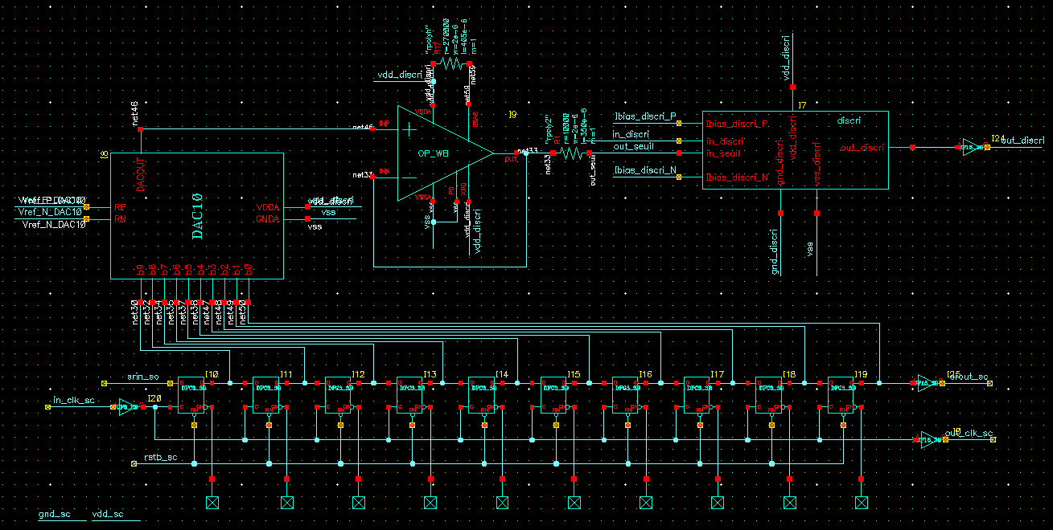
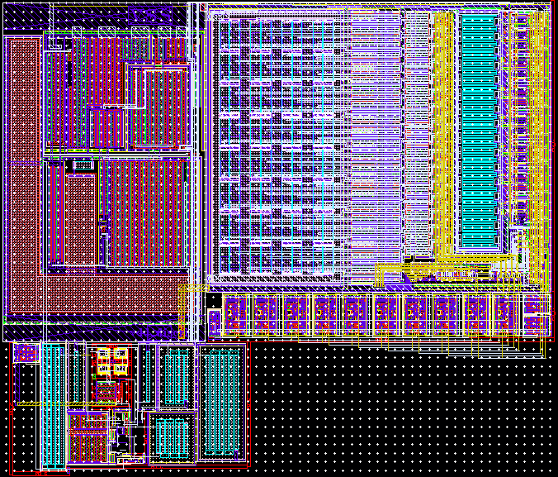
Trigger (DAC + discri)
DAC
Discri
Layout
Slow control
Discriminator (full custom) :
Dual bipolar input stage to minimize offset
Self-biased
Buffered digital output for trigger
10 bits DAC for threshold
AMS standard cell
Digitally controlled threshold

Slide 9
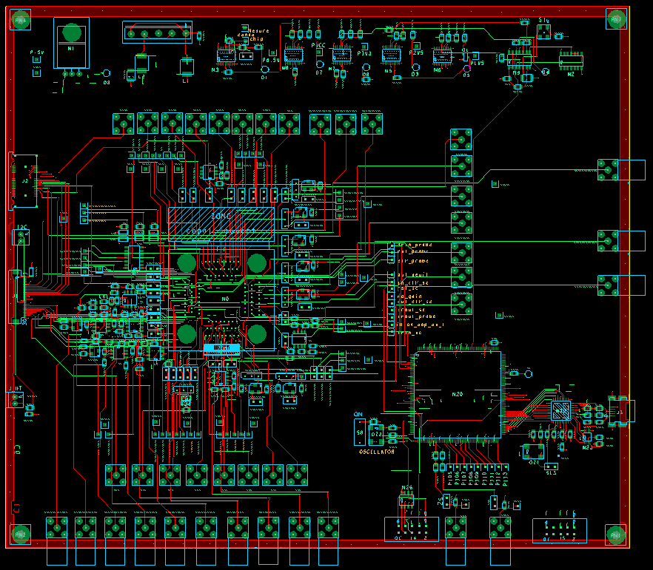
Test board- Scheme
Inputs:
Electrically generated
Inputs:
With interface
ALPS IC
FPGA Firmeware
USB connection
Labview➔FPGA
➔ALPS chip
Inputs:
Photo generated (from SiPM)
Analog Outputs

Slide 10
Test board- Labview Interface
ALPS Slow Control registers
DAC: overvoltage adjustment
High/low gain adjustment
DAC: discriminator threshold
ALPS Probe Registers
High gain output
Low Gain output

Slide 11
Perspective:
Planned tests:
Electrical tests
Tests with false signals
ALPS chip functionality and performance tests
SiPM tests and measurements

