Slide 1
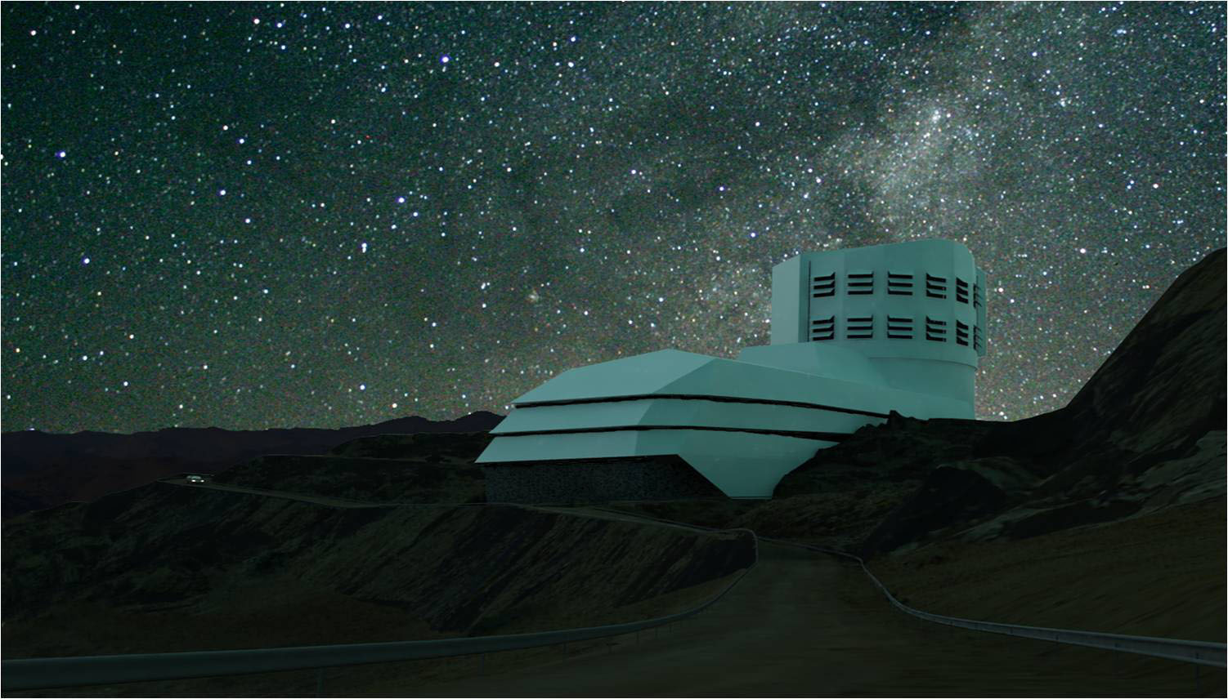

LSST
Context in France
Technical activities
Aurélien Barrau
ENIGMASS Meeting

Slide 2
Dark energy ….
… is not a detail
even if this is just a cosmological constant

Slide 3
LSST & French Agencies : Status
IN2P3 (8 laboratories) is involved since 2007 in the LSST .
IN2P3 is involved in the LSST camera construction . This is a join DOE-IN2P3 effort , where IN2P3 contribution should reach the 15-20 % range. This the only non-US contribution to the core of LSST construction
50% of LSST computing foreseen at CCIN2P3 + copy of all LSST data . This is the only in kind/non-US contribution to the running under discussion today.
IN2P3 team includes in 2014 45 Scientists and 40 Engineers and Technical staff , for a total effort of 40 FTE in LSST in 2013. + ~10% by the end of 2014.
Integration in LSST for 30-50 Non-IN2P3 scientist is foreseen associated to CNRS-IN2P3 in kind contribution during LSST running . This will be associated to the MOA’s signature between LSST and IN2P3 : we hope to conclude in 2015.
➔ Discussion with interested French scientist outside the current IN2P3 LSST-France team has started.

Slide 4
LSST-France coordination in 2014
45 Scientists (10 FTE) / 50 ITA ( 30 FTE) 8 IN2P3 laboratories (9 expected by the fall) :
APC , CCIN2P3, CCPM,LAL,LMA,LPC,LPNHE,LPSC
Contribution to the camera fully structured (started in 2007, construction started in 2014)
Contribution to Science and Computing taking off now

Slide 5
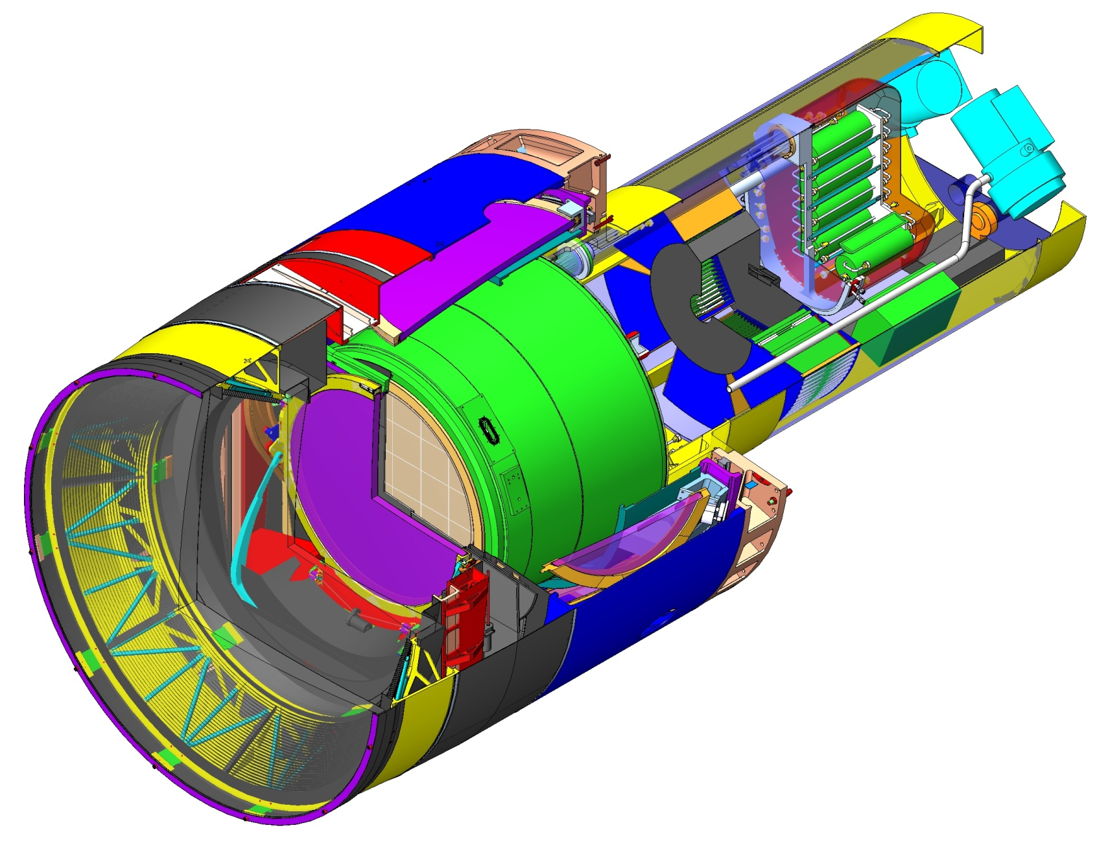

Camera Layout
Focal plane
Utility Trunk—houses support electronics and utilities
Cryostat—contains focal plane & its electronics
Camera Parameters
Property | Value
Lifetime | 15 years
Incident half-angle in air | 14.2º-23.6º
Focal plane diameter | 634 mm
Maximum mass | 3000 kg
Maximum diameter | 1650 mm
Total length | 3732 mm
1.65 m
(5’-5”)
L3 Lens
Filter
L2 Lens
L1 Lens

Slide 6
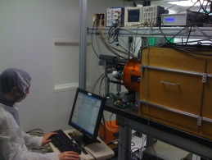
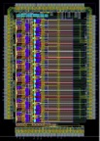
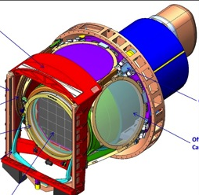
Baseline of the IN2P3 contribution to the LSST camera
( as agreed between DOE and IN2P3 since CD1 / fall 2011)
LSST CCD and associated electronics :
Procurement of 25% of the LSST CCDs (~55 CCDs for a total of 225 CCDs foreseen by LSST),
Initial testing of at least 25% of the CCD production,
Design, qualification, production and testing of the focal plane ASICs: ASPIC for the CCD readout & CABAC for CCD control
Responsibility for the design, implementation and qualification of the FPGA micro-code controlling the LSST Raft (a raft is an autonomous camera of 9 CCDs, with a total of 21 making up the LSST focal plane).
Filter Exchange system & control :
Delivery of the filter exchange system
Support on Filter and optics coating (LMA)
Contribution to the core of the camera slow control , and provide the filter exchange system slow control.
Calibration :
Studies on the survey calibration design (atmosphere , auxiliary telescope)
Delivery of the CCOB : a system to characterize the LSST camera during assembly at SLAC

Slide 7
Camera Management & IN2P3 :
French contribution to the LSST-camera coordination

Slide 8
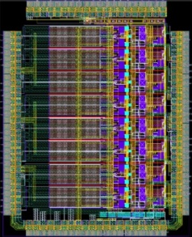
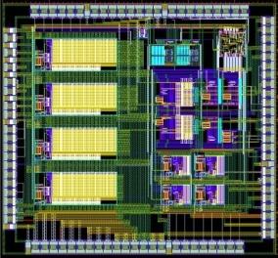
Sensor & Readout electronic
(LAL/LPNHE) →20 People / 12 ETP
  CCD readout chip (ASPIC III, design final: under test since the fall)
  CCD control HV (CABAC I, final design: submitted in May 2014 , CABAC 0 under test since end 2012, ok.)
  FPGA Microcode / full board/CCD control : includes an extended clocking and diagnostic capability for in cryostat optimization and monitoring
  Sensor: Sensor reception test , sensor study , readout optimisation
3 CCD per 1 REB
9 CCD per RAFT
2/CCD - 6/REB
16/CCD - 48/REB
1/REB – 3/RAFT
To DAQ.
(Crate ATCA)
3.12 Gbit/s available for the 0.5 Gb/s needed to read 3 CCD in 2s
18bits ADC
(1Ms/s - AD7982)
+ buffer
FPGA
(Xilinx Vertex 5 )
CCD readout :
16 chanels
CCD
16 Mpixel
DREB
ASPIC
2/CCD - 6/REB
CCD config :
Clocks, Biases, OD
REB : 3/RAFT
CABAC

Slide 9
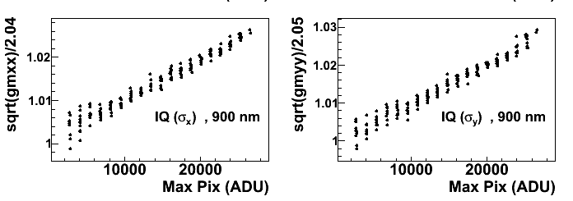
Sensor studies Brighter-Fatter effect
(LPNHE)
  Understanding instrument properties is a key for the LSST science. Our contribution to the CCD and CCD readout allows us to contribute to this sector in an unique way.
  This hardware&science approach has been successful in 2013 with our discovery of the brighter-fatter effect :
    « brighter / fatter » : «the psf of an object is flux dependant » : charge collected in a pixel pushes field lines (=drifting charges) toward neighbor/less filed pixels.
    This effect is present in all CCD , but wasn’t understood/fully identified up to this work in LSST (see for example : arXiv:1402.0725 , new paper ready soon)
    This effect cannot be neglected in lensing studies any “psf analysis” , where “bright” stars are used to constrain the psf of faint objects. We have a frame work to correct this effect ( from studies in LSST,DES and SNL) and today there is also work in DES and HSC collaboration.
σ_{x}
σ_{y}
~Taille de l’étoile →
Flux →

Slide 10
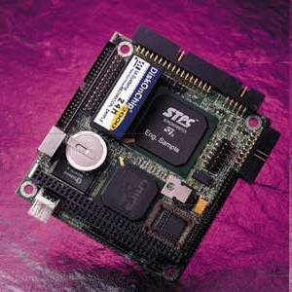
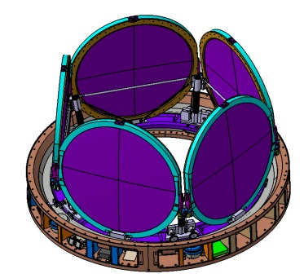
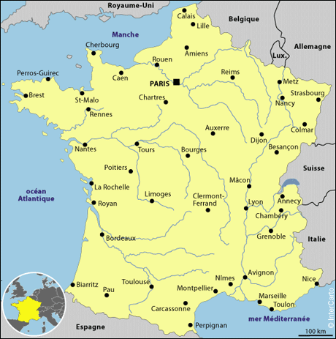
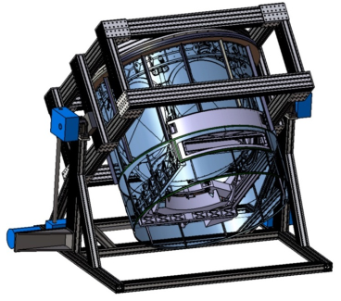
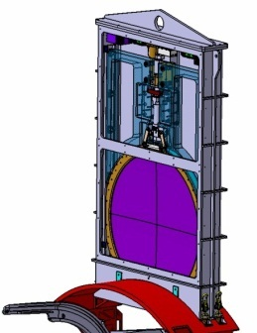
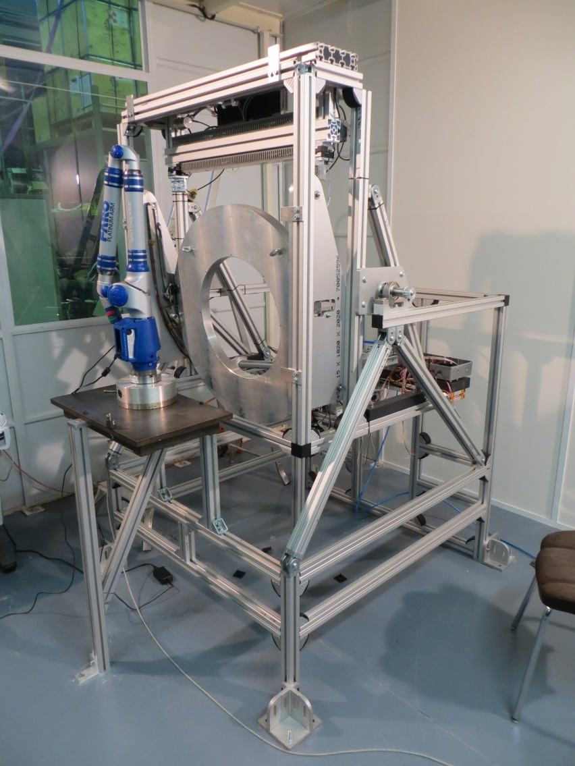
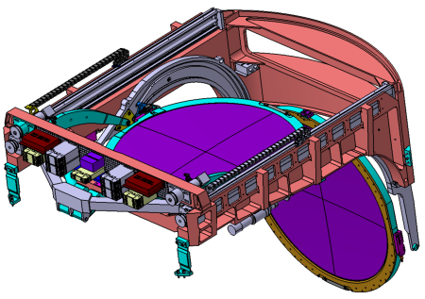
Filter Exchange system
(APC,CCPM,LPC,LPNHE,LPSC)
Filter Control System FCS (APC)
PARIS
Françoise Virieux, PM & Eng
Bernard Amade, Eng
Carousel (LPNHE)
PARIS
Daniel Vincent, PM
Guillaume Daubard, PM & Eng
Christophe Evrard, Designer
Felipe De Matos, Eng
Yann Orain, Designer
Diego Terront, HCU
Full Scale Prototype Test Bench (LPC)
Clermont Ferrand
Guy Reinmuth, PM & Eng
Patrick Lafarguette
Philippe Chassagny
Romeo Bonnefoy
Loader (LPSC)
GRENOBLE
Francis Vezzu, PM & Engineer
E. Perbet, Designer
E Lagorio, Eng
J. Giraud, Analyst
Y. Cargagno, Engineer
Auto-Changer (CPPM)
MARSEILLE
Pierre Karst, PM & Eng
Daniel Labat, Designer
Françoise Rivière, Designer
Patrick Breugnon, Elect Eng
Fabrice Gallo, Fab & Assy
Total Manpower
22 people – 12 ETP
2014 : Single filter test

Slide 11
LSST computing at IN2P3

Slide 12
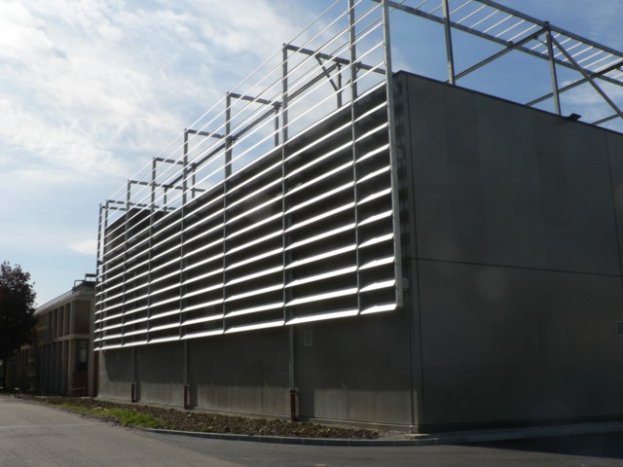
LSST computing at IN2P3 (1/3)
The French scientific community involved in LSST will not have access to computing facilities in the US for science analysis.
Efficient access to the very large LSST dataset will be one of the primary challenges for scientific exploitation, and most particularly for dark energy science
To support running costs/share of the data reduction effort and to ensure competitive data access on this side of the Atlantic – a letter of intent was sent by the IN2P3 director to the LSSTc in December 2011 :
  The CC-IN2P3 will provide CPU and storage resources corresponding to 50% of the LSST needs for the Data Release Processing (level 2)
  The full LSST dataset will be resident at the CC-IN2P3.
This proposal has been elaborated with a strong support from all parties ( LSST , IN2P3 , CCIN2P3 , LSST-France).
This in-kind contribution is evaluated by LSST to be equivalent to a cash contribution of 1-2 M$/year. Significant investment at CCIN2P3 should start in 2017. MOA is under discussion .
CC-IN2P3 new data center

Slide 13
LSST computing at IN2P3 (2/3)
Associated to the processing plan at CCIN2P3 , a computing activity with contribution from different LSST IN2P3 laboratories has been ramping up since 2012 :
Software installation & Hardware ramp-up since mid-2012
Contribution to the summer 2013 LSST data challenge ( SDSS stripe 82) :
    100 TB of data , 1000 jobs in // for ~ 1 month
Contribution from 7 IN2P3 laboratories , 5 FTE in 2013 , regular meeting and common working session . Work in close contact with the US.
Dominique Boutigny, director of the CCIN2P3 up to the end of 2012, is full time at SLAC since summer 2013 (for 2 years). He is coordinating our infrastructure effort at CCIN2P3 and smooth our integration in the LSST computing.

Slide 14
LSST computing at IN2P3 (3/3)
Contribution to the Dark Energy , “3rd level processing”, not discussed/agreed yet
Contribution to the 1-2 level computing started but not formally integrated in the project yet ( from NSF point of view any contribution to the construction should be subtracted to the US budget …), interest/work in DB and job control , ex :
  Evaluation of Qserv / LSST database work has been initiated in 2012 with a grant to our PetaSky project (E.Gangler et al.) within the MASTODONS call .
LSST will produce 15 TB / night , 7 PB of archive / year , 70 PB total at the end
11 PB of storage space on disk (image access /processing cache) at the start of the project , reaching 22-25 PB at the end of the survey
~ 100 TF (10¹² FLOPS) sustained computing power at the start of the survey, which should reach ~ 900 TF in 2029 ( dominated by the object measurement step)

Slide 15
Dark Energy Science Collaboration

Slide 16
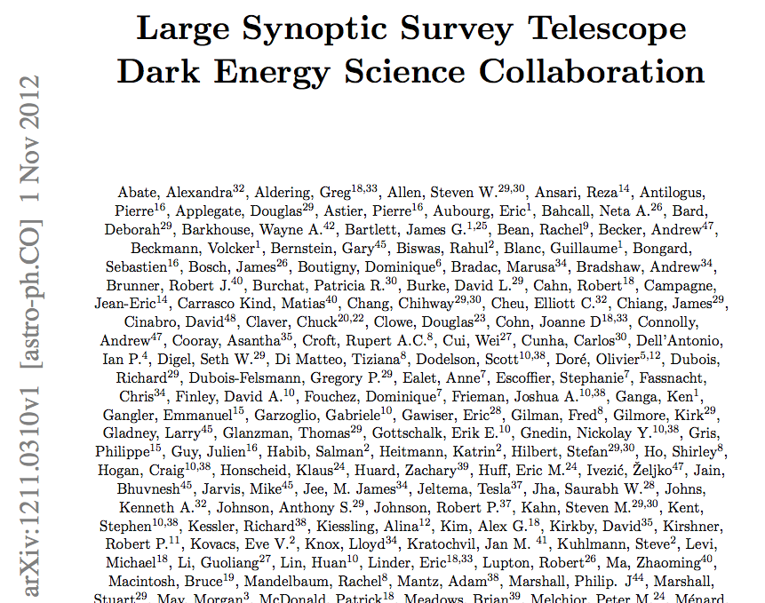
DESC (1/2)
Although the "LSST Science Collaborations" have been successful in producing the LSST Science Book in 2009, we see the DESC as the correct collaboration structure to face the complex challenges of the Dark Energy science
We/IN2P3 actively contributed to the DESC creation:
The French-PI was involved in the initial process (P.Antiliogus)
3 of us attended the founding meeting in June 2012 (P.Antilogus, E.Aubourg, M.Moniez)
One of us sits in the DESC executive committee. (R.Pain)
Over the Summer 2012 as the collaboration took shape with production of a white paper, 23 French members joined DESC working groups with dark energy science tasks involving all major probes, as well as strategic activities in calibration and photometric redshift determination.
in 2014 DESC collaboration will be fully operational (30 IN2P3 scientists applied to full membership), meeting next week at Upenn .

Slide 17
DESC (2/2)
IN2P3 scientist are involved in all the faces of the LSST multi-probe cosmology, from the calibration aspect to the metrology with each DE probe.
46 IN2P3 scientists in LSST-France , 23 already joined DESC in 2012, we should be ~ 30 this year.
Many scientists active in other surveys (Planck, SNLS...) will transfer progressively their activity to LSST over the next 5 years .
SN (LPNHE, CPPM, LPC – 10 scientists)
observing strategies
Synergies with IR observations (EUCLID)
Imroving image subtraction technique
Weak lensing (APC – 3 scientists)
Cosmic magnification
Cluster mass measurements
Weak lensing analysis algorithm
Large scale structures incl. BAO (APC, LAL, LPSC – 9 scientists)
Simulation
Galaxy clusters (APC -1 scientist)
Detection and mass determination techniques
Combination of probes (LAL, CPPM – 4 scientists)
Combine CMB+LSST -> neutrino mass contraint
Statistical analysis (compare bayesian/frequentist...)
Transverse tasks (APC, LAL, LPNHE, LPSC - 12 scientists)
Photometric calibration
Determination of redshifts through photometry
Complementary observations: follow-up

Slide 18
A bit more about the COOB

Slide 19
Large Beam (LB) CCOB specifications
  deliver camera 1st light → bad & dead pixels
  measure the pixel to pixel relative response @ 0.5% level precision entire FP, 0.2% at raft scale
  uniformity/precise measurement of the beam shape
  stable beam, flux variations < 0.1 %
  scan entire FP
  beam Φ ≈ 20 mm
  flux control @ 0.1% level
LB CCOB compatible with clean assembly & test rooms (@SLAC and Chili)
Camera vertically mounted
LB CCOB source integrated on the BOT
LB projector sizes : Φ ≤120 mm, L ≤ 150-200 mm

Slide 20
R&D LB CCOB: Technical solution
    Dark, clean room
    LED source : Lambertian emitter, flat top, Golden Dragon, 120° FOV, λ in each LSST bandwidth, 1.4 W max, welded on Al ThermalClad (actually, blue LED, 470 nm),
    Photodiode to control in real time the illumination (DKD or NIST) TBD
    integrating sphere
    Stable thermal electronics, current control (TBD)
    Large beam scan technique

Slide 21
Large Beam Scan Technique
Each CCD 4×4 cm
For each scan, ~ 4000 overlapped exposures to cover the focal plane
One scan each 2/3 hours

Slide 22
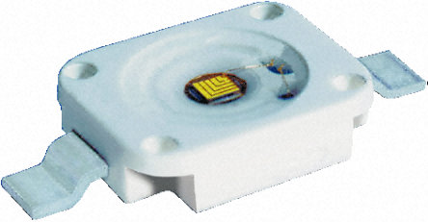
LB light source
OSRAM Golden Dragon® LED
ACTUAL DESIGN : LEDs
Good uniformity & angular aperture
Stability under stable conditions
Beam easy to shape (no optics required)
Emission surface ~0.5 mm²
Emission varies with temperature (per °C): can be controlled + corrected !

Slide 23
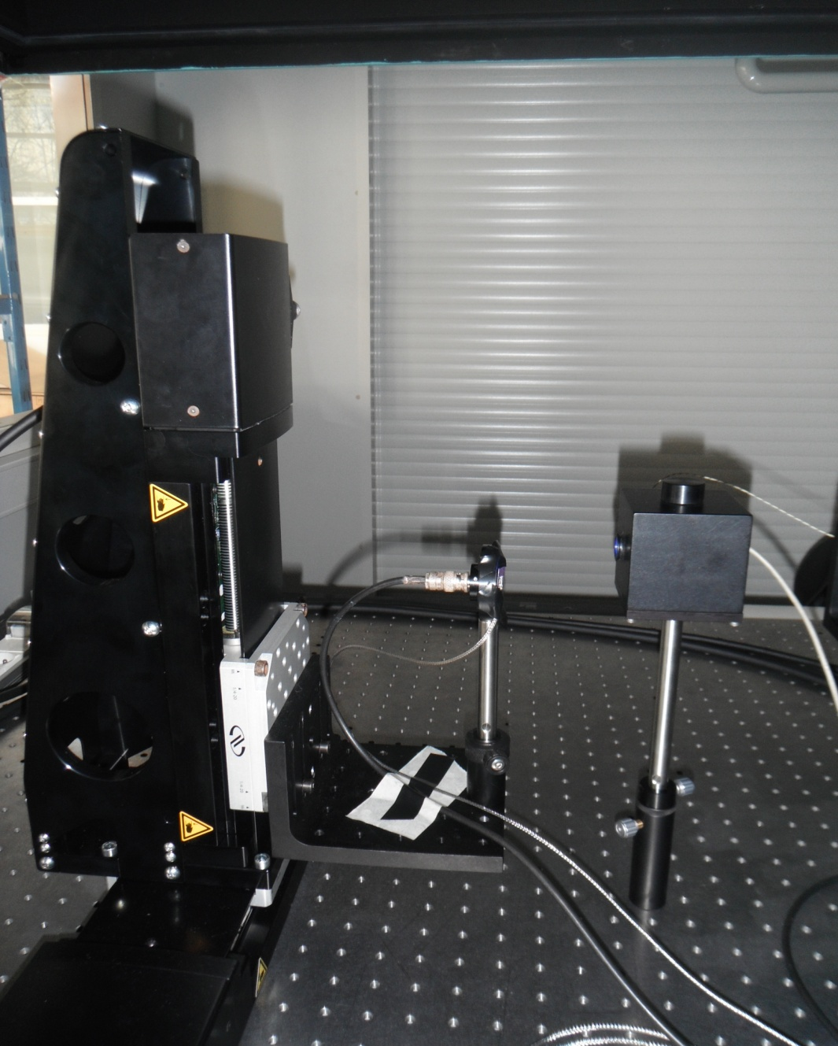
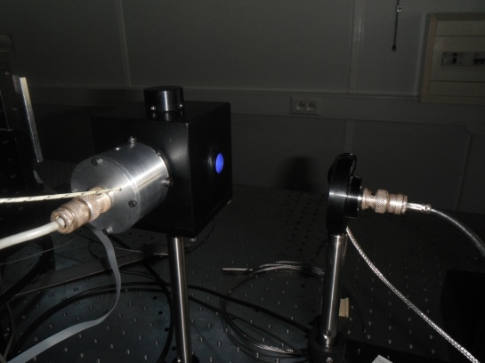
Test bench
Scan in the plane orthogonal to the beam emission
XY µ-positioning tables
Flux control photodiode site
Spectralon® Integrating sphere
LED adaptator
75 mm
NIST photodiode + 100 µm pinhole

Slide 24
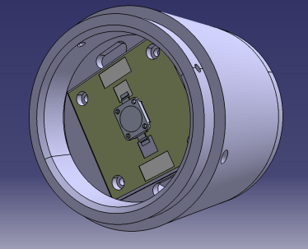
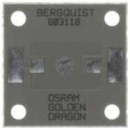
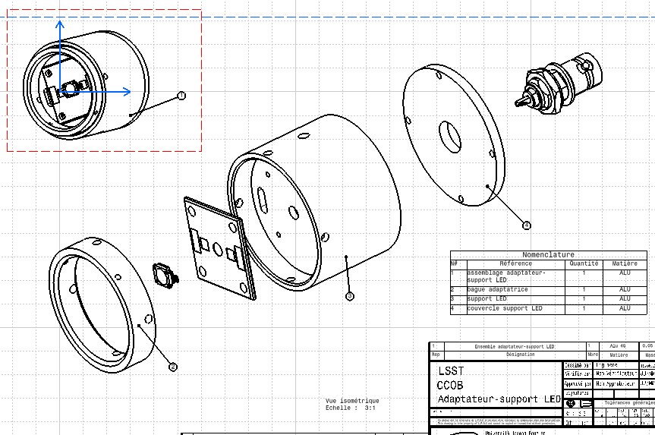
LED projector sphere adaptator
ThermalClad® IMS substrate
CATIA design, manufactured in LPSC
Aluminium support
IMS substrate : 1.3 W/mK thermal conductivity
Power LED lifetimes extended considerably

Slide 25
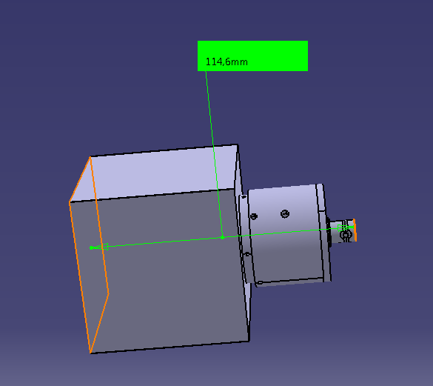
R&D LB LED projector sizes
Integrating sphere, 3 ports, h×l×L = 67×67×67 mm
~ 116 mm long
To cover (continiously or not - TBD) the LSST camera spectral band, we need to use several LEDs (6, 15, ?). The technical solution is to use either a cylinder barrel or a simple rail according spatial constraints.

Slide 26
LabVIEW® & CCS
@ hardware level and for R&D phase, CC software developed with LabVIEW®
      Plug & play software with commercial devices
high level functions + sequencing scenario to define with APC colleagues (CCS development)
for future : communication tests (LabVIEW/CCS) have been preliminary done. To carry on !

Slide 27
Beam scanning
Dimension of LSST camera pixel : 10μm
we want to characterize the beam at a pixel scale
  beam scanning with a calibrated photodiode with a step of ≈ 1 pixel
    our smaller pinhole : 20 μm
  scans with 20 μm steps take lot of time:
    measured current is too low (10⁻¹⁰A) -> we need 10 measures per point
    temperature variation during 1 scan
  is it possible to reduce this time without loosing beam information ?
    larger pinhole
    map reconstruction with an interpolation method ?
  beam shape as a function of intensity
  beam stability as a function of temperature
beam dimension we are interested in ?

Slide 28
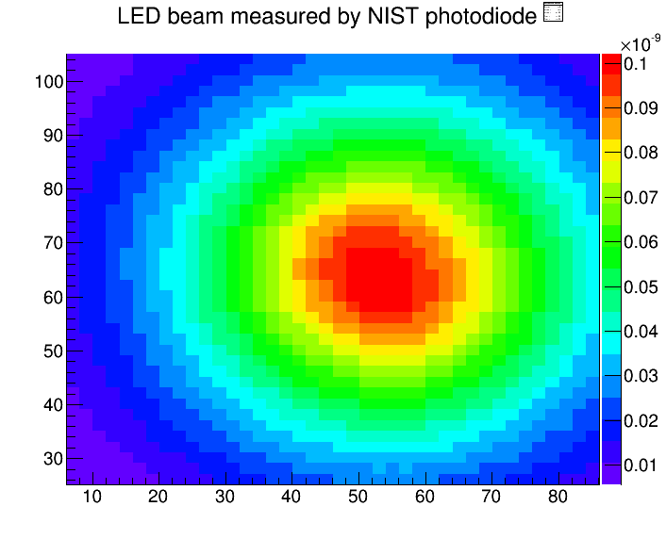
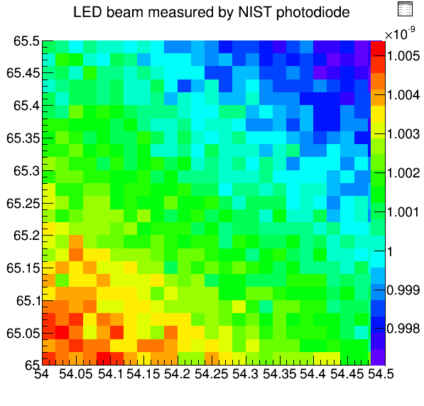
Pinhole size choice (1) : strategy
reference map :
  80x80 mm
  step : 2 mm
  1 measure per point
4 zones :
  0.5x0.5 mm
  step : 0.02 mm
  10 measures per point
y (mm)
x
x
x
x
p1
p2
p4
p3
zone 2
dz
zone 1
dz
x (mm)

Slide 29
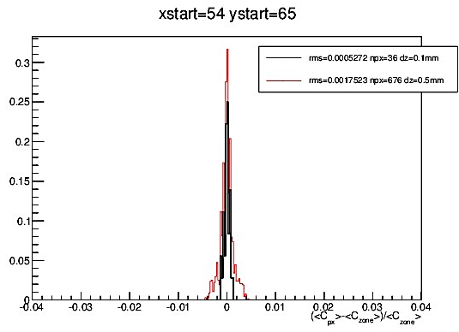
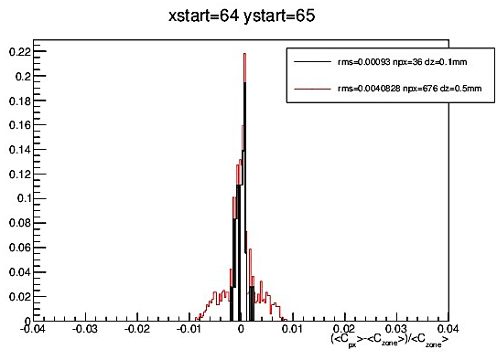
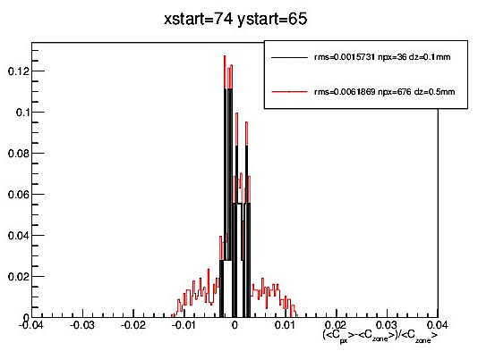
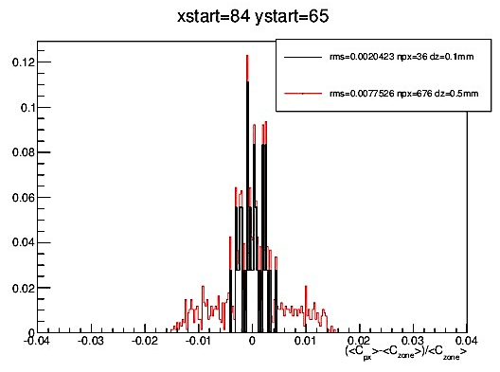
Pinhole choice (2):
flux mean in 1 px / mean flux in the zone
constraint : fluctuation < 2.10⁻³
-- RMS=5.25.10⁻⁴
-- RMS=1.75.10⁻³
-- RMS=9.3.10⁻⁵
-- RMS=4.08.10⁻³
zone 1:
dz = 0.1 mm
Npx=36 px
zone 2
dz =0.5 mm
Npx = 676 px
-- RMS=1.57.10⁻³
-- RMS=6.18.10⁻³
-- RMS=2.04.10⁻³
-- RMS=7.75.10⁻³
pinhole size : 100 μm OK
1 measure per point is now enough.

Slide 30
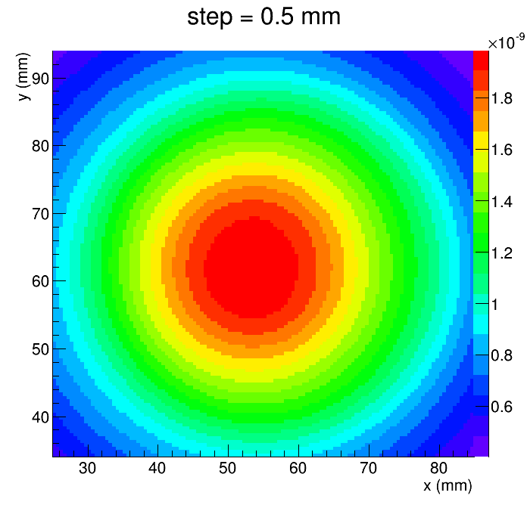
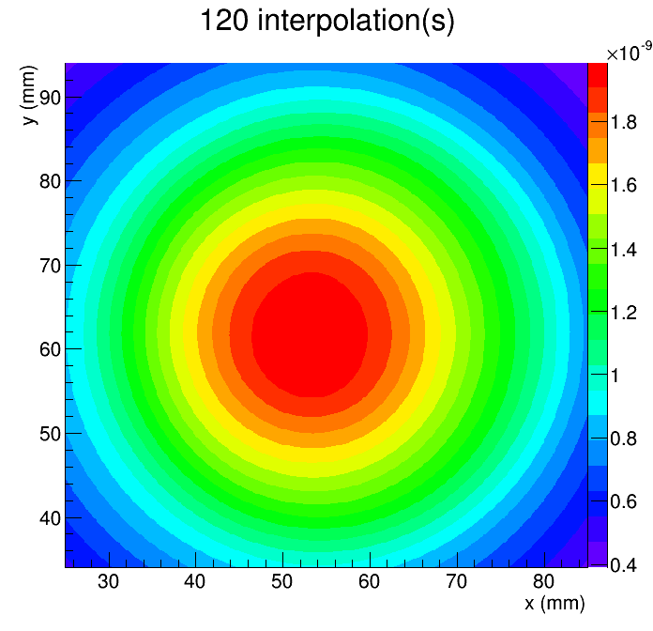
Beam interpolated map
pinhole 100 μm
60 x 60 mm
step : 0.5 mm
time ≈ 8 h
interpolated map

Slide 31
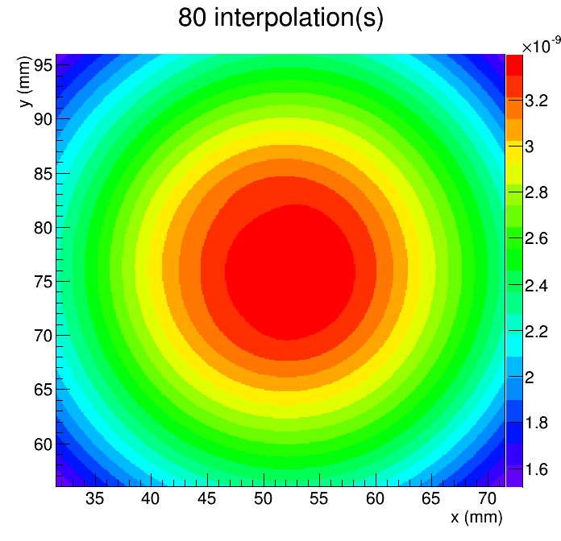
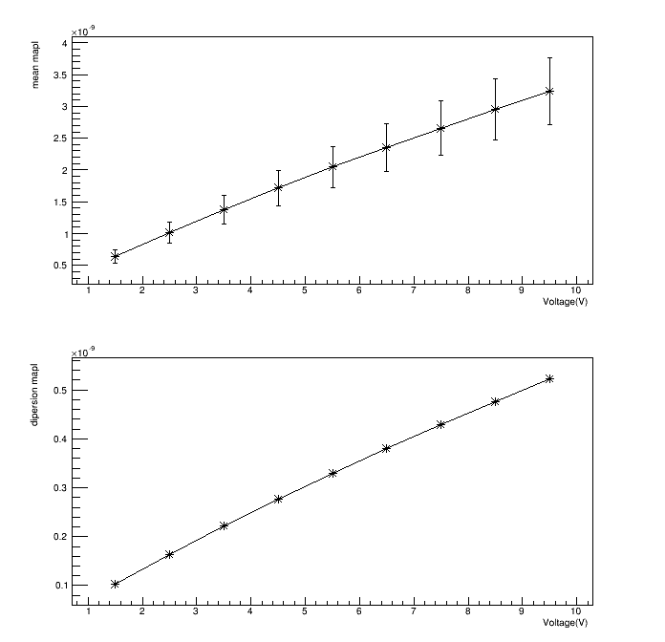
beam shape as a function of intensity
variation of intensity from 1.5 V to 9.5 V, step of 1V
reference map :
  U = 7.5 V, 40x40mm, reconstructed by interpolation
Comparison between each map :
  map normalisation over there
  current mean
  ratio between map
reference map (≈4h)

Slide 32
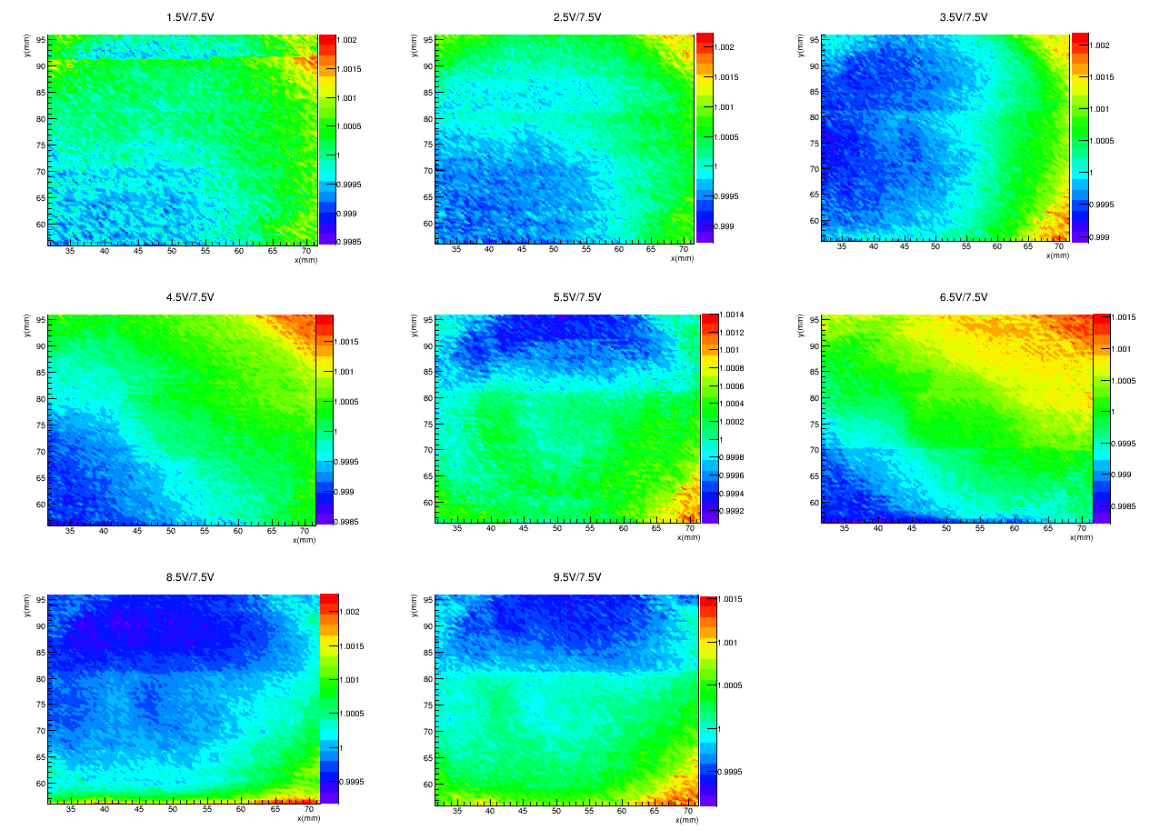
Map ratio
Intensity variation effect is not regular
globally map ratio < 10⁻³
≈ 2.10⁻³ at some points

Slide 33
Conclusion
We want to map our beam with a precision of around 1 LSST camera pixel.
beam scanning with a 0.02 mm step take too much time
  we can use a 0.1 mm pinhole (≈ scanning step of 0.1 mm) without loosing information
We can reconstruct beam map with an bilinear interpolation method, with an optimal step of 0.5 mm.
Beam shape as a function of intensity variation :
  intensity variation from 1.5V to 9.5V with 1V step
  globally variations are smaller than 10⁻³ Ok
  we have some variation around 2. 10⁻³
    40x40 mm beam useful zone is quite optimistic.
Work in progress :
  beam stability as a function of temperature,
  same measures with other LEDs to cover ugrizy filter bands.

Slide 34
Filter Exchange System
Filter Loader

Slide 35
Filter Exchange System -Etapes
PDR en novembre 2013 à Marseille
  Liste de recommandations (RFA)
    Pour le Loader 1 TIER 1, 2TIER 2 et quelques TIER 3
Workshop Filter exchange system en Avril 2014 au SLAC
  Présentation des mises à jour du Loader
  Présentation des premiers concepts des équipements de laboratoire
CD2 en novembre 2014
  Il faudra avoir répondu à tous les TIER 1 et TIER 2
Final Design Review en février 2015
Full scale prototype construit en septembre 2015
Prêt pour intégration 1er trimestre 2018

Slide 36
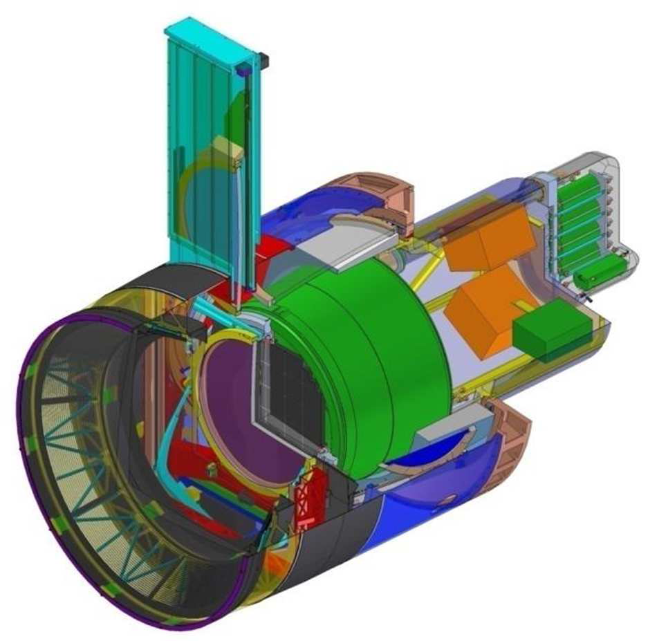
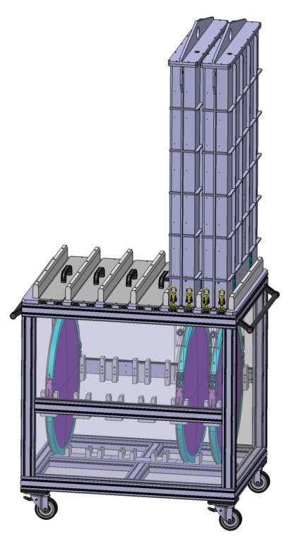
Filter Loader Overview
Loader
Auto-Changer
Storage stand
Transportation
3
Camera
Embedded on the camera
Connected to the camera power
Connected with FCS
Crane; Lifts;
Loader cart (tbd)
Not Connected
1
Inside the clean room
Stand Alone connection
Stand Alone control
3 different phases
2
Notes:
They are 3 different moments during cycle life of the loader. 1) embedded on the camera that means that we are connected with the FCS. 2) connected with the storage stand, located in the clean room and under stand alone control. 3) between those 2 moments the loader will be somewhere hang up on cranes or inside lifts and it is electrically disconnected.

Slide 37
Filter Loader Overview
Les fonctions principals du Loader:
  Charger les filtres depuis le loader sur l’Autochanger (camera)
  Charger les filtres depuis le loader dans la boite de stockage
  Décharger les filtres depuis le l’Autochanger dans le Loader
  Décharger les filtres depuis la boite de stockage dans le Loader
  Proteger les filtres pendant le transport et la manuetention entre la zone de stockage et la caméra between the storage zone and the camera
  Maintenir une propreté equivalente à une classe ISO 5 (FED STD-209, class 100 equiv.)
Fourniture de divers équipements de laboratoire
  Boite de stockage pour 6 filtres
  Stand de maintenance pour 1 filtre
  Chariot de transport pour 2 Loaders
  Outillage divers (manutention, montage…)
Fourniture de toute la documentation associée

Slide 38
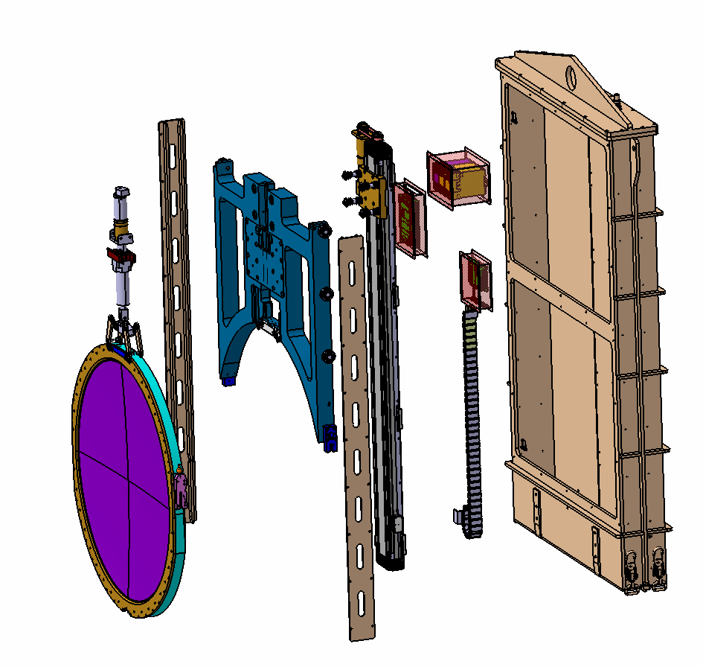
Filter Loader overview
Container
Filter Loader estimated mass (without filter) : 163kg
Electronic boxes
The Filter Loader is composed of :
  The filter clamp system
  The filter carriage system
  The filter loader container
  The control command
Filter Clamps system
Filter Carrier
Linear motion Unit
Rail Guides

Slide 39
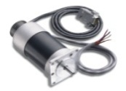
Filter Loader Control Command
PLC Architecture
CCS
Master Control Module
Master Protection Module Safety PLC
Ethernet 1
LPM “Auto-changer”
SAFETY PLC (PLUTO/Gateaway)
Hardware Control
Unit (PC104)
CAN
Inputs
Ouputs
CAN-0
CAN-1
" DIRTY "
POWER 24V
" SAFETY "
POWER 24V
" CLEAN "
POWER 24V
Loader
" SAFETY "
Status
Auto-charger
" SAFETY "
Status
Permit
Interlock
LPM “LOADER”
SAFETY PLC (PLUTO/Gateaway)
CAN
CAN Open Protocol
Inputs
Ouputs
CAN
Power In
Motor
Controller
EPOS 70/10
Relay
Contactor
Carrier
Status from
sensors
CAN
Relay
Contactor
Power In
Motor
Controller
EPOS 24/5
Eric Lagorio / LPSC
11/10/2013
Sensors
Clamps

Slide 40
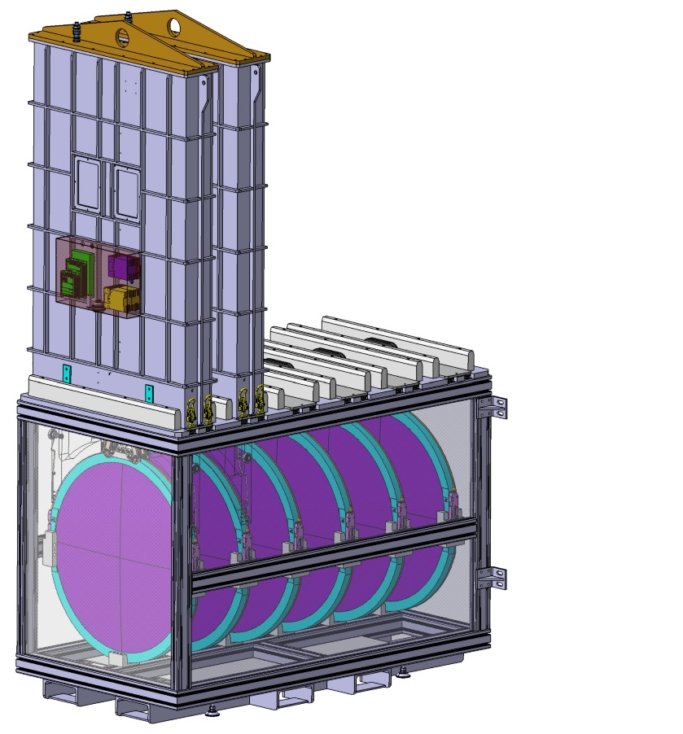
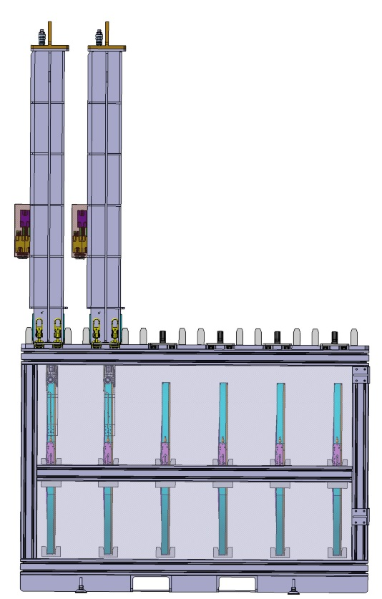
Filter Loader Filter Lab equipment
Storage Box
  Can store 6 filters
  Same connection as the one use for the Auto-changer
  Hermetically sealed
  Designed for clean room use
  Same loading and unloading process as the Auto-Changer
  Can be handle by fork lift in each direction
  Designed for seismic load (to be checked)
Length : 1700mm
Width : 935mm
Height without loader 1295mm
Height with loader : 2795mm

Slide 41
End of Presentation

