Slide 1
Acceptance Studies

Slide 2
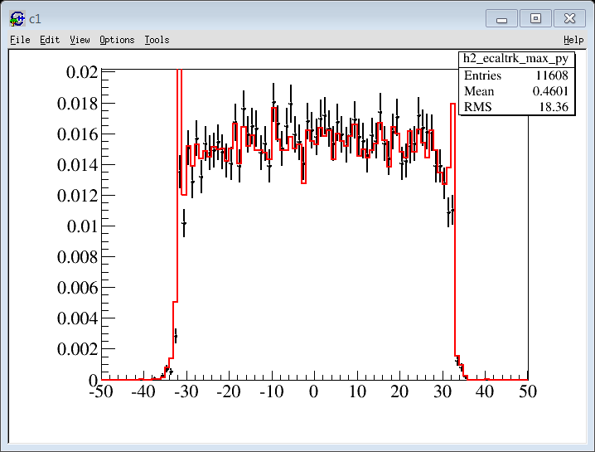
Li’s plot
Data/ MC

Slide 3
Selection
Pass4
N_track = 1
Max Span
Chi2x<10 && Chi2y < 20
No pattern selection (?)
Rig < 0 (Electrons )
|Rig | > 5.
N_trdtrack = 1
TrdRatio[0] < 0.55 (data) 0.8 (MC)

Slide 4
MC : N_ecalshower = 1
| Y_trackextrapol| < 27

Slide 5
MC : Necalshower = 1
| Y_trackextrapol| < 27
Cut on DeltaX & DeltaY
EnergyA > 1

Slide 6
Data: Necalshower = 1
| Y_trackextrapol| < 27
X_ecal
X track
MC in red

Slide 7
+ Cut on DeltaX & DeltaY
+ EnergyA > 1

Slide 8
Rigidity Cut-Off
DATA :
With Rcut
Without Rcut

Slide 9
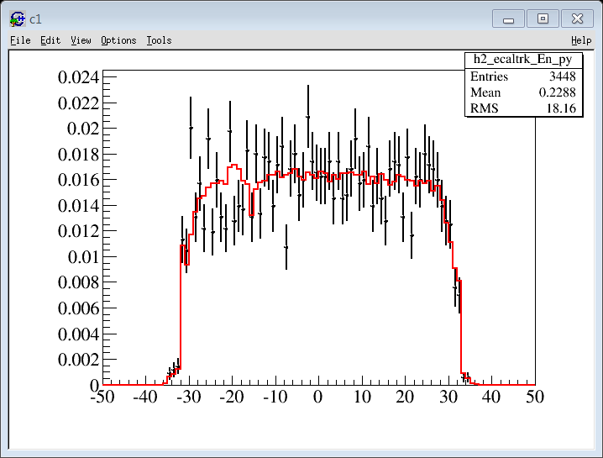
EnA > 30 GeV
MC / Data ( ~ 1 month)
El.pl1.5100.

Slide 10
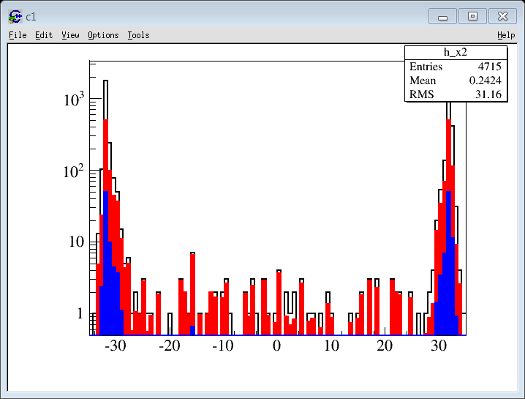
MC : el.pl1.1002000
|Y | < 25cm (contained)
enD < 80 GeV
Red with weight :
Pow(Mom,-1.7)/Pow(100,-1.7)
Blue
Weight + Int(1000,2000) = 40 evt (~ exposure time)
EcalEntry[0]
ecalEntry[0]
EcalEntry[0]

Slide 11
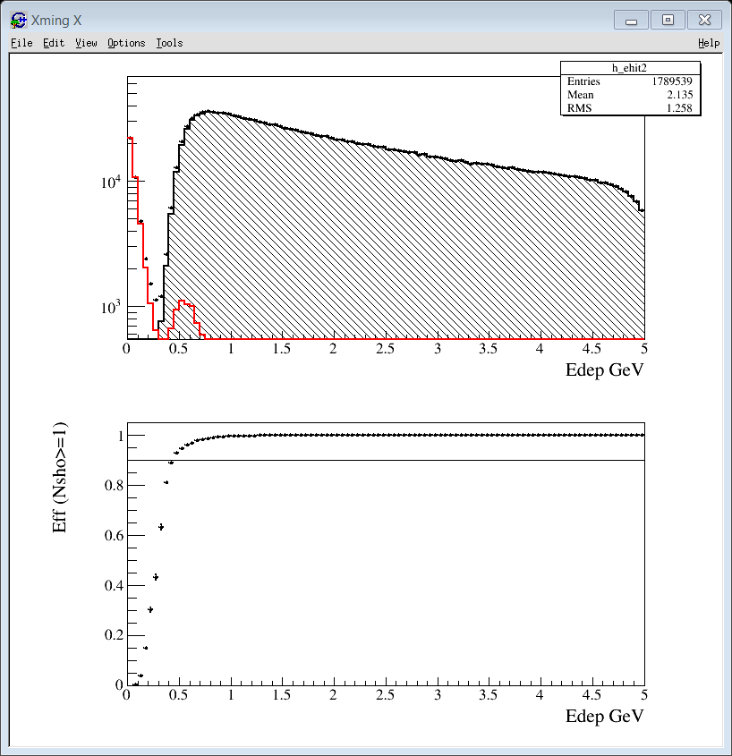
Preselection : Nsho >= 1 ?
Data 10 days june 2011
ECAL :
- Edep = Sum_Ehit
- CoGx & CogY : 10 cm from edges
Nsho ≥ 1
1! TrdT & TrdL < 0.6
1! TrT /
MaxSpan
Chi2X<5 & Chi2Y<10
Rig < 0
|rig| > 0.5 GeV
100 % above 1 GeV

Slide 12
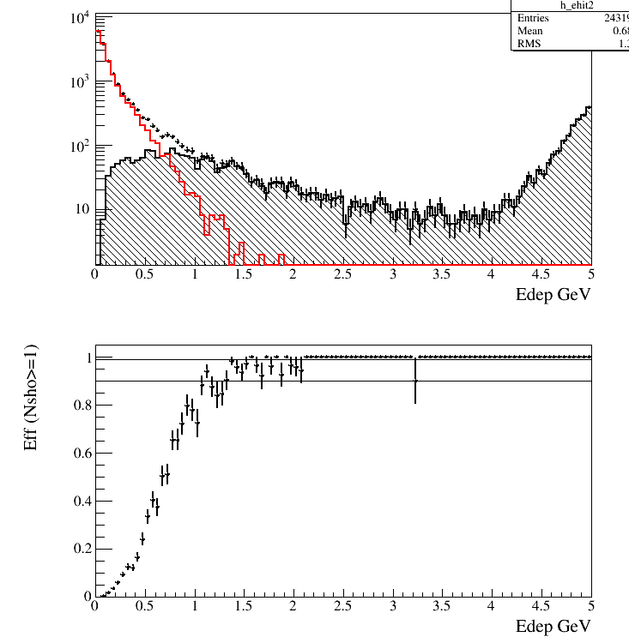
MC : 5 to 100 GeV

Slide 13
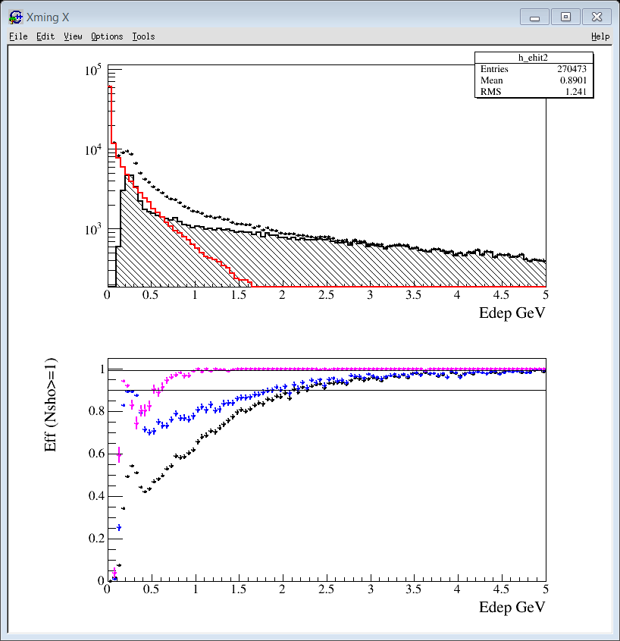
Nsho >= 1 ?
Data 10 days 2011
+ TRACK EXTRAPOLATION inside ECAL
+ betah > 0.75

Slide 14
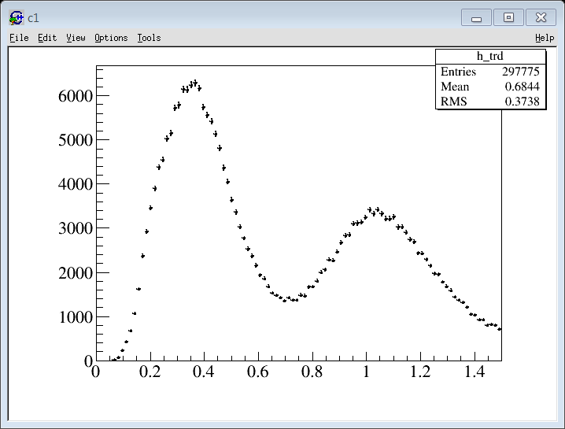
NTRACK > = 1 ?
1 month / June 2011
MC : 5-100 GeV
1! Ecal Shower
EnD > 5 GeV
No Ecal Fiducial Cut ….
Ese > -0.05
1! TrdT
TrdL (EA) < 0.55
Extrapolation :
TRD -> Ecal : 5 cm
Ecal (EMDIR) -> TRD : 20 cm

Slide 15
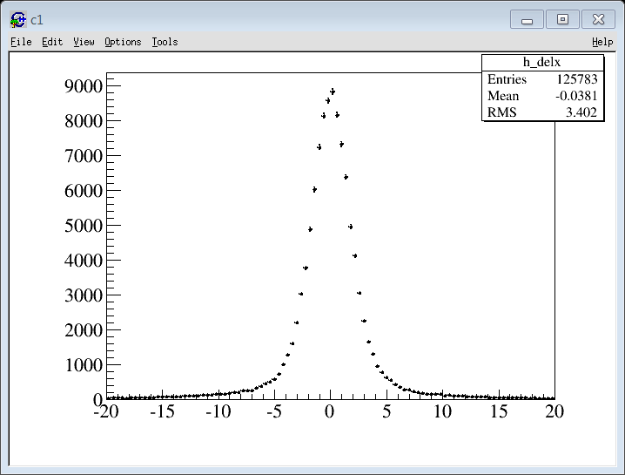
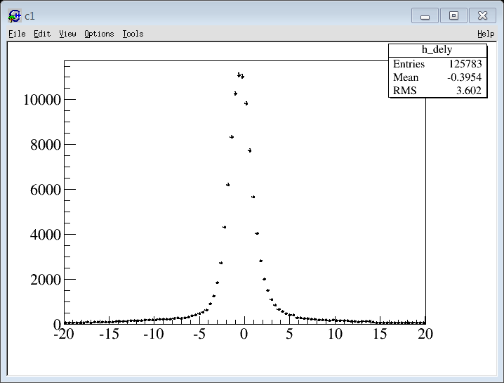
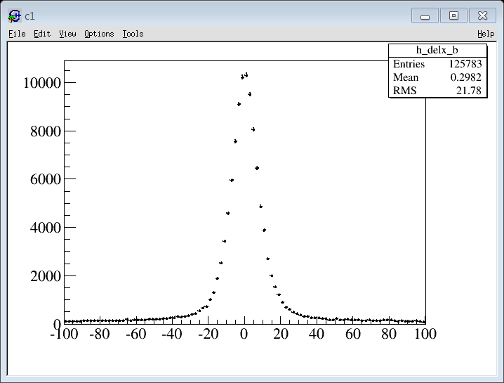
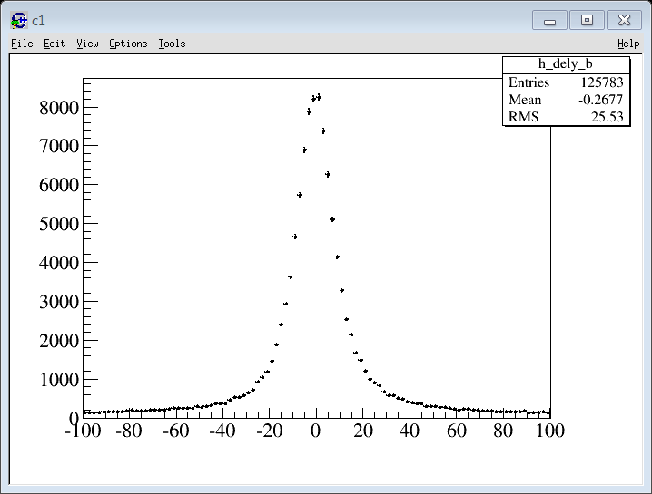

Slide 16
Acceptance Cut
TRD sel
First Layer

Slide 17
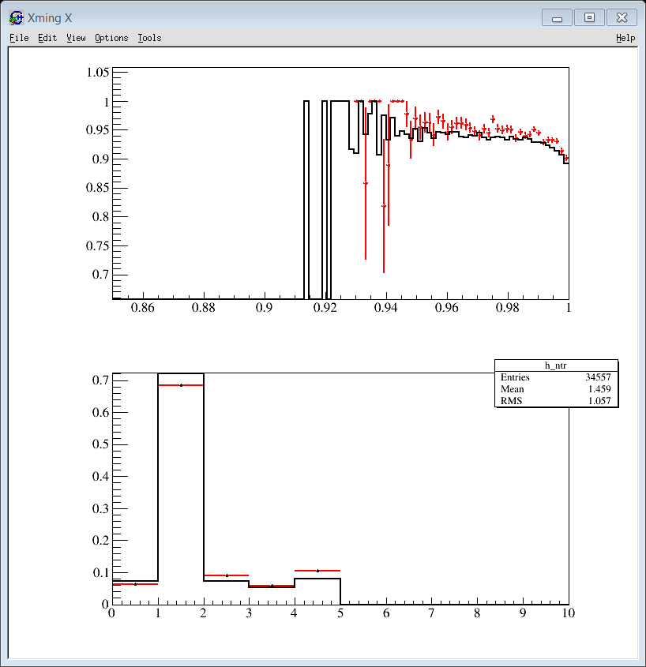
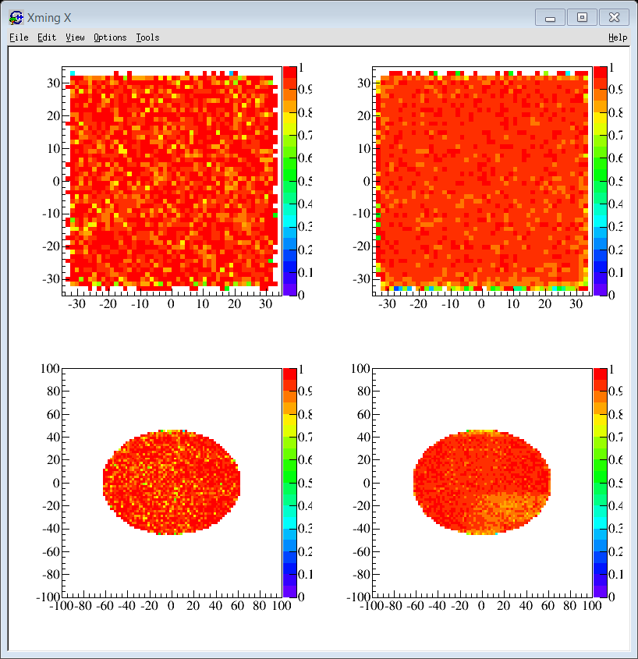
Eff (Ntr > = 1)
ECAL
Cos Theta (Ecal)
TRD
 | Ntr = 0 | Ntr = 1 | Ntr > = 1
Data (>5 GeV) | 6.28 | 72.94 | 27.06
MC : 5- 100 GeV | 7.33 | 77.72 | 22.28
Data/ MC | 0.857 | 0.939 | 1.22
Ntr (any track)

Slide 18
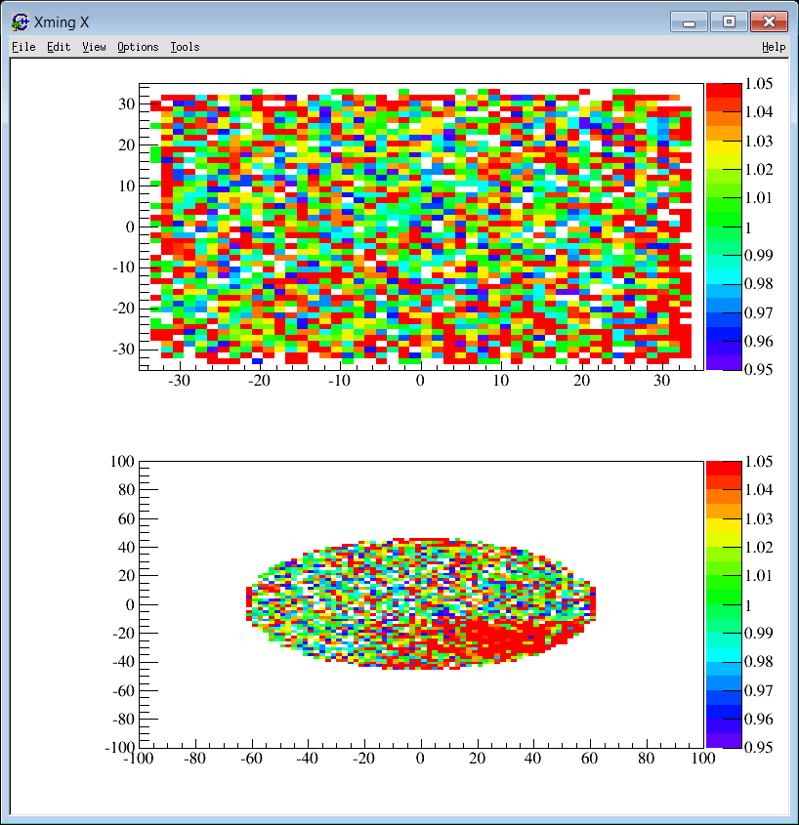
Eff_data/Eff_MC

Slide 19
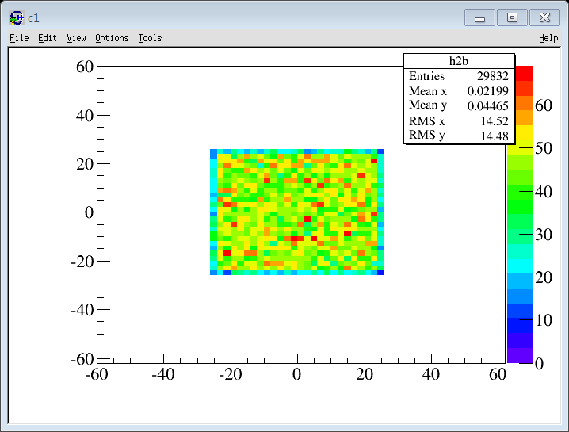
NTRACK > = 1 ?
TOY MC
1 month / June 2011
MC : 5-100 GeV
1! Ecal Shower
EnD > 5 GeV
Ecal Fiducial Fid : 25cm
Ese > -0.05
TrdT >= 1
TrdL (EA) < 0.55
Extrapolation :
TRD -> Ecal : 5 cm
Ecal (EMDIR) -> TRD : 20 cm
Angle in space [pi, pi+0.05]

