Slide 1
PisaEcalBDT v.s. ESEv3
Li.Tao and Jie.Feng

Slide 2
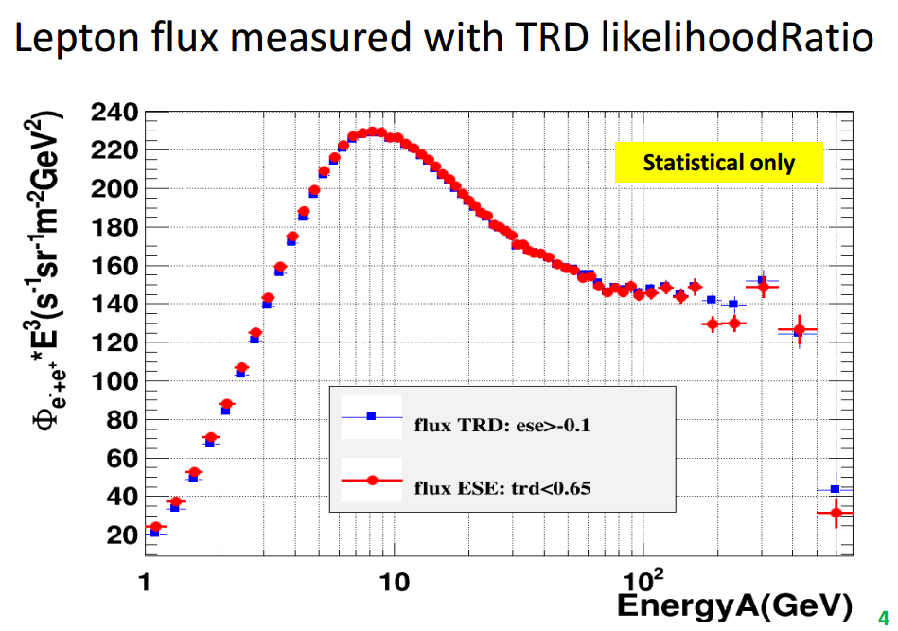
Motivation
By Li, 14 May

Slide 3
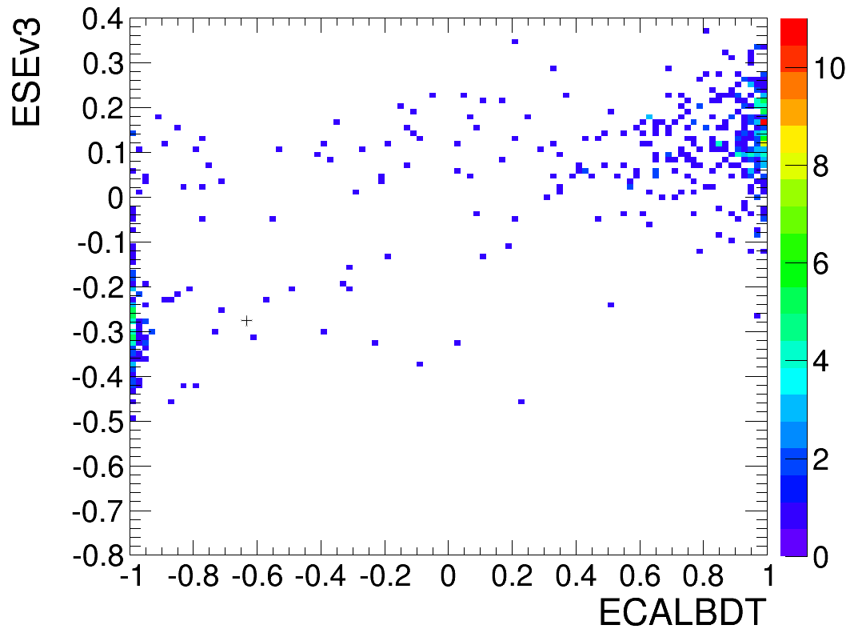
260~350GeV (rig<0)
23
352
17
(23-17)/352=1.7%

Slide 4
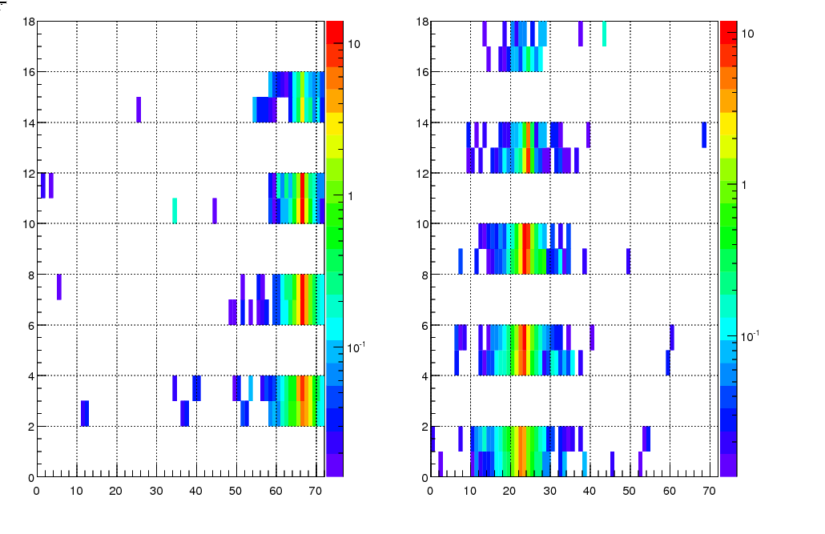
Esev3 proton-(1/3)
Proton?

Slide 5
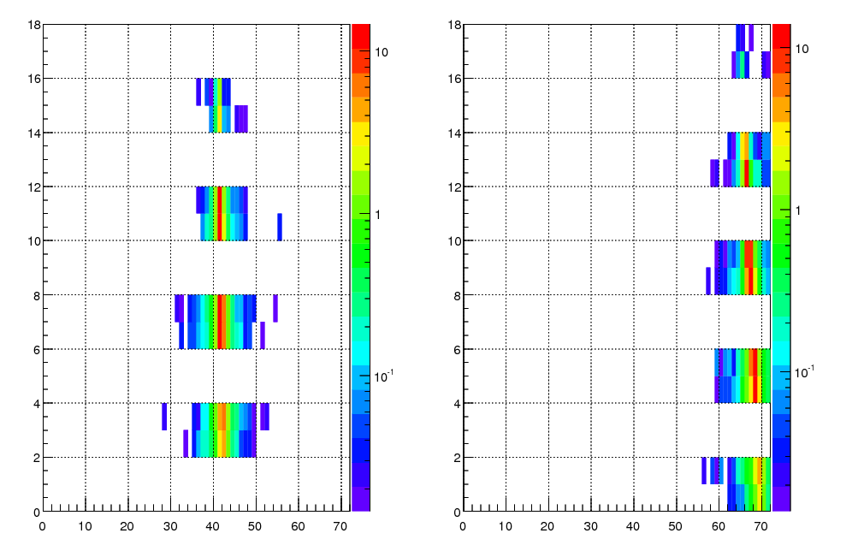
Esev3 proton-(2/3)
Side leakage electron?

Slide 6
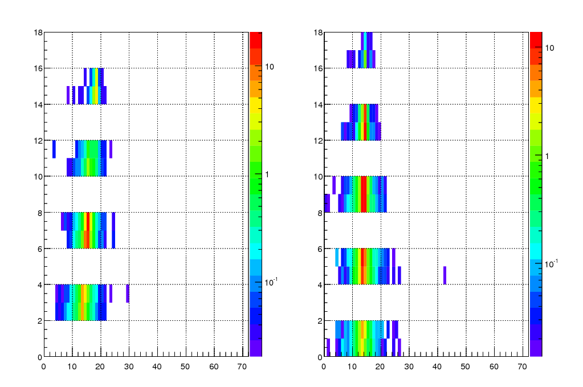
Esev3 proton-(3/3)
Shower axis go through dead cell

Slide 7
Sum up
These shower looks like proton:
1) proton
2) Side leakage electron
3) Shower axis goes through dead cell
We can correct 2) and 3) by a new function getCorrectedESEv3(EcalEntry, EcalExit).

Slide 8
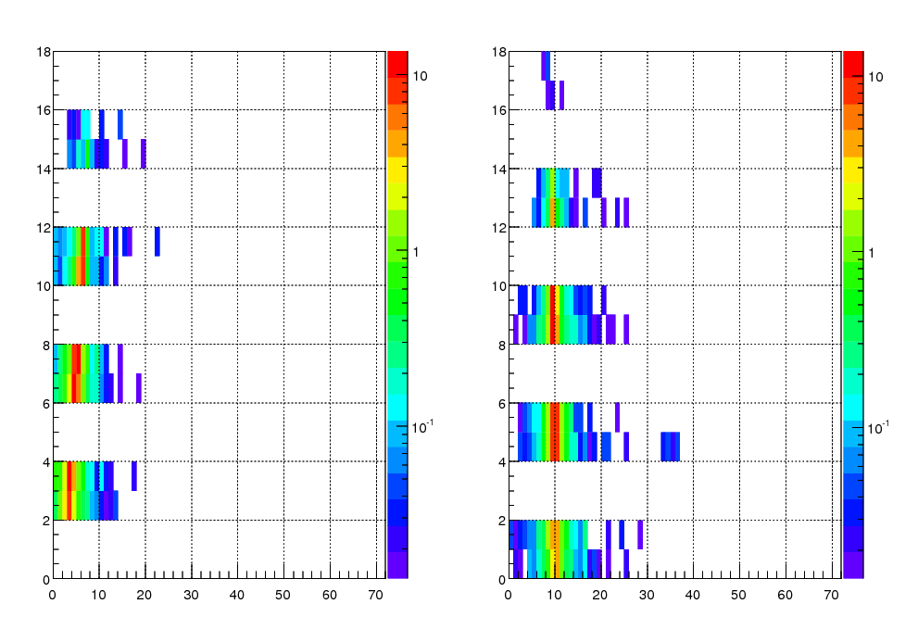
ECALBDT proton
Noise or MIP?

Slide 9
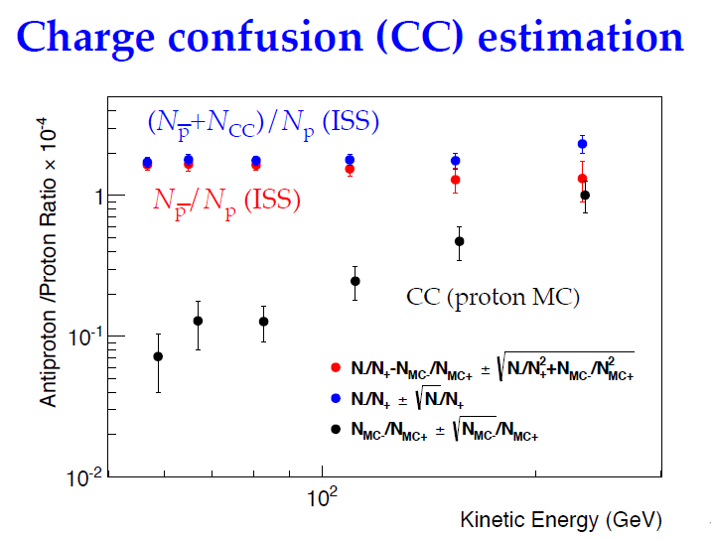
Antiproton
Uncertainty is dominated by statistical one.
By S. Haino, Oct 2013

Slide 10
Current studies Status and Plan
[_]Studies from other groups:
Cut on
TRDLikelihoodRatio>0.7 && EcalBDT<-0.8
To select proton and antiprotons
Fit on Data to get charge confusion.
Pure sample and low statistics.
[_]Plan:
Cut on TRD and 2D(ESEv3 and TrkBDT) fit on Data.
Higher statistics but more bins to fit.

Slide 11
First try
Pre-selection from IHEP-MIT study ( Oct. 2013)
1 Full-span track, XY-hit on each tracker plane
1 shower
1 TRD track
4 layers of TOF reconstruction
0.8<QInner<1.4
0.8<TOF β<1.2
Tracker external alignments agree
ecalbdt<-0.8
ECAL-tracker match
TRD EPLikelihoodRatio>0.7
Above cutoff

Slide 12
First try
My Selection:
1 shower
4 layers of TOF reconstruction
0.8<QInner<1.4
0.8<TOF β<1.2
ecalbdt<-0.8
ECAL-tracker match
TRD EPLikelihoodRatio>0.7
Above cutoff
ECALEntry&Exit cut
Q_tofu<1.5
Other patterns except fullspan.
Need to do:
1 Full-span track
XY-hit on each tracker plane
1 TRD track
Tracker external alignments agree
Magnet temperature correction

Slide 13
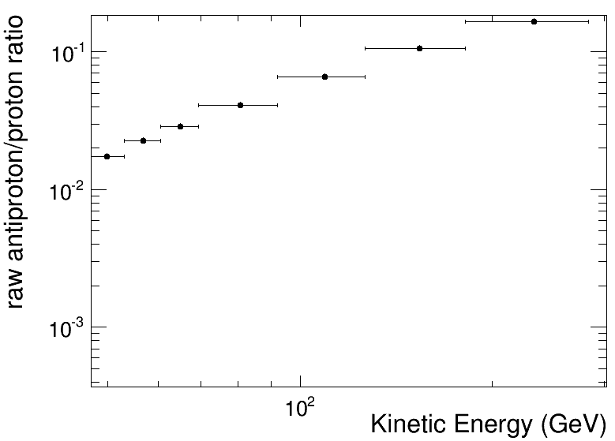
First try- No full span
Without full span or new alignment, the contamination from proton is too large.
Waiting for the new alignment. Only using full-span.

Slide 14
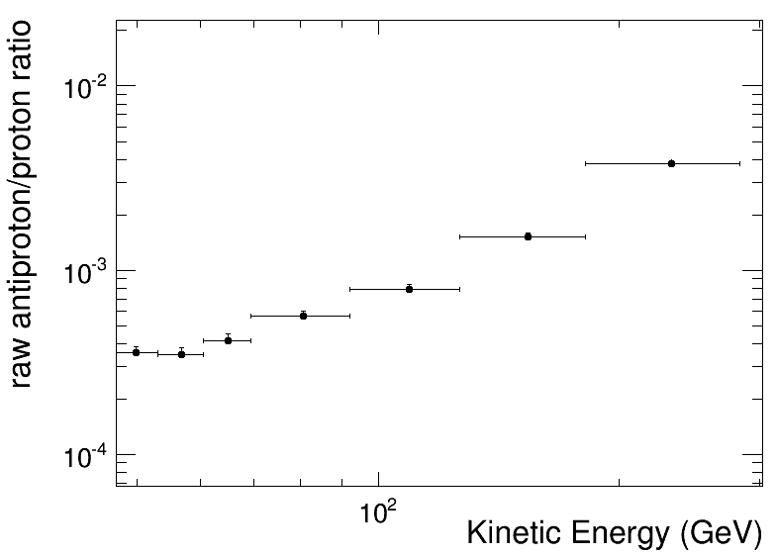
First try- full span
Alignment, temperature correction and 1 TRD track needed.

Slide 15
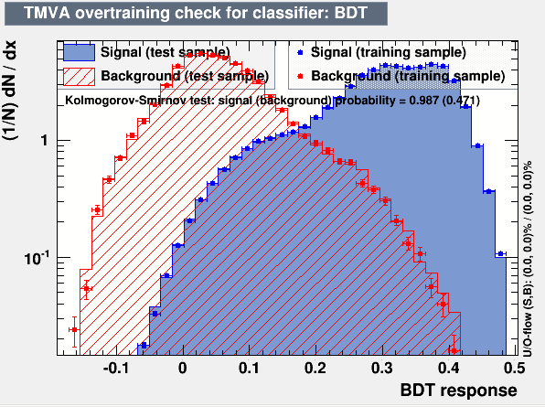
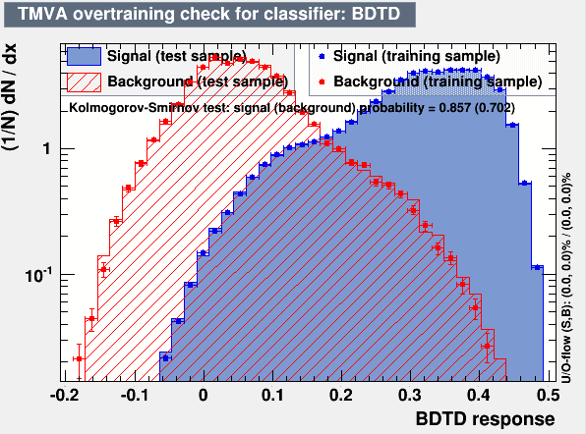
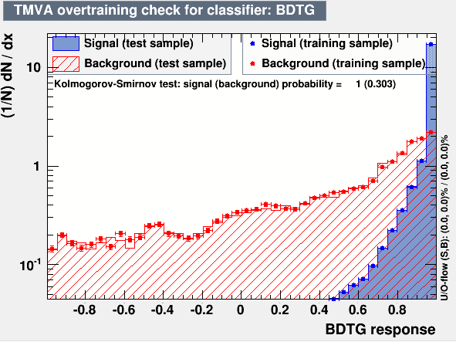
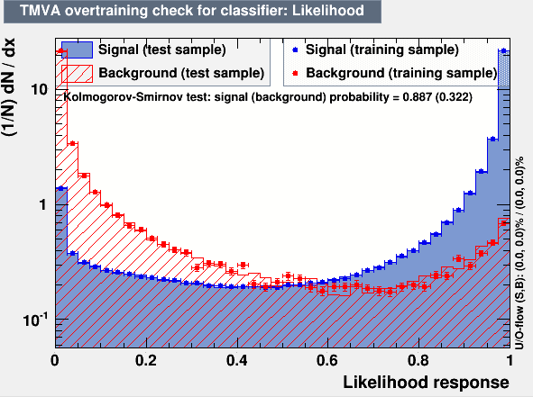
TrkBDT-Proton(on going)
TB 400GeV Protons:

Slide 16
Other plans
Develop multi-valued Decision Trees to count protons, antiprotons and electrons.(at least 3 months)
Use other tools to cross check.( ex. TSplot suggested by Li).

