Slide 2
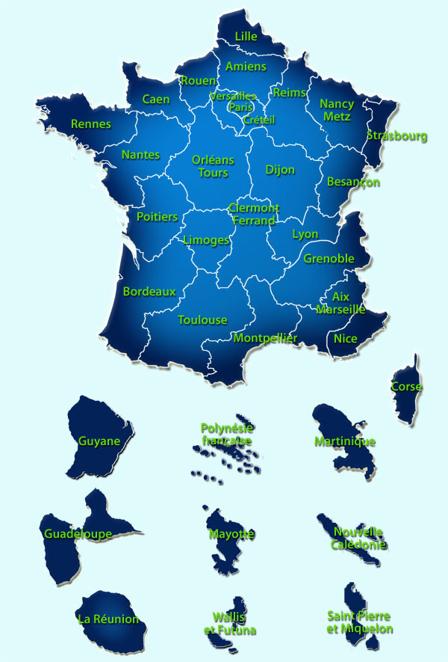
Key data on french Universities
First french university was created in Paris in 1200 – La Sorbonne
Today, French university is composed of :
75 universities
56 600 assistant-Prof. or full Prof.
40% are working in Sciences & Medecine
Women represent 22% of Full Professors and 43% of Assistant Professors
2 400 000 students in France :
1 460 000 students in 2012 in universities
250 000 in BTS
82 000 in “Classe Préparatoires”
134 000 in engineer schools

Slide 6
1e

Slide 12
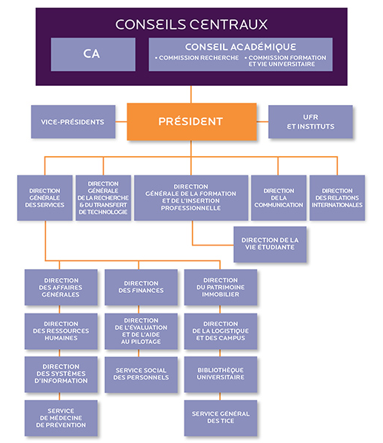
Organisation @ UPMC

Slide 13
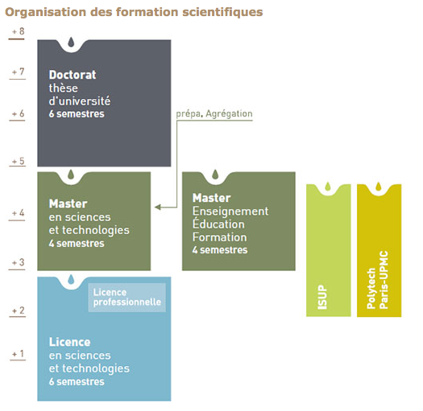
Curriculum @ UPMC

