Slide 1
Computing in IHEP
Yaodong Cheng
IHEPCC
10 June 2014

Slide 2
Outline
IHEP
IHEP-CC
My interest topics

Slide 3
IHEP at a Glance
~ 1400 staffs, ~ 400 students (master and Ph.D.), ~ 400 visitors
Budget：~ 1.1 B RMB/year
The largest fundamental research center in China with research fields:
Particle Physics Experiments
Theoretical Physics
Cosmic Ray/Astrophysics experiments
Accelerator Technology and applications
Synchrotron radiation facility
Nuclear analytical technique
Multiple Discipline research
Computing and Network application
…

Slide 4
Large science facilities
IHEP serves as the backbone of China’s large science facilities
In operation
Beijing Electron Positron Collider (BEPCII)
Beijing Spectrometer (BESIII)
Beijing Synchrotron Radiation Facility (BSRF)
Yangbajing Cosmic Ray Observatory: ASg & ARGO: tibet
Daya Bay Neutrino Experiment: Guangdong
Under construction
China Spallation Neutron Source (CSNS): Guangdong
Hard X-ray Modulation Telescope(HXMT)
Accelerator-driven Sub-critical System (ADS) : Guangdong
Jiangmen Neutrino Underground Observatory (JUNO): Guangdong
Under planning
Beijing Advanced Photon Source(BAPS), LHAASO, XTP, HERD, …
Notes:
High Energy cosmic Radiation Detection (HERD) onboard the China’s Space Station

Slide 5
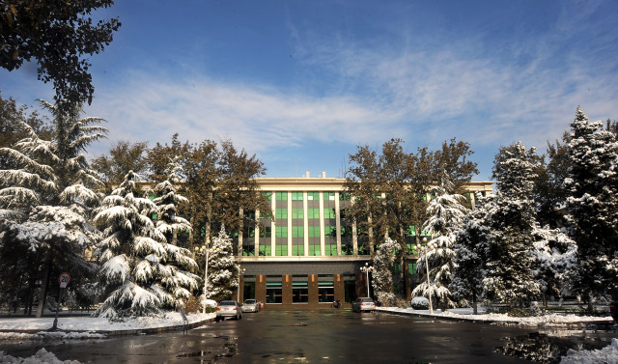
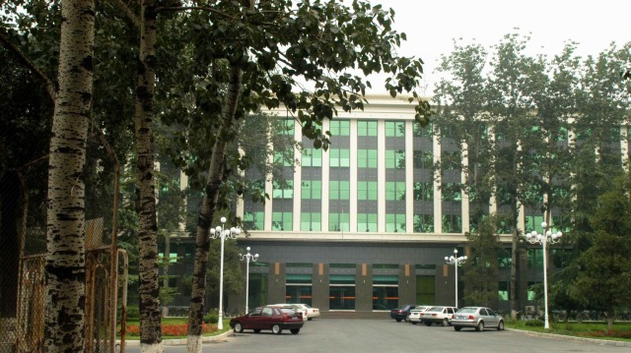
Campus Scenery
Main Building

Slide 6
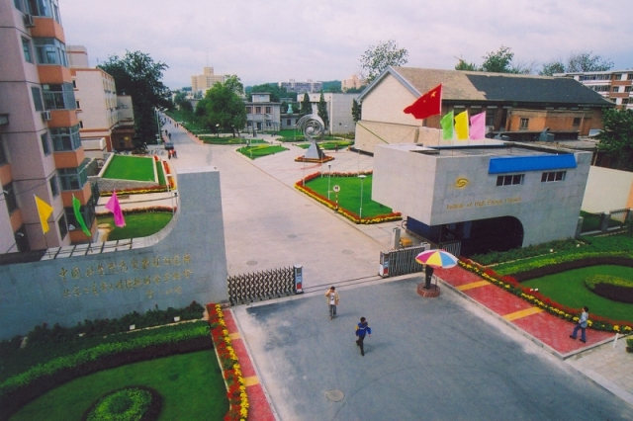
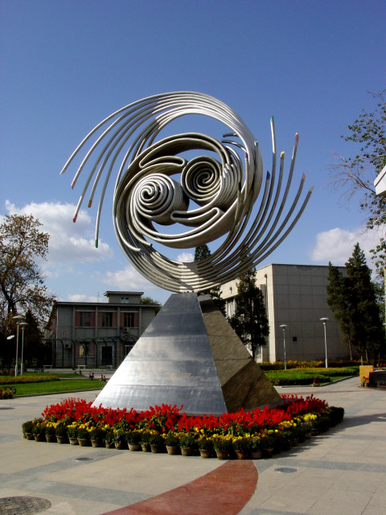
East Gate of IHEP
IHEP logo Sculpture

Slide 7
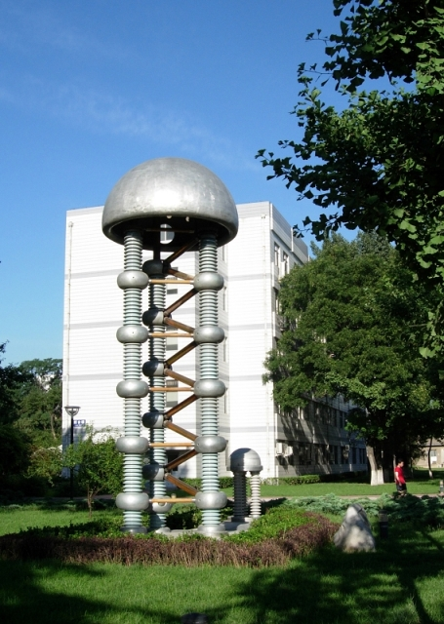
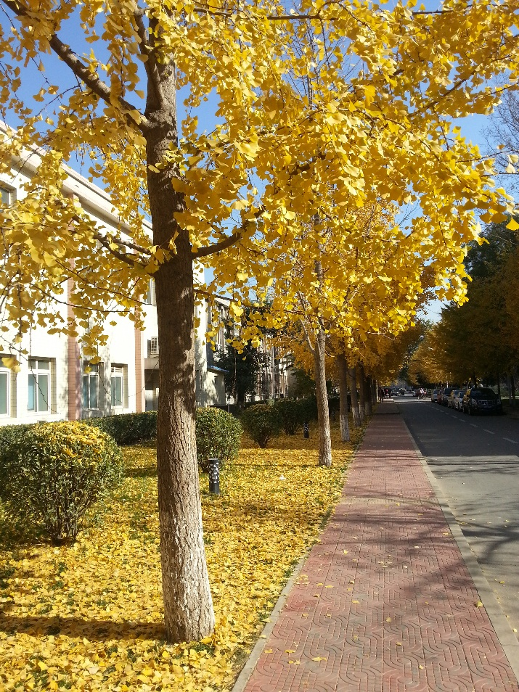
High voltage multiplier
Ginkgo Avenue

Slide 8
IHEP Computing Center
The Computing Center was created in 1980’s
Provide computing services to BES, the experiment on BEPC
Rebuilt in 2005 for the new projects:
BES-III on BEPC-II
Tier-2’s for ATLAS, CMS
Cosmic ray, neutrino and other experiments
38 FTEs, half of them for computing facility

Slide 9
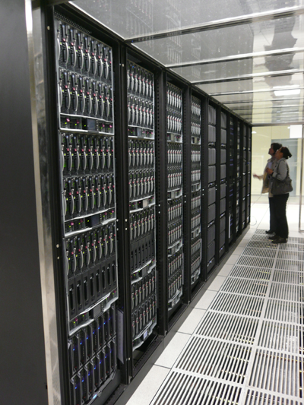
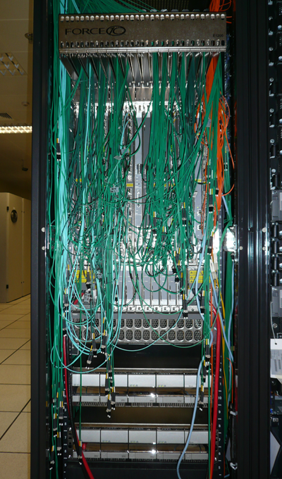
Local Computing Resources
~9000 CPU-cores for local experiments (BESIII, YBJ, …)
Scheduler: Toque 2.5.5 + Maui 3.2.6
Support serial jobs, MPI jobs and GPU jobs
Blade system, IBM/HP/Dell
Blade links with GigE/IB
Chassis links to central switch with 10GigE
PC farm built
with blades
Force10 E1200
Central Switch

Slide 10
Storage Architecture
Computing
nodes
…
1G
10G
HSM
（CASTOR）
Shared File systems
(Lustre, Gluster, NFS, …)
Storage
system
10G
mds
Name Server
hardware
Disk pool
HSM
OSS
OSS
Tape pool

Slide 11
Storage -- Lustre
7 file systems share a similar ( commodity server DAS SATA disk arrays ) architecture, totally 7 MDSs,34 OSSs, 3.3 PB
5 used for physics data of different experiments, 1 for individual data, 1 for temporary data storage

Slide 12
Storage - Gluster
No metadata server architecture
More scalability, no single point fault
Used for YBJ experiment
5 IO servers, 39 bricks, 315 TB
Monitoring: Add new Nagios monitoring plugins to check brick target status
Directory consistency problem when user mkdir and rmdir one directory frequently
We have to handle this manually

Slide 13
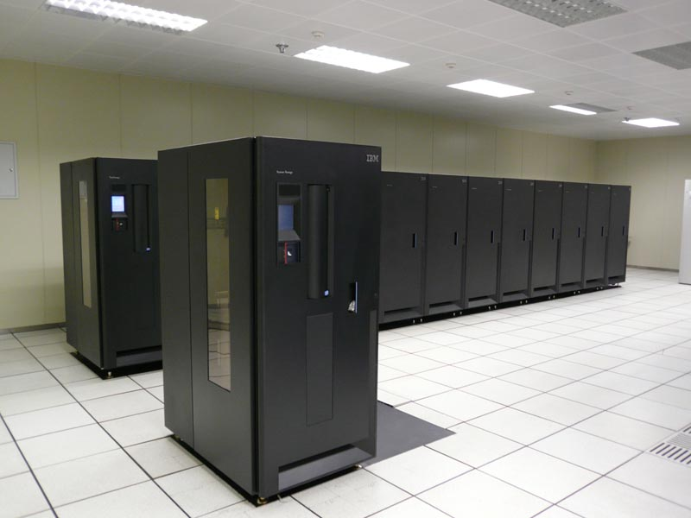
Storage - CASTOR
Hardware
Two IBM 3584 tape libraries
~5800 slots，with 26 LTO-4 tape drivers
10 tape servers and 10 disk servers with 200TB disk pool
Software
Customized version based on CASTOR 1.7.1.5
Support the new types of hardware
Optimize the performance of tape read and write operation
Network
10Gbps link between disk servers and tape servers
2.4PB, 4.5M files currently

Slide 14
BEIJING-LCG2 Site
WLCG Tier2 site for CMS and Atlas
2116 CPUs and 640TB disk totally
Some disk are degraded, will be replaced soon
All grid server will be replaced this year
Old server had been run over 5 years
EMI3 update
Updated: Cream, WN, Argus, BDII, Myproxy
To be updated: dCache, DPM, LFC, APEL,
All Nodes upgraded to SL6.5

Slide 15
My main work experiences
Development of WLCG data management middleware during my visit CERN IT LCG-GD group in 2005
Modified CASTOR 1.7.1.5 to support LTO4 tape device, fast data migration between tape and lustre, and other functions
Gluster file system research and deployment, added some valuable functions, including unified file distribution, multiple layout versions and so on.
Research on SSD cache and small file storage to reduce the response time in case of high-concurrency access
Build a system successfully with Gluster and flashcache to support 50 billion small files (30kb average) for one commercial company
Build IHEP cloud infrastructure with Openstack
Notes:
millisecond

Slide 16
My interest topics
Distributed file system management
Each file system has advantage and disadvantage, which one is best or suitable for the applications
Cloud storage promotion
cloud storage like s3 or swift has more scalability, but isn’t POSIX-compliance
Is it a trend for HEP computing?
Will the user who always uses file system adopt the new method?
Cloud infrastructure management
Openstack is enough for our IaaS services?
Which storage will support VM images storage and immigration? Is CEPH OK?
How to integrate virtual machine into existing computing system? Network planning and VM deployment

Slide 17
Thank you for your attention

