Slide 1
France China COLABORATION In HIGH ENERGY PHSYICS: PAST & FUTURE
Olivier Martineau-Huynh
IHEP visit to LPNHE – June 20, 2014

Slide 2
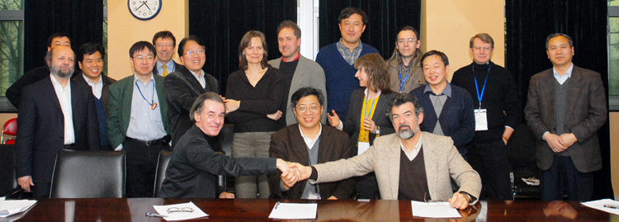
France China Particle Physics Laboratory
FCPPL agreement signed in 2007.
Goal: structurate and promote collaboration in HE physics fields between France and China.
First directors: Jin Shan (IHEP) & Lydia Roos (LPNHE). Since 2011: Chen Gang (IHEP) & OMH (LPNHE)
Jin Shan
(IHEP)
Lydia Roos
(LPNHE)
See Esthere Garnier’s talk @ CPPMarseille next week
François Le Diberder
(IN2P3)
Chen Hesheng
(IHEP)
Bruno Mansoulié
(CEA)

Slide 3
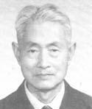
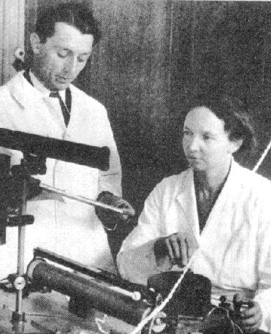
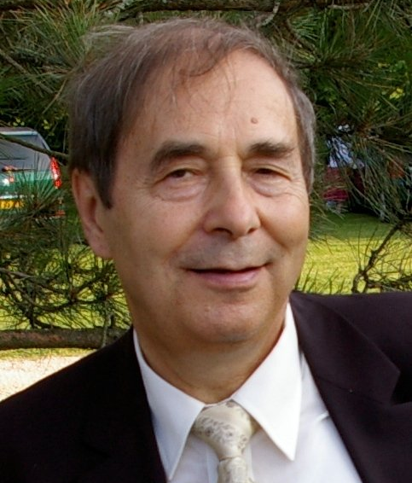
France China collaboration: a long history
Shi ShiYuan (1908-2007)
Father of Chinese nuclear physics…
and former student of Pierre et Marie Curie.
Qian Sanqiang (1913-1992) & He ZeHui (1914-2011),
responsibles of the Chinese nuclear research program … and collaborators of the Joliot-Curie (1946-48).
Michel Davier,
(member of the French Academy of Science & FCPPL steering committee co-chair, together with Chen Hesheng, IHEP director)
advisor for the Beijing Electron Positron Collider (1988).

Slide 4
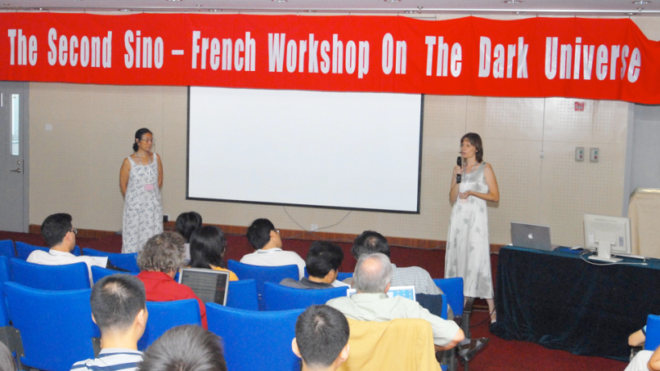
France China collaboration: a long history
IN2P3 staff in China in the last decades:
Charling Tao, scientific advisor at the French Embassy (1990), now sharing time between Marseille & Tsinghua.
Lydia Roos, scientific advisor at the French Embassy (2004-06), then @ IHEP (2006-08)
OMH @ IHEP+NAOC (2008-13)
Fabio Hernandez @ IHEP-CC (2010-14)
Long lasting relationship + continuous interest & efforts from IN2P3 (and LPNHE!) to foster links with Chinese researchers.

Slide 5
LPNHE & IHEP: ATLAS
Contacts with Cosmology groups in China (C. Tao)
ATLAS: FCPPL founding collaboration (L. Roos+Jin Shan)
H→ 2γ : signal search, noise bckrd estimation, Detector performance (trigger efficiency, γ energy callibration
Yuan Li (Shan+Roos, 2008-11), now @ Kobe.
Yao Liwen (Shan+Laforge, 2010-13)
Heavy ions @ Shanghai
Now @ Geneva Ruan Xifeng
♥ ♥ [FCPPL love story!]

Slide 6
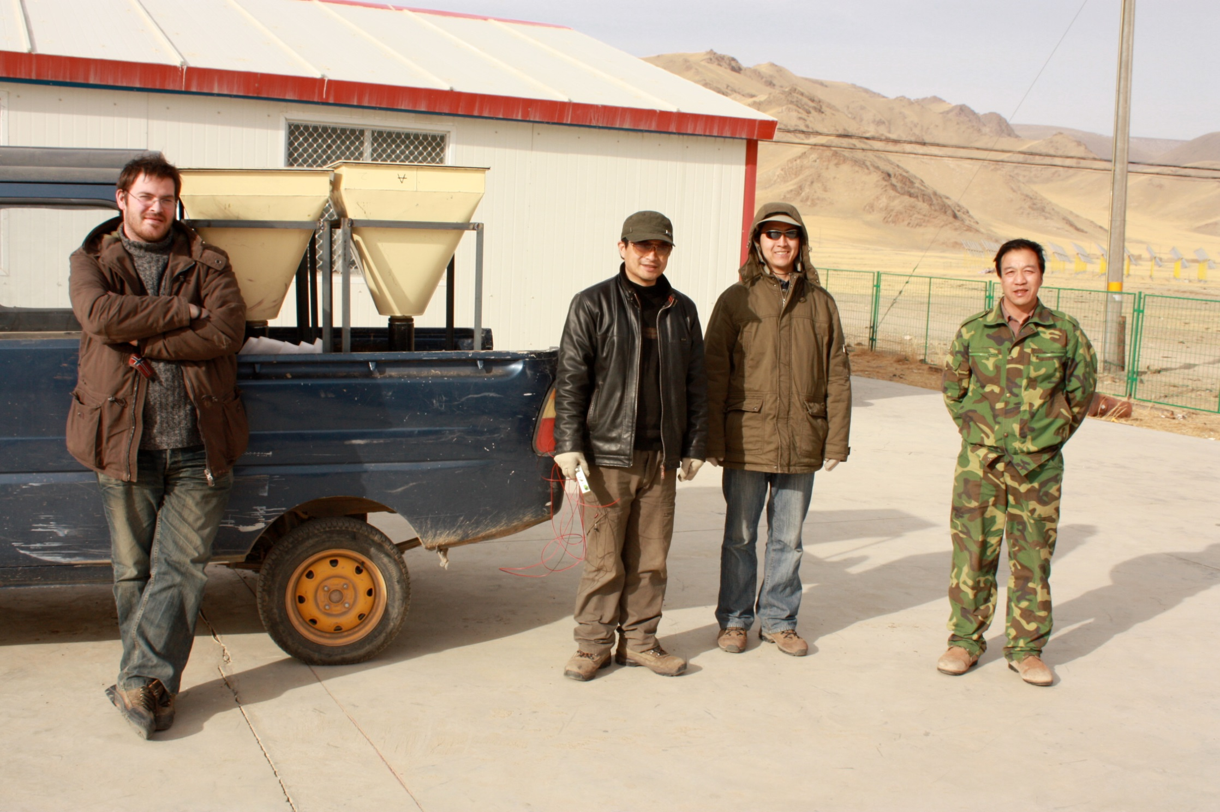
LPNHE & IHEP
TREND:
Goal: autonomous radio-detection of extensive air showers
Project initiated in 2008 with groups of Hu HongBo (IHEP) & Wu XiangPing (NAOC) in the framework of FCPPL.
Not (yet) an official project in IHEP&LPNHE, but selected by NSFC in 2012 (lead: Gou QuanBu, IHEP)
New phase to be started early 2015.

Slide 7
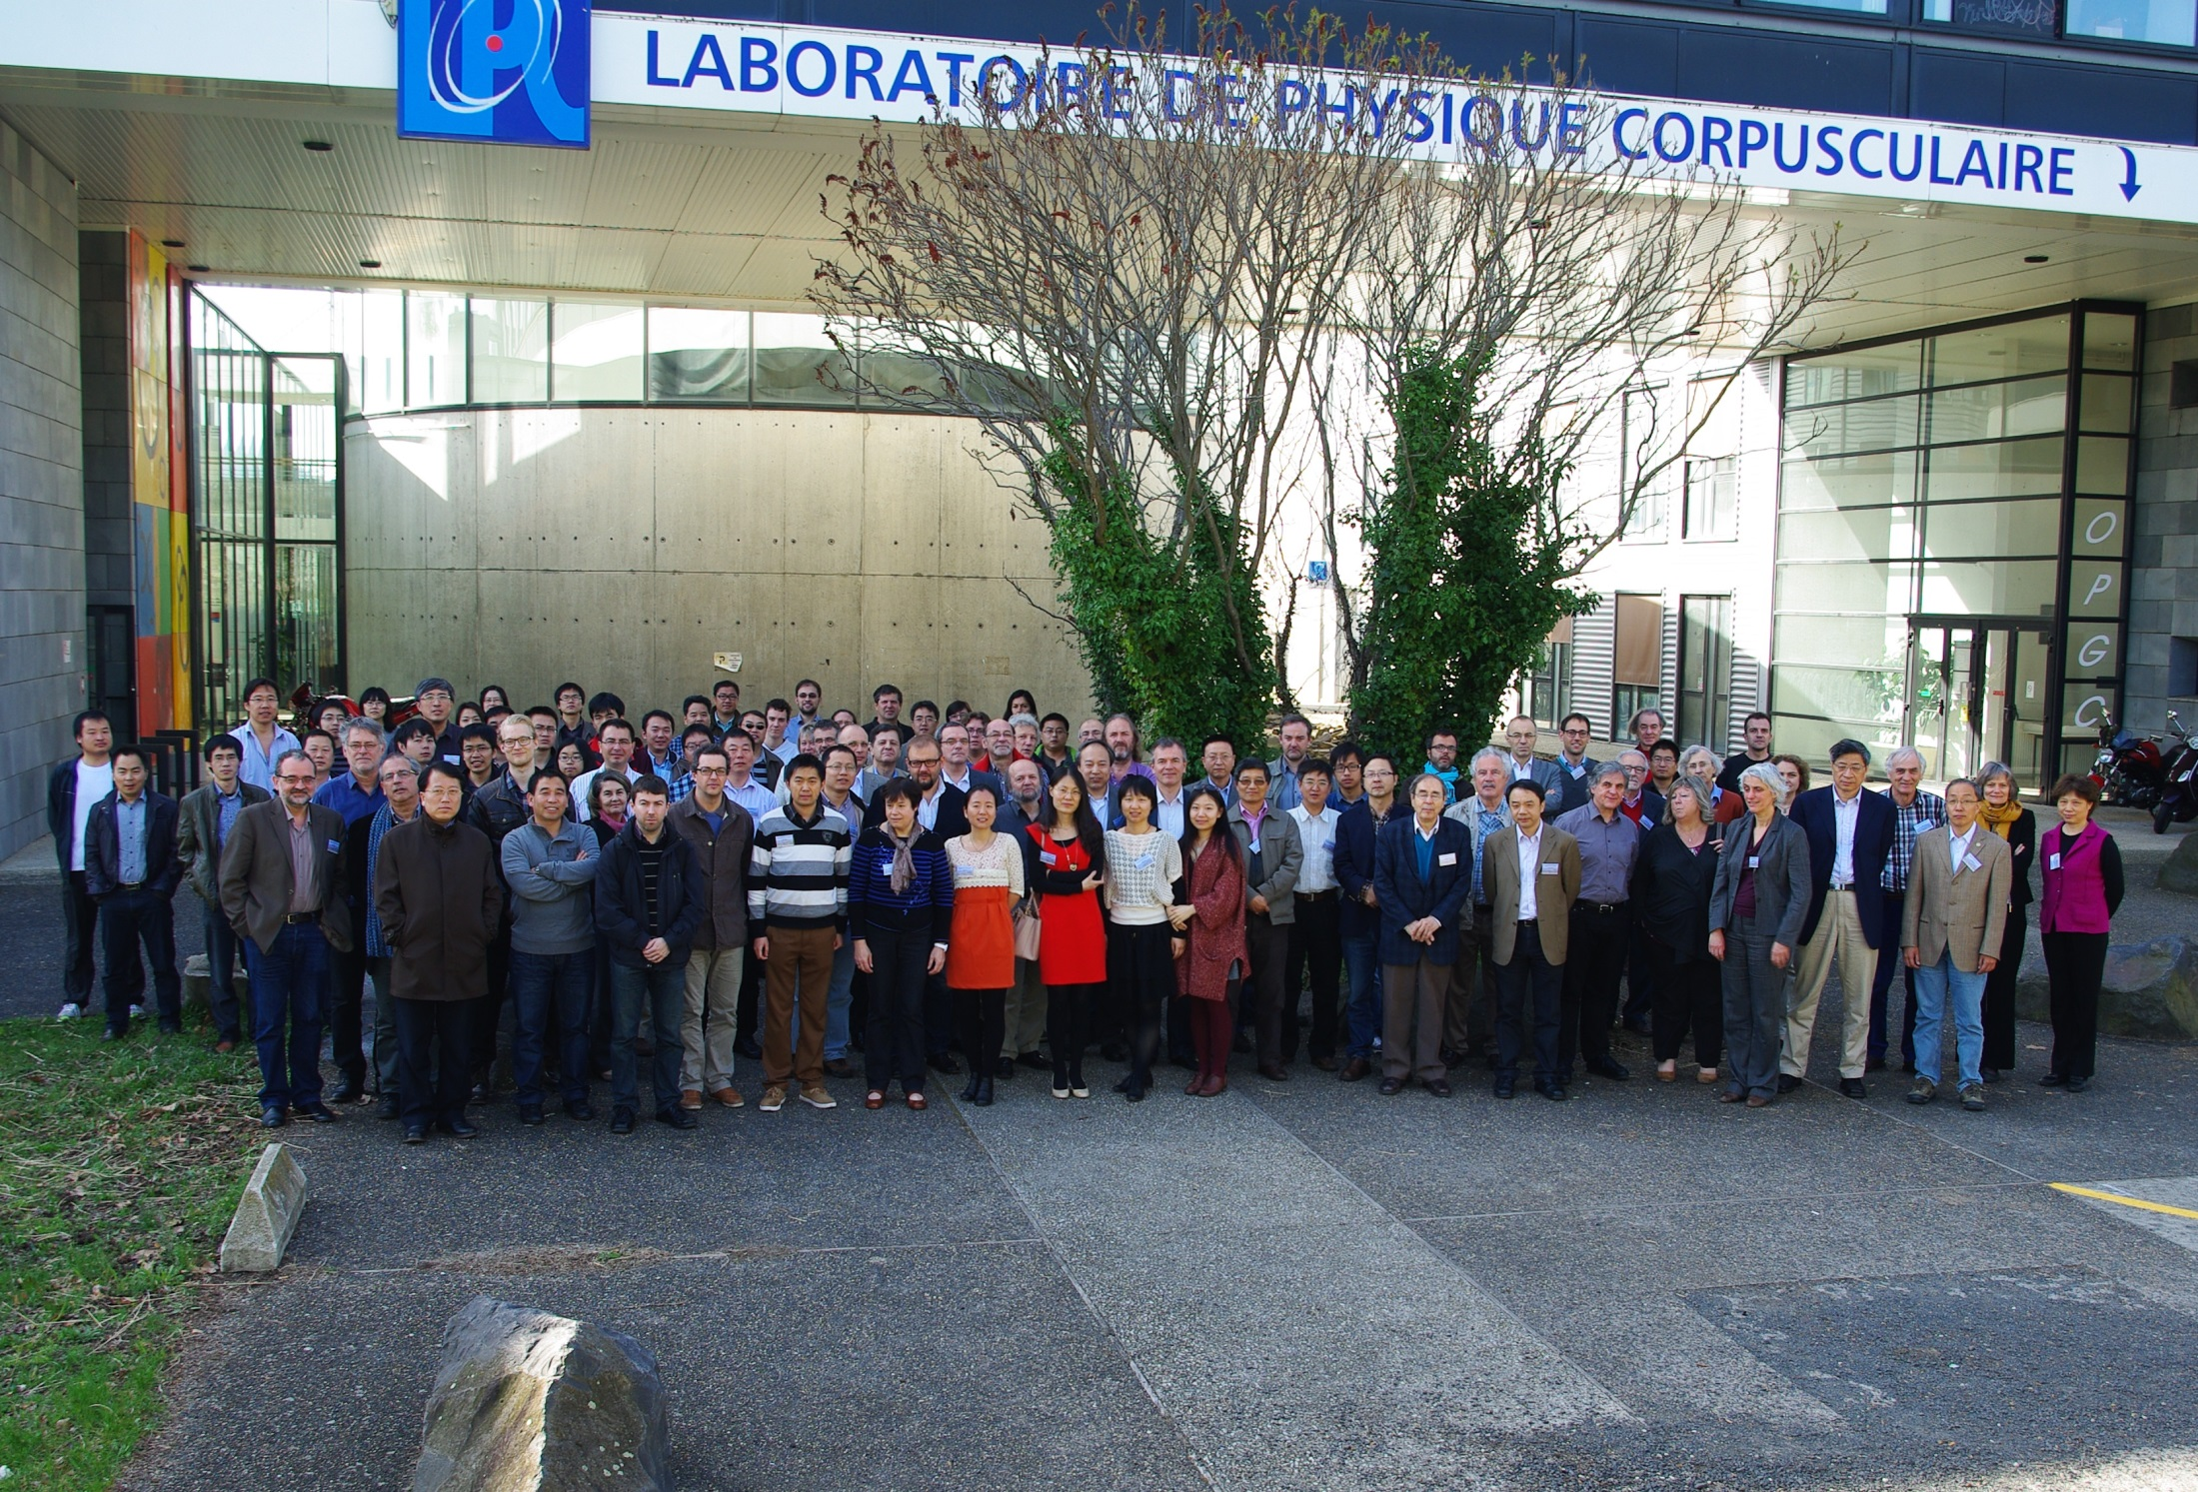
FCPPL: what’s next?
FCPPL succesfull but supposed to stop in 2015.
IHEP2007≠IHEP2014: rising ambition of Chinese physics (JUNO, SVOM, LHAASO, CEPC, …)
Wang Yifang + Jacques Martino (head of IN2P3) common statement at last FCPPL workshop, aiming at a reinforcement of French – Chinese links.
Scientific strategy, regulations & funding issues on both sides to be taken into account.

