Slide 1
IceCube, DeepCore, and Future Neutrino Observatories at the South Pole
Kael Hanson
University of Wisconsin Department of Physics and the Wisconsin IceCube Particle Astrophysics Center
NNN’14, Paris
4-6 nov 2014

Slide 2
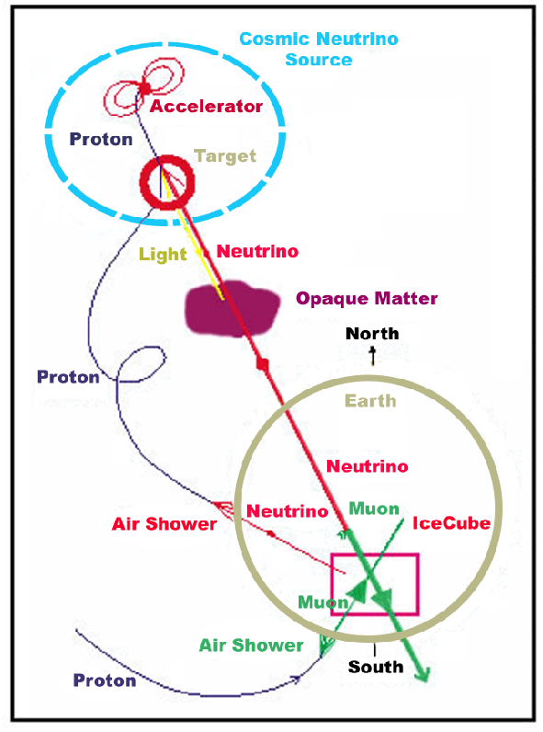
Extraterrestrial Neutrinos
Neutrinos produced at CR accelerators:
From decay of π/K mesons – in vacuo neutrino energy follows injection spectrum (e.g., no galactic diffusion)
Energies can be boosted by p+γ interactions in intense photon fields in AGN/GRB
Fluxes of UHE neutrinos can be generically linked to total extra-galactic CR energy density → this gives WB (Waxman-Bahcall) benchmark flux:
2-4 × 10⁻⁸ GeV/cm²/s/sr
Neutrinos offer clear signature of hadronic acceleration and point back to sources
Neutrinos from interaction of UHECR:
Guaranteed flux – GZK effect observed, the neutrinos must be there
Flux models depend on UHECR composition, constrained by gamma ray measurements.
At these energies neutrinos are the only messenger particle capable of reaching us from cosmological distances.

Slide 3
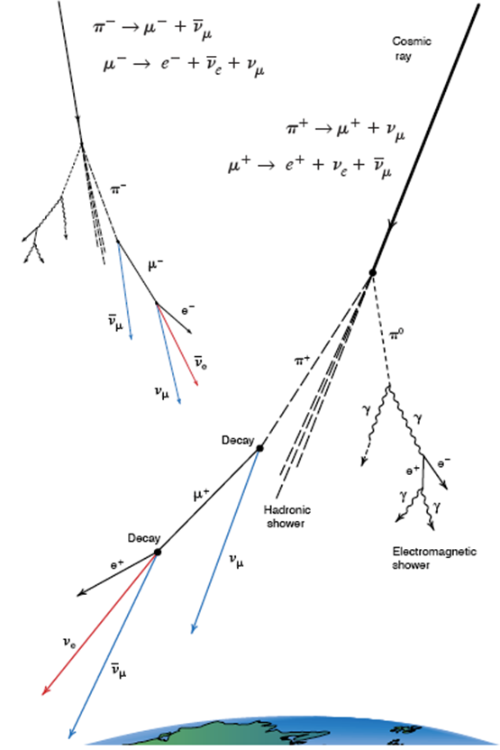
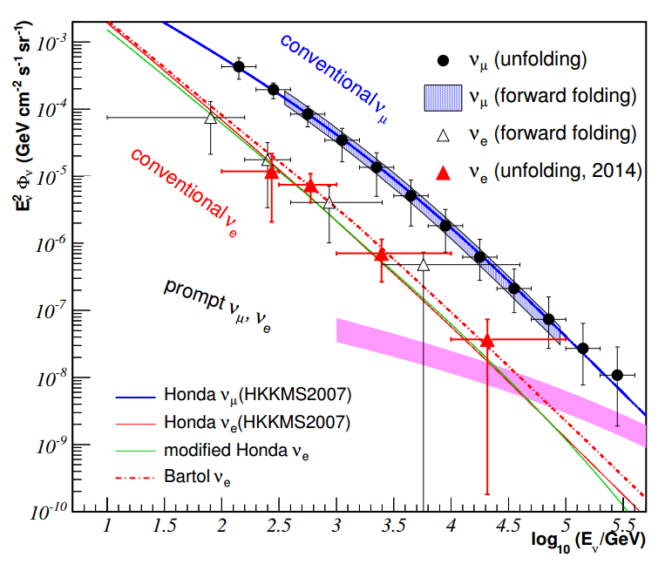
Atmospheric Neutrinos
Neutrinos produced by meson decay in Earth’s atmosphere – detected since 1960’s.
Tend to have harder spectra due to relatively long-lived meson – decay is overcome by energy loss in atmosphere giving spectrum 1 power harder than CR primaries.
Background for cosmic neutrinos – but interesting beam for oscillation studies.
As yet unknown contribution from prompt neutrinos from decays of charm mesons.

Slide 5
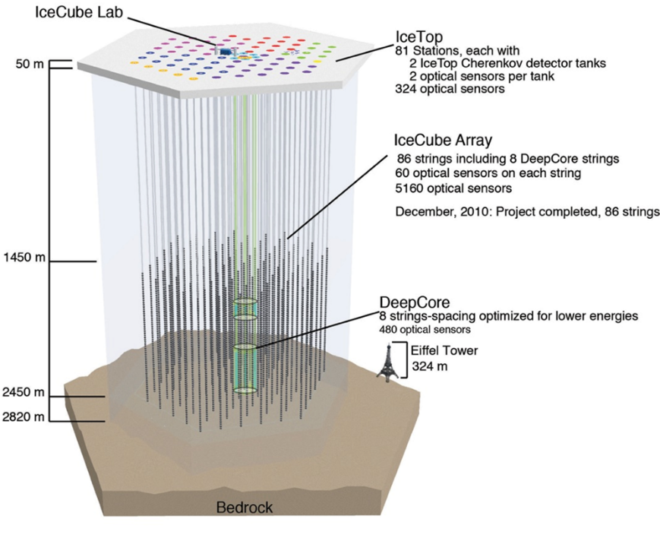
The IceCube Detector
Notes:
IceCube also a capable SN detector for galactic SN (put into backup slides)
Point out that the only modification for DeepCore was the PMT

Slide 6
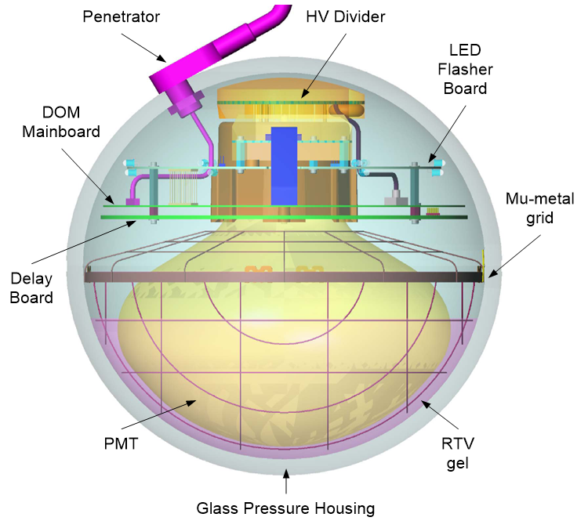
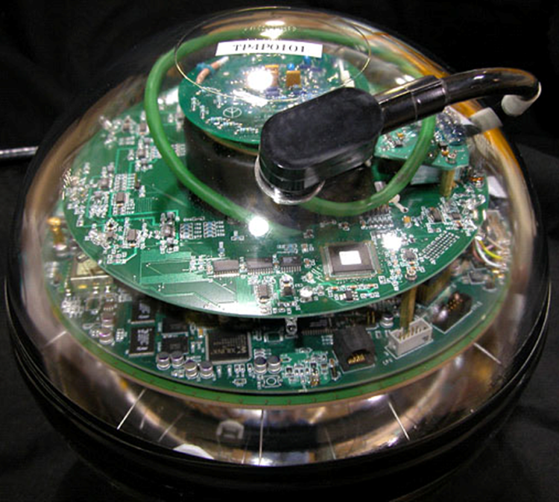
The IceCube DOM
DOM Optical Characteristics
Large Area Photocathode 10” 10-stage Hamamatsu R7081-02 PMT (QE 24% @ 420 nm); High QE variant (QE 35% @ 420 nm) used in DeepCore DOMs
Low noise 500 Hz bkg count rate in-ice @ 0.25 pe threshold.
Glass / Gel 0.5” thick Benthos pressure housing rated to 10,000 psi. Better transmission in 330 - 400 nm relative to AMANDA OM. Low radioactivity glass.
Optical calibration Each DOM calibrated ε(λ, T) in the lab to about 7%; in-situ flashers additionally permit in-ice optical measurements
Smart sensor
Digitizer
Timing
Power
FPGA + ARM CPU SoC. 4k-hit deep memory buffer stores hits until readout over 1 Mbit digital link to surface.
300 MSPS ASIC 14-bit effective resolution. Slow pipelined ADC capture to 6.4 µs
1 ns time resolution thru automatic clock sync protocol embedded in 1 Mbit/s comms system.
Power supplied by 18 AWG Cu pair to surface (3.5 km). 96 V, 3.75 W per channel (DOM)

Slide 7
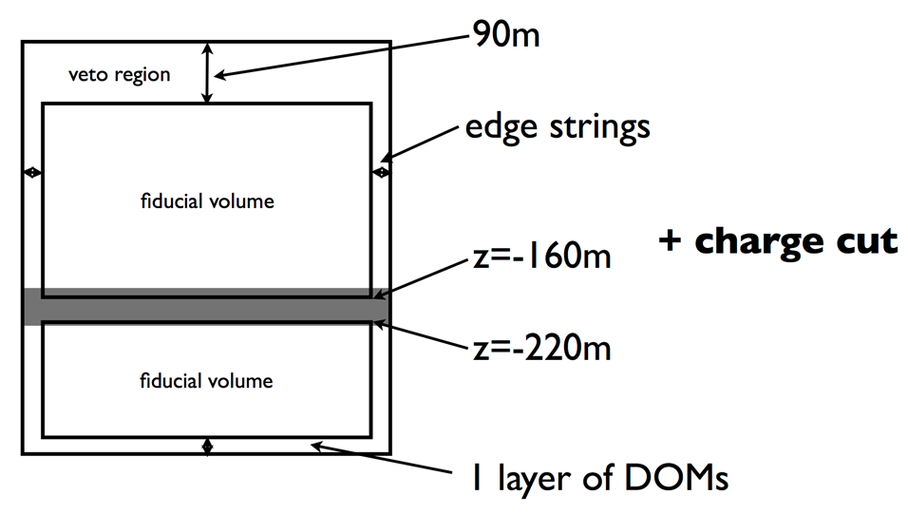
Discovery of HE Neutrinos (!!!)
Following the announcement of Bert and Ernie, two PeV-scale neutrino events in the full 86-string detector (2013), a follow-up analysis focused on contained or partially contained events.
This first follow-up used the same 2010 / 2011 data run and found 28 events from 30 TeV to 1 PeV inconsistent in flavor content and energy spectrum with atmospheric neutrinos (Science 342, 1242856)
Data from a 3rd year was recently published (PRL 113, 101101) – 9 more events, including 2 PeV contained cascade (“Big Bird”).
4th year of data (2013 season) under analysis
6000 p.e.

Slide 8
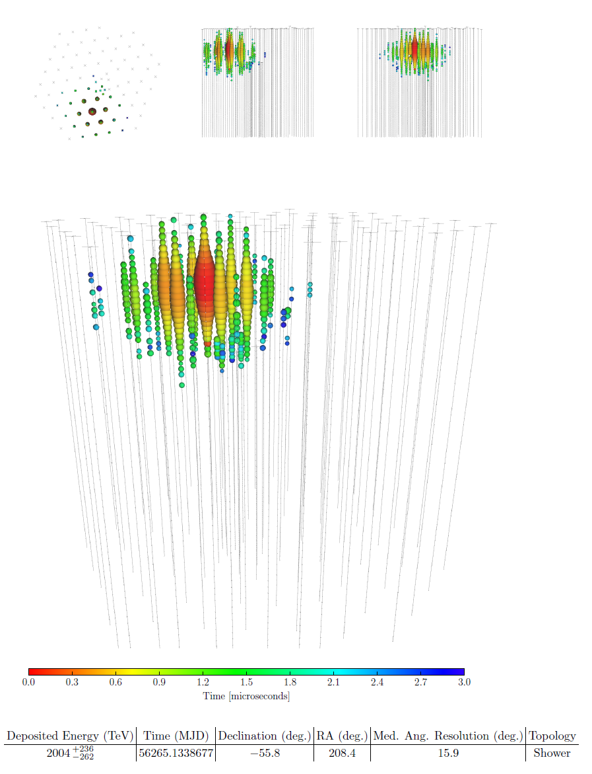
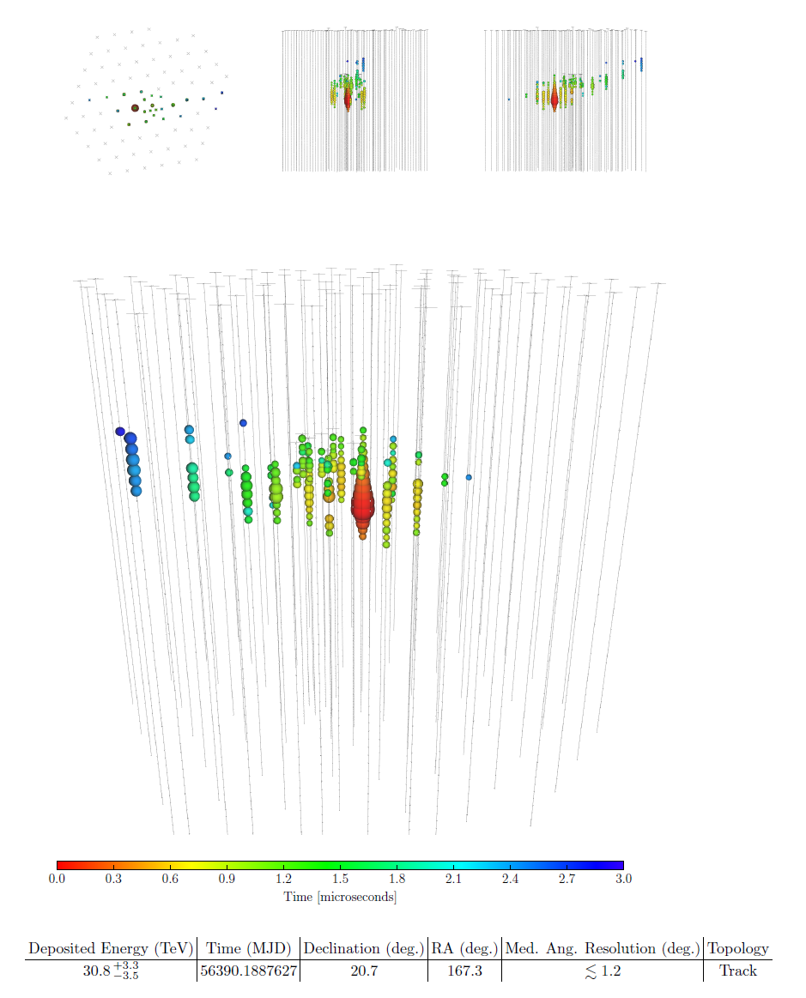
Starting Events

Slide 9
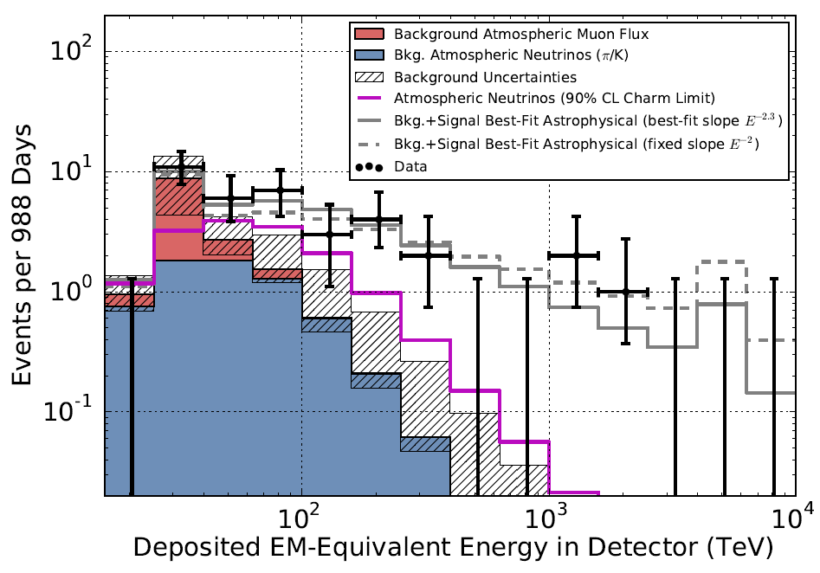
Energy Spectrum

Slide 10
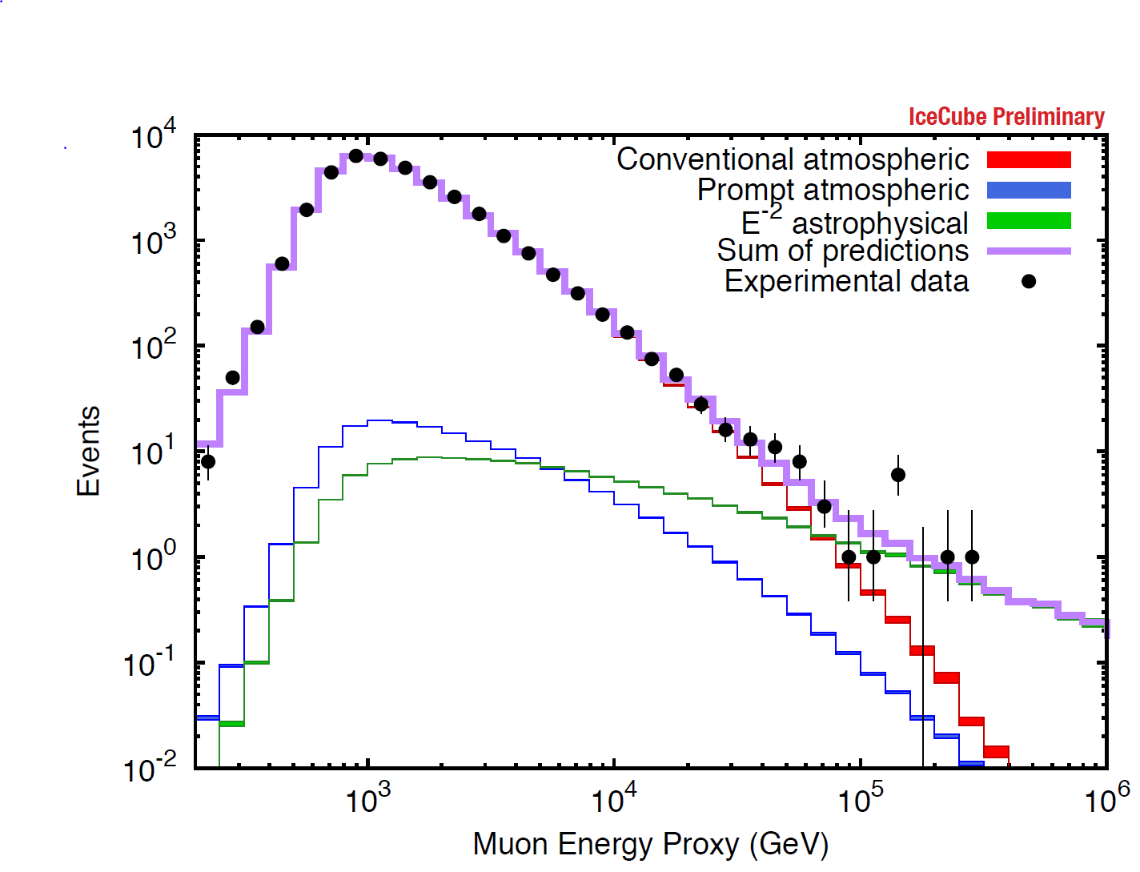
High Energy Tail in Muon Diffuse Analysis
2-year data sample

Slide 11
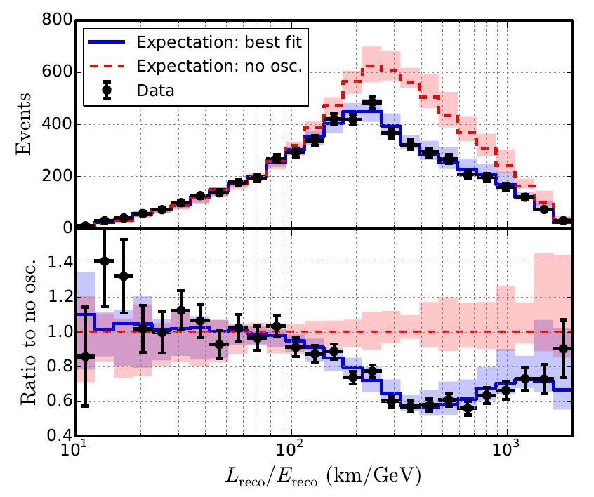
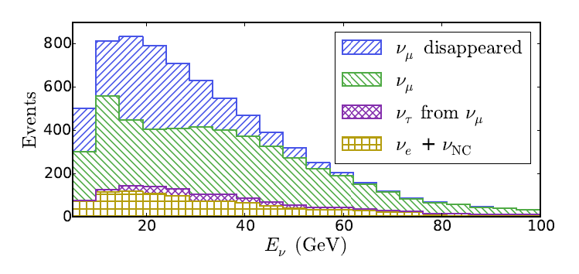
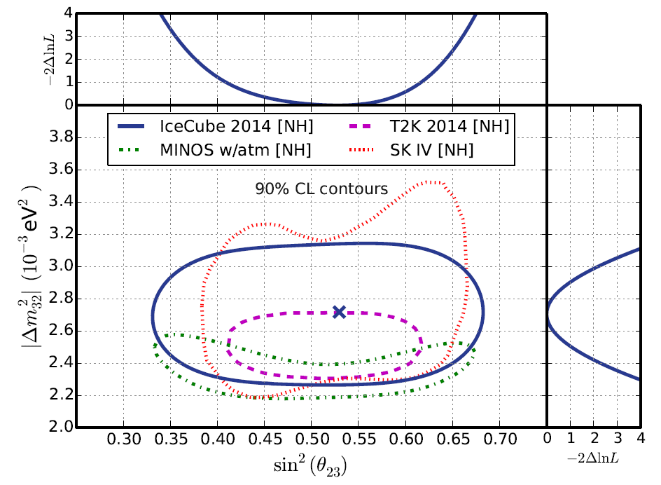
Neutrino Oscillations in DeepCore
arXiv:1410.7227
Range of neutrino energies
6-60 GeV.

Slide 12
Future Detectors

Slide 13
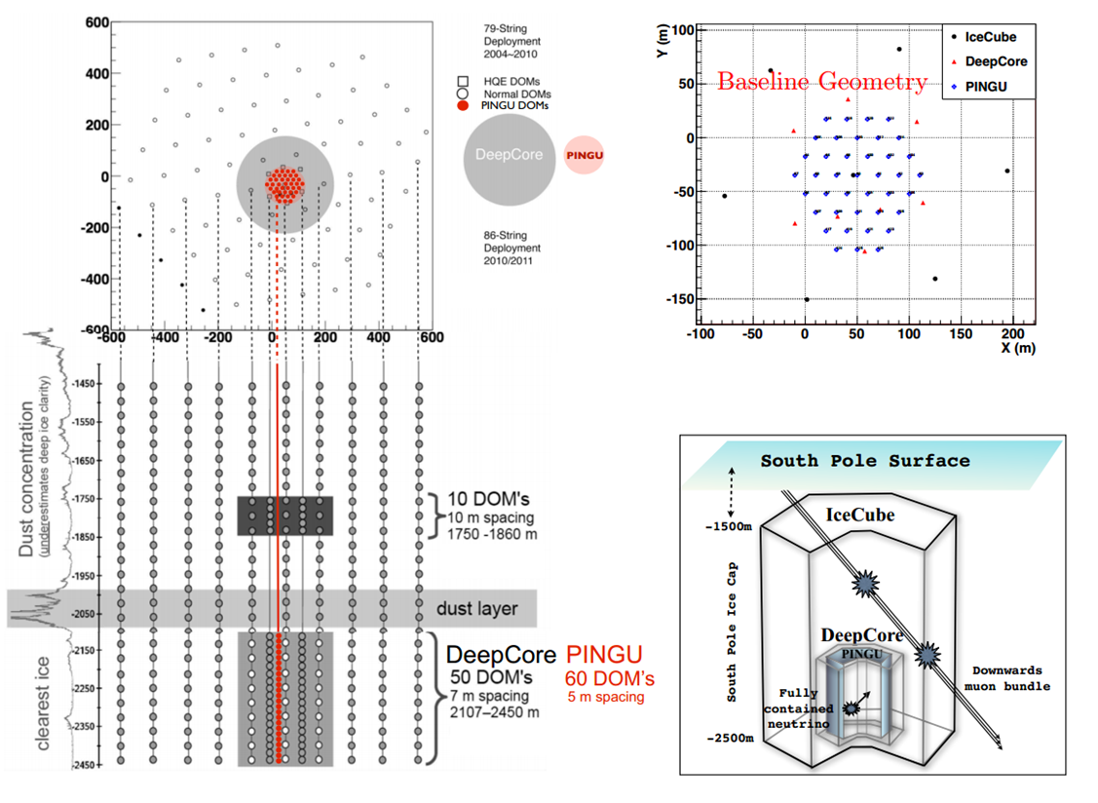
PINGU

Slide 14
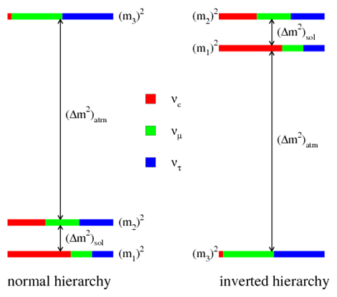
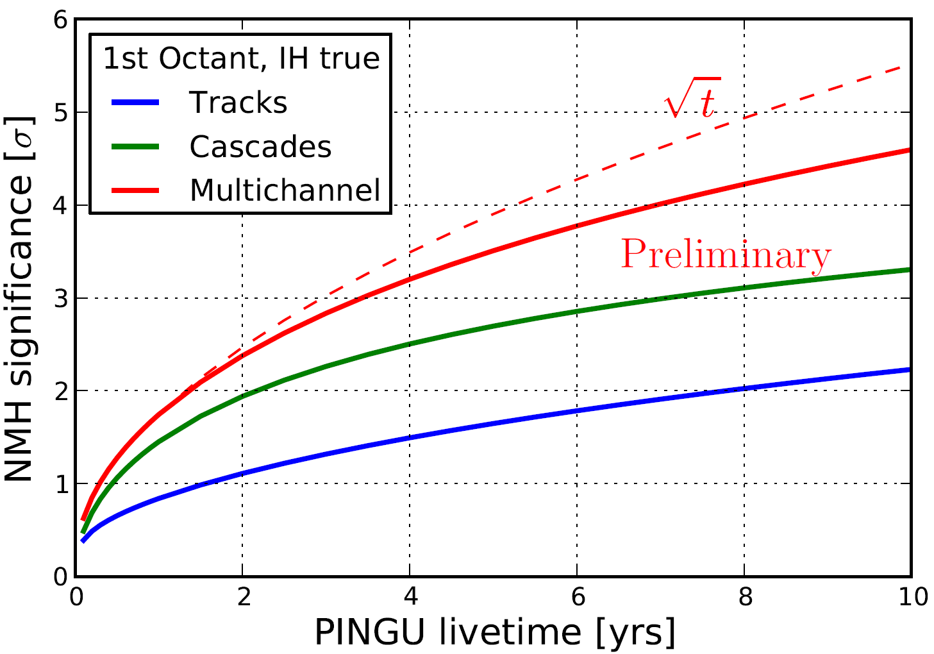
Neutrino Mass Hierarchy

Slide 15
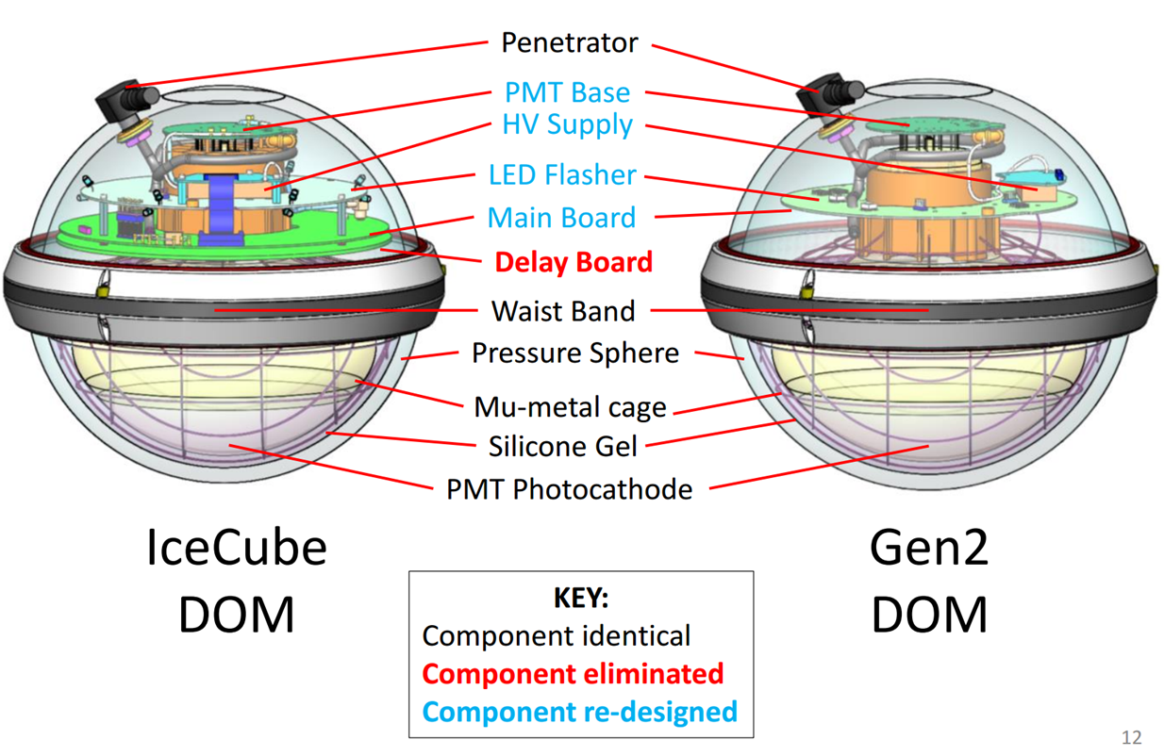
PINGU DOM
PINGU DOM retains much of the design of the IceCube ancestor due to good experience with the latter. Updates mainly focused on evolutions in electronics.

Slide 16
New Analog FE / Digitizer
Extremely simple AFE
Possible high speed input buffer amp
Analog shaping for Nyquist sampling
No analog discriminator:
Digital trigger for maximum flexibility
No delay lines needed to trigger SCA
High speed, low power commercial pipelined ADC IC: (TI’s) ADS4149:
14-bit resolution: covers resolution of PMT
~2 mV SPE approx. 20 LSB
2 V full range analog input
265 mW at 250 MSPS
200 mW at 160 MSPS

Slide 17
In Situ Digital Signal Processing
Hard ARM Cortex-A9 processor core (HPS) FPGAs offered by Altera (Cyclone V) and Xilinx (Zynq) – dual core 666 MHz
NEON vector floating point support
IceCube pulse deconvolution software ported to “embedded” Linux environment.
O(500 mW) power penalty

Slide 18
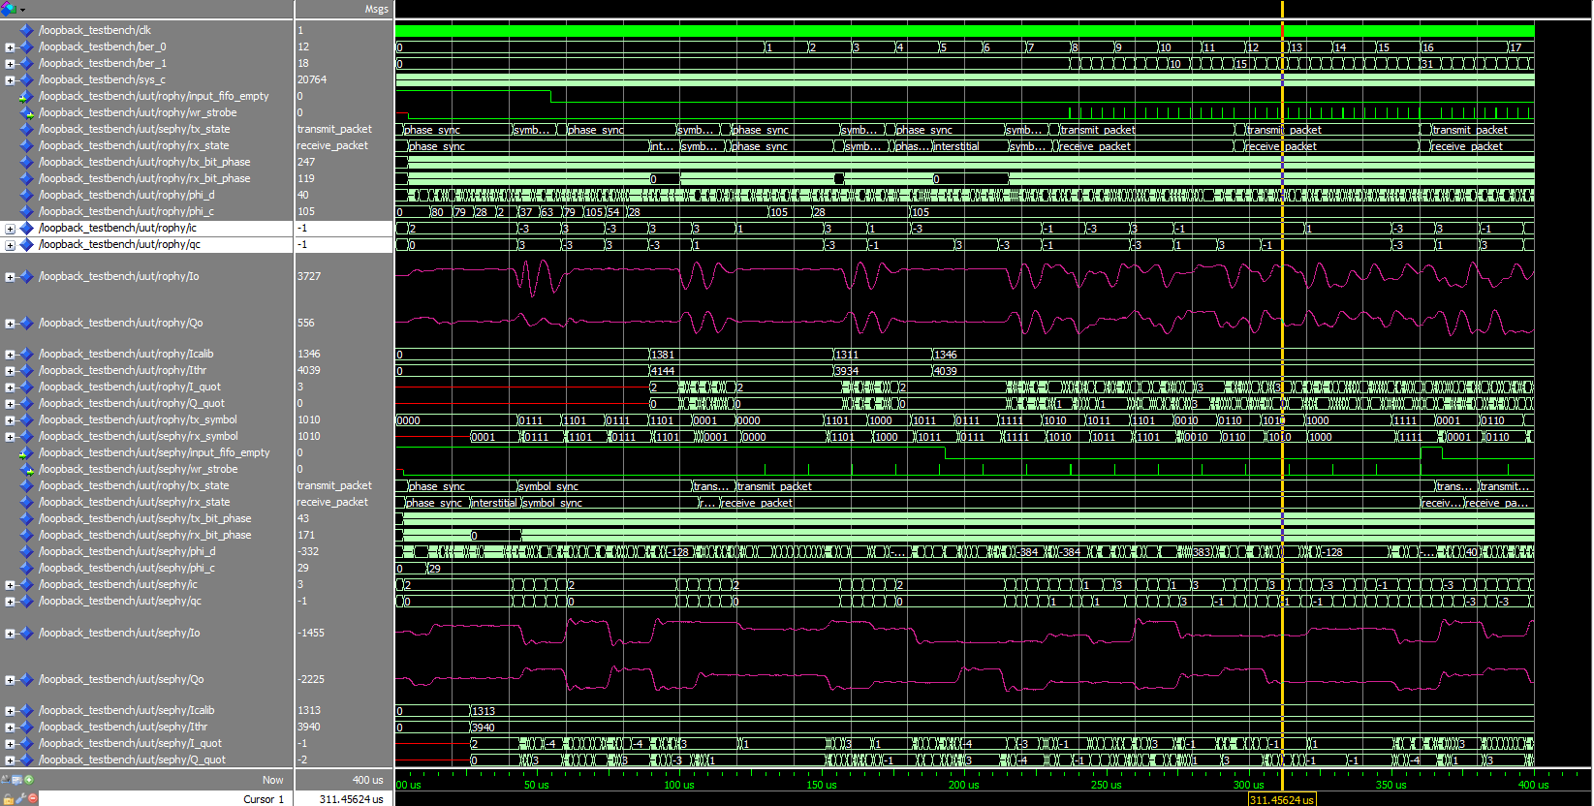
New Developments in Communications
IceCube current comms (Cu Quad 19 AWG):
1 Mbit/s, time synchronization via RAPCal
2 DOMs per wire pair
Baseband signaling – 20 dB atten at 3 km, severe pulse dispersion, highly engineered cable from Ericsson (no longer available)
New comms design goals:
Stay with copper cabling
Profit from design opportunity to relax cable spec.
At least 1 Mbit/s
4-8 DOMs / pair
Looking at passband signaling schemes: QAM16

Slide 19
Going after PeV Neutrinos

Slide 20
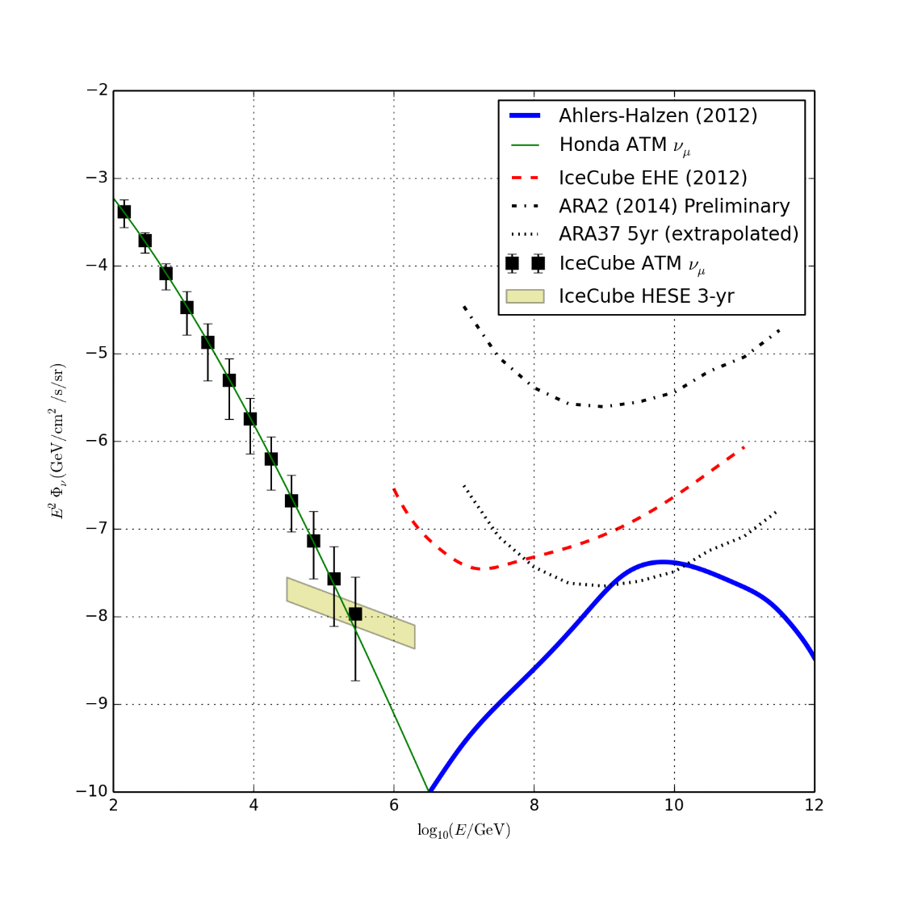
PeV Neutrinos (II)
Some indications that the flux at PeV detected by IceCube steepens.
Limited sensitivity to HE flux with only volume for starting events of 0.5 km³.
Radio detectors not comptetitve until 10¹⁷ eV
➔ GAP at 10¹⁶ – 10¹⁷ eV

Slide 21
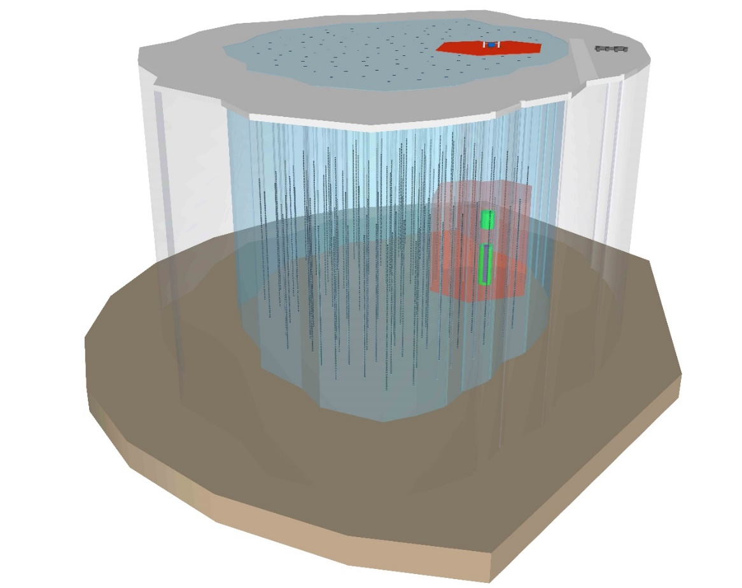
High Energy Extension
Parameter | Gen2 | IceCube
Depth at Top | 1450 | 1380
Depth at Bottom | 2450 | 2650
Surface Area (km²) | 0.9 | 5
Inst. Volume (km³) | 0.9 | 6.5
Threshold (TeV) | 0.1 | 30
Self Veto Volume (km³) | 0.5 | 5

Slide 22
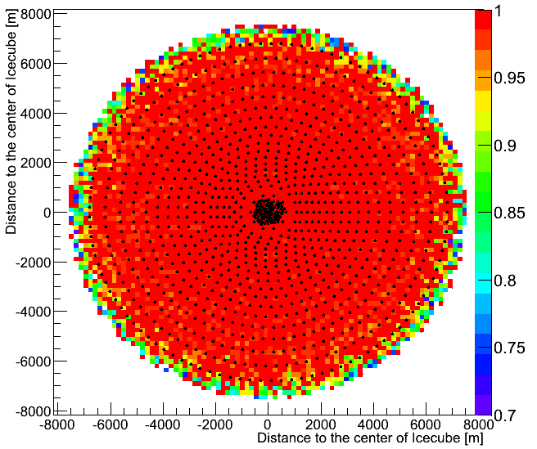
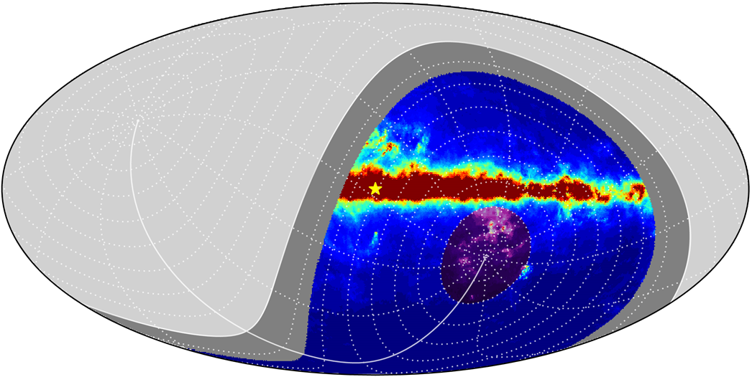
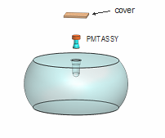
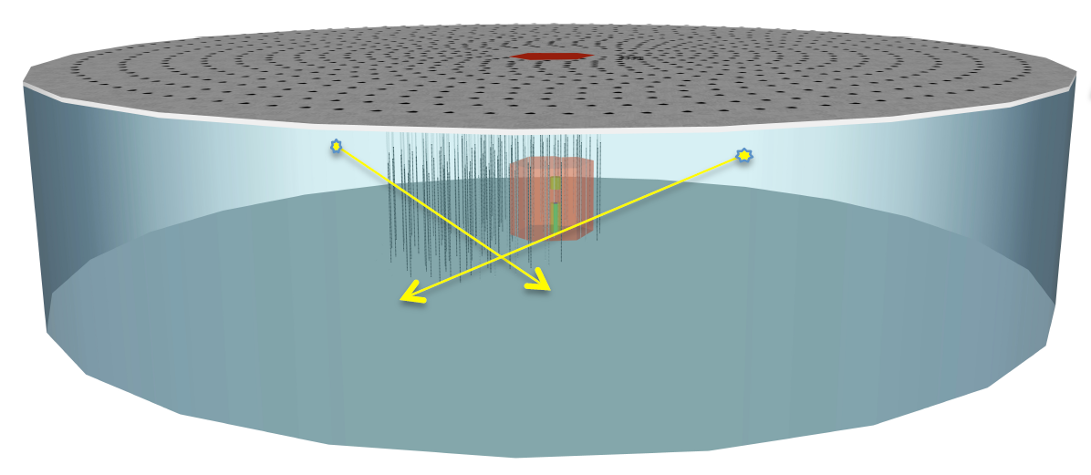
Surface Veto
Galactic center

Slide 23
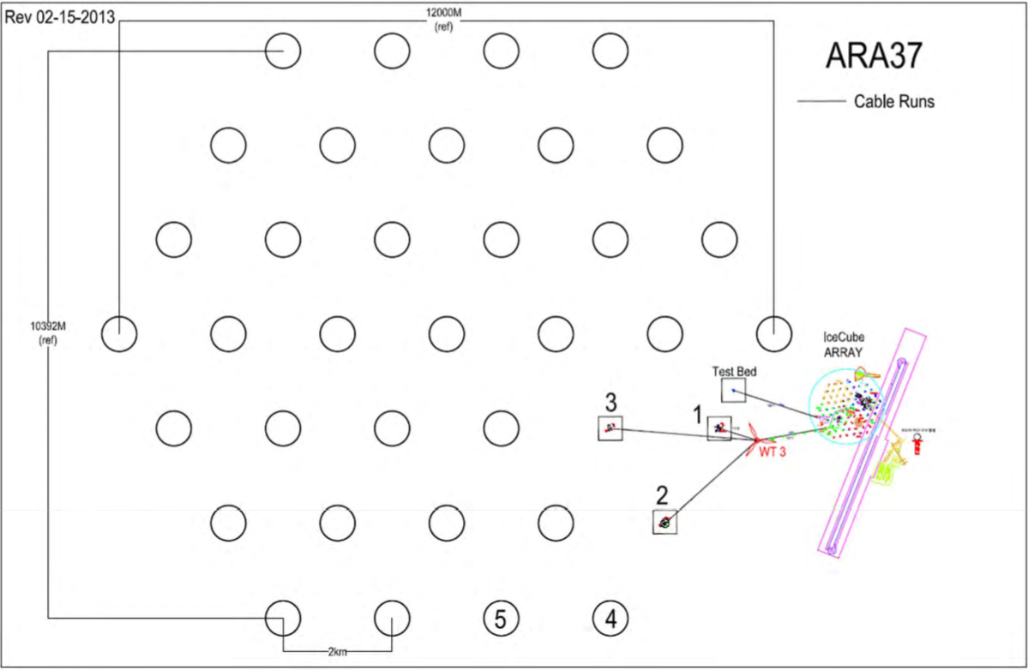
Radio Detection of UHE Neutrinos

Slide 24
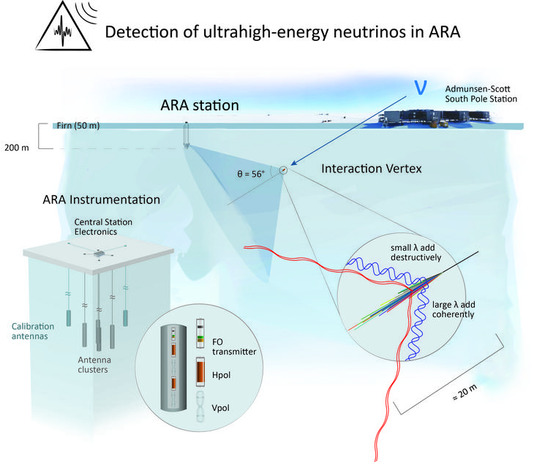
ARA Stations
Each station an autonomous UHE neutrino detector.
4 strings at 200 m depth – each string has 2x VPOL and 2x HPOL antenna.
Performance: require 10’s ps time resolution btw antennas to cross-correlate RF
(Neutrino) direction: 6°
Energy: TBD

Slide 25
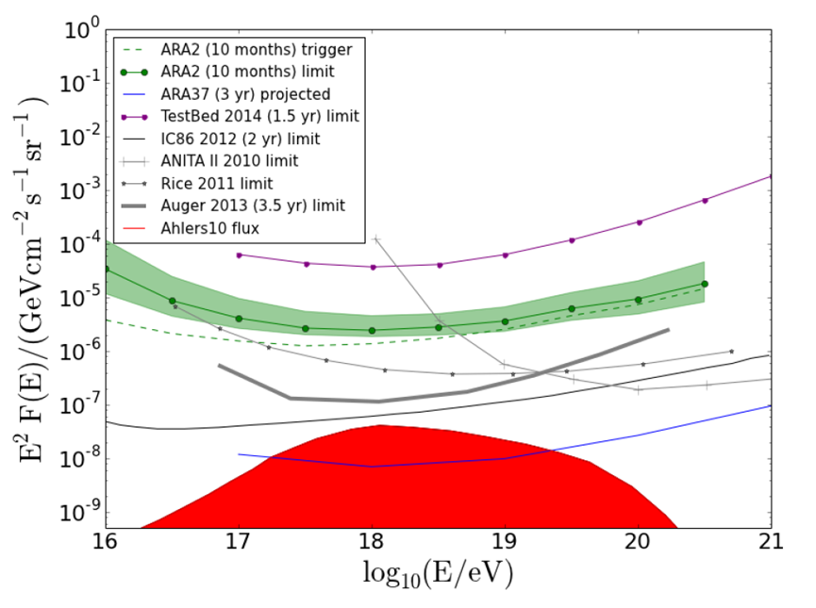
First Results from 2 Station ARA
Preliminary!
Ph.D. Thesis Thomas Meures (ULB)

Slide 26
Conclusions
IceCube detector continues into its 4th year of full 86-string operation in excellent condition: detector up times > 99%, DOMs robustly deliver data despite decade old digital design.
Science at both energy extremes looking very encouraging:
Results from 4 years of HE starting events unblinded, under analysis.
Low-energy oscillations in DeepCore confirm atmospheric mixing parameters well into 50+ GeV energy region.
Future detectors looking to push both energy frontiers: PINGU with NMH, High-Energy Extentions (HEXen) to explore the PeV fluxes with O(10x) bigger detection volume / area.
Radio detection in ice is taking flight – first results from 10 months of ARA 2 station operation coming out – show potential of radio technique.

