Slide 1
Future Plans in the Americas
Jim Strait, LBNE Project Director
NNN 2014
5 November 2014

Slide 2
Outline
Survey of Neutrino Programs and Initiatives in the Americas
Fermilab Neutrino Program
LBNE
Towards a new Long-Baseline Neutrino Facility (LBNF)

Slide 3
Outline
Survey of Neutrino Programs and Initiatives in the Americas
ANDES Underground Laboratory Proposal (Argentina-Chile)
Angra and CONNIE (Brazil)
SNO+ (Canada)
IceCube / PINGU (Antarctica)
WATCHMAN, PROSPECT, DAEδALUS/IsoDAR, CAPTAIN (US)
Fermilab Neutrino Program
LBNE
Towards a new Long-Baseline Neutrino Facility (LBNF)
Towards a new international collaboration

Slide 4
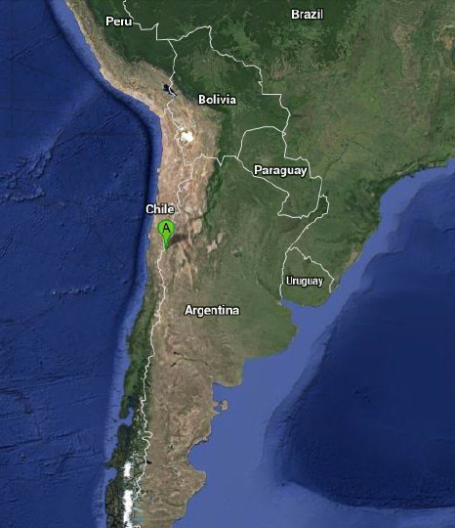
ANDES Project
*
andeslab.org
ANDES unit established as part of the Latin American Center for Physics
Tunnel construction 2015-23
Lab is potential addendum
Decision with ~ 1 year
* ~4500 mwe

Slide 5
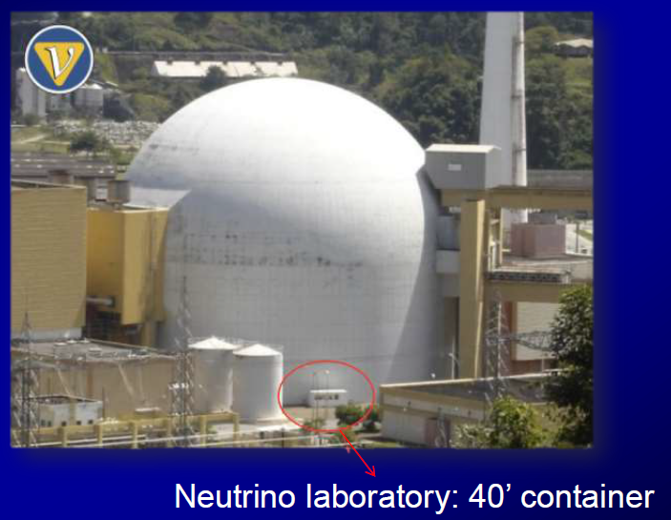
Angra Neutrino Experiment
Angra dos Reis Reactor Rio de Janiero
Collaboration of 8 Brazilian institutions
~1 ton Gd-loaded WCD

Slide 6
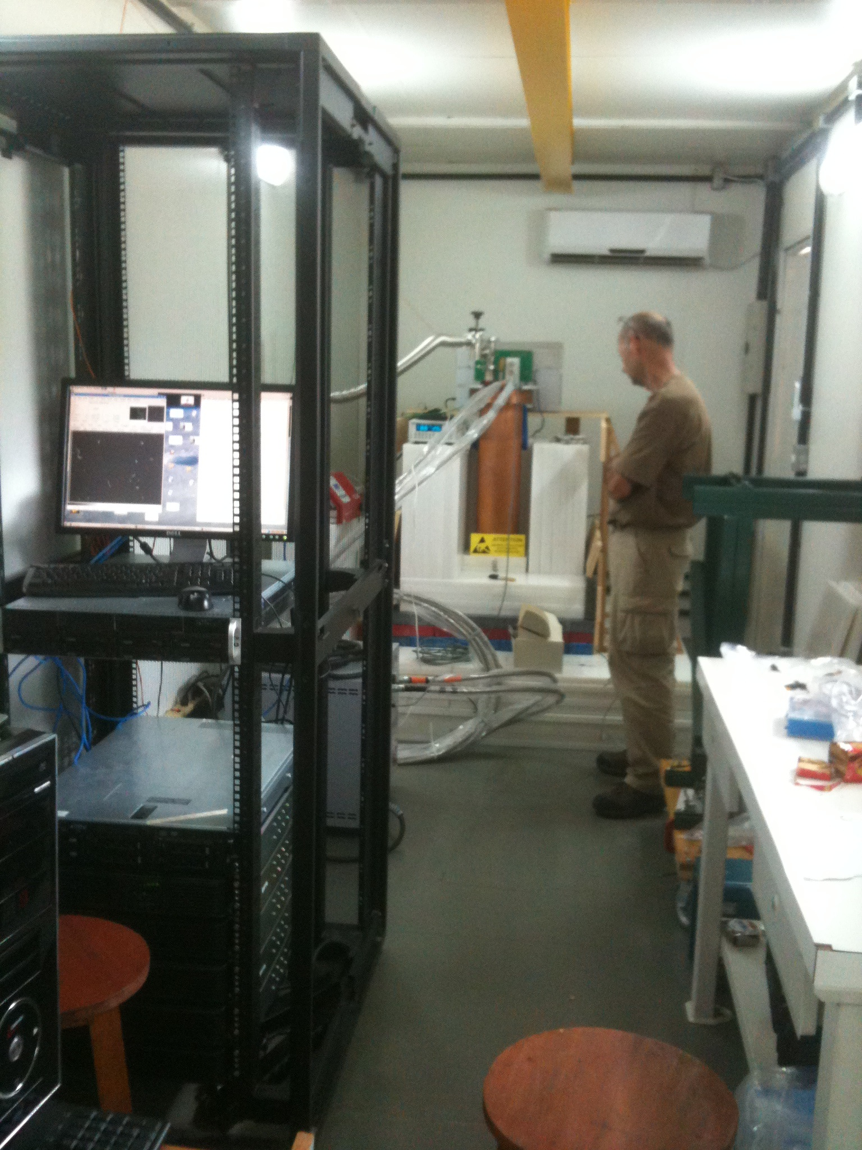
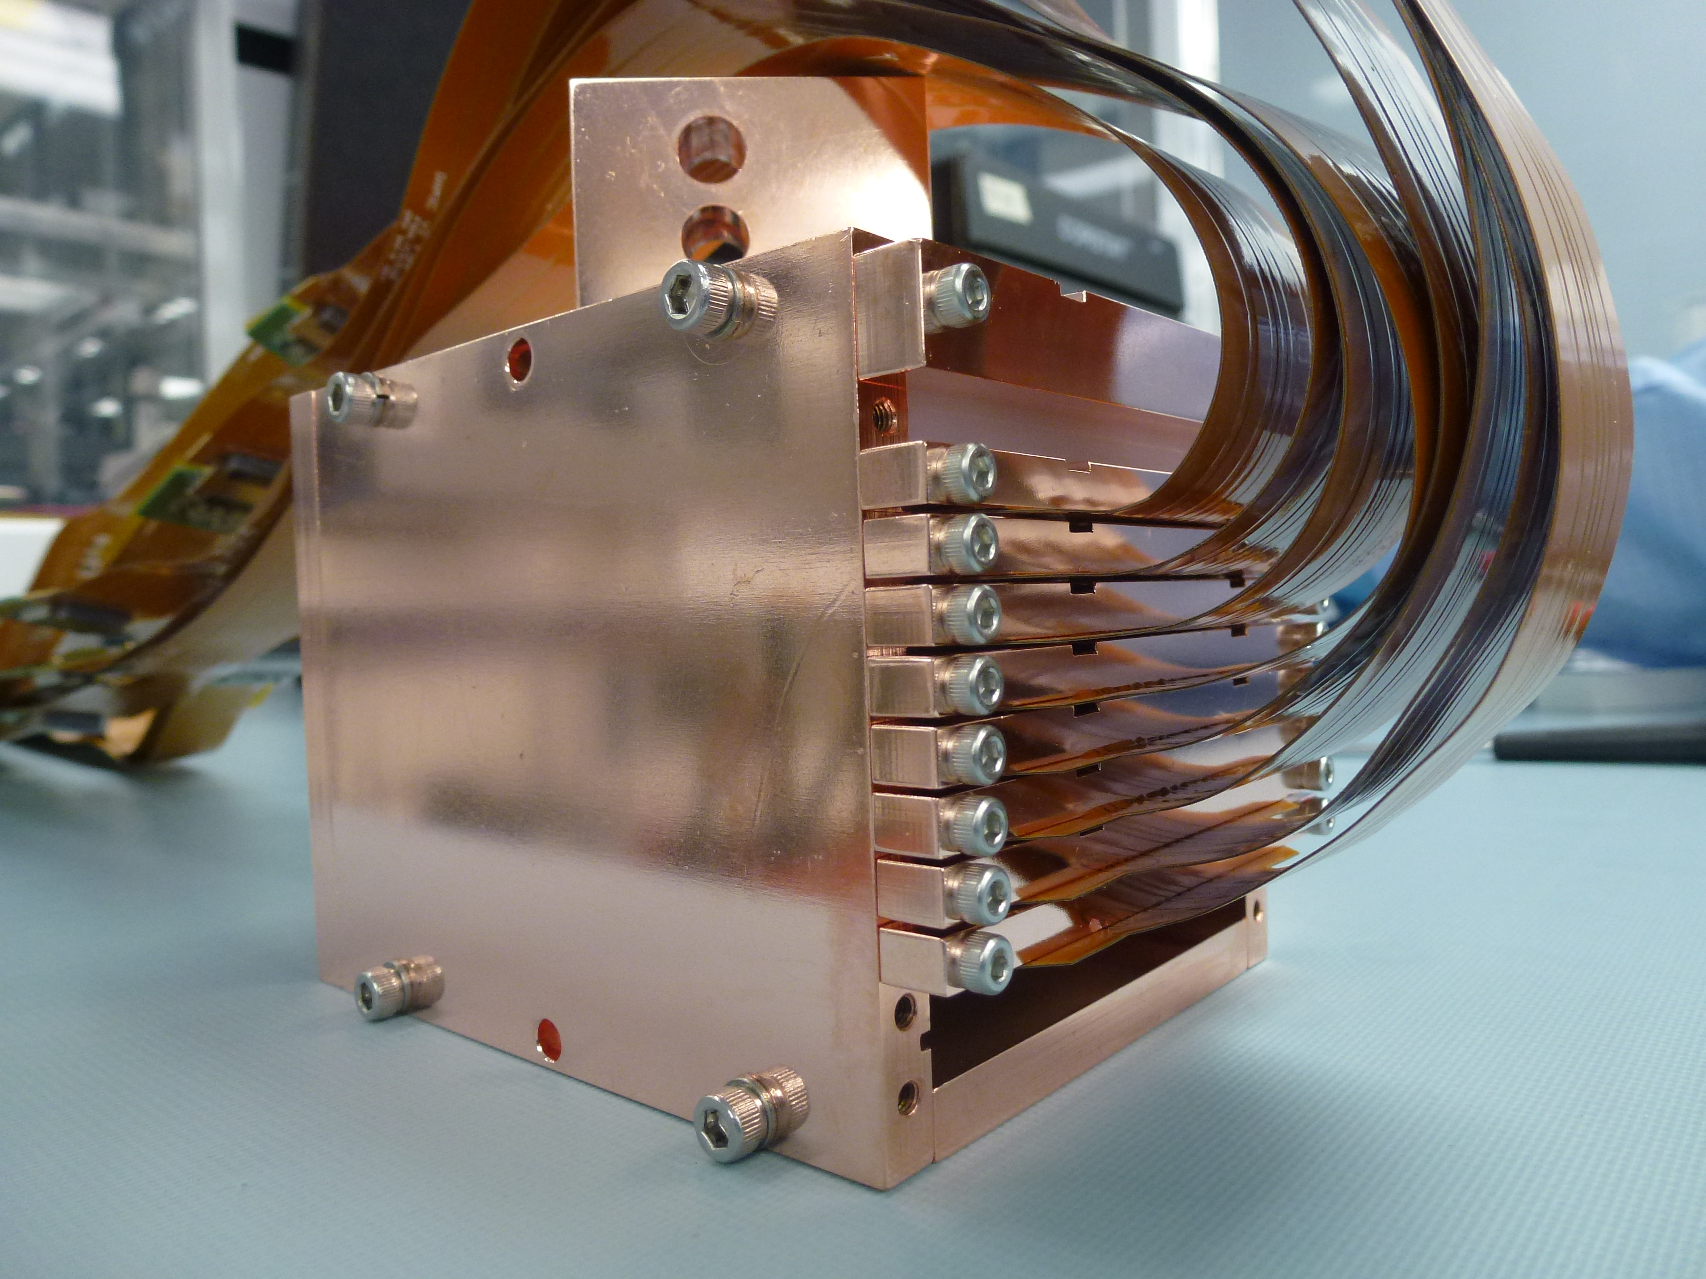
Courtesy of Juan Estrada, Fermilab
Second Experiment at Angra
CONNIE (Coherent Neutrino-Nucleus Interaction Experiment)
Scientific goal:
First detection of neutrino-nucleus coherent scattering.
Technique:
Measure low energy nuclear recoils in scientific CCDs produced by antineutrinos with a threshold of 40 eV.
Collaboration:
Argentina, Brazil, Mexico, Paraguay, Switzerland and USA.
(all contributing with funding)
Same detector technology as DAMIC experiment. This is possible thanks to LBNL’s development of thick fully depleted CCDs for astrophysics.
Poly + lead shield, cryogenics, vacuum and DAQ operating on site Oct-2014.
CCD array for CONNIE

Slide 7
SNO+
J. Wilson Parallel Session 2

Slide 8
ICECUBE / PINGU
K. Hanson
NNN 2014 Plenary

Slide 9
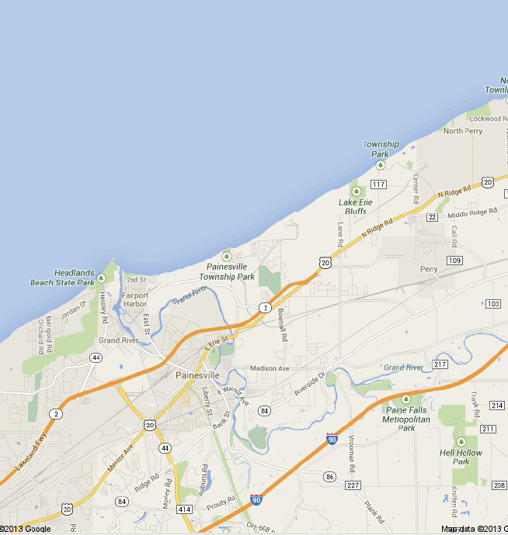
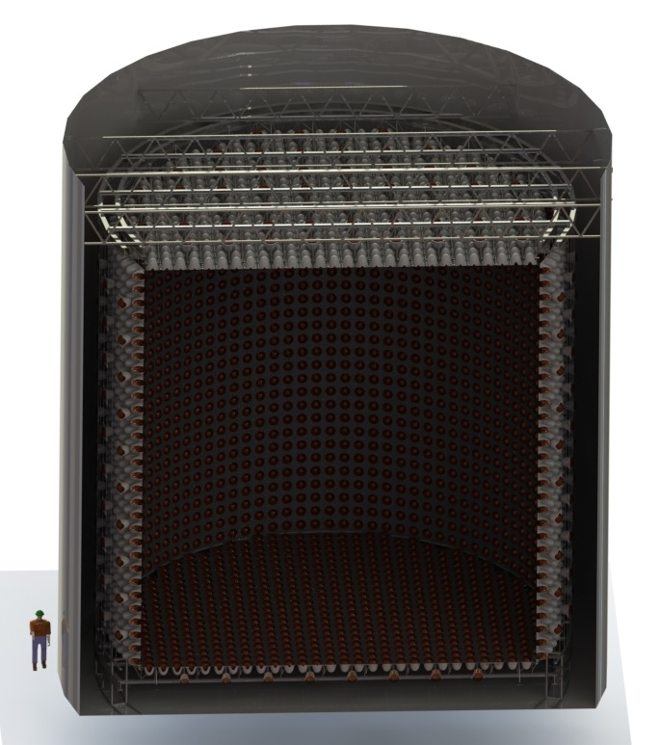
WATCHMAN: A 3 kton detector for the existing underground lab at Fairport Mine,
Joint project with Defense Nuclear Non-Proliferation (DNN)
Demonstrate remote monitoring of nuclear reactors
R&D Prototype of Advanced Water Detector for LBNF
Deployment and use of Large Area Picosecond PhotoDetectors (LAPPD)
Water-based Liquid Scntillator (WbLS)
Supernovae, reactor neutrinos, sterile neutrinos
Lake Erie
Perry Reactor
to Canada
13 km
Fairport
Mine
3 kt Gd-loaded WCD
DNN will lead project, but HEP
will contribute in order to utilize
detector for R&D and physics
Courtesy of Bob Svoboda, UC Davis

Slide 10
D. Lhuillier, CEA Saclay, review talk at Neutrino 2014

Slide 11
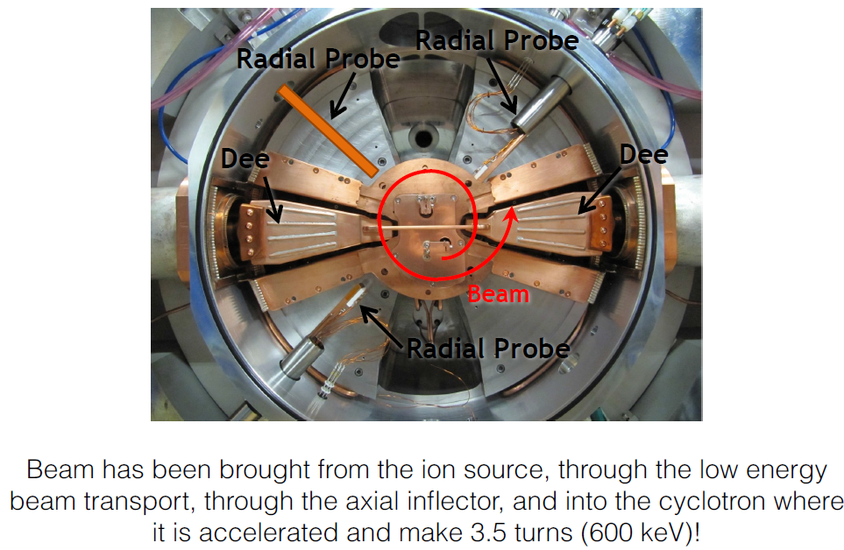
DAEδALUS / IsoDAR
R&D under way on high-power cyclotrons to provide compact, high-intensity, low-energy neutrino sources:
Stopped pion “beam” π⁺ → μ⁺ ν_{μ}; e⁺ ν_{e} ν_{¯μ} (DAEdALUS)
Isotope decay- at-rest “beam” (IsoDAR)
IsoDAR R&D Test Stand
J. Spitz, NuFact 2014

Slide 12
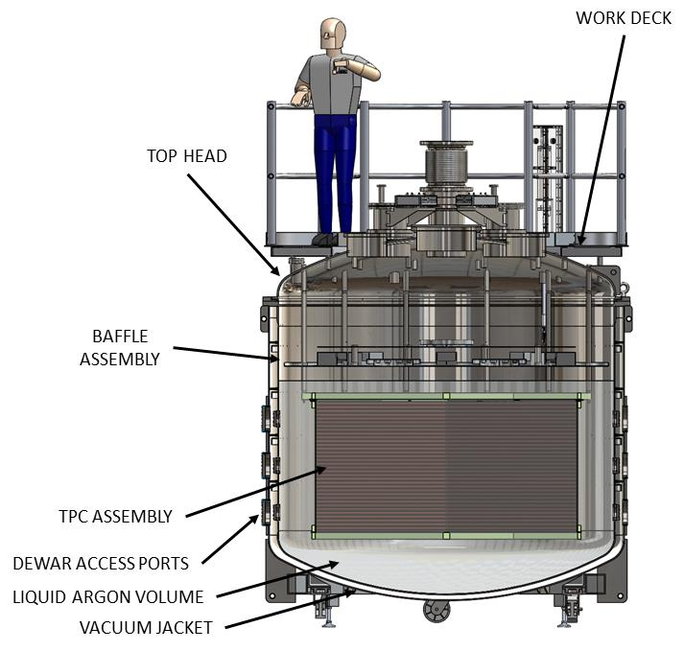
CAPTAIN: Cryogenic Apparatus for Precision Tests of Argon Interactions with Neutrinos
LAr TPC for detector R&D and physics
5 instrumented tonnes of LAr
Proposed physics measurements
Measure response to neutrons (energy reconstruction, backgrounds)
Measure cross sections for low-energy neutrinos from stopped pion beam (calibration for supernova neutrino measurements)
Smaller prototype being assembled
Cryostat for full-size detector has been received
2m
1m
Courtesy of Christopher Mauger, LANL

Slide 13
Outline
Survey of Neutrino Programs and Initiatives in the Americas
Fermilab Neutrino Program
NuMI and Booster Neutrino Beams
Experiments in the NuMI Beam
Experiments in the Booster Neutrino Beam
Increasing beam power: PIP and PIP-II
LBNE
Towards a new Long-Baseline Neutrino Facility (LBNF)

Slide 14
Accelerator-Based Neutrino Program in the U.S.
Fermilab hosts an active and diverse accelerator-based neutrino program.
Two neutrino beams in operation and a third under design
Four experiments currently taking data
Three completed experiments analyzing data
One experiment under construction
Two experiments under design
One proposals reviewed by the PAC and under consideration by Fermilab management
Several experimental proposals submitted or in development
Various R&D programs proposed or under way
Supporting test beam program for detector development and calibration.

Slide 15
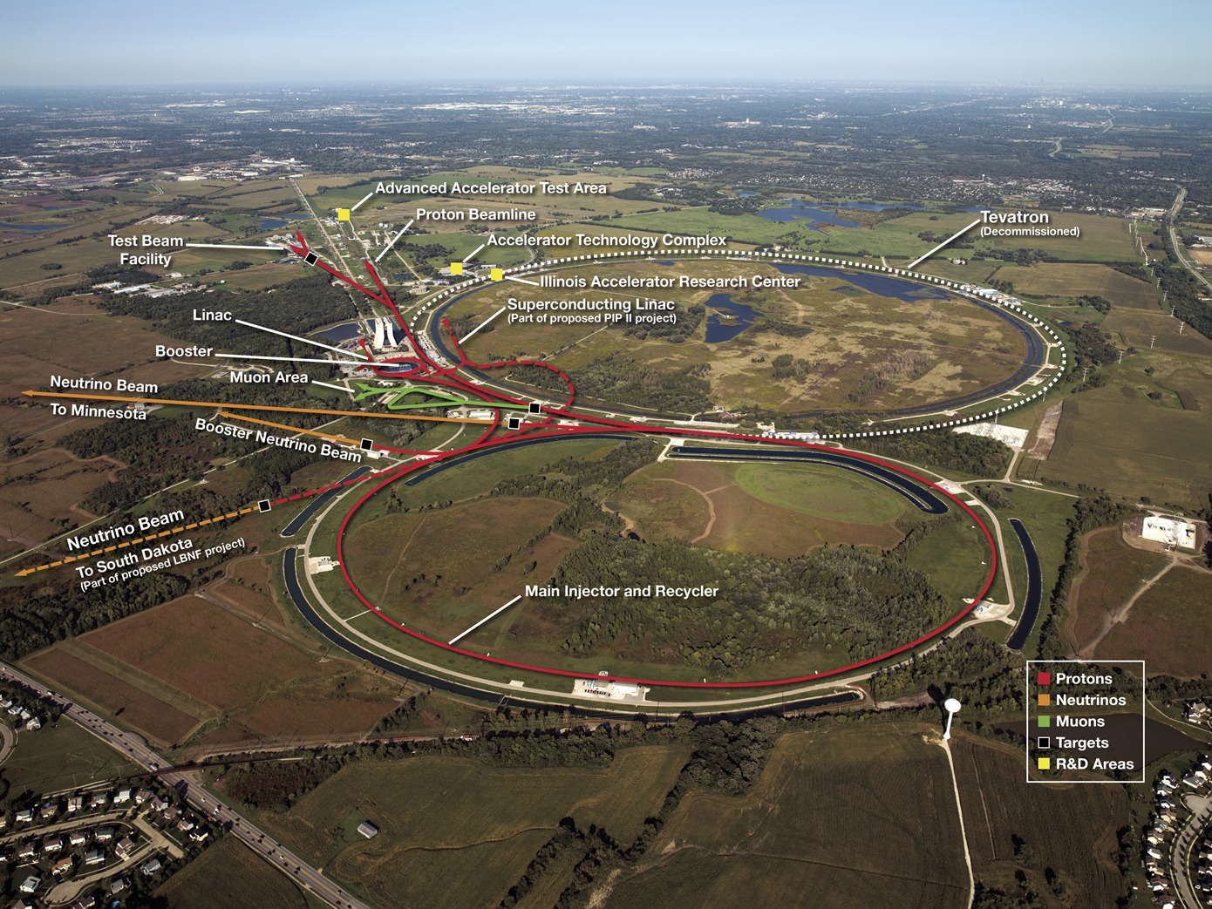
Fermilab Accelerator Complex

Slide 16
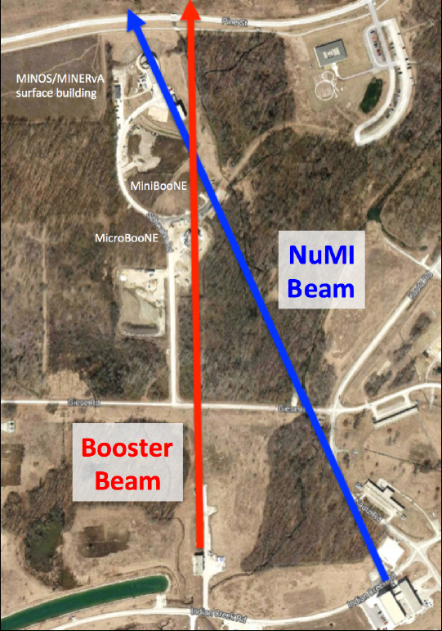
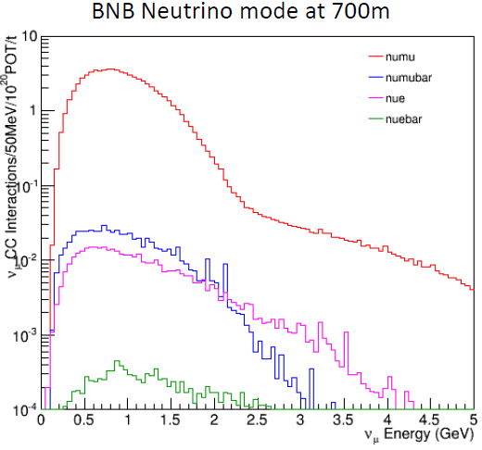
NuMI and Booster Beams
NuMI:
- tunable 1 GeV to >10 GeV
- Near hall at 1 km
- Far detectors 735 – 810 km
BNB:
- Low energy 0.1 – 1.5 GeV
- Focused on short-baseline oscillations and cross sections

Slide 17
Experiments in the NuMI Beam
Experiments include collaborators from Brazil, Chile, Mexico, Peru
as well as US and other countries

Slide 18
MINERvA Physics Results
Courtesy of Debbie Harris

Slide 19
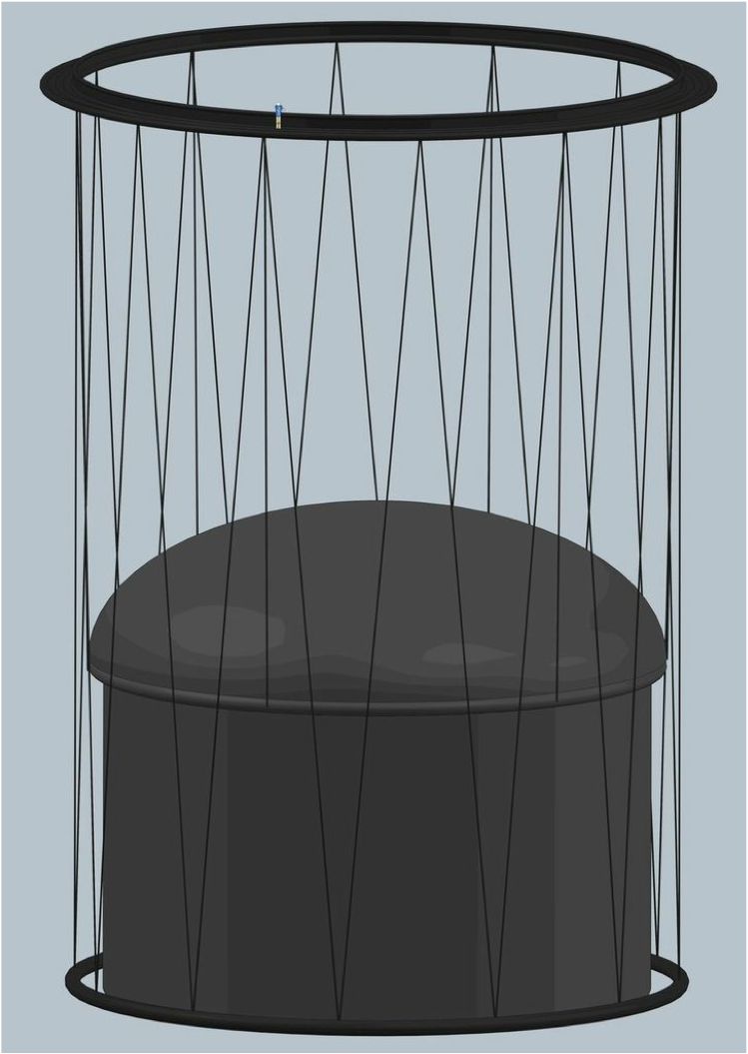
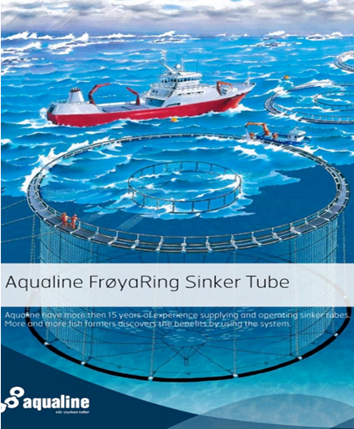
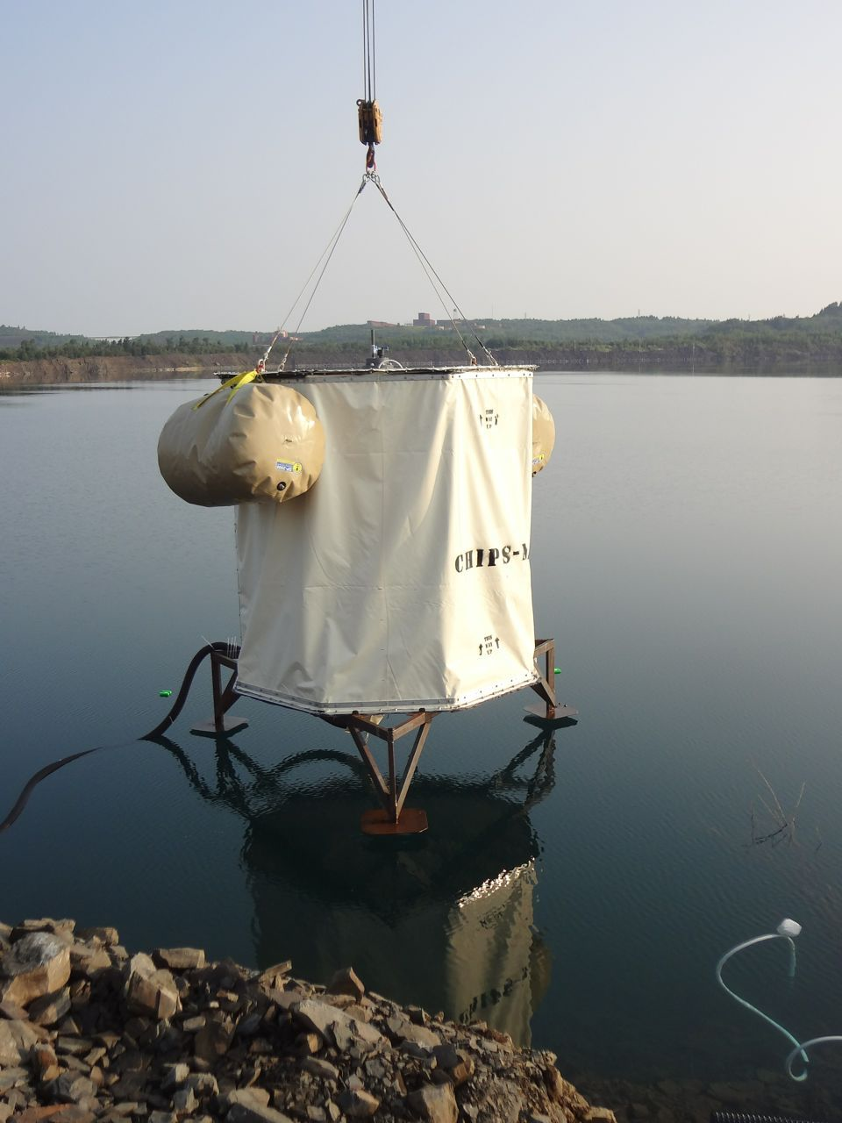
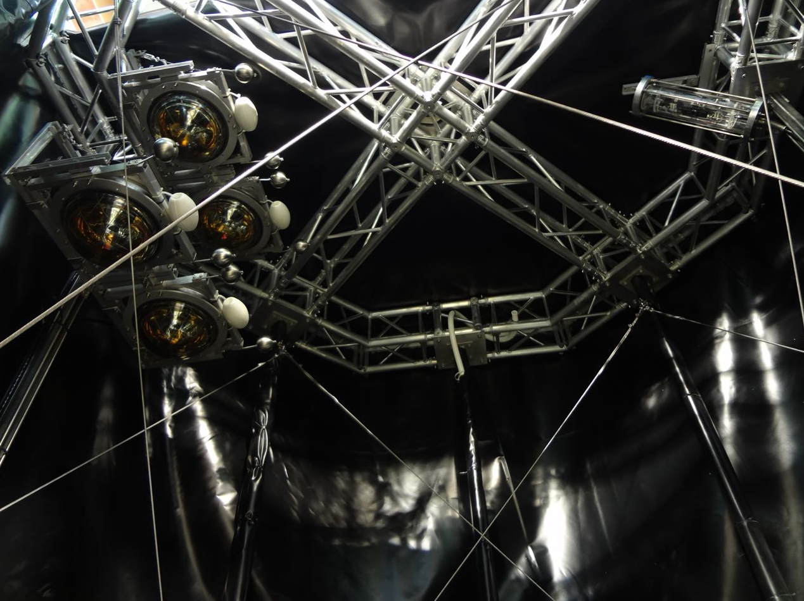
CHIPS Detector Concept
CHIPS is a water Cherenkov detector which will be sunk in a flooded mine pit in the path of the NuMI beam : water will provide mechanical support
Its main development goal is to chart a path towards cost effective Megaton scale neutrino detectors, aiming for $200k/kt (presently $1M/kt)
It will complement NOνA (being more on-axis) and LBNE (more off-axis) when redeployed in the LBNE beam and will measure δ_{CP}
It will comprise a series of prototypes which will deliver physics results and demonstrate real costs for (O)100kt
Deployment of R&D detector with 4 ICECUBE DOMs in Wentworth Mine Pit, northern Minnesota.
Courtesy of Jenny Thomas

Slide 20
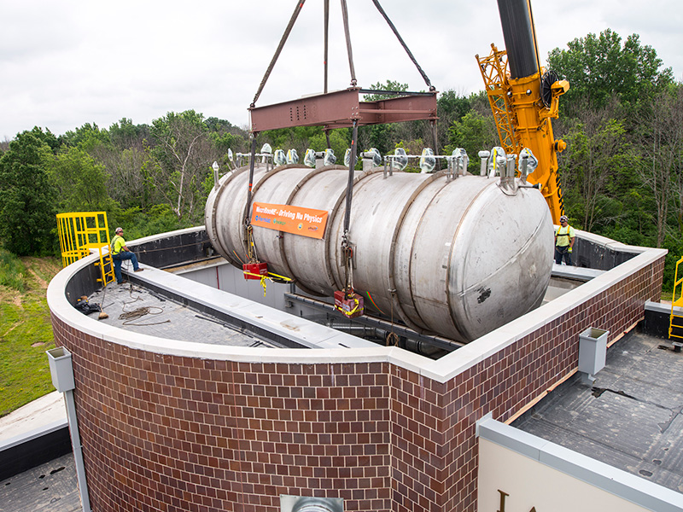
Experiments in the Booster Neutrino Beam
MicroBooNE

Slide 21
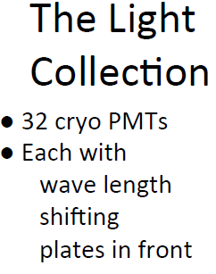
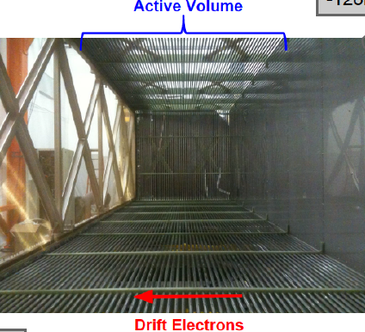
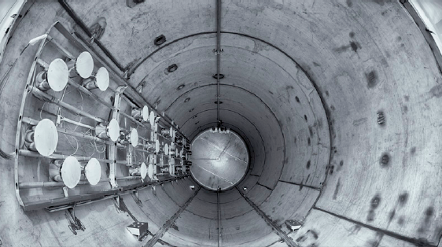
MicroBooNE
Goals: - Resolve short-baseline anomalies in ν_{μ} → ν_{e} searches - Measure ν_{μ}-Ar cross sections - Develop LAr TPC technology
Detector characteristics:
The TPC
G.Collin, MIT, DNP 2014

Slide 22
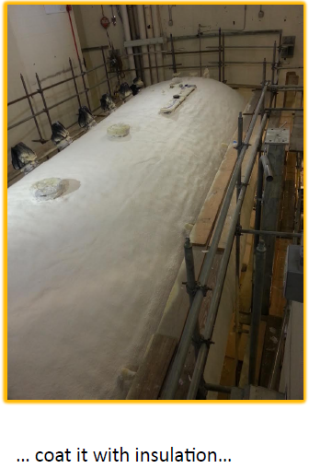
MicroBooNE Status
Completing installation in the detector hall.
Cryogenic plumbing
Cabling, etc.
Filling foreseen for January 2015
Start data taking soon thereafter.
A.Szelc, Yale, NOW 2014

Slide 23
Fermilab Short Baseline Neutrino (SBN) Program
Utilize successful Booster Neutrino Beamline (BNB) developed for MiniBooNE
In 2015 next phase: MicroBooNE (approved for 6.6E20 P.O.T.)
In 2018: Three LAr-TPC detectors:
Near: New detector using LBNE technology @ 110m from BNB target
Middle: MicroBooNE @ 470m
Far: refurbished ICARUS detector moved from Gran Sasso, Italy @ 600m
Motivations
Science: precise study of ν anomalies from the MiniBooNE and LSND experiments. Search for Sterile ν’s
R&D: continued development of LAr-TPC technology for LBNF program
Build international partnerships for LBNF program

Slide 24
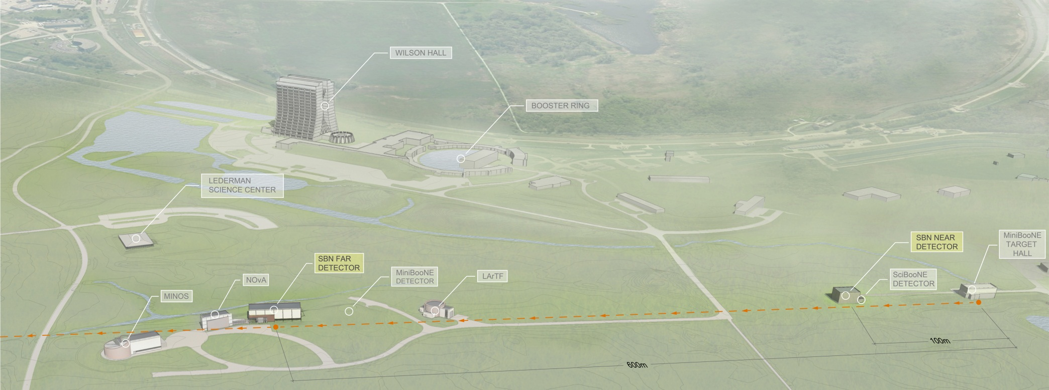
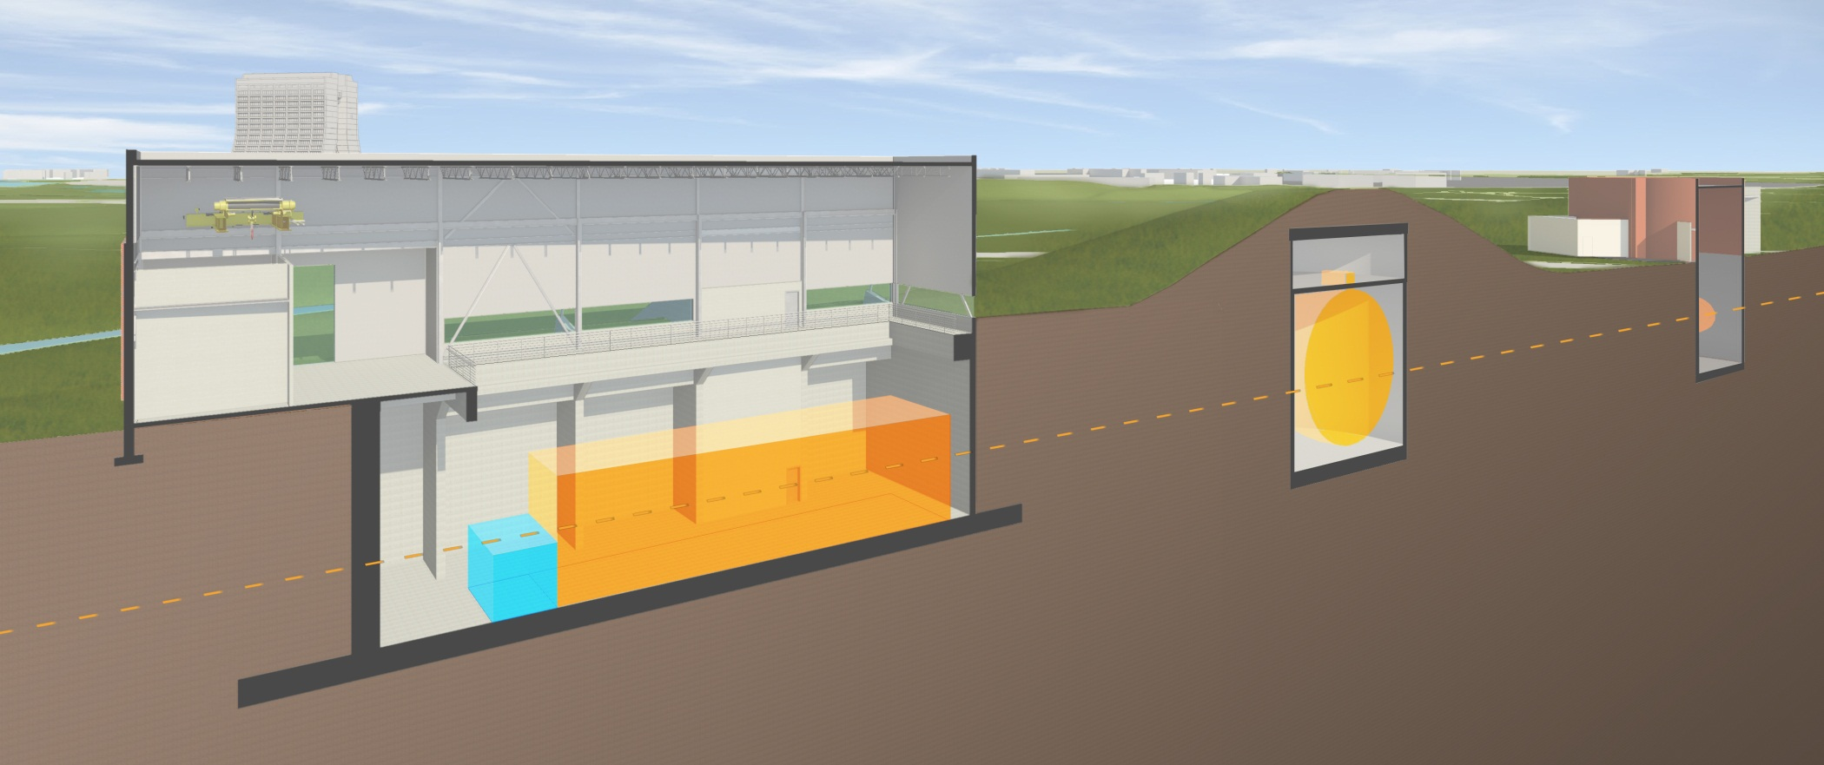
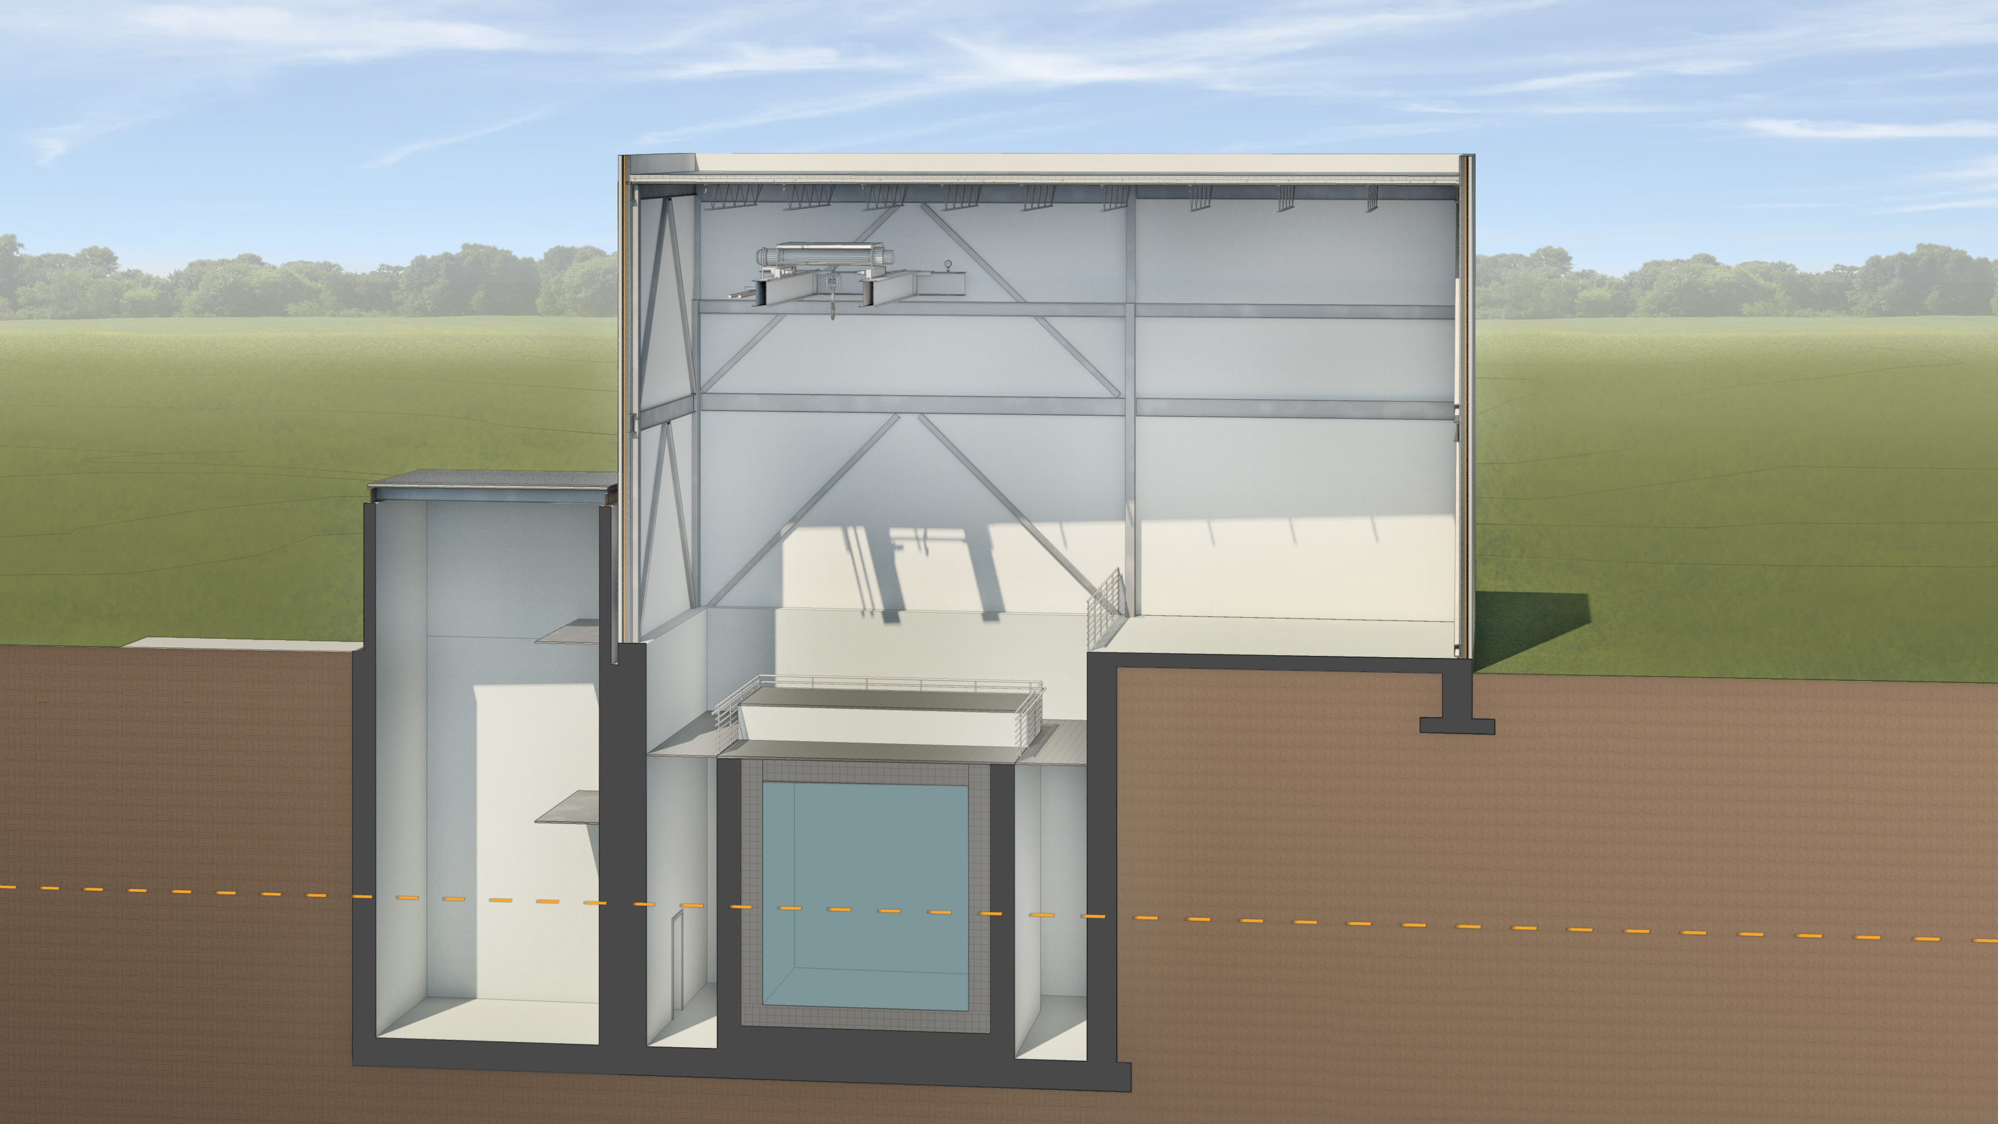
SBN Program Layout
MicroBooNE
DETECTOR

Slide 25
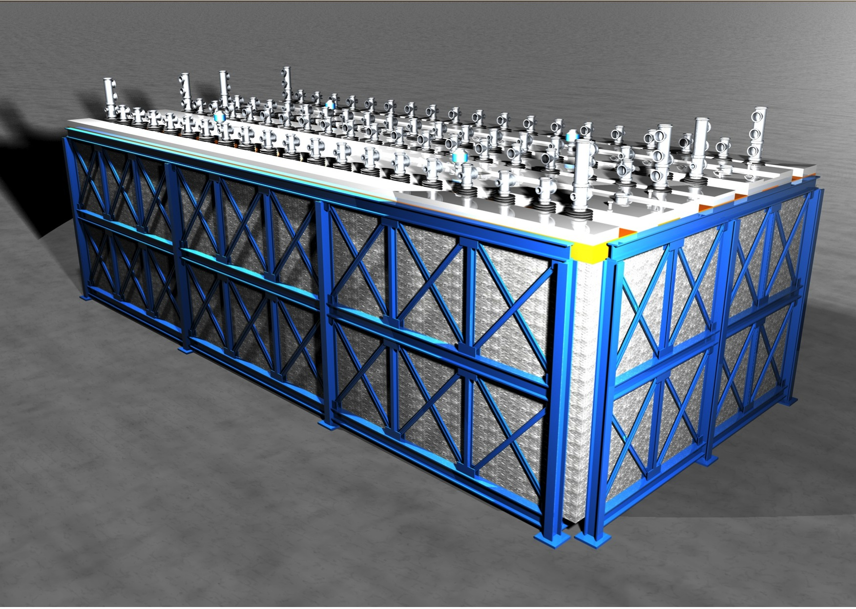
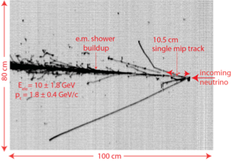
Far Detector: ICARUS T600
T600 detector consists of two 300t cryostat modules
Successful operation at Gran Sasso in CNGS beam
Achieved electron lifetime >15ms
Move from Gran Sasso to CERN Fall 2014
Refurbish at CERN: new cryostats, new electronics, upgraded light detection
ICARUS data event with:
Evisible = 11.5 ± 1.8 GeV
Eelectron = 10 ± 1.8 GeV
ptransverse = 1.8 ± 0.4 GeV/c

Slide 26
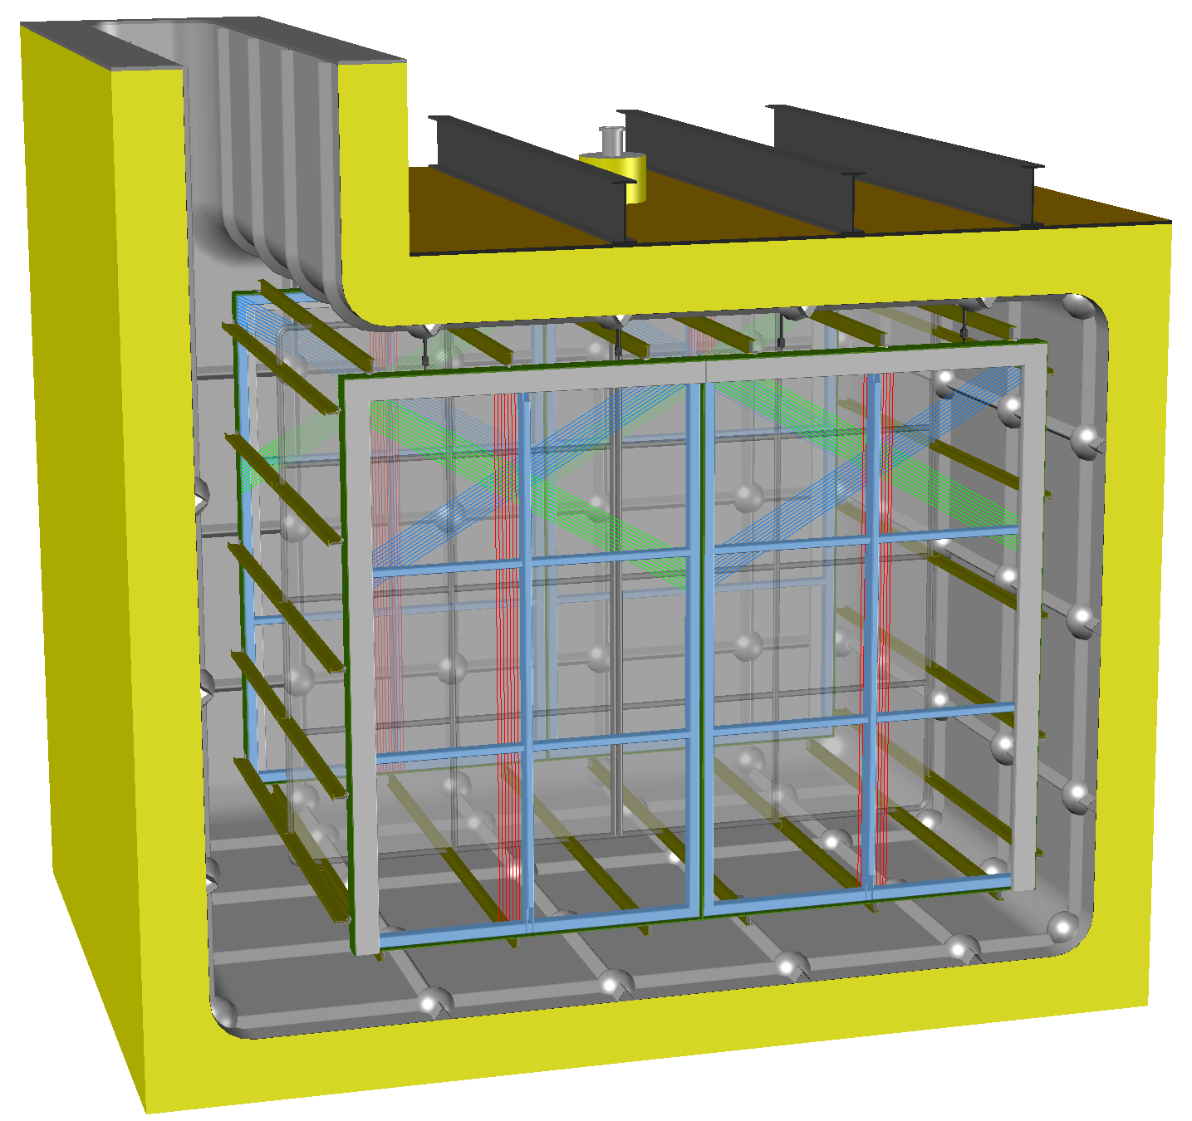
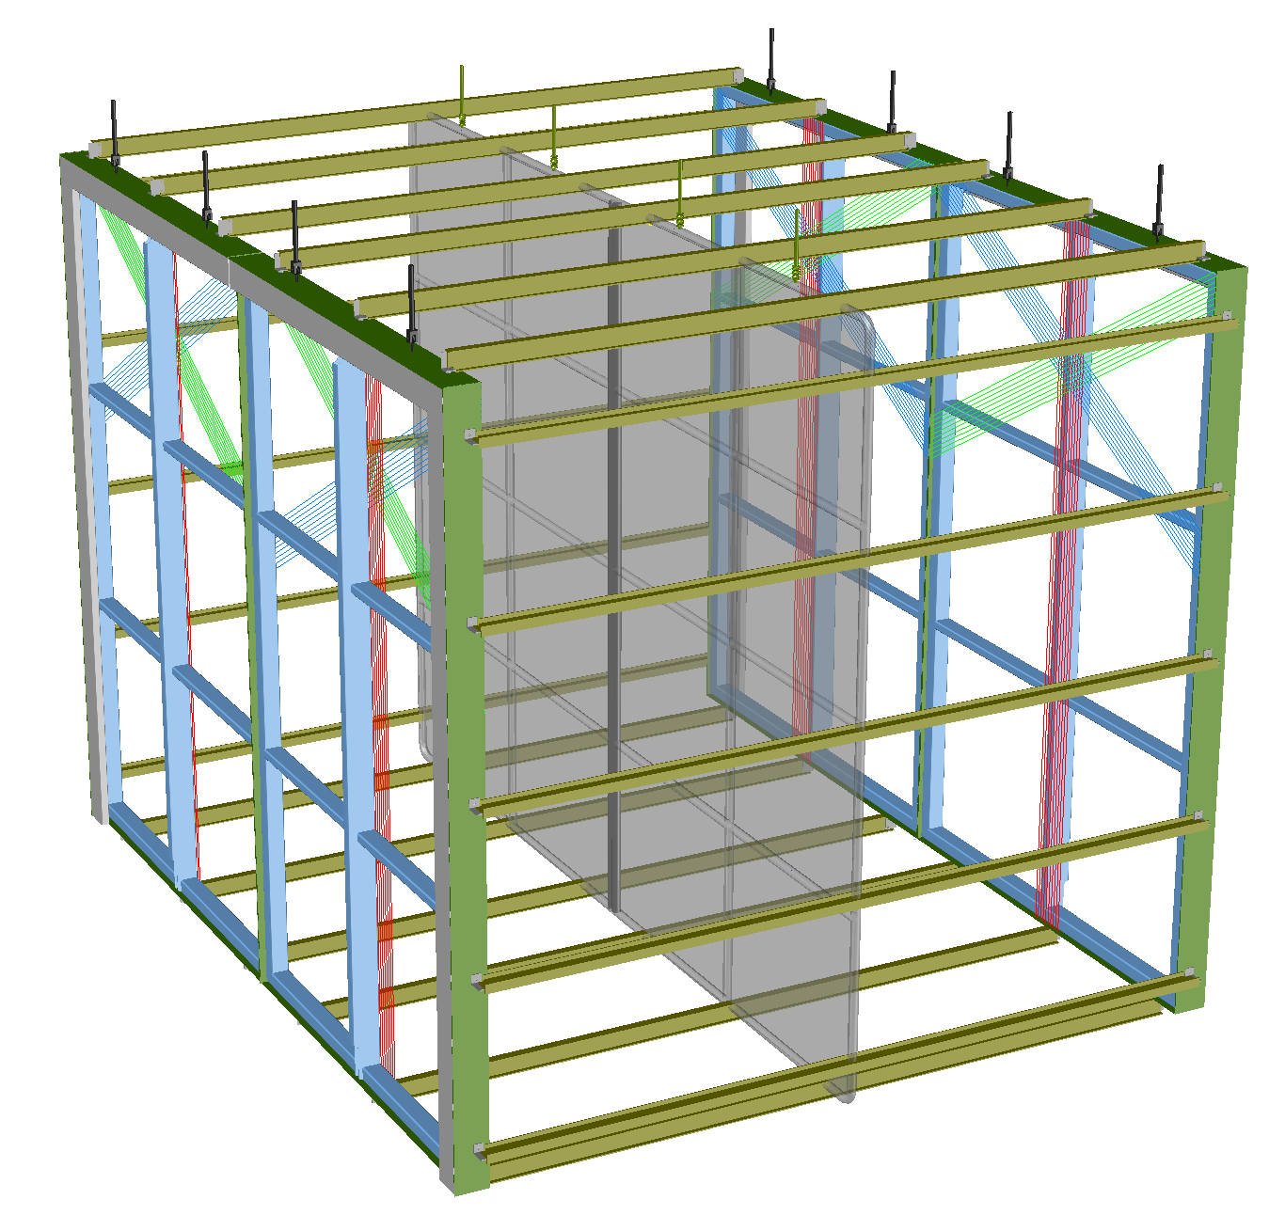
Near detector: LAr1-ND
New LAr TPC detector based on and testing LBNE single-phase technology
Build on MicroBooNE and LBNE 35 ton experience
Test LBNF components in neutrino beam
Explore design alternatives
Cryostat: membrane technology and minimize surfaces in LAr gas ullage
TPC: LBNE-like preassembled cathode and anode planes but with cathode in the middle and no wire wrap on the anode planes
Electronics: LBNE cold electronics including processing FPGA in cold
Light detection: starting point is LBNE-style acrylic bars with SiPM readout.
BNB

Slide 27
SBN Program Development
International partnership of the three collaborations developing joint proposal for submission to January 2015 PAC meeting
More than 40 institutions from 5 countries including 4 DOE labs and CER
Strong support from US DOE and NSF, INFN, and CERN. Additional support requests to CH NSF and UK STFC
Very Fast timeline
2014 – Proposal preparation initial design and logistics
2014 – Civil construction start, near detector design, T600 refurbishing
2016 – Civil construction complete, near detector construction, T600 refurbishing
2017 – Detector installation
2018 – Beam operations with all three detectors
Support expected from US DOE, US NSF, INFN and CERN.

Slide 28
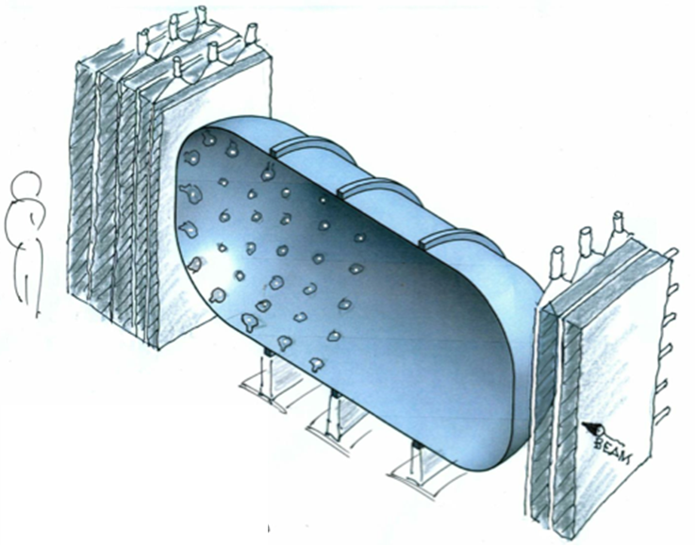
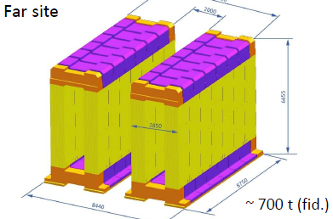
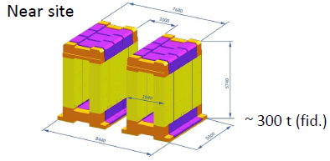
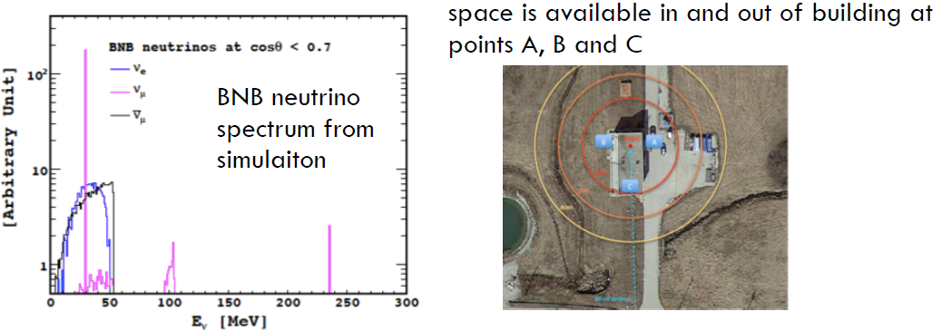
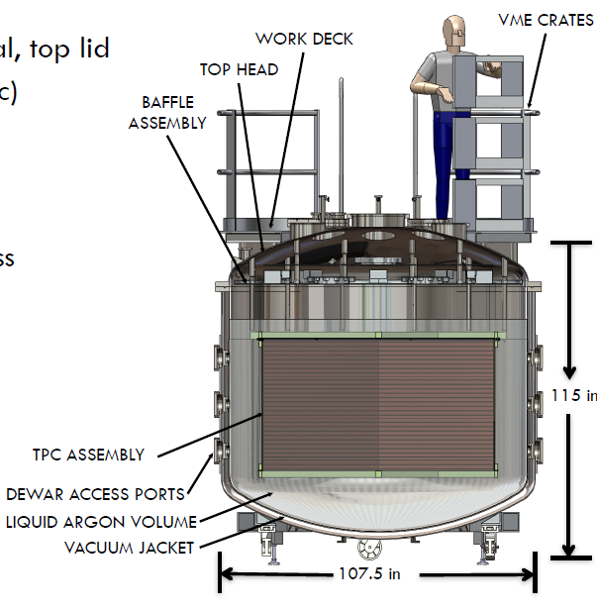
Additional Possible Experiments in the Booster Beam
L.Stanco et al.
M.Sanchez et al.
Short-baseline ν_{μ}-disappearance measurement in BNB (NESSiE)
ANNIE: Measure ν-induced backgrounds relevant for large water detectors using an Optical Time Projection Chamber in BNB
CAPTAIN
Calibrate LAr TPC response to low-energy neutrinos with stopped pion beam

Slide 29
Increasing beam intensity
Upgrades to the Main Injector and Recycler done as part of the NOvA construction will enable doubling the NuMI beam power to 700 kW
Convert Recycler to proton-stacking ring
Increase Main Injector ramp rate
~10% increase in intensity per pulse
Proton Improvement Plan (PIP) to increase proton flux from Booster to the Main Injector
Refurbish Booster RF system: 7.5 → 15 Hz beam operation
Upgrades to Linac and Booster for higher reliability
Combined upgrades will deliver 700 kW to NOvA and increase the intensity of the Booster Neutrino Beam.

Slide 30
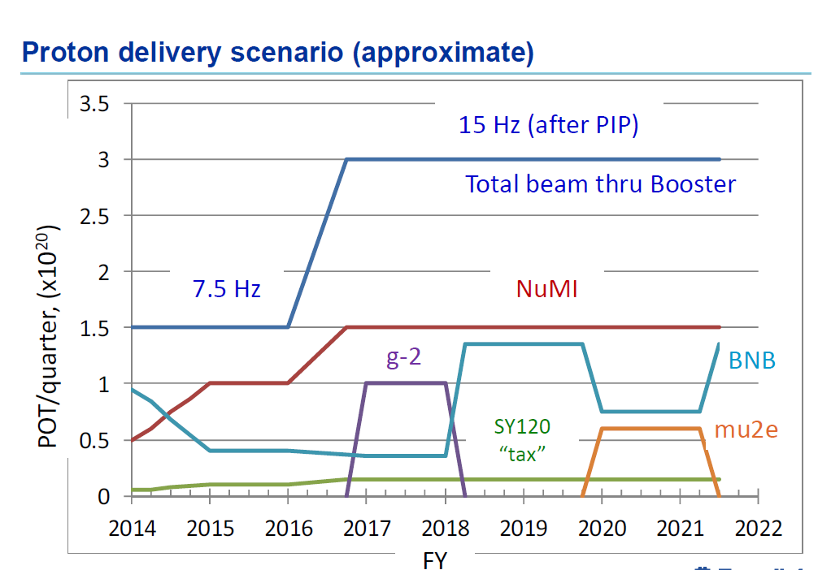

Slide 31
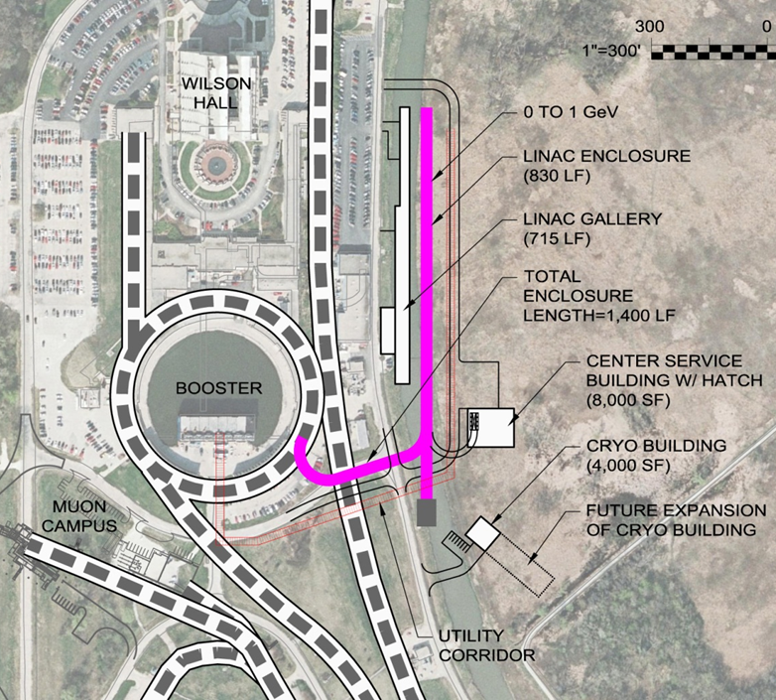
Proton Improvement Plan II (PIP-II)
Goal is to increase Main Injector beam power to 1.2 MW.
Replace the existing 400 MeV linac with a new 800 MeV superconducting linac => 50% increase in Booster intensity.
Shorten Main Injector cycle time 1.33 → 1.2 sec.
Build this concurrently with new long-baseline facility => deliver 1.2 MW to LBNE from t = 0.
This plan is based on well- developed SRF technology.
Developing an international partnership for its construction
Strong support from DOE and P5

Slide 32
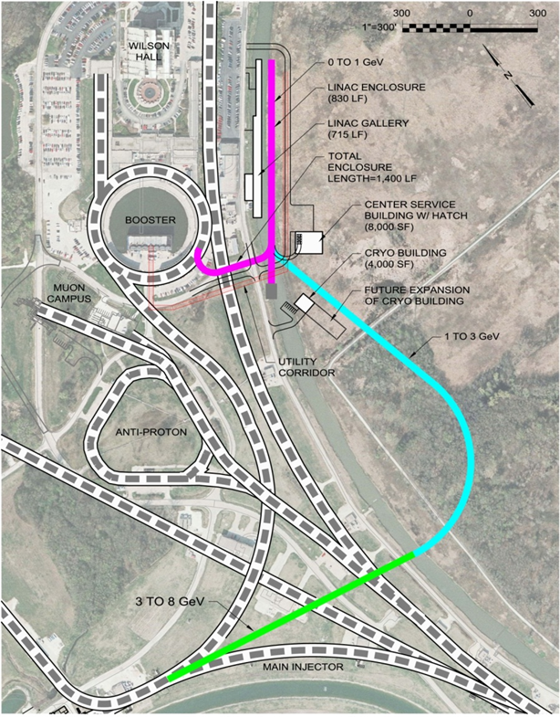
Flexible Platform for the Future
PIP-II Inherent Capability
~200 kW @ 800 MeV
x10 Mu2e sensitivity
Future upgrade would provide > 2 MW to LBNE
Flexibility for future experiments
Muons, Kaons at 100’s kW
More in the talk by V.Papadimitriou in Parallel session 4

Slide 33
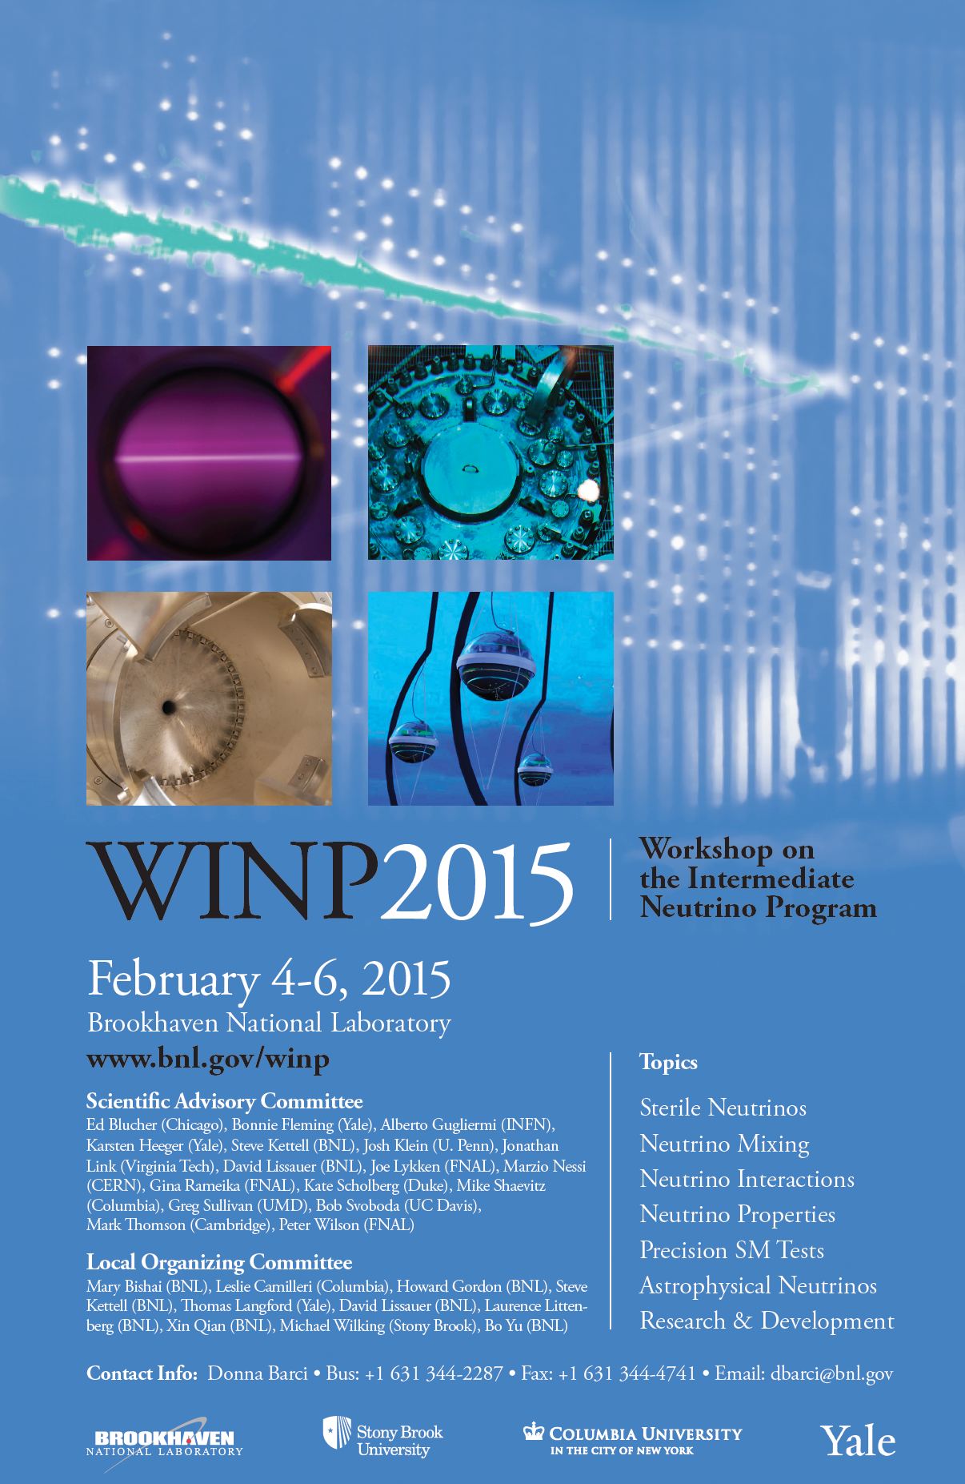
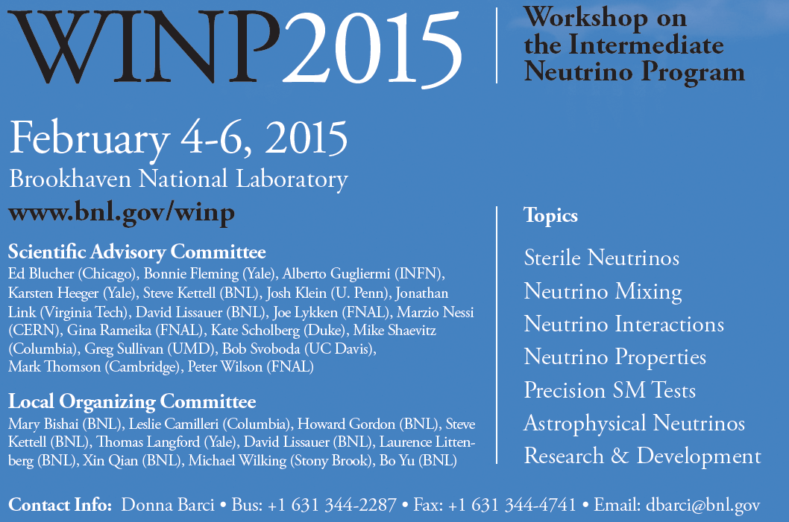

Slide 34
Outline
Survey of Neutrino Programs and Initiatives in the Americas
Fermilab Neutrino Program
LBNE
LBNE Collaboration
Experiment Design and Development
Scientific Capabilities
Towards a new Long-Baseline Neutrino Facility (LBNF)

Slide 35
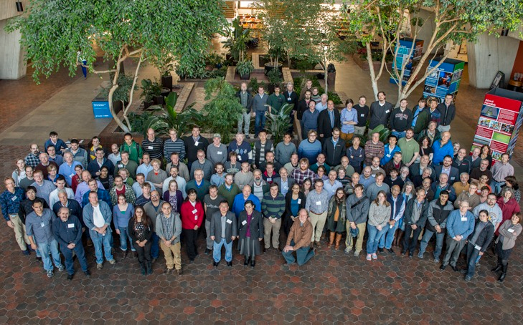
LBNE Collaboration
UFABC
Alabama
Argonne
Banaras
Boston
Brookhaven
Cambridge
Catania/INFN
CBPF
Charles U
Chicago
Cincinnati
Colorado
Colorado State
Columbia
Czech Technical U
Dakota State
Delhi
Davis
Drexel
Duke
Duluth
Fermilab
FZU
Goias
Gran Sasso
GSSI
HRI
Hawaii
Houston
IIT Guwahati
Indiana
INR
Iowa State
Irvine
Kansas State
Kavli/IPMU-Tokyo
Lancaster
Lawrence Berkeley NL
Livermore NL
Liverpool
London UCL
Los Alamos NL
Louisiana State
Manchester
Maryland
Michigan State
Milano
Milano/Bicocca
Minnesota
MIT
Napoli
NGA
New Mexico
Northwestern
Notre Dame
Oxford
Padova
Panjab
Pavia
Pennsylvania
Pittsburgh
Princeton
Rensselaer
Rochester
Rutherfod Lab
Sanford Lab
Sheffield
SLAC
South Carolina
South Dakota
South Dakota State
SDSMT
Southern Methodis
Stonybrookt
Sussex
Syracuse
Tennessee
Texas, Arlington
Texas, Austin
Tufts
UCLA
UEFS
UNICAMP
UNIFAL
Virginia Tech
Warwick
Washington
William and Mary
Wisconsin
Yale
Yerevan
552 (~25% non-US) members, 90 (35 non-US) institutions, 9 countries

Slide 36
LBNE Science Goals
CP Violation in neutrino sector
Violation of a fundamental symmetry of nature; viability of leptogenesis models->matter/antimatter
Neutrino Mass Hierarchy
GUTs, Dirac vs. Majorana nature and feasibility of 0νββ decay
Testing the Three-Flavor Paradigm
Precision measurements of known fundamental mixing parameters for neutrinos and anti-neutrinos
New physics -> non-standard interactions, sterile neutrinos… (beam + atmospheric ν sources)
Precision neutrino interactions studies (near detector)
Nucleon Decay
Astrophysics: Supernova ν burst

Slide 37
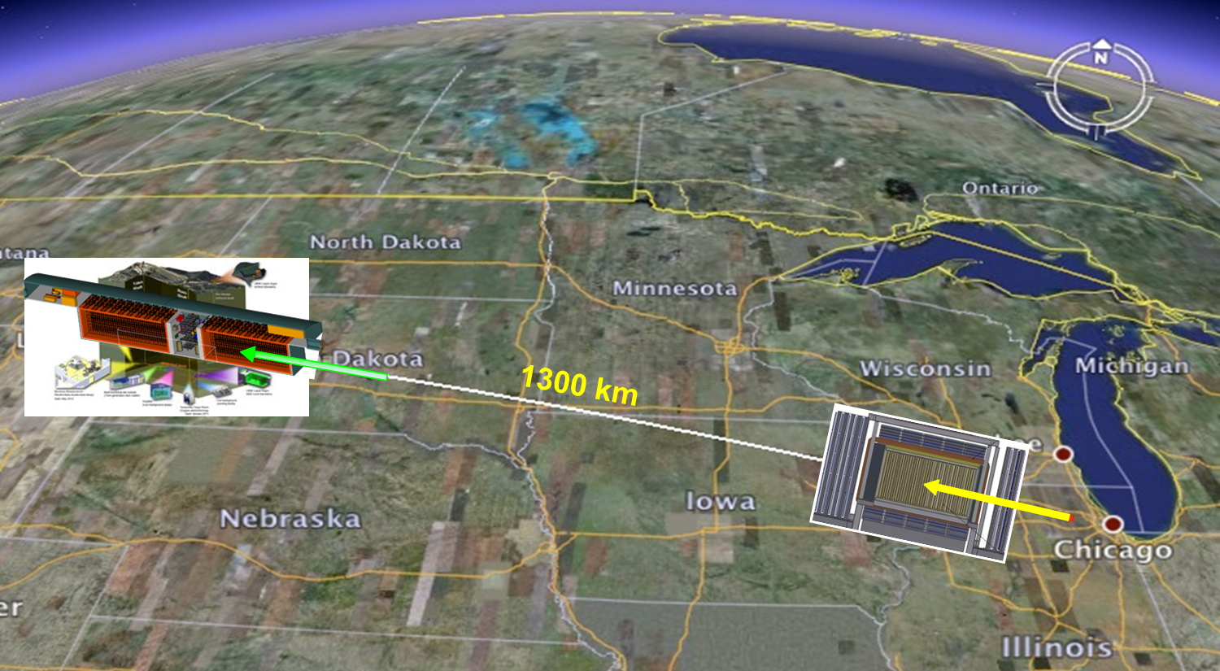
LBNE Design
1.2 MW Proton Beam (PIP-II)
Upgradeable to ≥ 2.4 MW
34 kt fiducial mass
single-phase LAr TPC
Depth = 4300 m.w.e
Magnetized, low-density
fine-grained tracker

Slide 38
LBNE
Talk by V.Papadimitriou in Parallel session 4
Talk by J.Yu in Parallel session 3
Complete Conceptual Design Report Exists

Slide 39
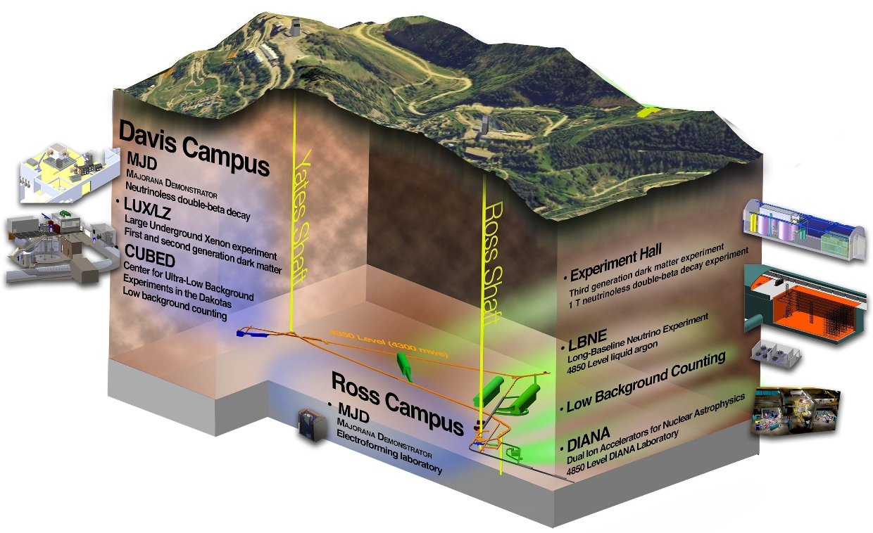
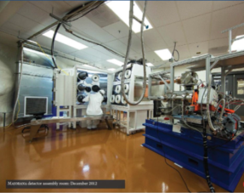
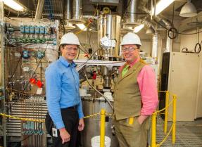
Sanford Underground Research Facility
CASPAR
Compact Accelerator System for Astrophysical Research

Slide 40
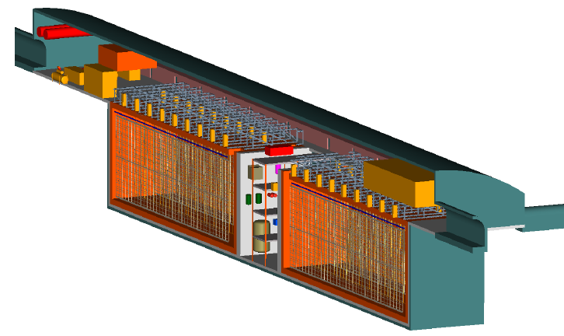
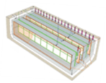
LBNE Far Detector Design
LBNE Liquid Argon TPC
GOAL: ≥35 kt fiducial mass
Volume: 18m x 23m x 51m x 2
Total Liquid Argon Mass: ~50,000 tonnes
Based on the ICARUS design
Actual detector design will evolve as new partners join the effort, and may involve multiple modules of different designs.

Slide 41
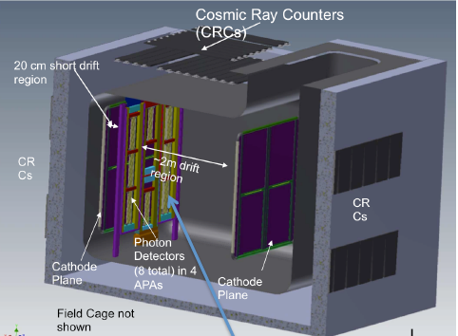
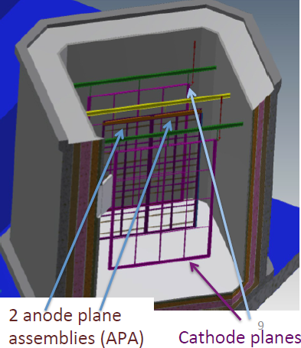
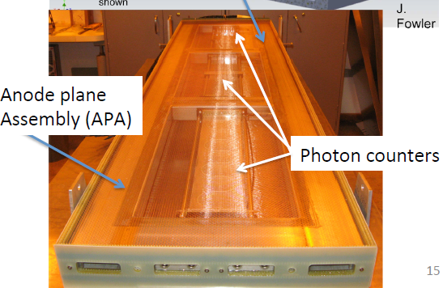
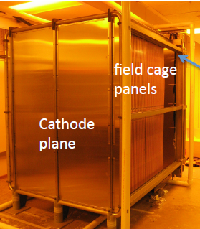
Prototyping Work
Reduced-scale prototype in Fermilab 35 t cryostat
Proposed full-scale prototype and beam test in CERN Neutrino Platform
8 x 8 x 8 m³ cryostat
Photon counters

Slide 42
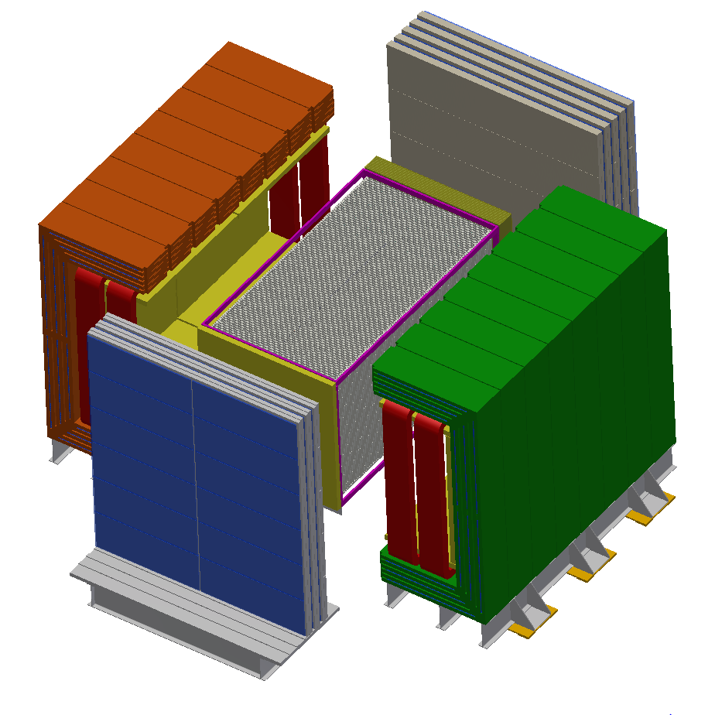
LBNE Near Neutrino Detector
Proposed by collaborators from the Indian institutions and others
High precision straw-tube tracker with embedded high- pressure argon gas targets
4π electromagnetic calorimeter and muon identification systems
Large-aperture dipole magnet
Addition of LAr TPC or GAr TPC would enhance capabilities
3.5 m
7 m

Slide 43
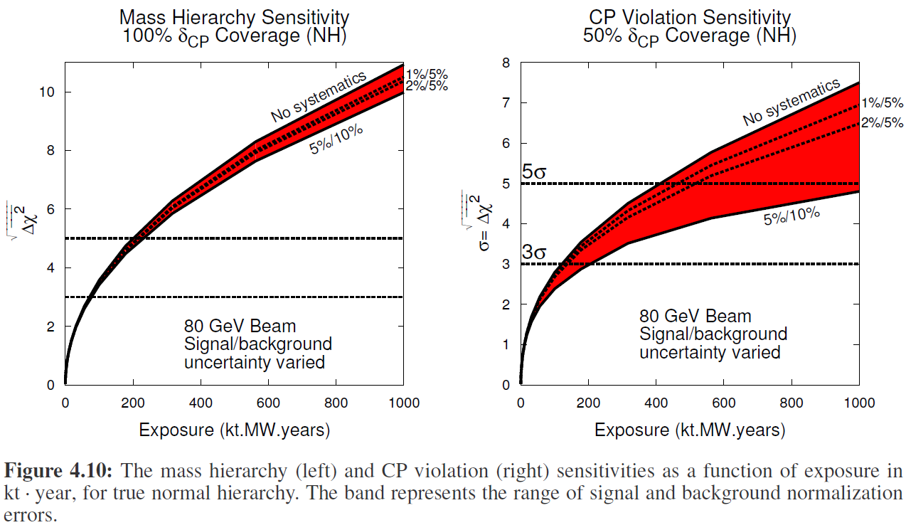
LBNE Sensitivity for MH and CP Violation
arXiv:1307.7335v3 [hep-ex] 22 Apr 2014

Slide 44
Apply LBNO-design low-energy beam (HPPS LE) to LBNE
LBNE with LBNO
HPPS LE Beam
LBNE with LBNO
HPPS LE Beam
LBNE with LBNE Beam
LBNE with LBNE Beam
Application of HPPS LE beam spectrum to LBNE baseline - modestly improves CP violation reach - improves minimum Δ^{χ2} by ~x2 for MH

Slide 45
Proton Decay Sensitivity: p → K⁺ ν¯

Slide 47
Outline
Survey of Neutrino Programs and Initiatives in the Americas
Fermilab Neutrino Program
LBNE
Towards a new Long-Baseline Neutrino Facility (LBNF)
P5 Recommendations
Steps toward formulation of LBNF
Activities building a Global Collaboration

Slide 49
Steps toward formulation of LBNF
Fermilab has formed two groups to help form the new international collaboration to design and execute LBNF
interim International Executive Board (iIEB)
Members drawn from the long-baseline neutrino scientific community
Focused mainly on science and the formation of the collaboration
Two meetings held so far: 23-24 September and 20 October
Developing draft Letter of Intent (LOI) for LBNF
More info at https://web.fnal.gov/project/iiEB
Working group on international project governance
Representatives from key funding agencies and labs
Focused on international framework at the funding agency level
Developing a short, high-level proposal for international framework for LBNF, as common starting point for formal gov’t to gov’t negotiations
Three meetings so far

Slide 50
Steps toward formulation of LBNF
The CERN / LHC model will be used as a starting point.
The experiment and the facilities will be two distinct entities.
Fermilab, as host lab, will be responsible for the facilities and for oversight of the experiment
International partners may contribute to one or the other or both
LBNF – Facility
Neutrino beamline
Conventional facilities for beamline and near detector at Fermilab
Conventional facilities for the far detector at SURF
Major technical infrastructure such as cryostat and cryogenics
LBNF – Experiment and collaboration
Definition of scientific goals and requirements
Design, construction and operation of the detector systems
Scientific research program
Experiment-Facility Interface Group to ensure the required coordination

Slide 51
Steps toward formulation of LBNF
Open meetings for all interested PIs scheduled
December 5 and 12 at CERN and Fermilab.
Video links will be available
Objectives:
Discuss LOI and provide opportunity to “sign” it.
Discuss steps toward formation of the new collaboration
Mechanisms will be provided to facilitate input from those unable to attend.
People are encouraged to attend both meetings in person or by video.
More detailed information soon ... Save the dates!
Goals:
Submit LOI to Fermilab PAC before end of 2014
New (proto-)collaboration functioning in early 2015
Submit full Proposal/CDR by mid-2015

Slide 52
Activities Building a Global Collaboration
iIEB engaging with and inviting all interested parties, whether or not they are currently involved in neutrino oscillation programs or collaborations
The LOI and full proposal should include the best ideas from everyone interested in this science.
LBNE-LBNO task force has been meeting for > 1 year
Goal to bring these two collaborations closer together
Exchange of information and ideas regarding beam and detectors for a unified long-baseline program
LBNE-sponsored Near Detector Open Workshop in July
Included participants from LBNE, LBNO and others
Fine-grained tracker taken to be the reference design
Other options explored included magnetized LAr TPC or high-pressure GAr TPC, alone or together with fine-grained tracker

Slide 53
Building a Global Collaboration
LBNE-LBNO joint meeting at SURF on rock mechanics and LAr cryostat design in October
Working towards a common understanding of cryostat design within the SURF facility => common design for single- and dual-phase detectors?
Conclusion: focus efforts at quickly resolving pending issues with implementation at SURF. https://indico.fnal.gov/getFile.py/access?contribId=1&resId=0&materialId=1&confId=9013
EOI submitted to CERN for prototype and beam test of LBNE-type single-phase LAr TPC submitted with authors from LBNE, ICARUS and LBNO.
Plan cooperative work with test of LBNO-type dual-phase detector (WA105).
Full proposal invited by SPSC, to be submitted in the spring.
Significant CERN engagement with Fermilab and DOE to plan a joint neutrino program utilizing the Fermilab beams
Developing joint CERN-Fermilab cryogenic engineering team to support LAr detectors for neutrinos
Fermilab SBN program represents a “prototype” for the global program.

Slide 54
Summary / Conclusions
There is a very active program of neutrino experiments and R&D programs across the Americas
Fermilab hosts an active and diverse accelerator-based neutrino program
The LBNE Collaboration has developed a comprehensive design for a next-generation long-baseline oscillation experiment
A global community is coming together to capitalize on the opportunity to build and exploit a new Long-Baseline Neutrino Facility based at Fermilab and SURF

