Slide 2


Future of Large Surveys at CFHT
Doug Simons
Executive Director, CFHT

Slide 3
Total Papers Published Per Telescope
(2008 - 2012)*
For reference HST had ~3700 papers
* Plot Courtesy Dennis Crabtree

Slide 4
Papers Published Per Telescope
(By Year)*
Product of large, homogenous, well calibrated data sets
* Plot Courtesy Dennis Crabtree

Slide 5
Total Impact per Telescope
(2008 - 2012)*
* Plot Courtesy Dennis Crabtree

Slide 6
Total Impact per Telescope (by Year)*
From these publication metrics it is safe to conclude that the scientific productivity of CFHT (and similar facilities like UKIRT) has been significantly enhanced through the inclusion of large surveys in our observing programs
We should continue them in the future…
* Plot Courtesy Dennis Crabtree

Slide 7
Expanding CFHT’s Survey Horizon
From the September 2013 SAC resolutions –
“We note that for maximum scientific return, either of the two options will require observing time commitments of the order of 1000 nights to realize the full potential of these instruments. We recommend that CFHT carry out future very large, proposal-driven, community-based collaborative surveys in the spirit of CFHTLS.”
In addition I gleaned from the 2013 Board discussions interest in possibly expanding CFHT’s survey programs (given our strong track record), as long as Associate Partner interests are preserved, significant amounts of dark time are preserved (e.g., SITELLE), PI time is available, etc.

Slide 8
Notional Timescales
2014
2015
2016
2017
2018
2019
2020
2021
2022
2023
2024
2025
2026
2031
2032
2033
2034
Current Operations
MegaCam, WIRCam, Espadons
SITELLE
Com.
Operate
SPIRou
Build
Operate
Large Programs
Current
New
UKIRT Operations?
10 yr Agreement?
MSE?
Proj. Office - CoDR
Detailed Study
Construction
→
Operations
Sub-lease Expires
New Sub-lease?
→

Slide 9
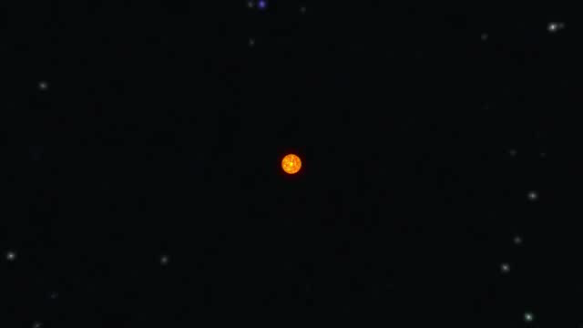
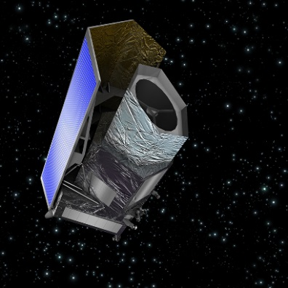

Notional Timescales
TESS
SPIRou
Build
Operate
EUCLID
Large Programs
Current
New
GAIA
MSE?
Proj. Office - CoDR
Detailed Study
Construction
→
Operations

Slide 10
Boundary Conditions
Clear evidence that major surveys increase the scientific productivity of CFHT – meaning we should continue them in the future
Commitment to build SPIRou, which is a survey machine, means we have also committed to a ~500 night ~5 yr SLS, albeit many details remain to be sorted
Time needed for the SLS is similar to what we now allocate to LP’s so if we do not expand our survey “horizon”, the SLS will be it through ~2022
  SPIRou data products are probably not as broadly applicable to varied research interests as imaging data has been in the past

Slide 11
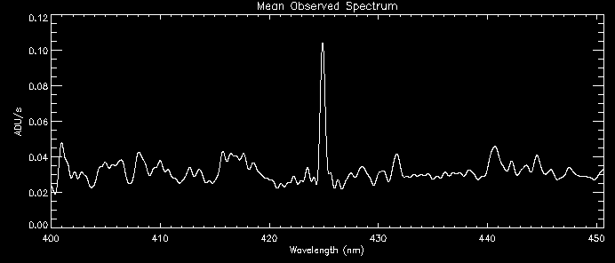
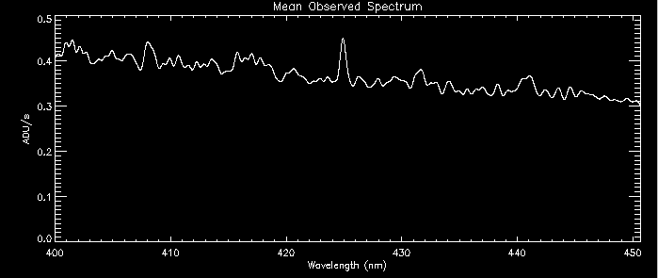
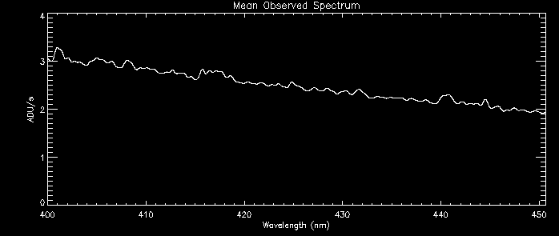
Boundary Conditions
If we expand the fraction of time allocated to surveys, we need to ensure adequate –
  PI time available to partners that are generally not interested in survey participation
  Dark/bright time for all needs
  ToO time, engineering time, opportunity to use available instruments in non-survey applications
New moon
First quarter moon
Red shifted [OII] 3727 line
SITELLE simulation
Full moon

Slide 12
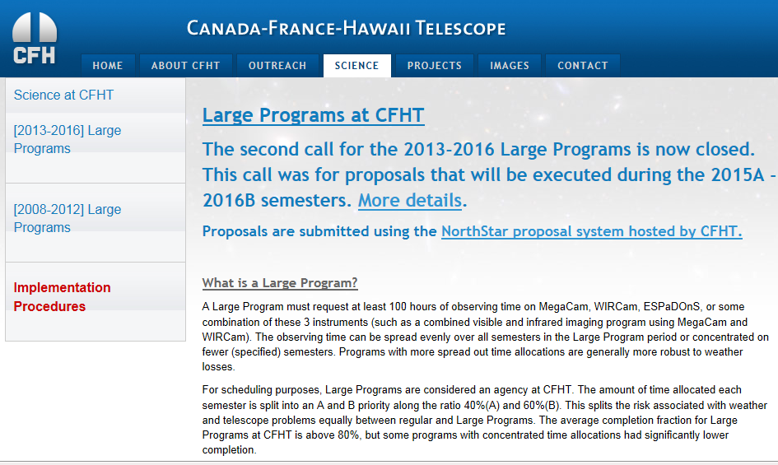
Boundary Conditions
We need to be ready to start some form of new surveys/LP’s in 17A, when current and planned LP’s all nominally come to an end
  Means we need to decide upon a strategy in 2014 to launch a call in 2015 and/or put in place SLS
  Give teams time to organize, write grant proposals, hire key staff, etc.
Given these various “boundary conditions”, where from here…

Slide 13
Finding the “Sweet Spot”
Surveys → Science
SPIRou (500 nights)
Dark/Bright Time
PI Time
Associate Partners
Ready to Start 17A

Slide 14
For SAC’s Consideration
(From Last Week’s SAC Meeting)
Proceed with SPIRou LS under TBD conditions
  Subject to review by SAC of SPIRou team’s SLS proposal
  Amounts to 500 nights over 5 years
In parallel proceed with similar allocation of time for large survey(s) –
  Release Call for Proposal early 2015, with selection later that year
  500 nights from 17A – 21B
  Competed through proposals solicited from CFHT partnership
  Open for any CFHT facility or guest instrument
  Proposal time constraints would be -
    At a minimum the same as current LP’s
    At a maximum up to 500 nights
Proposals reviewed by independent panel that makes recommendation to SAC

