Slide 1

ESGARD and H2020
http://www.esgard.org/
R. Aleksan
ESSnuSB meeting
May 26th, 2014
H2020
Projects under investigation
Integrating Activities
Conclusion

Slide 2

News from the EC
Proposed funding (in M€ for 2014-2020, 2011 constant prices)
European Research Council Frontier research by the best individual teams | 13 268
Future and Emerging Technologies Collaborative research to open new fields of innovation | 3 100
Marie Curie actions Opportunities for training and career development | 5 572
Research infrastructures (including e-infrastructures) (IA,DS, CNI-PP, ERA-NET…) Ensuring access to world-class facilities | 2 478
Estimated Work programme 2014-2015 Budget:
~580 M€

Slide 3
ESGARD developed and implemented a strategy to promote Accelerator R&D
with the incentive of the EC Framework Programme within ERA
 | 2003 |  | 2004 | 2005 | 2006 | 2007 | 2008 |  | 2009 |  | 2010 | 2011 |  | 2012 |  | 2013 | 2014 | 2105
Accelerator R&D
CARE |  | 3 Networks (e, ν, p) |  |  |  |  |  |  | EuCARD |  |  |  |  |  |  | EuCARD2
CARE |  | SRF |  |  |  |  |  |  | EuCARD (SRF)
CARE |  | PHIN |  |  |  |  |  |  | EuCARD (SRF, ANAC)
CARE |  |  |  | HIPPI |  |  |  |  | EuCARD (SRF, ColMat)
CARE |  |  |  | NED |  |  |  |  | EuCARD (HFM)
SLHC |  |  |  |  |  |  | SLHC-PP |  |  |  |  |  | HiLumi
EUROTEV |  |  |  | DS: ILC+CLIC |  |  | ILC-HiGrade (PP)
EURISOL |  |  |  | DS: Neutrino β-beam
DS νFact |  |  |  | Scoping study |  |  |  | DS-EuroNu
EUROLEAP |  |  |  |  | e in plasma
SuperB
TIARA |  |  |  |  |  |  |  |  |  |  |  | R&D-RI & program
FP6
FP7
EuCARD (ANAC)
EuCARD (ANAC)
Altogether EC has partially financed projects in FP6 and FP7
with a total budget of ~228 M€ (68 M€ from EC)

Slide 4
3 DS (INFRADEV-1) projects being prepared
Calls | 2014 (M€) | «Max.» EC co. (M€) | Deadline
INFRADEV-1 (DS) | 15 | « 3 » | 2 Sept. 2014
ESGARD oversees the preparation these projects to ensure high quality proposals
FCC (Future Circular Colliders): 100km Circular (pp, ee, ep) collider
Coordination: lab a CERN, coordinator a M. Benedikt
Contact: M. Benedikt (CERN)
ESSnuSB : neutrino Super-Beam based on ESS linac
Coordination: lab a ? , coordinator a ?
Contacts: T. Ekelof (Uppsala) and/or M. Dracos (IPHC)
European Plasma Accelerator with High Beam Quality and Pilot Applications
Coordination: lab a?, coordinator a ?
Contacts: R. Assmann (DESY)

Slide 5
FCC : 100km Circular (pp, ee, ep) collider
FCC DS is huge a WP with EC funding and WP without EC funding
a number of partners for H2020 part should be limited

Slide 6
FCC : 100km Circular (pp, ee, ep) collider
H2020-DS subpart: Key activities
Management
Projet Management , Global collaboration issues, Projet Costing, CD&O…
Arc Design, lattice, magnet aperture. Electron cloud Beam pipe design, coating …
Hadron
Collider design
Lattice & IR Design, beam-beam int. collimation, shielding quad protection, MDI …
Vaccuum system: chambers, beam screening, heat extraction…
Lepton Collider design
Lattice & IR Design, momemtum acceptance …
FCC is likely to be the next large scale project in particle physics in Europe after the LHC
H2020-DS is important for FCC
  To get a European visibility
  For being in the list of ESFRI infrastructures
  To get funding for some key partners

Slide 7
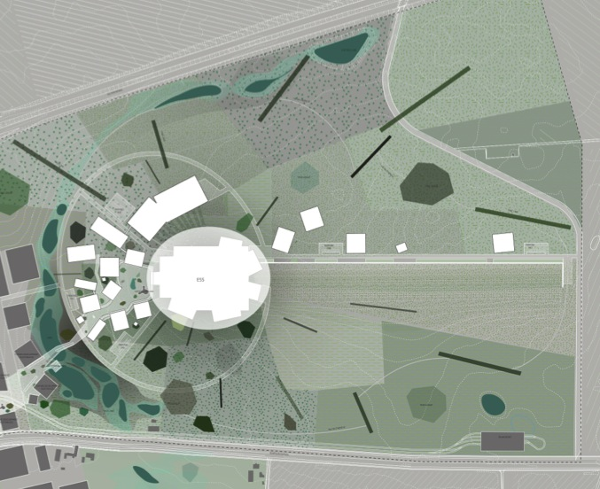
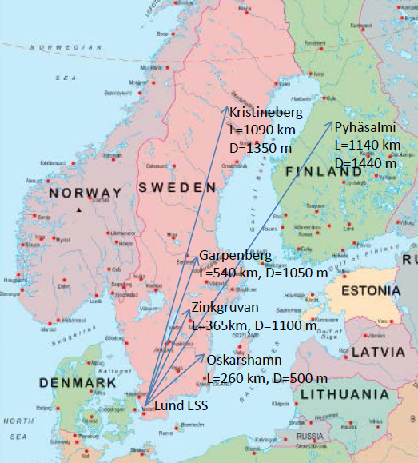
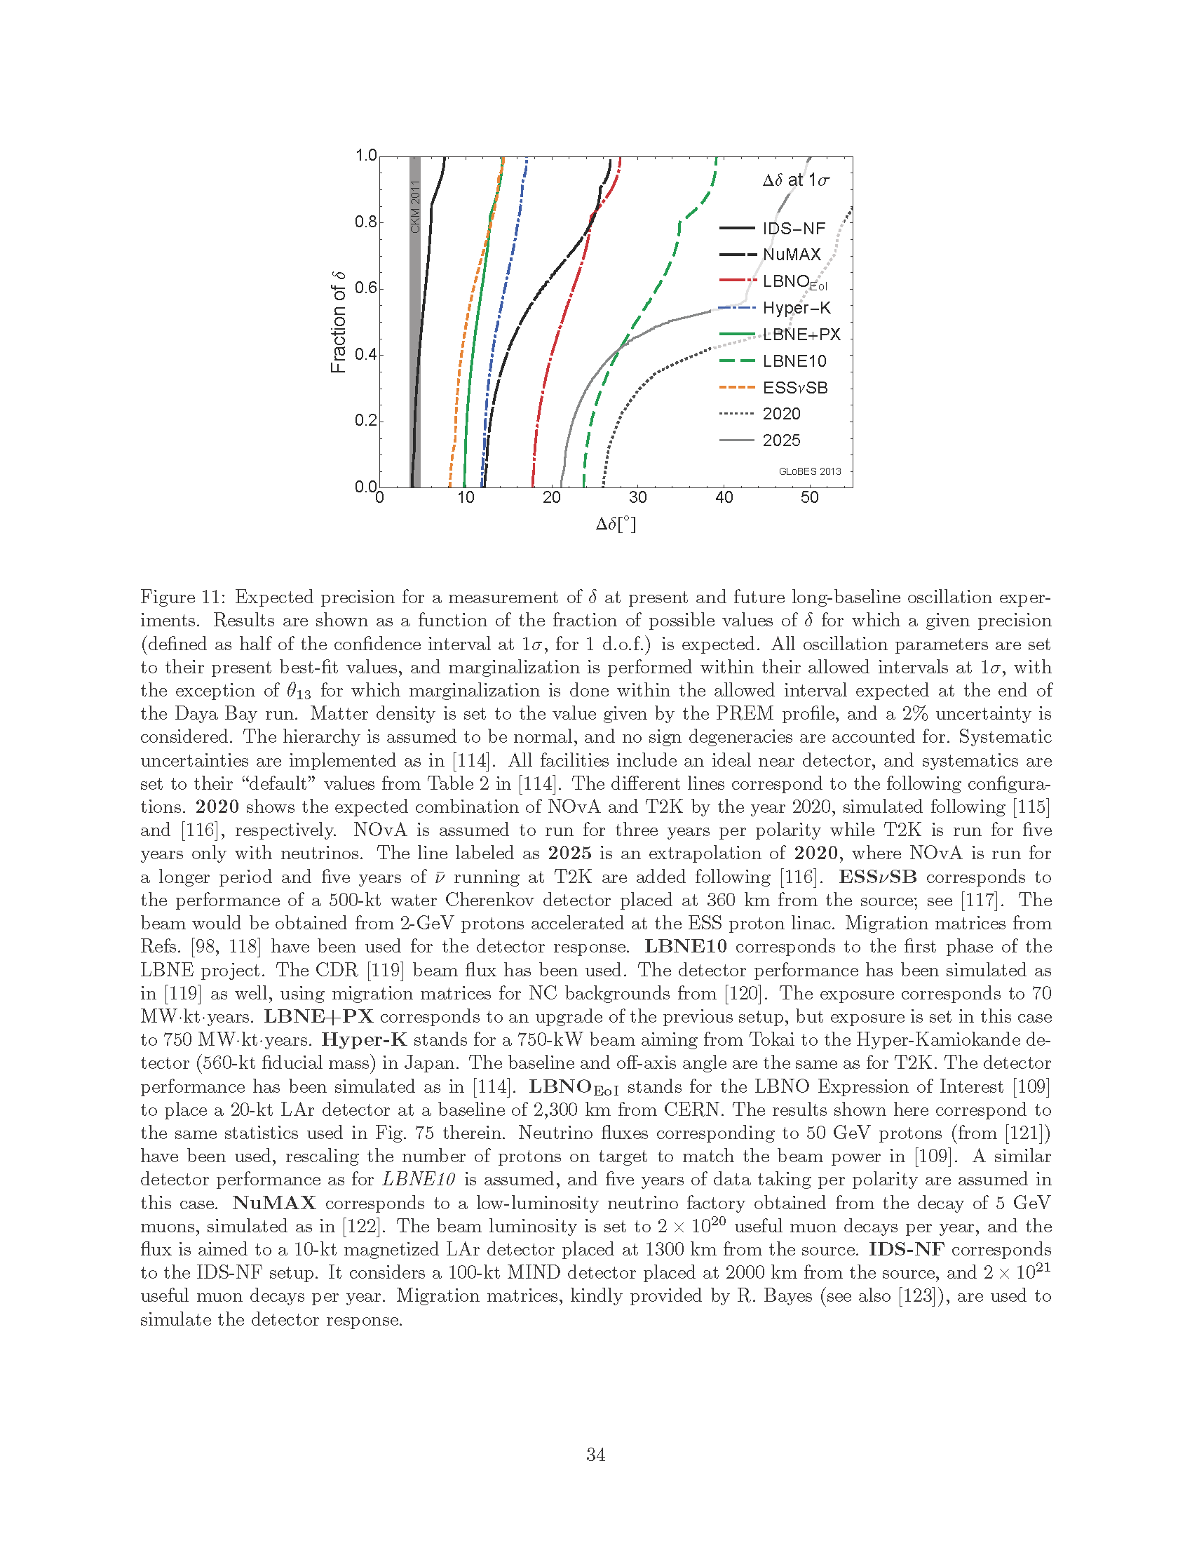
ESSnuSB : neutrino Super-Beam based on ESS linac
a Doubling the power of the linac (10MW) by doubling the duty cycle (4% to 8%)
a Buiding accumulator ring(s), target, horn, detectors
ν
accumulator
target/horn station
Envisaged Work Packages and participants
Management
Linac
accumulator
Target station Horn
Detectors
Physics performance
Uppsala, Strasbourg, ESS, CERN
ESS, CERN, Uppsala
ESS, CERN, Uppsala, CNRS
RAL, Krakow, CNRS, Uppsala
Uppsala, Sofia, CNRS, Lund
KTH, Madrid, Lund, Durham

Slide 8
European Plasma Accelerator with High Beam Quality and Pilot Applications
a Go from Plasma Acceleration to Plasma Accelerator with useable beam quality
Envisaged Work Packages and participants
State of the art
Design of a compact European Plasma Accelerator
Pilot applications with FEL physics or other novel methods (photon source)
Pilot applications with particle physics and material science (particle source)
Impact for science and society
Site study
Technical R&D Issues
Roadmap for technical design report, including milestones for critical R&D
Cost and Schedule
Governance and budgetary model for a European Plasma Accelerator
  DESY, CERN, INFN, Ecole polytechnique, JAI
  Plus open call to all EU EuroNNAc members (30+)
  Possible industry participation and non-EU partners

Slide 9
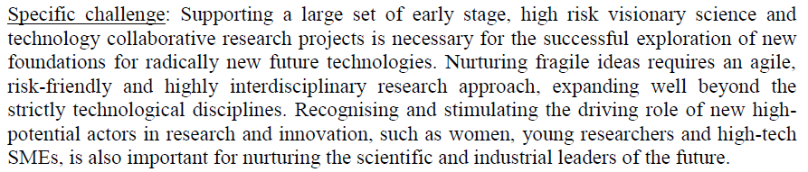
Horizon 2020: FET calls
Future and Emerging Technologies
Calls id. | M€ | Type | Deadline
FETOPEN | 160 | Novel Ideas for Radically New Tech. | 30/09/2014, 31/03/2015, 29/09/2015
Calls | 2014 (M€) | 2015 (M€) | Max. EC contr. (M€)
FETOPEN-1 (Open research projects ) | 77 | 37+40 | 4
Key words:
Long-term vision, Breakthrough S&T target, Foundamental, Novelty , High-risk, Interdisciplinary

Slide 10
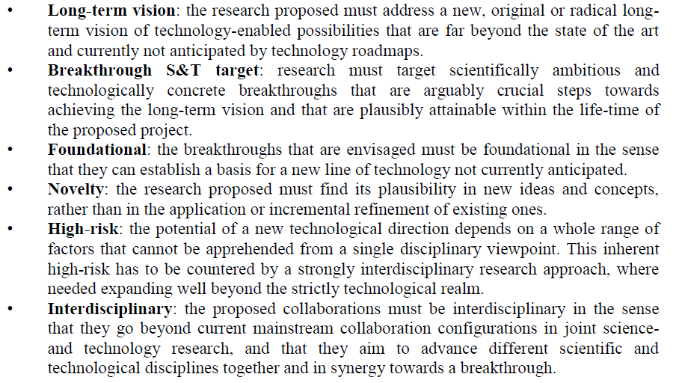
Horizon 2020 : Projects for FET

Slide 11
Horizon 2020 : Projects for FET
Plasma Acceleration
Project: HiFLUX: High repetition rate Fiber Laser-Plasma accelerators for Ultrabright X-rays
Objective: Use a train of laser pulse separated by plasma period to resonantly excite wakefield
Proposer labs a UK (JAI, ICL) +DE (JENA)
Project: GILA – GeV Ion Laser Acceleration
Objective: Explore for the first time high gradient / High energy Laser wakefield acceleration of ion beams using an injection scheme based on a ion accelerator
Proposer labs a DE (TU Darmstadt, GSI/FAIR), FR (CELIA, Bordeaux, LULI), UK (RAL, Strathclyde)

Slide 12
Horizon 2020 : Projects for FET
Project: Electron-Beam driven Plasma Acceleration
Objective: Plasma accelerator driven by single or multi-pulse electron beams for advanced light source applications (FLASH, SPARC, VELA/CLARA)
Proposer labs a IT (INFN, Roma uni), DE (Max Planck Inst., DESY), UK (STFC, Strathclyde)
  ESGARD oversees these projects with the objective to support the submission of 2 projects for the FET call in September in collaboration with EuroNNAc

Slide 13
Horizon 2020 : Projects for FET
HTS technology for Magnet development
Project: HTS Fast Cycling Magnet
Objective: Development of superferric HTS magnets operating at 77 degree K with fast cycling period with low power consumption
Proposer labs a CERN
  ESGARD find this project very interesting and will work toward implementing the proposal in H2020.
  ESGARD aims at submitting this project at the 2nd or 3rd FET deadline. A proposal needs to be prepared

Slide 14
Horizon 2020 : Other Projects
Medical Application
Project: High Frequency RFQ (+DTL)
Objective: Development of a proton linac with high frequency RFQ (18_20 MeV; 2 mA) for FDG/^{99m}TC production & Brachytherapy
Proposer labs a CERN
  ESGARD find this project very interesting and will work toward implementing the proposal in H2020.
  ESGARD should investigate the best way to get funding for this project in H2020. A proposal needs to be prepared

Slide 15
Horizon 2020: INFRAIA calls (1/3)
Integrating Activities (starting and advanced communities)
Calls id. | Type | Deadline
INFRAIA-1-2014 /2015 | Integrating Act. | 02/09/2014 at 17.00.00 Brussels time
Calls | 2014 (M€) | 2015 (M€) | Max. EC contr. (M€)
INFRAIA-1-2014/2015 | 90 | 50 | 5 (10 advanced)
Unfortunately Accelerators Science and Technology is not included in the call because EuCARD2 has just been accepted.
This is a real limitation as we have several very interesting projects in the pipe

Slide 16
Horizon 2020: INFRAIA calls (2/3)
Hopefully, Accelerator R&D should be in the following call in one form or the other
i.e. 2016/2017 timely with the end of EuCARD2
ESGARD is initiating the preparation of a proposal
ESGARD would like to collect topics proposals from
EuCARD2 partners
TIARA and ESGARD partners
… and AS&T community at large
Set a template for topic proposals ?
According to proposals, we would
Define a few main themes
Nominate theme conveners in charge of developing a coherent theme package within specific budget guidelines (as we did for EuCARD2)

Slide 17
Horizon 2020: INFRAIA calls (3/3)
A possible H2020 schedule could be :
Fall 2015: H2020 call
Submission deadline : Spring 2016
Start of project : Fall 2016/early 2017
Accordingly, a possible schedule from our side could be:
End 2014: Collect topic proposals
Early 2015: Definition of themes and nomination of conveners
Fall 2015: very first organization of the proposal:
  Definition of proposal scope and topics
  Nomination of coordinator and WP leaders to build the proposal

Slide 18

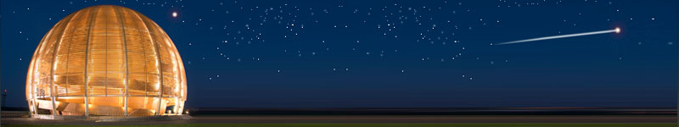
Conclusions
After having established an accelerator R&D strategy,
implemented through several very successful projects in FP6 & FP7, we need to go one step further in the integration of the Accelerator R&D programme and infrastructure.
We have the possibility to use Horizon2020 to this end.
We should define a strategy on the projects to be supported
Accelerator science is a powerful mean
toward scientific, technical and
industrial breakthroughs and innovations…
TIARA will strengthen significantly this potential

