Slide 1
MINE RELATED ASPECTS REGARDING CONSTRUCTION OF A LARGE UNDERGROUND NEUTRINO DETECTOR CLOSE TO THE GARPENBERG MINE
INITIAL STUDY BY LARS NORLING
INDEPENDENT MINE CONSULTANT

Slide 2
General
General Location Map
Post-Svecofennian rocks (e.g Svecokarelian
late- or post-tectonic, intrusive rocks, Proterozoic
Sandviken
and Cambro-Silurian sedimentary rocks)
F
Kalvbäcken
Älvkarleby
Svecokarelian, early granitoids or Svecofennian,
synvolcanic intrusions, mostly 1870-1890 Ma
+
-
Ös
Prästhyttan
Vallberg
Svecofennian metasedimentary rocks
Sx
So
Garpenberg
D
Svecofennian metavolcanic rocks
Bg
B
N
Lb
S
Sa
H
Uppsala
Lindesby S
Sr
Iron- / sulphide ore, mine or prospect
Stockholm
U
Swedish National Grid 2.5 gon W

Slide 3
GARPENBERG
Garpenberg is a small village Hedemora, a small town in central Sweden
Hedemora has 16000 inhabitants and Garpenberg about 600
Distance to Hedemora 16 km
Distance to Arlanda Airport 160 km
Distance to Uppsala 120 km
Distance to Stockholm 180 km
Railway connections to Uppsala and Stockholm every 2 hours

Slide 4
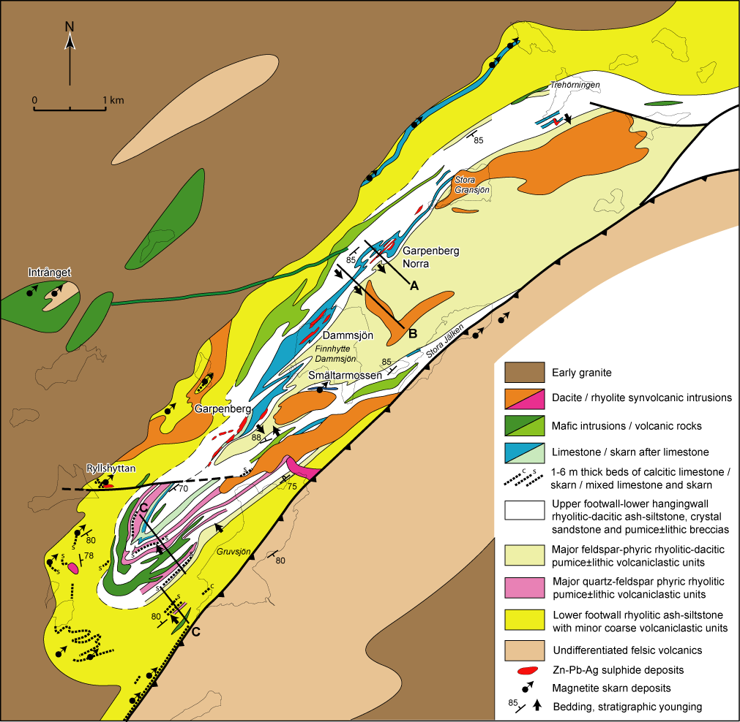

Slide 5
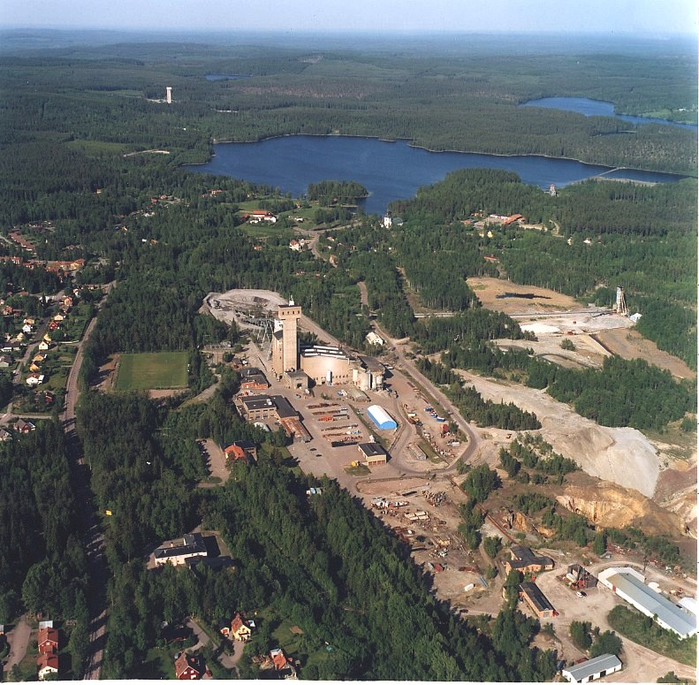

Slide 6
Mineral Reserves/Resources in Garpenberg mine 2012-12-31
frontvy
Garpenberg
Garpenberg norra
Dammsjön
0 Z
200Z
Lappberget
Kyrkan-
Tyskgården
400Z
Finnhyttan
Dammsjön
Potential
600Z
Gransjön
Kaspersbo
870 Z
800Z
Kvarn-
berget
910 Z
Strand
Kanal
1000Z
Potential
Kvarnberget
1200Z
Potential
Potential
1400Z
1600 Y
2000 Y
2400 Y
2800 Y
3200 Y
3600 Y
Potential
4000 Y
4400Y
4800 Y
5200 Y
Mineral Reserves:
Mineral Resources:
mined out ore

Slide 7
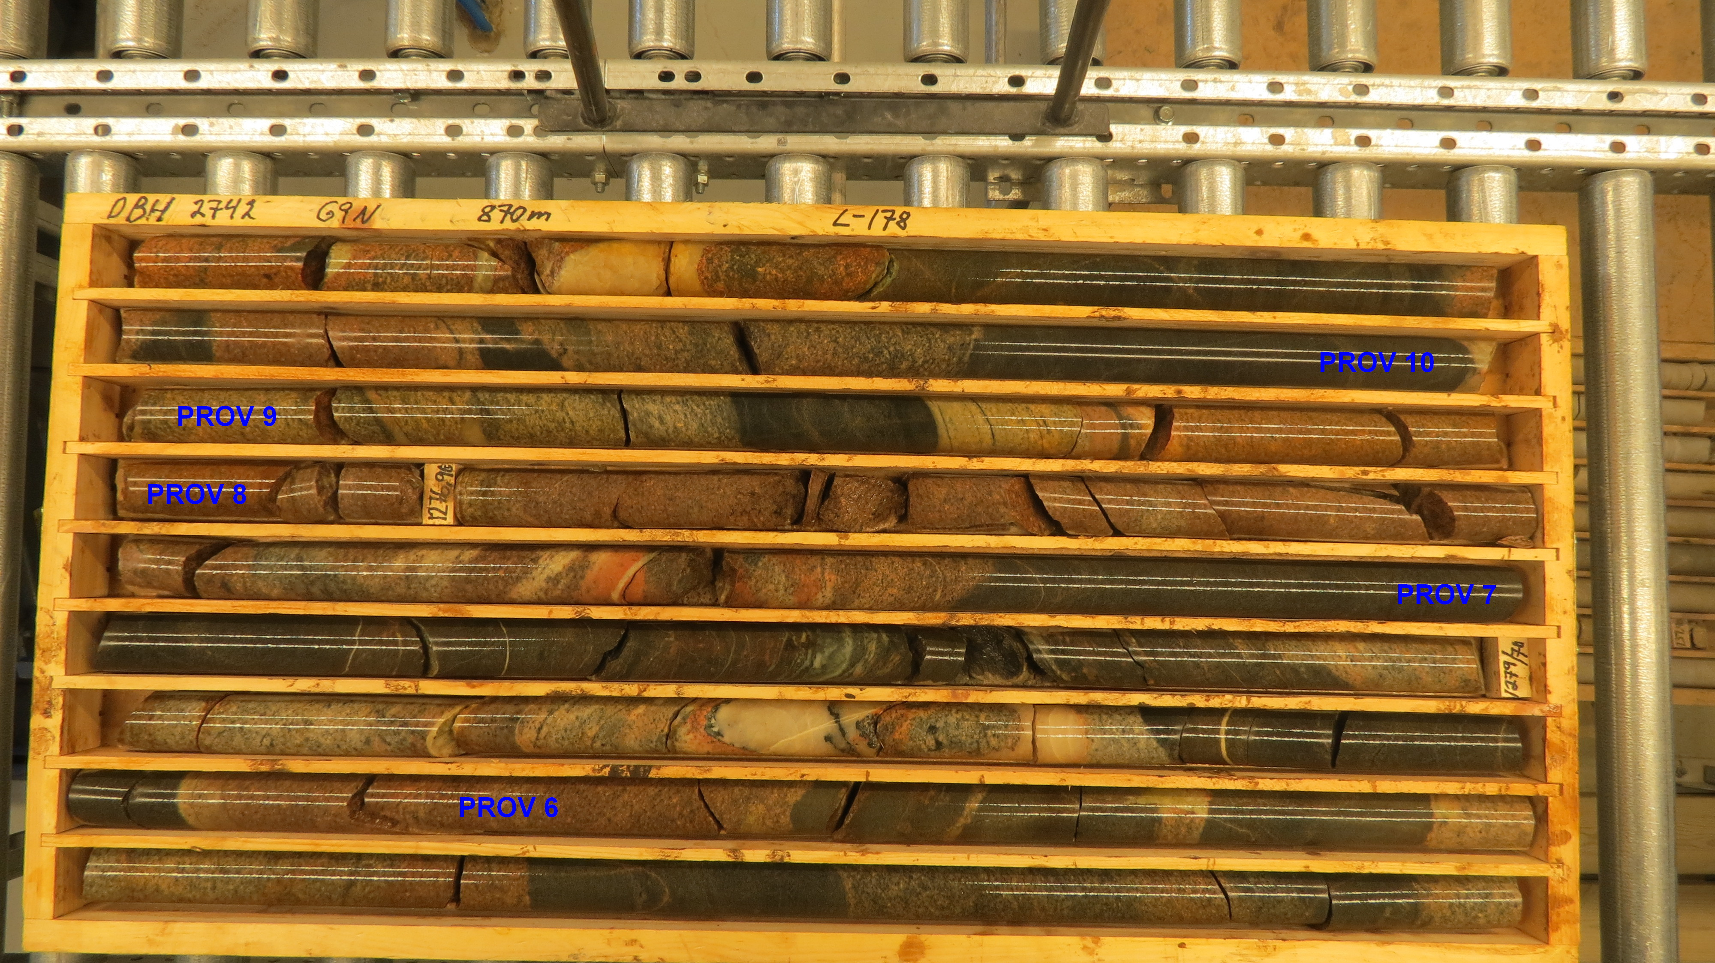

Slide 8
POINT LOAD INDEX AND UNIAXIAL COMPRESSIVE STRENGTH
Portable and stationary point load tester
This spreadsheet calculates point load index and uniaxial compressive strength for tests using either
a portable or a stationary point load tester.
Portable PLT: |  |  | Obtained pressure (in kPa) is input in the column under "M". "P" is calculated automatically.
Stationary PLT: |  |  | "P" is input directly (in kN).
"Type of test": d = diametral; a = axial; l = lump/block test; h = half-core (split core)
Note! D = distance between the contact points; d = core diamater only for diametral tests!
Hole nr | Rock type | Tester | Type of test | D | W | M | P | De² | De | I_{s} | F | I_{s(50)} | σ_{c} | a/d-strength
 |  | P=Portable | (a,d,l,h) |  |  |  |  |  |  | (P*1000)/De² | (De/50)0.45 | F*I_{s} | 22*I_{s(50)} | (a,d)
(m) |  | S=Stationary |  | (mm) | (mm) | (KPa) | (kN) | (mm²) | (mm) | (MPa) |  | (MPa) | (MPa)
1 |  | P | d | 40,5 |  |  | 18,17 | 1640 | 41 | 11,08 | 0,91 | 10,08 | 221,7 | d
2 |  | P | d | 40,5 |  |  | 12,70 | 1640 | 41 | 7,74 | 0,91 | 7,04 | 154,9 | d
3 |  | P | d | 40,5 |  |  | 18,61 | 1640 | 41 | 11,35 | 0,91 | 10,32 | 227,0 | d
4 |  | P | d | 40,5 |  |  | 19,36 | 1640 | 41 | 11,80 | 0,91 | 10,74 | 236,2 | d
5 |  | P | d | 40,5 |  |  | 21,18 | 1640 | 41 | 12,91 | 0,91 | 11,74 | 258,4 | d
6 |  | P | d | 40,5 |  |  | 18,87 | 1640 | 41 | 11,50 | 0,91 | 10,46 | 230,2 | d
7 |  | P | d | 40,5 |  |  | 15,59 | 1640 | 41 | 9,50 | 0,91 | 8,64 | 190,2 | d
8 |  | P | d | 40,5 |  |  | 11,01 | 1640 | 41 | 6,71 | 0,91 | 6,11 | 134,3 | d
9 |  | P | d | 40,5 |  |  | 16,44 | 1640 | 41 | 10,02 | 0,91 | 9,12 | 200,6 | d
10 |  | P | d | 40,5 |  |  | 15,84 | 1640 | 41 | 9,66 | 0,91 | 8,78 | 193,2 | d
11 |  | P | d | 40,5 |  |  | 13,00 | 1640 | 41 | 7,93 | 0,91 | 7,21 | 158,6 | d
12 |  | P | d | 40,5 |  |  | 20,73 | 1640 | 41 | 12,64 | 0,91 | 11,49 | 252,9 | d
13 |  | P | d | 40,5 |  |  | 9,88 | 1640 | 41 | 6,02 | 0,91 | 5,48 | 120,5 | d
14 |  | P | d | 40,5 |  |  | 20,81 | 1640 | 41 | 12,69 | 0,91 | 11,54 | 253,9 | d
15 |  | P | d | 40,5 |  |  | 12,96 | 1640 | 41 | 7,90 | 0,91 | 7,19 | 158,1 | d
16 |  | P | d | 40,5 |  |  | 16,17 | 1640 | 41 | 9,86 | 0,91 | 8,97 | 197,3 | d
17 |  | P | d | 40,5 |  |  | 21,15 | 1640 | 41 | 12,89 | 0,91 | 11,73 | 258,0 | d
18 |  | P | d | 40,5 |  |  | 21,65 | 1640 | 41 | 13,20 | 0,91 | 12,01 | 264,1 | d
 |  |  |  |  |  |  |  |  |  |  |  | Medel: | 206,1

Slide 9
CONCLUSIONS
We have a mine infrastructure 500 km from the ESS with access to areas more than 1000 m below surface.
The available geological and geotechnical data of the surroundings of Garpenberg indicate that the possibilities are good for the construction of the planned neutrino detector about 1 km away from the mine.
Bolidens plans for the future of the old infrastructure have to be clarified and also the possibilities to lease or purchase part of the crushing and hoisting system in Garpenberg Norra. The mineral resources indicate a life of the mine operation of 25 to 30 years.
It is also recommended that a program with control of the available magnetic and electric survey data of the proposed area shall be organized and after that a drilling program has to be performed as a first step of the future investigations.

Slide 10
FUTURE PROGRAM
Evaluation of results from core drilling, rock strength, rock type
Calculation of maximal span and height, design of rock reinforcement
Measurements of rock stress
Risks for seismic activities caused by the mining operation have to be investigated
Design of detector with regard of rock stress and stress direction
Environmental study and application for environmental permits
Design of the rock excavation,
Ventilation, power distribution , supply of process water via the Boliden systems at the start of access drifts but systems independent of Boliden have to be designed
For the excavation, construction and installations a system independent of Boliden may be necessary
Investigations and calculations indicated above have to be done by competent engineering consultants

